Slide 1

HOW TO CREATE A CLUB LOGO IN THE
BRAND CENTRE
Using Brand Center Update February 2022
Presentation by PDG Merewyn Wright
Rotary District 9560
b name here
Title Page Option

Slide 2
subhead
Recently improved templates in the Brand Center make it easier create club logos.

Slide 3

Creating a club logo
1. Log in to My Rotary and open “Brand Center”.
Three paths to the Brand Center:
Via the “Manage” tab
Via the “News & Media” Tab
Via “Member Center” Tab

Slide 4
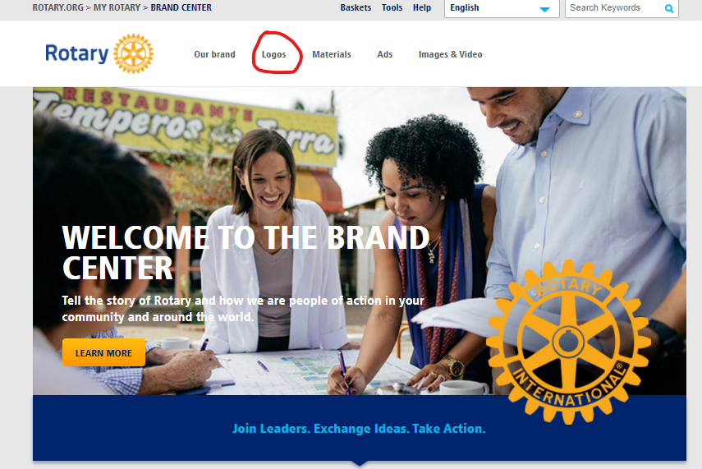
Creating a club logo
2. In the brand centre click on “logos”

Slide 5
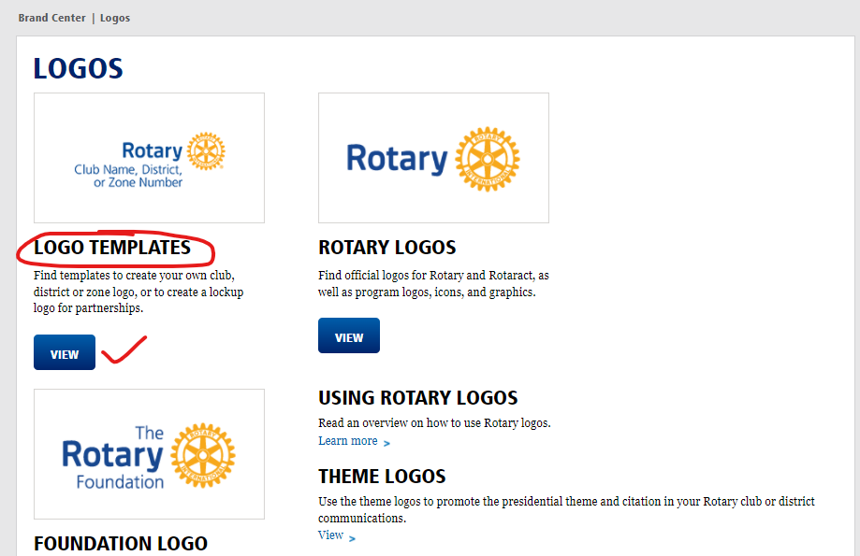
Creating a club logo
3. Go to Logo Templates and click “View”

Slide 6
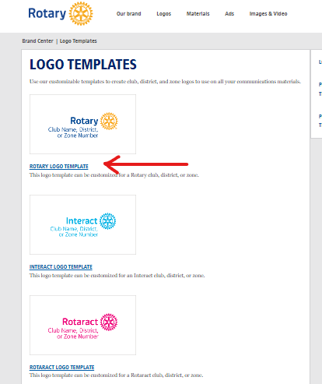
4. Choose either Rotary, Interact or Rotaract Logo Template by clicking on the link under the relevant sample
Creating a club logo

Slide 7
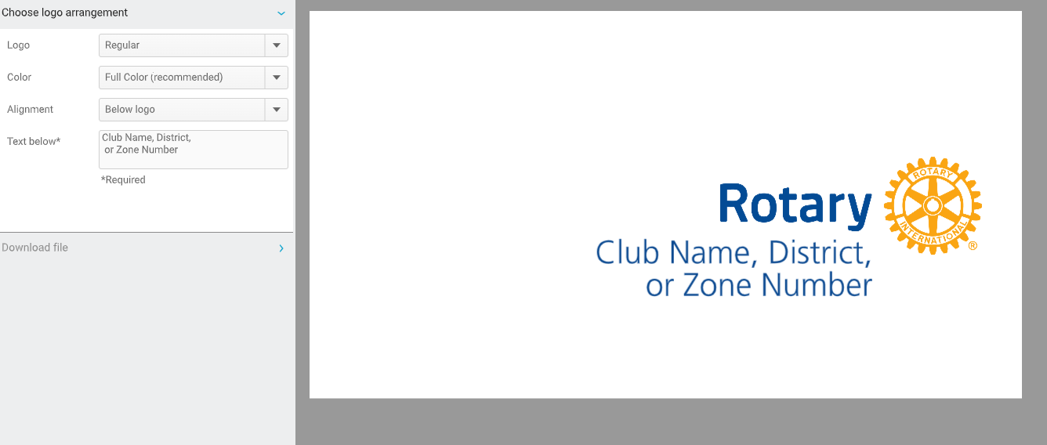
Creating a club logo
5. This is the template for a Rotary club or district logo

Slide 8
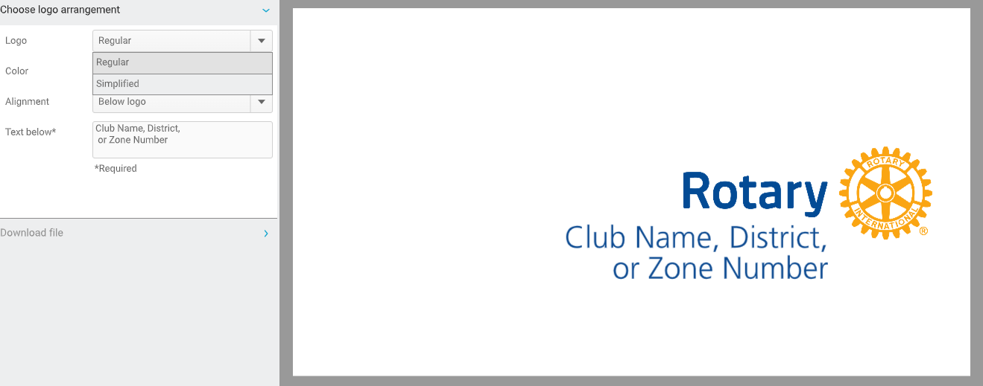
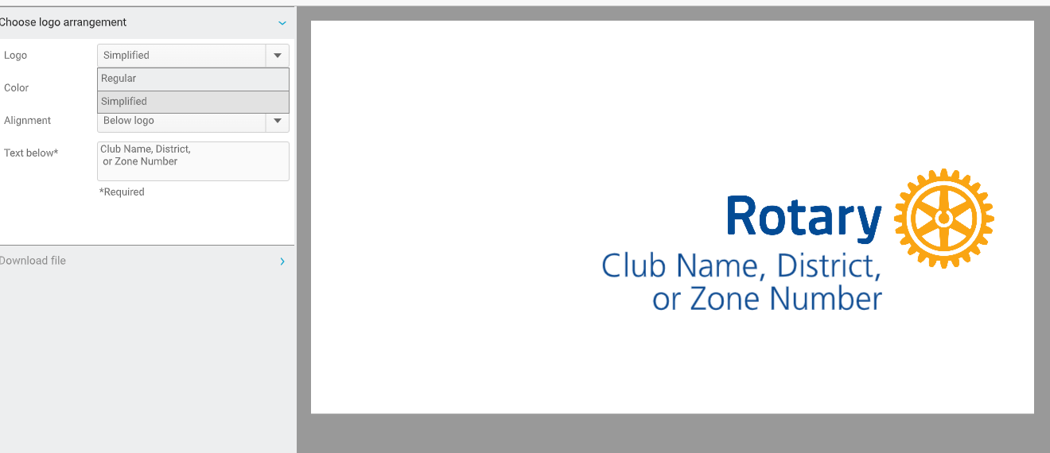
Creating a club logo
6. Choose “regular” or “simplified” version
Regular: Use for most purposes
Simplified: Use e.g. in embroidery where detail is too small

Slide 9
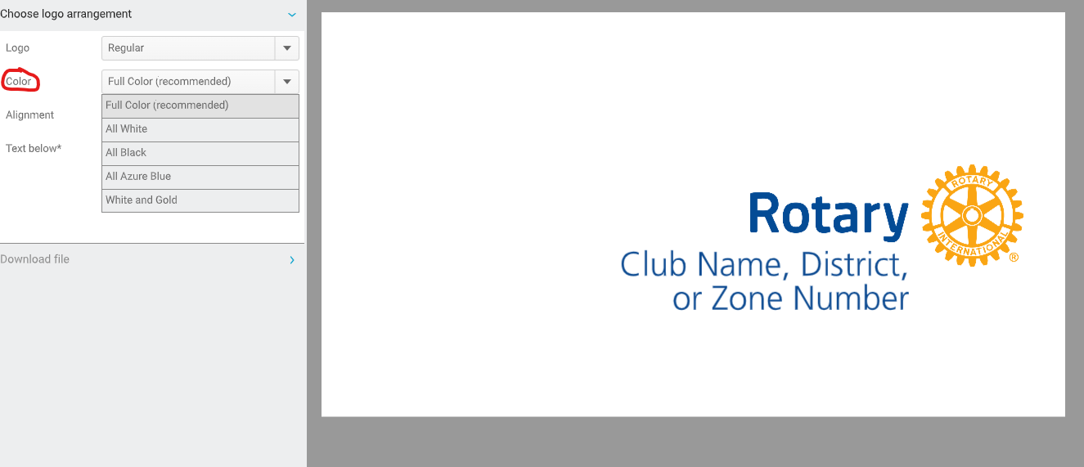
Creating a club logo
7. Select your colour choice – note there are five options
Full colour is recommended (as shown – right) but for some backgrounds, another choice might be more suitable.

Slide 10
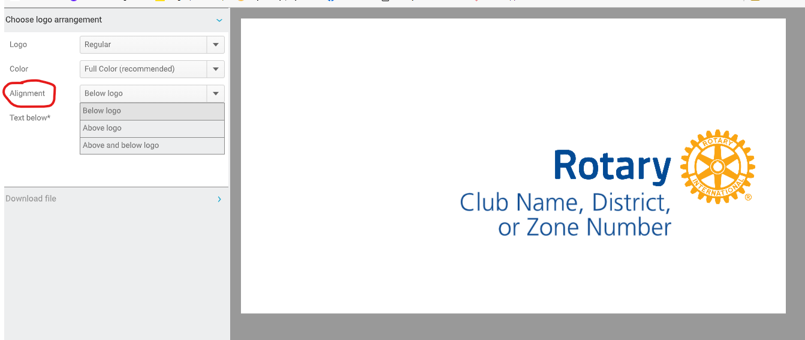
Creating a club logo
8. Select alignment – choose where you want your club name to be placed in relation to the logo
Note there are 3 options
Below
Above
Above and Below

Slide 11
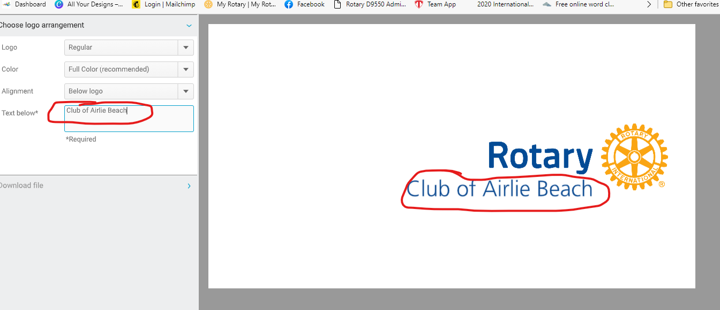
Creating a club logo
9. Type your club's name in the space provided on the left – it will appear on the template to the right
You can use the club's oﬃcial name or what it's called locally, so just “Airlie Beach” is acceptable

Slide 12
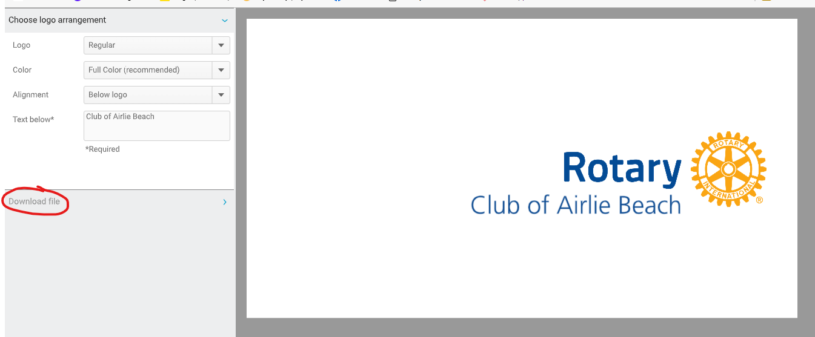
Creating a club logo
10. Now you are ready to download your logo. Click on “Download File”.

Slide 13
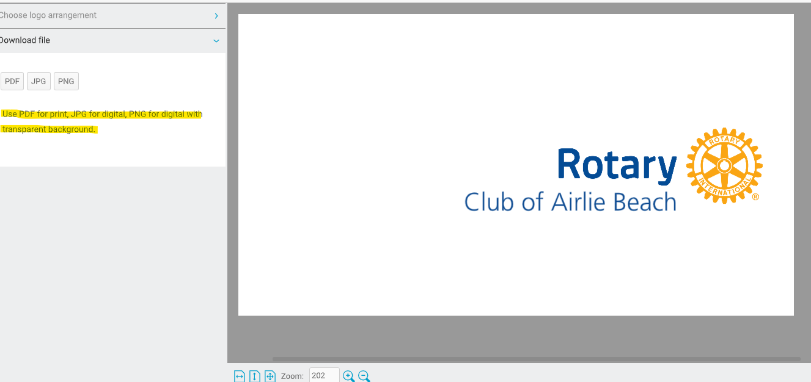
Creating a club logo
11. Select the type of file you wish to download – PDF, JPG, or PNG.
Use PDF if supplying to a printer, signwriter, t-shirt maker.
PNG is best for digital material e.g. website, social media.

Slide 14

Creating a club logo
12. Downloaded logo

Slide 15










Creating a club logo
13. Samples of other versions
Rotary Black - Below
Rotary Full Colour Above
Rotary Azure - Below
Rotaract – Below - Cranberry
Rotary Full Colour Above & below
Rotary - Above - SIMPLIFIED
Interact – Below – Sky Blue
Rotary – Below - White
Rotary – Above – White & Gold
Interact – Above – White

Slide 16
Creating a club logo
Links and Resources
Brand Center | Brand Center (rotary.org)
Logos | Brand Center (rotary.org)
Learning Center Course – Our Logo: Representing Rotary
Your logos at a glance: Downloadable overview of Rotary Logos

Slide 17
QUESTIONS

