Slide 1
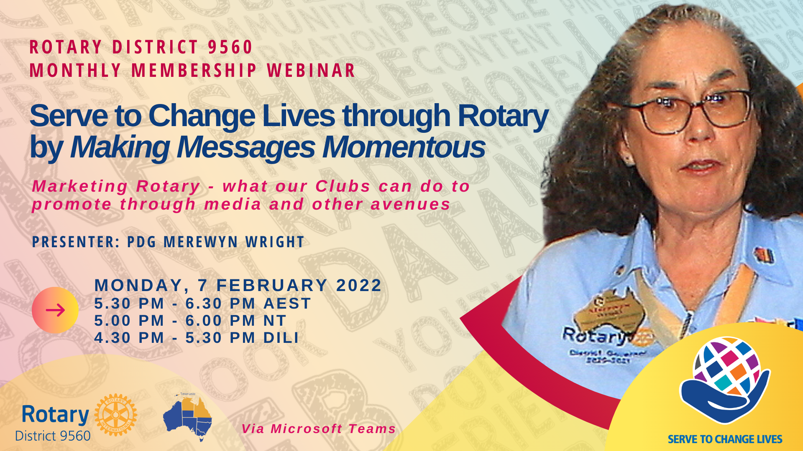

Slide 2

ROTARY DISTRICT 9560
monthly membership webinar
7 February, 2022
SERVE TO CHANGE LIVES THROUGH ROTARY
BY MAKING MESSAGES MOMENTOUS
Marketing Rotary - what our Clubs can do to promote through media and other avenues
Presenter
IPDG Merewyn Wright
Title Page Option

Slide 3

subhead
Let’s not just “do good” in our communities;
let’s make sure we tell everyone about it!
But let’s do it well!
It helps people to know who we are;
it helps us get more members;
it helps us gain more community partners
– it opens opportunities to “Serve to Change Lives”

Slide 4
  WHY – do you want to promote your club?
  WHAT – do you want to promote?
  WHEN – is the best time?
  WHO – is your audience?
  HOW – will you promote it?
  WHERE – can you go for help?
Making messages momentous
Presentation overview

Slide 5
  Making messages momentous
  WHY – do you want to promote your club?
General awareness-raising?
Seeking members?
Looking for a project partner?

Slide 6
  Making messages momentous
  WHAT – do you want to promote?
A specific upcoming event or project?
An achievement of your club or individual member?
Promoting “big picture” Rotary e.g., polio eradication

Slide 7
  Making messages momentous
  WHEN – is the best time?
ARE YOU READY…
TO ATTRACT NEW MEMBERS?
Do you have your club branding – logos, signage, banners, club apparel - up to date and in good condition?
Will people like what they see at your event and at your club meetings (Refer Jessie Harman’s Top Tips from our previous webinar – “Create the right first impression”; “Make it fun”).

Slide 8
“…we need to be cautious about putting the cart before the horse. To sell anything (cars, homes, plumbing services) you need two things: a great PRODUCT and great PROMOTION. One will not work without the other. You can have the best product in the world, but if you don't promote it effectively, you will struggle to grow your operation. Likewise, if your product is sub-standard, the greatest promotional initiatives will struggle to sell it.
Rotary membership is a product.... If we can create flexible, impactful clubs with good leadership, direction and value for its members, the promotional side is made a lot easier.”
Mark Huddleston
Author – Creatures of Habit
Facebook Comment – circa 27/01/2022

Slide 9
  Making messages momentous
  WHEN – is the best time?
ARE YOU READY…
TO PROMOTE YOUR EVENT OR PROJECT?
Is your event well-planned - are all the details of your event organised and in place, ready for promotion?
Is publicity and promotion included as part of the planning process for your event (and not just an afterthought)?
Do you have a schedule for promotion? When will you publish the details, and how often?

Slide 10
  Making messages momentous
  WHO – is your audience?
Identifying your audience will determine what media you should use and how you frame your message.
General public?
Families with young children?
Young adults?
Professional / Business people?
Older citizens?
Other Rotarians?

Slide 11
  Making messages momentous
  HOW – will you promote it?
What promotional options are available?
Local newspapers including free community papers
Audience specific media e.g. Chamber of Commerce publication/social media
Radio (both networks and community radio) and television
Social Media – Facebook is the most commonly used by Rotary clubs – Club page and community Noticeboard / Chat / Special interest groups
Brochures, flyers, banners, signage, club apparel
Club bulletins / newsletters
Your members – their appearance, behaviour and demeanour in public and at your meetings

Slide 12
  NEWSPAPERS, RADIO, TELEVISION
  Identify your local providers
  Get to know the editor, journalist, announcer…invite them as a guest speaker
  Ascertain how they want the information / story provided – press release, phone call, …
  Will they come and take photo, or do they prefer photo provided?
  Be aware of, and stick to copy deadlines
  Learn how to write a press release / article *Articles that appeal – Zone 8 Public Image Webinar, 27/02/2022
Making messages momentous
HOW – will you promote it?

Slide 13
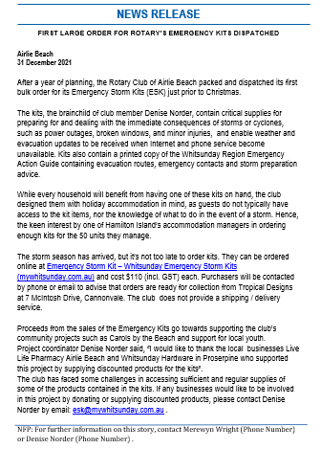
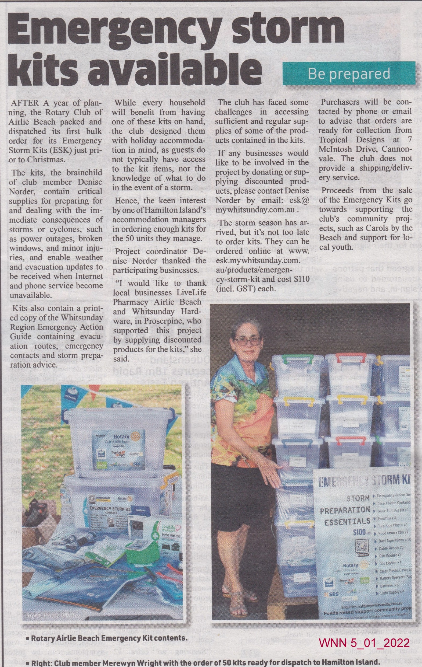

Slide 14
  SOCIAL MEDIA
DECIDE YOUR AUDIENCE
Is it your club members? – Create a Private Facebook Group
Is it the community at large? – Create a public-facing “page”
SHOW WE ARE “PEOPLE OF ACTION”
BE CONCISE
USE PHOTOS TO TELL YOUR STORY
TAG, TAG, TAG! - project partners, venues, sponsors, name of event
Making messages momentous
HOW – will you promote it?

Slide 15
  BROCHURES, SIGNAGE, CLUB APPAREL
Use the current branding - consistency in branding helps to show who we are
Refer to the Brand Center for logo and materials templates and guidance for correct usage
Budget for updates to your club signage, marquees, banners etc (a proportion of proceeds from fundraising can be invested in creating your public image)
Making messages momentous
HOW – will you promote it?

Slide 16










BROCHURES, SIGNAGE, CLUB APPAREL
Club logos
Lock up logos now only reserved for Rotary partnerships
Below: Out of date logos - do not use on new material

Slide 17
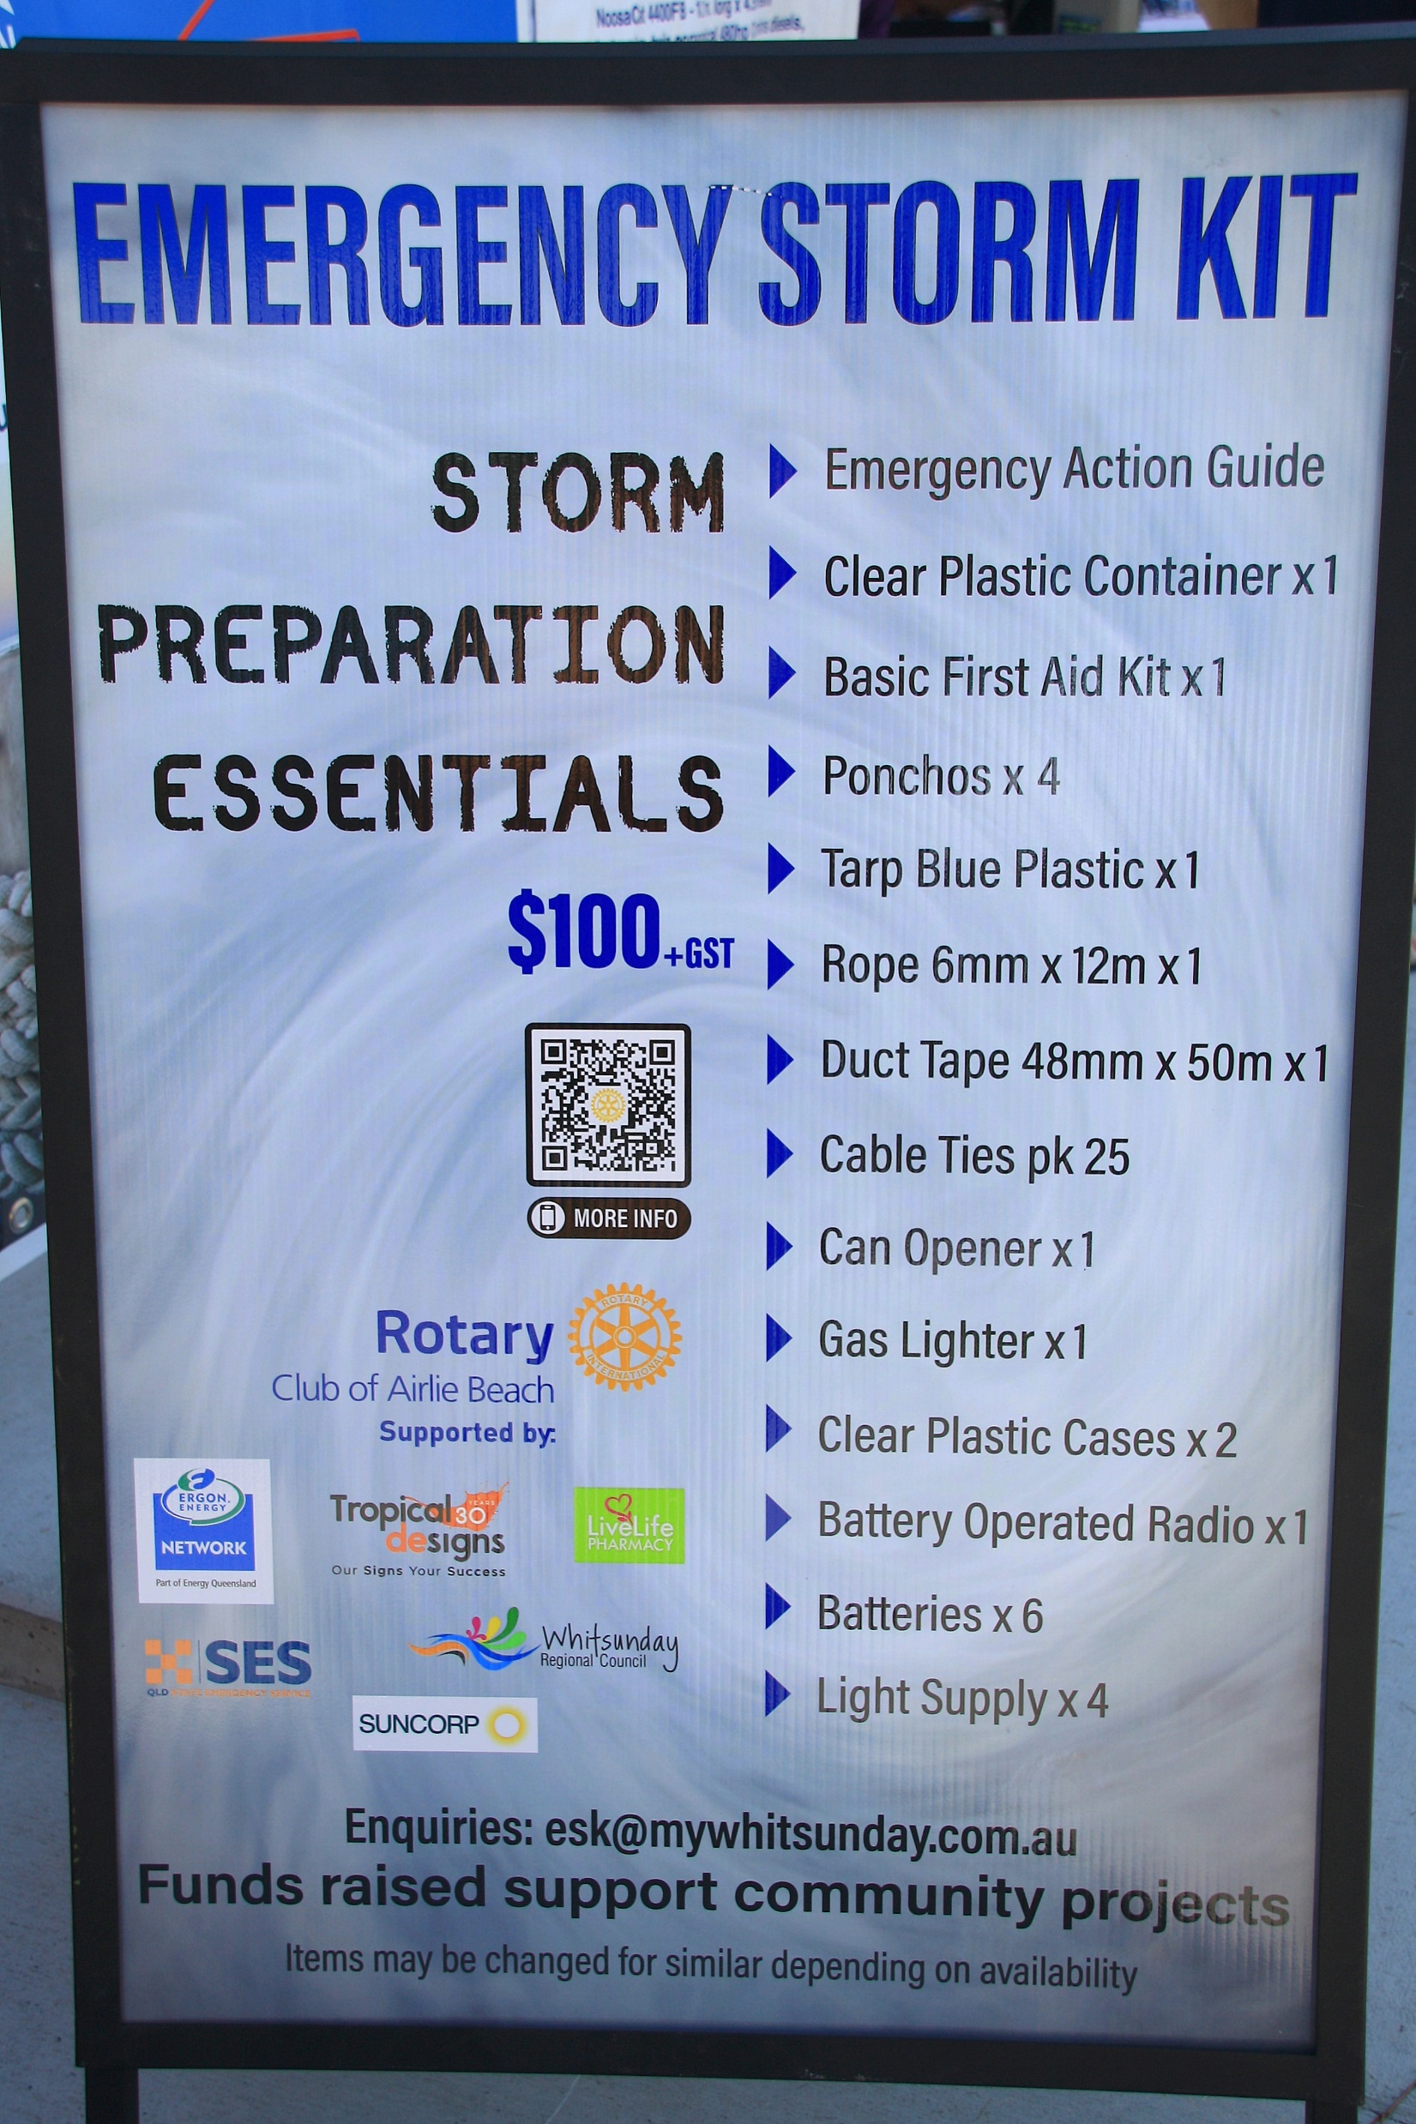
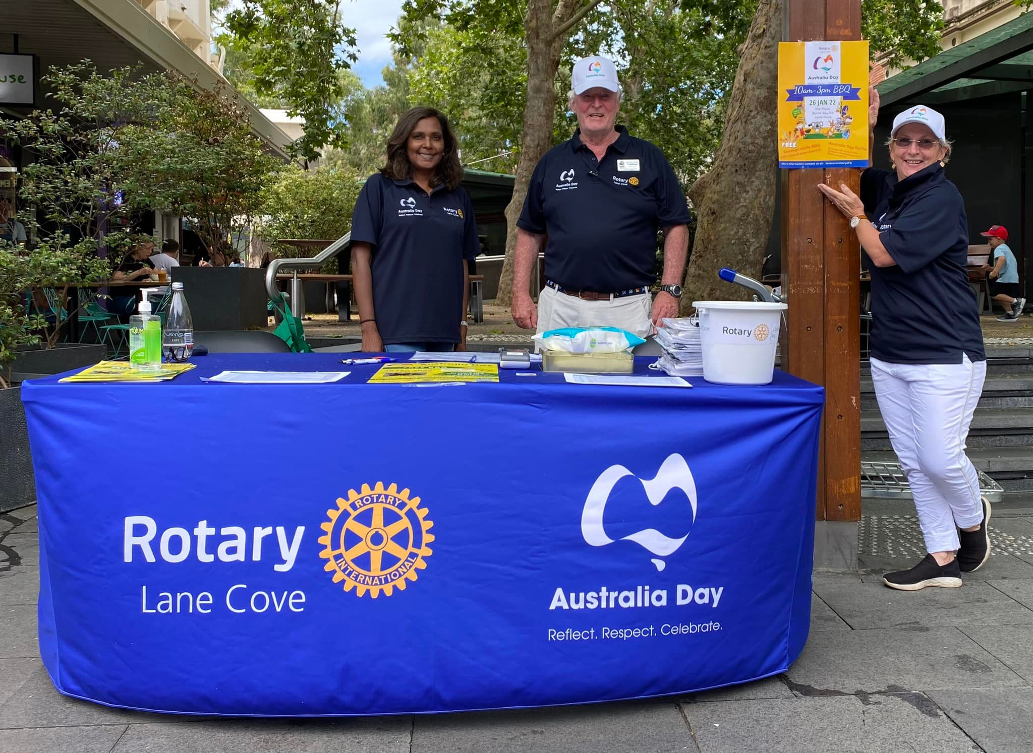
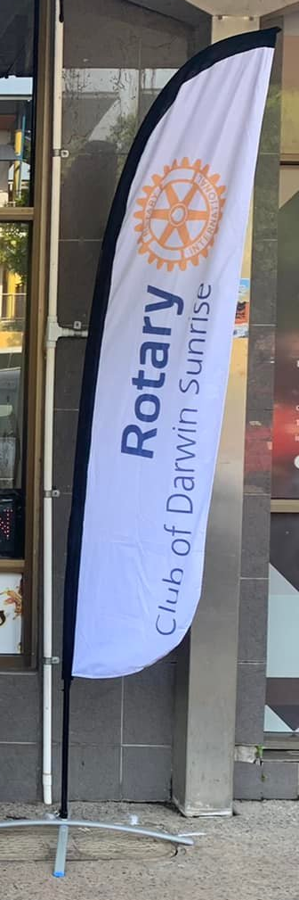
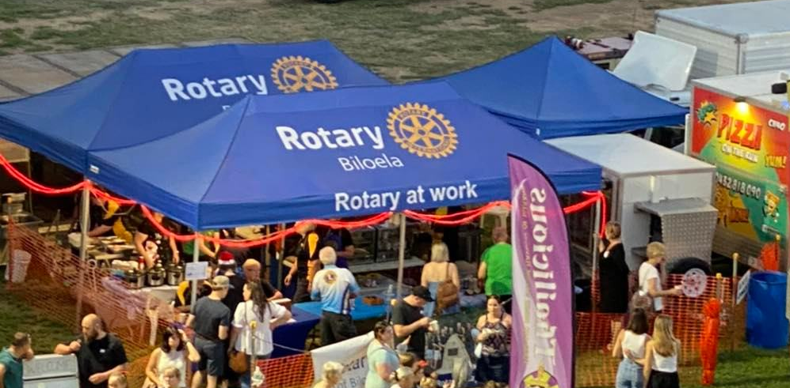
BROCHURES, SIGNAGE, CLUB APPAREL
Club logos

Slide 18
  CLUB BULLETINS / NEWSLETTERS
Put club supporters, project partners, local councillors, etc etc on your mailing list
Ensure that content is appropriate for a non-Rotary audience
Make it appealing, attractive and easy to read
Keep them concise - omit irrelevant content (do you need the Objects of Rotary, list of members, etc in every issue? There are other ways to provide this to members
Making messages momentous
HOW – will you promote it?

Slide 19
  YOUR MEMBERS
Your members can be your best asset in positive impression of your club and Rotary in general:
Appearance – tidy dress (club shirts are good), safety considerations (SunSmart; closed in shoes where appropriate etc)
Are they showing that they are having fun?
Avoid public showings of discontent, disagreements (with each other or members of the public), inappropriate language etc
Making messages momentous
HOW – will you promote it?

Slide 20
  Making messages momentous
  RESOURCES TO HELP YOU
MY ROTARY (you will need to sign in)
Learning & Reference / Learn by Topic / Public relations – Overview of why and how to promote Rotary.
https://my.rotary.org/en/learning-reference/learn-topic/public-relations

Slide 21
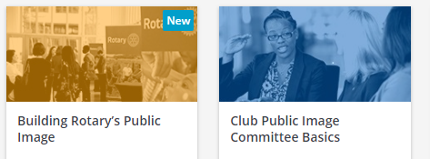

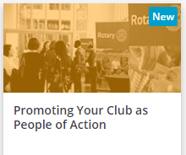
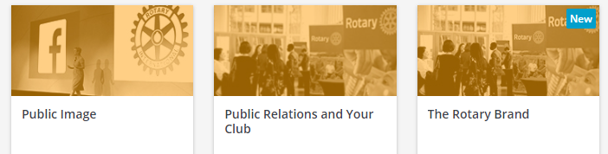
  Making messages momentous
  RESOURCES TO HELP YOU
MY ROTARY (you will need to sign in)
Learning Center Courses (Learning & Reference / Learning Center)

Slide 22
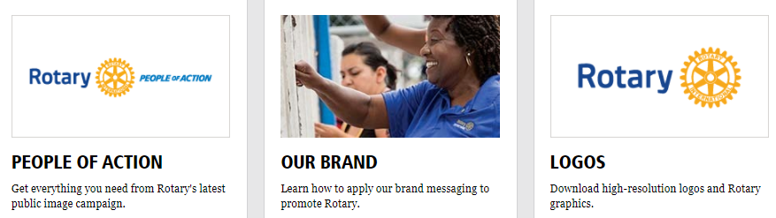
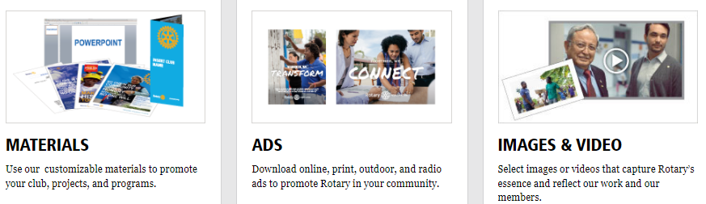
  Making messages momentous
  RESOURCES TO HELP YOU
MY ROTARY (you will need to sign in)
Brand Center (Look under Member Center tab)
Includes template to create & download your own club logo
Includes templates to create your own People of Action ads with your photos
Templates for club brochures, news releases, posters & more

Slide 23



PEOPLE OF ACTION CAMPAIGN
Although many people recognize Rotary’s name, we know that too many prospective members and supporters don’t understand who we are or what we do. People of Action messages capture and reflect the essence of who we are. It’s a way of talking about ourselves so that people outside Rotary better understand what connects us as committed volunteers who channel our skills and expertise into taking action to solve problems in our communities and around the world.
The People of Action message provides a simple, consistent answer to the question, “What is Rotary?” and rallies us around a single idea: telling — and showing — the world that we are people of action.

Slide 24
  Making messages momentous
  RESOURCES TO HELP YOU
2. People
District personnel
District Public Image Chair (Current PDG Mike Woods; MJW from 1 July)
District Trainer Rachael Sampson (Learning Center)
Zone 8 (Look out for monthly webinars by Zone 8 Team)
Public Image Coordinator PDG Sarita McLean (Christchurch, NZ)
Assistant Coordinator (D9560 & 9620) – PDG Darryl Iseppi
RISPPO – Trudy Grice or Angela Stavrogiannopoulos

Slide 25
  Making messages momentous
  RESOURCES TO HELP YOU
2. Other Resources
Useful Facebook Pages and Groups
Rotary International Page (Good “big picture” social media content to share to club pages)
Rotary Down Under Page (as above)
Rotary International South Pacific and Philippines Page (as above – plus events etc)
Rotary Northern Australia and Timor Leste Page (Our District page – as above)
Rotary Club Members: Public Image, Graphics & Ideas Hub (Group)
Canva – for designing social media posts, brochures, etc (Clubs can get a free Pro account, with more design options)

Slide 26

QUESTIONS

