Slide 1
Navigating
Small Claims Court:
Everything You Ever Wanted to Know About Small Claims
(But Were Afraid to Ask)
March 2026
Mark H. Shawhan, Esq.
Principal Law Clerk, Hon. Gerald Lebovits,
NY State Supreme Court, NY County

Slide 2
What Are Small Claims?
Small claims are lawsuits that seek only money—up to a maximum, in New York City, of $10,000.
Small and commercial claims in New York City are heard and decided by the Small Claims Part of the New York City Civil Court, sometimes called “Small Claims Court.”

Slide 3
Who Can File Small Claims Against Who?
Small claims may be filed by individual people or by businesses. Claims filed by businesses are called “commercial small claims” or “commercial claims.” The party filing the claim is called a “claimant.”
In New York City, claimants may bring small or commercial claims against people or businesses that live, work, or have an office in the City. The party being sued is called a “defendant.”
If the claimant is a New York City tenant suing about the apartment or the lease, the claim may be filed against the building’s landlord, even if the landlord doesn’t have an office in New York City.

Slide 4
How Do You Bring a Small Claim?
Go to the Small Claims Clerk’s Office in the county where you live.
  Manhattan: 111 Centre St., Rm. 118 (646-376-5484); 9am-5pm MTWF, 9am-8pm Thursday
  Bronx: 851 Grand Concourse, Rm. 105 (718-618-2517); 9am-4:30pm MTWF, 9am-7:30pm Thursday
  Brooklyn: 141 Livingston St., Rm. 303 (347-404-9021); 9am-5:00pm MWF, 9am-8pm Tuesday, Thursday
  Queens: 89-17 Sutphin Blvd., Rm. 116 (718-262-7122 or -7123); 9am-4:30pm MTWF, 9am-7:30pm Thursday
  Staten Island: 927 Castleton Ave., Basement (718-675-8460); 9am-4:30pm M-F, 9am-7:30pm on the third Thursday of each month

Slide 5
How to Bring a Small Claim (continued)
Tell the Small Claims Clerk that you want to bring a small claim.
Give the Small Claims Clerk basic information about the claim and pay the filing fee--$15 for small claims up to $1000; $20 for small claims over $1000; $25 for commercial small claims. (If you can’t afford the filing fee, you can fill out a one-page form in the Clerk’s Office asking them to let you file your claim without paying the fee.)
The Clerk will use the basic information that you have given them to prepare a one-page claim form (the document that starts a small-claims case).

Slide 6
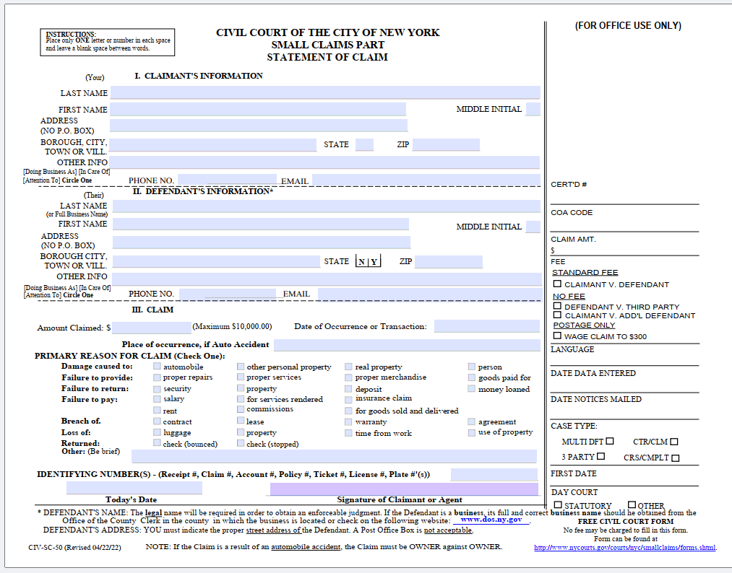
What Does a Claim Form Look Like?

Slide 7
What Information Do You Need?
You must know how much you want to sue for and when the event leading to your suit happened.
You must also know the full name and street address of the person or business that you want to sue.
If you are suing a business, you will need to know (either now or by the day of trial) the business’s official legal name.
Call the Small Claims Clerk’s Office in your county ahead of time to find out what forms of payment (cash, check, credit/debit card) you can use to pay the filing fee.

Slide 8
What Happens Then?
Once you give the Clerk the information for the claim form and have paid the filing fee, the Clerk will either tell you a trial date or say that you will get a letter in the mail with the trial date.
The Clerk will then mail a copy of the claim form and the trial date to the defendant, by both regular mail and certified mail. (If both mailings come back undeliverable, the Clerk will mail you a letter to let you know, and provide instructions on what to do next.)
The trial date will be a weekday. It may be in the daytime (usually the morning), or it may be in the evening.

Slide 9
What to do Before Trial
You are the claimant and have gotten a trial date (either in person or by mail), or you are the defendant and have gotten claimant’s claim form and a trial date in the mail. What then?
If you know ahead of time that you can’t appear in court on the trial date, call the Clerk’s Office to ask for a postponement.
If the Clerk’s Office won’t give you a postponement over the phone, write a letter to the court asking for a postponement and explaining why you need it. The judge hearing cases on your trial date will consider your letter and decide whether to give you the postponement. If they do, you’ll get a new trial date in the mail—probably at least a couple months later.

Slide 10
What to Do Before Trial (continued)
Gather the documents that you will need to make your claim against the defendant (or to defend yourself against the claimant)—photos, contracts, invoices, receipts, emails, and so on. Make sure to print out evidence from your phone.
  You will need to bring this evidence with you every time you come to court, so keep it together in a folder.
If you have witnesses that you will want to testify for you at trial, make sure they can come to court with you on the trial date.
If you are not sure that you can make your case properly to the judge in English, the court will provide a free interpreter—call the Clerk’s Office ahead of time to ask for one.

Slide 11
On the Trial Date
Wear court-appropriate clothes. (A collared shirt and jeans is fine; you don’t need to dress up in a suit.)
Arrive 15-30 minutes before the court starting time that you’ve been given, to allow plenty of time to go through the courthouse metal detectors, find your courtroom, and so on.
  If for some reason you are running late, call the Clerk’s Office to let them know.
If you aren’t sure which courtroom you are supposed to be in (or how to get there), ask a court officer for directions.

Slide 12
On the Trial Date (continued)
  At the scheduled start time (usually 9:30 a.m. for daytime sessions and 6:00 p.m. for evening sessions), the clerk will “call the calendar”—read off the name of each case in the order they will be heard that day, and ask if the parties in that case are present.
  The order of cases each day is essentially random-- so make sure to listen for the names of the parties in your case.
  When the clerk calls the name of your case, tell the clerk you are here and whether you are claimant or defendant, and say either “Ready” (if you are ready to go forward with trial) or “Application” (if you need a postponement).

Slide 13
On the Trial Date (continued)
  Once the clerk has called the calendar, the judge will be ready to start hearing cases, in calendar order.
  You must stay until the judge gets to your case. This may take multiple hours.
  Note: There may be so many cases on the calendar that the court can’t get to your case at all that day.
    Toward the end of a session (usually around noon for day court, and around 9:00 p.m. for night court), the judge or clerk will often tell the parties who are still waiting that the court won’t get to all of them that session. In that circumstance, the court will likely adjourn the remaining cases for the next available session—usually a couple of months later.

Slide 14
Judge or Arbitrator?
  Sometimes, particularly in evening court sessions, the judge will have one or more arbitrators helping them decide cases.
  An arbitrator is an unpaid volunteer lawyer—sometimes a lawyer with their own practice, sometimes a court attorney.
  Arbitrators are not judges, but they hear and decide small-claims cases in the same way that judges do. It is almost impossible to appeal an arbitrator’s ruling; but you are more likely to have your case heard that same day (or night) by an arbitrator than by the judge.
  Either way, it is your choice whether to have your case heard by the judge or by a volunteer arbitrator.

Slide 15
What if Your Adversary Isn’t There?
  If you show up to court on the scheduled trial date and your adversary isn’t there when the clerk calls the calendar (or when the judge starts hearing cases), don’t leave!
  The other side might have called the clerk’s office to let them know they were running late or couldn’t make it—in which case the trial date will likely get postponed and you’ll get a new date in the mail.
  And even if the other side doesn’t call, the judge and the clerk will wait until near the end of the session (normally noon for a daytime session, 9:00 p.m. for an evening session) before deciding for sure that the other side has failed to show up (or “defaulted”). So you have to wait there, too.

Slide 16
What if Your Adversary Defaults?
  If one side doesn’t show up on the trial date (or “defaults”), the judge will usually postpone the trial date at least once.
  If you are the defendant and claimant defaults a second time, the judge will likely enter an order dismissing the claim and send you a copy in the mail.
  If you are the claimant and defendant defaults a second time, you will be able to make your case to the judge or another court hearing officer (called a “referee”) without the other side there to oppose you. This is called an “inquest.”
  If you win because the other side defaulted, don’t get too excited yet! The other side can ask the court to set aside your judgment and order a new trial. That request is often granted.

Slide 17
What if You Default?
  What if you default? Not great, but not the end of the world!
  Again, the first time you don’t show up, the court will likely postpone the trial to a later date. But if you get a notice in the mail that the case has been decided against you because you failed to show up, you can still ask the court to set aside (or “vacate”) the judgment against you.
  Go to the Clerk’s Office, tell them that you would like to file a motion to vacate, and ask them for instructions on how to fill out the motion form.
  Make sure to include in the motion both why you had a reasonable excuse for failing to show up and why you should win the case.

Slide 18
Settlement
  You and your adversary may be able to come to an agreement about how to resolve (or “settle”) your dispute—either on your own or with the help of the judge or arbitrator.
  If you and your adversary agree to settle before trial, come to court on the scheduled trial date and tell the clerk that you’ve reached a settlement.
  The clerk will give you a settlement form to fill out and give back to the court. The judge will call you and your adversary up to go through the terms of the settlement with you and then will formally enter an order resolving the case based on the settlement.

Slide 19
Trial
  When the judge gets to your case, the judge will call you and your adversary up to the front of the courtroom and have you both sit at the table or tables there. Then the judge will ask you and your adversary to present your arguments.
    Before you and your adversary present, the judge will ask you, and any witnesses you have brought, to swear to tell the truth.
  The claimant goes first, then the defendant, then the claimant in response to defendant.
  The court will ask each party questions during their presentation. You and your adversary also have a right to ask each other questions, or “cross-examine.”

Slide 20
Trial (continued)
  Trial is your chance to tell your story to the judge—if you are the claimant, to explain why defendant owes you money; or, if you are the defendant, to explain why you shouldn’t have to pay claimant anything.
  Try to make the explanation as organized as you can, so that the judge will be able to understand what’s going on; but don’t worry about being formal or about using legal terms.
    If you need to rely on written notes, that’s fine.
  Remember to tell the judge about any documents that you have to support your case, and to show the judge the documents and ask them to consider them as evidence in the case.

Slide 21
Post-Trial Decision
  Once the trial is completed, the judge will not announce a ruling then and there.
  Instead, you will get a decision in the mail—usually within 2-3 weeks of trial, and almost always within 30 days.
    If it has been more than 30 days and you haven’t gotten a ruling, call the Clerk’s Office and ask what the status is of your case.
  The decision will say which side won (and, if the claimant won, how much money is being awarded); and will include at least a few sentences explaining the judge’s reasons for ruling the way they did.

Slide 22
Appeal
  If you think the judge clearly got their ruling wrong, you can appeal the ruling to the Appellate Term of Supreme Court.
    Note: if the judge’s ruling is based on finding one side more believable (or “credible”) at trial, the Appellate Term is unlikely to overturn that ruling on appeal.
  You have 35 days from when the court mailed you the decision to file your notice of appeal at the Clerk’s Office. (You can get the notice of appeal form from the clerk or the court’s website.)
  You must pay a $30 filing fee to appeal, and likely another $80-$150 to get a copy made of the trial transcript; but if you can’t afford those fees, you can make a formal request to have the fees waived in your case.

Slide 23
Collecting on a Judgement
  If you won a judgment in your case, the other side has 30 days to pay up. After that, you can take steps to collect your money.
  The court will not help you collect the money you are owed; you must take legal steps to collect on it yourself. (This can be challenging.)
  There are several tools you can use to try to collect on the judgment. The official court guide to small-claims cases has a helpful discussion of the different methods and how to use them (on pages 13-18). https://www.nycourts.gov/COURTS/nyc/SSI/pdfs/SmallClaimsHandbook.pdf.

Slide 24
Collecting on a Judgement (continued)
  For example, if you know which bank the person owing the judgment (the “judgment debtor”) uses, you can send the bank a legal document (called an “restraining notice”) ordering them to freeze some of the judgment debtor’s money at that bank.
  You can also hire a judgment-enforcement officer (in New York City, a “city marshal”) to get a court order to seize money in the bank account; or (if you know where the judgment debtor works) to require the employer to pay you part of the judgment debtor’s wages until the judgment is satisfied.

Slide 25

AND THAT’S ALL, FOLKS!

Slide 26


