Slide 1
Personal Fitness Trainer Certification Online
ApplicationinMotion.com
Prepared by Mike Rickett MS, CSCS*D, CSPS*D, RCPT*E

Slide 2

Dave Ramsey – Baby Steps
$1000 Emergency Fund ($2000)
Get out of Debt (ASAP)
3 – 6 Months Reserve Account (6)
15% to Investments (+5% per decade > 30)
College
Pay off Mortgage
Give

Slide 3

Generational Difference
Greatest Generation
Baby Boomers
Gen X
Millennials
Gen Z

Slide 4


Why
How
What
What
Product
How
Process
Why
Motivation
Why
How
What
Simon Sinek About the Why

Slide 5

Get Insurance
Get CPR
Take 10 Sessions
Team Train / Network
Tools
Business Cards / Brochure
Niche
Affiliates
Trademark
Product Development

Slide 6
First Steps
Know your Weaknesses
5-Year Plan
Find a Mentor
Club or Solo?
Ask Questions

Slide 7
Introduction to Teaching
Interview
Health History
Release Form
Goals / Plan
Evaluation

Slide 8

Fitness Components
Strength
Endurance
Flexibility
Balance /Coordination / Agility
Body Composition

Slide 9
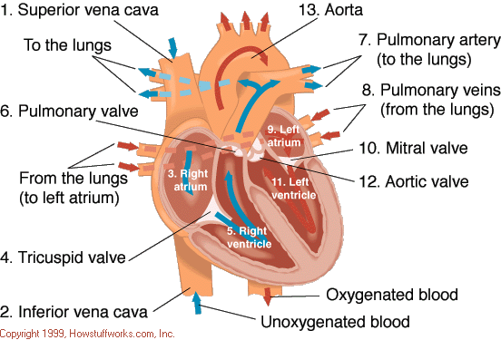
Heart Anatomy

Slide 10
Cardiovascular Physiology
VO_{2max} (ml O₂ / KG body weight / min)
1 MET = 3.5 ml O₂ / KG BW/ min
Cardiac Output = Stroke Volume (SV) X Heart Rate (HR)
Ejection Fraction
Blood Pressure Systolic / Diastolic

Slide 11
Karvonen’s Formula
220 (Maximum Heart Rate at Birth)
220 - Age = Predicted Maximum HR (PMHR)
PMHR - Resting Heart Rate (RHR) = Heart Rate Reserve (HRR)
HRR X Effort Percentages (i.e. 60%, 70%, 80%)
Add RHR to Effort Values = Target Heart Rates

Slide 12
Muscle Physiology
Hypertrophy
Hyperplasia
Atrophy
Sarcopenia
Contraction Types
Eccentric
Isometric
Concentric
Size vs. Strength

Slide 13
Size vs. Strength
Size
  #Type II_{b} Fibers
  Skeletal Size
  Muscle Belly Size
Strength
  #Type II_{b} Fibers
  Skeletal Size
  Recruitment
  Leverage
Other Factors
  • Genetics • Toxins
  • Nutrition • Hormonal Setup

Slide 14
Muscle Distinctions
Cardiac
  Characteristics
Smooth
  Characteristics
Skeletal
  Functions

Slide 15

Muscle Fiber Types
Type I Oxidative
Slow Twitch
Type IIa
Fast
Oxidative
Glycolytic
FOG
Type IIb(x)
Glycolytic
Fast Twitch

Slide 16
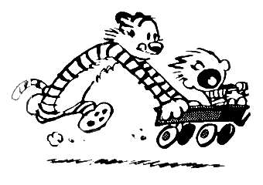
Major Energy Producing Systems

Slide 17
Adaptation to Exercise - Intensity
Level | %VO_{2max} / HRR | % max HR | Adaptations | Type of Exercise
2-3 | 55-65 | 60-70 | Aerobic Source Pathways | Over Distance
3-4 | 66-75 | 71-75 | Capillarization FFA Mitrochondria | Endurance Foundation / Base
4-5 | 76-80 | 76-80 | FOG Fibers O₂ Transport Glycolysis | Endurance Foundation
5-6 | 81-90 | 81-90 | FOG Fibers AT O₂ Transport Lactate Clearing | Intervals / Race Pace
7-10 | 91-100 | 91-100 | FT Fibers Speed Neurons Muscle Coordination | Race
Brooks, D. The Complete Book of Personal Training. Human Kinetics Publishers 2003.

Slide 18
Success Pyramid
motor units
Agility
Power
neurons
muscle types
Strength
Flexibility
movement
Stability
proprioceptors
Mobility

Slide 19
Periodization
Cycles
Macro
Meso
Micro
Basic Workout Components
Mental Prep
Warm-up
Skill
Strength
Cardiovascular
Cool-down

Slide 20

Non-Linear Periodization
Perfect Week:
  Monday – Foundation work
  Tuesday – Tempo
  Wednesday – Circuit
  Thursday – Rest
  Friday – Neurological
  Saturday – Interval
  Sunday - Rest

Slide 21
Workouts Made Simple
Corrective Continuum
Squat
Lunge
Push
Pull
Twist
Inhibit
Lengthen
Activate
Integrate
Primary Movements

Slide 22
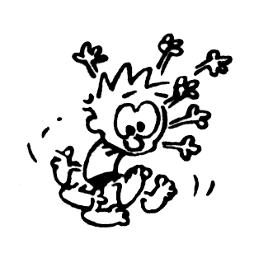
Proprioception
Golgi Tendon Organ
Muscle Spindle Unit
Labyrinthian Receptors
Cutaneous Receptors

Slide 23

Lifting Acronyms
SAID
Specific
Adaptation
to Imposed
Demands
FITT
Frequency
Intensity
Time
Type
GPO
Gradual
Progressive
Overload

Slide 24
Recovery
Rhabdomyolysis
Mental Reboot
Duration
  Resistance
  Cardio
  Neurological
  Injury
Over Training Symptoms
  Decline in Performance
  Increased RHR
  Decreased Immune System
  Lack of Motivation
  Injuries
  Etc.

Slide 25
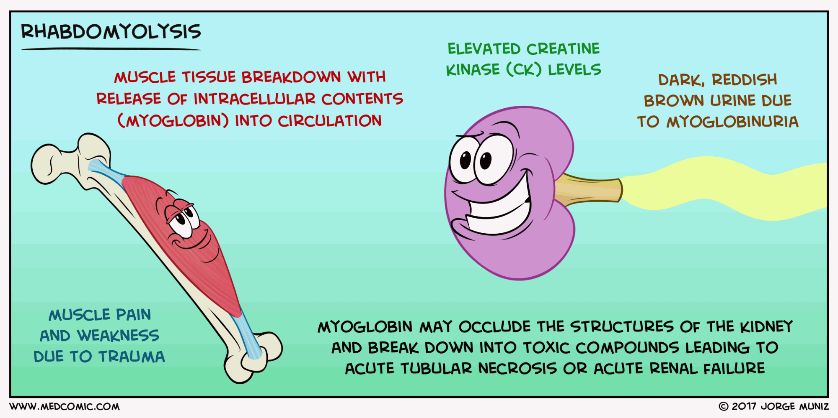
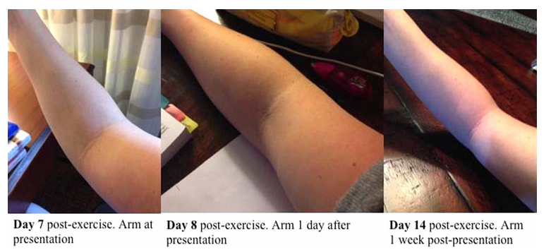
Rhabadomyolysis
Muscle tissue breakdown
Release of a (myoglobin) into the blood.
Myoglobin can damage the kidneys.
Symptoms include
  Dark, reddish urine,
  Decreased amount of urine, weakness
  Severe muscle aches.
Early treatment with aggressive fluid replacement reduces the risk of kidney damage.
Society of Hospital Medicine: 2014 RIV Abstract Issue, Volume 9, March 2014 Abstract Supplement

Slide 26
Injuries
Types
  Sprains
  Strains
  Tendonitis
  Bursitis
  Stress Fractures
  Shin Splints
Treatment
RICE Rest Ice
Compression
Elevation

Slide 27
Basic Nutrition
Carbohydrates
4 Kcal / gram
Sources
Protein
4 Kcal / gram
Sources
Fats
9 Kcal / gram
Kinds
Sources
Alcohol
7 Kcal / gram

Slide 28
Nutrition Components
3500 Kcal / Lb
1.0 – 2.0 lbs/week loss
5 Components
  Increase water
  Increase fiber
  Reduce toxins
  Eat a variety of foods
  Move

Slide 29
Mike Rickett
1116 South Hillcrest Drive
Fort Collins CO 80521
970-484-8847
Web site: www.mikerickett.com
E-mail: mike@mikerickett.com
Instagram: mrickett6069
ApplicationinMotion.com
advancing health

