Slide 1

Sports Conditioning Certification
Creating Happy Bodies
Presented by:
Mike Rickett MS, CSCS*D, CSPS*D, RCPT*E

Slide 2
Disclaimer
This Certification is designed to assist Personal Trainers to develop programs to prevent injuries.
It is NOT designed to diagnose or treat any condition.

Slide 3
Common Areas of Concern
Runner injuries
Runners Knee
Shin splints
Stress fractures
Achilles tendinopathy
Muscle pull
Ankle sprain
It (Iliotibial) Band Syndrome
Plantar fasciitis
Blisters
Temperature related
Group Exercise
(Crossfit, Yoga, Zumba, etc.)
Ankle sprain
Shin splints
Stress fractures
Achilles tendinopathy
Muscle pull
Ankle sprain
It (Iliotibial) Band Syndrome
Plantar fasciitis
Blisters
Shoulder overuse

Slide 4
Common Areas of Concern
Contact Sports
(Football, Rugby, etc.)
Concussions
Dislocations
Breaks
Ankle sprain/strain
Shin splints
Stress fractures
Achilles tendinopathy
Muscle pull
Ankle sprain
It (Iliotibial) Band Syndrome
Plantar fasciitis
Gliding Sports
(Hockey, Figure Skating, Rollerblading, etc.)
Concussions
Dislocations
Groin injuries
Wrist injuries
Ankle sprain
Shin splints
Stress fractures
Muscle pull
It (Iliotibial) Band Syndrome

Slide 5
Common Areas of Concern
Jumping Sports
(Basketball, Volleyball, etc.)
Ankle sprain
Shin splints
Stress fractures
Achilles tendinopathy
Muscle pull
Ankle sprain
It (Iliotibial) Band Syndrome
Plantar fasciitis
Shoulder injuries
Water Sports / Swimming
Shoulder / rotator overuse injuries
Swimmers ear
Groin injuries
Plantar fasciitis
Foot abrasions

Slide 6
Common Areas of Concern
Performer Sports
(Cheerleading, Dance, Gymnastics, etc.)
Concussions
Ankle sprain
Shin splints
Stress fractures
Achilles tendinopathy
Groin injuries
Muscle pull
Ankle sprain
It (Iliotibial) Band Syndrome
Plantar fasciitis
Wrist strain
Shoulder injuries
Bunions
Blisters

Slide 7
Intangibles to Success
Body Weight
  (fat / lean, etc)
Recovery
  (sleep, etc.)
Nutrition
Hydration
Supplementation
Addictions
  (exercise, etc.)
Fear

Slide 8
Principles & Biomechanics of Sports Conditioning
Presented by:
Mike Rickett

Slide 9
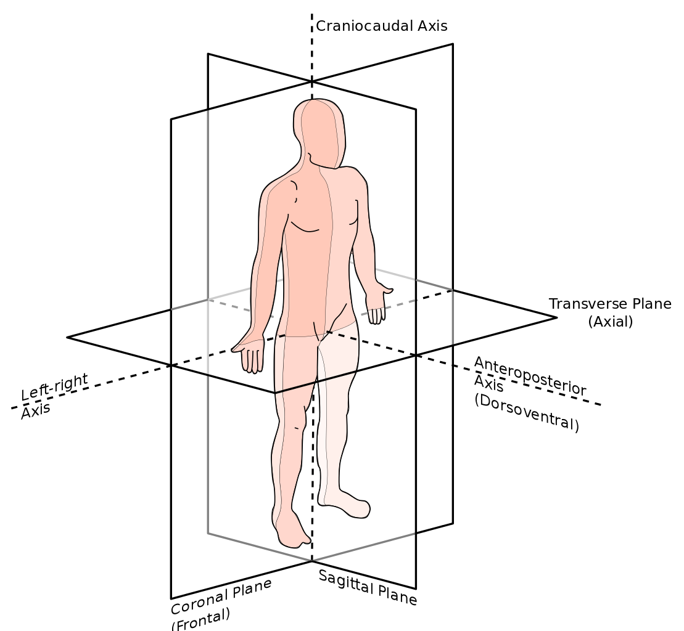
Terminology
Frontal - front/back
Sagittal - side to side
Horizontal - rotate
Medial-Lateral
Anterior-Posterior
Proximal-Distal
Supine-Prone
Superior-Inferior
Flexion-Extension
Rotation
  Internal-External

Slide 10
Eccentric F < R
Isometric F = R
Concentric F > R
Isotonic – constant tension
Isokinetic – constant speed
Plyometric
Contraction Types

Slide 11
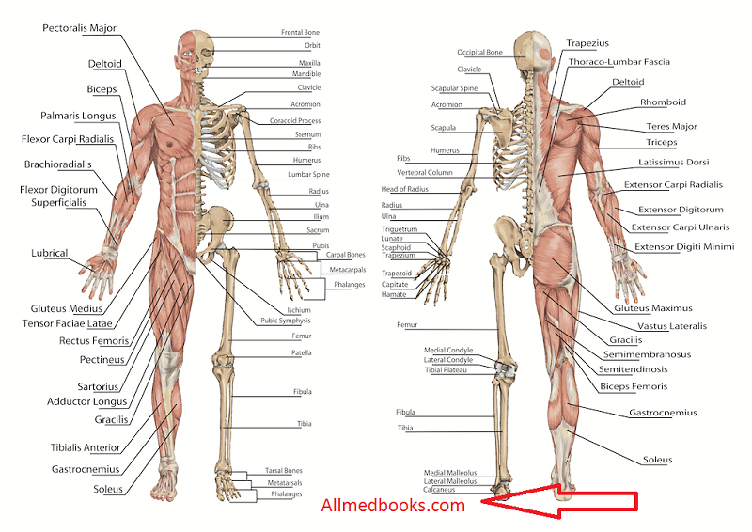

Slide 12
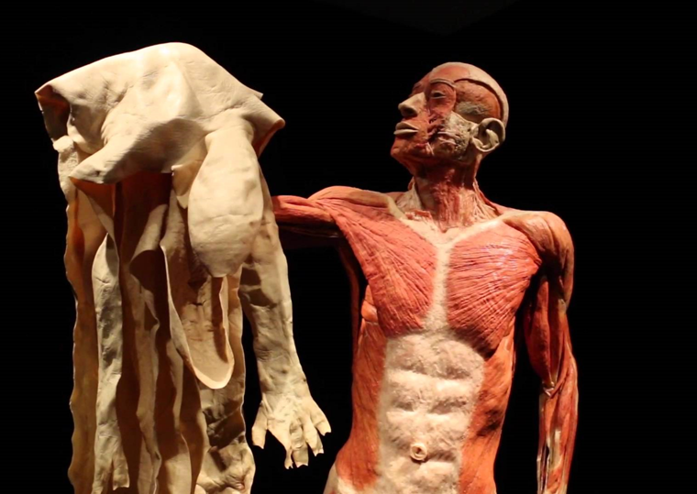
Body Worlds
Mike Rickett 2019©

Slide 13
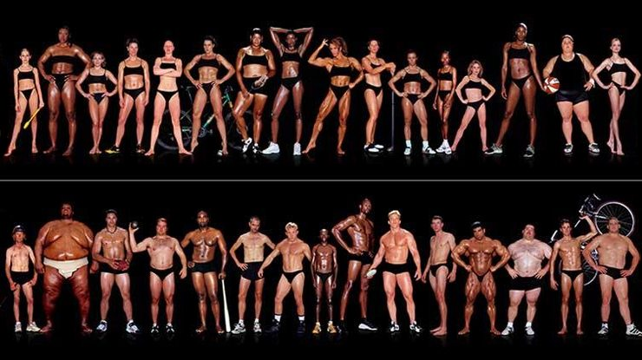
One Size Fits…None!
Mike Rickett 2018©

Slide 14
Client
Assessment
Creating Happy Bodies
Presented by:
Mike Rickett

Slide 15
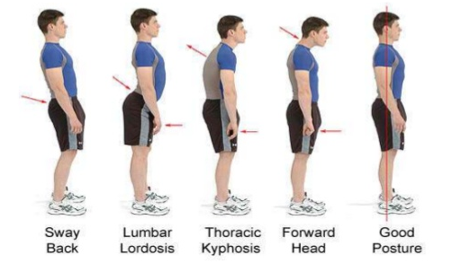
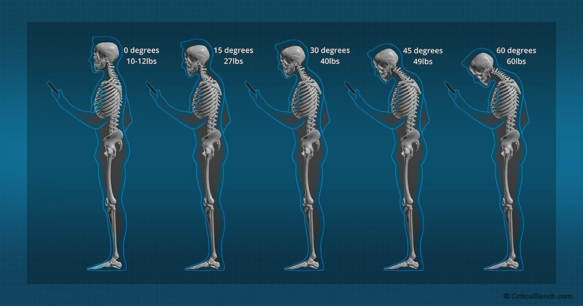
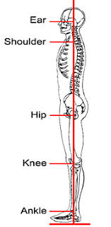
Posture

Slide 16
Common Evaluations
Overhead squat
Hurdle step
Inline lunge
Shoulder mobility
Rotate stability
Active leg raise
Trunk stability
Mike Rickett 2018©

Slide 17
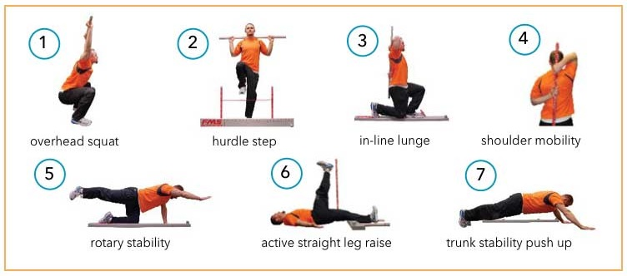
1. Overhead Squat
1 | 2 | 3
Torso parallel with lower leg / knee aligned with foot | Torso parallel with lower leg / knee aligned with foot | Torso parallel with lower leg / knee aligned with foot

Slide 18
2. Hurdle Step
1 | 2 | 3
Ankles, knees and hips remain aligned and back is neutral | Ankles, knees and hips no longer aligned | Out of balance or cannot clear hurdle

Slide 19
3. Inline Lunge
1 | 2 | 3
Ankles, knees and hips remain aligned and back is neutral | Ankles, knees and hips no longer aligned, lean forward/side | Out of balance or cannot bring knee to floor

Slide 20
4. Shoulder Mobility
1 | 2 | 3
Fingers touching | Fingers within 6 inches | Fingers greater than 6 inches apart

Slide 21
5. Rotary Stability
1 | 2 | 3
Unilateral alternate repetitions | Diagonal alternate repetitions | Cannot perform a diagonal repetition

Slide 22
6. Straight Leg Raise
1 | 2 | 3
90+degrees of Flexion | Les than 90 degrees of Flexion | Heel at knee level

Slide 23
7. Stability Push Up
1 | 2 | 3
Stable pushup repetition | Unstable pushup reps / stable plank position | Unstable plank position

Slide 24
Corrective Continuum
Inhibit
Lengthen
Activate
Integrate
Myofascial Release
Stretching
Strengthen
Create Patterns

Slide 25
Workout Components
Squat
Lunge
Push
Pull
Rotate

Slide 26
Sports Conditioning Exercises for the Foot & Ankle
Creating Happy Feet
Presented by:
Mike Rickett

Slide 27
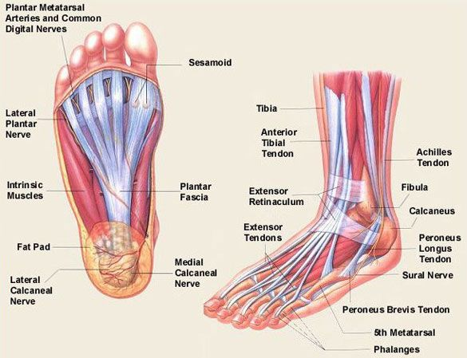
Ankle / Foot Anatomy

Slide 28
Common Injuries / Movement Patterns
Achilles Tendonitis
Plantar Tendon Tendinitis
Stress Fractures
Ankle Sprain
Neuromas
Heel Spur

Slide 29
Potential Exercises:
Balance on one leg
Dorsi/Plantar flexion
Circumduction
Toe grabs
Barefoot training
Short foot

Slide 30
Sports Conditioning Exercises for the Knee
Creating Happy Knees
Presented by:
Mike Rickett

Slide 31
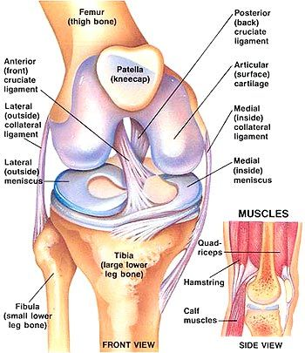
Knee
Anatomy

Slide 32
Common Injuries / Movement Patterns
Fractures
Dislocation
Anterior Cruciate Ligament
Posterior Cruciate Ligament
Medial / Lateral Collateral Ligament injuries
Meniscus Tears
Patellar Ligament Tear
Quadriceps Tendon Tear
Iliotibial Band Syndrome

Slide 33
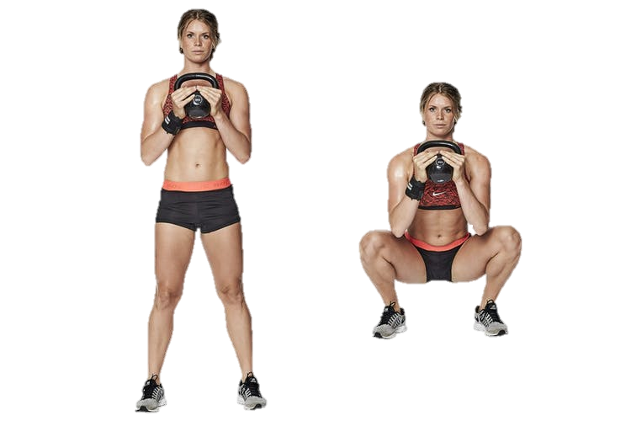
Potential Exercises:
Modified leg extension
Balance challenges
Deadlift
Squat modifications

Slide 34
Sports Conditioning Exercises for the Hip
Creating Buns of Steel
Presented by:
Mike Rickett

Slide 35
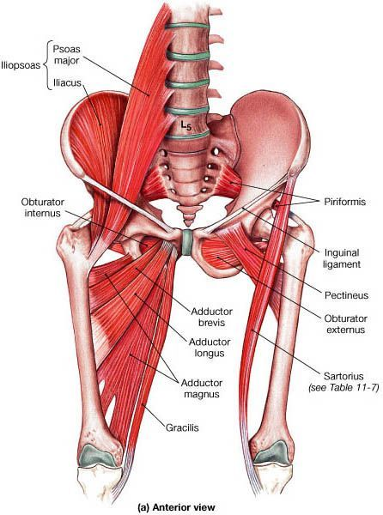
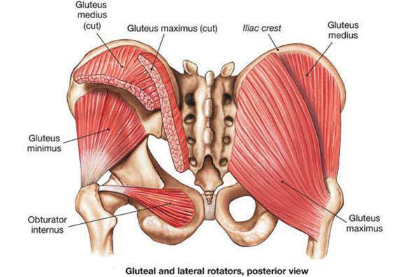
Hip Anatomy

Slide 36
Common Injuries / Movement Patterns
Groin Pulls and Strains
IT Band Syndrome
Osteoarthritis
Hip Pointer
Hamstring Dysfunction
Iliopsoas Syndrome
Bursitis
Piriformis Syndrome
Stress Fractures
Tailbone Pain / Injury

Slide 37
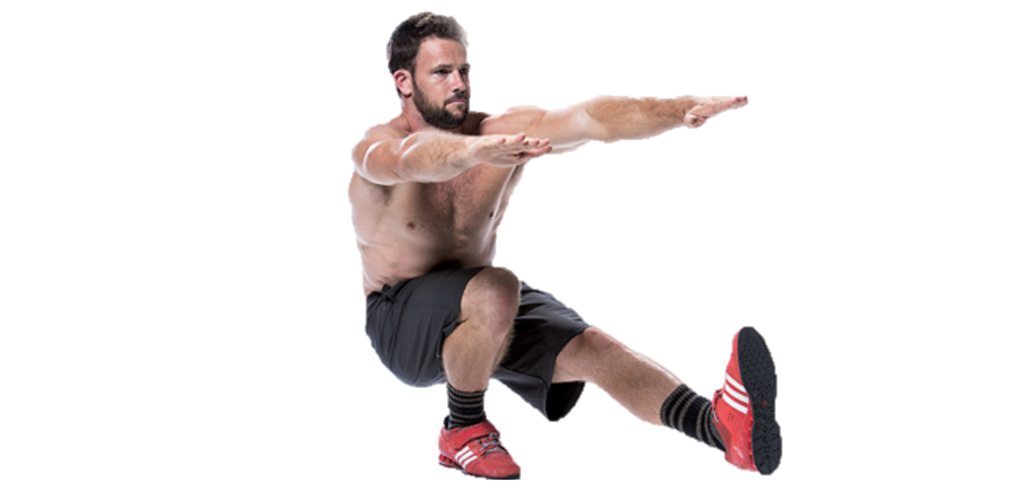
Potential Exercises:
Hip Bridge
Straight leg deadlift
Courtesy squat
Squat patterns
Band Walks
Pistol Squats

Slide 38
Sports Conditioning Exercises for the Shoulder
Creating Happy Shoulders
Presented by:
Mike Rickett

Slide 39
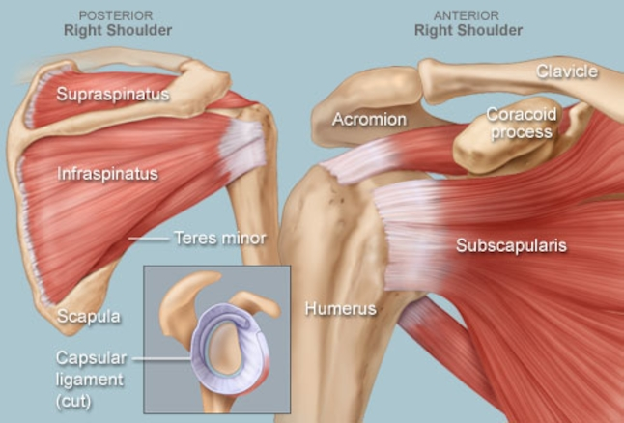
Shoulder Anatomy

Slide 40
Common Injuries / Movement Patterns
Rotator Cuff Tears
Shoulder Impingement
Rotator Cuff Tendinitis
Dislocated Shoulder
Shoulder Instability
SLAP Tear (Superior Labrum Anterior and Posterior)
Frozen Shoulder
Arthritis

Slide 41
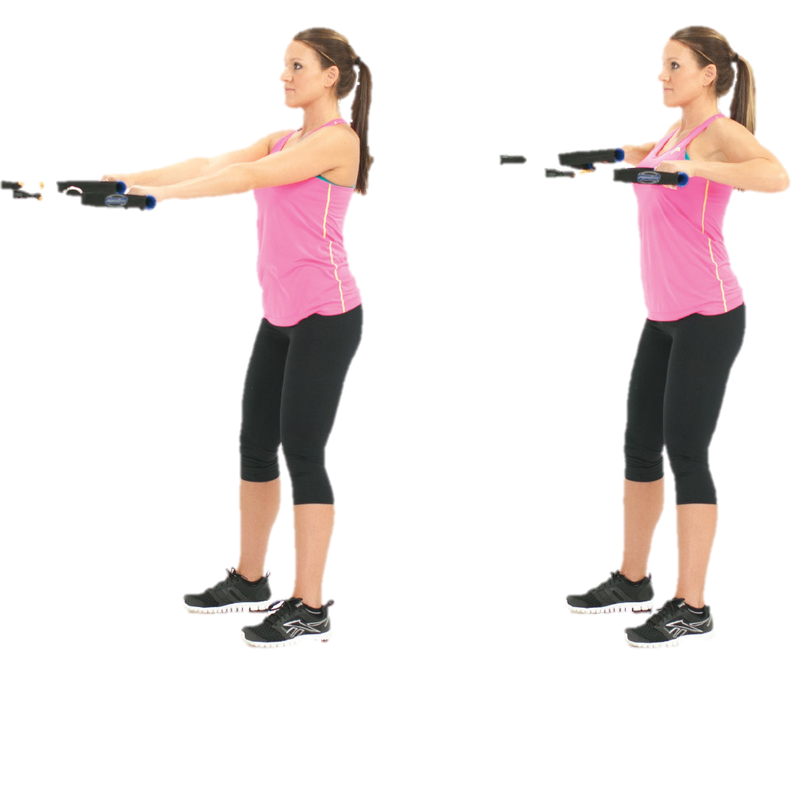
Potential Exercises
Internal / External Rotation
Scapular Stabilization
Circumduction
Back Flies
High Rows

Slide 42
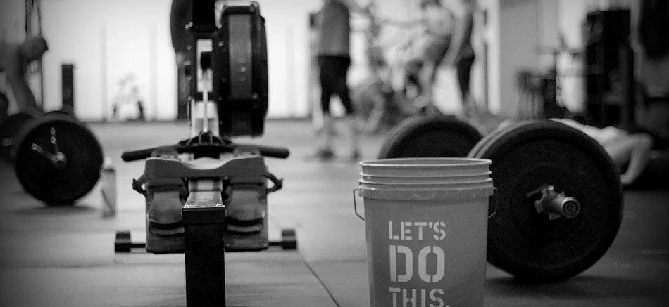
Thank you!
Time to Excel!
Mike Rickett 2018©

Slide 43
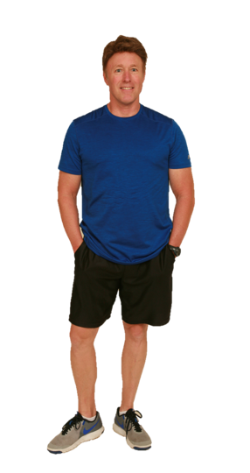
Mike Rickett
MS, CSCS*D, CSPS*D, NSCA-CPT*D, RCPT*E www.applicationinmotion.com mike@mikerickett.com
970-484-8847
Instagram: mrickett6069
Facebook: Mike Rickett

