Slide 1
Stretching For Flexibility, Function & Strength
Mike Rickett MS, CSCS*D, CSPS*D, RCPT*E

Slide 2
Stretching Introduction
Mike Rickett MS, CSCS*D, CSPS*D, RCPT*E

Slide 3
Fitness: train/stretch individual muscle to improve function
Biomechanical
Body is made of separate/different parts located in separate/different systems that mechanically work together
Traditional
Rehab: Rehab individual body part to improve function
Soft tissue enable joint ROM
Medical: Replace body part and it will work fine
Fitness: train kinetic chain and nets not just muscle
Fascia System
Body more than sum of parts do to the connection and communication between FS and the body
Integrated
Rehab: Train kinetic chain and nets not just one body part
Movement imbedded in FS
Medical: Rehabilitate the body before replacing the part
Traditional vs Integrated Flexibility Training

Slide 4
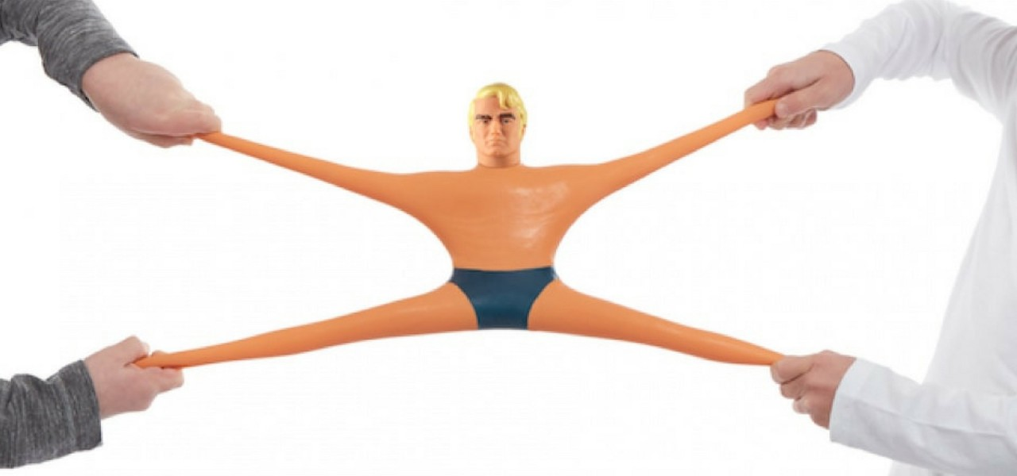
Definition of Stretch / Flexibility
Stretch
Be made or be capable of being made longer
Flexibility
Bending without breaking
Strength
Force over distance
Power
Force over distance / time
Agility
Ability to adapt quickly
© 2023

Slide 5
Components of Elasticity
Tension
Tension:
A baseline amount of tension throughout the myofascial network is necessary to accommodate, adapt, and respond to the multiple, varied forces generated by the human movement system.
Compression
Compression:
A baseline amount of compression through the skeletal system counterbalances the tension of the myofascial network.
Collagen:
The molecule is made of three long protein chains (polypeptides) and, after water, is the second largest component that makes up fascia. It represents about 30% of human body protein.
Elastin:
A protein that gives collagen the ability to tolerate stretch and distension; creates a three-dimensional network around collagen fibers.

Slide 6
How Bodies are Arranged
© 2023

Slide 7
Anatomy and Physiology of Stretching…Types and Benefits
Mike Rickett MS, CSCS*D, CSPS*D, RCPT*E

Slide 8
Types & Techniques
Static
Dynamic
Ballistic*
Assisted
PNF
Perpetual Motion
Hyperbolic
© 2023

Slide 9
Mechanisms of The Stretch
Mike Rickett MS, CSCS*D, CSPS*D, RCPT*E

Slide 10
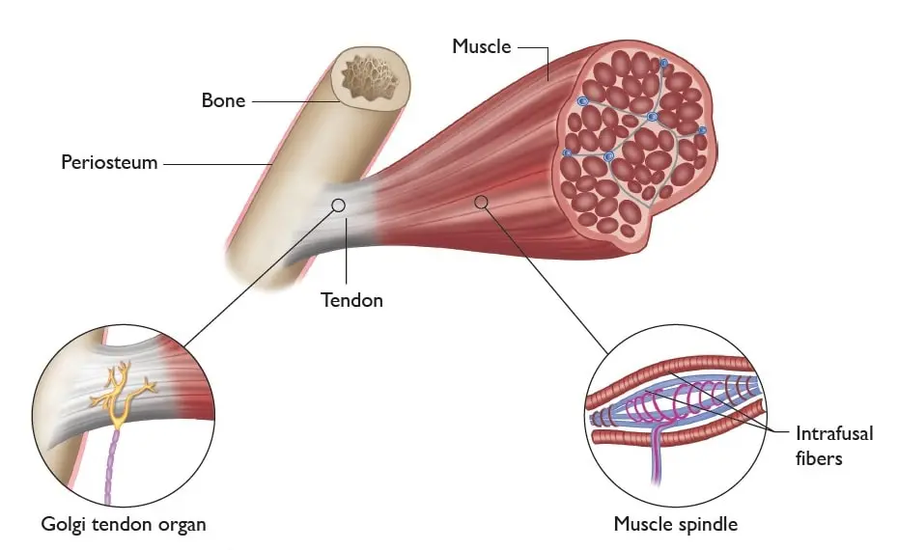
Proprioceptors
GTO
Muscle Spindles
Labyrinthian
Cutaneous
© 2023

Slide 11
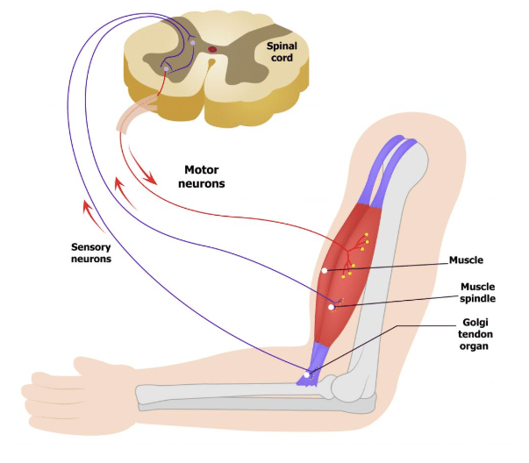
Structure
Skeletal
Ligaments
Tendons
Cartledge
Fascia
© 2023

Slide 12
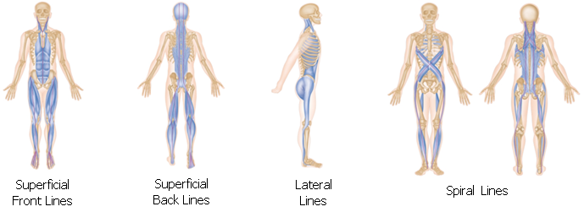
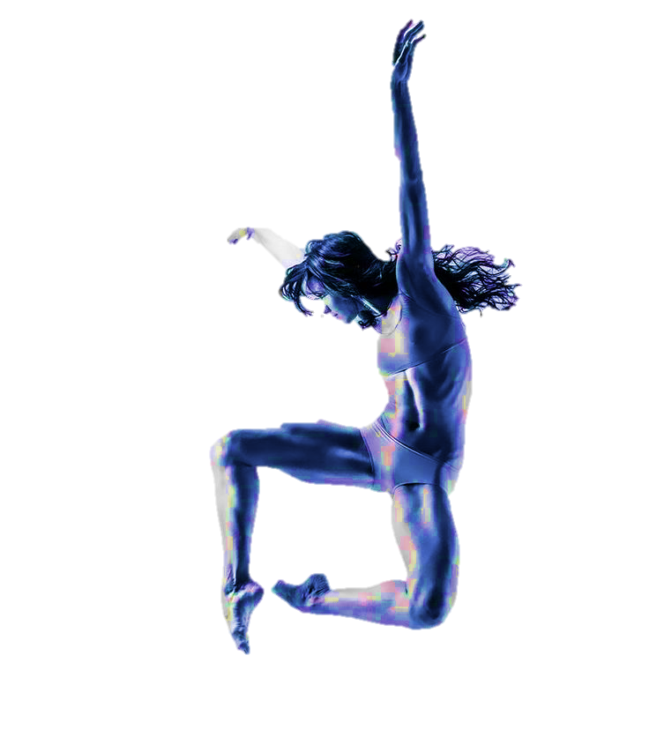
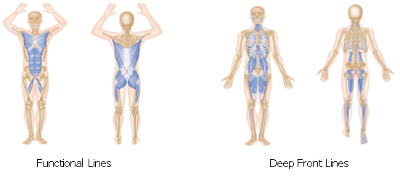
Fascial Nets

Slide 13
Compounding Issues
Age
Activity
Vagus Tone
Hydration
Nutrition
Recovery
© 2023

Slide 14
Protocol
Stabilize
Identify Issues
Move slowly
No Pain
Repeat until No Changes Occur
Assisted Stretching
Synchronized Breath
No Pain
Traction
Progress to Perpetual Movement
© 2023

Slide 15
Stretching and Flexibility Lower Body
Mike Rickett MS, CSCS*D, CSPS*D, RCPT*E

Slide 16
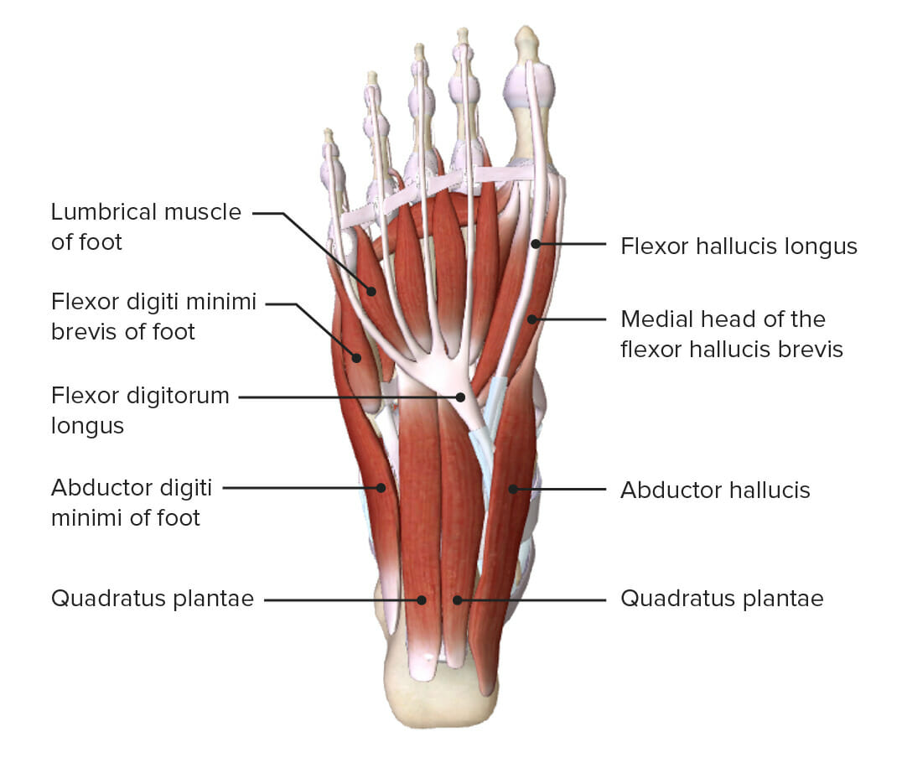
Feet
Introceptors Receptors
Extroceptive Receptors
Short Foot
Naboso
Toe Splayers
© 2023

Slide 17
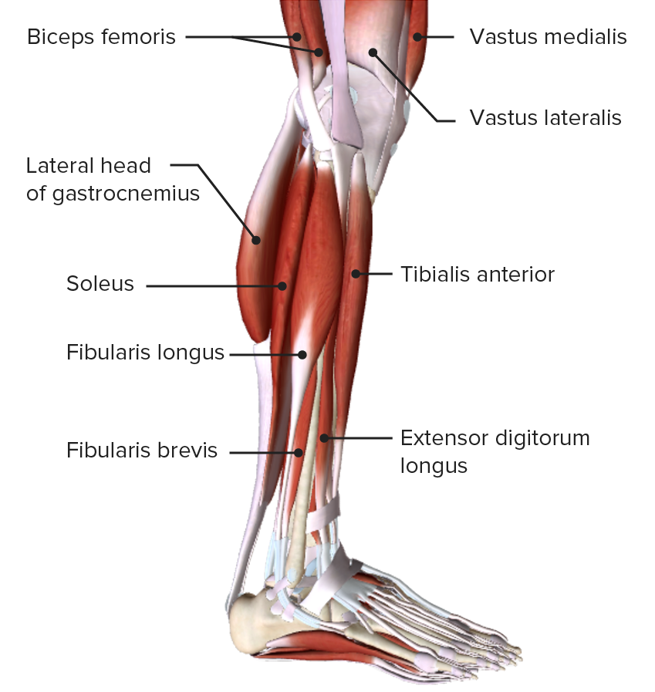
Calf & Shin
© 2023

Slide 18
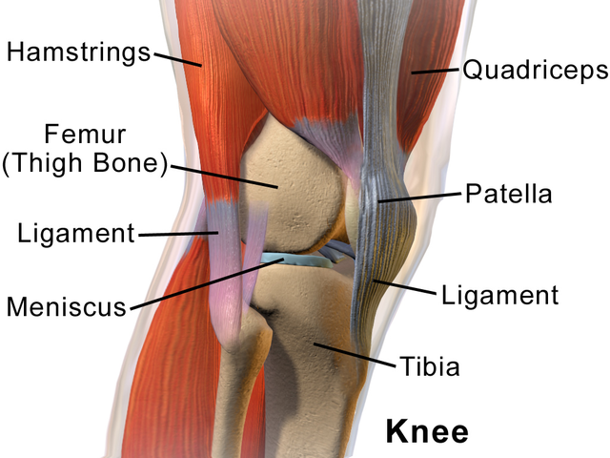
Knee & Thigh
© 2023

Slide 19
Stretching and Flexibility Hips and Torso
Mike Rickett MS, CSCS*D, CSPS*D, RCPT*E

Slide 20
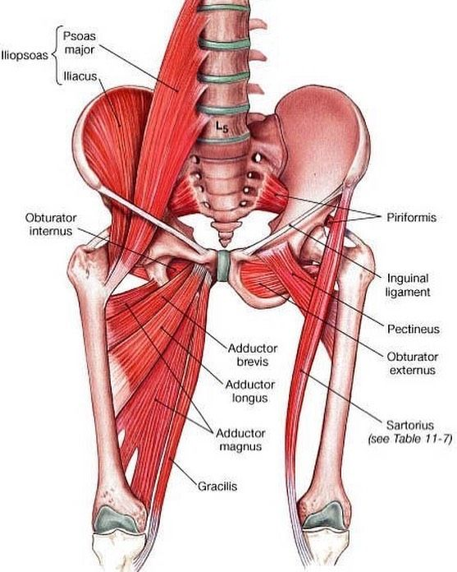
Hips
© 2023

Slide 21
Torso
© 2023

Slide 22
Stretching and Flexibility for the Chest Shoulders & Back
Mike Rickett MS, CSCS*D, CSPS*D, RCPT*E

Slide 23
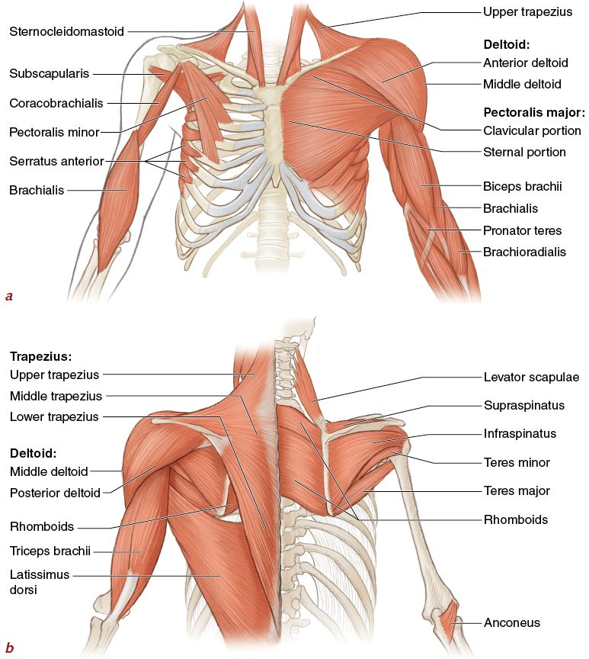
Back &
Chest
© 2023

Slide 24
Shoulders
© 2023

Slide 25
Stretching and Flexibility Hands, Wrists & Arms
Mike Rickett MS, CSCS*D, CSPS*D, RCPT*E

Slide 26
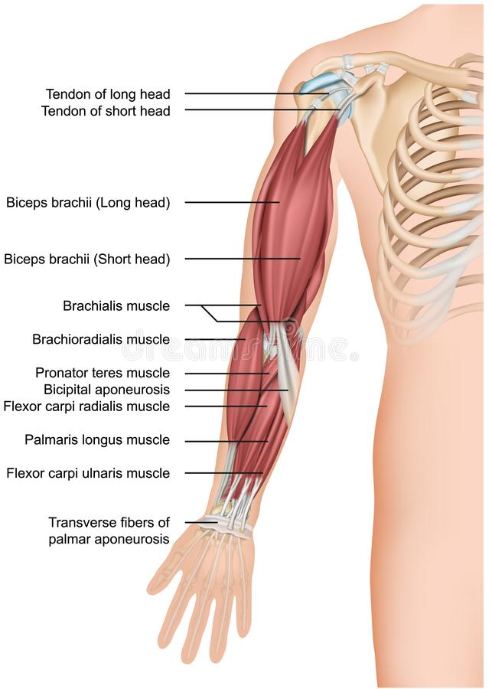
Arms
© 2023

Slide 27
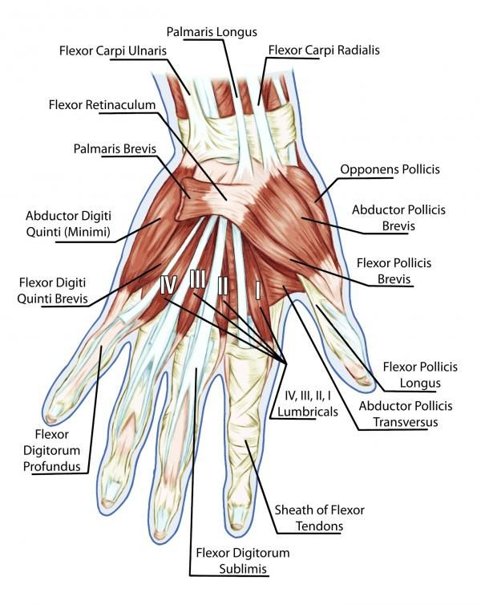
Wrist
© 2023

Slide 28
Stretching and Flexibility for the Neck
Mike Rickett MS, CSCS*D, CSPS*D, RCPT*E

Slide 29
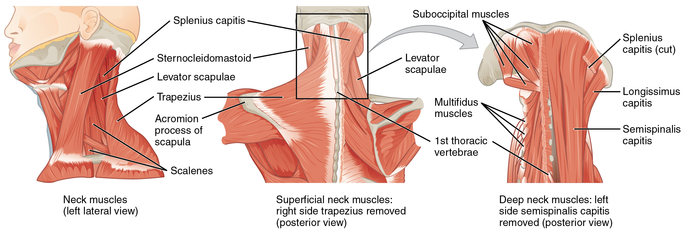
Neck
© 2023

Slide 30
Mindful Stretching, Breathing into the Movements
Mike Rickett MS< CSCS*D, CSPS*D, RCPT*E

Slide 31
Breathing Types
Eupnea - normal Hyperpnea.
Hyperpnea - deep breathing
Diaphragmatic - take deep low breaths
Costal – rib cage assisted

Slide 32
Breathing protocols
Box breathing
4-7-8 breathing
Pursed lip breathing
Diaphragmatic breathing
Alternate nostril breathing
© 2023

Slide 33
Breath’s Role
Increase O₂ Uptake
Increase Focus
Parasympathetic Enhancer
Increase Energy
Relax Muscles
© 2023

Slide 34
Sport Specific Stretching Programs
Mike Rickett MS, CSCS*D, CSPS*D, RCPT*E

Slide 35
Protocol
Movement Patterns
Flexibility Needs
Strength Required
Limitations
Manipulation
Assess Movement Patterns
© 2023

Slide 36
Hyperbolic Stretching
Warm-up
Activity
Protocol
Stretch hold 5 sec - 30-40% rest 3 sec
Stretch hold 5 sec - 40-50% rest 3 sec
Stretch hold 5 sec - 50-60% rest 3 sec
Stretch hold 5 sec - 100% rest 30 sec
Complete twice
Recovery

Slide 37
10 Basic Stretches
Stretch 1
Hip Joint Warm-Up
Stretch 2
Glute/Hip Rotator
Stretch 3
Quadratus Lumborum
Stretch 4
Iliopsoas
Stretch 5
Latissimus Dorsi
Stretch 6
Rhomboid
Stretch 7
Standing Calf
Stretch 8
Standing Pectoral
Stretch 9
Standing Rotator Cuff
Stretch 10
Standing Levator Scapula
© 2023

Slide 38
Mobility Makers
Biomimicry
Flow Exercises
© 2023

Slide 39
Enhancers
Kinesio tape
Compression
Vibration
Percussion
Electro Stimulation
Heat

Slide 40
Ehlers-Danlos Syndrome
Loose joints
Fragile, small blood vessels
Abnormal scar formation and wound healing
Soft, velvety, stretchy skin that bruises easily

Slide 41
Things to Remember…
Go Slow
Not a Competition
Select Stretches You Need First
Combine Stretches
No Pain
Vary Stretches

Slide 42
Thank you!
Mike Rickett
1116 S Hillcrest Dr
Fort Collins CO 80521
970-484-8847
Instagram: mrickett6069

