Slide 1

An Introduction to Fire Prevention & Safety.

Slide 2
1. Some basics.
Hopefully, few of use have ever been or will be confronted by a fire either while at work or at home.
Until we are and dependent upon the size of the fire, none of us will know how we would react.
FIRE & SMOKE IS A KILLER – FACT. So we must be aware of the dangers and take steps to prevent a fire from occurring.
This is especially so given your role as a Care Worker visiting Service Users in their own homes.
Some Service Users would have great difficulty leaving their homes quickly should a fire occur (whether you are present or not.)
So what can we do when working with Service Users:
to try and prevent a fire starting?
in the event of a fire?

Slide 3
2. What can we do to try prevent a fire occurring?
The company must carry out an Environmental Risk Assessment prior to starting work with a Service User as part of an overall Service User Risk Assessment procedure.
Any potential Fire risks should be highlighted and discussed with the Service User of the Service Users’ family to reduce risks.
Any Care Worker who notices a new fire hazard should report this to the office immediately.
We can inform the Service User that they can have a free Fire Assessment visit to their homes with recommendations and free offers of smoke alarms, carbon monoxide alarms and other possible preventative measures.
The difficulty we face is that we are working in the Service Users’ property and they may not agree with anything put to them to reduce fire risks.

Slide 4
3. What fire hazards to look out for:
Open Fires / No fire guards.
Gas / Electric fires / heaters in poor condition / Controls not working properly.
Hoarding paper or other flammable materials
Overflowing waste bins – fire / health hazard.
Fire hazards – paper / combustible materials near fires / heaters.
No smoke alarms / carbon monoxide monitors.
Dirty laundry / clothes lying around premises.
Electrical wiring in poor condition -Problems with electrical sockets – not working. Overloaded plug sockets or extension cables
Smoking – with signs of unsafe use of smoking or vaping materials (e.g. smoking in bed, unsafe disposal of cigarettes, burn or scorch marks on clothing, flooring or furniture.

Slide 5
4. What to do in the event of a fire.
If safe to do so call the fire brigade immediately and ambulance (if necessary) giving them the details of where the fire is etc.
If in premises with a fire alarm system, such as a block of flats or home, set the alarm off and follow their evacuation procedures and leave via the nearest (safest) exit.
If the fire is in one of the rooms then close the door where the fire is to try to slow the fire from spreading
Leave the premises by the nearest (safest) exit.
Only if you are able, assist the Service User to leave the premises and if it is safe to do so, take them outside and move a safe distance away from the premises - call fire brigade if not done so already.
Do not stop to collect belongings etc.
Do not take risks – your safety and that of the Service User is the priority.
Do not re-enter the property once you have left it - under any circumstances.
Contact the office telephone number to advise them of what has happened and that you and the Service User are safe.
Wait with the Service User for the Fire Brigade / Ambulance to arrive.
Above all else, your safety is the absolute priority so do not take unnecessary risks.

Slide 6
5. Working with Service Users in residential premises.
If you are working with Service Users who live in a residential setting (flats, etc.) you should:
Be aware or their fire safety policy and fire evacuation policy.
Know where the fire alarms are situated.
Know the location of the nearest fire escape to the Service Users’ property.
Know where the fire extinguishers are located.
Know which fire extinguisher to us on different types of fires.

Slide 7
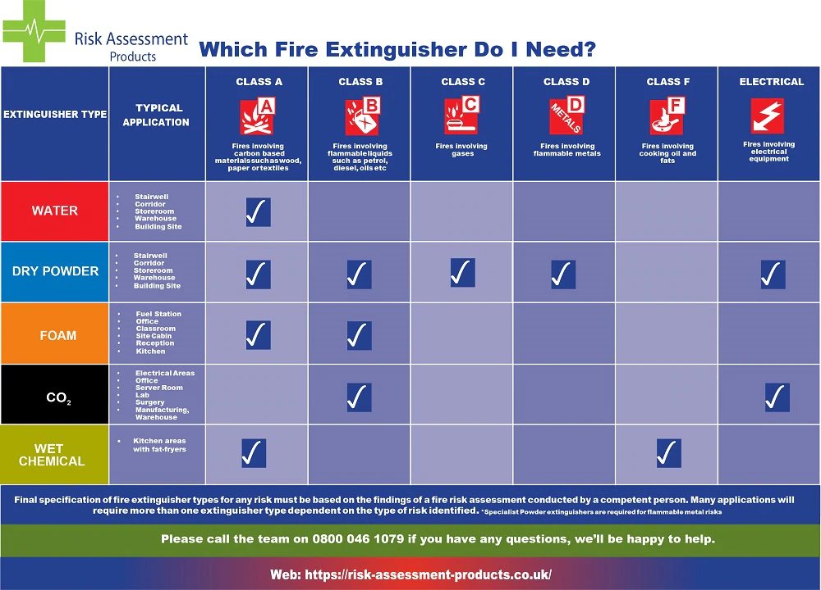
6. Which fire extinguisher to use.

Slide 8
7. Action Points for Employees.
Assess Service Users premises on every visit for new fire hazards or concerns – report to the office and enter concern on Daily Visit Report.
Identify other escape routes in Service Users’ premises, other than the front door.
Keep Service Users property as neat and tidy as possible.
Get to know the different types of fire extinguishers and what fires they can be used on (just for your own peace of mind)
Do not take any unnecessary risks where fire is concerned.
If possible help the Service User to safety in the event of a fire.
If possible, close doors in clients property to limit spread of fire.
Always Ring 999 for Fire Brigade straight away on seeing a fire

