Slide 1

Creating and recording your podcast episode
Laura McNabb
Continuing Studies, ELC, XJTLU
March 23, 2022

Slide 2


Introduction
Today the goal is to get you started and well on your way to recording your podcast episode.
The overall goal is to have a podcast channel for XJTLU students with episodes made by XJTLU students.
After you have completed your episode recording and submitted it, there will be a schedule for an ‘in-studio recording session’.
So, let’s get started!

Slide 3



Agenda
The topic and theme
The audience
The format
The structure
The content
The delivery
The recording
Look at the outline shared in Chat by Laura.

Slide 4

The topic & theme
What will you be talking about?

Slide 5
How to decide your topic
Think about a topic that is interesting and engaging for you. Something that you get excited to discuss.
Check out the categories suggested on the form.
After you have your topic, then you need a theme/thesis for your episode. What is your specific message?
Also, is this a one-off episode or a series (2 or more)?

Slide 6
The audience
Who are you talking to?

Slide 7
A profile XJTLU of students
While XJTLU students are from different backgrounds and have different interests, there are still key factors to consider about this demographic.
How much time do they have?
What do they do during the day?
When might they be listening to a podcast episode?
What purpose might they have for listening to a podcast episode?

Slide 8
The format
How will you set up your episode?

Slide 9
How many hosts?
Most podcasts are either a one-person show or co-hosts in conversation.
Both are good.
You may have a personal preference.
Your topic may lend itself better for one format or the other.
Both styles are challenging.

Slide 10
The structure
What is your story?

Slide 11
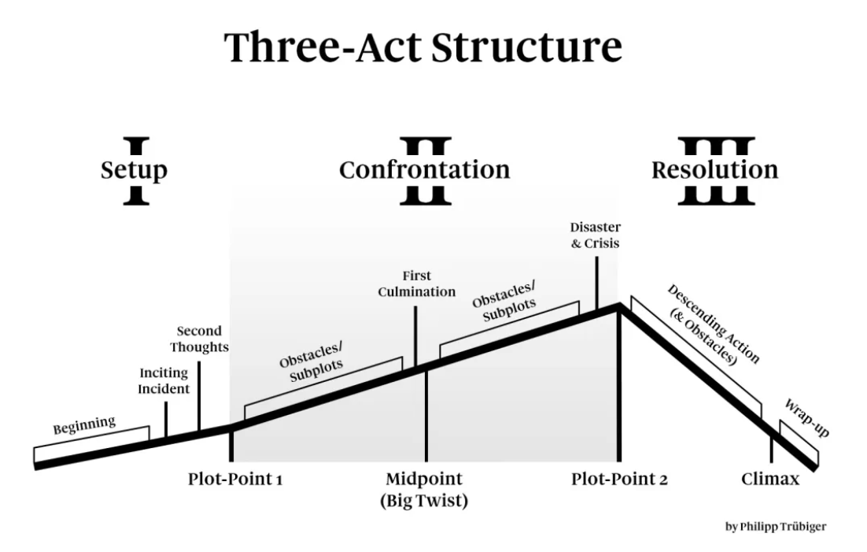

Slide 12
You are building a story
Your teachers have always called it Introduction, Body, Conclusion
Let’s get more specific.
What is the foundation of the story? What do listeners need to know?
How does the conflict develop? What went wrong?
How was the conflict solved? What was learned?
https://castos.com/podcast-structure/

Slide 13
The content
What specifically will you include? What references will you use?

Slide 14
What are the main points for your theme/thesis?
Create an outline. Just like an essay or speech or presentation.
Go back to your main idea/theme/thesis.
What are you supporting points and details?
Organize in paragraphs/chunks – idea, explanation, example, explanation, example
Very important! – what supporting source/material do you need?

Slide 15
Copyright and Plagiarism
Using other people’s ideas is fine, but we always need to give credit.
Referring to other people’s ideas can add authority to your own thoughts/opinions.
Ideas – give the author name, publication year, publication title
Using other people’s art is not fine (audio clips of movies, music, etc.) – only if you find it in the free music sites. Otherwise it is an infringement of copyright.
Check out websites for free images and sound bytes like https://mixkit.co/

Slide 16
The delivery
How will you make your speech dynamic and engaging?

Slide 17
Speech Prosody
Dynamic – word stress, word emphasis, pitch, volume
Good pace – energetic with changes communication clarity (speed up, slow down) (150-160 wpm; not less than 100 wpm for certain)
It is useful to either have a complete script or use cue cards.

Slide 18
The recording
How to make a quality recording

Slide 19
Equipment and Environment
What do you need?
A device with audio recording (laptop/tablet/phone)
A clear microphone (internal or external)
A quiet, undisturbed place to do your recording (beware of open windows or other reasons why unwanted sounds may show up on the recording)
An audio recording editing program (you don’t have to make it perfect all in one recording session)

Slide 20
Conclusion
A podcast episode can be about anything
Organize your content and follow the structure of 3-act arc.
Use a script if it will help you remain more fluent.
Remember to check your surroundings for ambient sound and interference before starting to record.
Check out these websites for further info:
https://improvepodcast.com/blog
https://castos.com/how-to-start-a-podcast/
https://www.smartpassiveincome.com/guide/how-to-start-a-podcast-tutorial-pat-flynn/

Slide 21


Thank You
Laura’s Podcast Office Hour is Wednesdays at 11am-noon at https://xjtlu.zhumu.com/j/629634548
Laura.Mcnabb@xjtlu.edu.cn
Submit your podcast to

