Slide 1
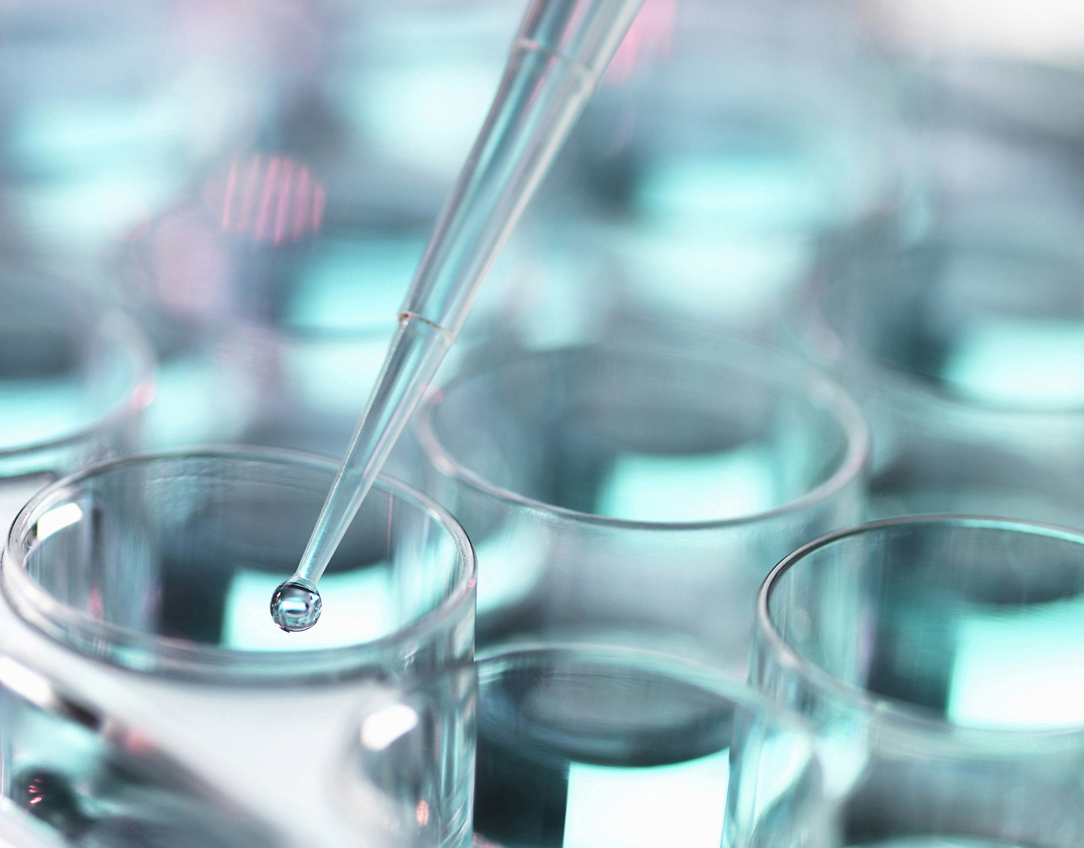
MEDICAL TECHNOLOGY
SHAPING THE FUTURE
Presented
By
Ferri Solaimani
October 2019

Slide 2
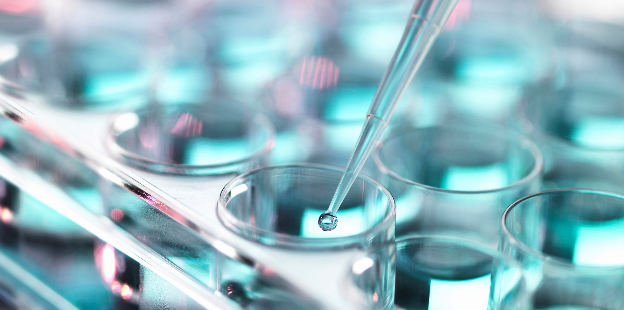
Agenda:
Presenter Bio
Medical Technology Program
Future State
Q & A

Slide 3
Presenter Bio, Ferri Solaimani
Bachelor of Science in Medical Technology
Master’s Degree in Business Administration
Clinical Laboratory Scientist Licensed by California DHS
Medical Laboratory Scientist Certified by ASCP
Certified Quality Improvement Associates by ASQ
Regulatory Affairs Management & Medical Product Development Certificates from UCI
Certificate of Competent Leader and Communicator by Toastmaster International
Over 30 Years Laboratory, Manufacturing & Management Experience
Educator & Consultant

Slide 4
Medical Technology Program
It is a study of clinical diagnostics testing and use knowledge of research to correlate laboratory findings with pathophysiology
Application of quality standards to conduct accurate, reliable clinical laboratory testing
Performing complex tests on biological specimens, analyzing test results, relaying test results to physicians or researchers
Making observation and recommendation based on statistical data and references, assist with the diagnosis, treatment and monitoring various conditions and diseases
Supervise or train Medical Lab Technicians and Phlebotomists
Apply principles of management to address lab operations, regulatory and compliance

Slide 5
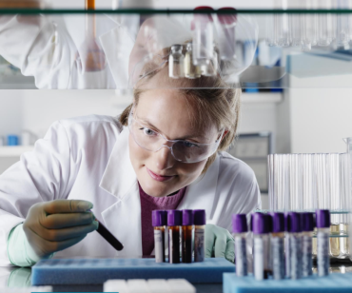
Medical Technology Program
Two programs: Associate Degree as Medical Lab Technician (MLT) or Bachelor Degree as Medical Technologist (MT) also known as Medical Laboratory Scientist or Clinical Laboratory Scientist
Four-year program covers:
General subjects: Biology, Human Anatomy, General Chemistry, Organic Chemistry, Physics, Statistics & Probability
Core subjects: Clinical Chemistry, Biochemistry, Molecular Biology, Microbiology, Clinical Urinalysis & Body Fluids, Immunology, Immunohematology, Hematology, Virology, Mycology, Parasitology and Phlebotomy
One year Clinical Internship
A license is required to work as MLT, CLS or Phlebotomists in California

Slide 6
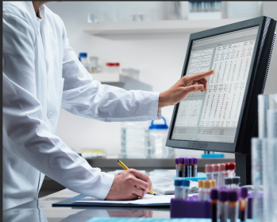
Medical Technology Program
Specialty license is available in Chemistry, Hematology, Microbiology, Blood Banking, Cytogenetics, Cytotechnology, Histotechnology and Molecular Biology
Average pay: $ 53, 230-$ 79,530 per year
There are 300,000 laboratory entities nationwide regulated by the Centers for Medicare & Medicaid Services (CMS)
Job Opportunities: Hospital Laboratory, Reference Laboratory, Physician Office Laboratory, Medical Device Manufacturing, Research and Pharmaceutical
Master’s degree available in Medical Laboratory Science and specialization in the area of Blood Banking, Chemistry, Cytogenetics, Cytotechnology, Hematology, Histotechnology, Microbiology and Molecular Biology

Slide 7
Future State
Addition of 2.4 million jobs in healthcare between 2016- 2026 (U.S. Bureau of Labor Statistics)
13% increase and projected 19,800 jobs will be added for Medical Technologists/Clinical Lab Scientists by 2026
Advances in technology and aging baby boomer generation are making laboratory testing more affordable and increase in demands
Expansion of Molecular and Genomic testing offers new opportunities in clinical diagnostics laboratory, research laboratory and pharmaceuticals

Slide 8
Q & A

Slide 9
Q & A
Why did you choose medical technology field?
What is like to be working in a laboratory?
What did you like most about it?
What skill sets are most important for this job?
How do you see ratio of female and male balance in the medical technology field?
What are some potential barriers for women to succeed in this field?
Why did you choose to move from the medical technology to industry?
How do you compare working in a medical laboratory vs. working in a medical device company?

