Slide 1

Notes:
Welcome everyone as they’re coming in – share in Chat your role and company
Have Amanda introduce herself
Introduce myself
“Thank you” & plug for Compass and LMS
We are using Zoom and Menti.com today, hopefully you were able to access the Zoom app, if not Amanda or Heather should be able to assist you. Also, please have a browser window open to Menti.com on either your cellphone or computer. Today’s session will be interactive.
Tech Check:
Note the microphone mute/unmute
Pull up participant list – the icons at the bottom will be used for participation
Raise your hand if you have a question
Give us a green check to make sure we’re all on the same page

Slide 2

Notes:
I’d like to start by first going to menti.com and hearing about what your greatest takeaway was from the online learning material before we dig in further.

Slide 3
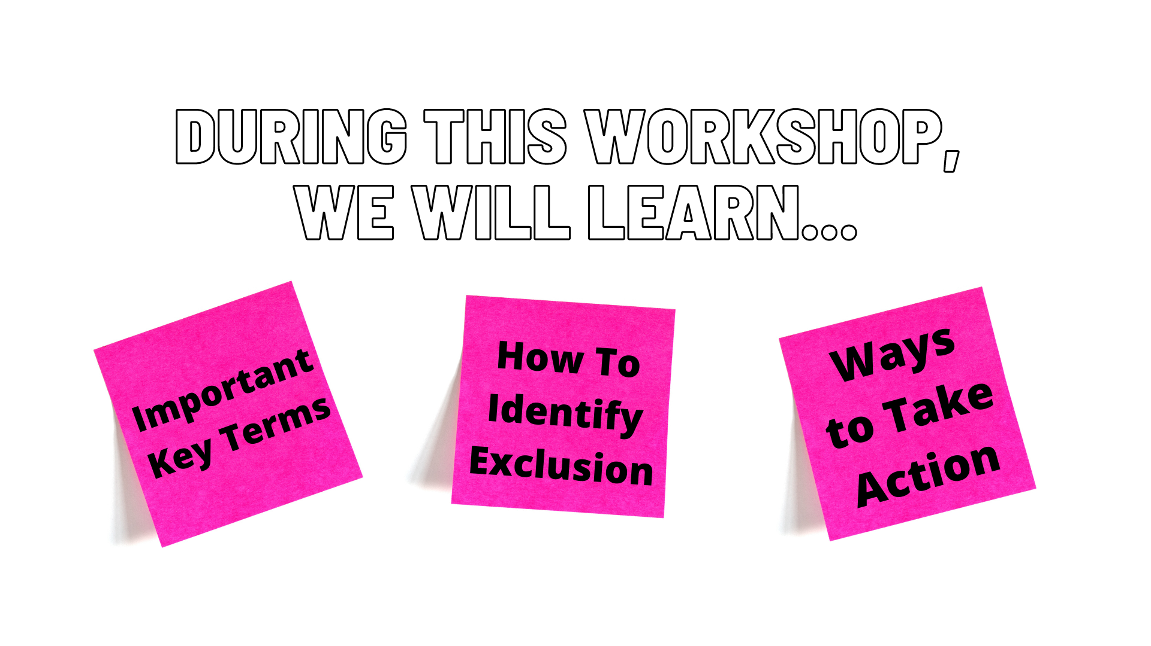
Notes:
This is a safe place for us to learn and share. So today, we’re going to

Slide 4
Notes:
Clarify important key terms
CLICK

Slide 5
Notes:
Learn what the very opposite of inclusion, “Exclusion”, looks like
CLICK

Slide 6
Notes:
And identify some ways we can make a difference in the world around us.
CLICK

Slide 7
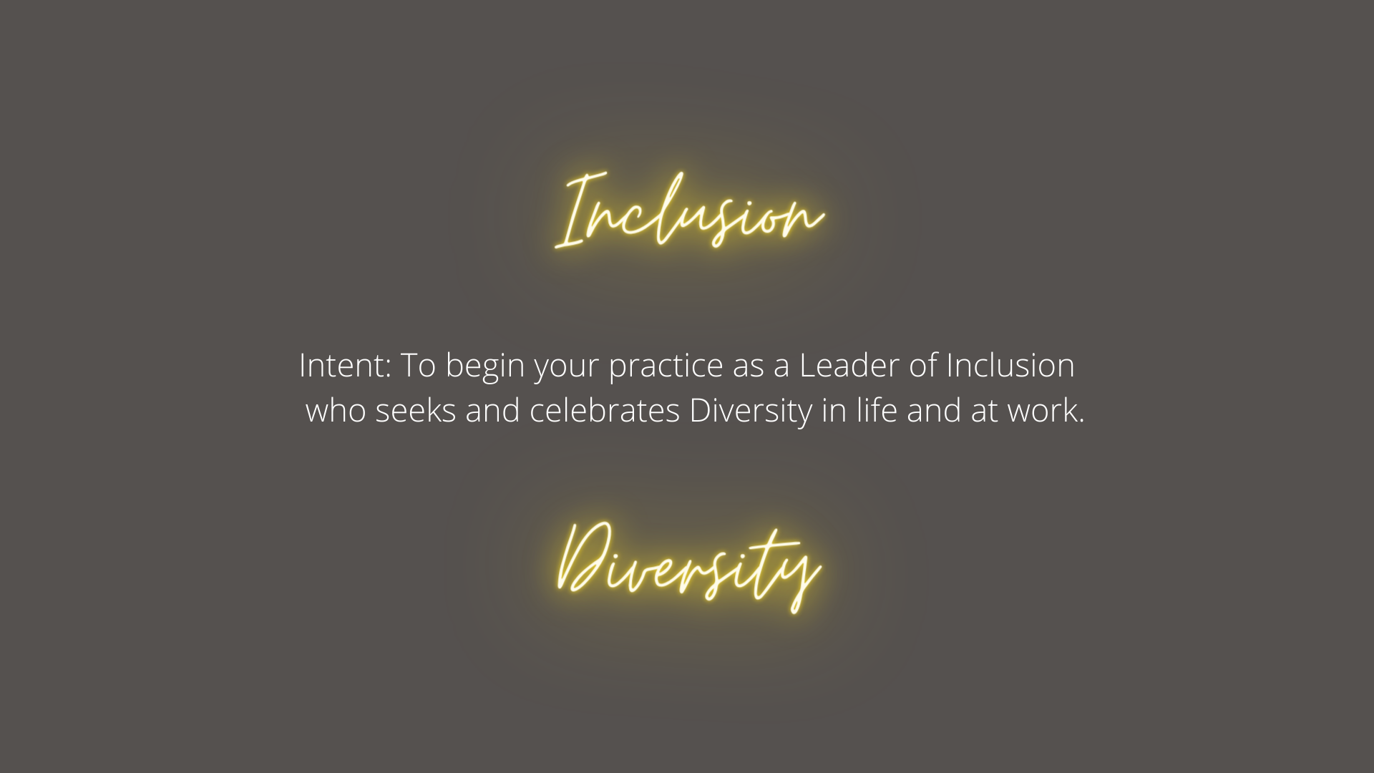
Notes:
This is our goal today. Much like leadership, there is no one destination for Inclusivity, it is a journey.
Here, we’ve called out two important terms: Inclusion and Diversity.
CLICK

Slide 8

Notes:
So let’s move on by clarifying these and some other key terms, which you may have been introduced to for the first time in the Online Learning Map
CLICK

Slide 9

Notes:
When I think of Diversity vs Inclusion, I am reminded of fruit platters and fruit salads:
Diversity is the platter to the left: colorful and many fruits are presented, but all still separate. There’s no mingling, only silos.
Inclusion on the other hand is more like the fruit salad to the right: a collaborative cocktail of flavor.
A metaphor used often to differentiate between Diversity and Inclusion is: “Diversity is being invited to the dance; Inclusion is being asked to dance.”
But I’ve found that a much more helpful metaphor that describes the lifecycle of a seed…
CLICK

Slide 10

Notes:
Any kind of seed has little value and little worth by itself. Its potential becomes immeasurable when in an inclusive environment: nutritious soil, oxygenated water, sunshine, pruning, weeding…this is when seeds produce.
I think we can all agree on the difference and importance of Inclusivity from Diversity, but just in case
Please raise your hand if you still need more clarification around the difference between Diversity and Inclusion. Or if you’re comfortable with these terms, please give us a green check.
Let’s look at some other key terms that you’ve learned about in the online learning map or that you’ll encounter in your journey towards Inclusive Leadership.
CLICK

Slide 11
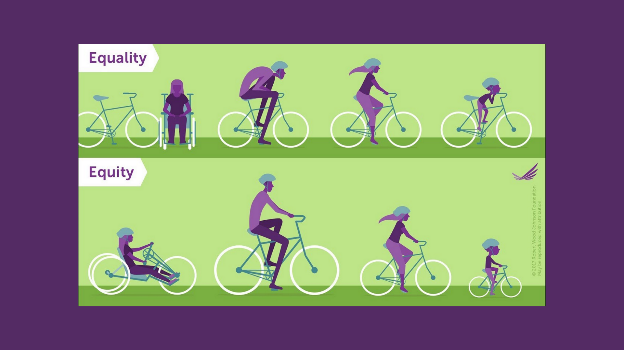
Notes:
ASK FOR VOLUNTEERS TO RAISE THEIR HAND AND DESCRIBE THE DIFFERENCES BETWEEN THE IMAGES
Take 1-2 volunteers

Slide 12
Notes:
These images represent in a simple way the difference between the ideas around Equality vs Equity.
The main difference is that Equality is everyone getting the same thing, and Equity is everyone getting what they need in order to succeed.
The notion of equity accepts that biases and obstacles exist for many that do not exist for others.
Essentially it means realizing that we don’t all begin on an even playing field and then working to compensate for that fact.
ASK: HAVE YOU SEEN EQUITY IN YOUR WORKPLACE? OR DO YOU HAVE AN IDEA OF WHAT THIS COULD LOOK LIKE? RAISE YOUR HAND
Take 1-2 Volunteers.
If not takers, offer up: “It could look like helping some employees get ot the point at which they can do their best work by implementing various support systems, like Employee Resource Groups.”
Now let’s talk about the difference of fitting in and belonging…CLICK

Slide 13
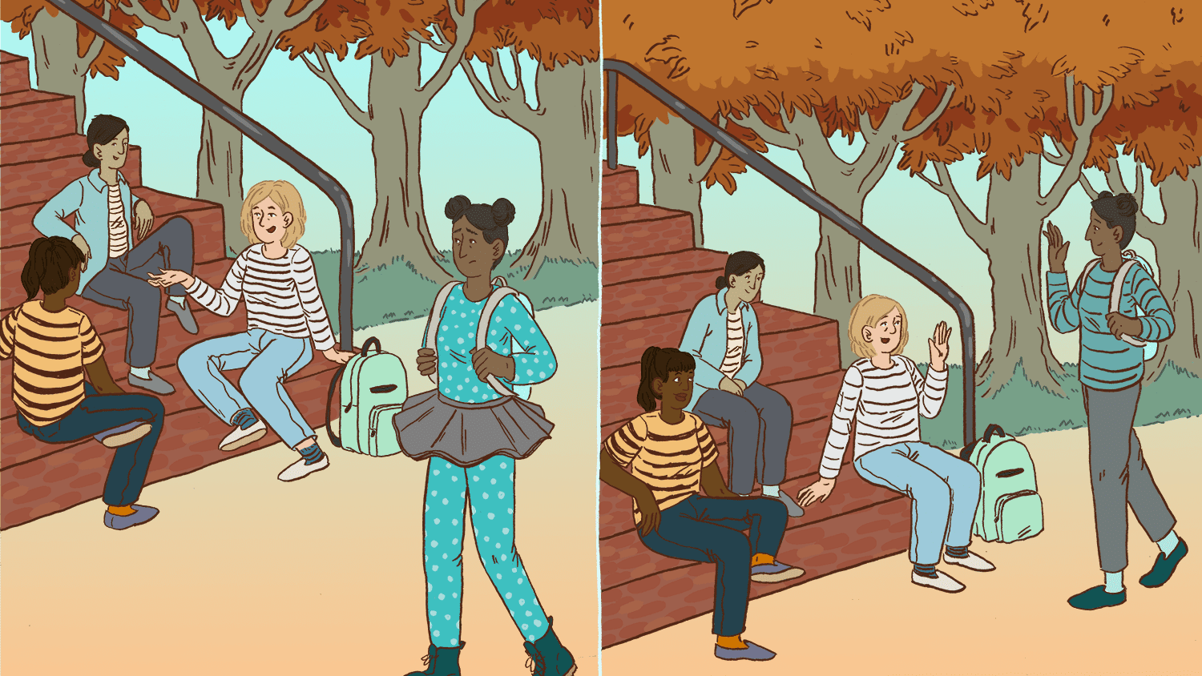
Notes:
To put it lightly, “fitting in” is not the same as “belonging.”
Take for example these images.
The person walking by in the image on the left is wearing polka dots and a tutu by a group of people engaged in conversation and not noticing them walk by. They all wear similar striped tops, what look like jeans, and flat shoes.
In the next image, the same person is now wearing a striped top and flat shoes, and you can see the group of people now noticing and waving them over.
These images probably, at least they do for me, conjure up memories of what being left out at school felt like.
It’s emotional and we can carry that feeling throughout our adult lives if the environments we work and communities we live in aren’t inclusive.
Let’s keep our focus on these differences and move into our group activity.
CLICK

Slide 14
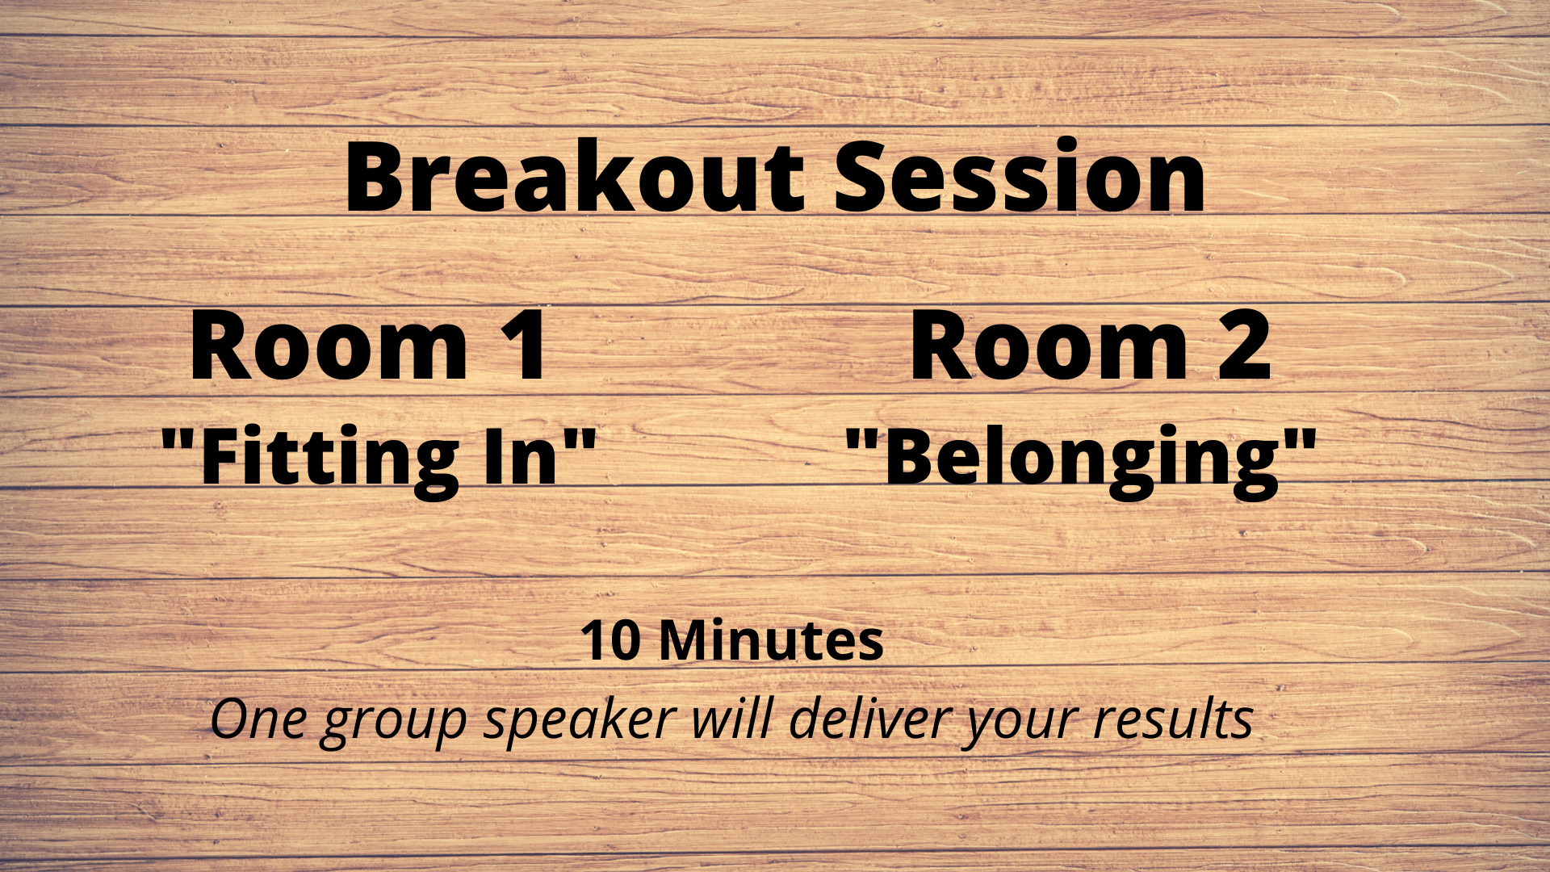
Notes:
Amanda will help with the breakout rooms
While Amanda is setting up the breakout rooms, I’m going to give you all some instructions.
This activity stems from Brene Brown’s work on Belonging from her book Rising Strong.
We will split the entire group into 2 breakout rooms.
Room 1 will discuss and create a deep and rich description of what “Fitting In” is and how it differs from “Belonging.”
Room 2 will similarly discuss and create their deep and rich description of what “Belonging” is and how it differs from “Fitting In.”
A couple more points before we start:
You can think of these terms in personal or professional situations but the resulting description should be robust enough to apply to either.
You will have 10 minutes to first choose who will speak for your group when we return to the main session and to then come to these descriptions.
We will then return to our main session here and discuss key themes before moving on.
Any Questions? Raise your hand
This is what I’m looking for: (also on the next slide)
Fitting in is not the same as belonging. Fitting in is trying to be like everyone else – how you look, talk, dress, think, act. But Belonging results from a safe space that values and embraces what makes you different.
Put another way, diversity is a fact (the numbers are what they are), inclusion is a choice (you decide whether to include someone or not), but belonging is a feeling that can be enforced by a culture that you can purposefully create.
CLICK

Slide 15
“Fitting in is about assessing a situation and becoming who you need to be to be accepted. Belonging, on the other hand, doesn't require us to change who we are; it requires us to be who we are.” Brené Brown
Notes:
Your descriptions were great, thank you for working together to define those.
This description is from Brene Brown read the quote
When we talk about inclusive spaces, often what we are really getting at is creating a space where more people have the opportunity to feel like they belong there
Fitting in takes a lot of energy from the individual.
Belonging may take special effort from the community, but a lot less energy from the individual
It is the responsibility of people who create the norms of a group or environment to consider who feels they belong and who is simply fitting in
CLICK

Slide 16
Notes:
At this point, we’ve clarified some very key terms when it comes to Inclusivity and Diversity.
Now, let’s move on to discover more about Exclusion and what its effects are on individuals and businesses
CLICK

Slide 17

Notes:
The word Exclusion derives from the latin “ex” meaning out and “clow-dare” meaning shut. So essentially, at the root of the word means to be shut out.
And this isn’t just in school cafeterias or social clubs. It’s in our businesses.
The Talent Magnet Think Tank sends out a survey each year to every employee across the organization and since 2018 have asked employees about whether they felt their company president seemed committed to Inclusion and Diversity. While the results have steadily improved since 2018, there are still 21% reporting at best Neutral in their opinion on whether their company presidents were committed. This tells us we definitely have a lot of room to improve when creating an inclusive organizational culture.
Similarly, a Harvard Business Review study found that 40% of people say they felt isolated at work and the ultimate result was lower organizational commitment and engagement.
The survey findings revealed that workplace exclusion generates hefty financial losses. So what does that look like?
CLICK

Slide 18
“U.S. businesses are losing $1 trillion every year due to voluntary turnover, and the annual turnover rate in 2017 was at 26.3%. In 2018, the Work Institute reported that 28.6% of employees will leave their jobs for other opportunities. And if this trend continues in 2020, as many as 33% of employees will leave to work somewhere else!”
According to Gallup
Notes:
Let’s start to dissect that by looking first at some statistics around turnover, specifically, from a Gallup study.
CLICK
Businesses in the US lose $1 trillion a year CLICK

Slide 19
“U.S. businesses are losing $1 trillion every year due to voluntary turnover, and the annual turnover rate in 2017 was at 26.3%. In 2018, the Work Institute reported that 28.6% of employees will leave their jobs for other opportunities. And if this trend continues in 2020, as many as 33% of employees will leave to work somewhere else!”
According to Gallup
Notes:
Due to VOLUNTARY turnover. That’s not layoffs or a termination. That’s a choice by an employee.
Gallup went on to predict that CLICK

Slide 20
“U.S. businesses are losing $1 trillion every year due to voluntary turnover, and the annual turnover rate in 2017 was at 26.3%. In 2018, the Work Institute reported that 28.6% of employees will leave their jobs for other opportunities. And if this trend continues in 2020, as many as 33% of employees will leave to work somewhere else!”
According to Gallup
Notes:
This year, 33% of employees would bring their talents elsewhere.
That can seem hard to wrap our heads around when looking at the country as a whole.
So what could that look like for turnover at APi Group? Even just one person?
CLICK

Slide 21

Notes:
Luckily, the Talent Magnet Think Tank provided some specific APi Group information on turnover as well.
CLICK

Slide 22

$50,000 Salary = ~$17,000 Onboarding
Notes:
It costs about 25-35% of an employee’s salary to recruit, train and onboard a team member
CLICK

Slide 23

$50,000 Salary = ~$17,000 Onboarding
$50,000 Salary = ~$17,000 Onboarding
Notes:
Typically, onboarding lasts at least 4-6 months until that individual is a fully contributing member of the team, so you won’t see your return on investment for nearly half a year.
CLICK

Slide 24

Notes:
For our field, the costs are less, mostly due to set union wages, but the majority of our safety incidents happen within the first 6 months that an employee is working for us. So, it ends up being costly in other ways.
CLICK

Slide 25
Notes:
SAY & ASK: These statistics do not call out Inclusion specifically.
But what are some reasons someone would leave a company due to a lack of inclusion? RAISE YOUR HAND
CLICK

Slide 26

Notes:
Other reasons if they hadn’t been shared:
Hours and flexibility
Pay
Advancement
Opportunities
Now what is there to GAIN from inclusion from a business perspective?
CLICK

Slide 27
“If workers feel like they belong, companies reap substantial bottom-line benefits. High belonging was linked to a whopping 56% increase in job performance, a 50% drop in turnover risk, and a 75% reduction in sick days. For a 10,000-person company, this would result in annual savings of more than $52M.”
According to Harvard Business Review
Notes:
A Harvard Business Review study found that….
CLICK

Slide 28
“If workers feel like they belong, companies reap substantial bottom-line benefits. High belonging was linked to a whopping 56% increase in job performance, a 50% drop in turnover risk, and a 75% reduction in sick days. For a 10,000-person company, this would result in annual savings of more than $52M.”
According to Harvard Business Review
Notes:
If workers felt a sense of belonging and inclusion within their company, that the company’s financial return…
CLICK

Slide 29
“If workers feel like they belong, companies reap substantial bottom-line benefits. High belonging was linked to a whopping 56% increase in job performance, a 50% drop in turnover risk, and a 75% reduction in sick days. For a 10,000-person company, this would result in annual savings of more than $52M.”
According to Harvard Business Review
~$78M in Savings for APi Group
Notes:
Could be well over $52 Million dollars for a 10,000-person company, which means for a 15,000-person company like APi Group…
CLICK
…that would result in annual savings of $78M
With these last few statistics, we have taken the 10,000-foot business-perspective. So let’s come to the ground for a bit with an individual exercise to understand where exclusion may exist at our own levels.
CLICK

Slide 30

Notes:
Either with your imaginary air-pencil, or a pen on paper, try connecting these nine dots.
THE CATCH is that you cannot lift your pen or pencil once you’ve started and you can only use 4 lines
Recognize that some may have seen this before and ask them to play along and not speak up just yet – GIVE A GREEN CHECK IF YOU HAVE SEEN AND REMEMBER THIS EXERCISE FROM THE PAST……give just a minute or two

Slide 31
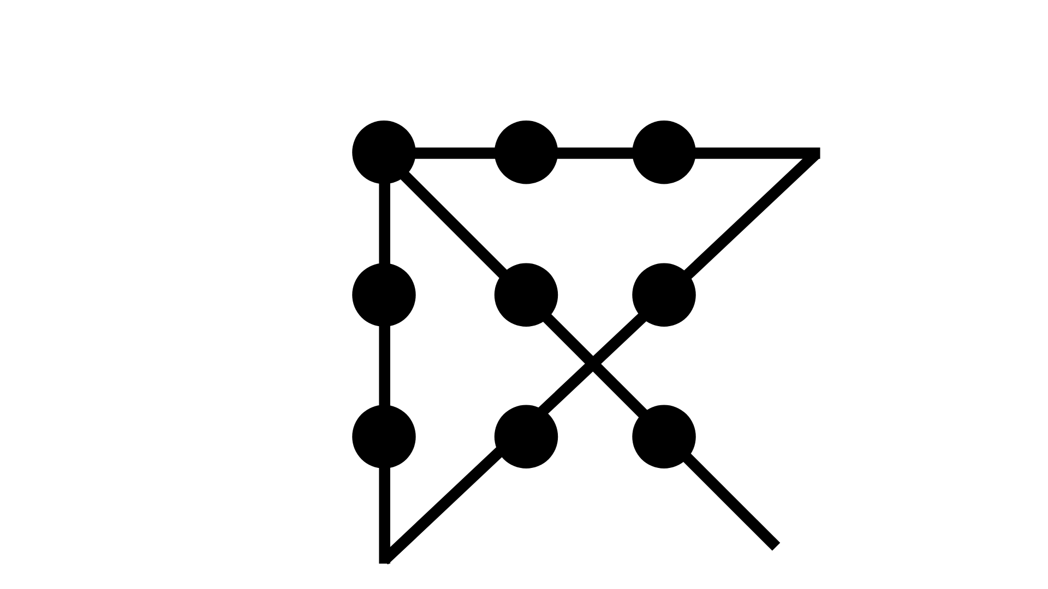
Notes:
Statistically, only 10%-15% of people will figure this out. The rest of us (me included)…
CLICK

Slide 32
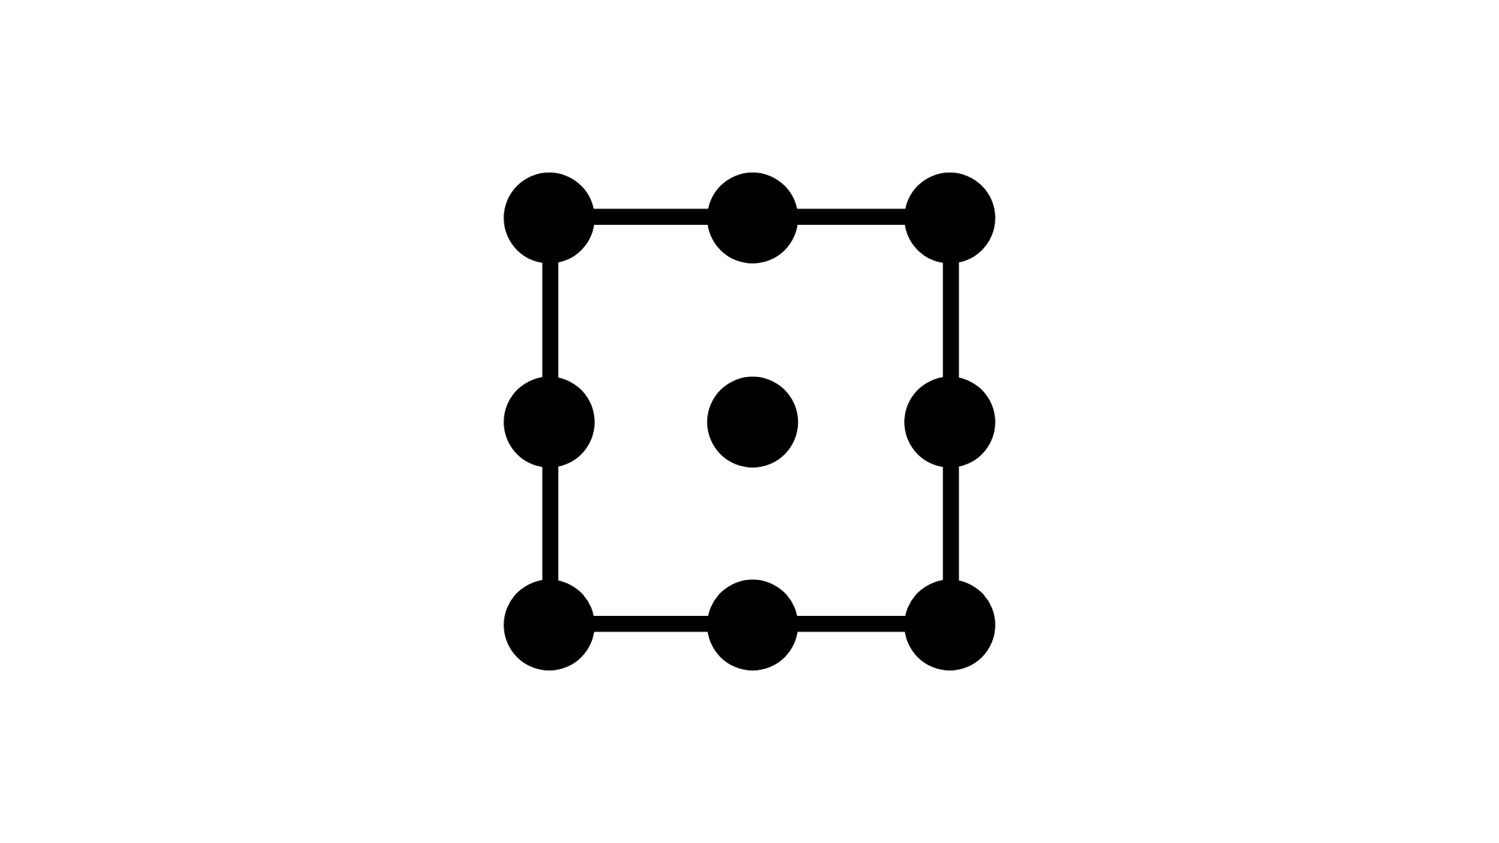
Notes:
…Will have kept ourselves in a box that never existed
Pause then CLICK

Slide 33
Notes:
Fred Falker of the Falker Consulting Group says “We as human beings are line drawers. It helps us understand and make sense of the world.”
We draw lines between ourselves and other people.
We often do this unintentionally.
For example, as I was designing this course, I noted that many white males would be attending, and I started designing the course for white males. With some help and a heavy dose of awareness, I caught this. We all do this.
It isn’t our fault that we’re doing this. Like Falker said, this is a human trait.
But as Maya Angelou once said, “Do your best until you know better. When you know better, do better.”
The problem isn't the lines themselves, as humans we try to understand the world, it's that we believe they are real and don’t catch ourselves doing them. But these lines make boxes - and keep us from connecting in life and innovating at work.
And speaking of innovation…
CLICK

Slide 34

Notes:
One of the first teams that put self-driving cars on the road were seen as leaders of innovation.
Until some devastatingly horrifying and potentially life-threatening safety issues arose.
Ultimately: the cars were not detecting dark skinned.
ASK: DOES ANYONE HAVE ANY IDEA WHY THIS MIGHT HAVE BEEN THE CASE?
Upon investigation, it was found that the engineer team were all white and it translated into the training scenarios and data.
Put another way: pedestrian detection systems are typically better at saving the lives of walkers who look like the walkers they’ve seen most often in their training models — and the computers are looking at way fewer images of dark-skinned people.

Slide 35
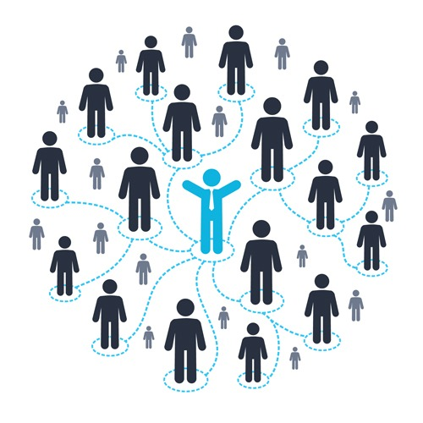
Your Circle of Influence
Notes:
Now that we’ve discussed the importance of Inclusion and the perils of Exclusion, let’s reflect on ourselves a bit.
We are going to do a pared-down version of an exercise called “Your Circle of Influence.”
This is different than the Circle of Influence we’re taught in 7 Habits for Highly Effective People.
This circle of influence is reflective of your personal network. These are the people who are the most influential to your life and the decisions you make.
We’re going to be using Menti.com for this exercise.
CLICK
We will look at four types of people in your circle of influence and you will select all that applies on the screen (whether they’re the same race as you, same gender, same political party, etc.)
We will spend a minute or two on screen, so select those that apply and click “SUBMIT” at the bottom of the screen
(STOP AT FAVORITE LEADER)
ASK FOR FEEDBACK – DID YOU SURPRISE YOURSELF? IN WHAT WAY? RAISE YOUR HAND
If they were pleasantly surprised:
Could you agree that where you are today and all that you’ve overcome in your life has a great deal to do with the people you’ve put in your circle?
If they were not pleasantly surprised:
How do you think you can start gaining more perspective?
(Perhaps asking others they know and work with their own exclusion experience? This is a great first step in creating an inclusive environment.)
CLICK

Slide 36
Notes:
So now that we’ve done some work to learn what exclusion may look like in the workplace but even in our own lives, what can we do about it?
Let’s dig into ways to enact change by learning a little from another Harvard Business Review experiment.
CLICK

Slide 37

Notes:
This intruiging experiment was done wherein two sets of workers were put into two teams: One Inclusive and One Exclusive.
The teams were then asked to play a ball-toss game.
There were bot participants too that were programmed to either be Exclusive, keeping the ball away from certain team members, or Inclusive, by passing the ball to those they thought weren’t being tossed the ball enough.
After this, the participants completed a simple task where they could earn money.
When it was revealed that the benefits would be distributed amongst the entire team, the members within the Exclusive were more likely to work less hard even though it would sacrifice their own earnings.
This introduces two eye-opening concepts; one we’ve already talked about that Inclusive companies out perform and out earn their competition.
But it also introduces the idea of the Ally – those bots in the Inclusive Group that were programmed to Include others, were the allies.

Slide 38
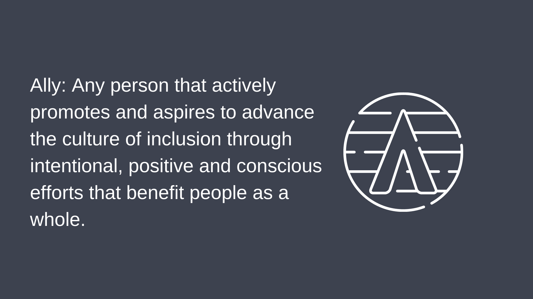
Notes:
An ally is any person that actively promotes and aspires to advance the culture of inclusion through intentional, positive and conscious efforts that benefit people as a whole.
Allyship isn’t a flag you can wave, it’s getting up and doing something that truly makes a difference for a colleague. If we’re not in that mindset, it becomes someone else’s issue and the buck is passed over and over again.
Simply NOT being exclusive doesn’t make you an ally. You take purposeful action to ensure inclusion. It is PROACTIVE, not reactive.
And regardless of role or background, gender or race, or any other box drawn around you, we can ALL be better allies.
CLICK

Slide 39
Lead by example by including others in making shared decisions
Ask someone new for a virtual conversation or HH around their experiences
Begin using more inclusive language (“hey everyone” rather than “hey guys”)
Review and update the art and literature around your home or office to amplify other perspectives and voices
Create or sponsor an Employee Resource Group for underrepresented groups (BIPOC, Latinx, LGBTQIA, Women in Construction, etc.)
Notes:
So, to wrap up today, I would like to hear from you.
We are going to go back to our Menti survey and I’d like you to think about what can you PROACTIVELY do that you’re not doing right now to help you be even more inclusive than you already are?
IMPORTANT: What we’re looking for here are ACTIONS, not results. We saw a lot of “listening more” yesterday and that’s a result of an action you took.
Something said had to be provoked, so think on what ways you can make positive change through intentional actions.
Be specific as possible.
GO TO MENTI SCREEN
Do what you can to amplify new voices in your surroundings at work and home in these ways as well.
CLICK
Feel free to reach out to me as you take your next steps, I can help hear you out or hold you accountable as well. It’s important to take this journey with a support system yourself! Consider me your ally.

