Slide 1

Notes:
LINDSAY
Welcome​
Intros​: Amanda, Mai, Lindsay
Thanks for taking the map​
Tech check (Chat, Participation List)​
Have on hand:​
Prework (something that they want to accomplish over the next three months. Have it in mind/written down for the session.)
Phone​
Pen & Paper

Slide 2
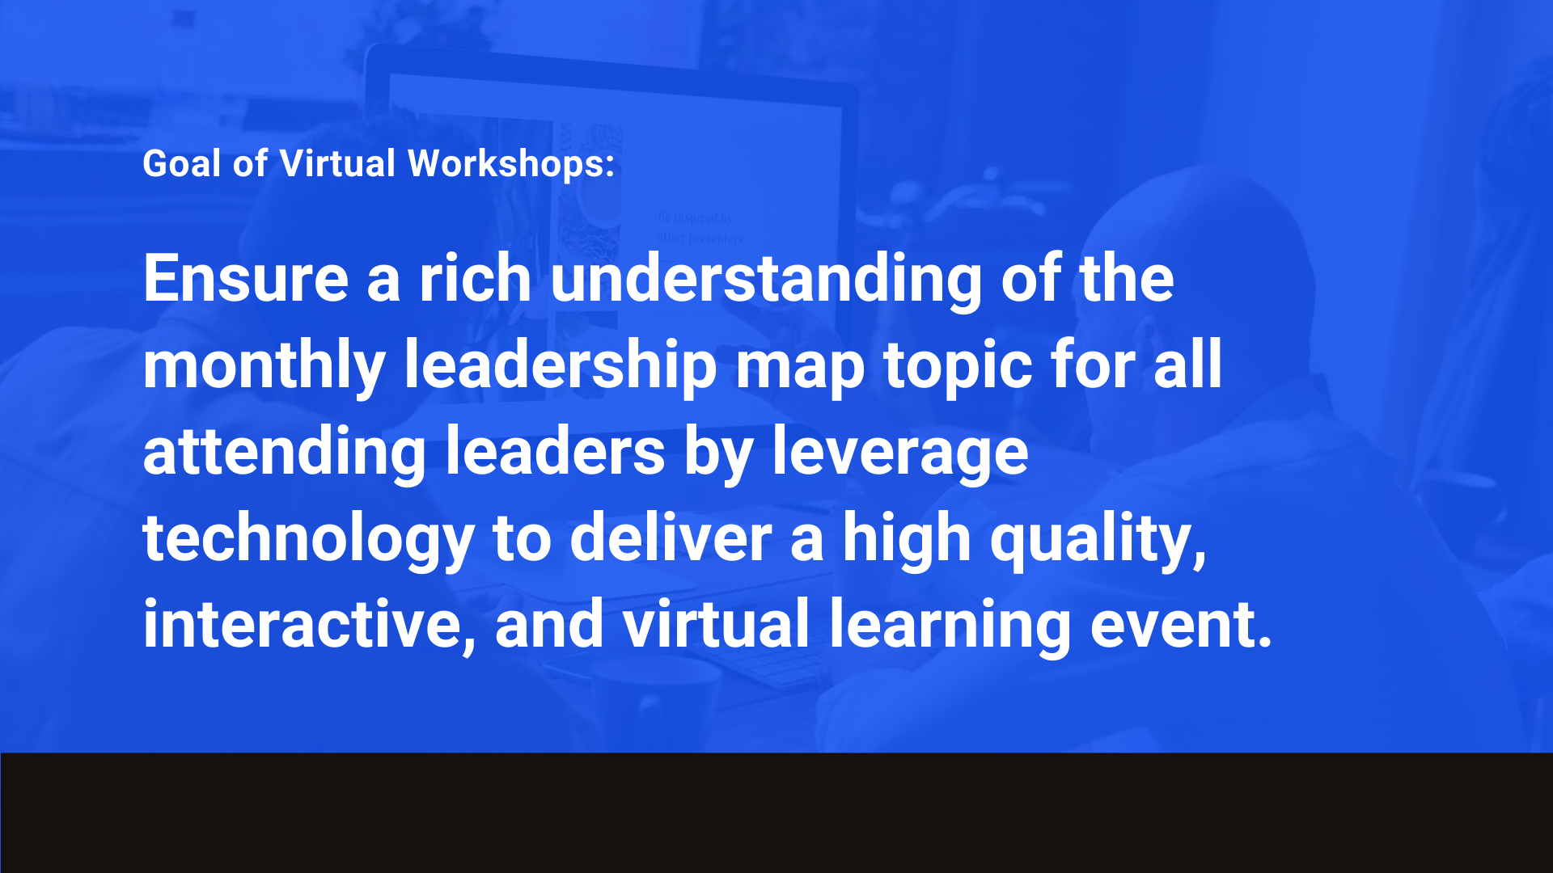

Slide 3

Construct clear, SMART goals and coach others to do the same
Maximize your coaching conversations utilizing the GROW framework
Notes:
ASK: What is a framework? Why is it important to have a framework when having these types of conversations?
(take input)
We are essentially following the GROW framework in a simplistic form.

Slide 4

Notes:
Click through questions, take feedback/input.

Slide 5


Notes:
So we considered the people in our lives that come to us, asking questions, looking for advice. If there is generally someone who asks a question and you believe they have the knowledge and will to find the answer themselves, they need coaching, not teaching or problem solving. Essentially (using the image) this person has a starting idea or issue and although they might know the answer, they’re stuck in a knot in their own mind. Where CLICK through effective coaching, we can help them untie that knot to discover what they already have the answer to.
ASK: What are some ways do you think that we can help our colleague or family member untie their “knot”?
(take input, we’re going to move to our definition of coaching next and then a framework of GROW)
We discussed the difference between problem solving, teaching, and coaching, let’s get a standard APi definition of coaching

Slide 6
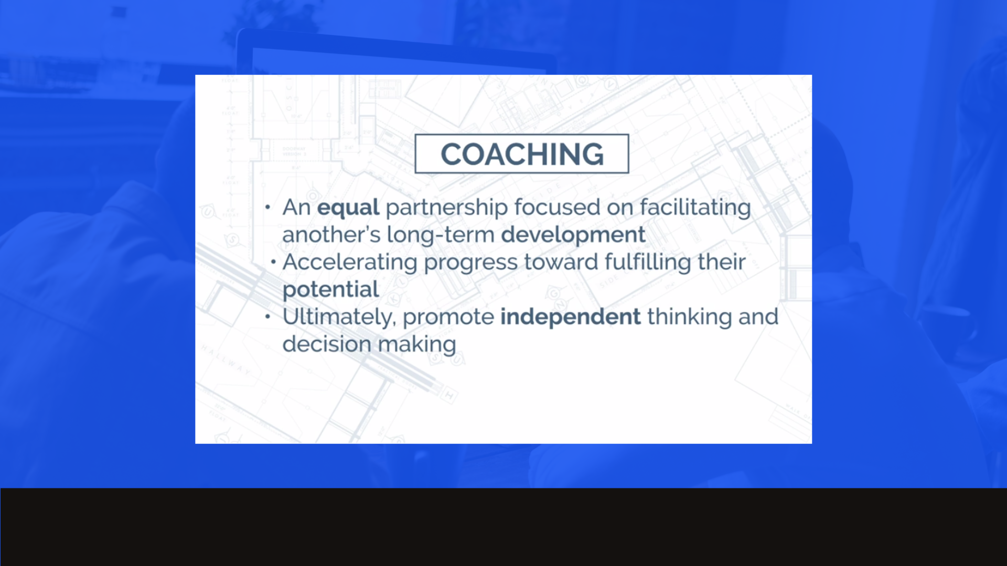
Notes:
Remind them of what we define as coaching before moving on – get consensus

Slide 7


Slide 8

Notes:
WHAT DO YOU WANT?

Slide 9

Notes:
WHERE ARE YOU NOW? (THEIR REALITY)

Slide 10

Notes:
WHAT COULD YOU DO?

Slide 11

Notes:
WHAT WILL YOU DO?

Slide 12

Notes:
The GROW model was originally developed in the 1980s by business coaches Graham Alexander, Alan Fine, and Sir John Whitmore.
GROW is more than a coaching model loved by the coaching community. It is also a top leadership tool that works across all disciplines and cultures. With its four deceptively simple steps, GROW has proved successful all over the world. It forms the backbone of coaching in many organizations and universities globally, due to the outstanding results. It helps people to achieve success personally or as part of a team.
We will start by taking on some GROW steps individually so that we can better coach others to follow the same steps. You’ll also get some coaching practice one on one.

Slide 13


Slide 14

Notes:
It is very important to set goals in a purposeful way in order to increase chances of success, for both them, as the coachee and you, as the coach.
Clarifying the goal:
what does the individual expect from the conversation?
what does this individual want to specifically accomplish?

Slide 15
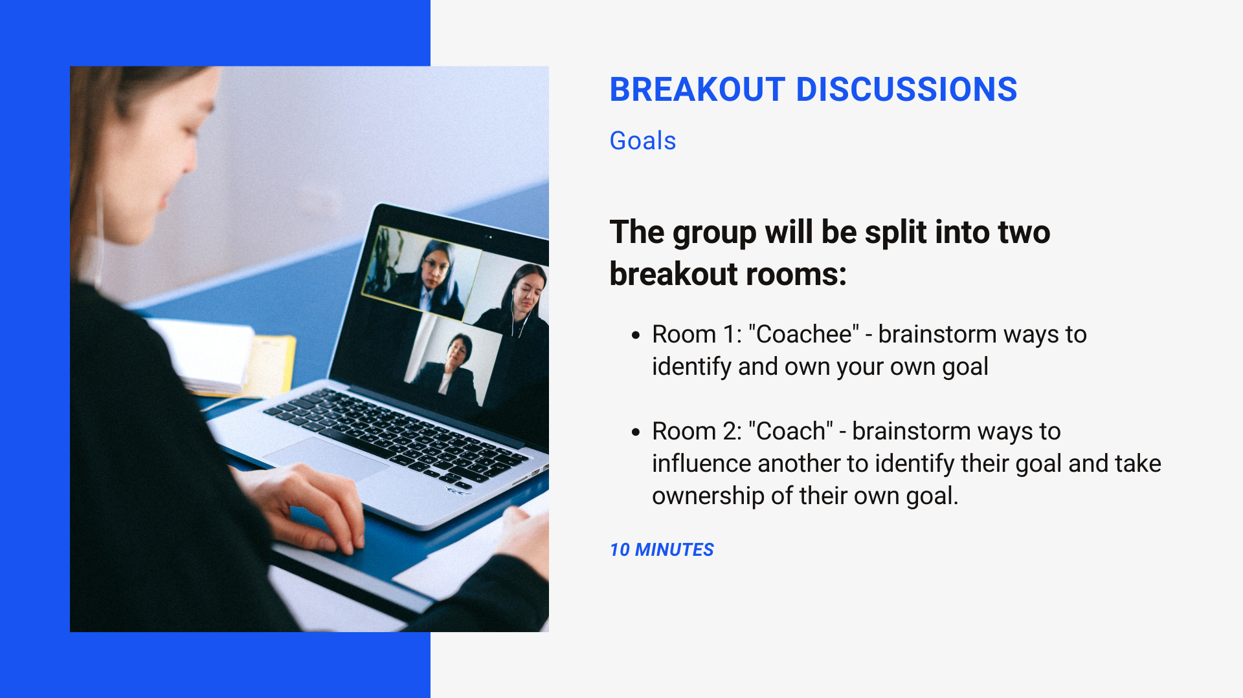
Notes:
Pick a scribe/presenter (they will report back to the room)
Brainstorm all the things that need to be present – as either the coach or the coachee depending on the room you’re in – in order for the goal to be clearly identified and owned by the individual.
Consider the pitfalls as well when the individual does NOT own their own goal
Be sure to allow each group member speak and have a say.

Slide 16
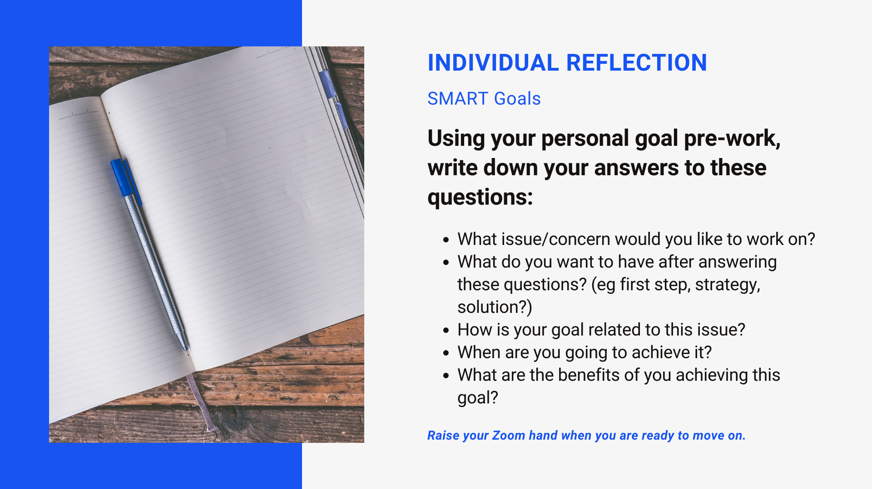
Notes:
Setting SMART goals (Specific, Measurable, Attainable, Realistic, and Time-Based)
Specific: Well-defined, clear, and unambiguous
Measurable: With specific criteria that measure your progress toward the accomplishment of the goal
Achievable: Attainable and not impossible to achieve
Relevant: Within reach, realistic, and relevant to your work and purpose
Timely: With a clearly defined timeline, including a starting date and a target date. The purpose is to create urgency.

Slide 17


Slide 18

Notes:
Reality is where a person believes themself to be in the present will have a significant impact on their ability to grow in the future. If they already believe they are proficient at a task, they may not try to grow.
Someone who isn’t sure of their stance on a position now will have problems solving future dilemmas.
You can help your team members, family members, etc, to understand what is currently happening in their lives so that they can form a foundation from which they can grow.
Great CLARIFYING questions for approaching REALITY:
What is the current state (in their perspective)?
What barriers exist?
What has been tried so far?
Is the goal still realistic after discussing?
ASK: What are some others?
Who else will benefit and in what way?
What will it be like if you achieve your goal?
What will you see/hear/feel?
What is the real issue?
What action have you taken so far?
What is moving you towards your goal?
What is getting in the way?

Slide 19
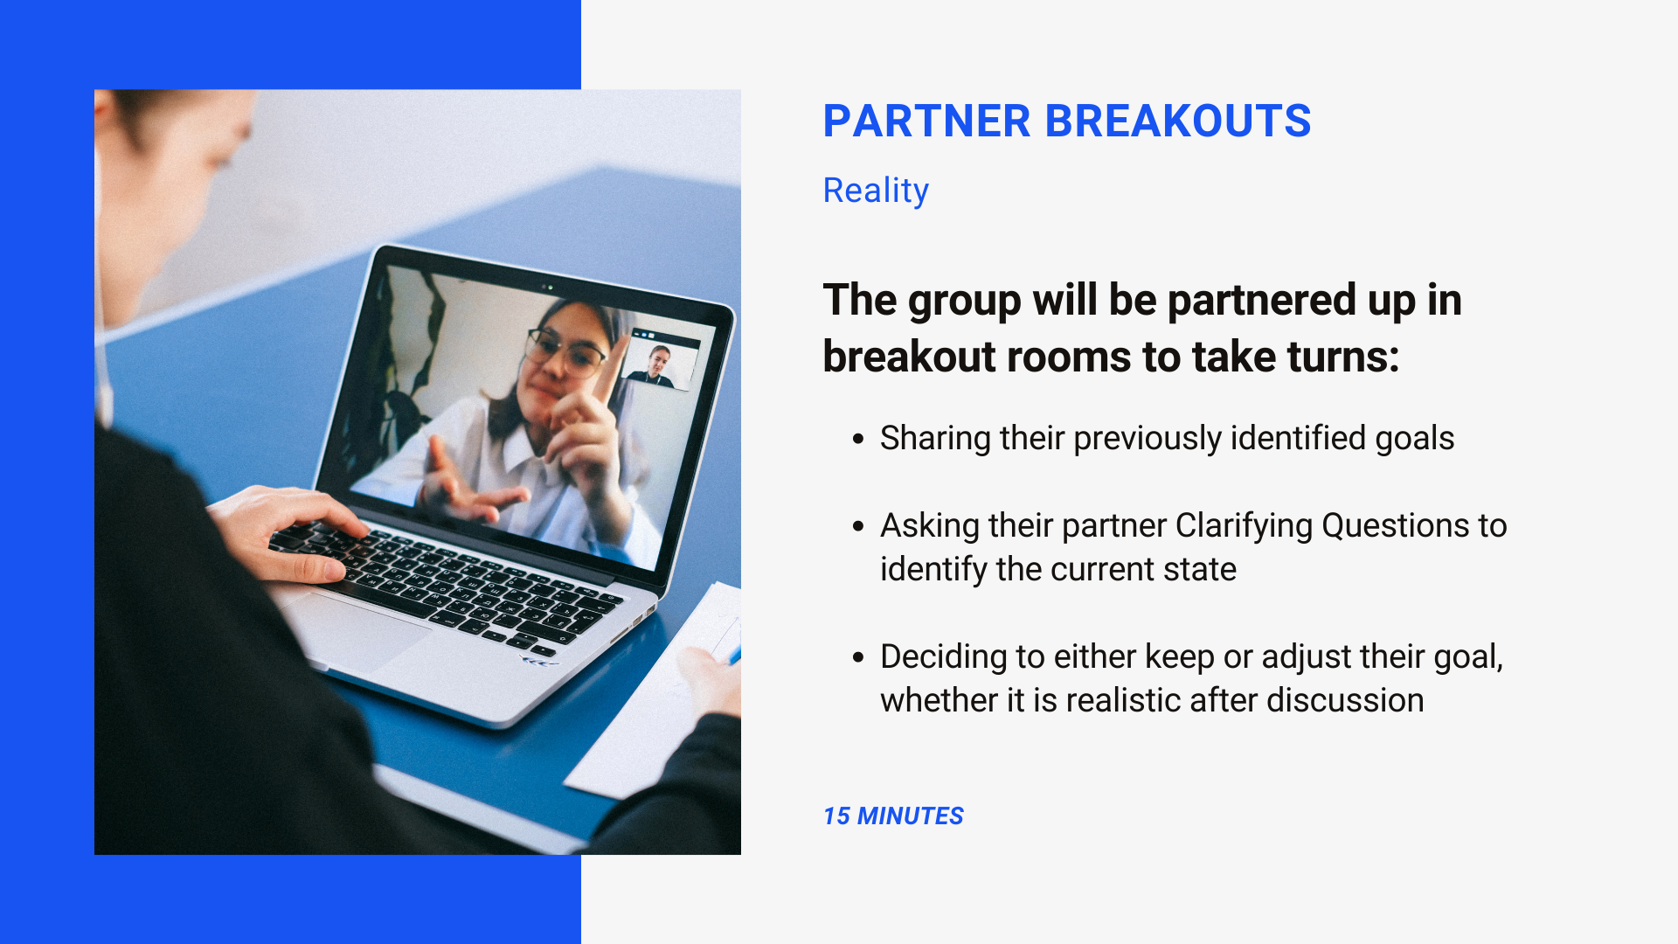
Notes:
Walk through the steps
They will not need to report out when we return

Slide 20

Notes:
Once we’ve helped our team member or family member identify their specific goal AND confirmed their current state or reality concerning that goal, we can then help coach them to identifying options. And it’s important to focus on PLURAL options.
Often, people can accept the first option they come up with but rarely is it the BEST option.

Slide 21

Notes:
A few ways to help coach others to identifying options: (time permitting, ask for input from others)
What are all the things that could be done?
“Yes, and…” and “What else?”
How might you attempt ANY of the options – and – can you combine any to find the best option?
OPTIONS questions: (time permitting, ask them for input)
What different kind of options do you have to achieve your goal?
What else could you do?
What are the advantages and disadvantages of each of these options?
Which options will you choose to act upon?

Slide 22
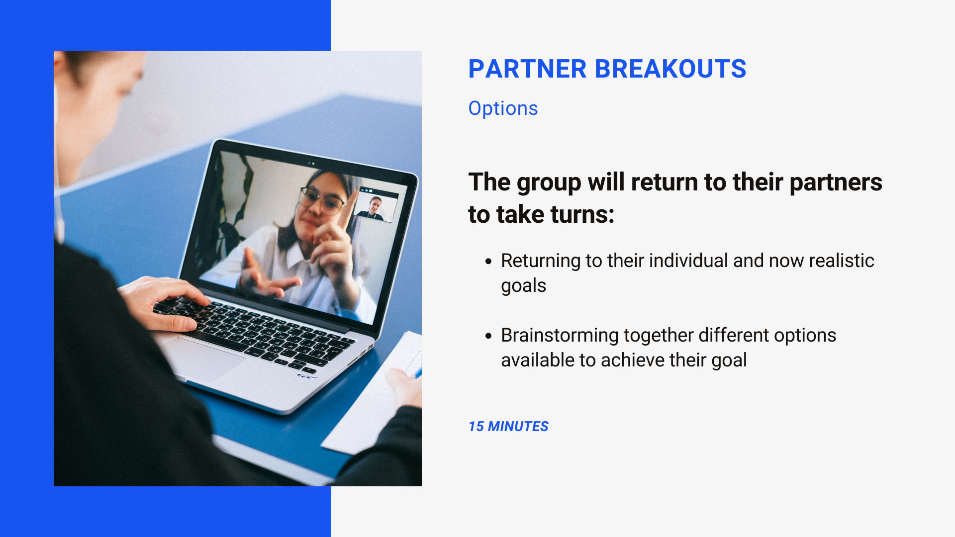
Notes:
Walk through the steps.
Remind them to leverage those questions to keep brainstorming.

Slide 23

Notes:
The final step of the GROW framework is figuring out the WAY FORWARD. How will they move forward and what actions will the individual take?

Slide 24

Notes:
ASK: Do you think it’s important that you define next steps or they do? (answer: THEY do! The responsibility lies on the individual, the other person, not you as the coach. You can help identify individual steps and timelines with them but be careful not to accept ownership.)
WAY FORWARD questions (time permitting, ask them for input)
When are you going to start each action?
What could anyone else do to give you support and when will you ask for it?
How committed are you, on a scale of 1–10, to taking each of these actions?
If it is not a 10, what would make it a 10?
What will you commit to doing?
(Note: It is also an option to do nothing and review at a later date.)

Slide 25
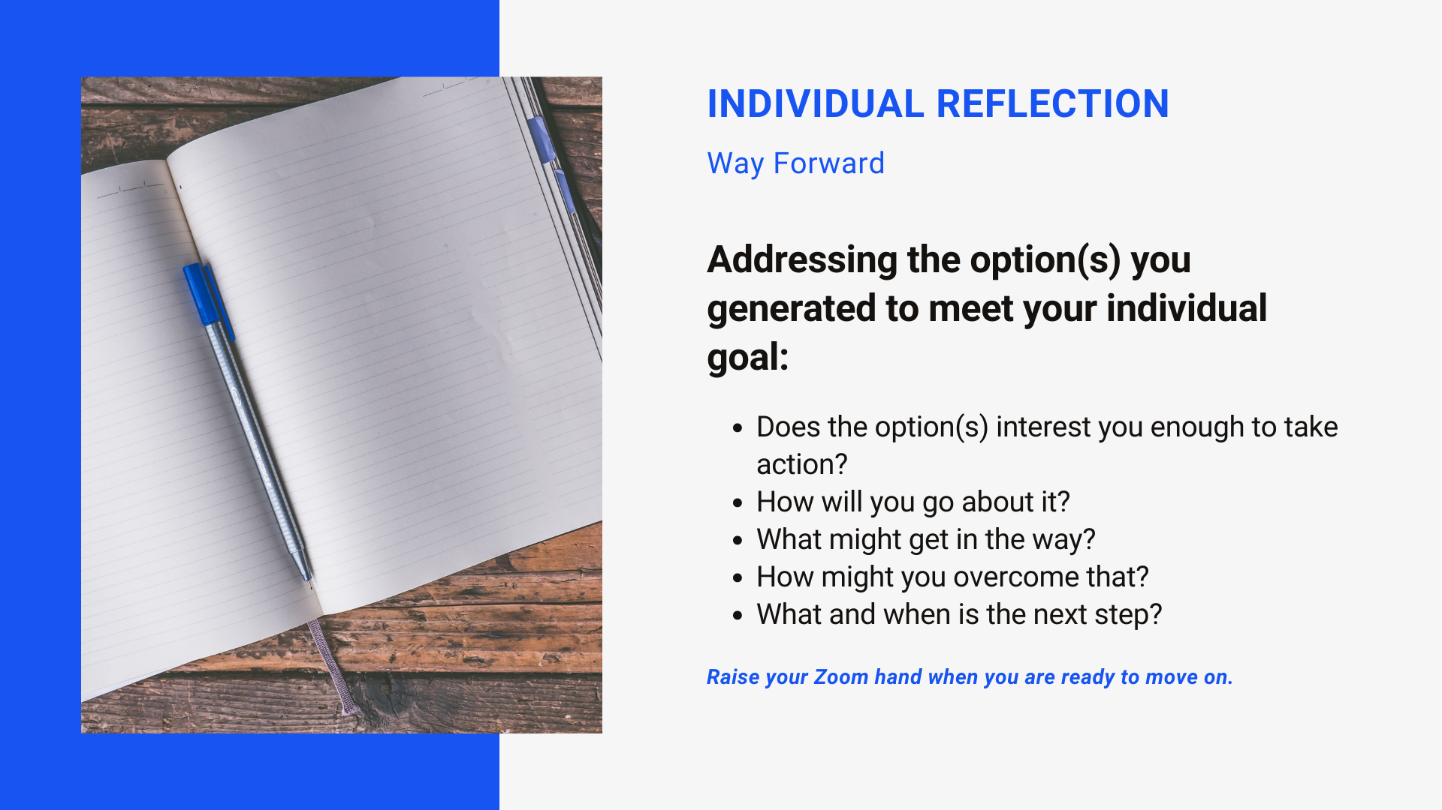
Notes:
Spend some time answering each of these questions regarding your option or options concerning your goal.
Raise your Zoom ‘hand’ when you have completed.
Move on if time is limited

Slide 26

Notes:
I will send an email with the GROW framework print out for you to use in the future and a link to the workshop evaluation – please take a moment to fill out the evaluation as I use the feedback to improve sessions in the future.
Thank you!

