Slide 1

Notes:
Welcome (don’t forget to share in Chat!)
This is a safe place (we’re ALL learning) and we’re constantly adjusting the way we do these virtual workshops, so when you receive the link to a survey after our time today, please take some time to provide feedback.
Intros (me and Amanda)
Thanks for taking the map!
Tech check (chat box, participation list)
Have on hand:
Phone
Pen & Paper
CLICK

Slide 2

What does not challenge you will not change you.
Take a moment to write down…
A current problem you or
your team are facing
A quick solution you have in mind for this problem
Notes:
Speaking of stretching, the title for this workshop came from some impactful signage I saw at the gym a few years ago.
Transition into the personal reflection exercise
Personal Reflection
Green checkmark when done (1-2 minutes)
We will return to this but for now, let’s move to Menti.

Slide 3
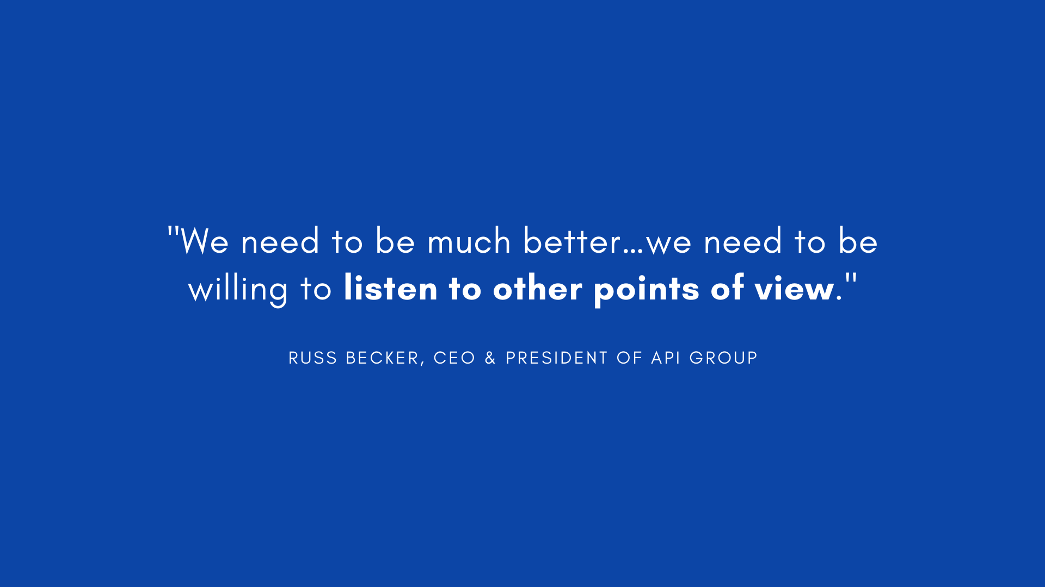
Notes:
In one of the biweekly videos of Russ Becker, when discussing specifically inclusion, he set a challenge on our organization. He said that we need to be willing to listen to other points of view. I think it’s a very timely call to action and aligned really well with this month’s learning map about embracing other perspectives.
CLICK

Slide 4

Notes:
So as we consider the moments and conversations where different perspectives may arise and challenge us within our team settings, like discussing issues/approaching a project/collaborating with a team, we can prepare ourselves by covering
CLICK

Slide 5

Notes:
The work we can do before

Slide 6
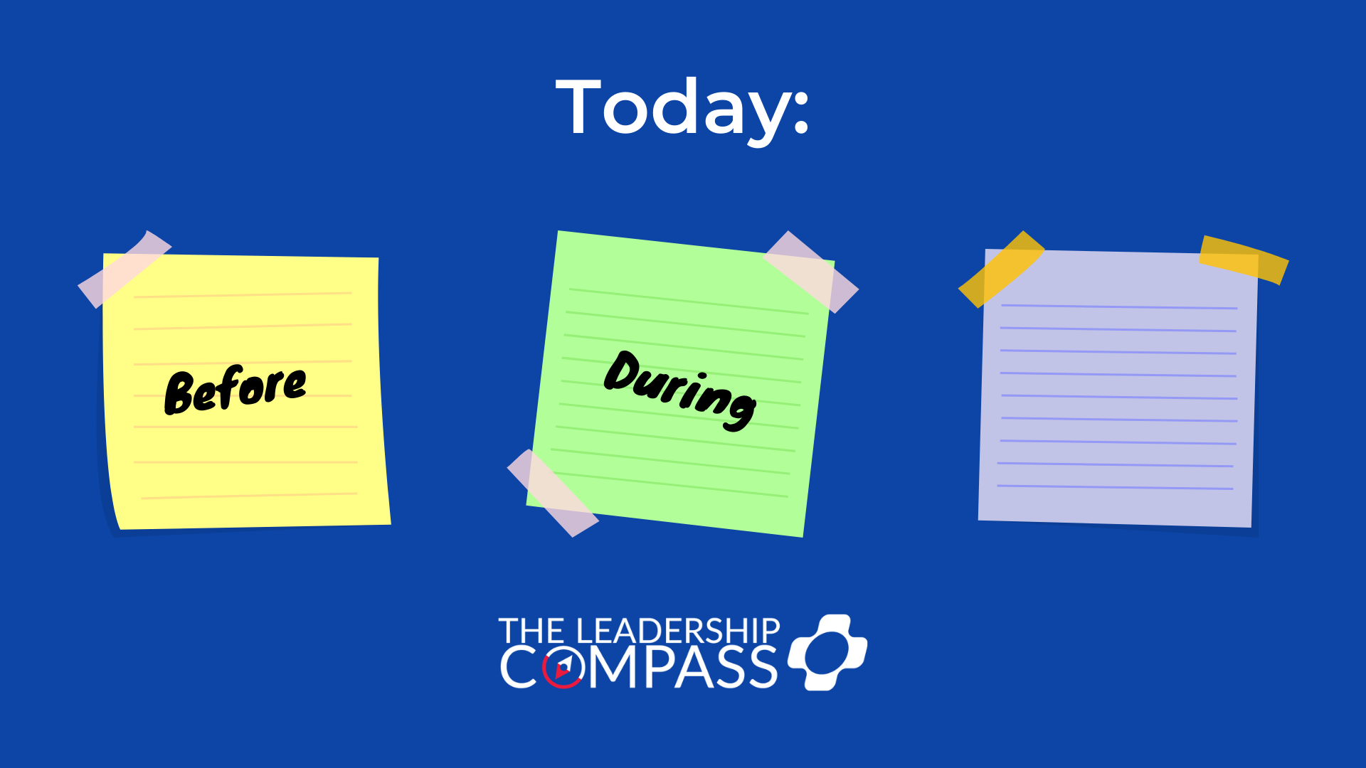
Notes:
during

Slide 7
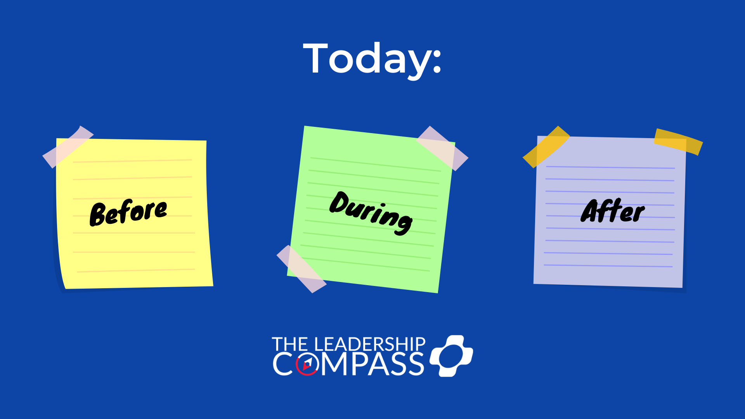
Notes:
And after our interactions.

Slide 8
Notes:
So we’ll start first with a little exercise some of you might be familiar with.
CLICK

Slide 9

Notes:
Ask them to cross their arms.
Then, once they are comfortable in that position, ask them to fold their arms the other way.
CLICK

Slide 10

Notes:
It feels quite different, doesn’t it? Despite the fact that you are only making a slight change to their stance, the feeling is not the same.
Ask: How does this small but noticeable change make you feel?
For some, the unfamiliarity of the posture might be frustrating.
Or, it might just be a bit uncomfortable.
However, the longer they sit with their arms this way, the more comfortable they’ll become.
Relate this feeling to how an organizational change can feel wrong at first but begins to feel more natural as time goes on.
If we relate this phenomena to stretching – training the muscles in our bodies to extending beyond their initial comfort – could we do this with our beliefs and ultimately our leadership?
CLICK

Slide 11
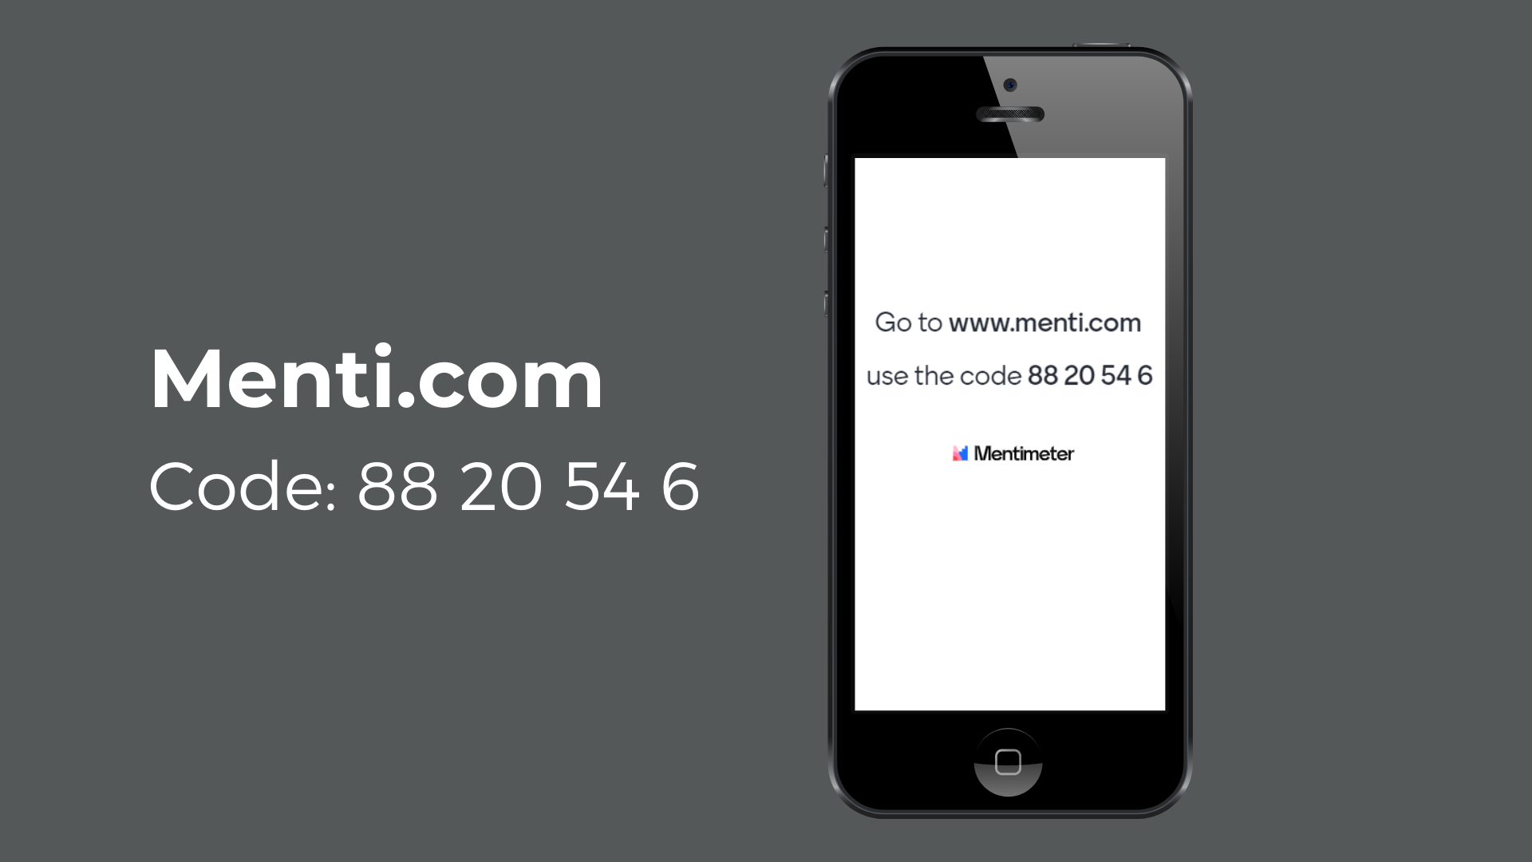
Notes:
Stop at “Where do worldviews come from?”
They're incomplete, they come from our experiences and we don't experience everything under the sun.
The thought here is that assumptions and beliefs are unconscious (bias comes into play here)
Just stopping to question moves you from unconscious to the conscious
Ask: How can this effect our leadership, whether how we lead others or lead ourselves?
Take some input

Slide 12
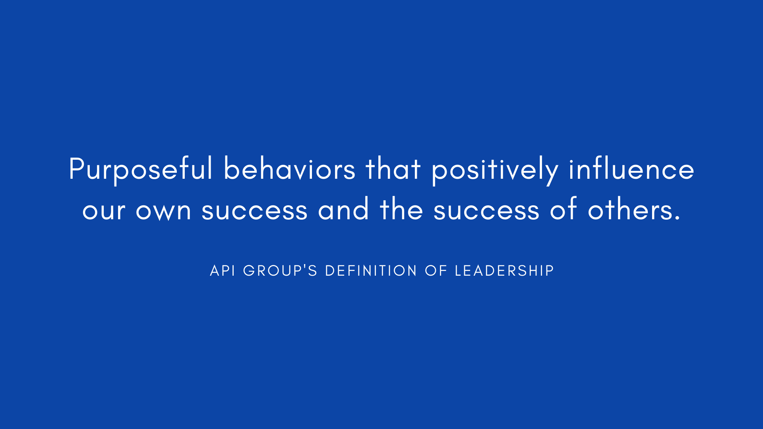
Notes:
Ask: What part of our definition of leadership is actionable? That we can work on?
Take some input – then CLICK

Slide 13
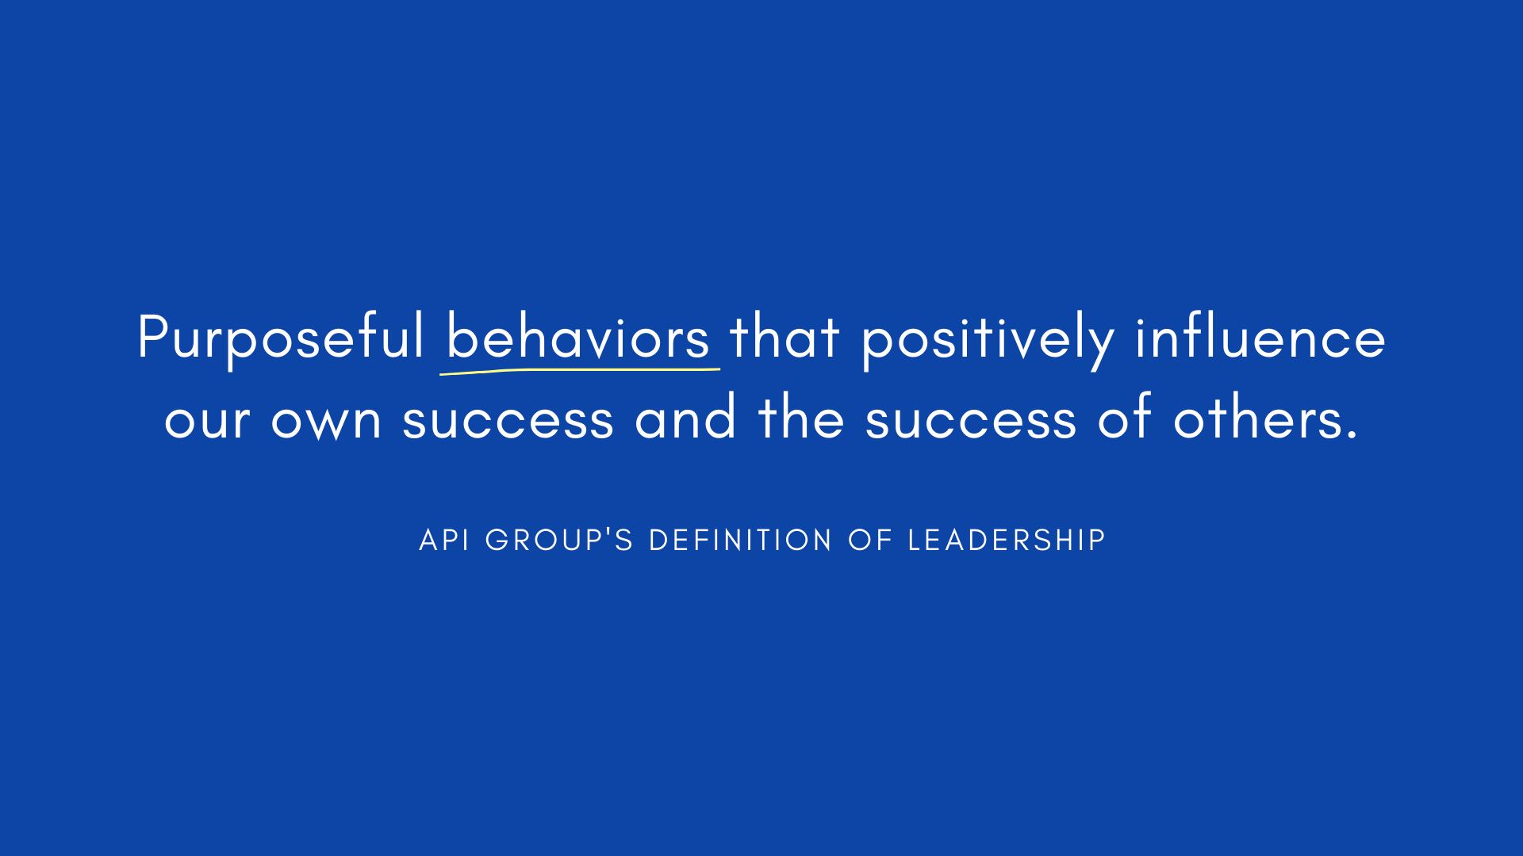
Notes:
When we focus on results, we’re less likely to hit our goals and really make an impact.
For example, in my story about the gym: losing weight, even saying lose 20 pounds, is an outcome, a result. When I changed my goal to focus on behaviors, something I included in my identity…like becoming the type of person who never misses a workout or drink a gallon of water a day…it made a great deal of difference in impacting my health.
So with that…CLICK

Slide 14
What does not challenge you will not change you.
Look at your solution from earlier. Did you write down
RESULTS or BEHAVIORS?
What behaviors can you focus on when looking to solve the problem?
Notes:
CLICK
Return to the problem you wrote down earlier that either you or your team are facing and let’s spend a little more time reflecting on that solution.
Only this time, we want to focus on the behaviors. If what you wrote down was a result (communicate better, increase profit margins…) then start again.
CLICK
Write down a behavior – specifically a behavior of yours because you can only influence others, you can’t change them – so focus on a behavior of yours that could be revisited, augmented, improved, changed completely, or reevaluated that would go a long way in solutioning the problem.
Give a green check when done.

Slide 15
Notes:
So we’ve covered the work we can do on our own – understanding we have individual worldviews that paint the way we see and show up in the world and how it can effect our leadership – we’ve even noted some behaviors we can work on or develop to be the leaders we want to be in approaching problems. Now, let’s look at approaching that problem.
CLICK

Slide 16

Notes:
Name pronunciation: AH-KITTY-UH-TAY AH-NOW-DOO-ONE
Ask: “You can’t run past for your shoes” – given what we’ve already talked about on worldviews, what does this mean to you?
Take some input
This means you can’t move past your circumstance. To truly understand someone, you have to walk a mile in someone else’s shoes but we can’t until we take our own shoes off. Letting go of how you see the world by taking the attention off of yourself and putting it on the other person. This is also known as empathy.
CLICK

Slide 17
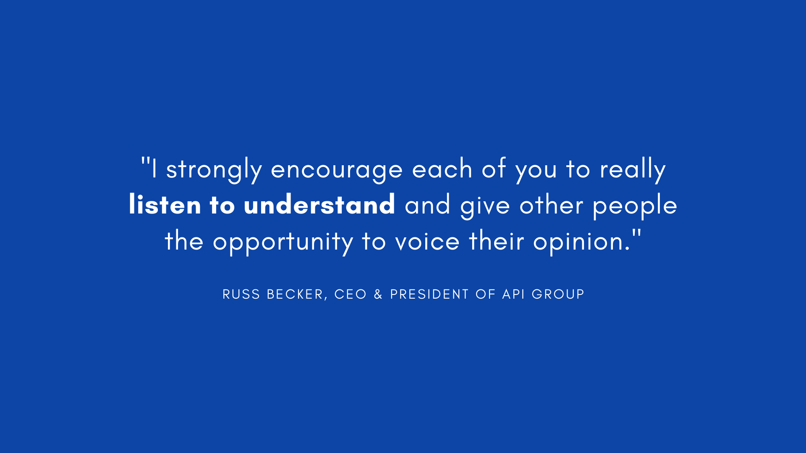
Notes:
Because people so often listen to reply and not to understand, we begin to prepare our minds with what we think the other person will say…this is all based on our own biases
If we prematurely decide what the other person will say OR what they’re meaning before they’re done communicating, we are filtering everything they’re saying through our own life experiences (everything we talked about on Worldviews)
Leadership ultimately means understanding people - from Speed of Trust by Stephen M. Covey

Slide 18

Round One:
Partner A will present their “problem” and propose their behavior solution.
Partner B will respond to the behavior solution and begin the conversation.
“Yes, but…”
Notes:
First round: "Yes, but“ 5 mins
So we are going to do our first breakout exercise by pairing you all up.
Here are the series of steps that will occur:
Amanda will open up the breakout rooms to the Partners A.
If you’re Partner A (first in the breakout room) you will be presenting the problem you wrote down earlier and sharing your behavior solution. Remember, originally we wrote down a quick solution but then revisited it looking at it from our own behaviors and how we could recognize our worldviews and perspectives and apply behavior change and awareness to the problem instead. So THAT behavior solution is what you will propose to your Partner B for their input.
Partners B, you will remain in this main session. After your partners are in the breakout rooms I’m going to give you a little bit more direction. So we’ll talk about that in just a moment.
Partners A: Any questions?
Open the breakout rooms
Once A’s are gone:
Partners B: What I want you to do is listen to your partner’s problem and proposed behavior solution and when you respond CLICK I want you to start all of your responses with “Yes, BUT…” and then challenge their point, tell them why it wouldn’t work. Look at the negatives…if they say “we need better customer metrics” you would say “Yes, but we have outdated technology.” Then let them respond to that. Essentially, you’re not going to be very helpful here. Poor partners A, they don’t know, so don’t let them know! We’ll debrief when we come back after the 5 minutes.
Any questions?
Put Partners B in their breakout rooms
Ask when they return: Is there a Partner A who would be open to sharing how that felt? Take some input then move on

Slide 19
Round Two:
Partner A will present their “problem” and propose their behavior solution.
Partner B will stick around for some coaching then
re-approach the conversation.
“Yes, and…”
Notes:
Second round: "Yes, but“ 5 mins
OK now we’re going into Round two and as you can see, these are the same instructions for Partners A. A partners, feel free to change your approach in presenting but it’s not important. The important piece is what Partners B will be doing. I’m going to give them a little bit more coaching before bringing them into your breakout groups again. So Partners A, same instructions for you but are there any questions before we place you in your rooms to wait for your partners?
After Partners A are gone
OK B partners. This time, I’d like you to continue starting your responses with a particular phrase only this time CLICK you will say “Yes AND…” and I’d like you to make an extra suggestion to support the previous idea. So for example, if your partner A said something like “The goal is to make our team meetings more effective.” You could reply “Yes AND you could schedule them for 45 minutes instead of 60 minutes.” or “Yes AND let’s send out a brief bullet point agenda the day before so the meetings stay in scope.” To be clear, this time there’s no arguing or questioning their ideas. No hesitation either, don’t try to find the perfect thing to add. Just simply jump in with “yes, AND” and then say whatever comes to mind. You may just inspire Partner A to think of something as well. Keep replying “Yes AND” until time is up.”
Any questions?
When everyone is back:
Debrief:
Ask Partners A first then Partners B:
What was different about the two versions? What was different about the quality of ideas?
What are the situations where “yes, but” is most likely to occur? What happens when “yes, but” becomes the default?
How can you encourage more “yes, and” in your team interactions?
Additional points: “But” is another way of saying no, which is often our go-to response. It shuts down the problem-solving and perpetuates circular conversation. With “Yes, and…”, people feel heard, valued, and part of the solution. It’s a more open and positive approach to disagreement and conflict. “Yes, and…”demonstrates you are listening and understand.

Slide 20
Notes:
Alright, so we started today revisiting the concept of worldviews, reflecting on what we can do to push ourselves outside of our comfort zone…and we just covered how empathy and listening to understand can encourage team synergy when problem solving….now, let’s look at what can go a long way in instilling trust within our team after situations and conversations like these.
CLICK

Slide 21
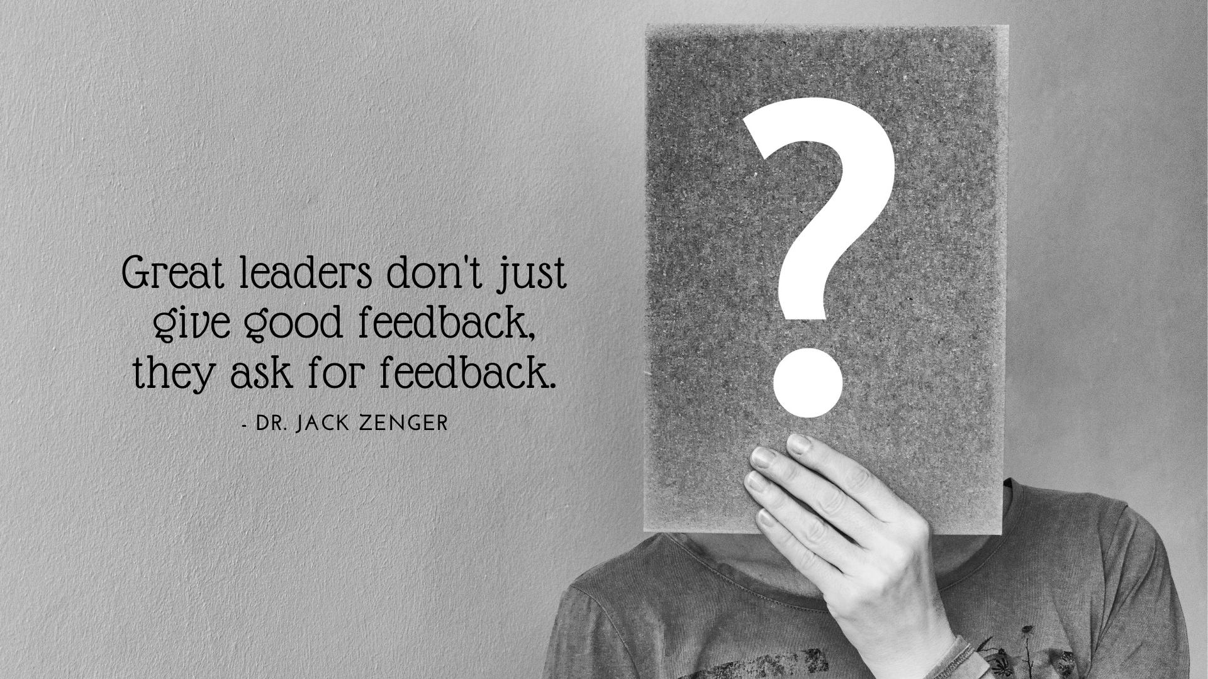
Notes:
This quote is directly from one of the online learning pieces.
I also ask for feedback on these workshops (in a linked survey I send out once the workshop is over).
I use that feedback to improve the experience for those that are directly effected by it.
CLICK

Slide 22
Notes:
Have you ever had a leader or coworker that seemed they felt they were ABOVE feedback? Probably didn’t trust them a lot…
After we return
So it’s not just ASKING for the feedback, it’s what we DO with the feedback.
Receiving feedback has been proven to actually help us reframe our paradigms, our worldviews.
A great way to show your team members that you plan to do something with their feedback is to write it down.
And luckily, the Business Analysis Community has a tool just for this.
CLICK

Slide 23

This Plus/Delta includes comments on:
Things you did well that should be repeated
Things you could do better in the future
Great for…
Meeting Debriefs
One-on-One’s
Performance Reviews
Customer Reviews
Project Wrap-Ups
Change Management
*Debrief document made available by the
APi Group Business Analysis Community
Notes:
You should thank others for their feedback and then follow-through.
Involving others when they’re directly effected creates more cohesion and makes them feel important to the cause.
Pull up document and do a live debrief – end with the debrief

