Slide 1

Notes:
Introductions (myself and Amanda or Heather)
Thank everyone for taking the online learning material
Introduce this concept of virtual leadership workshops (a development opportunity)
Tech check
Chat box
Participation List
Hand raise
Green check/red “x”
Participation tools to have on hand:
Phone
Pen/Paper
CLICK

Slide 2

Certifications
In person classes
eLearning
10%
“Formal”
Daily tasks
Hands-on experience
Taking on new challenges
70%
“Experiential”
Sharing knowledge
Observing others
Nurturing relationships
20%
“Interactional”
Notes:
Introduce this concept of development: 70-20-10
The 70/20/10 learning model was developed by Morgan McCall, Robert Eichinger and Michael Lombardo at the Center for Creative Leadership in the mid 1990s. Their studies and eventual discovery shifted the adult learning world’s concept of how someone can more successfully develop themselves into a leader.
The learning found that learning should come from a variety of sources
CLICK 10% of our learning should be formal learning. Ask: What are some types of formal learning that you can think of? Raise your hand if you have an idea.
CLICK A whopping 70% of our learning comes from things we can experience in our day to day, also known as on-the-job learning. Ask: What are some ways we can learn on the job, raise your hand if you have a thought.
CLICK: And the final 20% of learning comes from the interactions we can create, or learning from others. Ask: What are a couple of ways we can learn from others, does anyone have any ideas?
Following this type of learning within our organization is practical, empowering, and yields highly successful results.
Ask: Why do you think that of the model formal learning should only take up 10% of our total learning and development?
CLICK to next slide

Slide 3
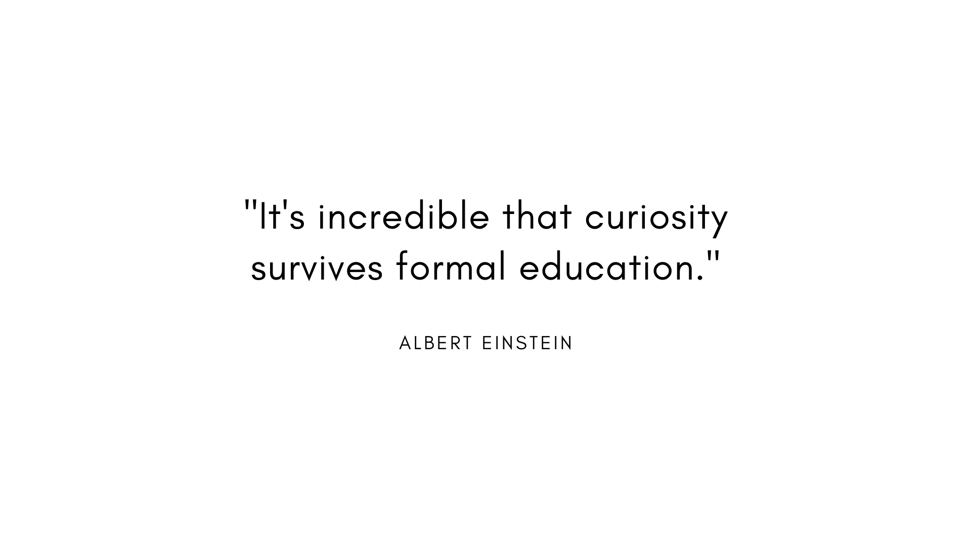
Notes:
Einstein lends an interesting perspective with this quote….that formal learning is a dangerous place to stop learning.
We may attend university, tack on a certificate per year to our resume, even take the leadership learning maps each month…
But if we stop there, we’re only 10% of the way. W
Formal learning can give us something tangible…a certificate to hold…a completion mark on a computer screen…an attendance record to show our supervisor…but if we stop there, that’s the only tangible evidence that we’re developing as a leader we’ll have.
That is why the 70% (experiential) and 20% (ineractional) are so vital to our full development as a leader.
CLICK

Slide 4
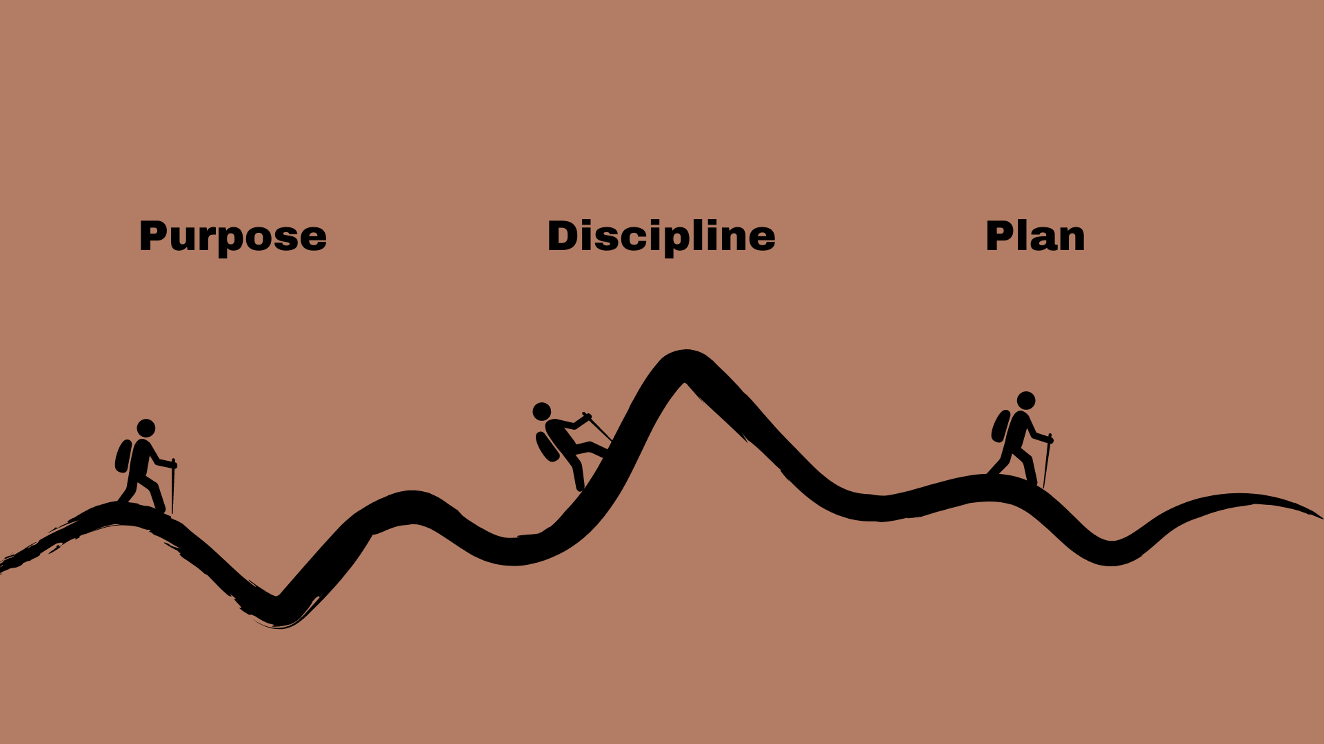
Notes:
This is how we’re going to spend our time today:
We will start with PURPOSE: and revisit our native genius.
Next we’ll move onto DISCIPLINE: This is where we focus on our habits…what do we do every day to get where we want to be.
Finally, we’ll look at PLANNING: Something we can move forward and act on.

Slide 5
Notes:
Let’s go ahead and get started with Purpose by moving to Menti.com
CLICK

Slide 6
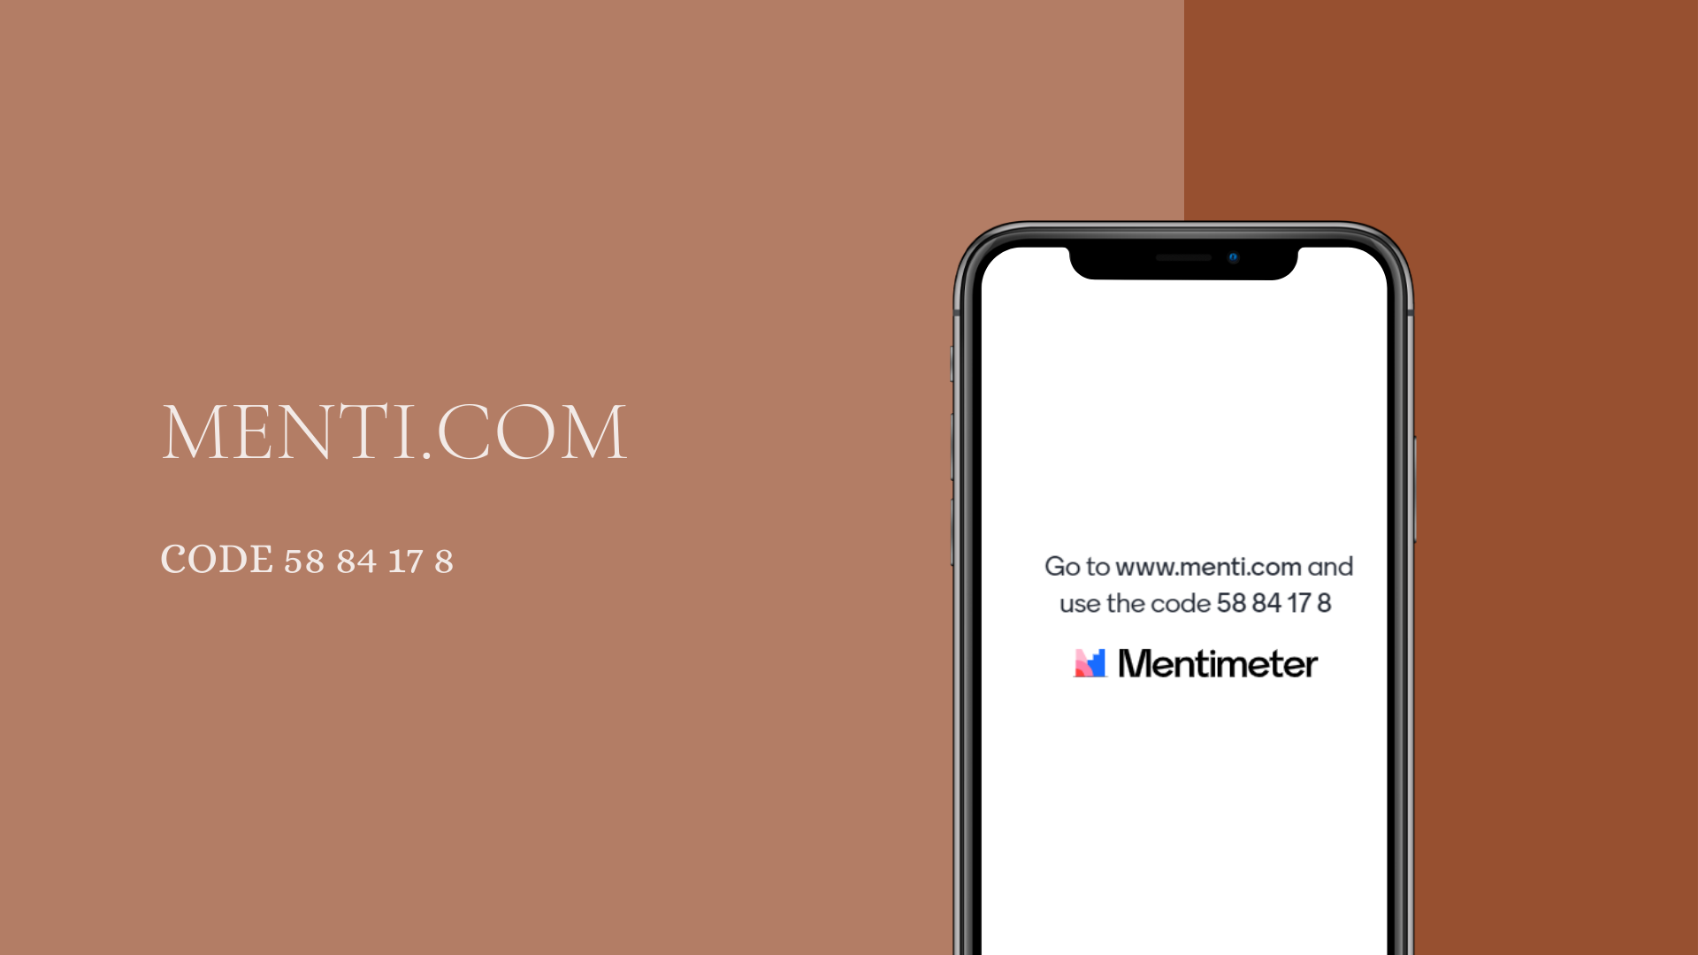
Notes:
Take out your phone or open another browser window and go to Menti.Com. Type in the code here on the screen.
Purpose and what brings us joy
MENTI SLIDE ONE:
In his BGL podcast episode that was featured at the beginning of this month’s leadership learning map, Alan Crabtree talks about aligning passion with job roles.
Finding joy in our work most assuredly helps with fulfillment in our roles and, from a company perspective, goes a long way in retaining talent.
But I’m not going to sit here and tell you to quit your job and find a new one inside or outside of your company. A lot of the time, it’s not plausible. Considering we find ourselves in the middle of a pandemic currently, it’s also probably not a very smart move personally.
So what about our current roles? Even if it’s not our dream role, we can almost always something we enjoy about our current role.
MENTI SLIDE TWO:
Take a moment and share here on the screen what about your role excites you? What are the things you look forward to doing each day or week?
Is it working with customers?
Coordinating a team event or schedule?
Solving problems?
Or maybe if your current role requires a lot of interaction, you prefer those quiet, head-down moments when you can think and strategize?
Let people fill out their responses, read out some STOP AT WHAT ABOUT YOUR ROLE…
BACK TO PPT: Ok, now that everyone has either submitted or is thinking of what about their role excites them and makes them feel this sense of purpose…let’s write that down, set it to the side to revisit in just a few minutes.
CLICK

Slide 7
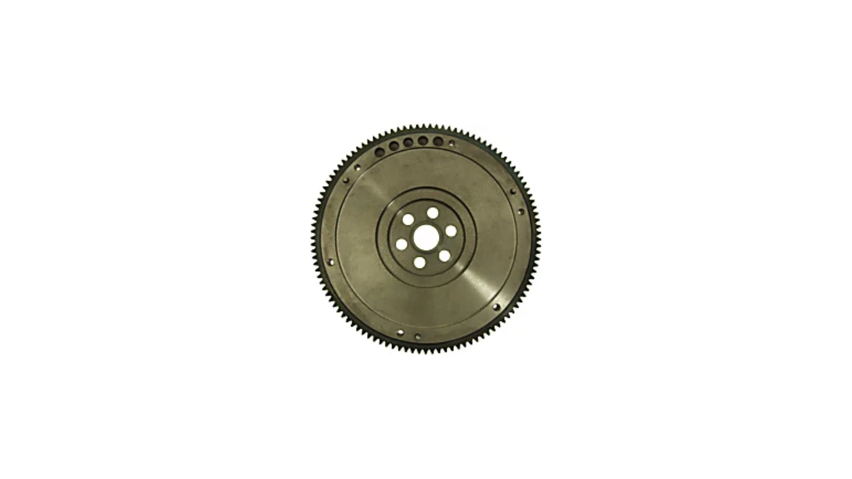
Notes:
In the TEDTalk featured in the online learning map, Jim Collins’ concept of the Flywheel was introduced by Edgar D Barron.
I believe in the presentation, he does share an image of a flywheel (also pictured here on the screen just in case).
Ask: Give me a green check if this metaphor resonated with you, a red x if not.
If you’re like me, this image and what this device’s purpose is a little lost on me, admittedly I’m not a mechanic nor do I have a very good grasp on the mechanics of a vehicle.
CLICK

Slide 8
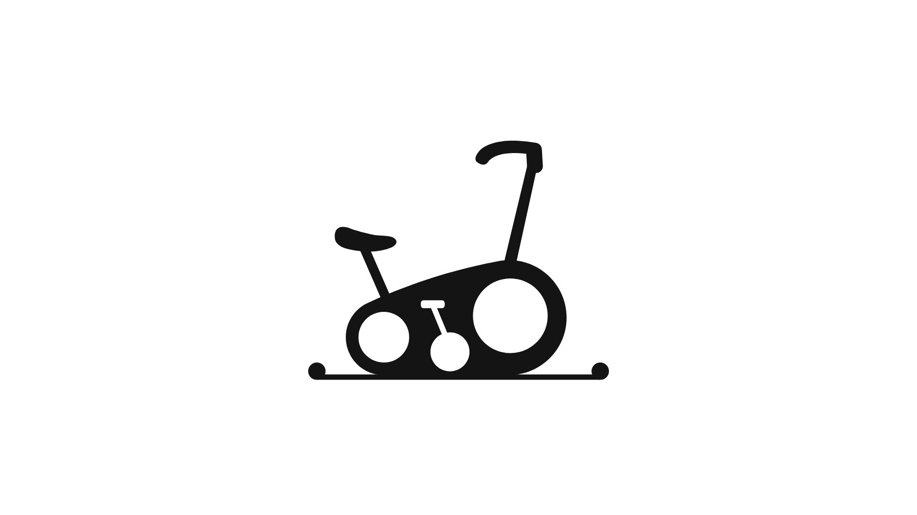
Notes:
So another way of understanding this concept is by picturing an exercise bike, which for me, resonates more.
Either way you look at it, the basic idea of The Flywheel is that while getting the wheel moving is difficult, once you GET THE WHEEL GOING, it’s incredibly hard to stop. Speed compounds and it moves faster and faster at a steady pace, smoothly, and with little effort.
And at the center of this wheel is what we do really well. For APi Group, as an example, it’s Building Great Leaders. It’s something our company leadership is passionate about and something they do really well.
CLICK

Slide 9
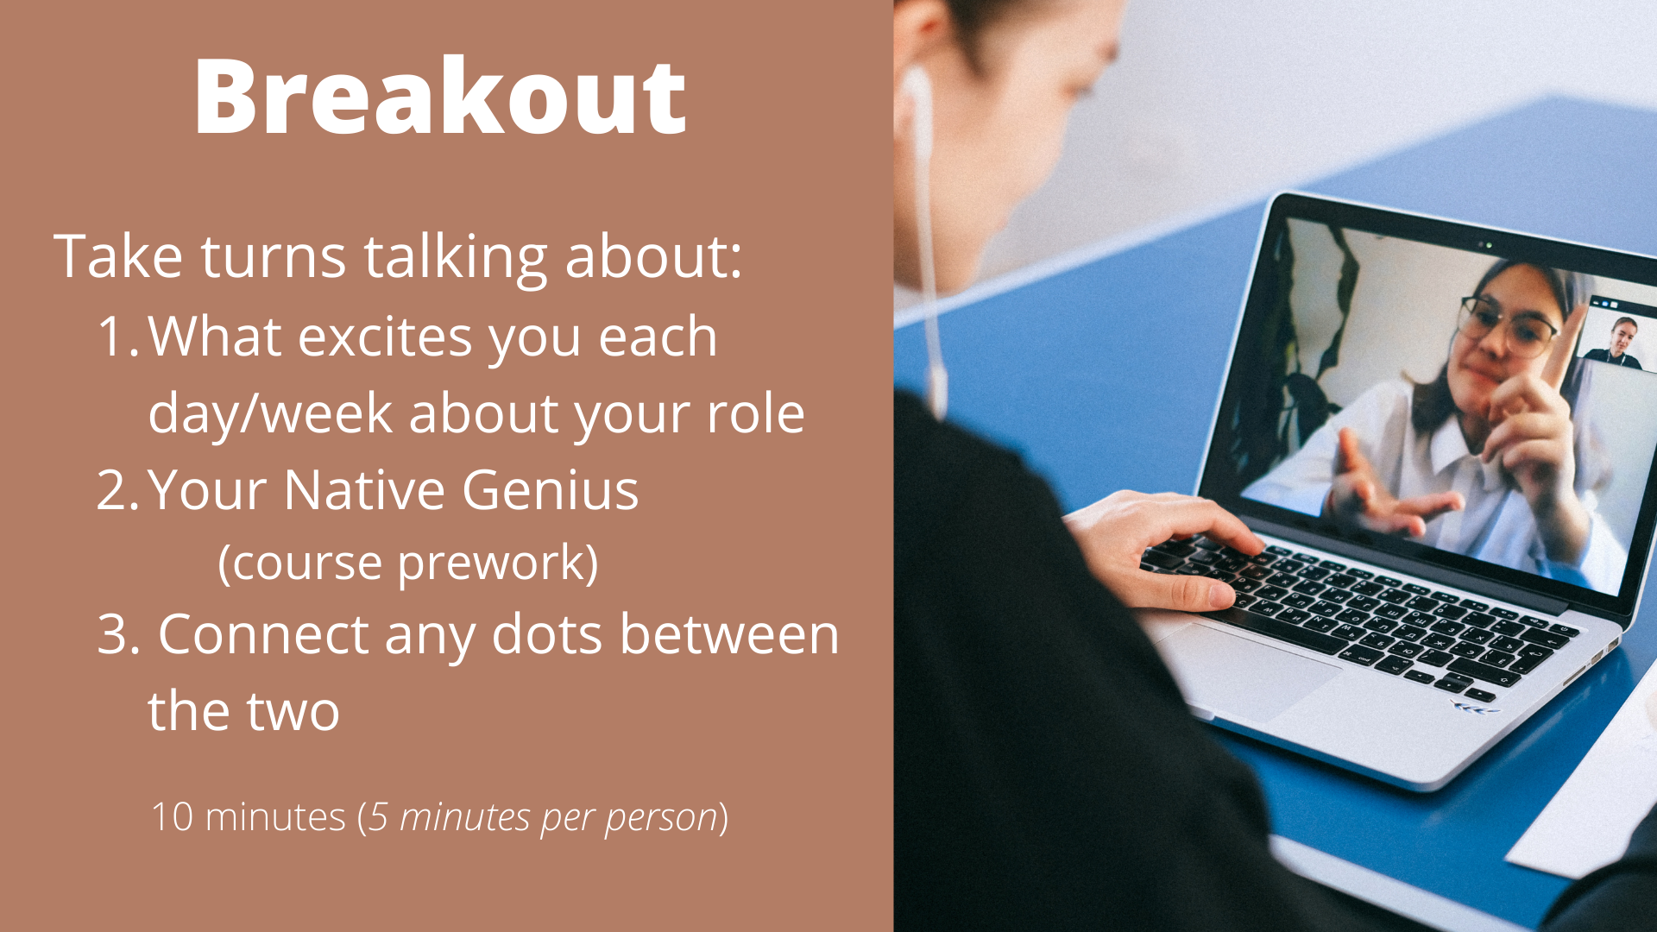
Notes:
So on that, we will split out everyone into groups of two.
Take about 5 minutes each to cover what each of you felt gave you purpose in your current role…that something that you really look forward to each week…
And within each of your 5 minutes, also share what your 2-5 colleagues, friends, mentors described as your Native Genius – the thing that you do better than anyone else, with little effort.
And finally, help one another connect any dots, any connections between the two. No need to get too deep on this, we’ll return to our one-on-one conversations later, but it’s a good stopping point for you to decide what those two things – what excites you and what you are innately good at – possibly have in common. It’s nice to talk this out with someone because sometimes, we’re too close to what we do day in and day out, in our role and what we do naturally, you can potentially help the other see any connections.
Example: As a department lead, you really enjoy coordinating…planning and executing, getting to really see things come together smoothly, making it look seamless. Your native genius according to those who know you well is connecting with others, especially customers. A possible connection could be a customer event that you can lead in organizing, to engage your customer base and create strong relationships. Another possible connection could be taking an interest in how your company keeps customers updated…maybe it’s a newsletter or your company’s website or social media outreach.
We will give you a warning when you have a couple minutes left. Be sure to take notes, since we will return to these breakout conversations.
This is a conversation, so help your partner make those connections.
After the breakout
So hopefully you made some notes on those connections between what brings you joy about your role and what you naturally good at doing. As I said before you paired off, we will return to our individual one on ones later on.

Slide 10
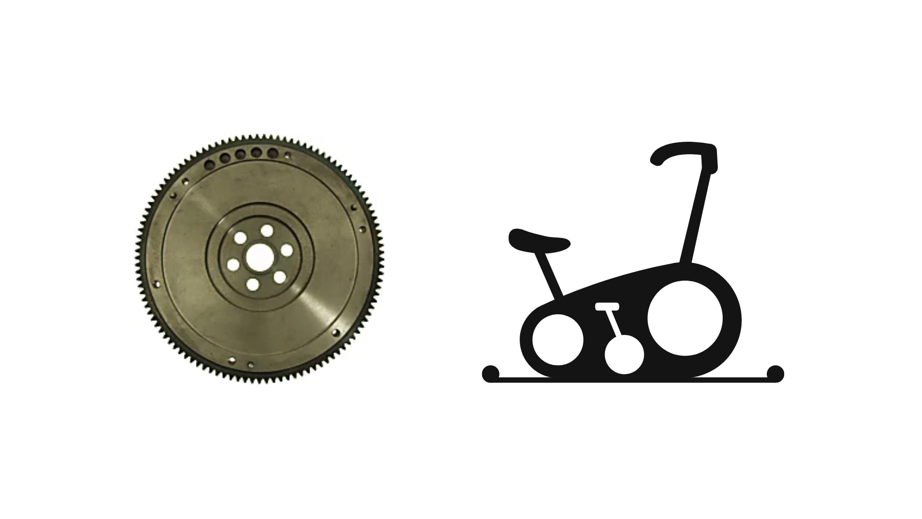
Notes:
So if we return to this idea of the flywheel introduced in the TEDTalk from our map specifically, what was sitting at the center was “POTENTIAL”.
But a Potential for what was pretty unclear.
Have you ever seen a venn diagram? The possible logical relation between what you enjoy in your role and what you’re good at sits in the center of your wheel.
Based on your conversations just now, what sits at the center of your wheel is what brings you joy and what you’re innately good at.
And what else the TEDTalk speaker didn't address specifically was HOW to start the flywheel. He spent the majority of his presentation relating the flywheel concept to experience – the idea that if you’ve seen it work before, it should help you get started on moving the wheel towards your goals - and while that's fine assumption, we really need to start somewhere else in order to get the wheel moving because that is the hardest part.
CLICK

Slide 11
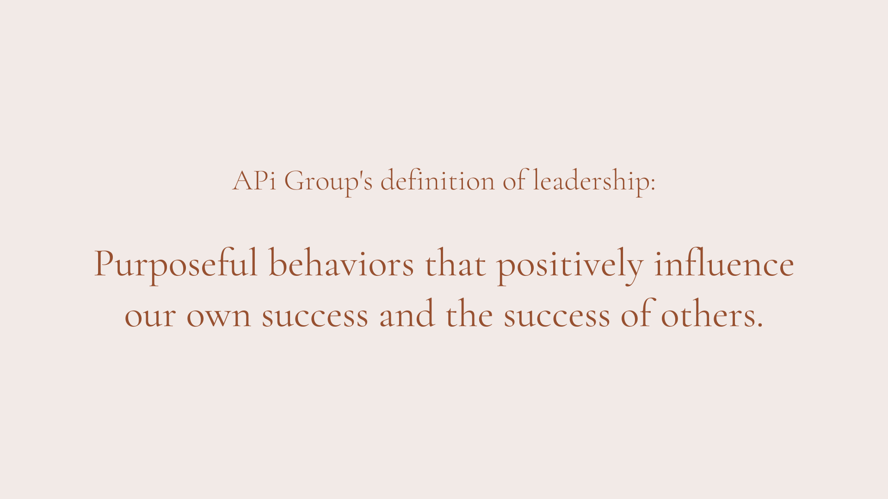
Notes:
Ask: When you think about the flywheel...getting it started, it’s movement building to create faster and faster momentum...what from our definition of leadership is the actionable item? What can we can compound on? What can we work on to reach our leadership goals?
The idea is that they recognize that the only way to influence success is to focus on our behaviors.
CLICK

Slide 12
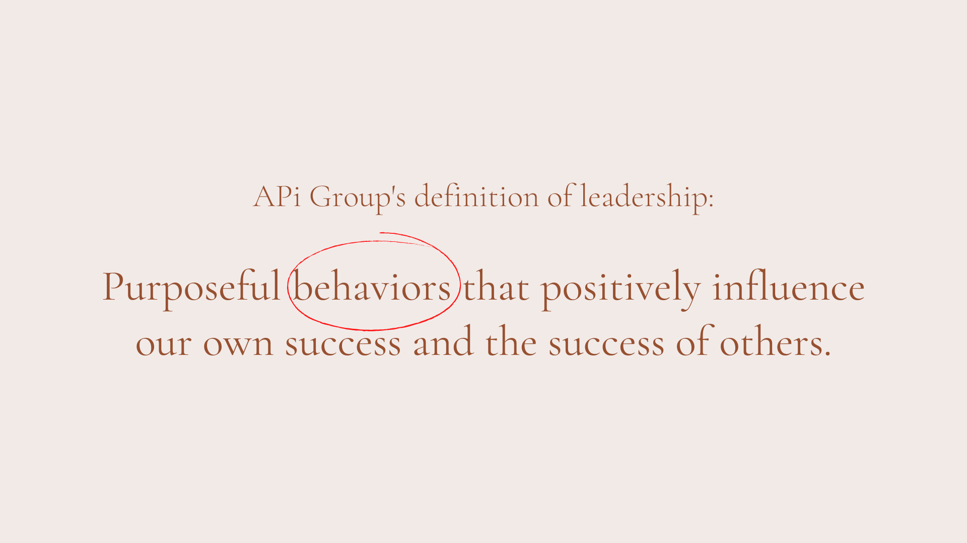
Notes:
So if of this definition, our behaviors are the items we can act on now, then a logical next step would be to focus on how we create behaviors that will lead to success. Another way of thinking of our behaviors in this way is to look at them as habits.
CLICK

Slide 13
Notes:
Which brings us to our next section: Discipline.
CLICK

Slide 14

Notes:
When we’re trying to get healthier, we can usually easily identify the habits we might need to change…
eating whole foods
looking into supplementing our diet with important vitamins and minerals
incorporating purposeful movement in our lives, perhaps even meditating
Or seeking help from a professional to help with a fully rounded sense of health.
So our goal might be to lose weight or get healthier overall, but it’s the habits we incorporate that will decide whether we’re successful or not.
The same can be said for our learning goals. If our professional goal right now is to become a supervisor in our department or take over a customer account or become controller one day, taking control of our learning habits helps shift our mindset.
Changing a mindset is far more difficult than changing a scheduling conflict. The will it takes to change your mindset takes a lot of energy and commitment; probably more energy and commitment than taking steps to improve your health. Small and repeatable steps build habit.
By maintaining that momentum, you start to see results and reach your goals. You can take this same approach to life-long learning, which will improve your influence and options.
CLICK

Slide 15
Notes:
Take out your phone or open another browser window and go to Menti.Com. Type in the code here on the screen.
We’re going to walk through a bit of a mindset self-assessment.
On each screen you’ll see a statement. Please move your toggle to the amount to which you agree with the statement.
Walk through all slides, ends at “opportunities”….
BACK TO PPT
CLICK

Slide 16

Notes:
Discuss Mindset by Carol Dweck
In her book, Dr. Dweck states that in a GROWTH mindset, people believe that their most basic abilities can be developed through dedication, hard work, and learning…our brains and talent are just the starting point. This view creates a LOVE of learning and a resilience that is essential for great accomplishment. A fixed mindset, however, believes that they are where they are….it is what it is….things can’t change and they can’t change….if they’ve never been good at it, they never will.
So back to the self assessment we just walked through…if your answers were closer to the left, it means you may have a limited or fixed mindset. The closer your responses were to the right, the more you exhibit a Growth mindset.
Luckily, today we’re already two steps ahead of that way of thinking because we have identified what in our current role brings us joy and what we seem to do naturally and with little effort…we have also made some connections between those two.
CLICK

Slide 17
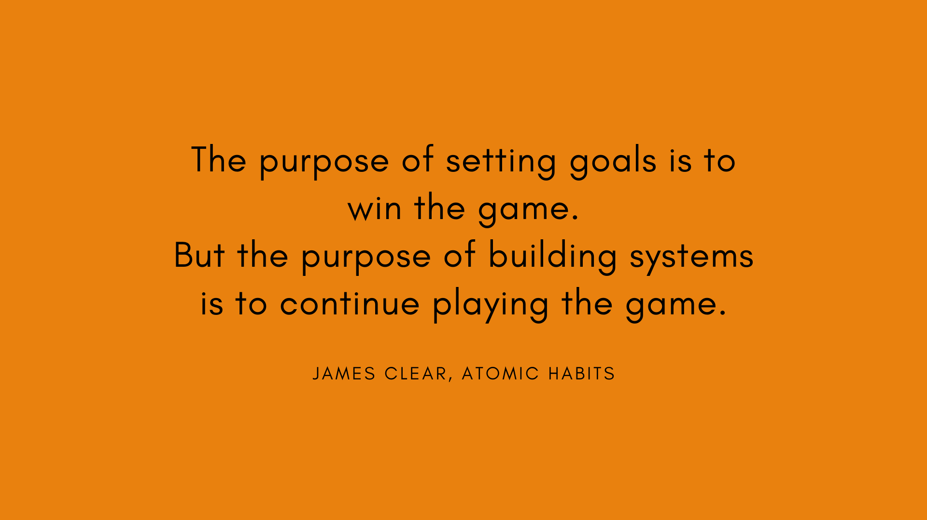
Notes:
To add onto Carol Dweck’s concept of the growth mindset, I’d like to introduce James Clear’s thoughts on improvement. He argues that possibly just setting goals really only inspires one thing: winning. And winning is great, setting goals is great, I’m definitely a big goal planner myself (show book) but his point is that if you can build a system that supports your improvement rather than “I either accomplished that goal or I failed…I won or I lost”, you’re set up for a lot more success. Let’s watch him talk a little more about that.
CLICK

Slide 18
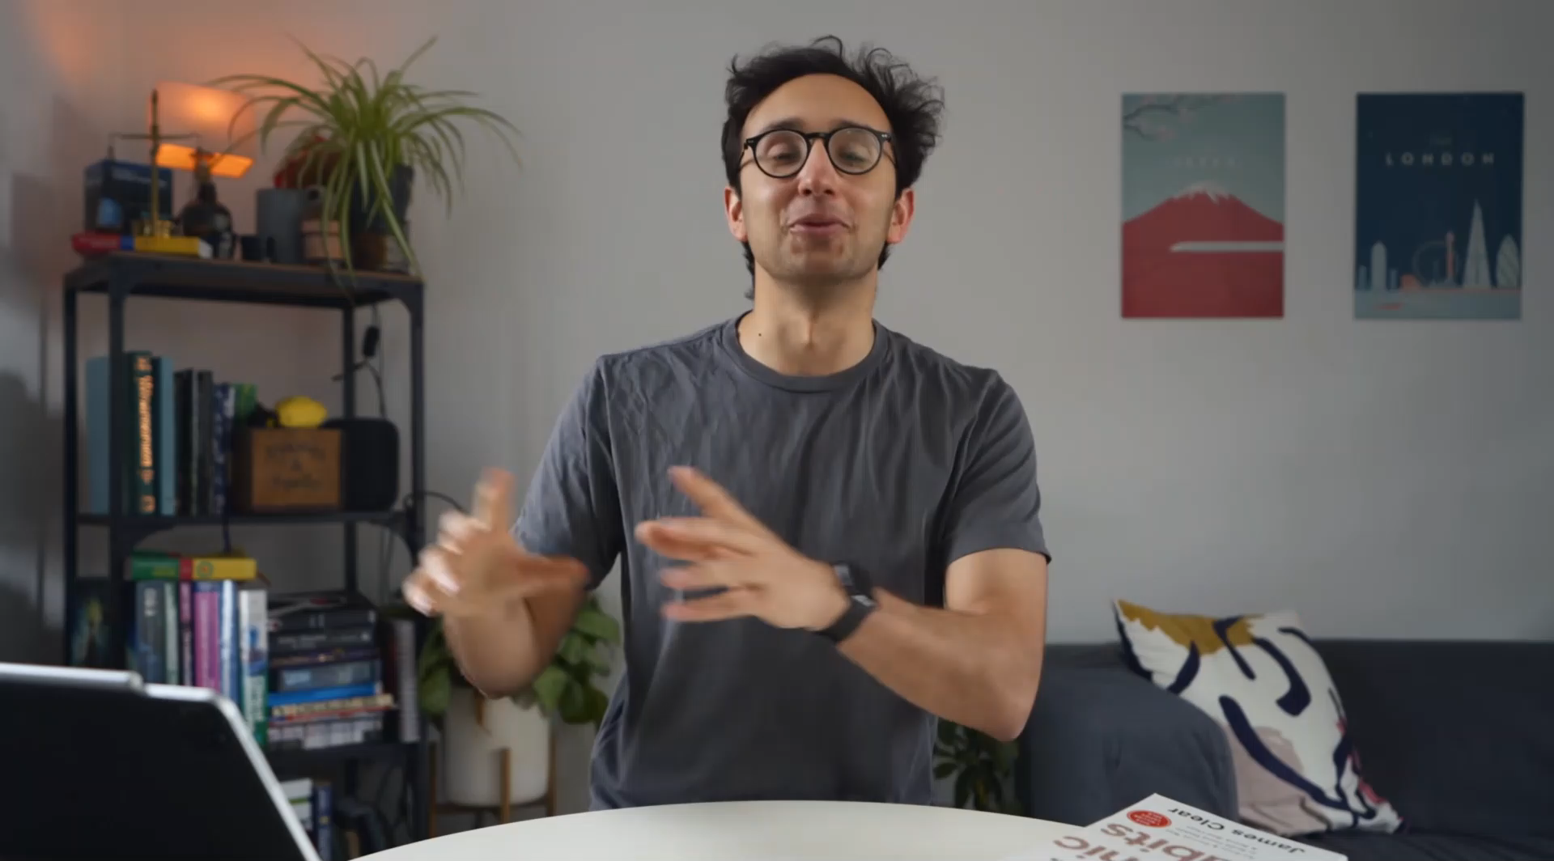
Notes:
Play the video
Ask: Why might way of thinking, this mindset shift, be helpful when you are becoming a better leader?

Slide 19
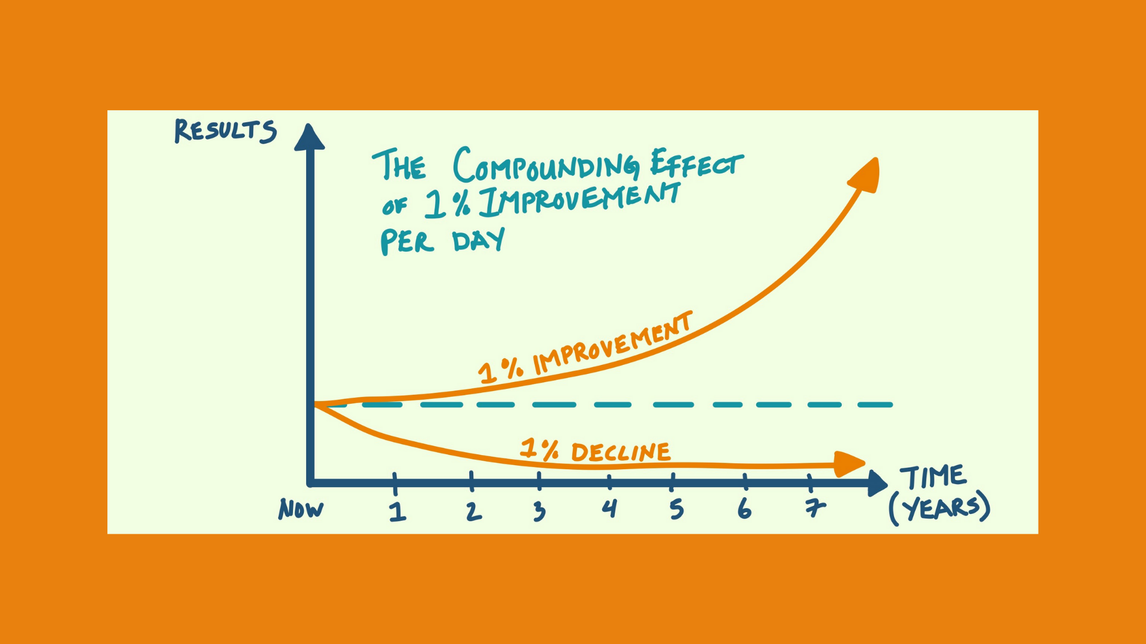
Notes:
One way to incorporate a better system of learning in your life is another James Clear idea, and that is to become 1% better each day. By focusing on just 1%, James argues we will become 37 TIMES better by the end of a year. So by his logic, if you started now, improving each day by 1%, that means you could be 10% better by 2021.
The same can be said for bad habits. 1% decline can really compound on you when not checked. Really zeroing in on having a growth mindset when looking at your professional and personal development can help you take this upward trend rather than this downward.
CLICK

Slide 20
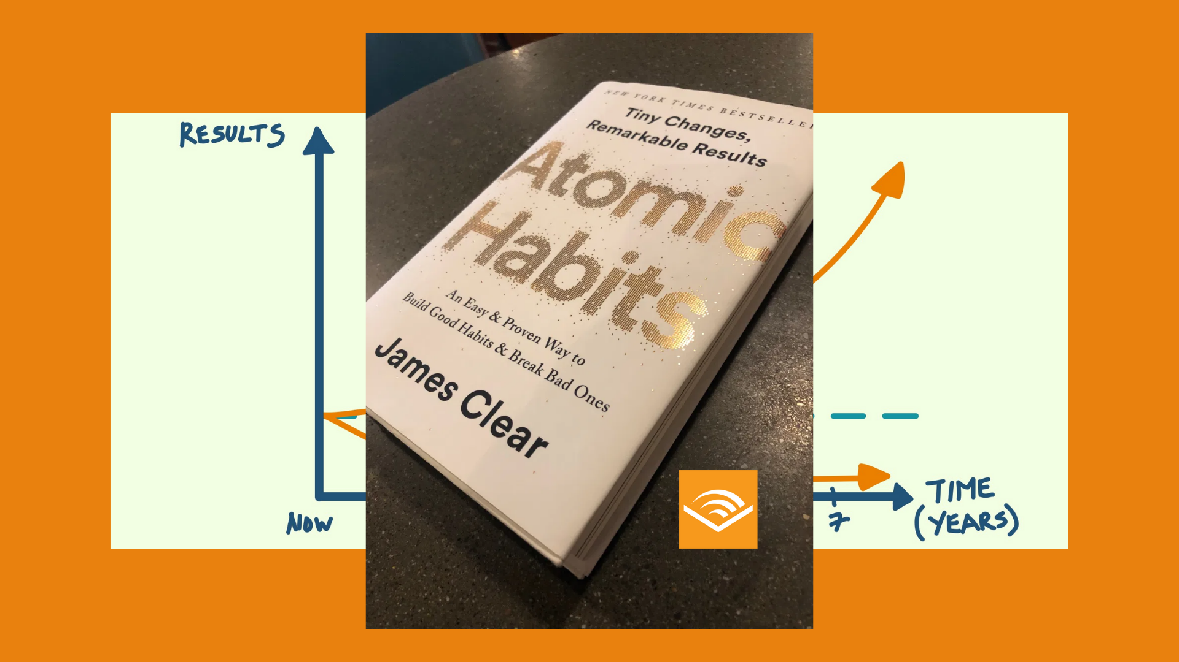
Notes:
This mindset shift over getting better just 1% a day and focusing on longevity also comes from the book Atomic Habits by James Clear who we just saw in that video.
You can find this audiobook in our new audiobook provider’s library: Audible for Business. I’ll send a link to get access to everyone attending today.
CLICK

Slide 21
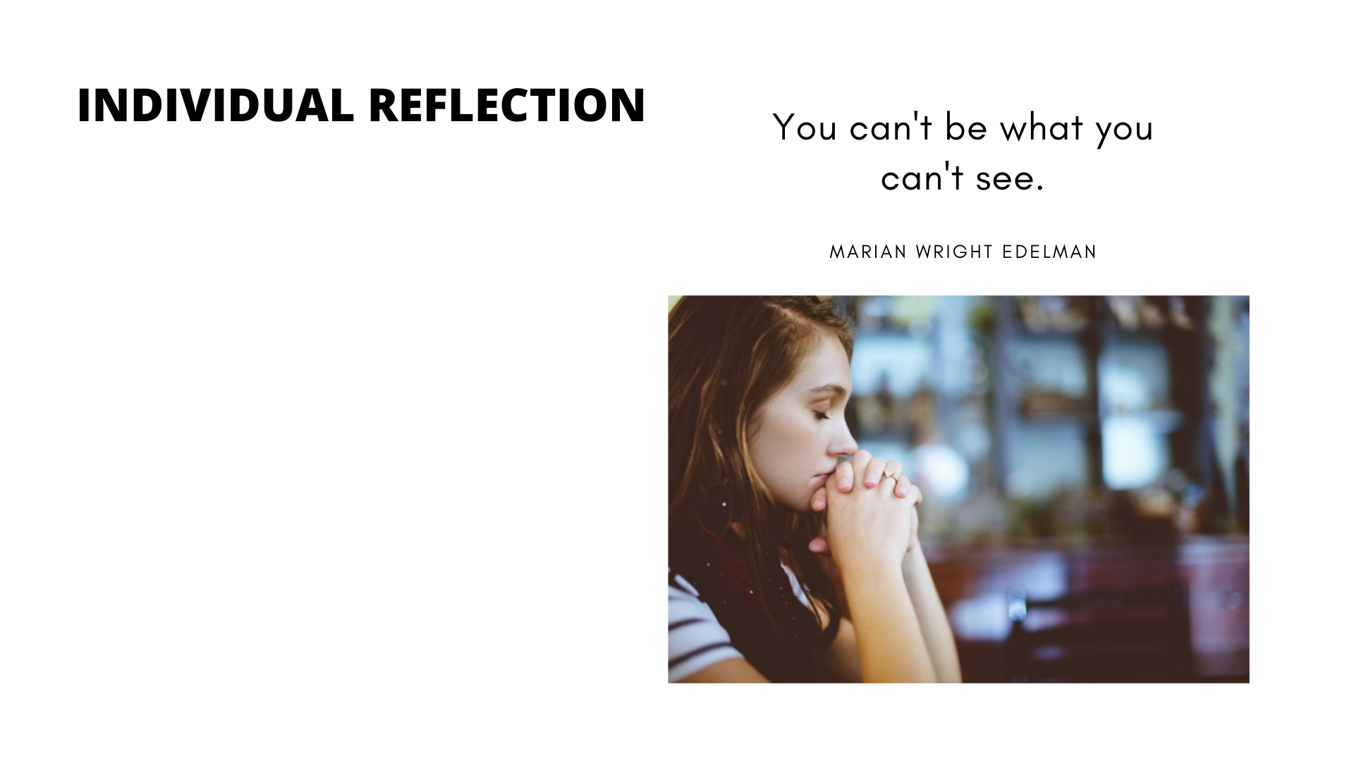
Think: What are my career options (1-5 years)?
  Purpose/Joy
  Native Genius
  Company need/availability
Think: What are 3-5 skills and attitudes that a great leader would need in order to be successful and influential in those roles?
Notes:
Now with all that we’ve talked about so far…what excites you, your native genius, growth mindset, let’s spend some time reflecting.
Read the screen
Ask everyone to give a green checkmark once they’ve completed the reflection, but I’m planning to give them 5 minutes.

Slide 22
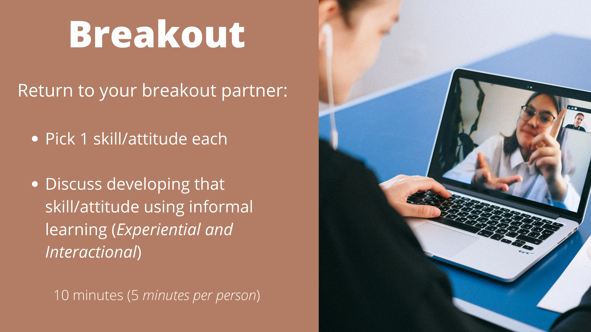
Notes:
By now, your partner is aware of your Native Genius, what brings you joy, and the connection between the two.
We will break out once more into our one on one conversations and I’d like you to let your partner know the skill or attitude you have decided you should develop in order to see that goal – or a professional goal – become a reality.
Together with your partner, try to think of 1-2 experiential or interactional learning experiences that can help you develop that goal
Like developing patience by delegating more tasks…or develop public speaking skills by volunteering to lead more meetings.
After breakout:
Does anyone care to share what you and your partner discussed for you personally?
Take 1-2 volunteers

Slide 23
Notes:
OK so so far we’ve identified what brings us joy, what could be our purpose in our current day-to-day. We also talked about how we can move toward our goals by taking action to create better habits and behaviors. Now, how to move forward with what we’ve learned about ourselves and learning and actually make a plan?
CLICK

Slide 24
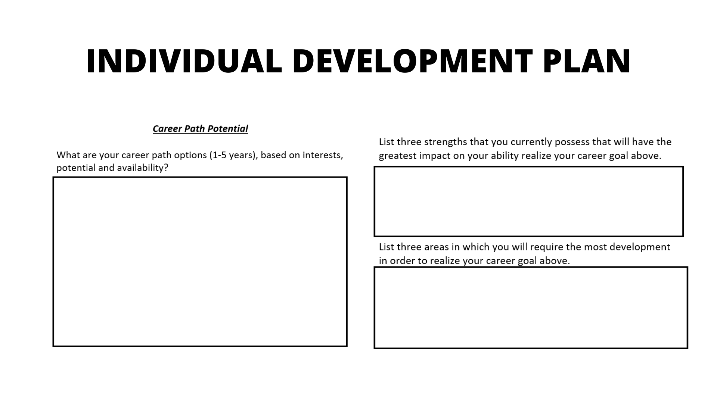
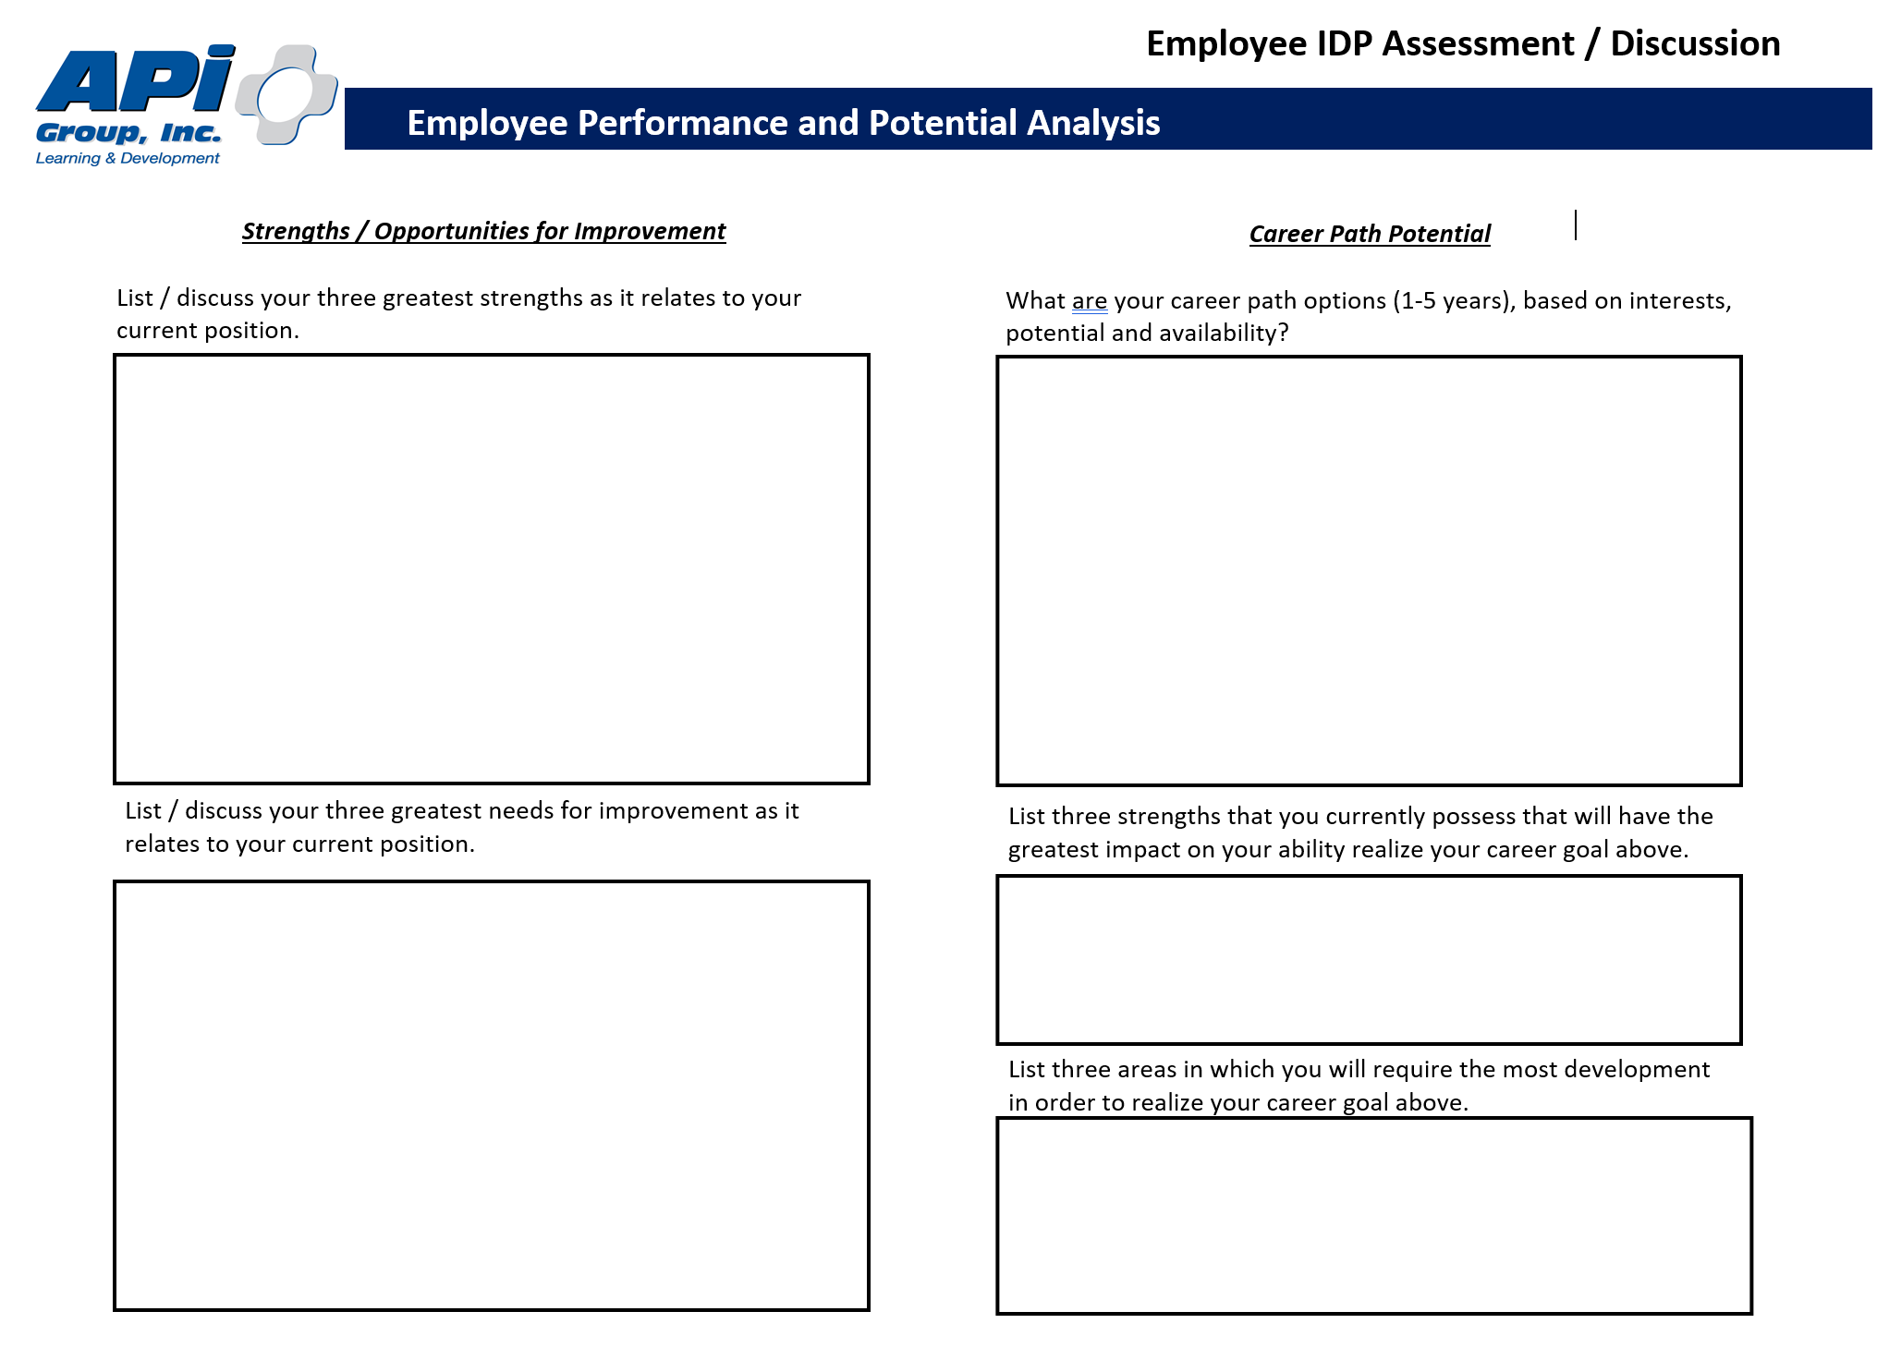
Notes:
This is the Individual Development Plan, as featured in the eLearning IDPs for Professional Growth in the LMS
Ask: Give me a green check if you have an IDP currently or a red ‘x’ if you do not.
CLICK

Slide 25

Notes:
Luckily for us, whether it’s time to update/revisit your IDP or you haven’t filled one out yet, we just spent some time today covering these three items on the right-hand side of the document (I will send the IDP documents in an email to everyone along with a supervisor’s template and some instructions for those who need them).
So you can take your purpose/joy statements along with your career goals and place them in the box to the left.
You can also use your Native Genius in the top-right box as well as
the items from your last breakout session – on the skills/attitudes you should work to develop – for the lower-right box.
I’m also happy to share a link to some 70/20/10 tips to help you consider how you can reach your potential and goals using that model of learning.
FYI: These one on one conversations we’ve been having today are a part of the 20%!
After session, send IDP templates, instructions, and this link; https://www.growthengineering.co.uk/wp-content/uploads/2019/11/70-20-10-60-top-tips.pdf
CLICK

Slide 26


SET OUTLOOK CALENDAR REMINDERS
This week
  (complete IDP)
Next week
  (schedule w/ supervisor or team)
Jan 2021
  (revisit IDP w/ supervisor)
Notes:
Have everyone at very end take 2 minutes to go set calendar reminders:
This week – complete/update IDP
October – schedule time with supervisor to cover IDP (if you’re a supervisor, remind your team)
3 months from now (beginning of 2021) to revisit their IDP
CLICK

Slide 27
GROWTH MINDSET
Notes:
So today, we:
Looked at what brings us joy in our current role, potentially uncovering our purpose (there’s a lot of work that can be done here, like creating a personal mission statement, to flesh out what you believe to be your Purpose, but starting with what brings you joy NOW is a good start.)
Discussed that on our path to great leadership, it is our behaviors (our habits) that control how far we go.
CLICK We also discussed how harnessing a growth mindset to our discipline will help us go further.
And finally, we looked at how we’ve been working to fill out an IDP, a helpful document (I will be sending everyone but it’s also featured in the eLearning on the LMS, just search “LMS”). We also hopefully set a reminder this upcoming month to discuss with our immediate supervisor and then another reminder at the beginning of 2021 to revisit our IDP.
Time permitting, ask: Are there any other questions or comments before we wrap up today?

