Slide 1

Notes:
LINDSAY
Welcome​
Intros​: Amanda, Alan, Lindsay
Thanks for taking the map​
Tech check (Chat, Participation List)​
Have on hand:​
Prework
Phone​
Pen & Paper

Slide 2
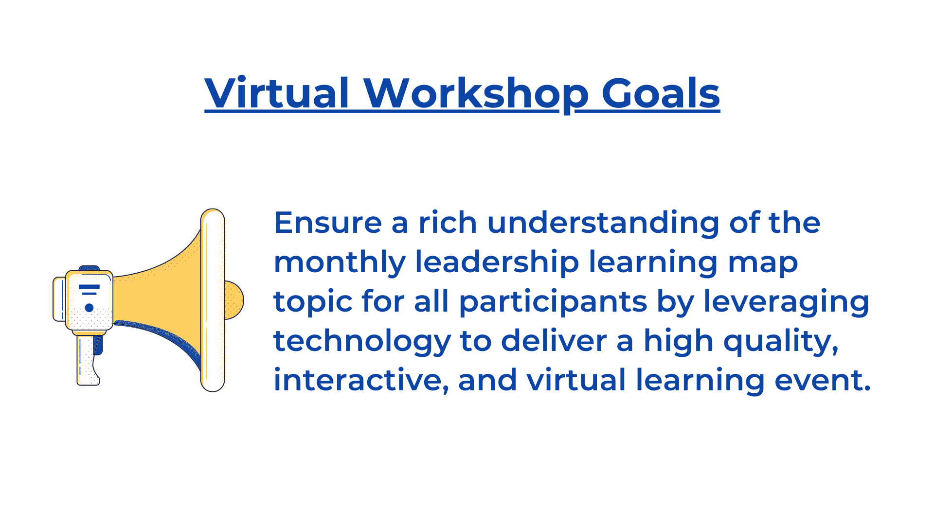
Notes:
LINDSAY

Slide 3
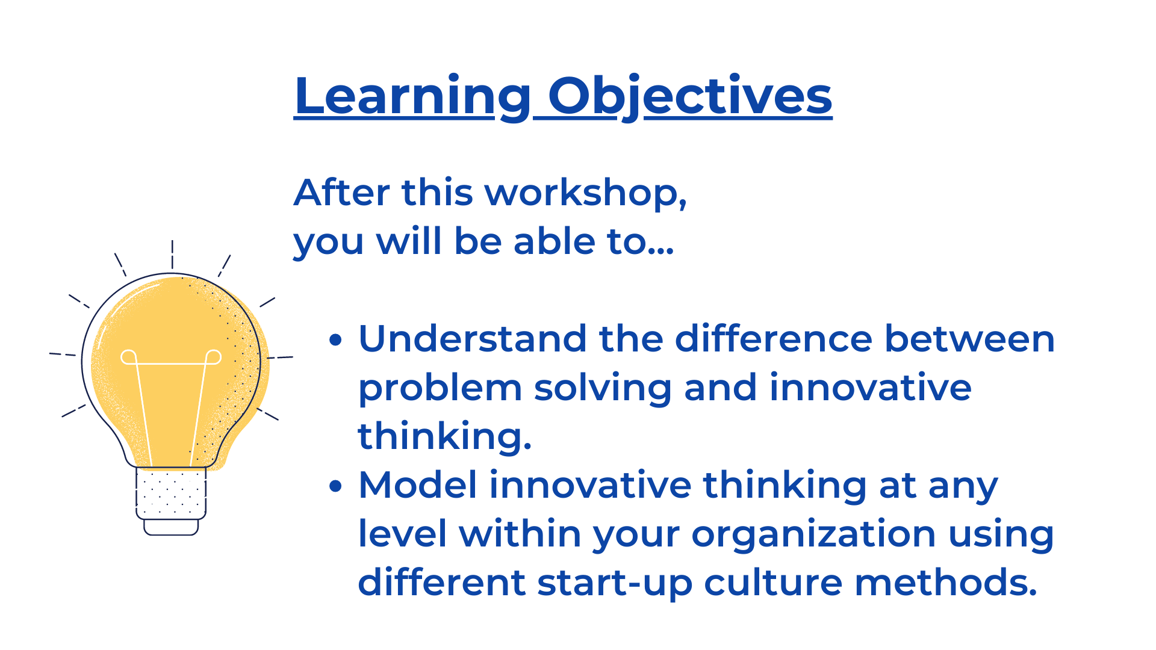
Notes:
LINDSAY

Slide 4
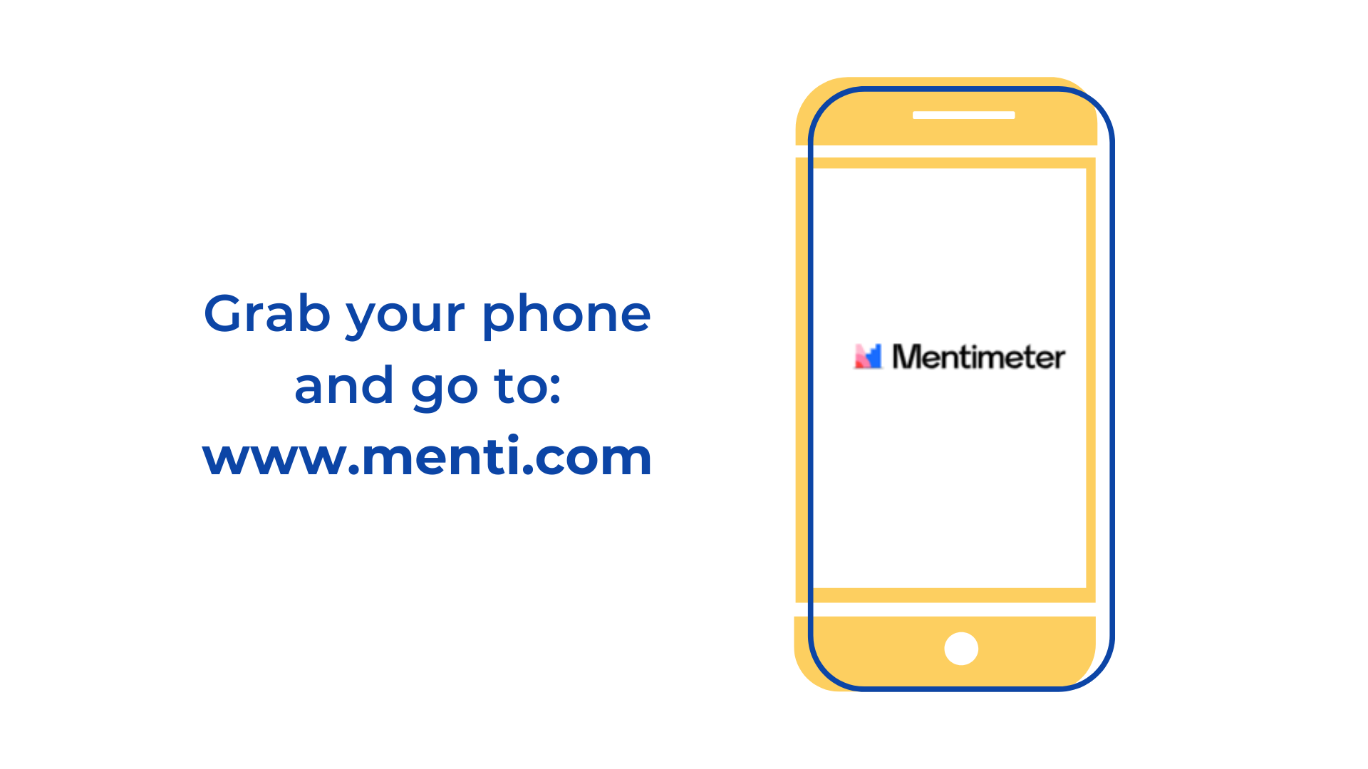
Notes:
LINDSAY
Mention that it depends on leadership too to create a culture that fosters innovation
Agile leaders are…
Open/transparent
Accepting and present
Collaborative
Comfortable with discomfort
Always listening
Always learning
Resilient
Curious
Flexible

Slide 5

Notes:
LINDSAY

Slide 6
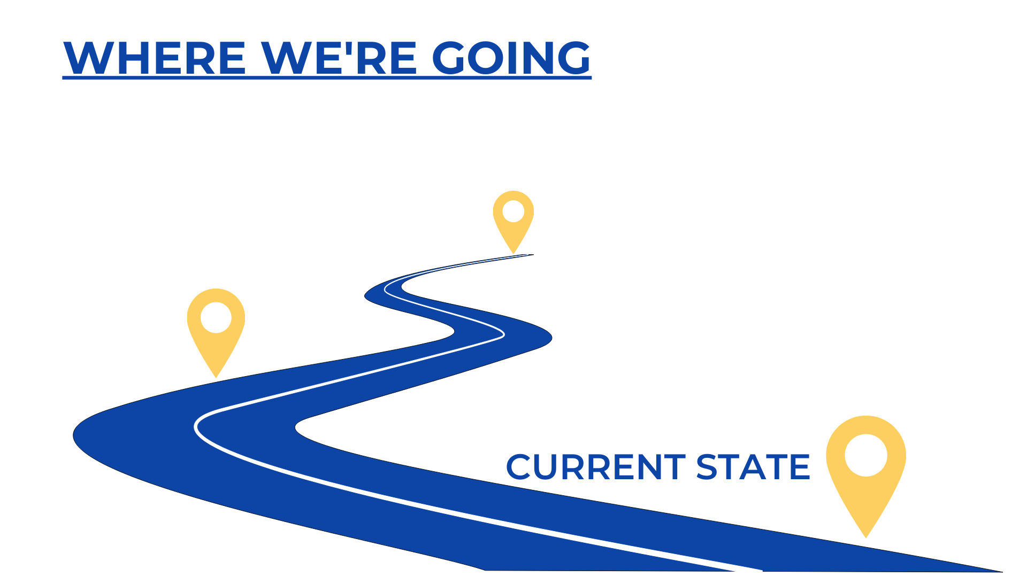
Notes:
LINDSAY
Where are we
Why are we here

Slide 7
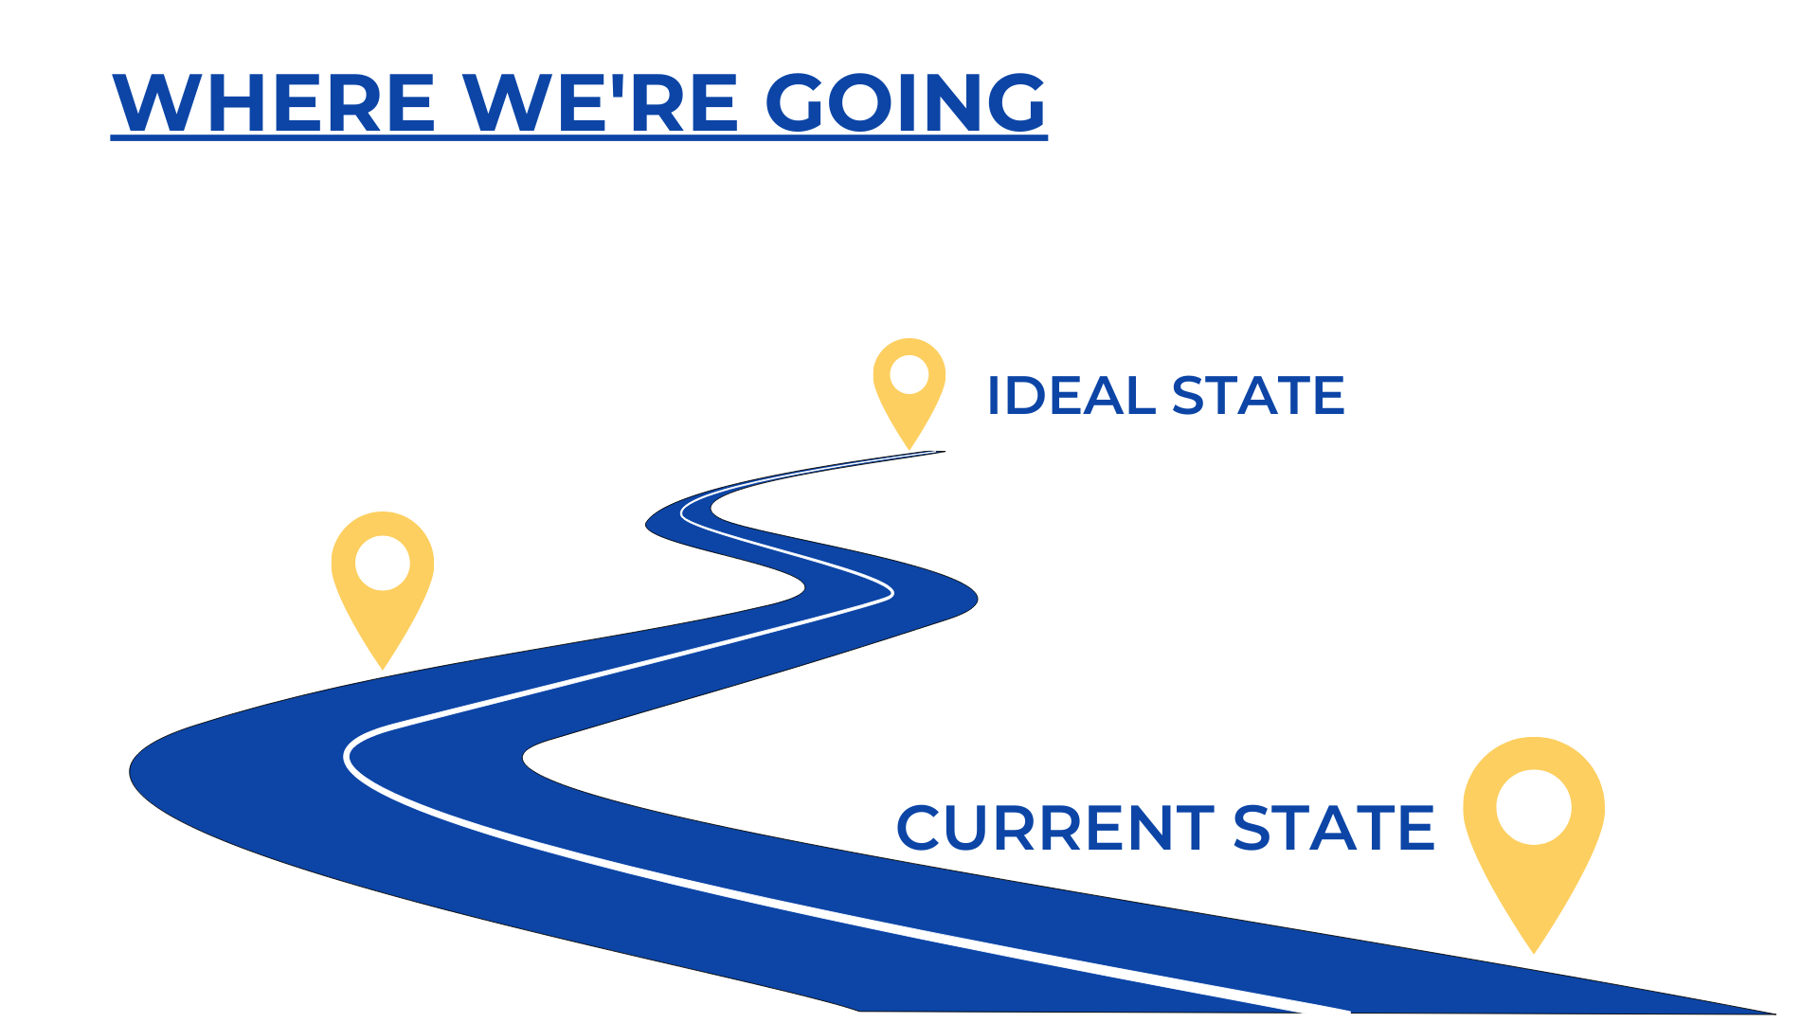
Notes:
LINDSAY
Where could we be?
There’s a third stop here on this map, and we’ll get to that. But…
CLICK

Slide 8
Notes:
LINDSAY
Let’s jump into the current state first, and figure out where we are right now.

Slide 9
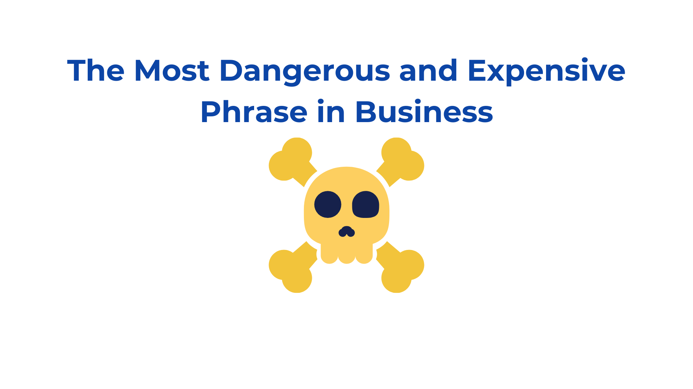
Notes:
ALAN
ASK: Does anyone know the most dangerous and arguably the most expensive phrase in business today? (ask them to raise their hands, invite them to come off mute)

Slide 10
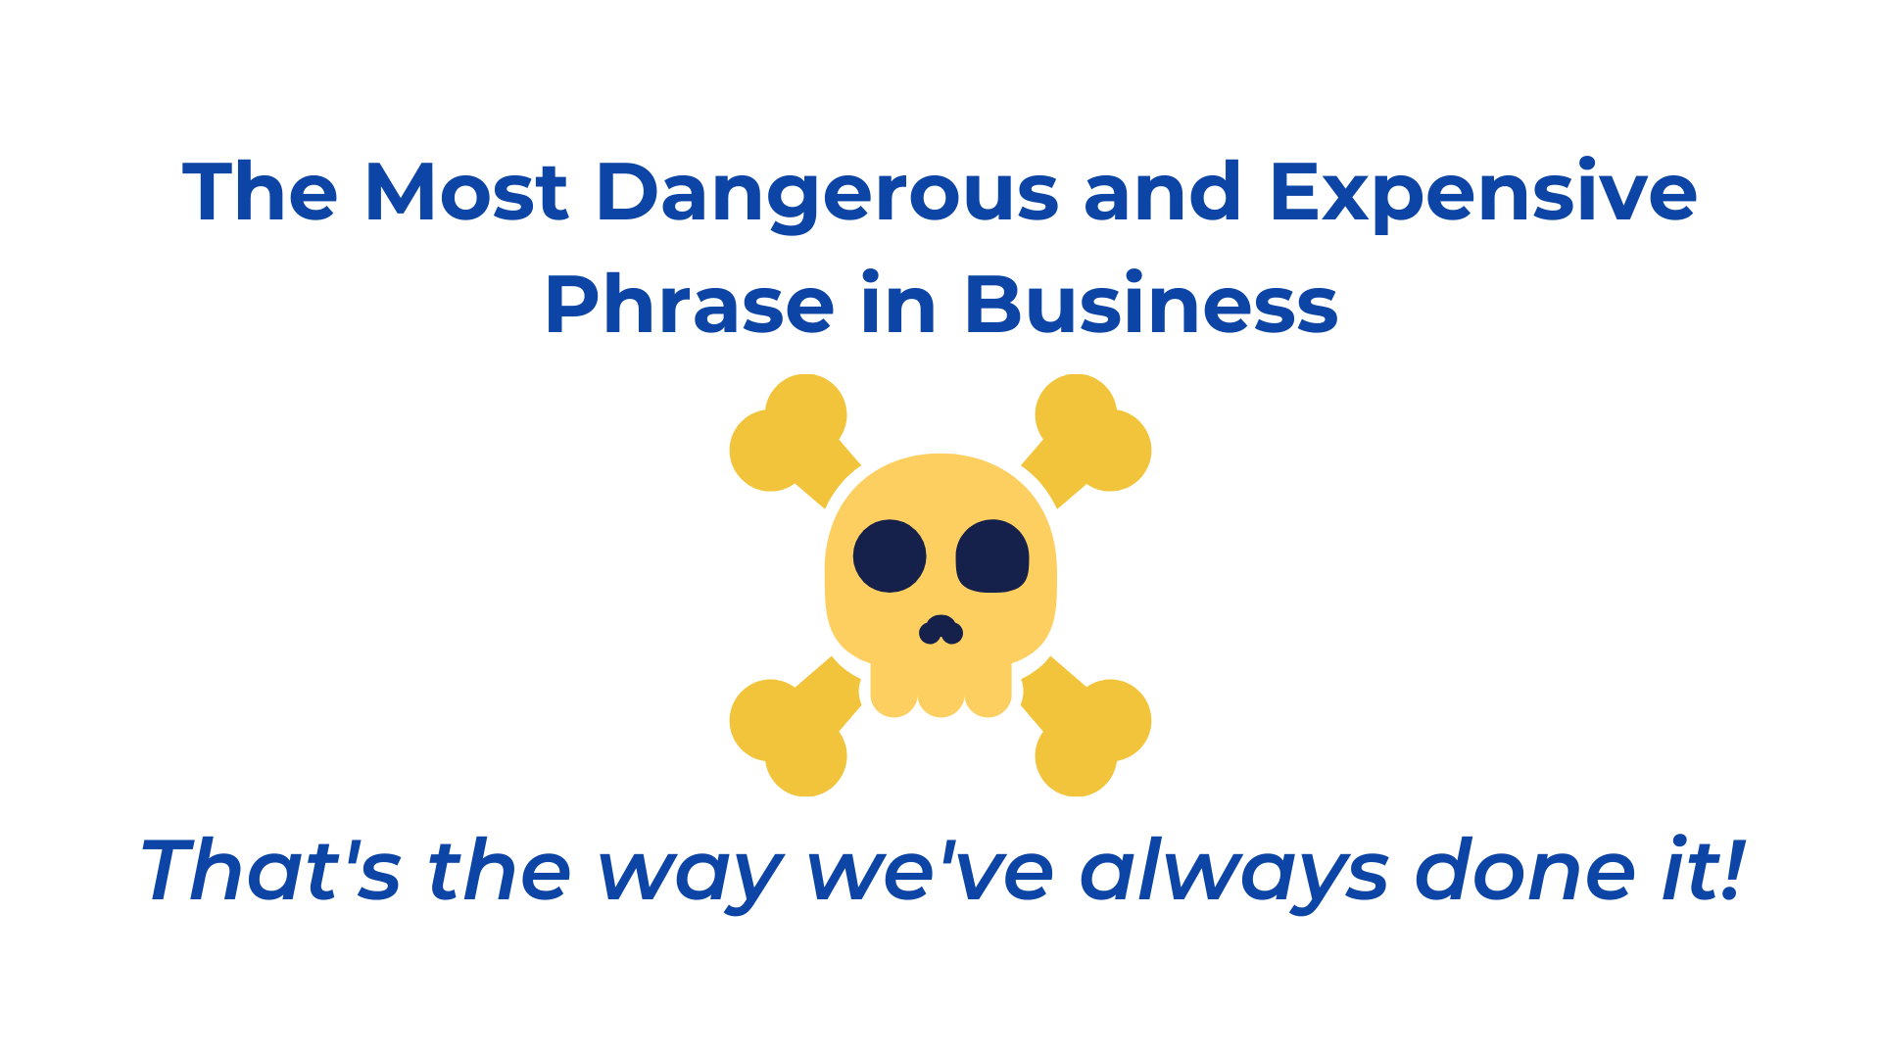
Notes:
ALAN
ASK: Why do you think we might call this dangerous? (take input) Why expensive? (take input)
Thinking like this stifles innovation (call back to what we identified as innovation in Menti)
If we’re complacent, we’re not learning or growing, workforce become incompetent and outdated.
Not being comfortable with things ‘the way they are’
Refer to Jim Collins’ work in Good to Great
Asking questions
Field leader breakfasts
Kroger/A&P

Slide 11

Notes:
LINDSAY
Transition to Subscription Based Service (AFPG)
Work from the end:
AFPG has implemented a Subscription Based Service with over 15 of their customers
Their goal was simply “provide simple, worry-free life safety compliance” and make that their value proposition – what helped them stand apart from competition
This offer is the first of its kind within our company and likely our industry.
It combats reactive thinking (putting-out-fires, current problem solving) and promotes proactive and innovative thinking
But before they could begin working towards that ideal, end-state, they had to take inventory of the current state, the way things are done NOW, which brings us to the next exercise
CLICK

Slide 12
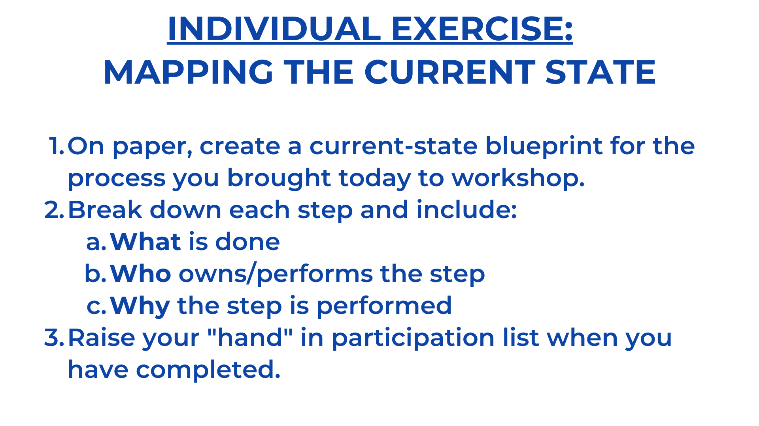
Notes:
LINDSAY
5-7 minutes, individual exercise
Everyone was asked to bring a current individual, team or department process with which they have challenges.
On paper, each participant will create a current-sate blueprint for the process they have in mind that includes
What is done/performed at this step
Who does it
Why they’re doing it
Remember to be SPECIFIC and try to delineate to 5-6 steps at most.
CLICK TO THE NEXT SLIDE TO PROVIDE EXAMPLE

Slide 13
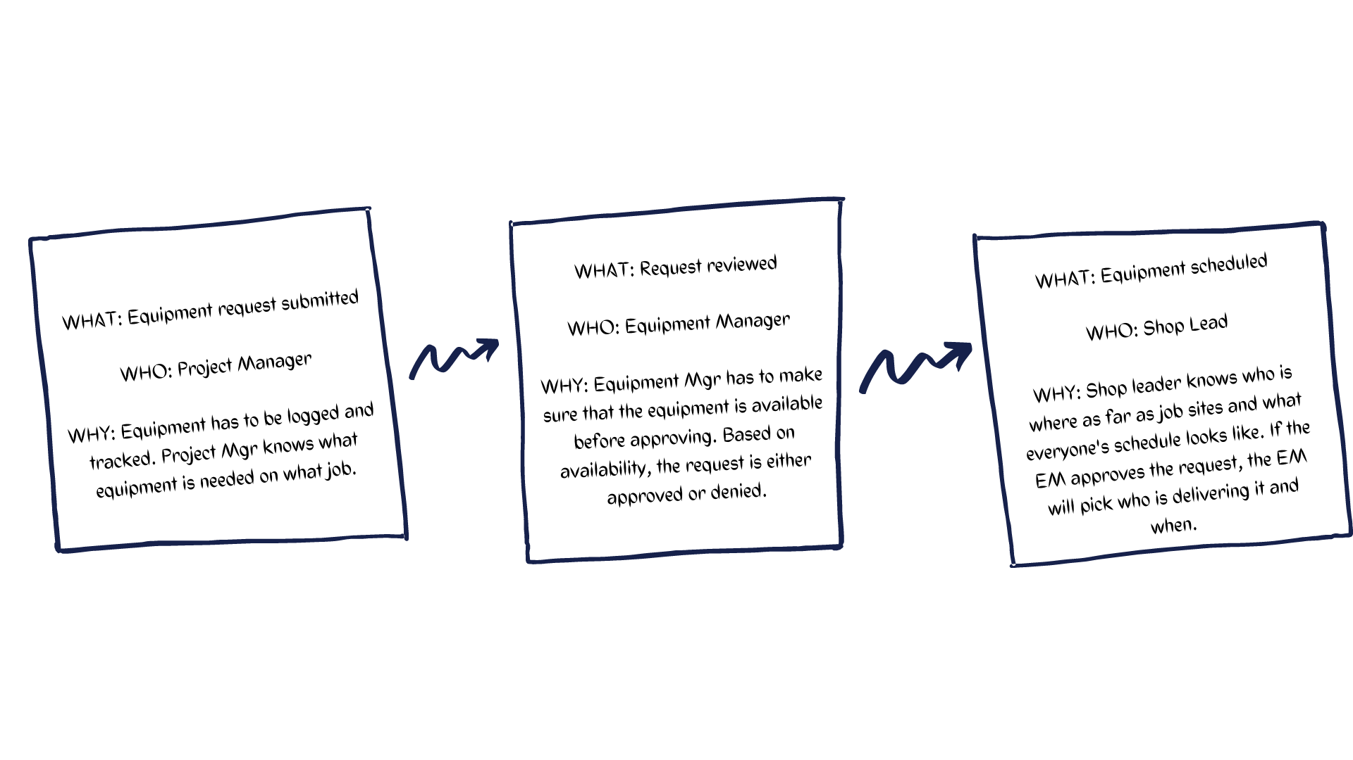
Notes:
LINDSAY
Example of what it will look like
Hands up in the Participant List when they’re done

Slide 14
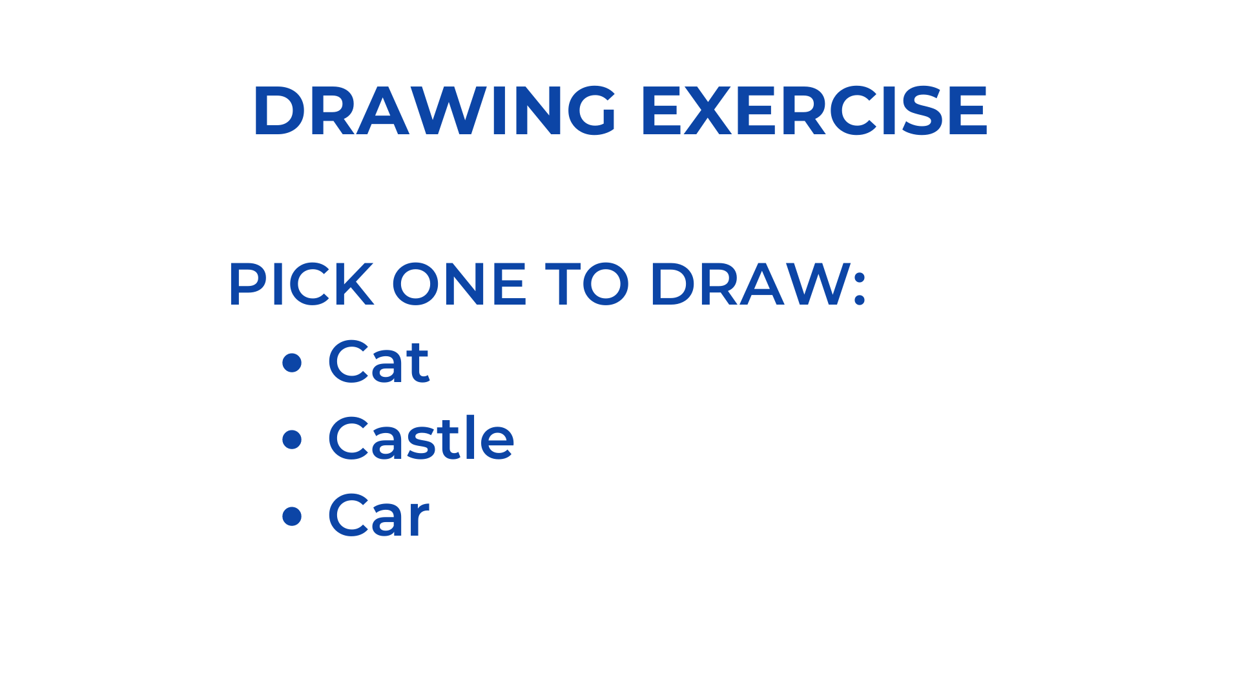
Notes:
LINDSAY
Everyone picks one of the following to draw during this next exercise – it doesn’t matter which you pick, just pick and quickly.

Slide 15
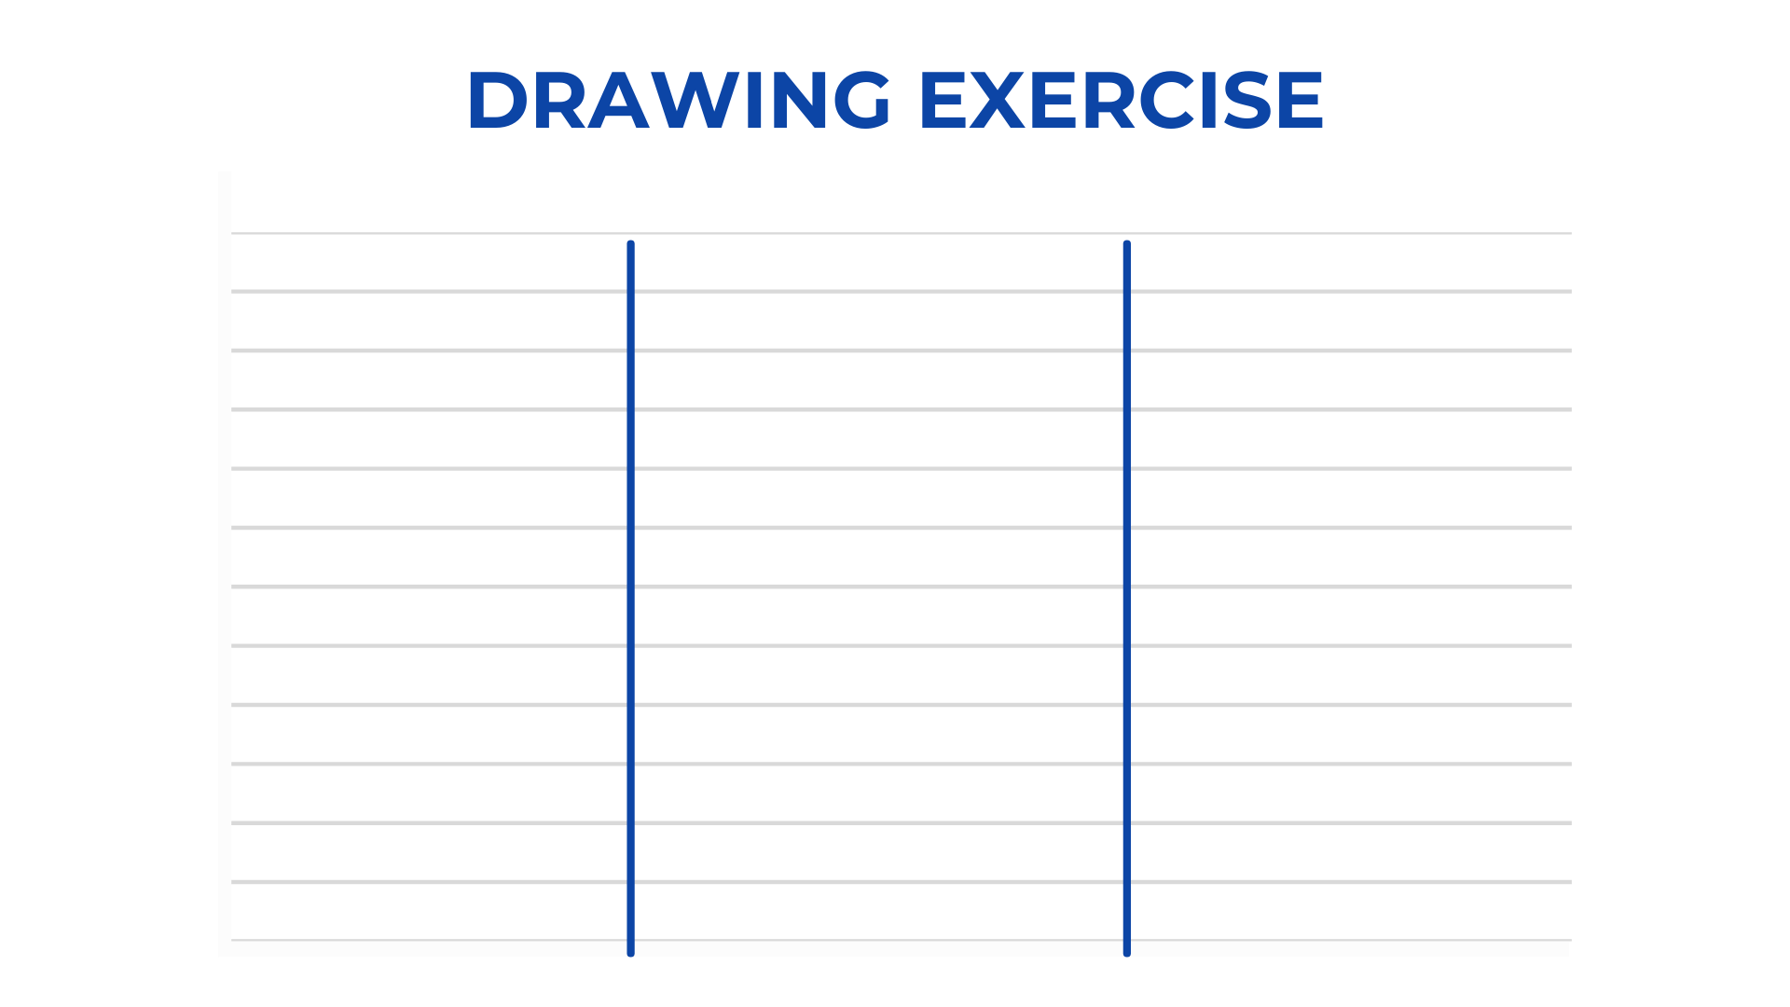
Notes:
LINDSAY
Next, on a scratch pad or piece of paper, draw 2 lines to create four quadrants. In each section, you will draw whatever you picked within a certain allotted amount of time. (don’t begin yet!)

Slide 16
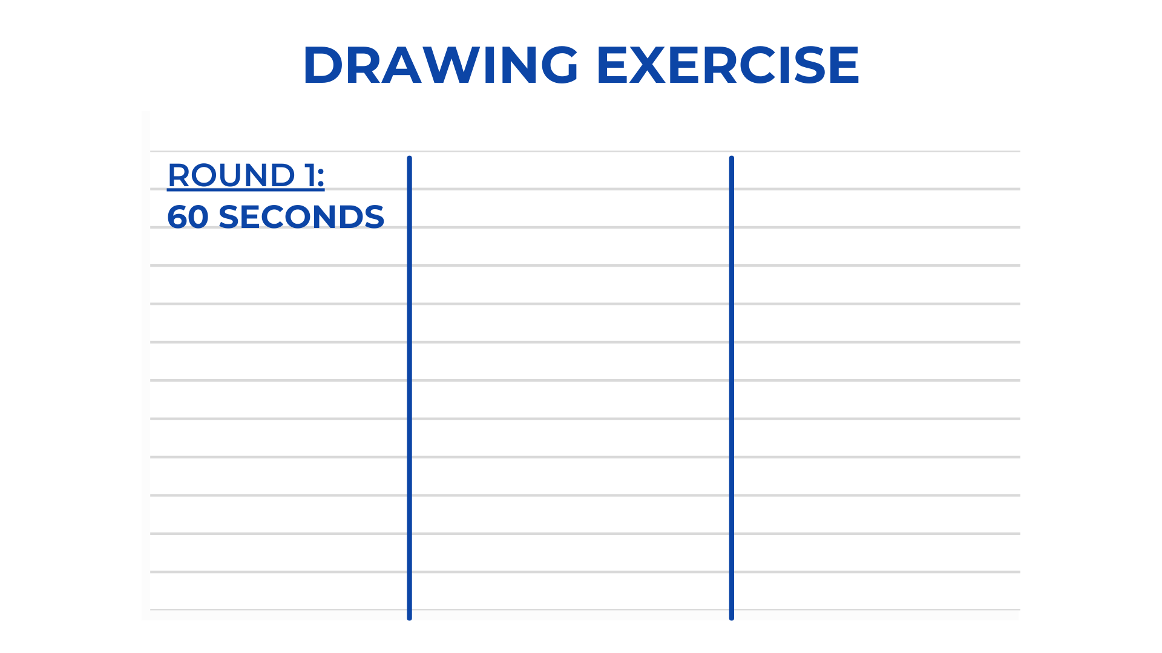
Notes:
LINDSAY
Next round is 15 seconds less – you will have 45 seconds to draw the same thing – GO!

Slide 17
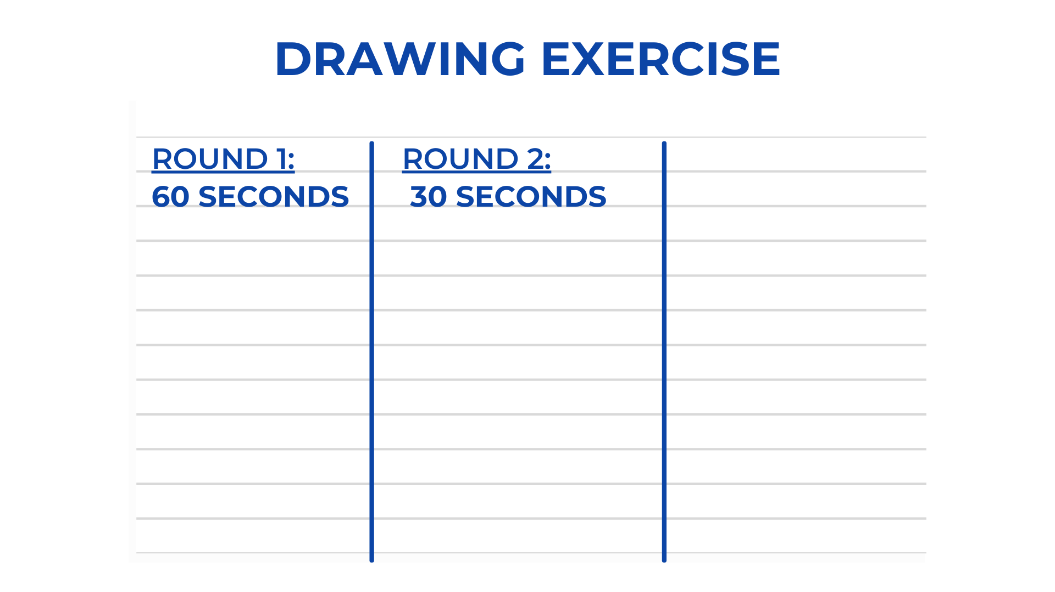
Notes:
LINDSAY
15 fewer seconds…30 seconds in this round. GO!

Slide 18
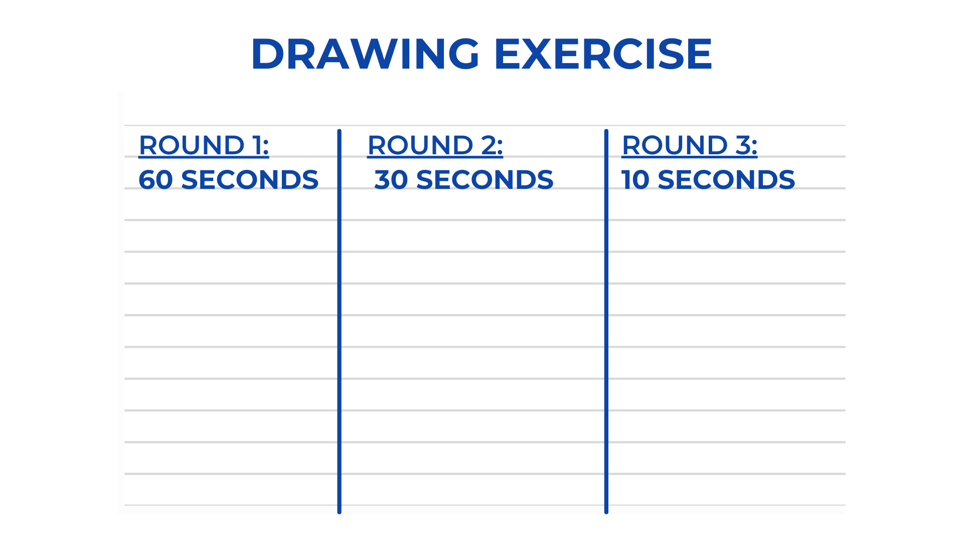
Notes:
LINDSAY
And finally, you will have TEN seconds to complete the same drawing. GO!
Have everyone hold their drawing up to the camera.

Slide 19
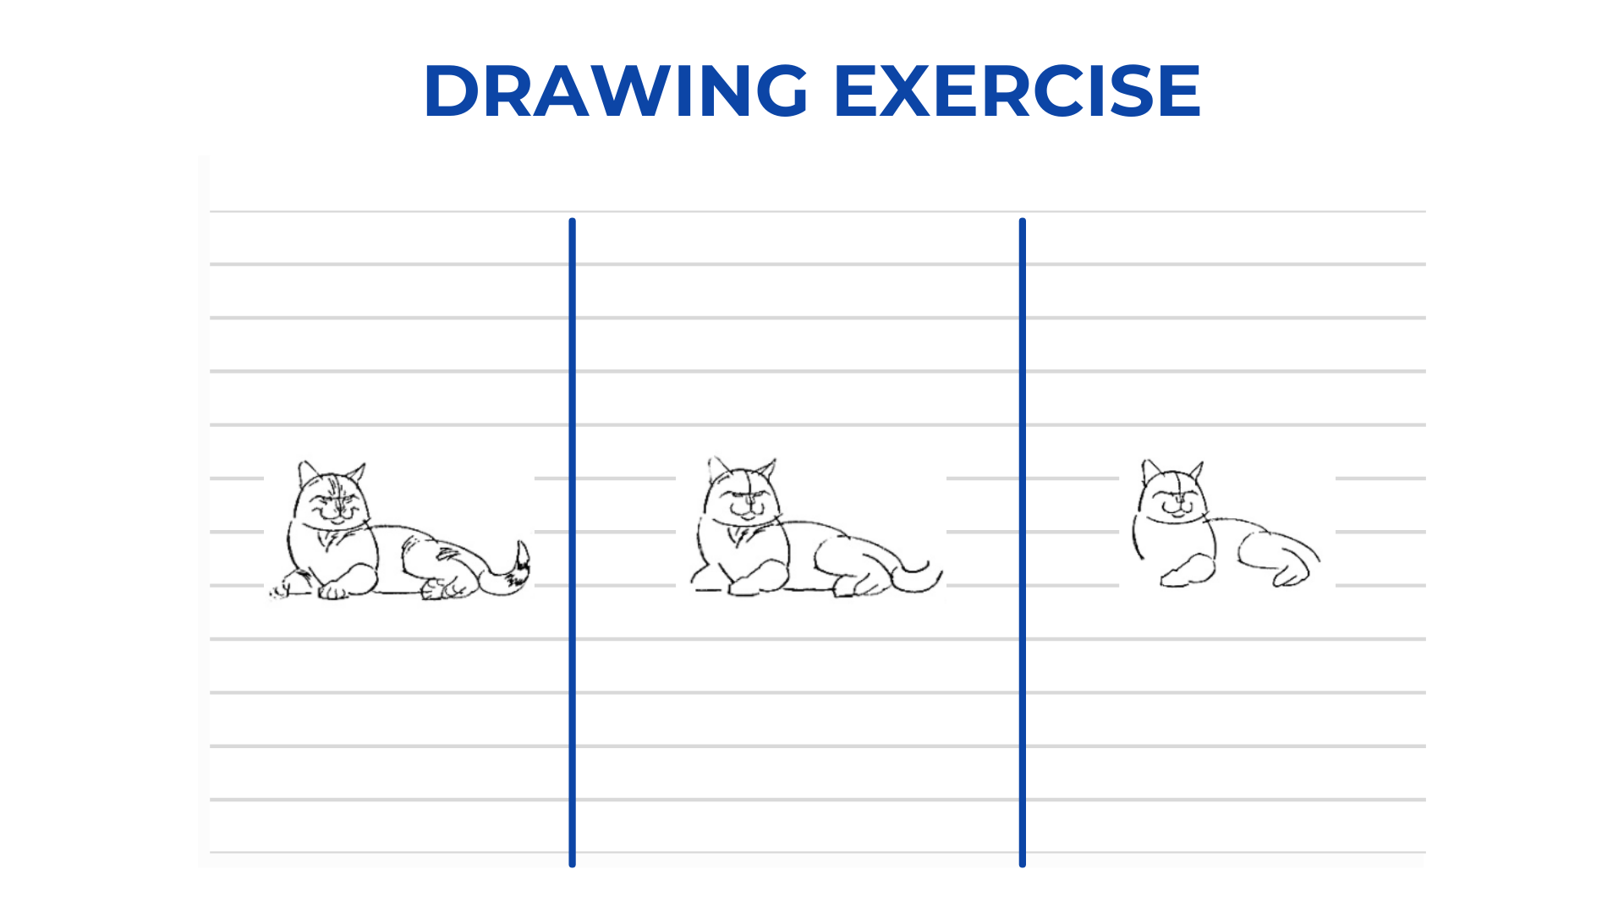
Notes:
LINDSAY
The point of this exercise is two-fold:
To illustrate that with more and more constraints, that we made up and imposed on you, you were able to find a more effective way to draw a cat, castle, or car. With less time, lines, and details, we could still tell what you were drawing.
To warm up your minds. Thinking creatively in order to consider innovation can’t be done cold, just like working out without warming up could likely not go well.
That brings us to our next exercise…

Slide 20
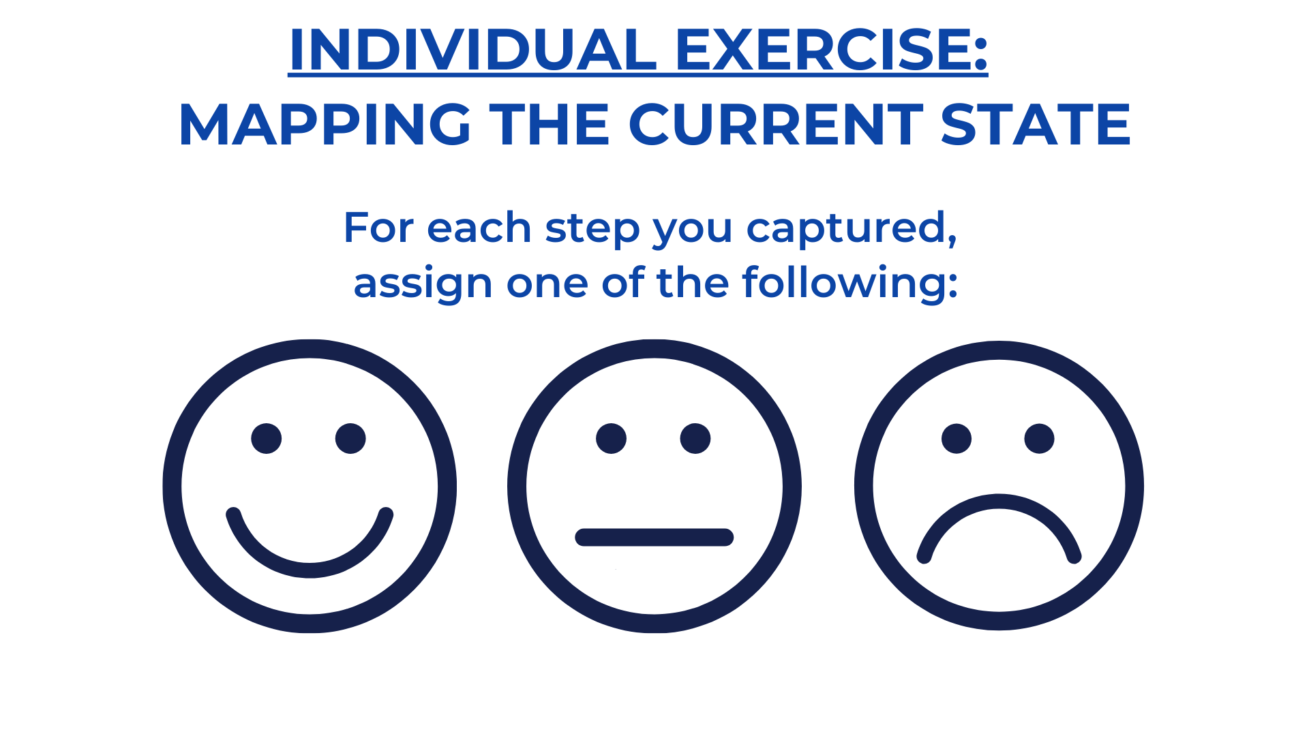
Notes:
ALAN
Add: and write WHY you’re giving it that rank

Slide 21
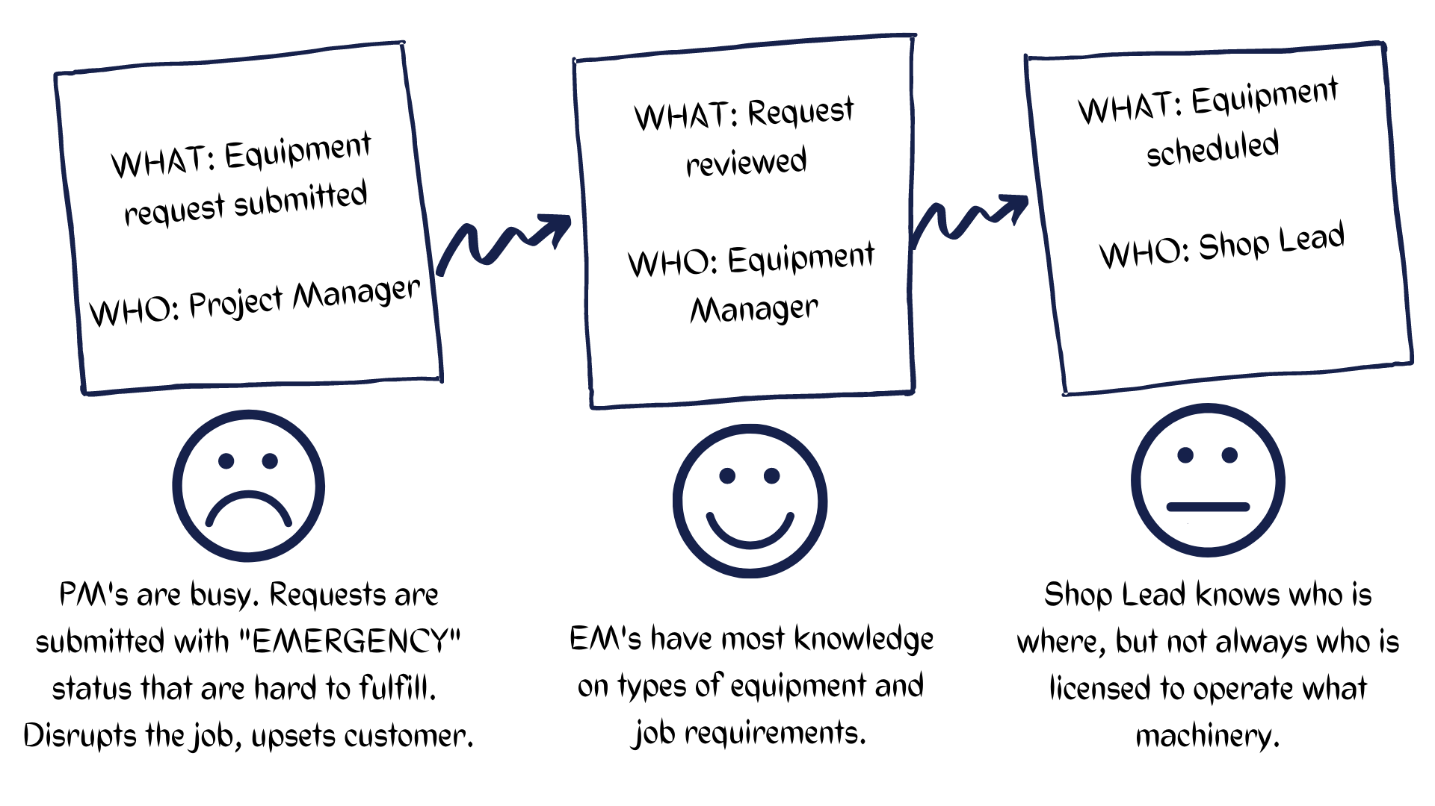
Notes:
ALAN
REMEMBER, for this exercise:
We don’t need to boil the whole ocean here.
Remember, we’re not problem solving…we’re trying to start thinking on a different plane than that.

Slide 22
Notes:
ALAN
Now we’ve talked about the current state a LOT. So clearly we need to move to what is our IDEAL state.
ASK: Do you think we’ll ever get there? Take input
Talk here about how the Ideal state is just that…ideal. A utopia where everything is done the way WE want it. Well, that’s not always achievable though it IS nice to set a BHAG so to speak. But the best way we can move towards something achievable, is to talk about the most important part of this journey…the FUTURE state (CLICK)

Slide 23
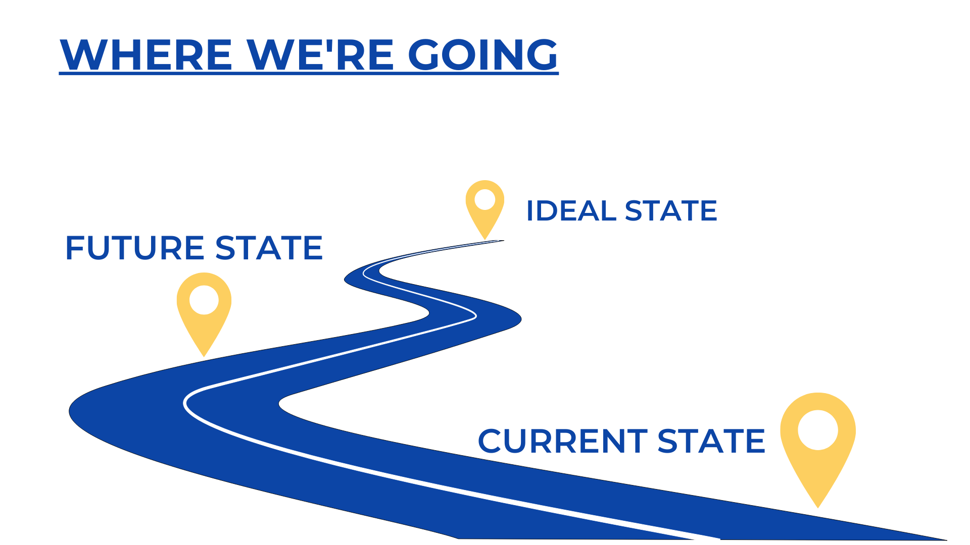
Notes:
ALAN - I’d like Alan to talk about how the ‘future state’ is never a destination.
Future state is:
How do we get there?
Monitoring if we’re there yet (this is beyond the workshop)
This is implementation; it bridges current and ideal states

Slide 24
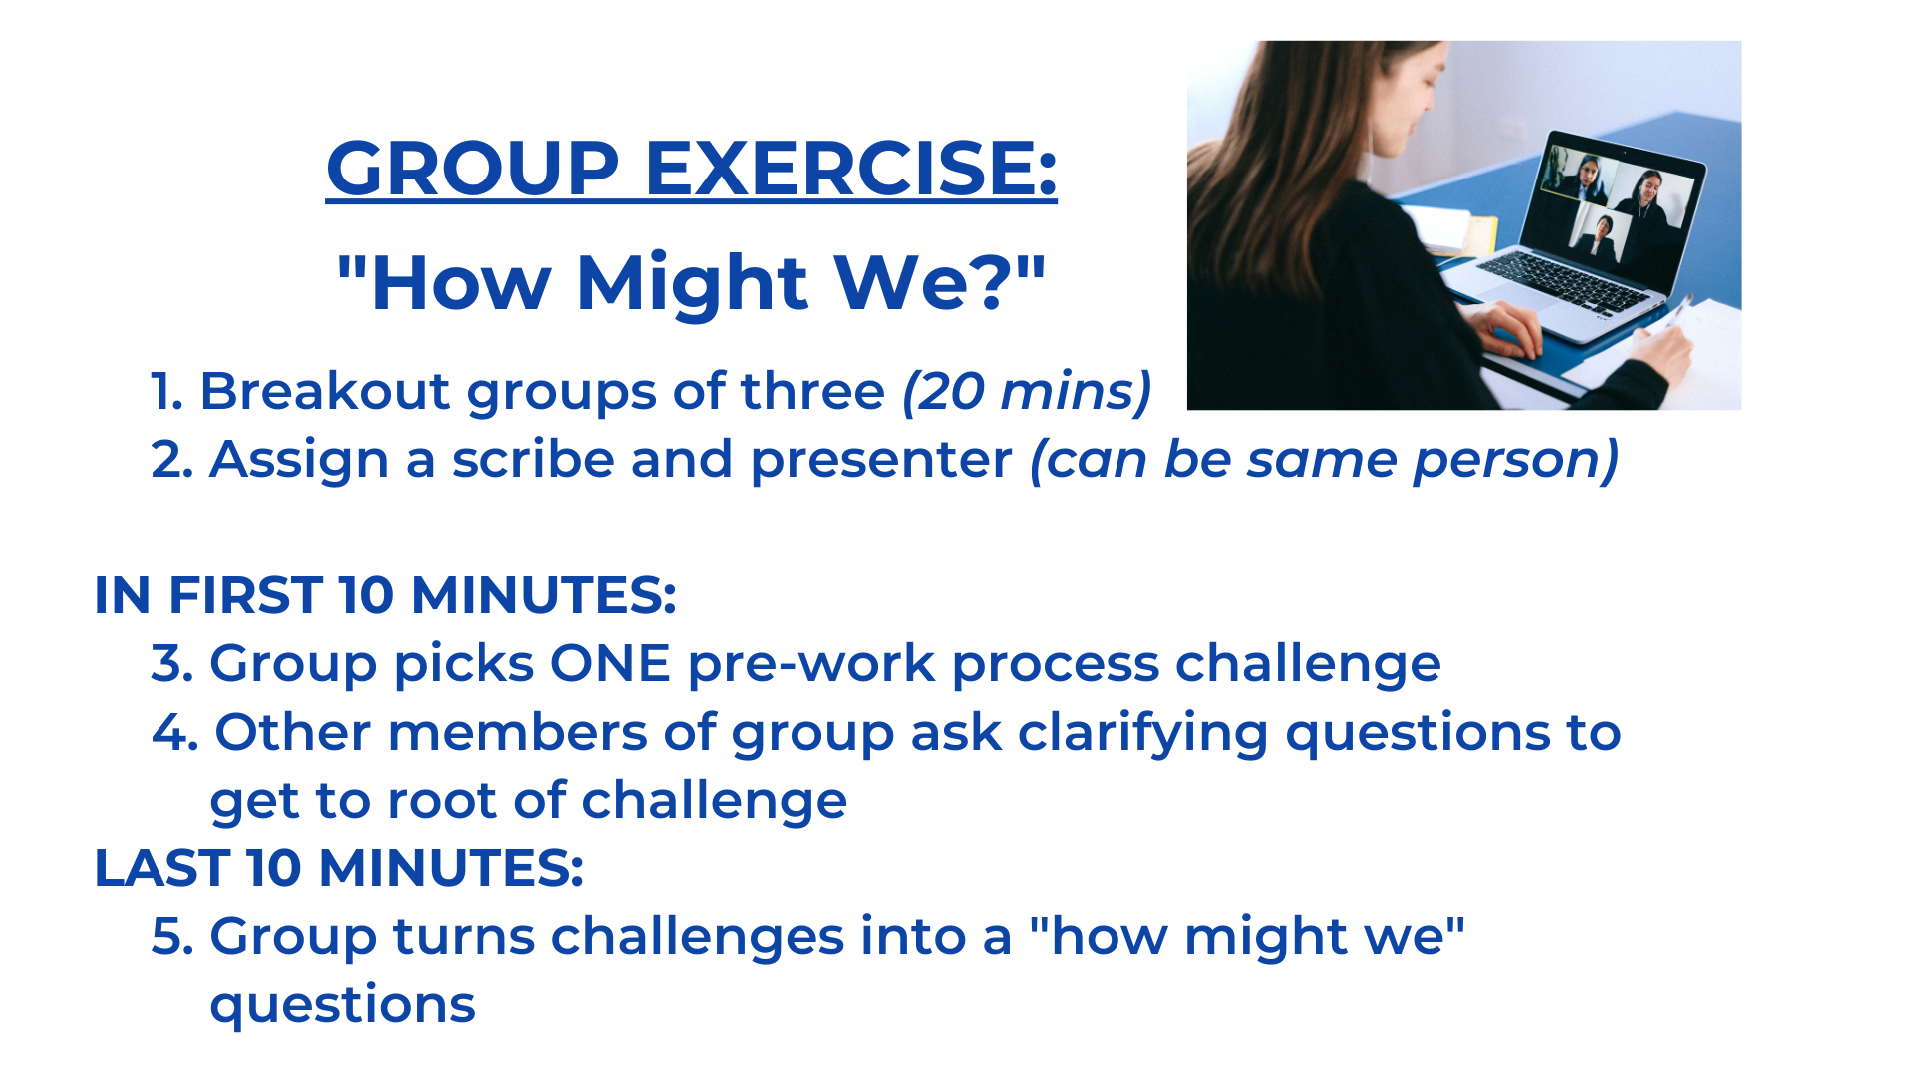
Notes:
LINDSAY
Group exercise: How Might We
This process is used in design thinking, design sprints, and in brainstorm meetings
Proctor & Gamble in the 1970s invented this process as a way to practice active listening skills when someone is sharing their wants and needs, challenges and direction
Reframing the way we look at problems as opportunities
Asking clarifying questions to get to the root of the challenge
Then writing down their challenge into a “how might we” question
Groups of 3 – 20 minutes
Each group will workshop 1 pre-work process challenge from their participants, assign a scribe and presenter
Each group will have a couple minutes to report back to the main group
Lindsay & Alan demo
Alan’s current state map looks like:
Job description written – Someone applies and is hired based on that job description – After onboarding, the role starts to look different and doesn’t match the original job description
Lindsay asks clarifying questions:
Who is writing the job descriptions? (department managers)
Who is involved in deciding roles needed within teams?
Is this an HR issue? (no)
Are these typically roles that should evolve based on growth of the company?
Could there be an opportunity to review role descriptions 30 days out from hiring? 60 days? 90+?
Create the question here:
How might we review roles in a way that encourages employee development and still supports the company needs?

Slide 25
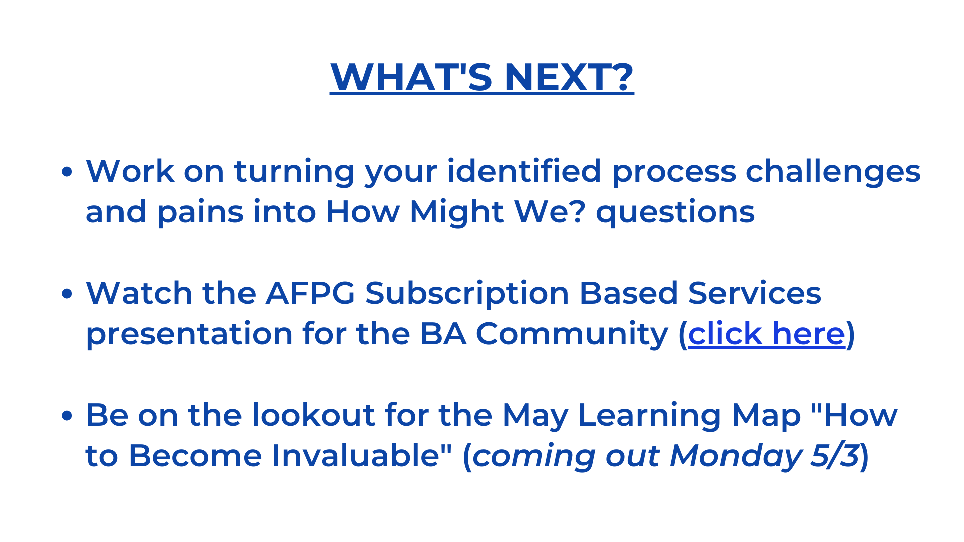
Notes:
LINDSAY

