Slide 1
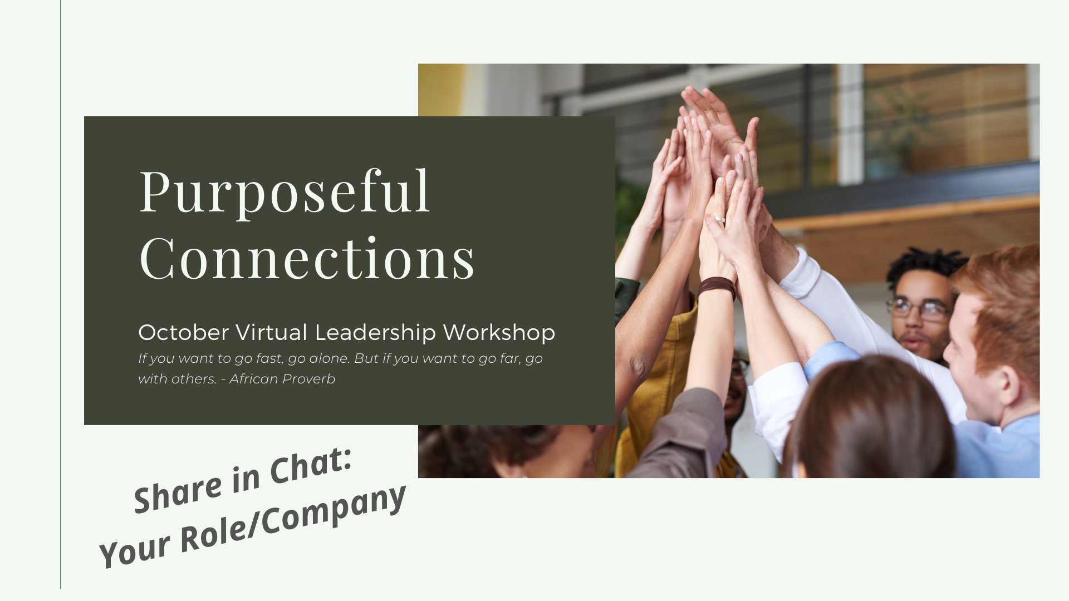
Notes:
Welcome (don’t forget to share in Chat!)
This is a safe place (we’re ALL learning) and we’re constantly adjusting the way we do these virtual workshops, so when you receive the link to a survey after our time today, please take some time to provide feedback.
Intros (me and Amanda)
Thanks for taking the map!
In one of the online learning pieces from the map, we heard about 5 simple things you can do create a better connection. One of those ways was to turn our cameras on! We’re doing lots of breakouts today, so be sure to turn your camera on so you’re present!
Tech check (chat box, participation list)
Have on hand:
Phone
Pen & Paper
Think of two people specifically in your life or work that you want to connect with. You must have had SOMEONE in mind at least when taking the online learning material. Give me a green check mark when you’ve written down your two names.
CLICK

Slide 2
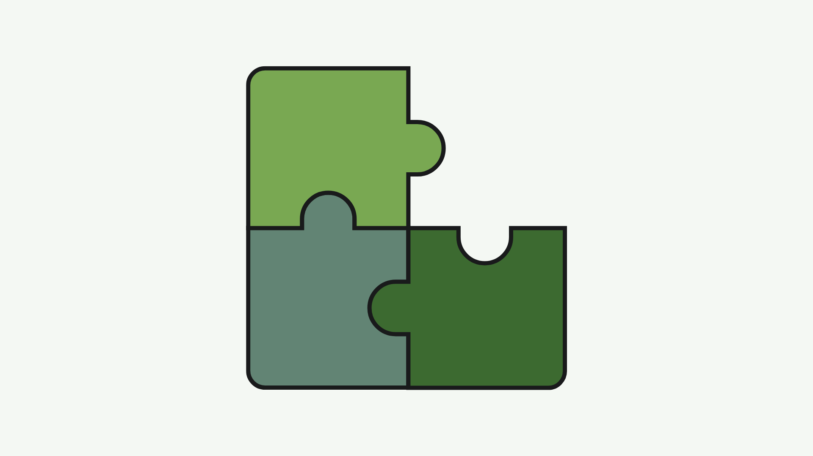

Slide 3
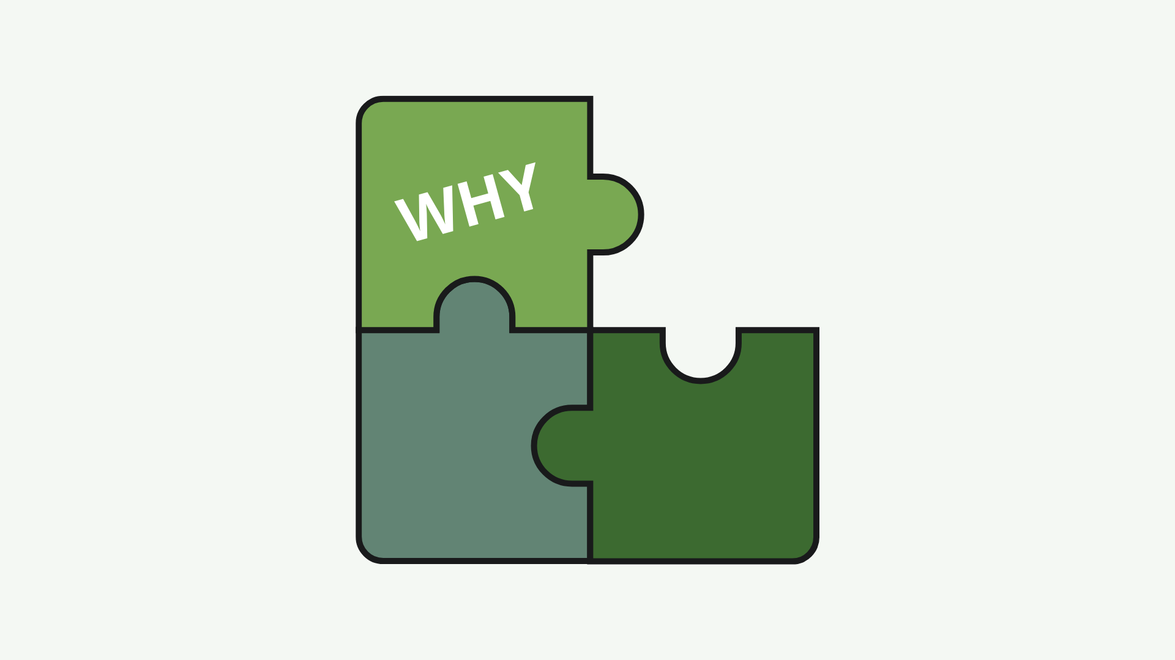
Notes:
Why it’s important, taking a look from both a business and personal perspective.

Slide 4
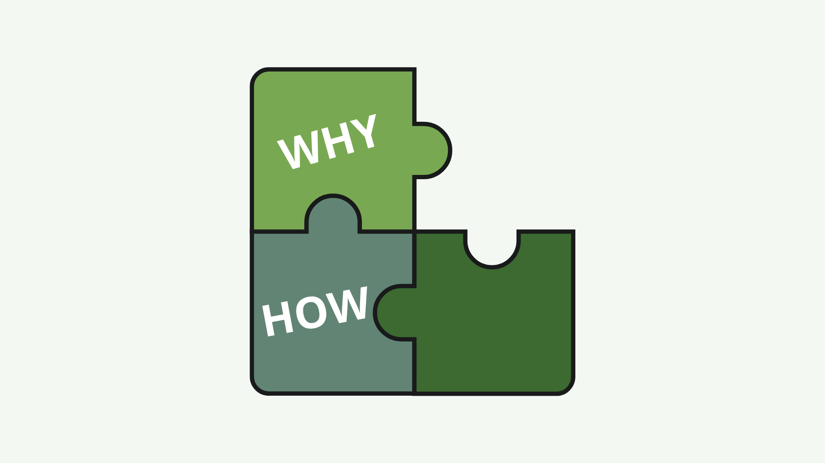
Notes:
Walk through and practice some things that came up in the online map about being more intentional and purposeful in the way you connect with others.

Slide 5
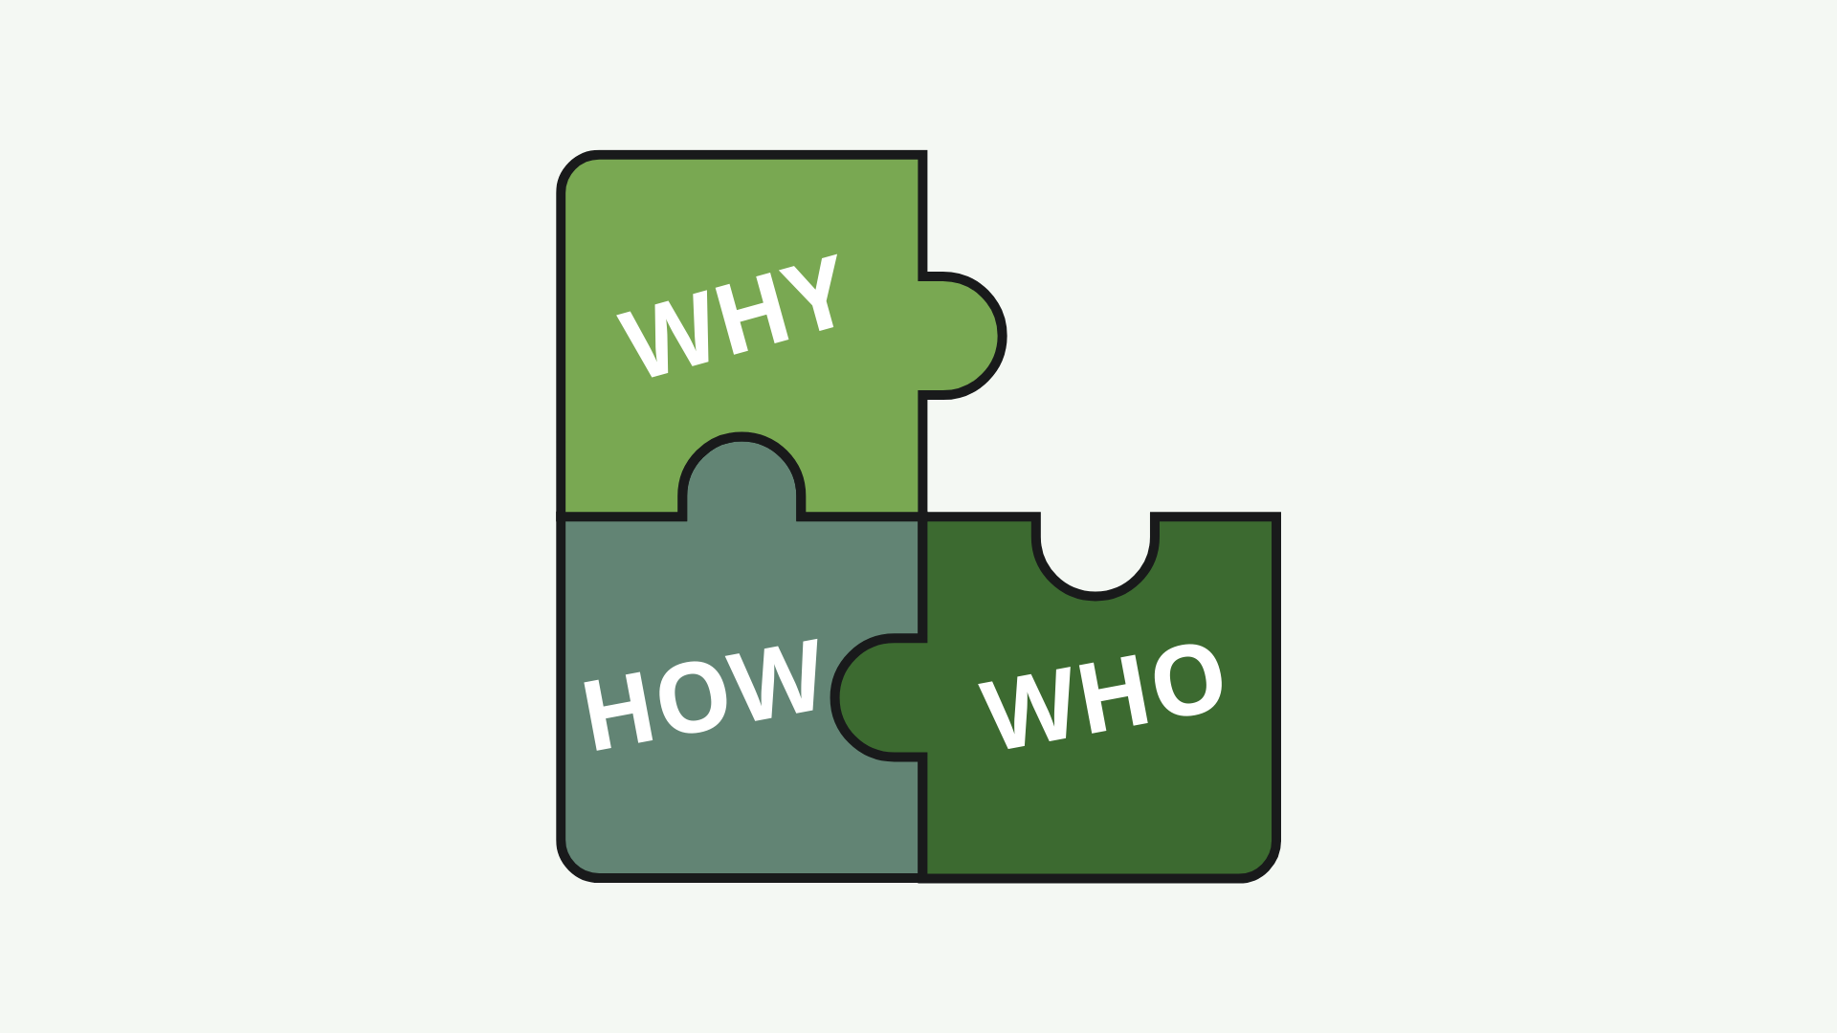
Notes:
I asked each person to have 2 people in mind when it came to making a purposeful connection.
We’ll each look at first WHO we’re wanting to connect with and bring it all together with touching back on Why and How to do that.
This will be your action planning.

Slide 6
Notes:
Why it’s so important

Slide 7
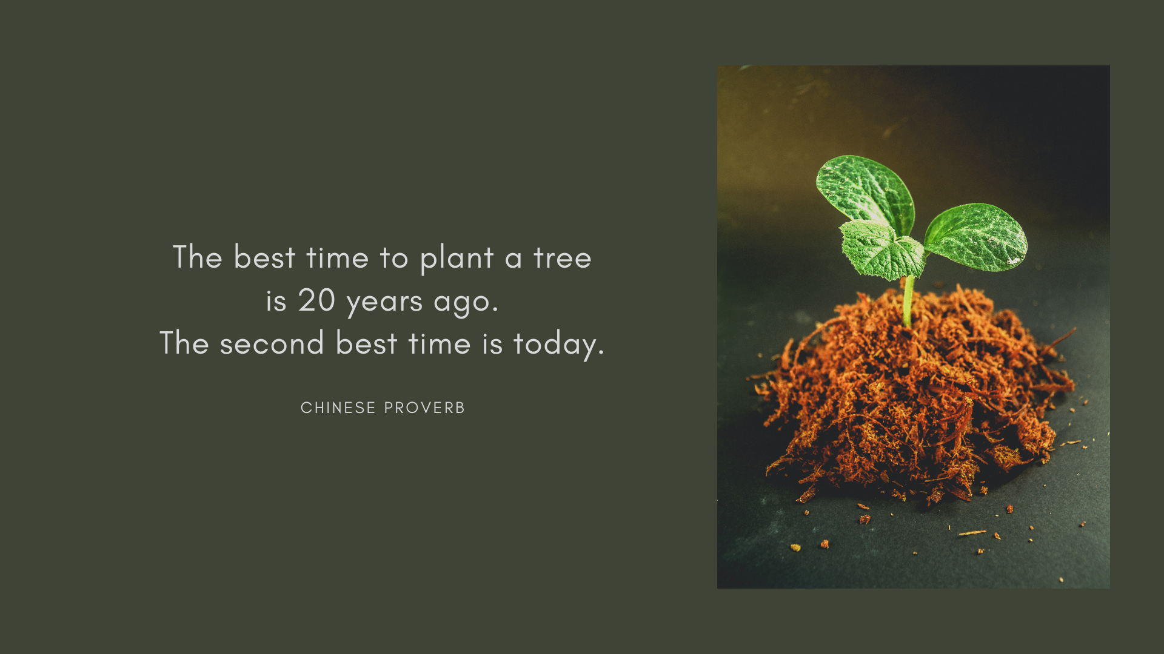
Notes:
Just taking the online learning content and attending today’s session, you’re already making a commitment to being more purposeful.
But WHY should we care, well organizations for one stand to gain from more collaborative teams through innovation and productivity, but why should you care?
CLICK

Slide 8
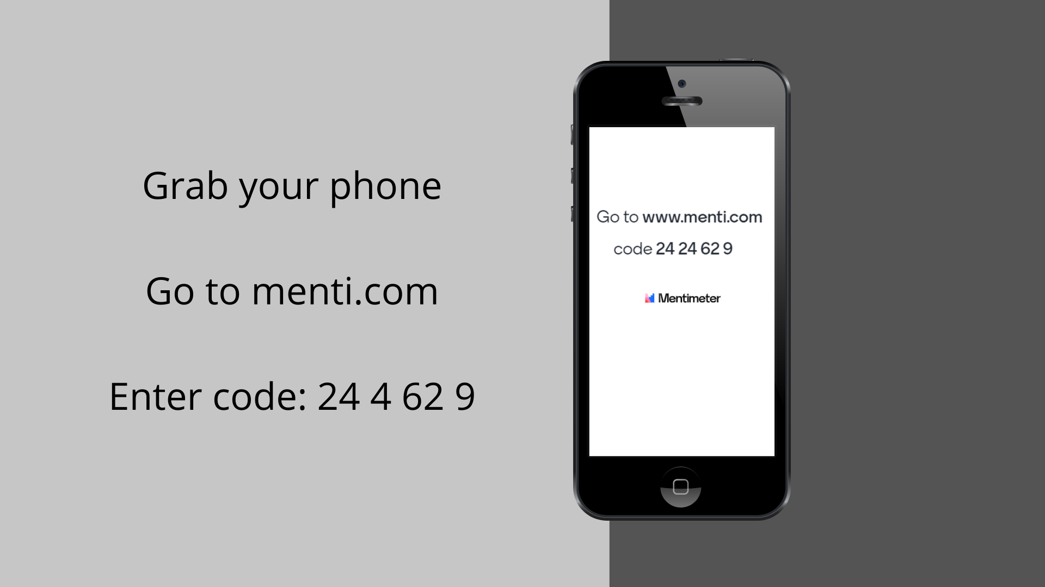
Notes:
Go to Menti
HIT ENTER FOR ANSWERS
I want to hear from you now…if you were to compel a new employee within your organization that building strong relationships was imperative to their growth and development, how would you do that?
Come off mute
CLICK

Slide 9
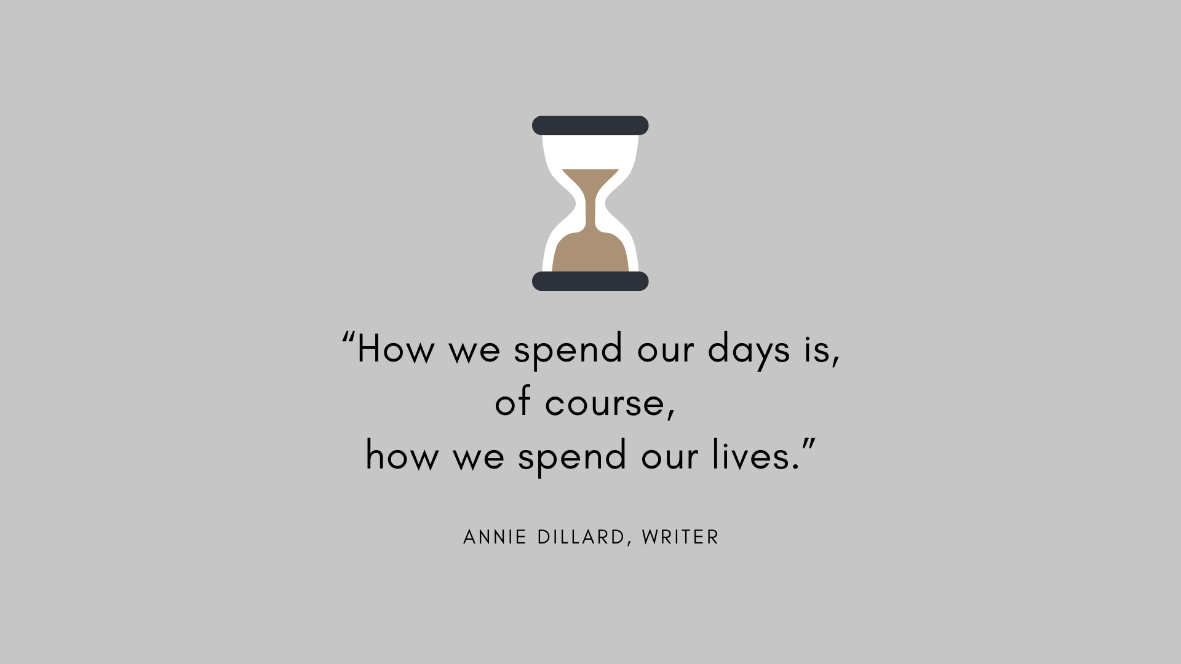
Notes:
After Menti:
I don’t know about the rest of you, but when I look at that data, it gives me a little bit of anxiety. Like I’m not leveraging my time or relationships enough. It can maybe even have the opposite effect…”time’s wasting, you’ll never get it or have it all.” But that’s a Fixed Mindset. What we want to do is think with a Growth Mindset.
ASK: Give a green check mark if you attended the virtual leadership workshop last month OR you read Mindset by Carol Dweck with the Book Club a couple months ago. Wait for responses. Pick someone to share what they remember was the difference between a FIXED and GROWTH mindset.
What I’m looking for:
Fixed – I can’t and never will. Growth – I can do it, it takes time and perseverance.
Now imagine what we could do if we were connecting with others who were of the same mindset…that we can all ‘get better, do more, get farther’. Combine that with our definition of leadership here at APi Group, and we have our WHY.
CLICK

Slide 10
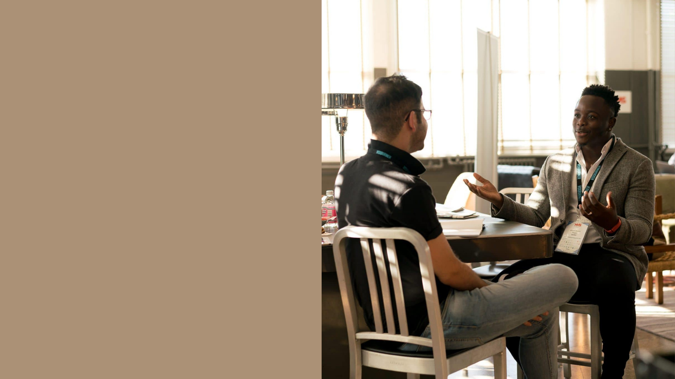
Leaders who demonstrated building positive relationships earned an 80th percentile trust score.
People at high-trust companies experience 74% less stress.
Opportunities > Dread
Influencing and connecting at home
Notes:
It might be helpful to look at some of the great things that can come out of spending time creating stronger relationships.
CLICK
Research done by the Accenture reported that that those who demonstrated building and maintaining positive relationships were ranked the highest in trust among their companies. And by APi Group’s definition, we are ALL leaders, regardless of role, that’s important to remember.
CLICK
Accenture then found that those at companies with a high-trust culture experience less stress, less burnout, more satisfaction, more engagement and more energy at work.
CLICK
By building relationships in and out of work, we’re far less likely to spend time on the management negative relationships demand and are instead free to open up to opportunities and possibilities.
CLICK
And finally, bringing your work home with you takes on a new meaning and is much more valuable and impactful when you actively work on connecting with others. If the average American family is spending 30-40 minutes of quality time a day together, aim to change the curve by making more meaningful connections at home as you do at work.
CLICK

Slide 11
Notes:
Now that we’ve solidified WHY building strong relationships is important, we’re going to look at HOW we can do this by partnering up.
CLICK

Slide 12
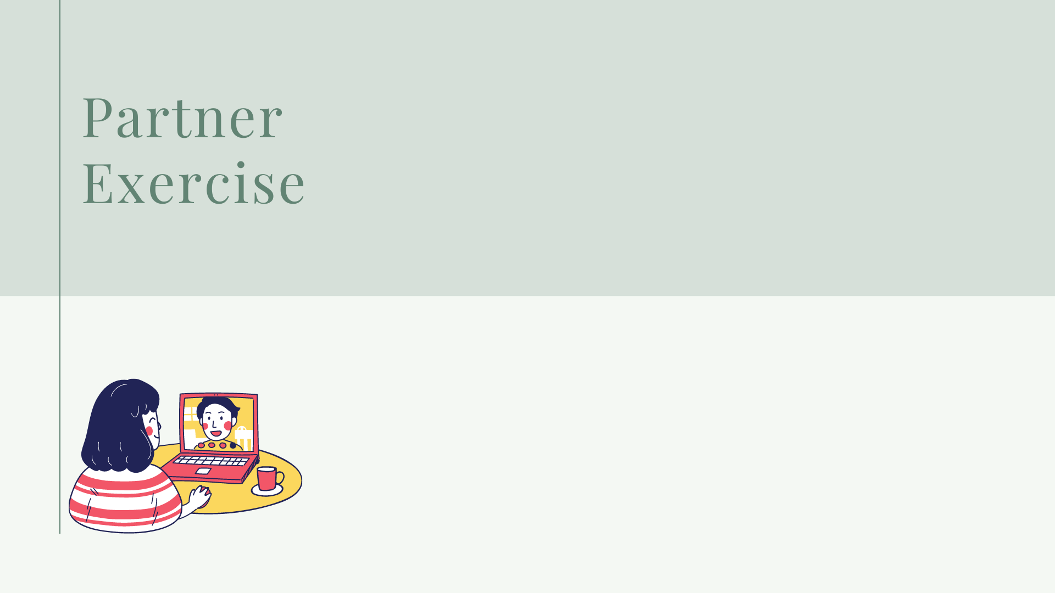
Notes:
You will each go through a series of conversations with one partner. Amanda has already planned the breakout rooms and in a moment we’ll open those rooms and you’ll see “join breakout room”. You’ll click that button and join your partner.
The first conversation CLICK

Slide 13
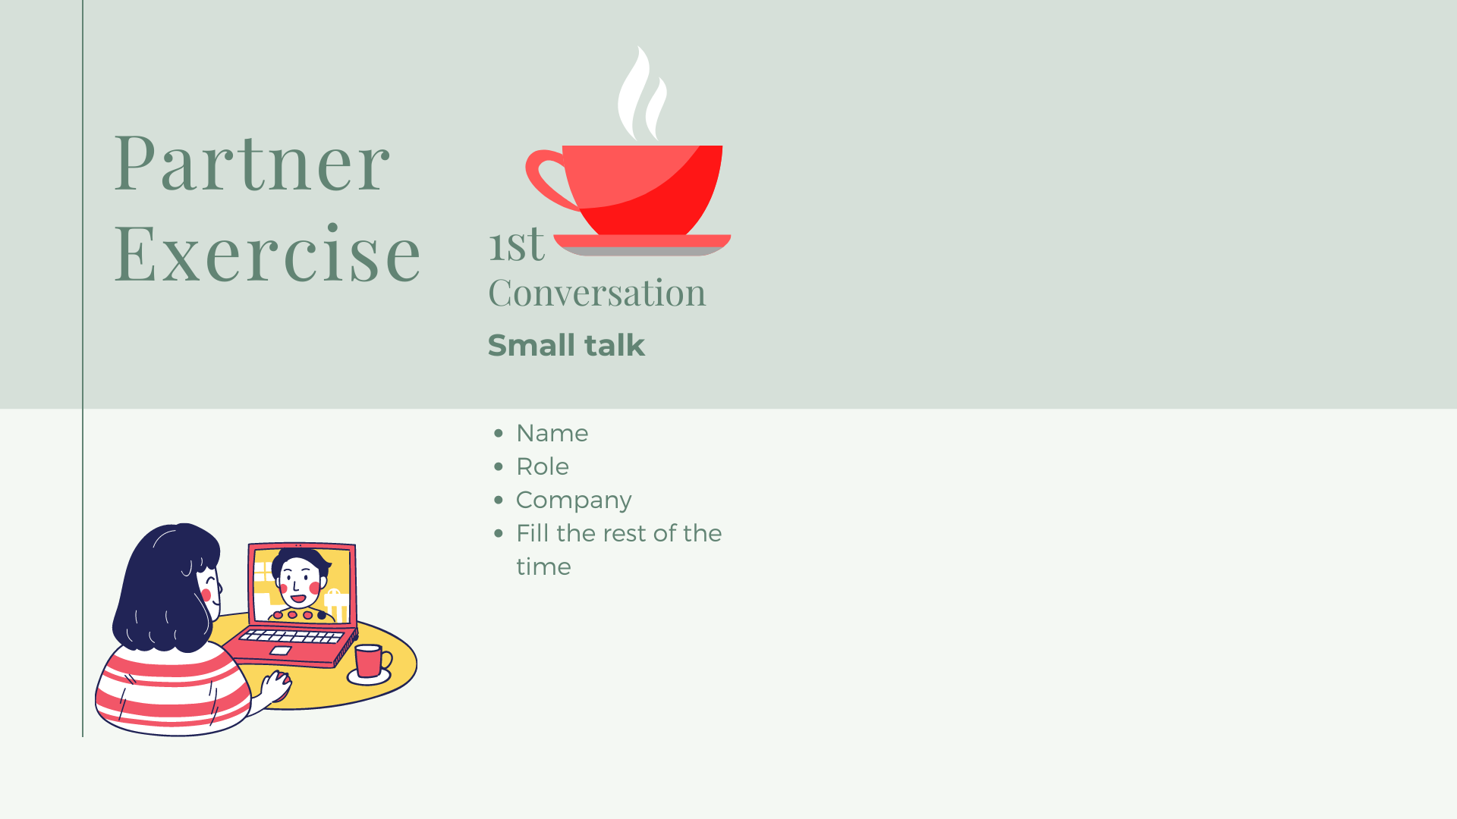
Notes:
We’ll stick to small talk.
4 minutes in breakout rooms
When we return:
ASK: Green checkmark if you connected well enough that you would show this person your IDP based on the conversation you just had. Take responses.
Essentially, based on small talk alone, we don’t build trust or connection.
Which brings us to our next conversation CLICK

Slide 14
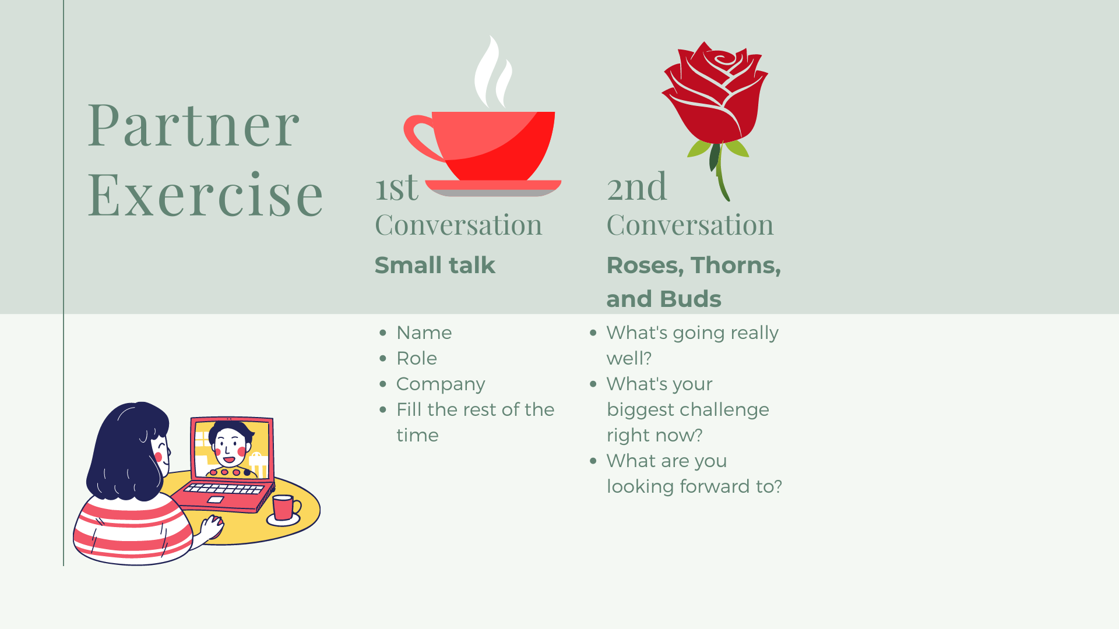
Notes:
This second conversation, we’ll go a little deeper in content and double our time together.
This exercise was introduced to me by the leader of our department here in Talent Development, Paul Grunau. Roses, Thorns, and Buds.
This is a great exercise to do with your families too during a shared meal or time.
Each of you take turns sharing your ROSE (something that’s going really well right now), your THORN (what you consider to be your largest challenge at the moment) and a BUD (something you’re looking forward to or are excited about).
Partners can decide whether to take turns going through the entire list each or both sharing first your Rose, then Thorn, then Buds. I leave that to you.
Any questions?
8 minutes in breakout rooms
When we’re back
I’d like to hear from a couple people, either from the same team or different teams, how was that? What did you learn?
Wait
Now before we step into our third conversations, we’re going to take a pause CLICK

Slide 15
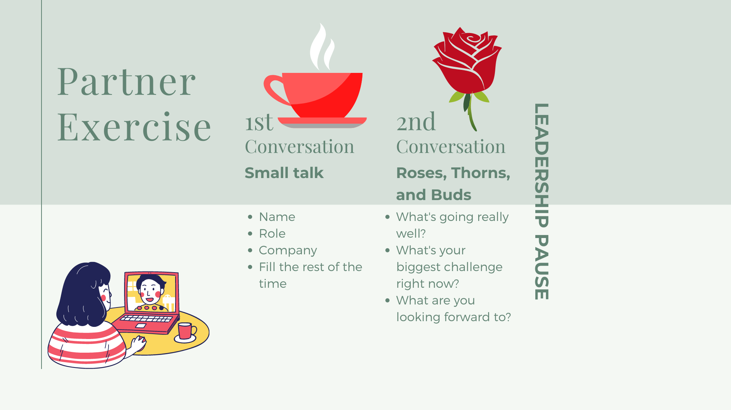
Notes:
A LEADERSHIP pause, specifically.
Now, in this last conversation, we were timed and told only to share and listen.
So as we move into the third conversation where we can actually respond, it’s important to understand and practice something.
If someone comes to me with a problem, it’s almost my gut reaction to start solutioning. The same happens in any kind of interchange, we can find ourselves getting ready to respond rather than really listening.
The Leadership Pause is a practice in taking a step back to lean forward, as coined by Kevin Cashman in his book The Pause Principle.
Essentially, to pause more deeply and not merely act immediately gives us time to evolve in our personal leadership as well as leading others and fostering cultures of innovation.
Before we take our pause, I want you to know what your third conversation will consist of…
CLICK

Slide 16
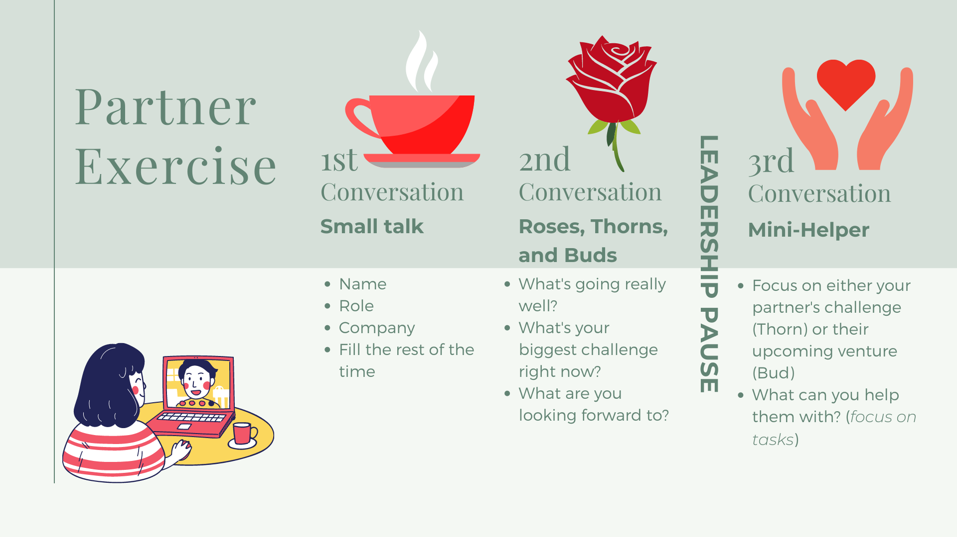
Notes:
For the final conversation with our partner, we’ll practice something we learned in the podcast episode from the learning map on being a mini-helper. The idea is that everyone has something that can help us, but we should first look to see how we can help THEM.
In just a second, I’m going to give you a couple minutes to practice the Leadership Pause, and I’d like you to focus on either your partner’s Thorn or Bud.
Think of a way that you can help them. Focus on tasks if possible.
This is a great way to not only make a deeper connection with that person, but instill Trust, which is incredibly valuable in leadership as we learned earlier when we were discussing WHY building strong connections is so important to us as humans.
We will hear more about that in this next clip from thought leader and coach, Simon Sinek.
CLICK

Slide 17
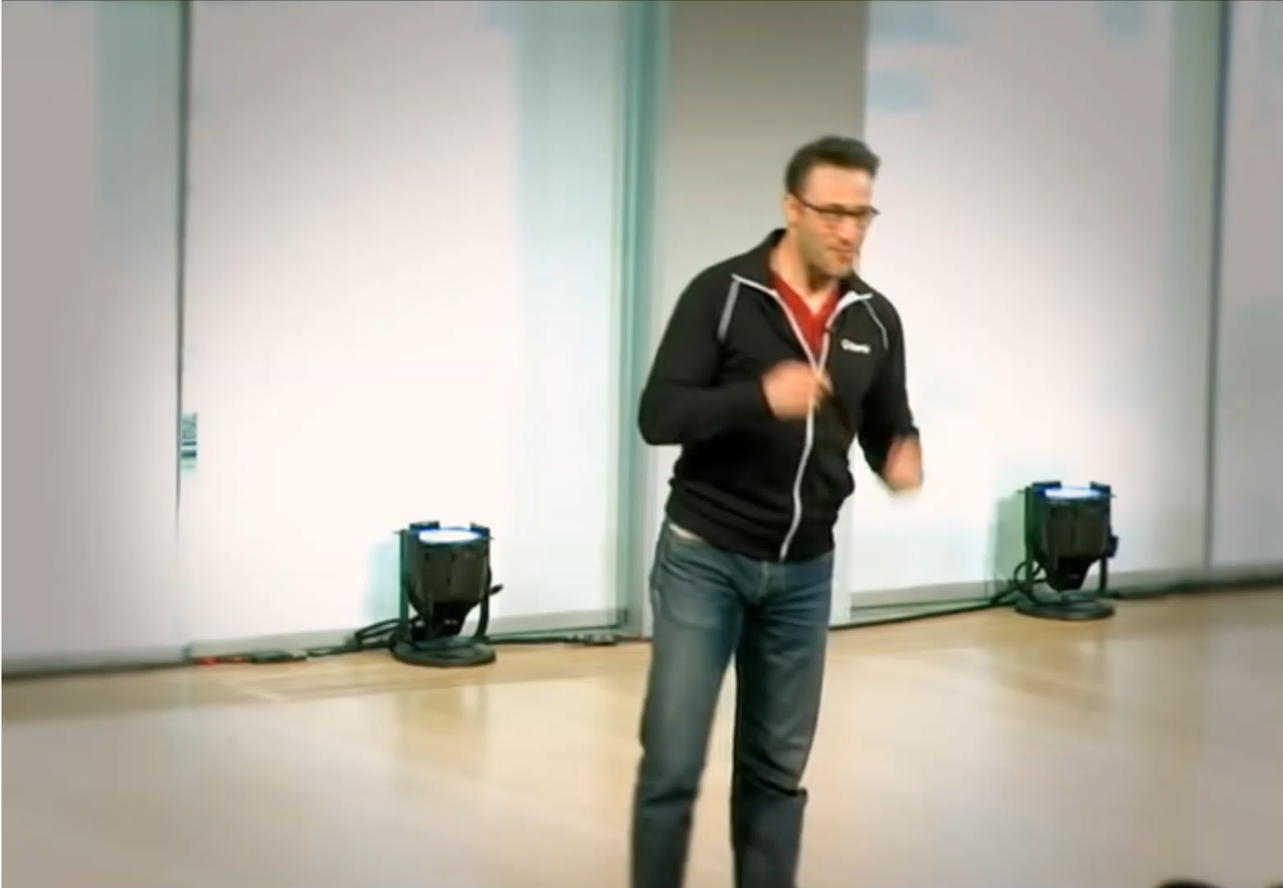
LEADERSHIP PAUSE
Simon Sinek
Notes:
CLICK when done

Slide 18
Notes:
OK, I’ll give a couple moments to everyone, and ask you to, with the comments Simon Sinek just made in the back of your mind, jot a couple notes down based on your last conversation with your partner.
Remember, they shared something they were challenged with and something they were looking forward to. Neither have come to pass, so focus on things you can help them with and try your hardest to focus on tasks.
Give a green check when you’re ready.
10 minutes in breakout rooms
When we return…
ASK: Who is willing to share how you’re stepping into the mini-helper role?
Take some input

Slide 19

ABUNDANCY
SCARCITY
“Make your scarcity mindset scarce.”
Notes:
The difference between the land on the left and the land on the right is stark. On the left, life, greenery, possibility. On the right, desolation, death.
It can feel like the way we approach situations and people aren’t nearly as dramatic, but have you ever felt fear from hearing of another’s success? Or questioned why someone else took interest in you at all? Sometimes our brains aren’t as far of as this. These mentalities are known as CLICK the Abundancy mindset and CLICK the Scarcity mindset.
What we just practiced in our Leadership Pause and our third conversation was the Abundancy mindset.
To feel and think abundant is to believe there’s enough for us all.
There’s always enough and more for each of us, and we can help one another reach our goals.
On the other hand, a scarcity mindset becomes protective, self preserving, distrusting. That can impact others as well to feel the same when interacting with you.
Conflict can arise with imbalance (you have an abundance mindset, the other person has a scarcity mindset) OR when both parties have scarcity mindsets (the same is true for personal and romantic relationships)
So that is important to keep in mind as we move into the next step of our time together today.
CLICK

Slide 20
Notes:
Let’s move into the last portion of today’s session, looking at WHO we can start creating stronger connections with.
CLICK

Slide 21
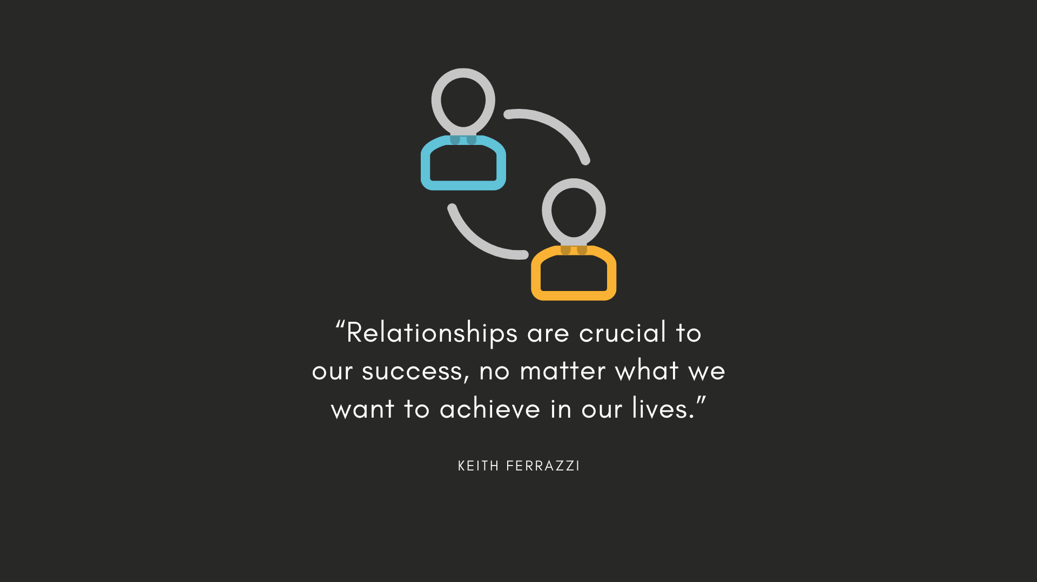
Notes:
I asked you at the beginning of our time together to think of two people in particular that you want to create a stronger relationship with…two people who you know the connection can be improved or created, if you think nothing exists at all.
Go ahead and take out a piece of paper and a pen, write down those two names. Don’t worry, you won’t be sharing them. When you’ve got your two names, give me a green checkmark.
CLICK

Slide 22
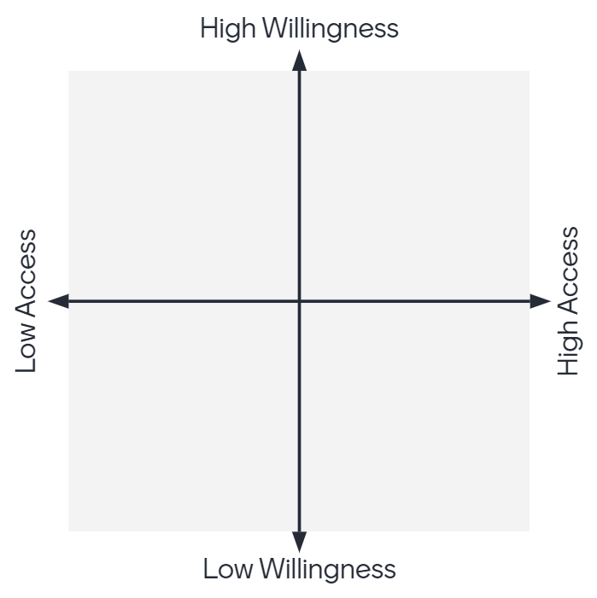
LT
PM
Notes:
This is the Connection Potential Matrix. I am proud to say I took two matrices and squeezed them together until something made sense.
The vertical line represents the ‘other person’ – THEIR willingness. Their willingness to connect to and with you.
ASK: What do you think willingness to connect sound like?
Happy to make time
Shows enthusiasm
The horizontal line represents them a little differently. How much access YOU have to THEM.
ASK: What do you think accessibility looks like?
Location
Roles
Schedule
Now let’s return to you scrap piece of paper. Below the names you’ve written, draw this box, with the vertical and horizontal lines. No need to write down the willingness/access, you can just my copy here on the screen for that.
Think of your first person. Think about what we just discussed about what it sounds like when someone is willing to be open and connect with you. Is this first person in the high willingness or low willingness portion of the vertical line? Go ahead and hover your pen or pencil over wherever you believe your first person lies as far as their willingness to connect with you.
Now, consider their accessibility. Could you call them right now and expect the phone to pickup? Do they accept direct messages from you? Will an email go unanswered for a week? Move your pen or pencil along the horizontal line to where you believe this first person belongs as far as accessibility.
When you’ve decided where they belong in your matrix as far as willingness to connect and accessibility, write down their initials wherever your pen ends up. CLICK it will look something like this.
Now that you know how it’s done, go ahead and place your second person. Remember, go with your gut. It helps to not think about it too long.
Once you place their initials you’ll have a matrix that looks slightly like this, CLICK, though the initials of your people and their location will be different.
Give me a green checkmark once you’ve completed placing initials, let me know if you have question. Placing these initials is key to the next step.
Once everyone is ready: CLICK

Slide 23
Mentors
Advocates
Blockers
Resistors
Notes:
Now that you’ve gotten your people placed, it’s of course helpful to know how willing and accessible they are, but what do these quadrants mean?
CLICK Advocates – these are fast wins.
CLICK Mentors – these are potentially full of opportunity for you (lots to learn)
CLICK Resistors – when we circle back about who THEY should be thinking of, they should focus here – challenging but easy to move them from a resistor to an advocate IF you can connect on a deeper level and find something you can do for them.
CLICK Blockers – harder to move blockers into anything further from resistor…if your person landed here you might want to reevaluate why you’re trying to connect.

Slide 24
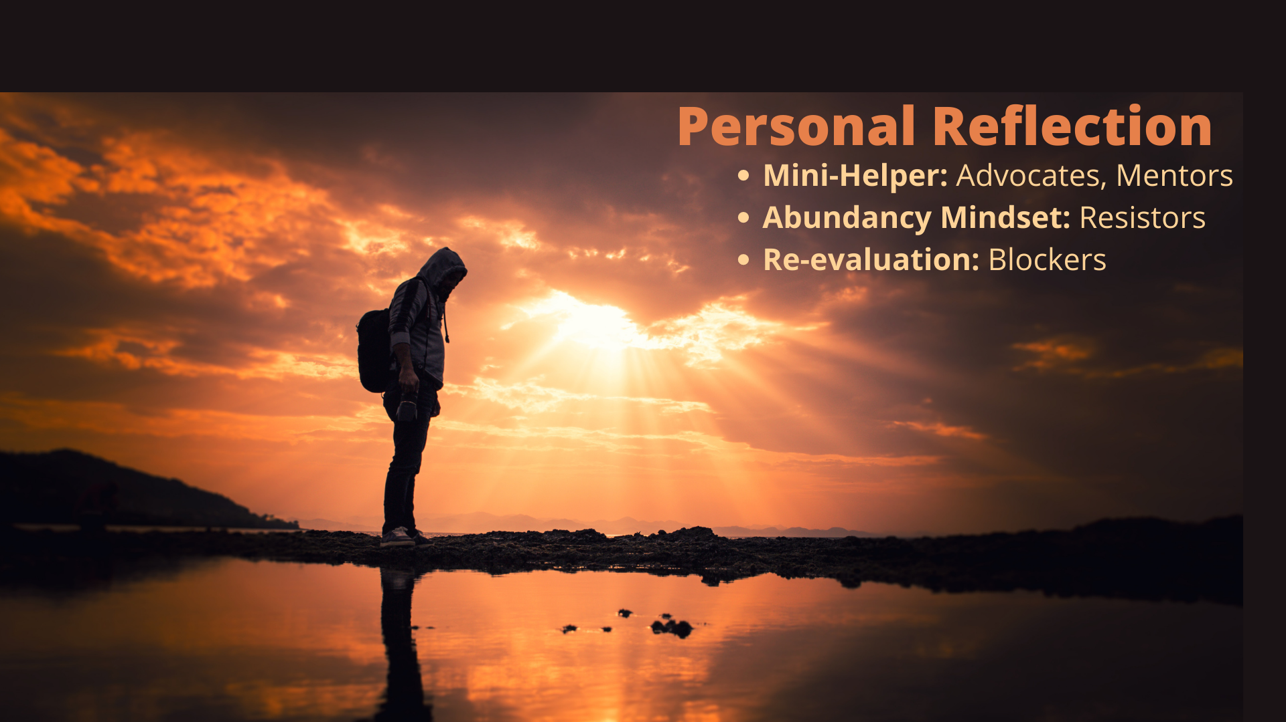
Notes:
We are going to take some time to personally reflect on the names we’ve just written.
What’s more, I’d like you to make an action plan. Write down 1-2 things that you can do for anyone who landed in a Mentor, Advocate or Resistor roles. Remember what we learned in the learning map about mini-helpers…you might have a goal in mind but it is so much more likely to come to fruition if you can first offer something to help them.
For resistors, try to think a level higher…remember the abundancy mindset and avoid the scarcity mindset…there’s enough for us all, so you can still make an offer.
If you had a Blocker, first ask yourself why you truly are looking to connect with this person. BE SURE you are confident that a stronger connection IS possible (we can’t do ALL the giving).
Before we move into this exercise, it’s important to note something foundational to the way we at APi Group believe about the behavior of a leader…nothing we do is neutral when we interact. We are either negatively or positively impacting others.
Please give me a green checkmark when you have written down one or two things you can do for both of the names you wrote down.
CLICK

Slide 25
Other Resources Available to You
Emotional Intelligence learning in the Leadership Compass
The Book Club (access to leadership literature, like trust and relationship building)
  Mindset by Carol Dweck
  Speed of Trust by Stephen M. R. Covey
  O Great One by David C. Novak
The 2021 Learning Catalog highlights:
  7 Habits of Highly Effective People in person course
  Relationship-Based Negotiations in person course
  Emotional Intelligence & Leadership in person course
  I Am A Leader eLearning course
  Everyone Can Be A Coach eLearning course
Notes:
I’ll be sending this slide to everyone who attended today’s workshop that includes additional resources that would benefit further learning and development around building strong relationships and connections with others
CLICK THROUGH OFFERINGS

Slide 26
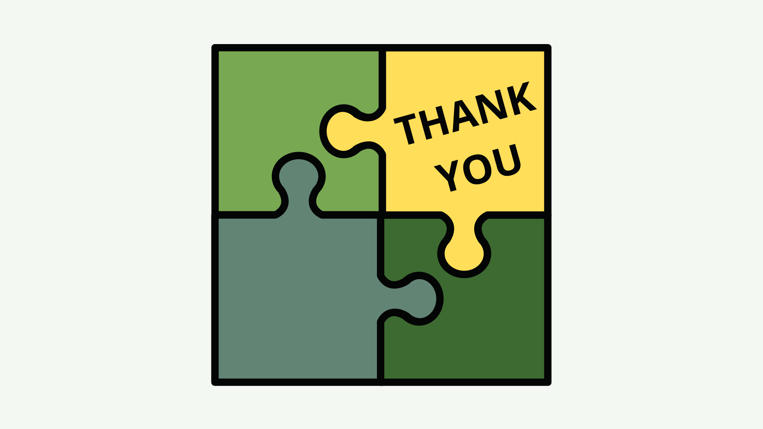
Notes:
Thank you all for taking the time today and for completing the learning map this month.
I’ll be sending out a workshop evaluation, your input goes directly into the next month’s workshop design so please be honest and specific.

