Slide 1
Continued Fractions
(starting with finite)
By
Matthew Anderson
2025

Slide 2
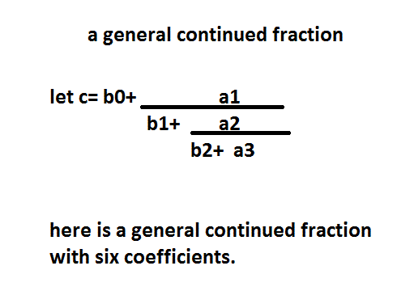
Most general finite continued fraction

Slide 3
Introduction
If there is a finite continued fraction,
with rational coefficients, then
the whole continued fraction will be a rational number.
In other words,
If you add and divide rational numbers,
You will end up with a rational number.

Slide 4
Rational Numbers
Rational numbers are a, countable, infinite set
The rational are a, dense, set
Between any two rational numbers, there is another rational number.
Namely, the average of the first two numbers.

Slide 5
Irrational continued fractions
Most infinite continued fractions,
With integer coefficients,
Converge to an irrational number.
Several examples to come on another slide

Slide 6
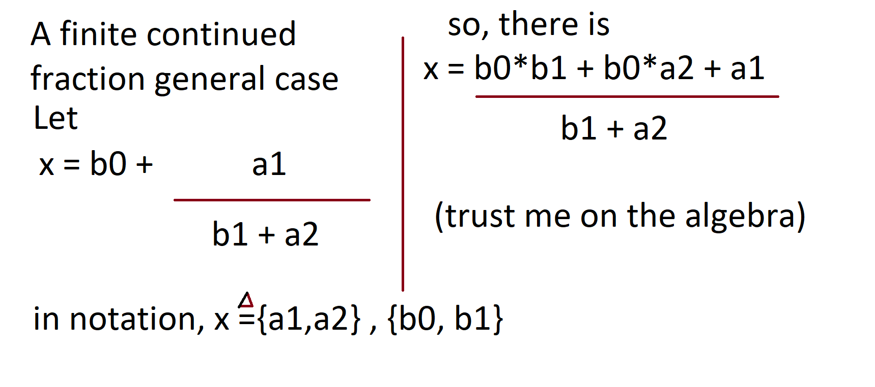

A, general case, finite continued fraction, with four coefficients

Slide 7
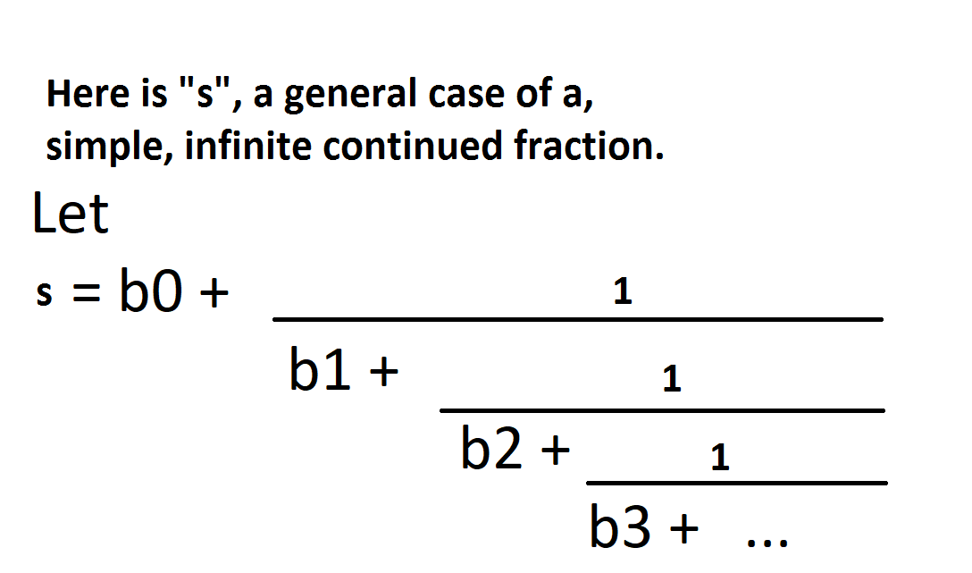
Definition, a simple continued fraction
Must have all the partial numerators equal to, the value of one.

Slide 8
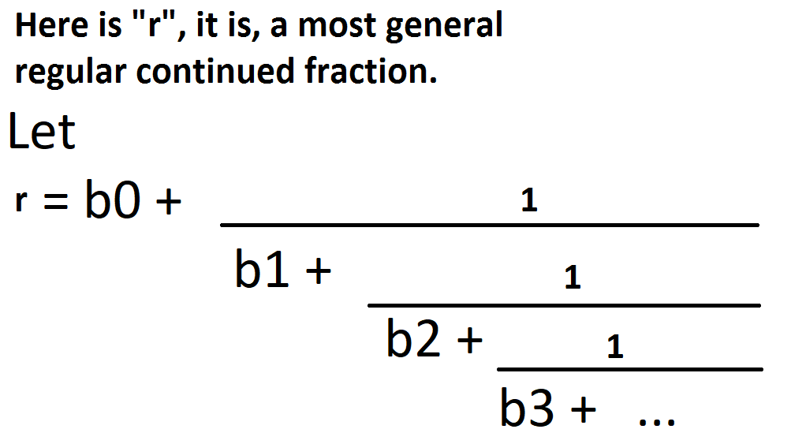
Another definition follows, a regular continued fraction
Must have all partial numerators equal to one,
and all partial denominators are positive integers, and b₀ is an integer.

Slide 9
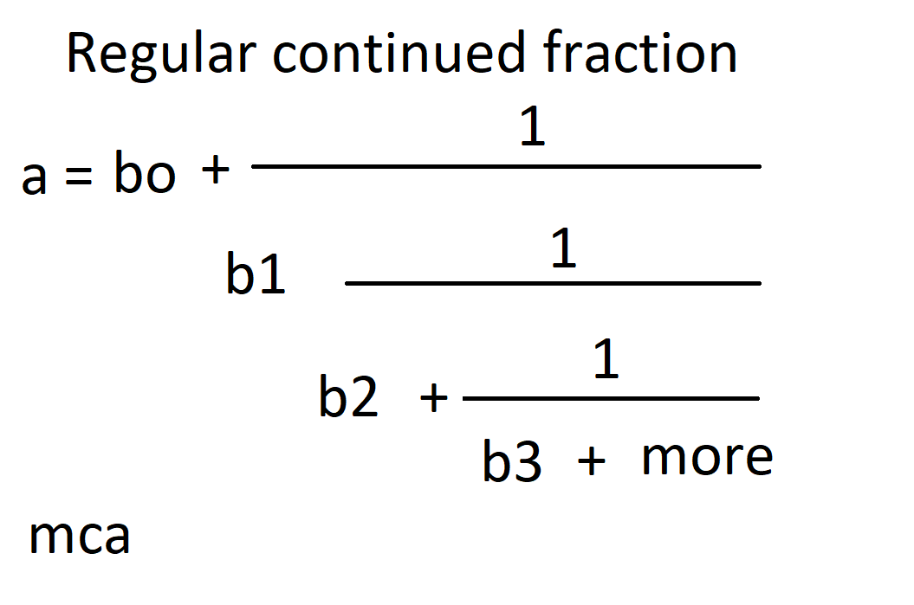
Regular continued fraction, where all b_i are positive integers

Slide 10
The story so far
General continued fractions
can have any number in numerators and denominators
Simple continued fractions
have one in all numerators
Regular continued fractions
are Simple continued fractions, and also
all denominators are positive integers.

Slide 11
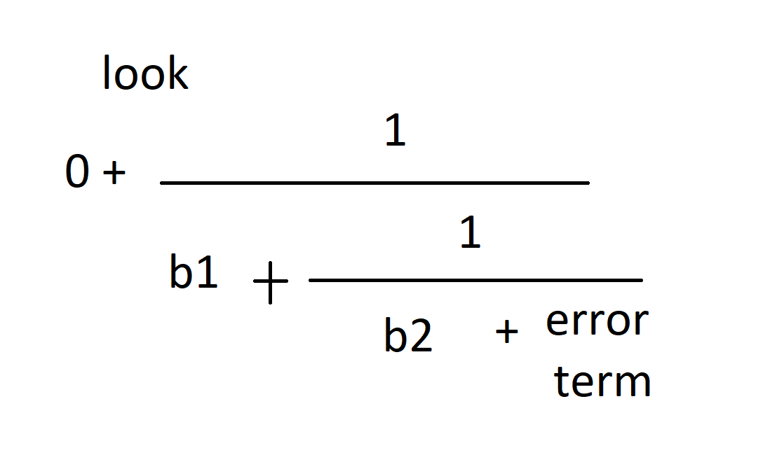
Example, assume that a₁ and a₂ are 1, and b₀ is 0 this is , a simple continued fraction with two variables. If we try to approximate a real number, between zero and one, we may get an error term.
Notes:
Simple continued fractions can be used to approximate any real number. You can restrict the b_i coefficients to positive natural numbers. (whole numbers)

Slide 12
The story so far
Generalized case of continued fractions
Restrict to simple continued fractions
Further restrict to regular continued fractions

Slide 13
It is true that
Any real number can be approximated, with arbitrary precision, by a regular continued fraction.
Seems true, if we use our intuition.
Similarly, there is a rational number, arbitrarily close to any real number.

Slide 14
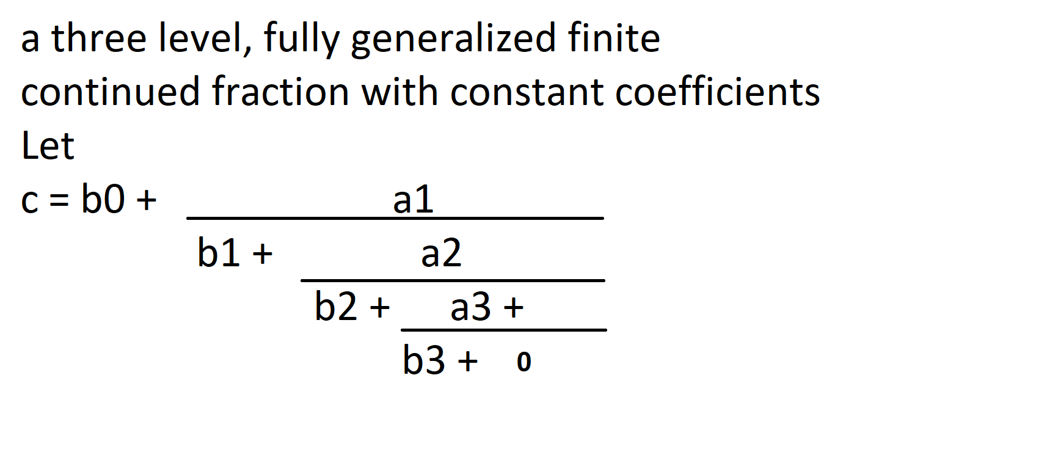
Again, by definition the a_{i} are partial numerators and the b_{i} are partial denominators, except for b0.

Slide 15
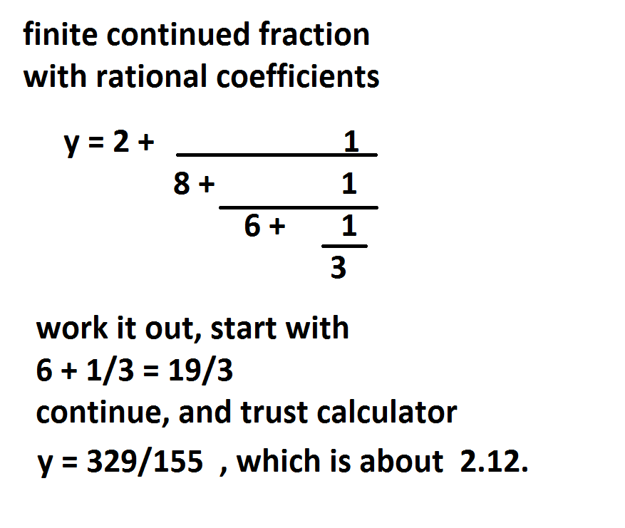
Rational numerical example

Slide 16
Combine fractions

Slide 17
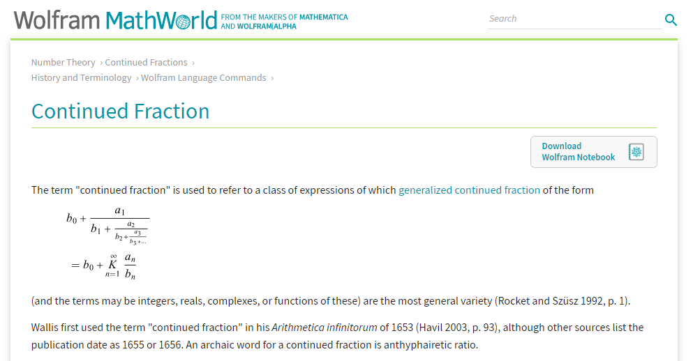
The continued fraction function,
as defined by Wolfram, Mathworld,
is “invert and add”, also called “K”
From the net, there is

Slide 18
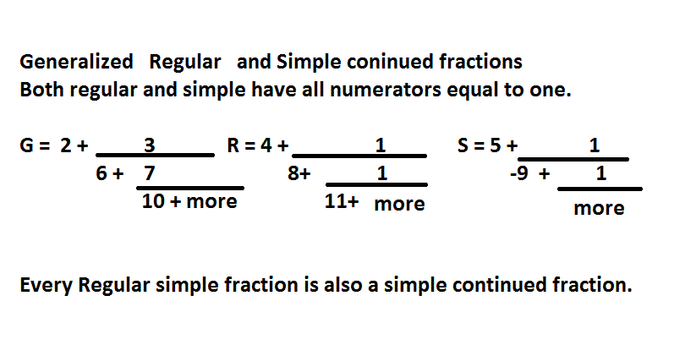
In summary, so far
There are generalized, simple and regular continued fractions

Slide 19
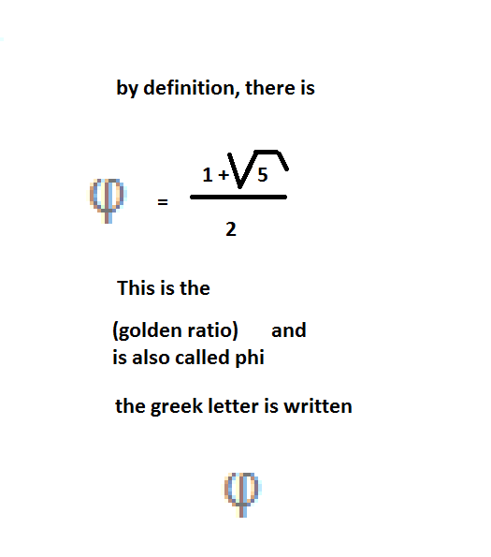
Infinite continued fraction that converges to the positive golden ratio

Slide 20
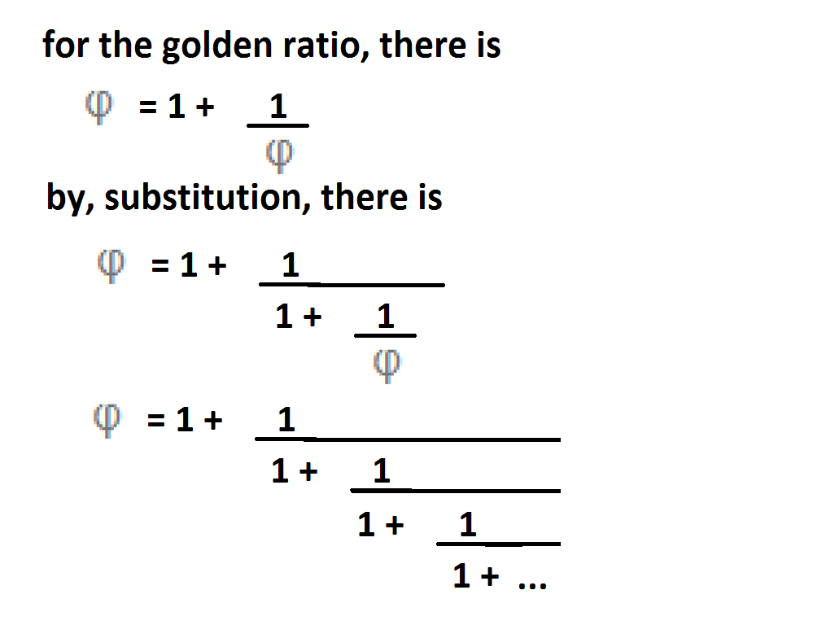
A fun example

Slide 21
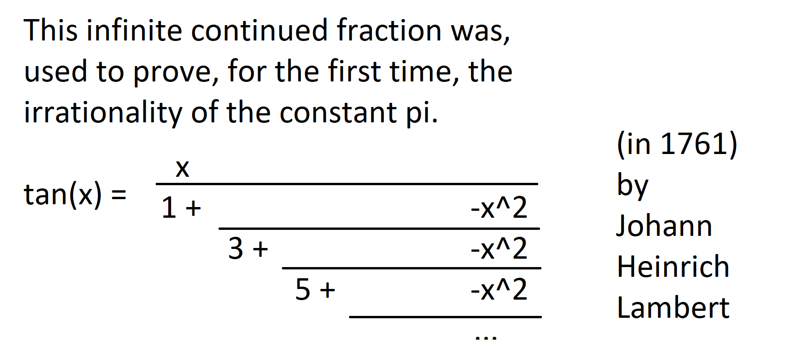
Here is a nifty, exact formula, for tangent of x

Slide 22
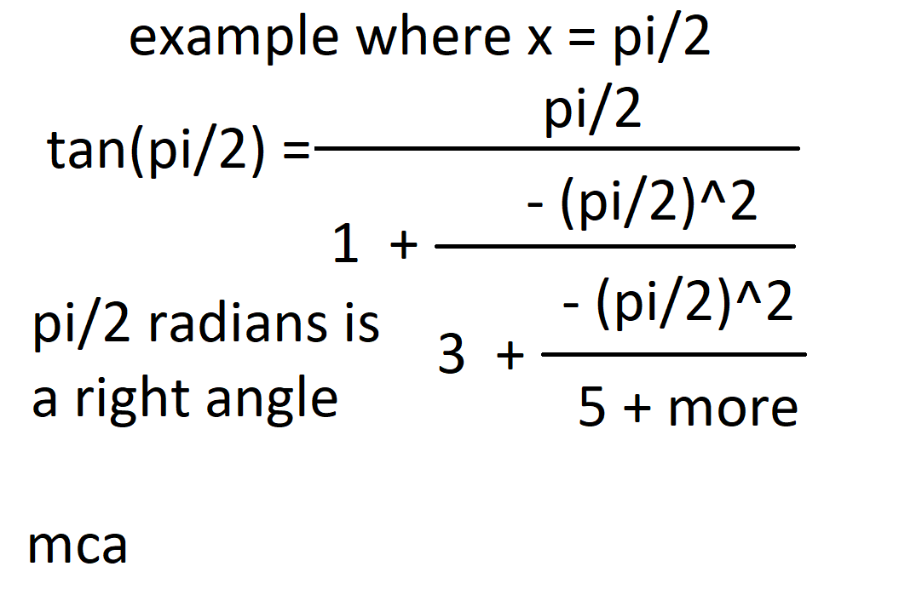
A tangent example

Slide 23
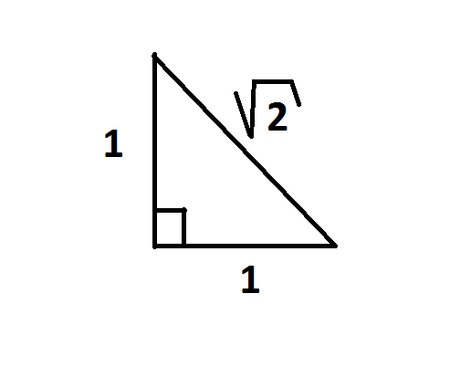
In Lambert’s proof of the irrationality of the constant pi, he used an isosceles, right triangle. There is
tan( pi/4) = tan( 45º) = 1
This was a key part to his proof. See wikipedia

Slide 24
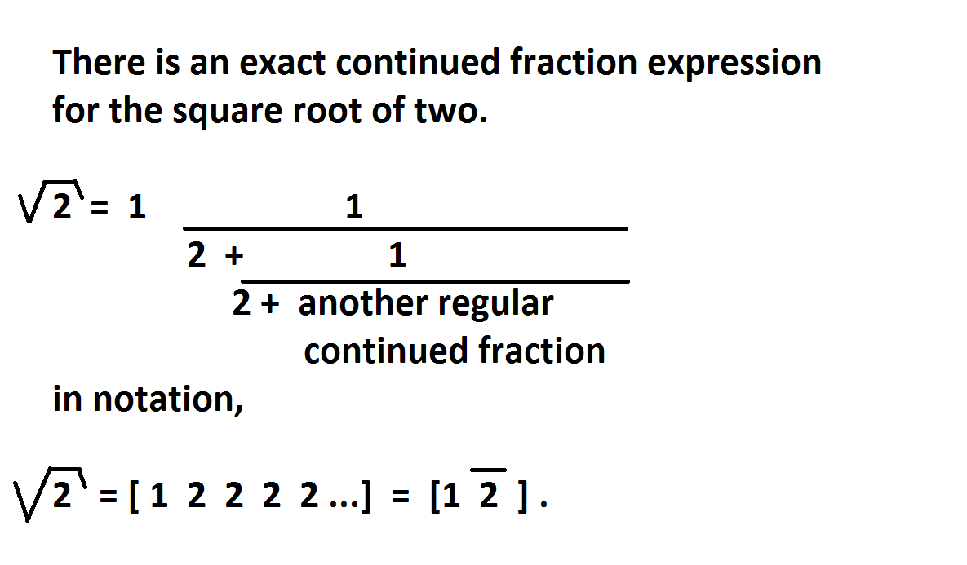
There is this nifty fact,

Slide 25
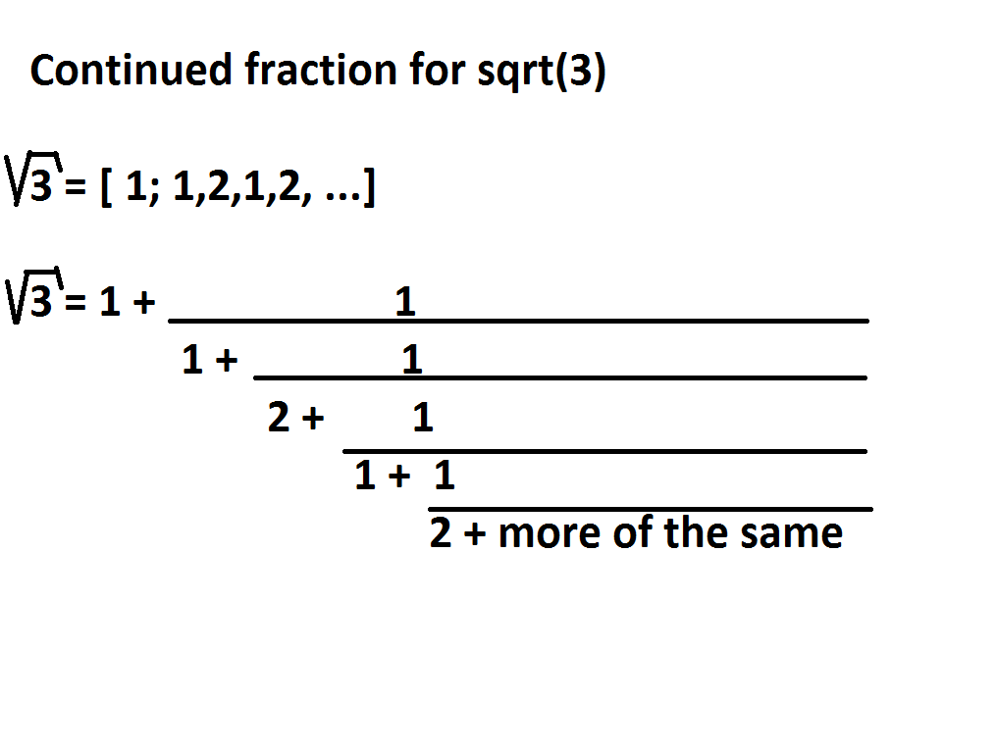
Continued fraction for square root of three

Slide 26
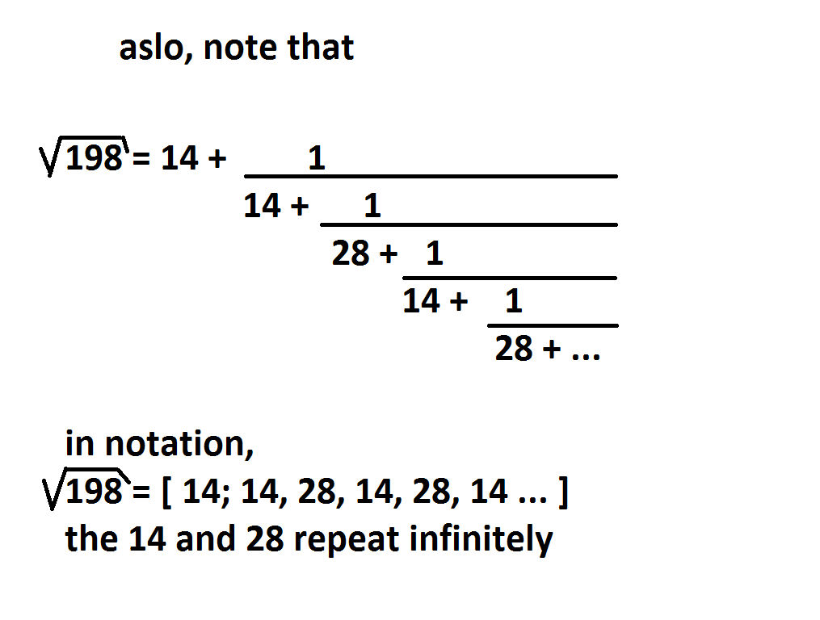
Continued fraction for the square root of 198

Slide 27
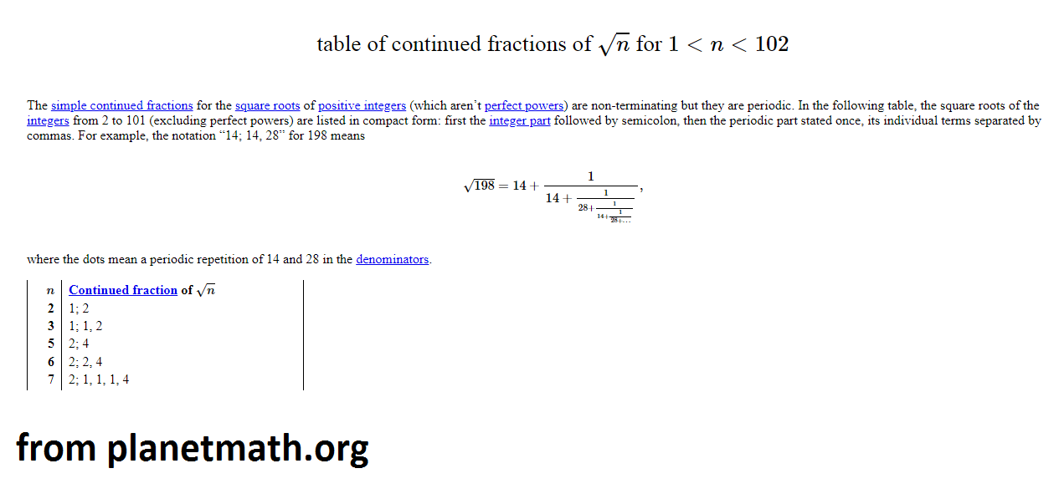
Table of sqrt n

Slide 28
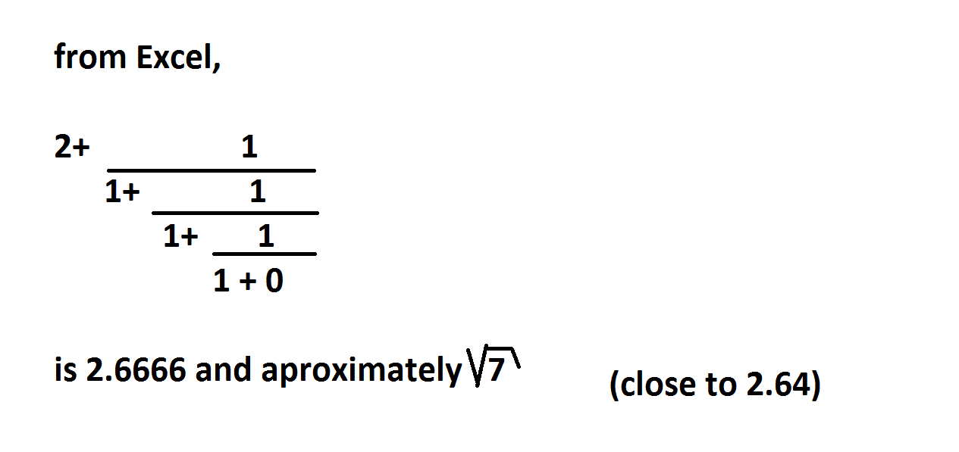
Square root of seven

Slide 29
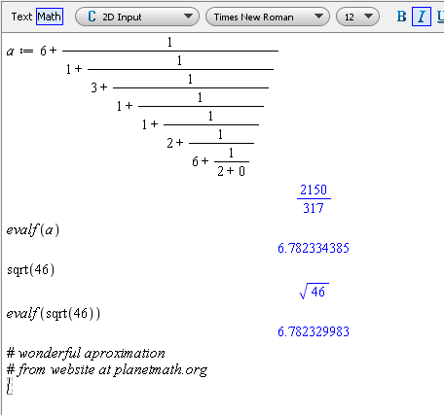
Square root of 46

Slide 30
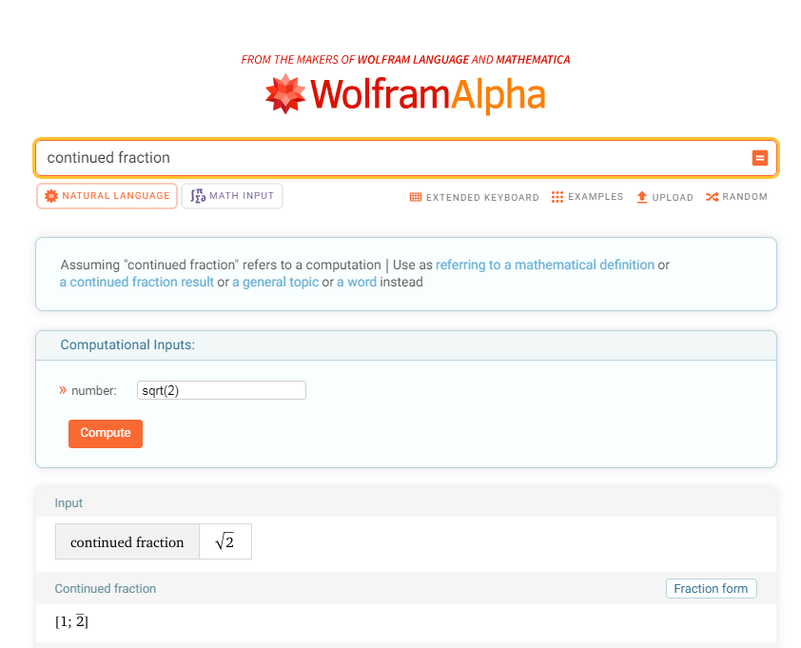
Wolfram Alpha for examples

Slide 31
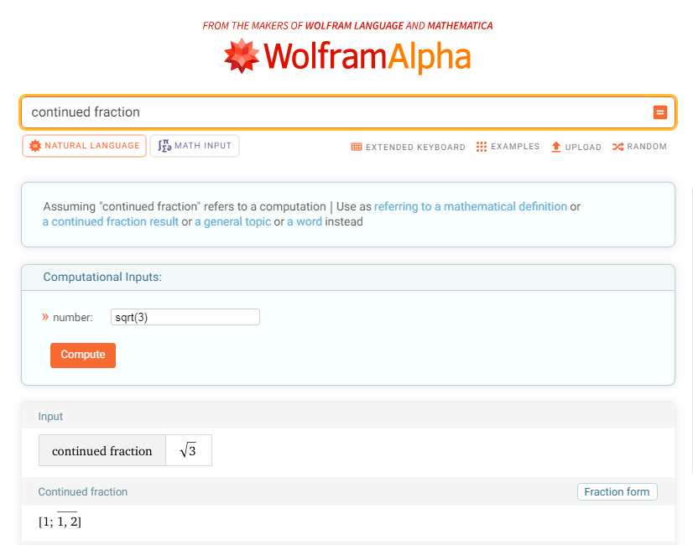
Wolfram Alpha for sqrt(3)

Slide 32

Wolfram Alpha for sqrt(5)

Slide 33
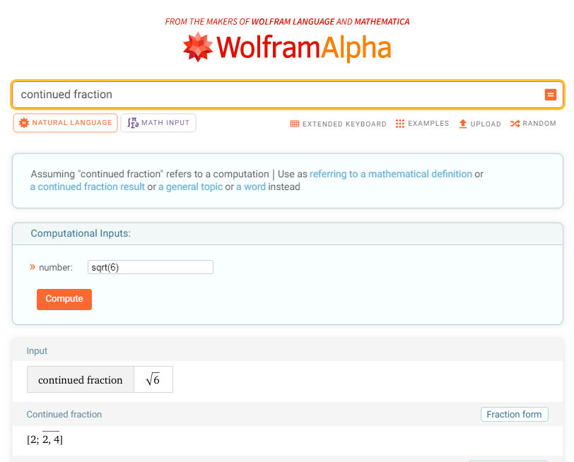
Wolfram Alpha for sqrt(6)

Slide 34

Wolfram Alpha for sqrt(7)

Slide 35
The next slide is about pi

Slide 36
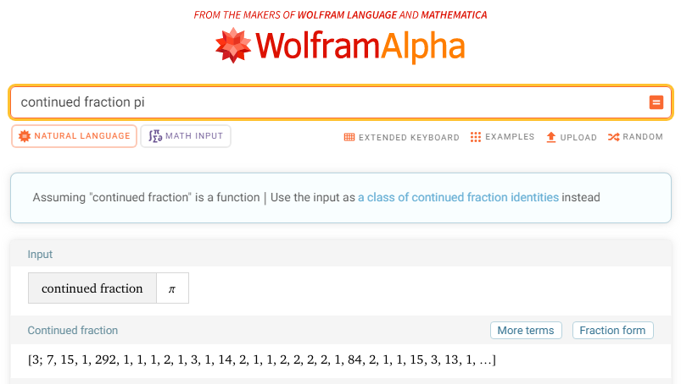
Free computer tool

Slide 37
This next slide is about something completely different
Enjoy it

Slide 38
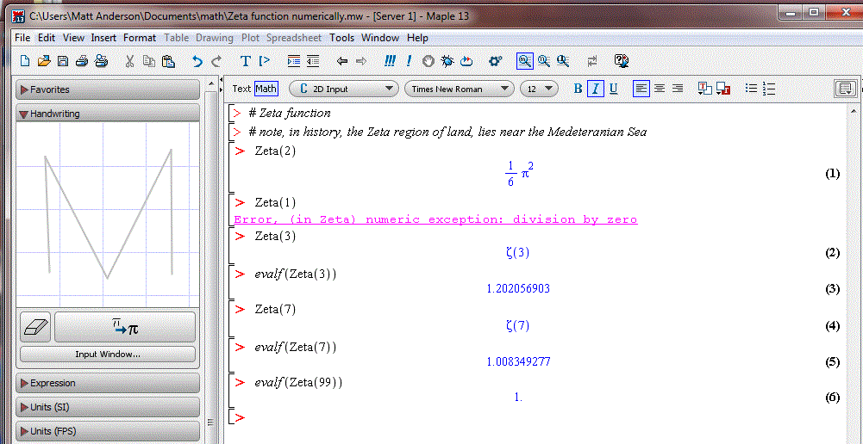
Numerical approximation of Zeta function

Slide 39
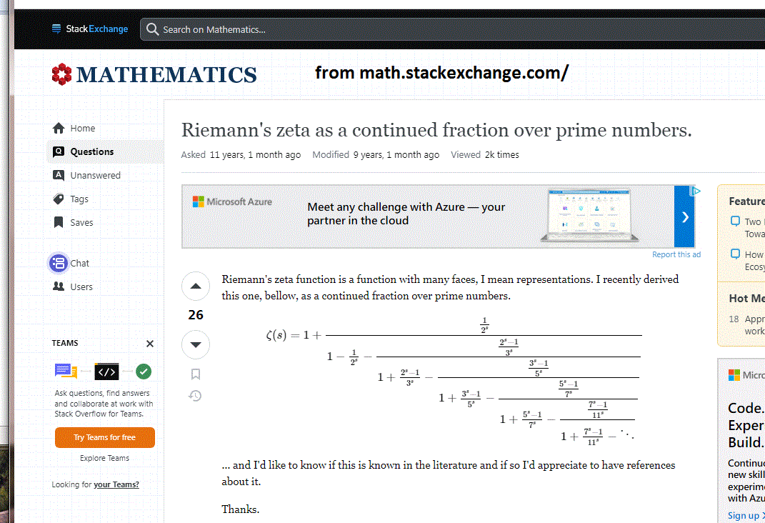
General continued fraction for Reimann Zeta function

Slide 40
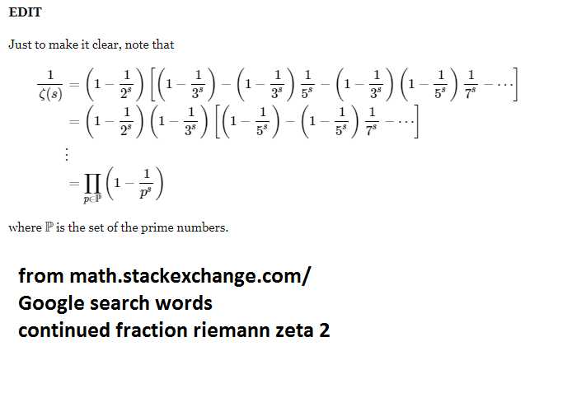
More Zeta Function

Slide 41
Thank you for watching and listening

