Slide 1
Big Prime Constellations
By Matt Anderson
March 2012

Slide 2
Prime Constellations
Definition and explanation
Example
Maple Code
Connection with Hardy-Littlewood 2nd conjecture

Slide 3
Prime Constellations are repeatable patterns of prime numbers that are as dense as possible.
For example {p, p+2}
is a prime constellation of length 2.
It represents twin primes.
Another way of writing {p, p+2} is [0,2].

Slide 4
Prime Constellations are repeatable patterns of prime numbers that are as dense as possible.
A general pattern of prime numbers is
{p, p+o₁, p+o₂, … p+o_{n}}
The o_{i} are the offsets.
The primes are ordered smallest to largest.

Slide 5
Prime Constellations are repeatable patterns of prime numbers that are as dense as possible.
A repeatable pattern of length k does not contain all possible remainders for any prime p<k.
For example [0, 1] contains both even and odd numbers. {2, 3} are the only primes that satisfy this pattern.

Slide 6
Since all primes greater than 2 are odd, a repeatable pattern starting with 0 must contain only even numbers.
Examples of repeatable patterns–
[0, 2]
[0, 4]
[0, 6]
[0, 2, 6]
[0, 4, 6]
Note [0, 2, 4] is not repeatable because of divisibility by 3.
Notes:
[0,n] is a repeatable pattern for any positive even n value.

Slide 7
Prime Constellations are repeatable patterns of prime numbers that are as dense as possible.
A repeatable pattern of length k is as dense as possible when the largest prime minus the smallest prime in the pattern is a minimum.
[0, 2, 6] is a pattern of length 3 and the largest minus the smallest prime is 6.

Slide 8
n primorial is the product of the first n primes.
n primorial is written n#.
n p_{n} n#
1 2 2
2 3 6
3 5 30
4 7 210
5 11 2310
Notes:
Note that 2*3 = 6 and 6*5 = 30.
Primorial grows faster than factorial.

Slide 9
Method to find twin primes
1 and 5 are relatively prime to 6.
All primes greater than 3 have remainder 1 or 5 when divided by 6.
The set of units mod 6, U6 = {1, 5}
Twin primes greater than 3, must have remainder 5 mod 6.
Notes:
Is it clear why twin primes greater than 3, must be of the form 6*n+5?

Slide 10
The set of units mod 30 can be determined
U6 5U6 U30
1 1 1
5 5
7 7
11 11
13 13
17 17
19 19
23 23
25
29 29
Notes:
I added 6, 12, 18, 24 to U6 to form 5U6.
The cardinality of U30 is determined by Euler’s totient function.
|U30| = (2-1)(3-1)(5-1) = 8

Slide 11
How can we refine our technique to find twin primes?
U30 = {1, 7, 11, 13, 17, 19, 23, 29}
o = {11, 17, 29}
30*n + o are possibilities for the smaller of a twin prime pair.

Slide 12
A figure of merit is the ratio of candidates to search space.
{smaller twins} С { 6*n+5 | n С Z }
{smaller twins} С { 30*n + {11, 17, 29} | n С Z}
fom₁ = 1/6 = 0.166
fom₂ = 3/30 = 0.1
This can be repeated to search in U210

Slide 13
Finding constellations
For example
m = multiplier 6
n = variable to search n
o = offset vector 5
p = pattern vector [0, 2]
Ask Maple – isprime (m*n + o + p)
Notes:
If the answer is yes for an entire p vector, you have found one.

Slide 14
Some constellations are subsets of other ones.
[0, 2] 2
[0, 4, 6] 4 2
[0, 2, 6] 2 4
[0, 2, 6, 8] 2 4 2

Slide 15
The prime counting function π(x) is the number of primes less than or equal to x.
x π(x)
1 0
2 1
3 2
4 2
5 3
Notes:
For example 5 is the 3rd prime number so π(5) = 3.

Slide 16
The Second Hardy–Littlewood conjecture state that the densest set of n primes is the first n primes.
Said another way,
π(x) ≥ π(x + y) - π(y)
I believe this conjecture is false.
Notes:
The number of primes less than or equal to x is greater or equal to the number of primes in any window of length x.

Slide 17
The first Hardy-Littlewood conjecture states that constellations of arbitrary length exist and gives an asymptotic formula for their density.
In 1974, Richards proved that the 1st and 2nd conjectures cannot both be true.

Slide 18
π(3159) = 446
but a pattern of 447 primes theoretically exists
with width 3159.
However, nobody has found a constellation of length 20 yet.
Finding a constellation of length 447 takes too much computer power to quickly.

Slide 19
Big Prime Constellations
Probably wont be found for 50 more years
Have length 447 and greater
Are constellations of length n and are denser than the first n primes.

Slide 20
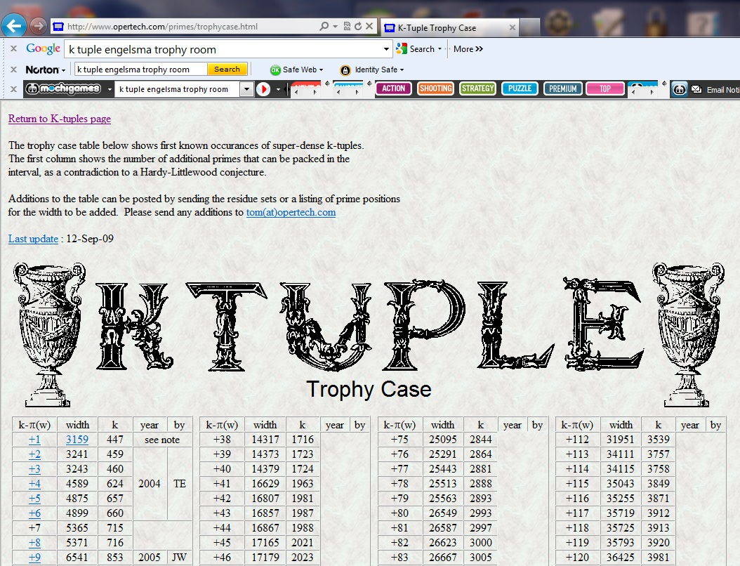

Slide 21
Since I have extra time…
I will talk about the computational number theory of Fermat numbers.

Slide 22
Fermat numbers are defined as
F(m) = 2^(2^{m}) + 1
m F(m)
0 3
1 5
2 17
3 256
4 65537 prime

Slide 23
There are no known prime Fermat numbers greater than F(4).
Euler showed that if a Fermat number F(m) has a factor, it must have the form
k.2^{n}+1, where n > m+2
Where k and n are integer constants.
Euler found that 641 divides F(5).

Slide 24
People have used computers to factor Fermat numbers.
F(5)..F(32) have been shown to be composite.
F(24) has 5,050,446 digits and has been shown to be composite, but no factor has been found. Richard Crandall helped do this.

Slide 25
Fermat numbers grow quickly
n digits in F(n)
ceiling(2^n*log10(2))
2 2
3 3
4 5
5 10
34 5.2E+09

Slide 26
If you want to help find Fermat factors, go to
Fermatsearch.com
Download the software and choose a search range.
There are about 20 active searchers in the world, and about 5 factors are found per year.
Notes:
Its like buying a lottery ticket.

Slide 27
References
http://anthony.d.forbes.googlepages.com/ktuplets.htm
An encyclopedia of record constellations
http://www.opertech.com/primes/k-tuples.html
Tabulates length of constellations
http://www.fermatsearch.org/
The search for Fermat number divisors
https://sites.google.com/site/mattc1anderson/home-1
My Constellation Finder, written in Maple

Slide 28
The End

