Slide 1
Some ways to tile the plane
By
Matt C Anderson
2026
Here in Oregon

Slide 2
Start with squares
Squares can form a simple pattern, that fill a space
Squares have four right angles
Squares also have all four sides , all the same length

Slide 3
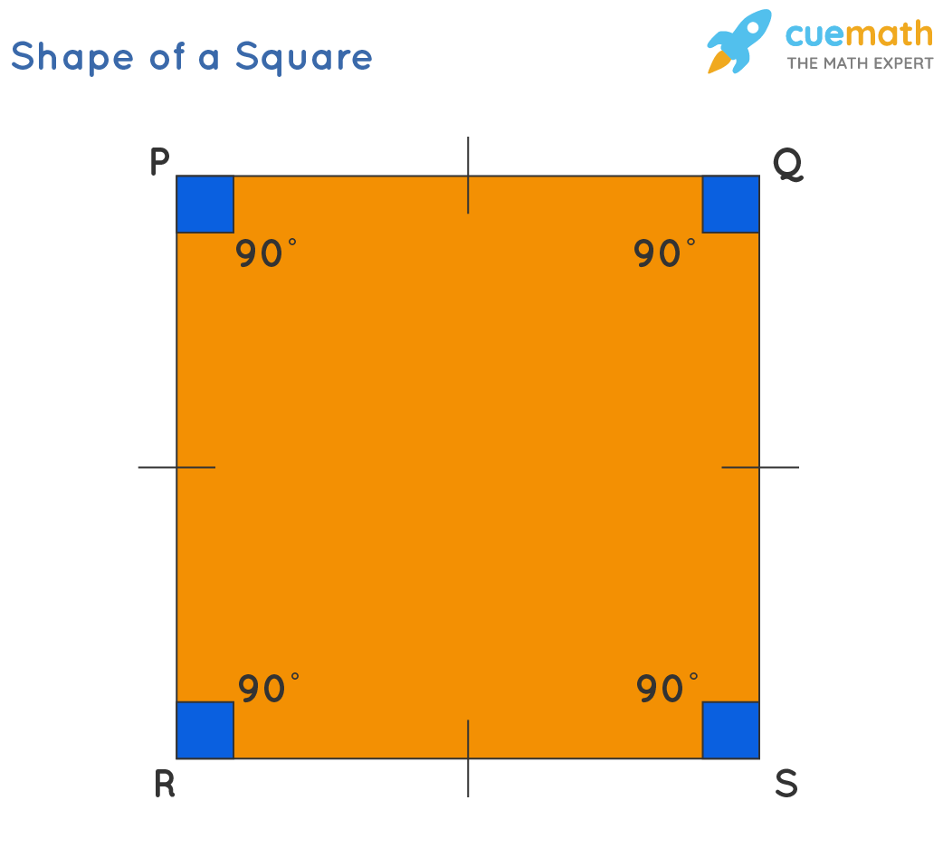
This is a square

Slide 4
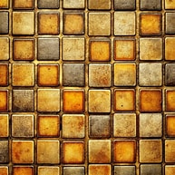
A square tiling
:-) of a room, or the mathematical plane

Slide 5
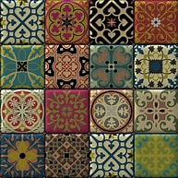
Two mathematical tilings

Slide 6
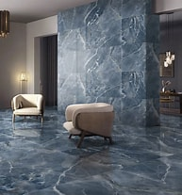

Slide 7
A tiling with curves
A tiling can be done with polygons that have straight lines
A tiling can be done with curved shapes.
Another word for a tiling is a tessellation
A tiling is possible with just circles
It is important that the circles “touch” or “overlap”.

Slide 8
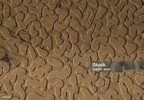
Get ready for some beautiful tessellations
(tilings) This one looks like sand.

Slide 9
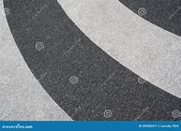

Slide 10
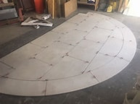

Slide 11
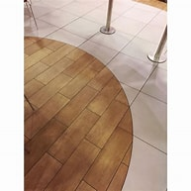

Slide 12
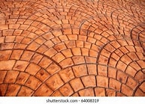

Slide 13
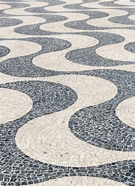

Slide 14
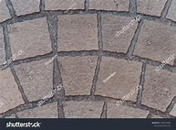

Slide 15
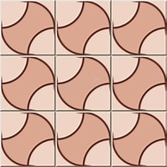

Slide 16
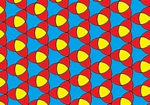
some more pretty tiling with curves see the red, blue and yellow colors

Slide 17
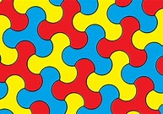
A three sided interlocking pattern

Slide 18
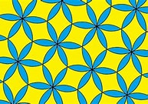
A pretty flower looking pattern

Slide 19
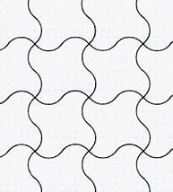
Here, four shapes meet at a point

Slide 20
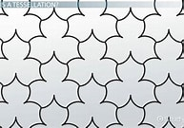
This pattern has curves and cusps looks like leaves Also, 3 lines meet at a point

Slide 21
Next comes rectangles
Rectangles can form a similar pattern to squares
Rectangles have four right angles
Rectangles have two pairs of parallel sides
All four angles of a rectangle measure 90 degrees
There can be two different side lengths in a rectangle

Slide 22
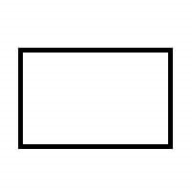
See this rectangle

Slide 23
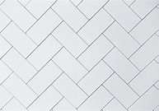
A fun rectangular tiling

Slide 24
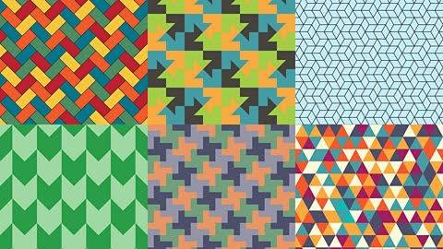
A tiling of the plane is called a tessellation.

Slide 25
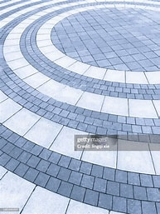
more tilling's (tessellations) note that the lines must touch

Slide 26
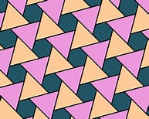

Slide 27
Recall that a tiling is called a tessellation.
In mathematics, a tessellation (or tiling) is the arrangement of shapes on a plane so that they fit together perfectly without any gaps or overlaps.
Tessellations can be made from one or more polygons, such as triangles, squares, rectangles, or hexagons, and the pattern can extend infinitely in all directions

Slide 28
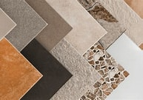
A tiling with a polygon

Slide 29
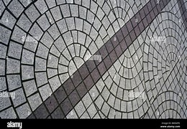
A tiling with a curved shape

Slide 30
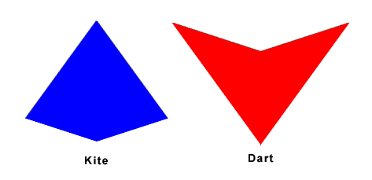
Mathematical kites and darts are geometric shapes notice red and blue colors

Slide 31
Kites can be paired up
Kites and Darts can be arranged so that they fill the plane,
with no overlaps and no gaps.

Slide 32
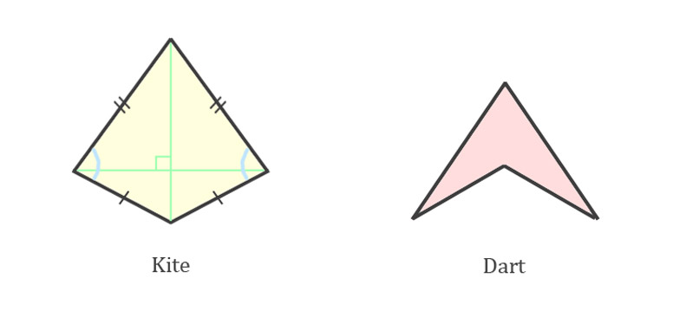
Kite and dart geometry

Slide 33
Kites and Darts
The angles involve the golden ratio
measured in radians
Also, the ratio of the side lengths is the golden ratio,
Golden Ratio is about 1.61
Golden ratio is exactly (1+sqrt(5))/2.
Thanks to Roger Penrose for first finding these kites and darts.
He investigated this in the 1970s

Slide 34
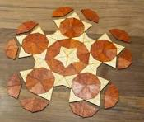
Penrose Tiling with Kites and Darts

Slide 35
When forming a tiling, kites can be paired up
Remember the five pointed star from the last slide
Also, there are two different side lengths
for kites and darts
Again, thanks to Roger Penrose for finding them in the 1970s
Later, comes the one stone shape
the “hat” with thirteen sides
the , so called, “Einstein Shape”
Not to be confused with the last name ☺

Slide 36
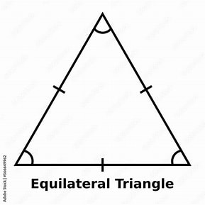
A regular triangle also called an equilateral triangle

Slide 37
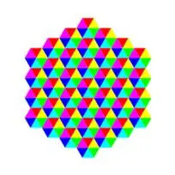
Here is a tiling of equilateral triangles.
There are six different colors

Slide 38
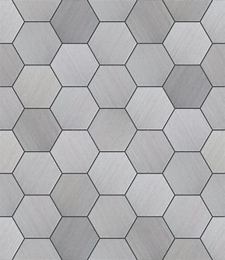
A tiling with regular hexagons, which are six sided shapes, similar to the honeycomb of bees

Slide 39
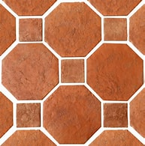
A tiling (tessellation) with squares and octagons

Slide 40
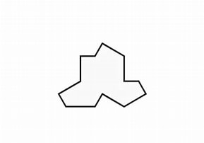
The 13 sided Einstein shape, also called the Hat pause to count the 13 sides

Slide 41
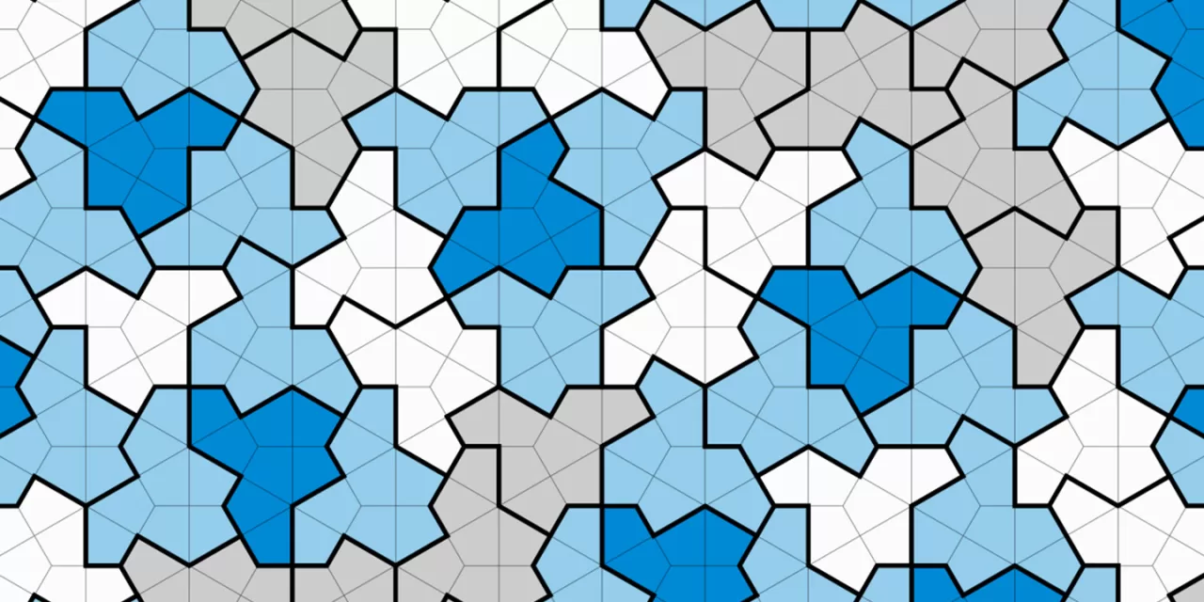
A fun tiling, with kites, darts and the Hat, sometimes the hat is upside down

Slide 42
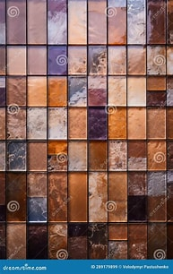
And finally, some more fun tiling's

Slide 44
A square tiling with curves fun

Slide 45
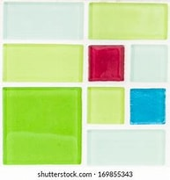
A square and rectangle tiling

Slide 46
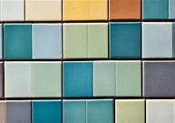
A cool tiling

Slide 47
Thank you for watching and listening

Slide 48
References
Scientific American article
Newfound Mathematical 'Einstein' Shape Creates a Never-Repeating Pattern | Scientific American
Bing video about Einstein Shape
https://www.bing.com/videos/riverview/relatedvideo?q=math+einstein+shape+tiling
Tiling the plane, also called a tessellation
1.1: Tiling the Plane - Mathematics LibreTexts

