Slide 1
HER
HEAL EMPOWER RESTORE
Let The Journey Begin…

Slide 2

Table of Contents
Developing a Routine
The Attitude of Gratitude
Prayer and Meditation
Diet and Exercise
Sefl Talk and Repetition

Slide 3

Developing routines
Consistency is the key to changing habits. Repetition is the key to consistency.
Creating and maintaining a daily routine increases focus and clarity.
Implementing a daily routine to your lifestyle can give you a sense of control; improve focus, productivity, and organization and five you a sense of accomplishment.

Slide 4

Day 1-7
Welcome to day 1 of your new journey! As we embark on our passage to our next level of achievements, growth and experiences, we will need to make a commitment to begin a daily routine and stick to it. We can tweak it as time goes on, but we will take it one day at a time.
We have developed this sample 7-day planner as a guide to help you get started on your transformation
So Let’s get started!

Slide 5

7 PRINCIPLES FOR 7 DAYS
Gratitude releases a multitude of blessings.
THE ATTITUDE OF GRATUTUDE
When you begin your days with a grateful heart, You will wake up saying “Thank You” and you’ll be off to a great start.
You can begin you new routine by writing down 3 things that you are grateful for. Do this each day. On days you can’t write them down just repeat them over and over in your mind and you will notice a transformation in your attitude throughout the day!

Slide 6

Different people may choose to title it differently, but when it comes down to it, Prayer and Meditation both move a person into a place of surrender and receptivity. They allow a release of negative energies such as stress, despair, or frustration.
These are good practices to incorporate into your daily routine.

Slide 7
7 PRINCIPLES FOR 7 DAYS cont”d
DIET
EXCERCISE
A well-balanced diet is essential to keep the mind alert and the body’s organs functioning.
WATER is THE MOST ESSENTIAL element the body requires. Start you day with 4 – 8 ounces each day. Then calibrate your intake to insure drinking 32 ounces each day
Try to stay away from fried foods, fast foods and sugary snacks. Grab fruit, nuts and healthy snacks. Almonds, walnuts, yogurt, granola and pretzels are a few options.
Exercise is to the body what reading is to the mind. Stretching your body in the morning gets your blood pumping and loosens your muscles.
Consistently physical acti will help stimulate your mind and contribute to better overall health and well being.
If you are a beginner, you can start with chair yoga or chair Pilates. A walk around the block outside it a good start as well.
Don’t forget to including deep breathing as a part of your routine. Consciously inhaling love thru the nose and exhaling peace through the mouth 2 reps of 10 can also reduce blood pressure and stress and increase

Slide 8
7 PRINCIPLES FOR 7 DAYS cont”d
Thought Patterns
Self Talk
REPETITION
Everything has a positive and a negative. Even thought patterns. Be careful of letting the negative thoughts creep in.
Blaming, Catastrophising, Jumping to conclusions – These negative thought patterns can be overcome with our own Self Talk.
The way that you speak to yourself or your inner voice combines conscious thoughts with inbuilt beliefs and biases to create an internal monologue.
Change, commitment and consistency can be used to quickly change negative self talk to positive affirmations.

Slide 9



Summary
This short presentation is provided to assist you on your journey to new beginnings.
Remember, your thoughts control your destiny. Gratitude, Daily Affirmations, are a great way to begin using your mental powers.
We hope this brief presentation meets your expectations and inspires you to continue on your journey with us. Whether your journey is one of personal growth or business or entrepreneur focused, our proven methods of NLP will aid in your progress towards reaching your goals.

Slide 10
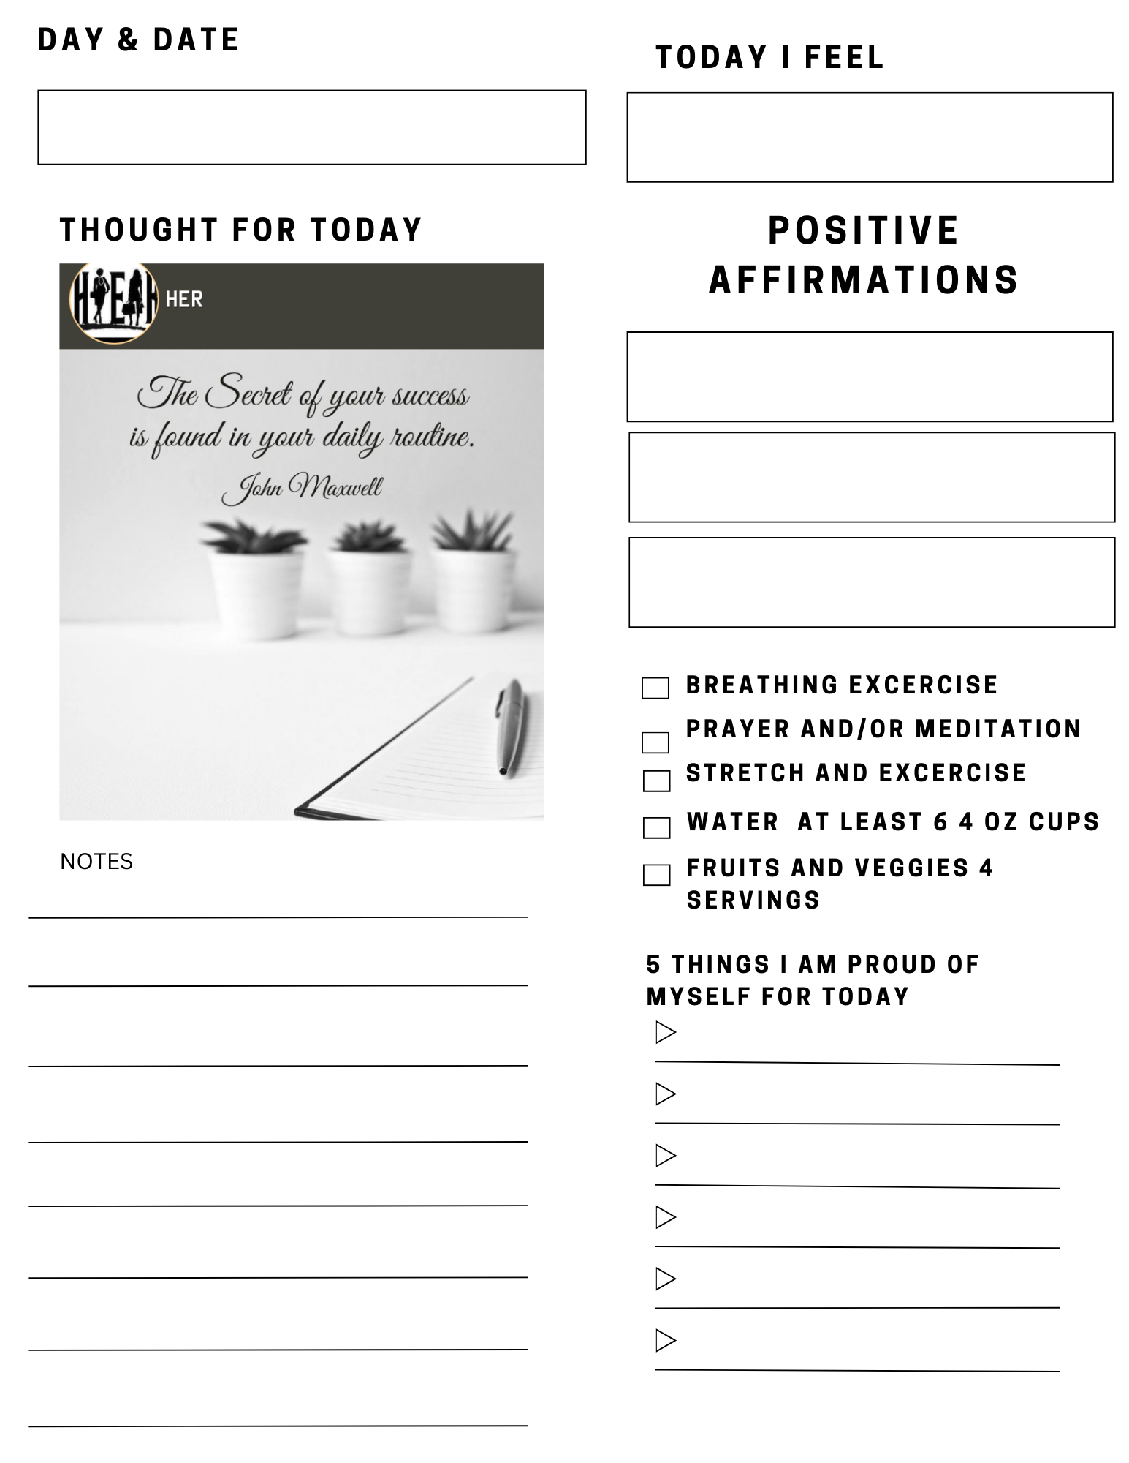
Please use this form to
Keep track of you first 7 days.
Please email us to let us know
when you complete your first
7 days.
info@herhealempowerrestore.com

