Slide 2
Questions?
You may use the chat to post questions or use the “raise hand” function
Please introduce yourself as you pose your question
If we don’t have time for all of your questions, please send them by e mail and we will follow up with all participants to provide a response

Slide 3
Where Do We Fit In and Who make up the Community Leadership Team?
The local community Leadership Team includes:
Branch Executive and Branch
Navy League Commanding Officer and their team of officers and CIs
Local Corps are assisted and supported directed by the local Branch
Each Branch reports to the Division through their Area Rep or First VP and the Division Office (in our case, Ontario Division the ED or AA with our office in Toronto)
Each Division reports to the National President and National Board (National Office in Ottawa)
Corps also have a “chain of command” through Division Squadron Officers (DSOs) and the Division Commander
Officers and C.I.’s cannot be voting Branch members

Slide 4
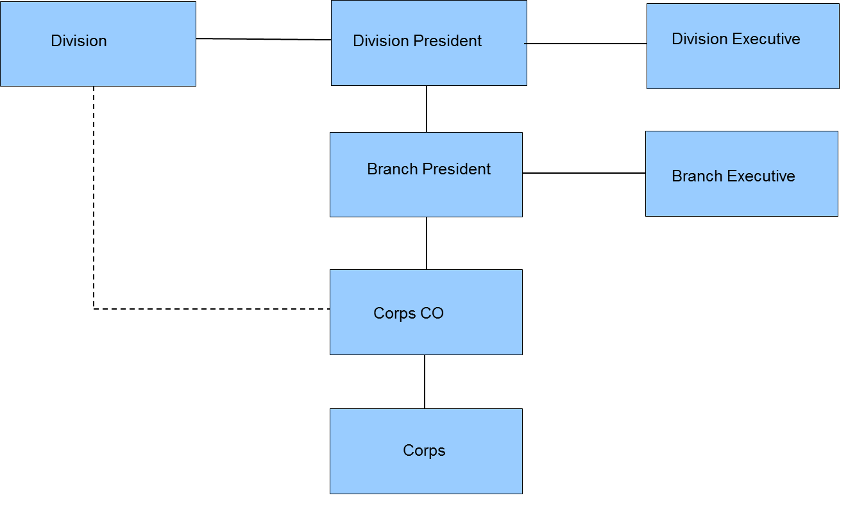
ORGANIZATIONAL CHART OUTLINING THE HIERARCHICAL STRUCTURE OF A NLC CORPS

Slide 5
Branch relationship with Ontario Division
The Division President is ultimately responsible to the Navy League of Canada for the delivery of the Navy League Cadet program and should be kept informed through the Division Vice President, Division VP NL, Division Commander or Division office staff
The Branch should maintain regular contact with Ontario Division through the Division office staff, the Division Vice President, Division VP NL, Division Commander or Treasurer as necessary
Branch Presidents are directly responsible to the Division President for Branch and local NLCC operations.
The Branch President should be the primary contact with Ontario Division on local corps issues
The Branch is responsible for collecting information and from the Corps and completing the initial processing of request forms to send to Ontario Division. This may include LOI’s, nominal rolls, facility info, request forms, award nominations, etc.
The Branch President should also ensure that Ontario Division has up to date contact information for both the Branch and the NLCC
Liaises directly with the Division Commander for guidance on issues related to cadet program , officer, training and NLC program.
Accepts advice and guidance from Division Commander and from Division President or his /or her representative.

Slide 6
Commanding Officer Relationship with ON Division
Directly responsible to the Branch President for local NLCC operations
Commanding Officers work with the Branch President to report all local issues and the Branch President would contact Ontario Division with issues outside of the purview of the DSO’s
Works through Branch President or Corps liaison for any requirements with Division Executive
Liaise directly with the NLC Division Commander and staff on NLCC issues related to their NLCC program officer training and NLC procedures. The CO must keep the Branch President apprised of interaction with the Division Commander
Respects and accepts advice, training and guidance from Division Commander and acts on orders given through the Branch President.
Ensures all marks of respect are afforded to the Division Commander and Division staff as Officers of superior rank.
The Commanding Officers primary point of contact with Ontario Division is their DSO or Division Commander as necessary
Commanding Officer should attend all Squadron meetings with the Branch President
Commanding Officers should ensure that all administration related to officers and cadets is completed and submitted to the Branch and/or Division in an accurate and timely manner

Slide 7
Division Command Team Roles, Responsibilities and Reporting Relationship
Division Commander – LCdr(NL) Michael Pigeon
Division Training Officer – LCdr(NL) Paul Simas
Assistant Training Officer - Lt. (NL) Richard Lewis
Division Administration Officer –LCdr(NL) Julie Giuntoli
Division Squadron Officers (DSOs)
Aurora – LCdr(NL) Pierre Joly
Rainbow –LCdr(NL) –Dave Butcher
5th Barber Pole- TBA
Magnificent -LCdr(NL) Jim Richards
Niobe -TBA
Jefferies- LCdr(NL) Scheshawna Lemaire
Bonaventure- LCdr (NL) Wayne Closs

Slide 8
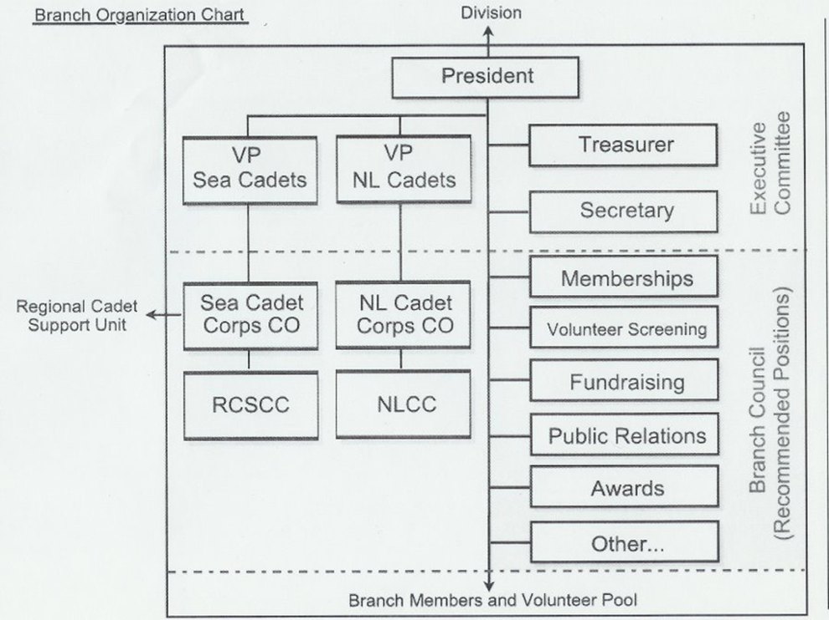
Local Branch Potential Organization * Note that this reflects a larger Branch structure beyond traditional Executive roles

Slide 9
What does the Branch do?
Responsible for all aspects of support to their Navy League Cadets Corps for their training and activities (i.e. sailing, competitions, band)
Responsible for all costs associated with operating the Navy League Cadet Corps
Responsible for providing facilities for the Navy League Cadet Corps to train in. i.e. your Ship, The Sail Centre, Stores etc.
The Branch needs to negotiate arrangements and pay for all spaces used by the NLCC whether owned or leased.

Slide 10
Responsibilities of the Branch President
For the supervision and direction of the Navy League Cadet Corps (NLCC). The Branch President maintains oversight of the Navy League Cadet Corps through the Corps Commanding Officer.
The Branch President directly takes charge of all Branch activities and personnel, directing and leading all functions of the Branch through the elected and appointed chairs of each committee.
The Branch President is concerned with the governance of the local Navy League of Canada operation in its entirety and is ultimately responsible for the actions of the Branch.

Slide 11
Responsibilities of the NLCC Commanding Officer
The NL Cadet Corps Commanding Officer is responsible directly to the Branch President for the operation of the Navy League Cadet Corps including:
Supervision of personnel and administration of the Corps and its training program;
Development and deliver of the Corps training program;
Coordinating volunteers and support for the NLCC with the Branch; and
Developing the Budget for all Corps activities, coordinating expenses with the Treasurer and making financial reports to the Branch President, or the Branch President's Representative, on a regular basis.
The Corps Commanding Officer is the direct authority over all NLCC officers, Civilian instructors and cadets.

Slide 12
Shared Responsibilities
The Branch President and the Commanding Officer are partners in the planning and delivery of the NL Cadet program and must establish and maintain an excellent relationship and partnership between the Branch and the NLCC
They need to collaborate and work together to achieve the objectives of the program and the Navy League of Canada and create a positive experience for the cadets
The NLCC Commanding Officer should work with the Branch President (and/or Branch Navy League Cadet Chair/VP) to create and implement the COVID-19 plan to ensure the health and safety of cadets, officers and League members in the COVID environment

Slide 13
Training in a COVID environment
A comprehensive plan needs to be developed by the Corps with a training facility checklist that must be approved by the Branch then the Division before the NLCC commences any in person training or activities
Information is available on the Division website and has been distributed through e mail
Commanding Officers should be doing the planning with the NLCC COVID Officer and the Branch President
Submit detailed plan and facilities checklist signed off by Branch President to the Division VP NL Cadets Eamonn Brennan and Division Commander LCdr (NL) Pigeon for review and then to the Division President for approval
All plans must have final approval by the Division President before commencing any in person training or activities

Slide 14
Branch Fundraising and Budgets
In order to have the funds to support NLCC training and activities, one of the key responsibilities of the Branch is fundraising as well as financial management and accounting.
The NLCC officers and cadets may assist with fundraising activities but Branch delegates are primarily responsible for the activities and to handle all monies collected.
The Branch needs to arrange tax receipts and the thank you letters and acknowledgement for donors and those involved in supporting activities
After consultation with the Commanding Officer on the development of a budget, the Branch will be presented with a budget for approval and management of expenses related to NLCC training and activities
The Branch must provide also provide their overall budget, year end info, financial statements and HST information to Ontario Division, as required

Slide 15
Budget
Branch Commanding Officer
Review annual budget submission from the CO and consult with CO as necessary on fundraising activities and plans
Treasurer should work with the CO to submit budget for approval by Executive and ensure sound financial management
Support Corps plan for budget expenditures and ensure timely payment and sufficient funds
Develop sort and long range plans and fundraising strategy to cover anticipated costs
Prepare an annual budget that acts as a cost estimate for the activities and operations planned for the training year
Work with the Branch to develop a Fundraising plan and strategy (limit cadet involvement to 3 max)
Work with the Branch to update and revise the budget and fundraising plan throughout the year (or as required)
Assist the Branch to develop short and long range plans and fundraising strategy to cover anticipated program costs
Notes:
Notes:
CO to submit budget within Branch timelines (as requested by NL ON Div)

Slide 16
Fundraising
Branch Commanding Officer
Organize and conduct fundraisers
Make necessary presentations to sponsors and benefactors
Submit receipts for donations for tax purposes
Thanks and invite donors to cadet events
Provide assistance to Branch by encouraging staff and cadets to assist and participate in activity
Welcome donors and respond to questions
Submit all fund raising monies to the Branch for accounting and safekeeping
Assist in hosting donors at cadet activities
Notes:
Commanding Officers will work with the Branch to develop a plan for fundraising and community engagement/outreach and provide support with officers and cadet participants but should endeavour to limit cadet participation to no more than 3 major events per year to maximize training time and cadet engagement in the program
Whenever possible do not always use cadets for solicitation of funds. It is recommended that cadets participate in no more than 3 fundraising campaigns annually.
CO/Staff must never be custodians of the funds raised.
All funds are to be held by the Branch for use in support of cadet activities

Slide 17
Financial Management - Branch Responsibilities
Responsible for financial commitment to the Corps and the Branch
Account for funds, ensure rebalance of expenditures
The Branch may authorize a small petty cash fund to CO for day to day minor expenses (subject to requirement, approval and proper management and accounting)
Ensure funds collected are deposited and a Branch member is appointed to the physical handling of funds raised through fundraising donations, canteen, etc
Take necessary steps required for negotiation and payment of goods and services including rent of facilities and utilities
Regularly inform Commanding officers of financial status and allocated funds for their budget
Ensure that there is an accurate and up to date inventory of equipment that belongs to the Branch
The Treasurer and President should meet regularly with the CO and be available to address requirements as they arise
Notes:
Notes:
Funding is intended to cover various expenses related to education and motivation of cadets, their activities and their presentation to the public
Branch President and CO must work together to develop the vision and ensure that available funds are spent in the best interest of cadets and NL

Slide 18
Financial Management
Commanding Officer
Work with the Branch President and Treasurer to create an annual budget for the NLCC
Notify Branch of necessary expenditures made against the approved budget
Provide Branch with claims or receipts for the Corps expenditures
If Petty Cash authorized, expenses must be pre-approved and receipts must be forwarded to the Branch in a timely manner
Prepare an evaluation or obtain quotes for the Branch of expected cost for the purchase of specific goods or services that will be required to support NLCC training and activities
Regularly inform the Branch President and Treasurer on the status of approved budget and expenditures
Ensure all inventory held by the Corps on behalf of the Branch is accounted for and inventories presented to the Branch each September
Be available to address requirements as they arise
Notes:
Notes:

Slide 19
Promoting the Program
Public Affairs and Community Engagement
Branch Commanding Officer
Represent the Branch and Corps in public and organize the distribution to the public
Advertise and recruit volunteers, officers. and cadets
Communicate various events of importance to the media
Organize Corps participation in public events
Solicit parents to volunteer for events and activities
Utilize parents and volunteers to assist in advertising Corps activities
Provide the Branch with information on training or activities for release to the media
Assist the Branch in recruiting volunteers, officers and cadets
Support the Branch in organizing cadets public appearances and be part of it with the Branch
Direct parents to Branch to volunteer related with their expertise/competency
Notes:
Notes:

Slide 20
Branch Responsibilities for volunteers
Branch needs to advertise and recruit (with the assistance of the Commanding Officer) to encourage active participation by parents and volunteers to utilize their talents and experiences to the greatest benefit to the Corps and the program overall
The Branch should always be communicating about opportunities to recruit new cadets and volunteers to become officers and CIs or Branch members
Branch is responsible to ensure that all volunteers are properly screened and approved for participation and interaction with cadets
The Branch should be proactive and work with the Commanding Officer to ensure that training and activities are beneficial to the cadet and respect the spirit of the program

Slide 21
Commanding Officer Responsibilities for Volunteers
Commanding Officer must work with the Branch President on all personnel issues and ensure that all officers, CIs and volunteers working with cadets have the proper screening
Commanding officer is charged with setting staff positions and to maximize the efforts of the corps volunteers to facilitate the training
The Commanding Officer is responsible for ensuring that all administration related to officers and cadets is completed in an accurate and timely manner and forwarded to Branch President to be sent to Ontario Division (Division Commander or Division President through the Division Office) for approval

Slide 22
Hosting
Branch Commanding Officer
Establish and foster relationships with key dignitaries and local community leaders
Invite local leaders and dignitaries to special ceremonies or events, welcome them, present them to Corps staff Highlight their presence as appropriate
Promote opportunities to recognize and thank benefactors
Represent the Corps by attending meetings and other activities in the community
Support Branch to foster good relationships with local community by attending meetings and facilitating access to the Corps by invitation
Ensure invited dignitaries are welcomed and receive the due respect
Work closely with Branch to promote these opportunities and assist with drafting letters of appreciation
Be available at the meetings held by the Branch, in uniform as required. Note that the CO may attend as an invited guest but has no vote at these meetings
Notes:
Notes: Commanding Officer plans events (like annuals) and works with the Branch President to develop the guest list, format and presentations
The Commanding Officer may attend Branch meetings as an invited guest but has no vote at these meetings. The Commanding officer or the Corps volunteers do not have active role at these meeting unless requested to make a report or contribute to a topic on the agenda
Commanding Officers will work with the Branch to develop a plan for fundraising and community engagement/outreach and provide support with officers and cadet participants but should endeavour to limit cadet participation to no more than 3 major events per year to maximize training time and cadet engagement in the program

Slide 23
Assessment of Cadets (Branch President roles)
Learn and support the process recommended by the CO
Discuss importance of merit awards
Be aware of how the NLCC will promote cadets and provide feedback
to the NLCC CO
The NLCC CO will be responsible for promotions
Attend the award selection board with the CO and attend award ceremonies

Slide 24
Assessment of Cadets (NLCC CO roles)
Review and consult with Corps staff on how to assess the NL Cadets
Provide the Branch with the method in which this will be done
Account for academic results obtained for each cadet
Announce to Branch and Cadets at the beginning of the training season how the process will be done
Maintain the standard of criteria used to award promotions and gather comments from the Branch .
Invite Branch Liaison and/or Branch President to attend Selection and Promotion Boards
Provide the Branch with names and information on Cadets promoted

Slide 25
Honours and Awards (Branch President roles)
Learn the process
Ensure the process of choosing the candidates and the order of priority is fair to the cadets
Provide comments to the CO about the candidates
The CO will select and provide the candidates to the Branch
Ensure applications are filled out properly with all supporting documents
Ensure recognition of Cadets, Officers , Cis and Volunteers

Slide 26
Honours and Awards (Commanding Officer roles)
Follow all instructions issued by the Navy League of Canada and the Division Commander ensuring eligibility of candidates, compliance with process of nominations
Provide the Branch with the way in which the candidates will be assessed and chosen
Provide the Branch with parent contact information ,cadet records in support or the awards and recommendations of the awards
Provide the Branch President with complete documentation
letters of support and written recommendation for each applicant

Slide 27
Conflict Resolution
Always start with lowest level as possible and begin with an Informal Process:
Need to identify and work to resolve the underlying causes of conflict
Resolution must be flexible and effective
Allows for those involved to create their own durable solutions that will foster the continuation or restoral of good working relationships
If unable to resolve informally at the local level or concerns are with the President and/or CO, elevate through respective chains of command but do not blindside your partners – be transparent!
Both parties expected to make every effort to act in spirit of cooperation to resolve issues and come to a solution
Always respect privacy and maintain confidentiality and do not involve or engage cadets
Notes:
Lowest level of resolution always recommended – talk to each other!
Process emphasizes responsibility of participants to reach resolutions concerning their situations within their areas of responsibility
If issues cannot be resolved – elevate through respective organizations but do not blindside your partners – be transparent!
Both parties expected to make every effort to act in spirit of cooperation to resolve issues and come to a solution
Start with informal, amiable process, this often leads to a resolution
At all times all issues will be kept confidential.
Notes:
Situations that require interpretation of interpersonal communications or matters requiring some clarification between people may be quickly and effectively resolved if the parties are able to raise issues in a non-threatening manner, listening to others point of view and recognizing others contribution of the situation.
Working within this model most conflicts or differences at the local level can be resolved
A positively managed conflict will result in more collegial relationships, promote productivity and the well being of the Branch/Corps staffs

Slide 28
Conflict Resolution
If informal process is not successful ☹ - first consult with the Division then move to Formal Process
Either Branch President or NLCC CO may refer the issue to mediation by contacting the Division
Only use when multiple attempts at informal process are unsuccessful,
Branch President and CO will meet with a League Rep , both parties will outline issue as they see it.
At this level of conflict resolution, most conflicts can still be resolved simply by involved parties working with a mediator by:
Listening to all sides of the conflict and ensuring confidentiality and fairness
Organizing the facts and analyzing them
Listing several solutions and trying to identify what changes would help resolve the problem
When a resolution has been reached with the assistance of the mediator, the results and recommendations must be documented and a solution process developed for implementation with measures to monitor progress and evaluate and/or measure success or desired outcome.

Slide 29
Partnership and Collaboration are key!
Communicate and meet regularly
Establish the training schedule early so that you can facilitate the budget and fundraising planning
Keep everyone informed
Consult and communicate with the Area reps and DSOs
Work to resolve challenges early at the local level and seek assistance from the Division
Share good news stories locally and with the Division

Slide 30
Thank You!
More detail on this is offered in the NL64 available on-line
It can be downloaded to your phone or tablet,
so it is always accessible to you

