Slide 1




Weymouth Music Boosters
Coming to a School Near You!

Slide 2
Research Reveals
Strong Correlations
Between Quality
MUSIC EDUCATION in School and...
    Academic achievement
    Healthy social development
    Preparation for the 21st century workplace
    Quality of a young
    person’s life
    NAMM Foundation
Notes:
It must be said that the opportunity to learn music for its own sake is in itself a sound reason for studying music. But there are additional benefits that seem to be important to us now. Research informs us that music instruction trains the mind in many ways beyond acquiring musical skill and knowledge. Studying an instrument increases spatial-temporal reasoning skills — our ability to visualize in space and time. It’s an important skill in solving math and engineering problems and in understanding fractions and proportions. Music students develop the mental flexibility to think and read ahead while performing a precise task in the present. As students begin to compose and improvise, they learn to consider options in real time and make quick decisions. Since music is a language in its own right, musicians learn to think in pitches, timbres and tempos without the aid of words and sentences. Translating these musical thoughts into the act of playing an instrument introduces young minds to thinking in the abstract. Musicians practice in order to master a piece of music. The discipline and honest self-evaluation required is excellent training for any future activity. All of these skills are necessary for success in the 21st century workplace, and we want to give our kids every opportunity to succeed.

Slide 3
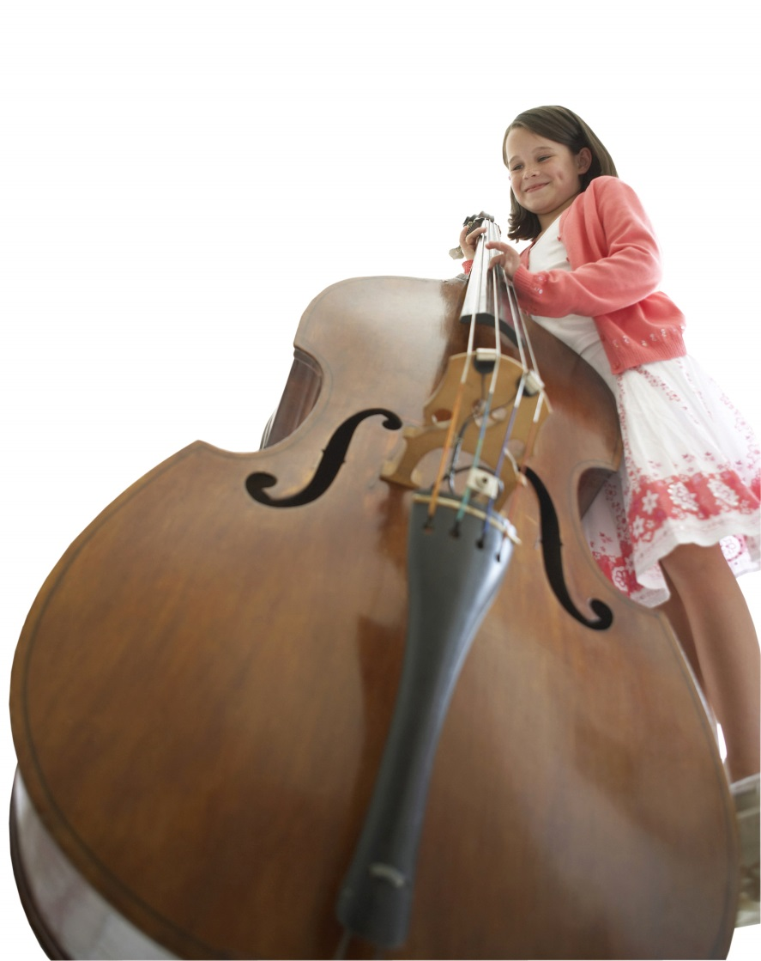
MUSIC MAKING
Develops Students in Many Ways
    Better math skills
    Better social skills
    More transferable skills
    Development of lifelong skill — making music
Notes:
Many studies support similar conclusions — music-making helps the brain develop in many positive ways, and it advances core learning and personal skills for life. With so many studies indicating the relationship of music-making to academic achievement, the case for music instruction is compelling. Many people, including the U.S. Congress, believe that the benefits to children and learning are undeniable. When we consider the challenges that our children will face in the workplace of the new millennium, we need to prepare them adequately. Music must be part of the curriculum. This enlightening information leads us to our statement of belief...

Slide 4
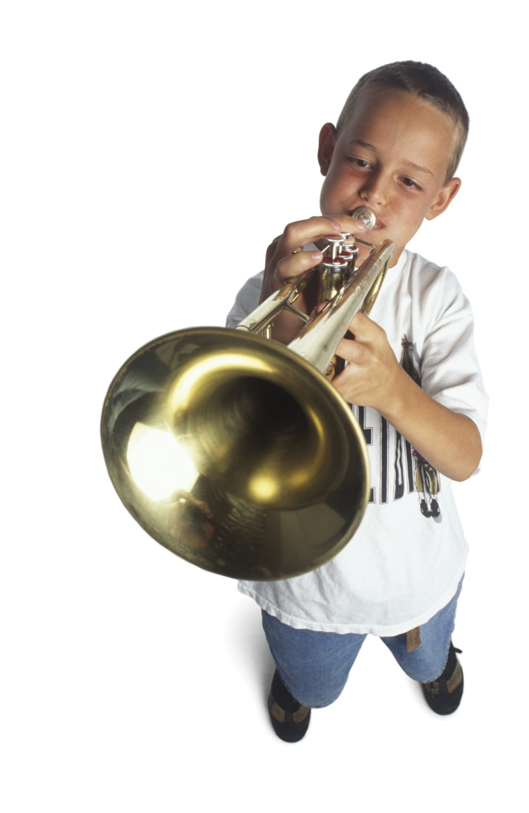
MUSIC STUDENTS
Score Higher on SATs
    Average 57 points
    higher in verbal
    Average 41 points
    higher in math
"Profile of SAT and Achievement Test Takers." The College Board, compiled by Music Educators National Conference, 2001.
With an average combined increase of almost 100 points, access to music study could make the difference in gaining admission to a student’s college of choice.
Notes:
The College Entrance Examination Board reports the following:
“Students of the arts continue to outperform their non-arts peers on the SAT. In 2000, SAT takers with coursework/experience in music performance scored 57 points higher on the verbal portion of the test and 41 points higher on the math portion than students with no coursework/experience in the arts.”
Source: "Profile of SAT and Achievement Test Takers." The College Board, compiled by Music Educators National Conference, 2001.
With an average combined increase of almost 100 points, access to music study could make the difference in gaining admission to a student’s college of choice.

Slide 5

Special Needs Students
            Children do not come in tidy packages — they come with spontaneity, energy, and delicious individuality. Some have learning challenges that affect them physically, cognitively, emotionally, and/or behaviorally. The good news is that music can help with most of them.
Music strengthens the areas of the brain that, in the child with ADHD, are weak. Music builds and strengthens the auditory, visual/spatial, and motor cortices of the brain. These areas are tied to speech and language, reading, reading comprehension, math, problem solving, brain organization, focusing, concentration, and attention issues.

Slide 6

MUSIC AT A YOUNG AGE
A study published in September 2006 in the scientific journal Brain indicates that young children who received a a year of musical training showed brain changes and superior memory when compared with children who did not receive the instruction.
Music builds imagination and intellectual curiosity: Introducing music in the early childhood years can help foster a positive attitude toward learning and curiosity. Artistic education develops the whole brain and develops a child’s imagination.
Dr. Nicolucci sites Dr. Edwin Gordon in promoting early childhood musical training: “musical aptitude can be increased through sustained musical exposures from birth through age 9 after which aptitude stabilizes for life”. His findings clearly demonstrate the critical need for regular music education during the earliest years of brain plasticity.

Slide 7


HISTORY OF WMB
WMB was formerly Weymouth Band Parents Association.
WBPA incorporated in 2004 as a non-profit corporation. Also is a 501(c)(3) tax qualified organization.
WBPA was a parent booster organization supporting WHS extra curricular band programs.
2014 Weymouth retained services of Dr. Sandra Nicolucci from BU who is an expert in music education and an evaluator of public school programs.

Slide 8


Weymouth Music Program before Report
Weymouth music program suffered from:
Lack of one person in charge of town wide music program;
At time of Dr. N’s report only 3 K’s receiving formal music
education!
Failure to teach all students how to read music;
No uniform curriculum;
Lack of updated technology;
Low budget; and
Poor feeder program for chorus and instrumentalists between 5th grade and HS.

Slide 9
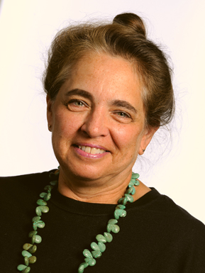
Dr. Nicolucci’s Report
Dr. N interviewed administration, music teachers K-12, parents and students in January of 2014.
WBPA met with Dr. N.
WBPA’s main concerns:
1. Weymouth music program as a whole
2. Feeder program from middle school to HS
3. Future of WHS Marching Band Program

Slide 10
Report’s Conclusions
Dr. N issued a 52 page report which she presented to the Weymouth School Committee in February of 2014.
Dr. N recommended the WHS Marching Band be disbanded and recommended a pep band instead.
Dr. N recommended as 1 of 6 major commendations to SC:
“a newly conceived K-12 Weymouth Music Parent Association that would absorb the current WBPA while expanding its support and advocacy to cover all music teachers and initiatives in the department [that] has been expressed during this review.”

Slide 11

Then she left town!

Slide 12

What Next?
WBPA changed its name to the Weymouth Music Boosters in spring of 2014.
WMB changed its purpose in fall of 2014 to: “to promote all aspects of music education for grade K-12 students of Weymouth Public Schools. The WMBA shall provide support to enhance the experiences of music students, and to serve as a resource to the staff and administration of the music department of Weymouth Public Schools.”
WMB expanded horizontally at the WHS Chapter level to include chorus and other musicians.

Slide 13
What Next?
We researched and developed a program that we believed met the unique needs of the Town of Weymouth’s Music Program.
We amended our By Laws to create a town wide K-12 10 Chapter music booster organization that is 501(c)(3) exempt.
We introduced by letter the Program to the school administration, the mayor, the school committee, the principals, and the music teachers.
And now after 4 years we are excited and
very proud to present the new program to you!

Slide 14
Weymouth Music Boosters
K-12 Program

Slide 15

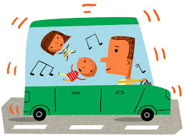
Who may be a member of a WMB Chapter?
“The WMBA shall consist of Parents, Guardians and Friends of students participating in the music programs of the Weymouth Public Schools, and any other individuals interested in furthering the purpose of the WMBA.”

Slide 16
Structure
The town wide WMB will potentially consist of 10 chapters.
The chapters will consist of:
1. Each of the 8 primary schools.
2. One middle school chapter consisting of Adams and Chapman.
3. The WHS chapter that already exists.
4. Parents or a school’s parent council are not required to organize a WMB chapter at any school.
Organizational makeup
1. Necessary numbers of members to allow for the election of Officer’s and follow Roberts Rules of Order (WHS currently), or
2. One member on a school’s parent’s council, or
3. Several member’s meeting monthly.

Slide 17
Requirements
Each chapter must:
1. Follow the WMB Bylaws.
2. Open up a joint bank account using WMB tax id #, when you have income or expenses.
3. Report at the end of August its financial infor- mation to the WHS treasurer for the purpose of preparing the tax return and non-profit filings due annually by the Association.
4. One representative of Chapter meets once annually in May with other chapter representatives at WHS.
5. Any fundraiser must be clearly identified by the Chapter name.

Slide 18

Other than the above, your Chapter is free to operate however it elects. One member or many. Set your own goals. Meet your own music teacher’s and students’ needs. Work with other chapters if it is beneficial.

Slide 19

Sounds great! How do we start!
Go to your school’s next parent council meeting, and tell them all about the WMB’s.
Have a K-12 Committee Rep. speak at your next PC meeting.
Fill in the chapter membership form and email it to info@weymouthmusicboosters.org
Introduce yourselves to your music teachers. Give them your contact information. Invite them to a meeting.
Get to know your music teacher. We prepared a survey based on Dr.N’s report. You can download it in word from our Website, edit it, and email to your teacher. Or prepare one of your own. The music teachers know the surveys are coming!

Slide 20

How do we help our music teacher?
Volunteer in a music classroom if teacher thinks helpful.
Conduct fundraisers.
Assist in extracurricular programs, including providing an honorarium for your music teacher if there is no stipend available.
Purchase music and/or instruments beyond current music budget.
Volunteer and assist with expenses regarding musically themed field trips.

Slide 21

What else can we do?
Start a music program during Wey Care.
Coordinate after school enrichment programs with WHS and/or middle school students teaching them.
Coordinate performances outside school (for example, nursing homes or the Whipple Senior Center).
Coordinate with outside school musical groups.
Research grant opportunities.
Create a donate an instrument program.
Invite parents with musical training to perform for students.
Create musical programs for special needs students.
Organize a Music Summer Camp.

Slide 22
Inspirational Quotes
“Some people think music education is a privilege, but I think it’s essential to being human.” – Jewel, singer, songwriter, and instrumentalist
“The life of the arts, far from being an interruption, a distraction, in the life of the nation, is close to the center of a nation's purpose - and is a test to the quality of a nation's civilization.” – President John F. Kennedy
“Logic will get you from A to B. Imagination will take you everywhere.”
-Albert Einstein
“In every successful business…there is one budget line that never gets cut. It’s called ‘Product Development’ – and it’s the key to any company’s future growth. Music education is critical to the product development of this nation’s most important resource – our children.”– John Sykes, Pres., VH1

Slide 23

Thank you for listening!
Please invite us to your school so we can introduce our K-12 Program!

