Slide 1
Weymouth Wildcats Drum Line
Interested?
Sign Up To Learn More

Slide 2
Weymouth Wildcats Drum Line
Name | Grade | Instrument/Experience (Snare, Bass, Quads, Mallets, Cymbals)

Slide 3
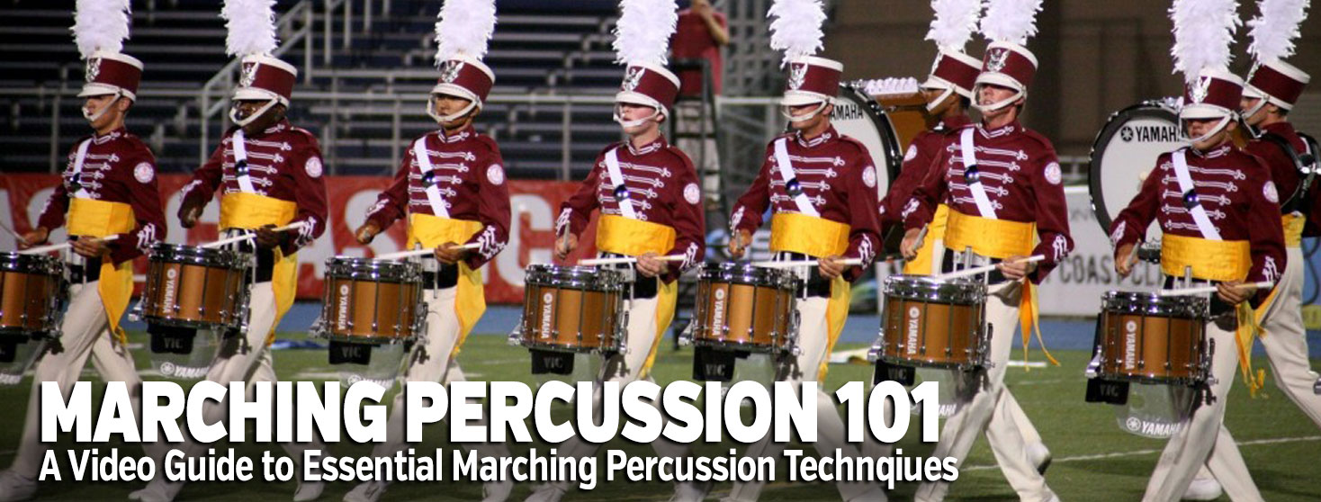
Weymouth Wildcats Drum Line
We will utilize the marching percussion portal available at www.vicfirth.com
http://vicfirth.com/marching-percussion-101-technique-exercises//

Slide 4
Weymouth Wildcats Drum Line
Tape Your Sticks with White Electrical Tape
click to watch how
Snares:
Marching Sticks
Traditional Grip is encouraged but not required.
Tenors:
Marching Sticks
Matched Grip
Bass Drums:
BD Mallets, size dependent on drum size
Matched Grip
Front Ensemble:
Mallets, No Tape
Matched Grip

Slide 5
Weymouth Wildcats Drum Line
Download the Instructional booklet from the Vic Firth Web Site:
http://vicfirth.com/marching-percussion-101-technique-exercises/
http://vicfirth.com/wp-content/uploads/2014/09/MP101_Exercise_Packet.pdf
Printed copies are available
Get a Metronome: Lots or free apps
App for Iphone
App for Android
Web Metronome
Old school: South Shore Music in Weymouth Landing has them for about $20.00
Practice Pad: Many options out there…here’s a tip: cloth covered mouse pads work great and are cheap.

Slide 6
Weymouth Wildcats Drum Line
Watch the Video of the exercise
Have the music on a stand in front of you
Start with Exercise 1
8 on a Hand:
https://youtu.be/Wmr5RbNk79U
Battery players use “sticks out/sticks In” technique for each exercise (see Mason booklet page 2)
Front Ensemble players use concert approach
Start each exercise slowly, ex: mm=90 bpm ¼ note pulse.
“even” and “clean” is always more important than fast…speed will come gradually
Use a wrist “Moeller “technique in your stroke…this will be important at faster tempos.
Keep Stick Heights consistent (see Mason Book, page 2)

Slide 7
Weymouth Wildcats Drum Line
Exercise 2
16th Note Timing
https://youtu.be/I3pSy7Vt1wE

Slide 8
Weymouth Wildcats Drum Line
Cool Drumline examples
Umass
https://umassdrumline.org/2016/04/07/flam-thing-micca/
https://umassdrumline.org/2016/04/07/hot-hot-hot-micca/
Thunderbolt
Video
https://www.youtube.com/watch?v=Yfvv6OGn2Bw
PDF:
http://www.freedrumlinemusic.com/Thunderbolt.pdf
Printed copies available…mark your part with a highlighter

Slide 9
Weymouth Wildcats Drum Line
Front Ensemble/PIT Players interested in keyboard instruction will also benefit from the Vic Firth Series on Marimba technique:
http://vicfirth.com/sequential-studies-for-4-mallet-marimba/

Slide 10
Weymouth Wildcats Drum Line
More links to Cool Sites
Umass Drumline
Spartans Drum and Bugle Corps
DCI
WGI

