Slide 1
Neurodivergence and Co-occurring Chronic Health Conditions
Ruth Dottin, MD

Slide 2
Objectives
1. Define Neurodivergence: Explain what neurodivergence is and how differences in sensory processing, body awareness (interoception), and executive function affect health care.
2. Recognize the "Triad" of Co-Occurring Conditions: Identify the common overlap between neurodivergence, hypermobility (loose joints), POTS (autonomic dysregulation), and MCAS (mast cell/immune reactivity).
3. Understand Why These Conditions Co-Occur: Outline the underlying connections, including shared tissue development, overactive stress responses, and systemic inflammation.
4. Introduce a Multimodal Treatment Approach to these Conditions
5. Adapt Care for Neurodivergent Patients: Use patient-centered adjustments, such as alternative pain scales, sensory-friendly practices, clear written instructions, and pacing strategies.

Slide 3
What is Neurodivergence?
Neurodivergence refers to brain function, learning, and information processing that naturally diverges from dominant neurotypical standards. It is an umbrella term coined within the neurodiversity paradigm, framing variations in human brain function as natural diversity rather than purely medical deficits.
It Includes Diagnoses & Neurotypes of:
  Autism
  Attention-Deficit/Hyperactivity Disorder (ADHD)
  Developmental Coordination Disorder (DCD/Dyspraxia)
  Tourette Syndrome and Tic Disorders
  Learning Differences (Dyslexia, Dyscalculia, Dysgraphia)

Slide 4
What are some key traits that are relevant to these individuals’ physical health?
1. Sensory Processing Differences: Hyper- or hypo-sensitivity to light, sound, texture, temperature and internal bodily signals
2. Interoceptive Differences: Difficulty recognizing or interpreting internal physical sensations (i.e. hunger, full bladder, illness, pain levels, or emotional states)
3. Executive Functioning: Differences in planning, working memory, task initiation, and energy regulation

Slide 5
What are commonly co-occurring chronic physical health conditions?
The “Neurodivergent Triad”
  1. Hypermobility Spectrum Disorders (HSD) & Hypermobile Ehlers-Danlos Syndrome (hEDS)
  2. Dysautonomia (particularly POTS – Postural Orthostatic Tachycardia Syndrome)
  3. Mast Cell Activation Syndrome (MCAS)
Other Commonly Associated conditions
  Gastrointestinal Disorders: Irritable Bowel Syndrome (IBS), delayed gastric emptying (gastroparesis), small intestinal bacterial overgrowth (SIBO)
  Chronic Pain Conditions: Fibromyalgia, vulvodynia, temporomandibular joint disorder (TMJ), Central Sensitization Syndrome
  Myalgic Encephalomyelitis/Chronic Fatigue Syndrome (ME/CFS)

Slide 6
Hypermobility Spectrum Disorders (HSD) & Hypermobile Ehlers-Danlos Syndrome (hEDS)
Genetic/heritable connective tissue disorders characterized by joint hypermobility, tissue fragility, soft skin, and systemic joint instability
Common symptoms:
  Generalized Joint Hypermobility
  Joint instability: frequent subluxations and dislocations with minimal triggers
  Chronic musculoskeletal pain: often stemming from chronic strain as muscles overcompensate for loose ligaments
  Soft tissue injuries: recurrent sprains, strains, tendonitis, bursitis, etc.
  Early-onset osteoarthritis
  Impaired proprioception: Leading to clumsiness, poor balance, frequent tripping

Slide 7
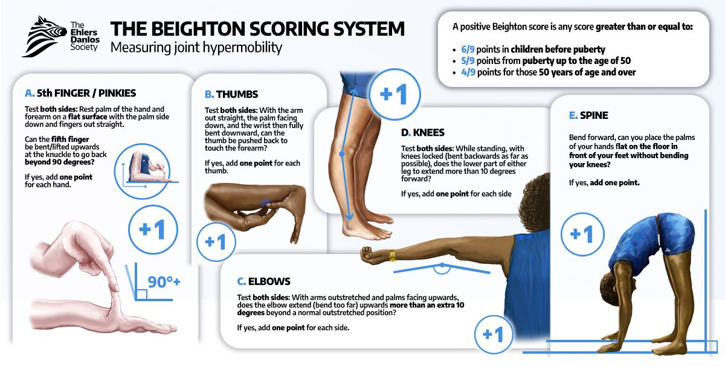
Notes:
https://www.ehlers-danlos.com/assessing-joint-hypermobility/

Slide 8
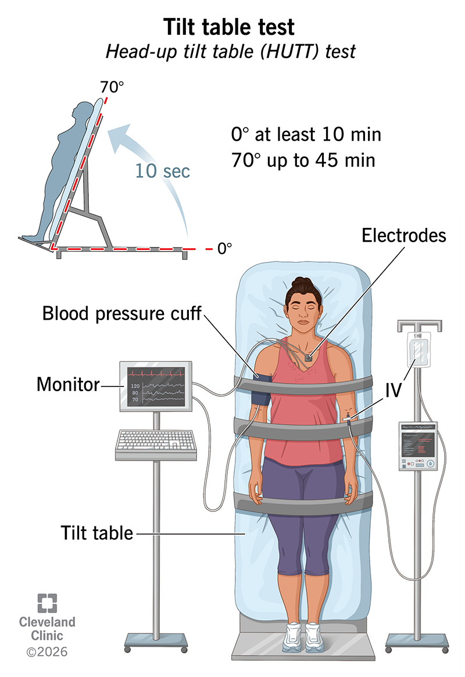
Dysautonomia/Postural Orthostatic Tachycardia Syndrome (POTS)
Malfunction of the autonomic nervous system (ANS), which controls involuntary functions like heart rate, blood pressure, digestion, and temperature control.
Manifests as orthostatic intolerance (dizziness/racing heart upon standing), brain fog, temperature dysregulation, and exercise intolerance.
Notes:
https://my.clevelandclinic.org/health/diagnostics/17043-tilt-table-test

Slide 9
Mast Cell Activation Syndrome (MCAS)
Immunological condition where mast cells inappropriately release inflammatory chemical mediators (histamine, leukotrienes, prostaglandins, etc.).
Causes multi-system allergic-type symptoms:
  Dermatologic: Flushing, itching, hives, angioedema
  Gastrointestinal: constipation, diarrhea, cramping, bloating, reflux, nausea, vomiting
  Cardiovascular/Autonomic: high or low blood pressure, tachycardia, palpitations, lightheadedness, dizziness
  Respiratory/Nasopharyngeal: nasal congestion, runny nose, shortness of breath, wheezing, coughing
  Neuropsychiatric: Headaches, migraines, brain fog, anxiety, panic, insomnia, irritability
  Musculoskeletal: diffuse pain, bone and muscle aches
  Urogynecological: urinary frequency, bladder pain, painful, heavy periods

Slide 10
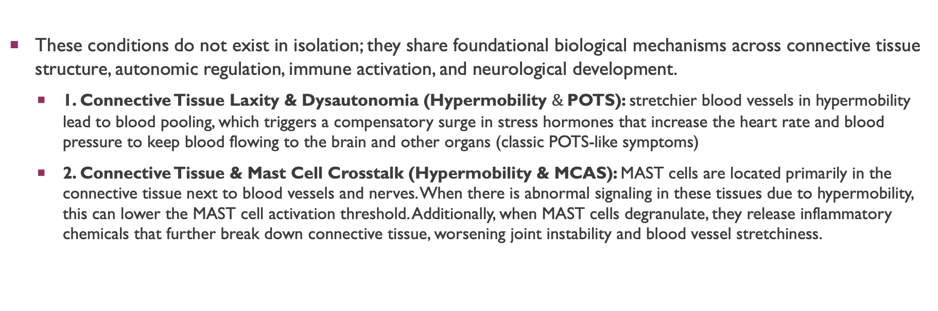
Why do these conditions Co-occur?
These conditions do not exist in isolation; they share foundational biological mechanisms across connective tissue structure, autonomic regulation, immune activation, and neurological development.
  1. Connective Tissue Laxity & Dysautonomia (Hypermobility $\&$POTS): stretchier blood vessels in hypermobility lead to blood pooling, which triggers a compensatory surge in stress hormones that increase the heart rate and blood pressure to keep blood flowing to the brain and other organs (classic POTS-like symptoms)
  2. Connective Tissue & Mast Cell Crosstalk (Hypermobility & MCAS): MAST cells are located primarily in the connective tissue next to blood vessels and nerves. When there is abnormal signaling in these tissues due to hypermobility, this can lower the MAST cell activation threshold. Additionally, when MAST cells degranulate, they release inflammatory chemicals that further break down connective tissue, worsening joint instability and blood vessel stretchiness.

Slide 11
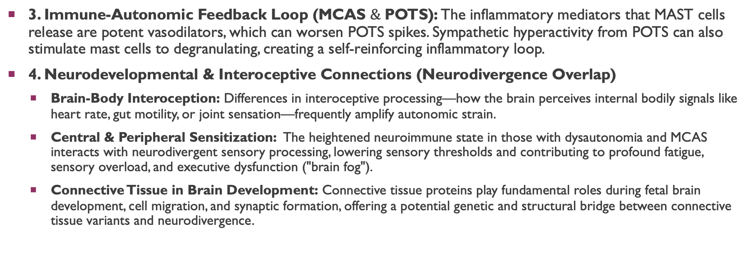
Why do these conditions Co-occur?
3. Immune-Autonomic Feedback Loop (MCAS $\&$POTS): The inflammatory mediators that MAST cells release are potent vasodilators, which can worsen POTS spikes. Sympathetic hyperactivity from POTS can also stimulate mast cells to degranulating, creating a self-reinforcing inflammatory loop.
4. Neurodevelopmental & Interoceptive Connections (Neurodivergence Overlap)
  Brain-Body Interoception: Differences in interoceptive processing—how the brain perceives internal bodily signals like heart rate, gut motility, or joint sensation—frequently amplify autonomic strain.
  Central & Peripheral Sensitization: The heightened neuroimmune state in those with dysautonomia and MCAS interacts with neurodivergent sensory processing, lowering sensory thresholds and contributing to profound fatigue, sensory overload, and executive dysfunction ("brain fog").
  Connective Tissue in Brain Development: Connective tissue proteins play fundamental roles during fetal brain development, cell migration, and synaptic formation, offering a potential genetic and structural bridge between connective tissue variants and neurodivergence.

Slide 12
Treatment is Multimodal and interdisciplinary
Specialist Care: Cardiologist, Neurologist, Immunologist/Allergist, Rheumatologist, Clinical Geneticist
Medications: H1/H2 blockers, other MAST Cell Stabilizers, Propranolol, Stimulants, antidepressants, benzodiazepines
Physical and Occupational Therapy
Psychotherapy: CBT, Mind/Body Work, Somatic Practices (The Gupta Program, Primal Trust, PRT)

Slide 13
Treatment is Multimodal and interdisciplinary
Lifestyle Changes:
  Dietary: Whole food diet with minimal chemical additives, low histamine diet, fluid and electrolyte supplementation
  Exercise: Strengthening muscles to stabilize joints, limiting triggering exercise forms and incorporating moving meditation exercise (Yoga, Tai Chi, QiGong)
  Sleep: maintaining normal circadian rhythms, early morning light exposure
  Stress Management
  Elimination of Toxins: Alcohol, tobacco, other environmental toxins (fragranced cleaning and personal care products, microplastics, tephlon, etc.)
  Social Support and Connection: Support groups, Family Therapy and Treatment planning, enlisting the support of loved ones

Slide 14
Unique considerations for managing symptoms in this population
Differences in Interoception: these individuals may be have either an increase or decrease in interoceptive awareness (or a combination of both). This can lead to either heightened sensitivity to symptoms or not realizing they are having a reaction or flair until there is a severe decompensation
  Use objective tracking over subjective scales
  Pair specific physical sensations with immediate corrective actions
Sensory Issues: These individuals may not be able to tolerate certain interventions (a restrictive diet, compression stockings or abdominal binders) due to their sensory sensitivities
  Use compressive devices that have soft seamless fabrics or a weighted compression vest that also helps with sensory regulation
  Work with the patient to find well-tolerated and nutritious “Safe foods”

Slide 15
Unique considerations for managing symptoms in this population
Differences in responses to medications:
  Tend to be very sensitive to the effects of medications (both the therapeutic and adverse effects): start low and go slow
  More prone to having paradoxical reactions
  More susceptible to having an adverse reaction to a non-active ingredient (binders, fillers, dyes, etc.): They may need to try different formulations or take a compounded formulation that is mixed with more benign excipient ingredients
Executive Functioning differences: taking a medication or implementing an intervention multiple times per day can be a challenge, or trying to incorporate multiple lifestyle changes at once can be difficult.
  Habit stack – link intervention with a previously established daily routine (brushing teeth, eating lunch, etc.)
  Start with one intervention at a time
  Use visible pill organizers or other visual aids (water bottle with intake goals)

Slide 16
Resources
Afrin, L. B., et al. (2020). Often unseen: Mast cell activation syndrome. The American Journal of the Medical Sciences, 360(6), 650–668.
Baeza-Velasco, C., et al. (2018). Autism, hypermobility, and dysautonomia: On the cause of neurodivergent sensory differences. Frontiers in Integrative Neuroscience, 12, 49.
Casanova, E. L., et al. (2020). The relationship between autism and Ehlers-Danlos syndromes/hypermobility spectrum disorders. Journal of Personalized Medicine, 10(4), 260.
Csecs, F. L. V., et al. (2022). Joint hypermobility links neurodivergence to dysautonomia and pain. Frontiers in Psychiatry, 13, 786916.
Eccles, J. A., et al. (2015). Variant connective tissue (joint hypermobility) and its relevance to psychiatric presentation. Current Psychiatry Reports, 17(7), 55.
Eccles, J. A., et al. (2021). Brain structure and autonomic neuroimmunology in joint hypermobility and neurodivergence. Trends in Neurosciences, 44(8), 612–623.
Fu, Q., & Levine, B. D. (2018). Exercise and non-pharmacological treatment of postural tachycardia syndrome. Autonomic Neuroscience, 215, 116–127.
Gensemer, C., et al. (2021). Hypermobile Ehlers-Danlos syndrome: Clinical description and neurodivergent considerations. American Journal of Medical Genetics Part C, 187(4), 429–444.
Glans, M., et al. (2022). High prevalence of joint hypermobility region in neurodevelopmental conditions: A systematic review and meta-analysis. Journal of Psychiatric Research, 155, 300–308.
Hakim, A., Keer, R., & Grahame, R. (2010). Hypermobility, Fibromyalgia and Chronic Pain. Elsevier Health Sciences.
Kohn, A., & Chang, C. (2020). The relationship between hypermobile Ehlers-Danlos syndrome (hEDS), postural orthostatic tachycardia syndrome (POTS), and mast cell activation syndrome (MCAS). Clinical Reviews in Allergy & Immunology, 58(3), 273–297.
Raj, S. R. (2013). Postural tachycardia syndrome (POTS). Circulation, 127(23), 2336–2342.
Theoharides, T. C. (2024). Mast cells in Autism Spectrum Disorder—The enigma to be solved? International Journal of Molecular Sciences, 25(5), 2630.
Wang, E., Ganti, T., et al. (2021). The relationship between mast cell activation syndrome, postural tachycardia syndrome, and Ehlers-Danlos syndrome. Allergy and Asthma Proceedings, 42(3), 243–246.

Slide 17
Thank you!

