Slide 1
ECG Review
Fil Gilic

Slide 2
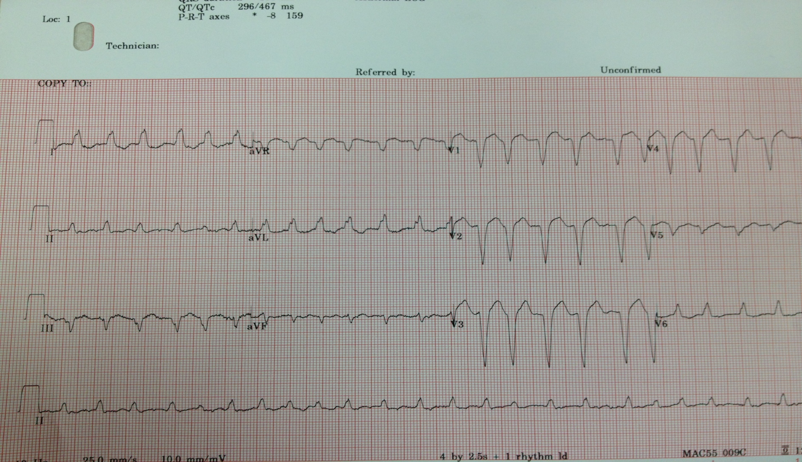
1

Slide 3
Rate 150
Afib
LAD/away from chest wall
LBBB
No ST changes

Slide 4
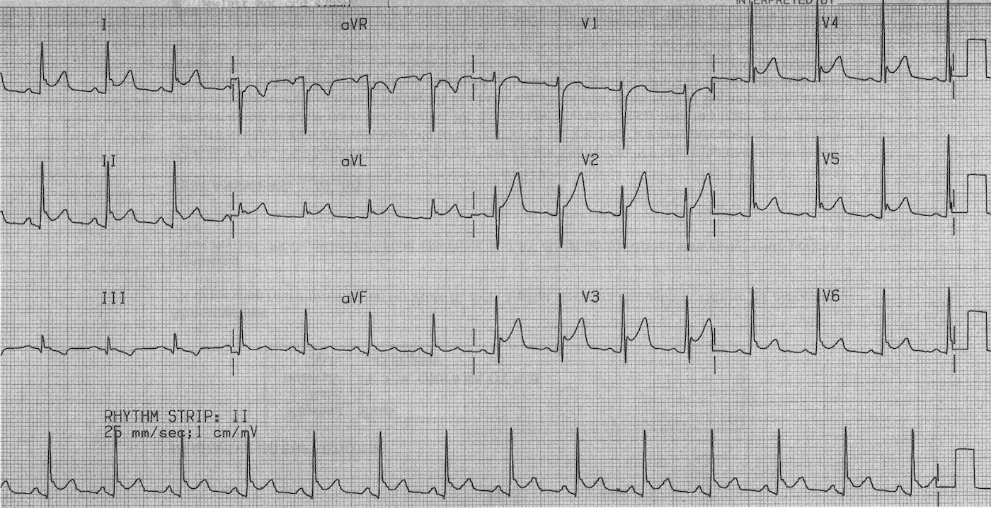
2

Slide 5
Rate 90
Sinus
N axis 2D/3D
No hypertrophy
No block
Diffuse ST elevations with pr depression
pericarditis

Slide 6
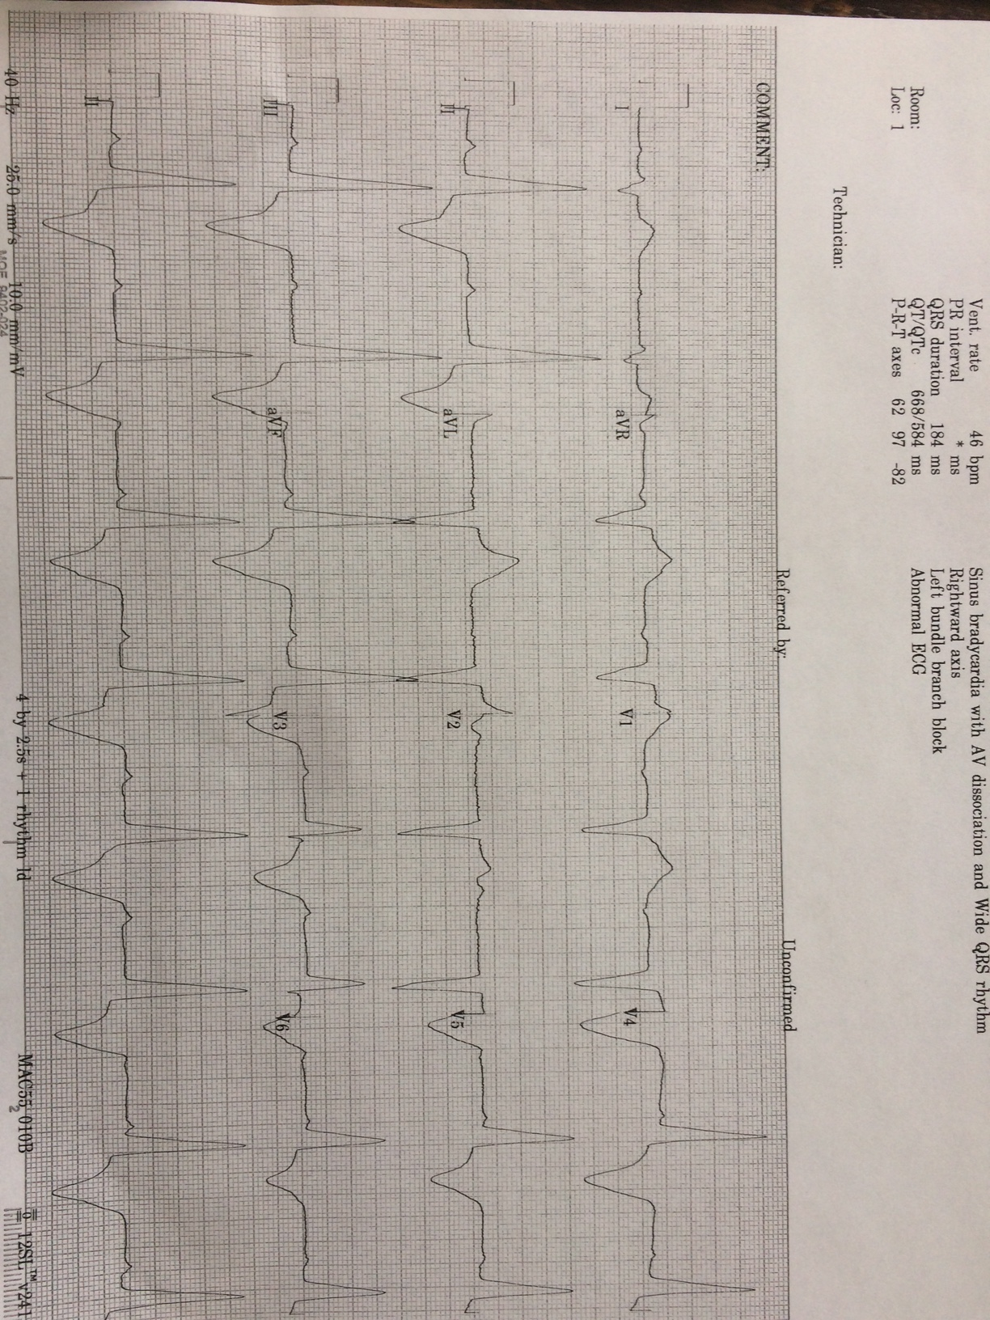
3

Slide 7
Rate :30
AVB 3rd degree
RAD/away from the chest wall
No hypertrophy
No conduction block
No ST changes

Slide 8
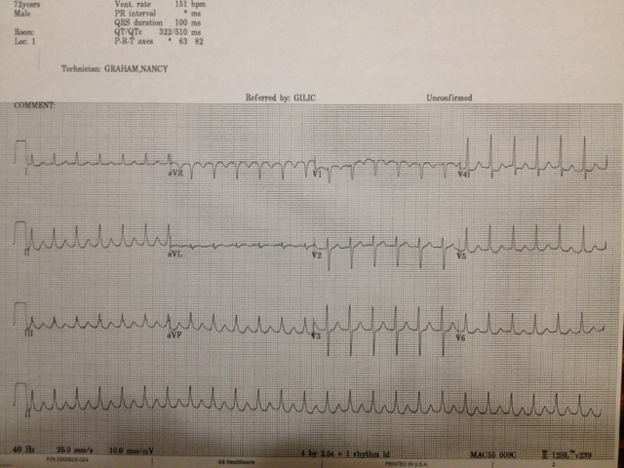
4

Slide 9
Rate 150
Aflutter 2:1 (1 squiggle!)
Axis N 2D/3D
No hypertrophy
No block
No ST changes (ignore ST depression in tachyarrhythmias)

Slide 10
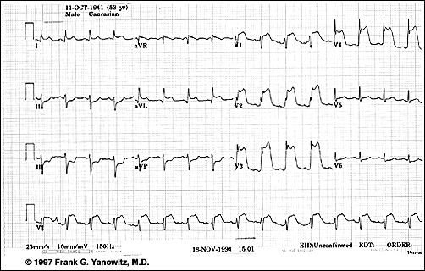
5

Slide 11
Rate 80
Sinus
Slight LAD/ N 3D
No hypertrophy
No block
Anterolateral STEMI (w inferior reciprocal ST Dep)

Slide 12
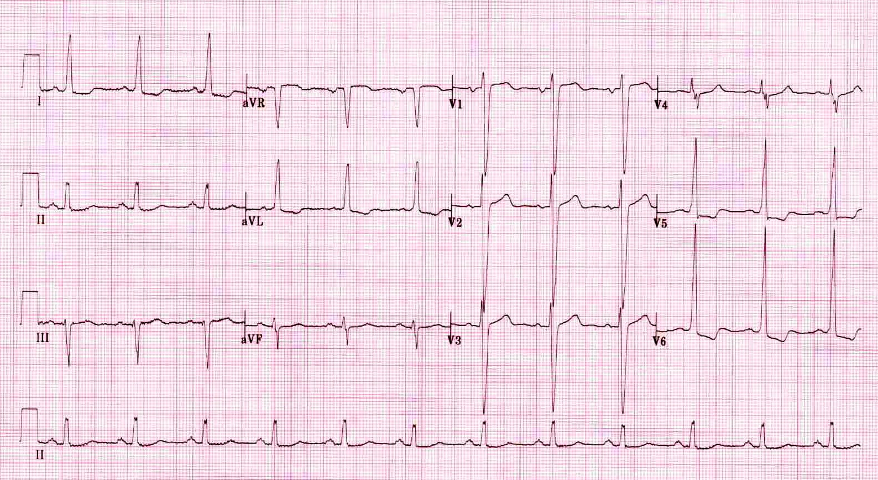
6

Slide 13
Rate 80
Sinus
LAD
LVH
No block
No ST changes (appropriate discordance)

Slide 14
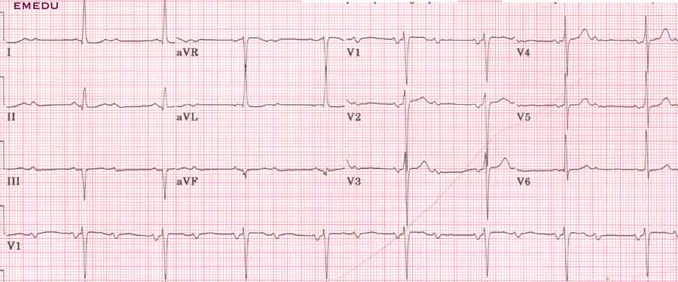
7

Slide 15
Rate 50
AVB: 2nd type 2
LAD/ N 3D
?LVH- >11mm in aVL
No conduction block
No ST changes

Slide 16
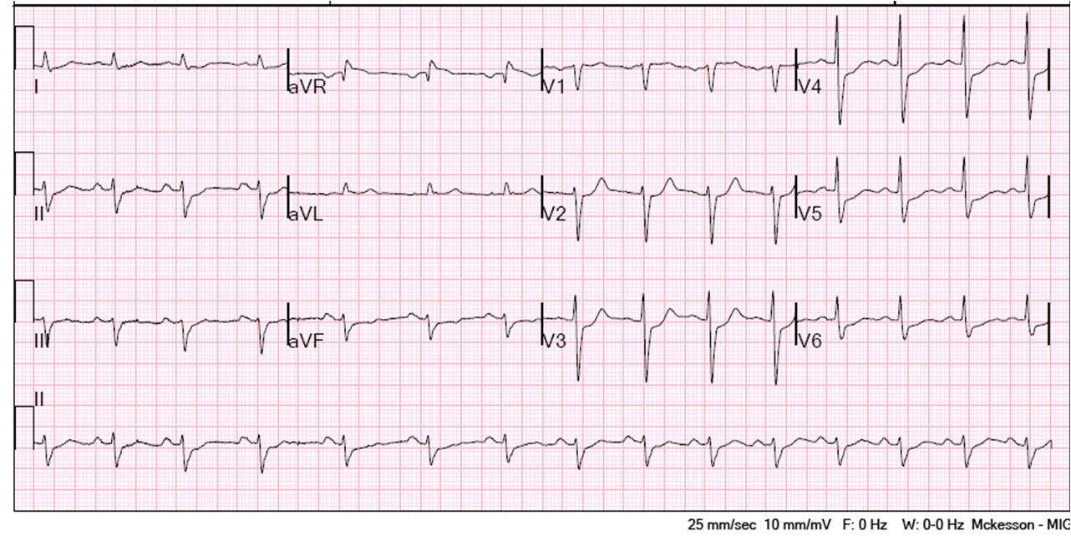
8

Slide 17
Rate 80
Sinus
L leaning axis/ N 3D
No hypertrophy
No block
ST depressions

Slide 18
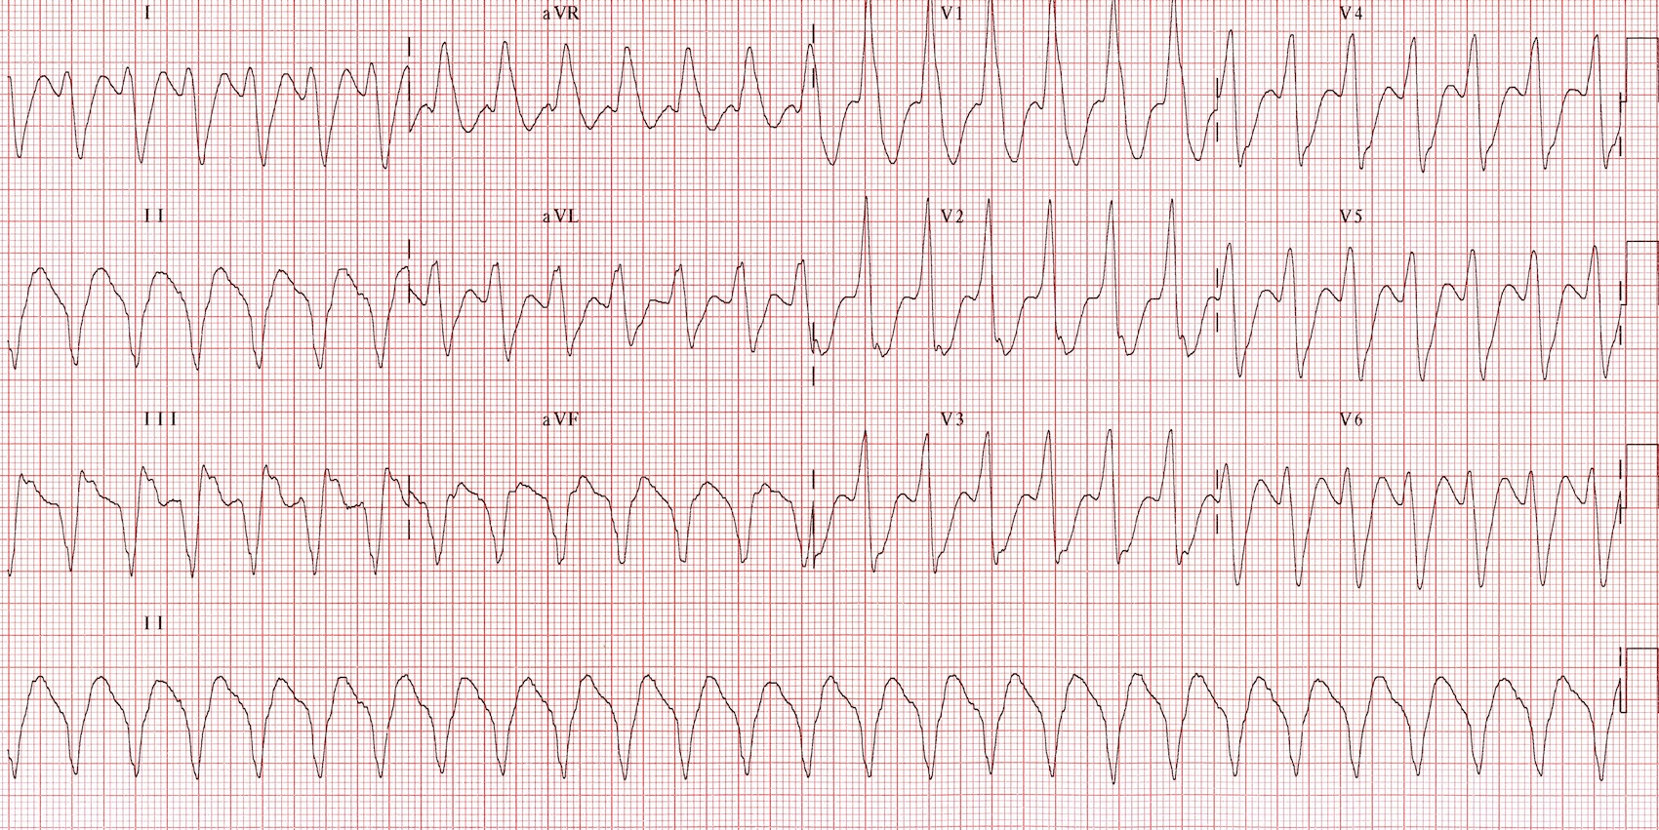
9

Slide 19
Rate 150
VT (shark’s teeth in II)
Extreme RAD (up and right)/ towards the chest wall
No hypertrophy
No block
No ST changes

Slide 20
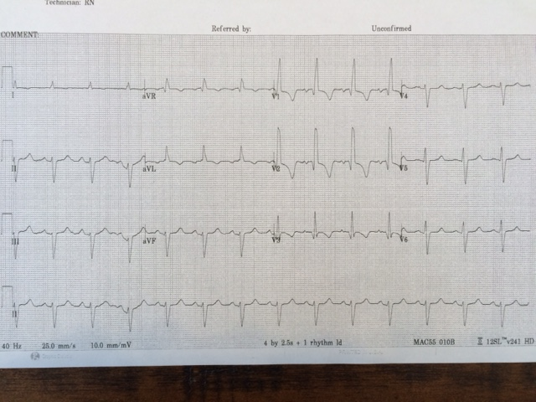
10

Slide 21
Rate: 100
Sinus
Mild LAD/strong towards chest wall
No LVH, so LAFB
RBBB
No ST changes

