Slide 1

When Lives are on the Line; and Seconds Count
Filip Gilic, CCFP-EM

Slide 2





Disclosures – Filip Gilic
Notes:
CADAVERS
NO PICTURES

Slide 3
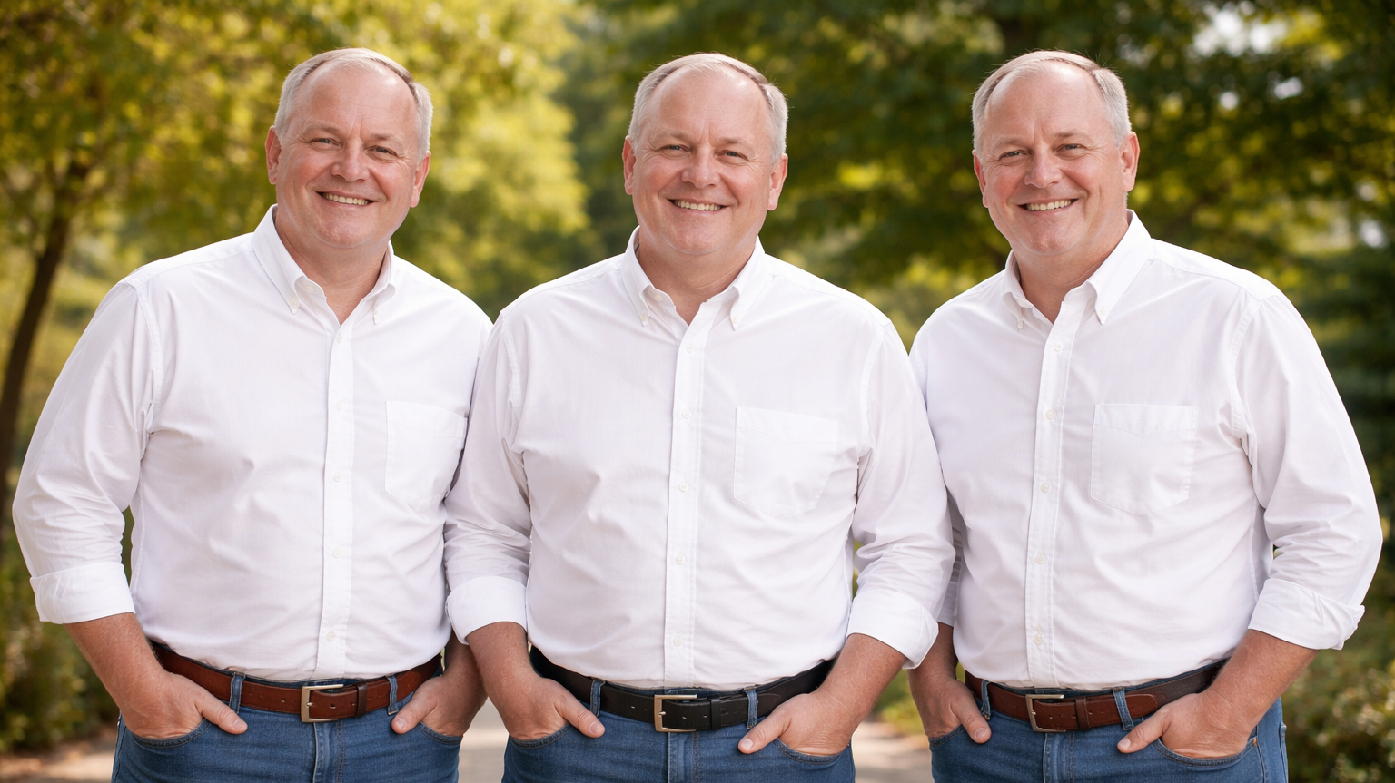
Notes:
Jim, Bob and Jimbo

Slide 4
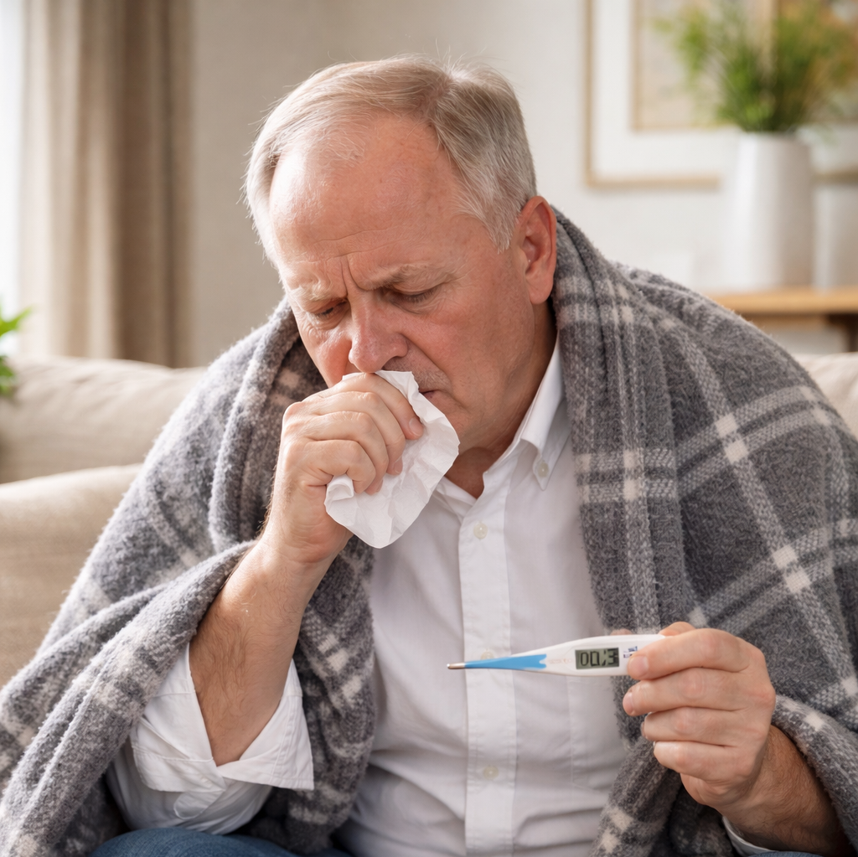
Jim
Cough and sputum
Fever
HR 105, BP 120/80, RR 18, SpO2 93%, Temp 38.2
Crackles RML

Slide 5
Forced To Act
Business As Usual
Slowing Down When You Should
Don’t Have Time
Consequence to Inaction
Have Time
Things Make Sense
Have Time
Things Don’t Make Sense
Action Loops
Observe
Orient
Decide
Act
Internal Medicine Model
Pause
Confirm Your Facts
Zoom Out
Widen the Search
Use First Principles

Slide 6
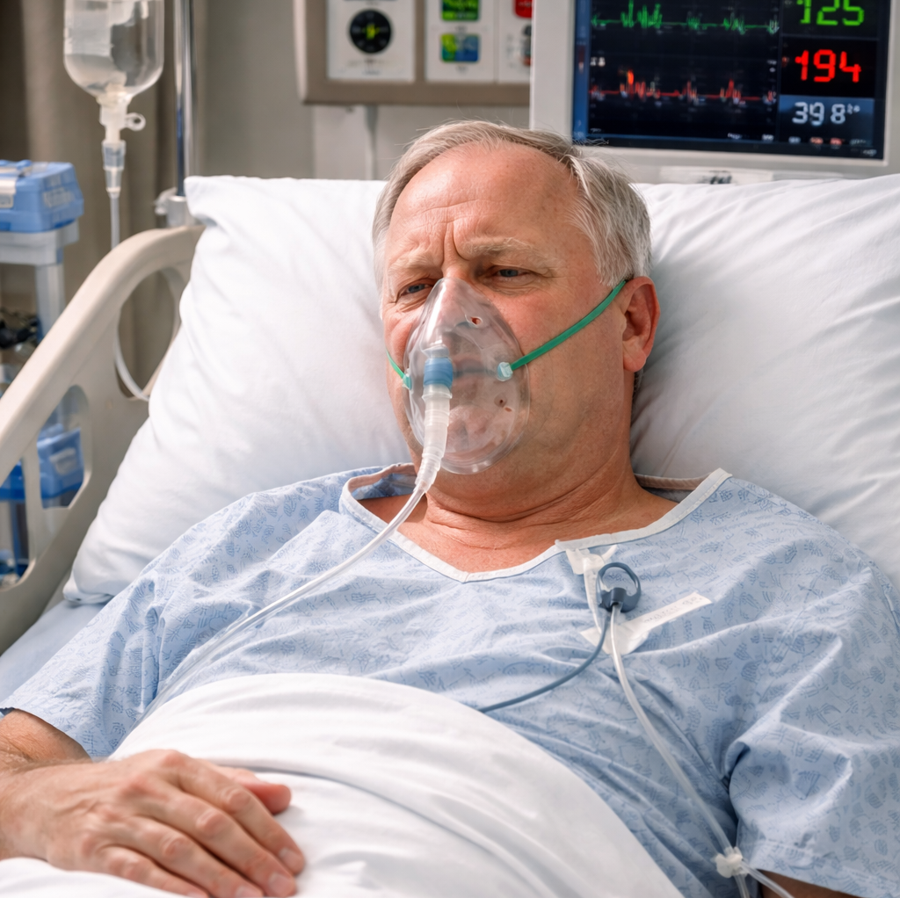
Bob
Cough and sputum
Fever
Gasping for air
HR 145, BP 90/60, RR 35, SpO2 73%, Temp 39.6
High work of breathing
Crackles diffuse bilateral

Slide 7
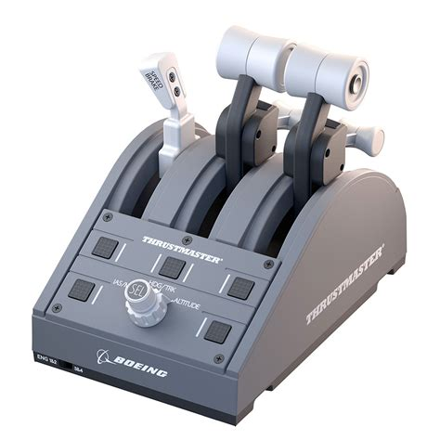

Slide 8
Forced To Act
Business As Usual
Slowing Down When You Should
Don’t Have Time
Consequence to Inaction
Have Time
Things Make Sense
Have Time
Things Don’t Make Sense
?
Internal Medicine Model
Pause
Confirm Your Facts
Zoom Out
Widen the Search
Use First Principles

Slide 9
A
B
C

Slide 10
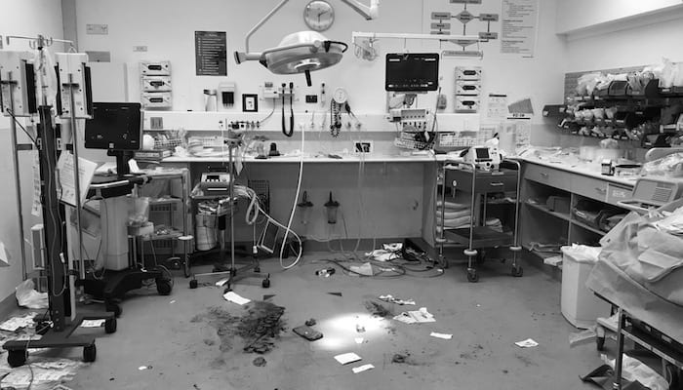
Notes:
It is a complex reality- patient is screaming, monitors are beeping, EMS wants to give you a report, nurses are talking to each other and RT is asking you what you want to set up
It is a complex reality- patient is screaming, monitors are beeping, EMS wants to give you a report, nurses are talking to each other and RT is asking you what you want to set up

Slide 11

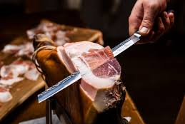
What are our natural tendencies?
Notes:
KS
Trying to solve the entire problem at once rather than taking it a thin slice at a time. Divide a complex decision into a series of simpler binary decisions

Slide 12
Forced To Act
Business As Usual
Slowing Down When You Should
Don’t Have Time
Consequence to Inaction
Have Time
Things Make Sense
Have Time
Things Don’t Make Sense
Action Loops
Internal Medicine Model
Pause
Confirm Your Facts
Zoom Out
Widen the Search
Use First Principles
Notes:
Observe
Orient
Decide
Act

Slide 13
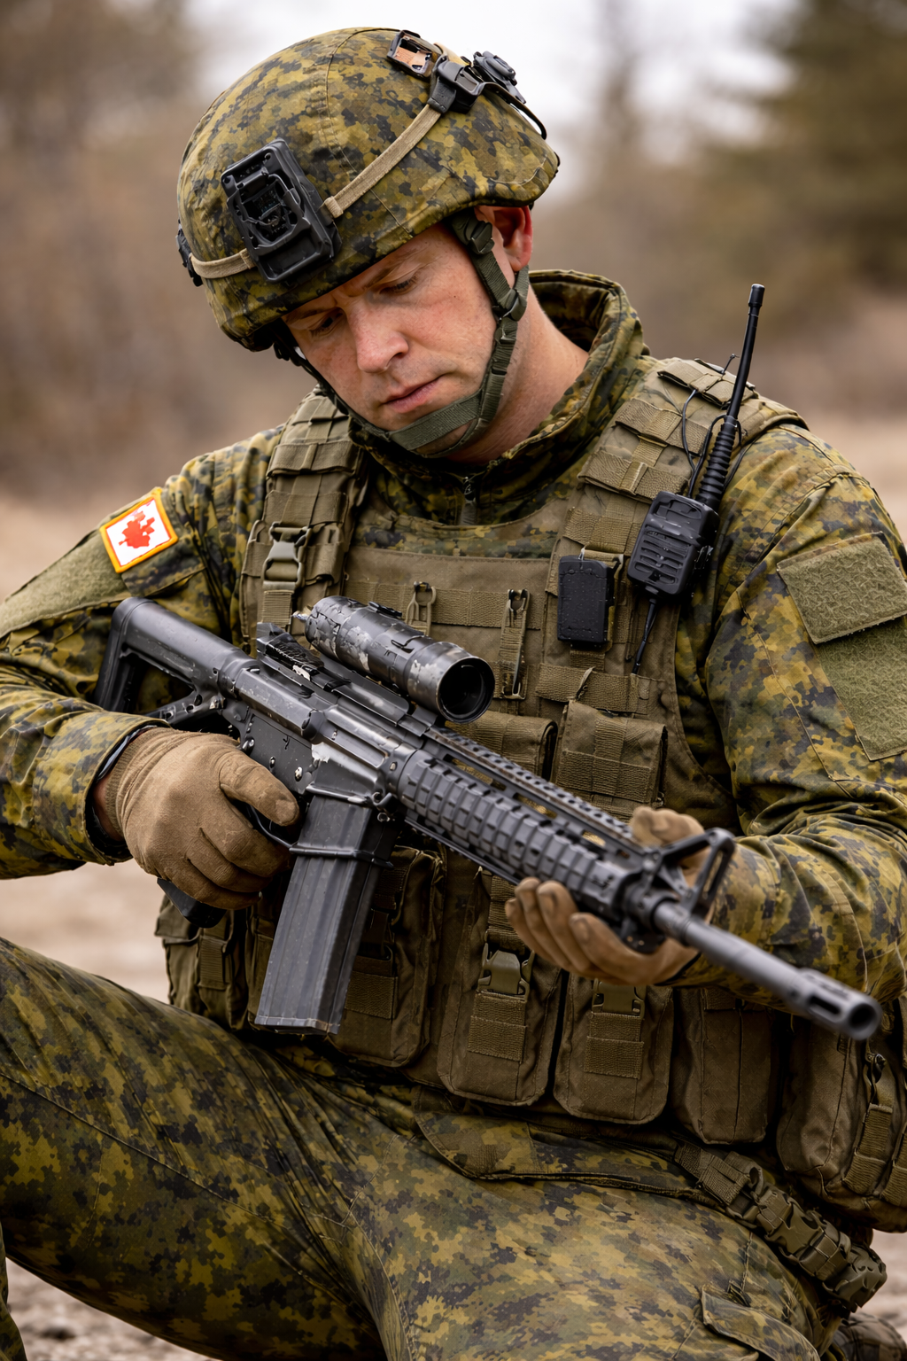
Notes:
Story of immediate action drill for rifle stoppage

Slide 14
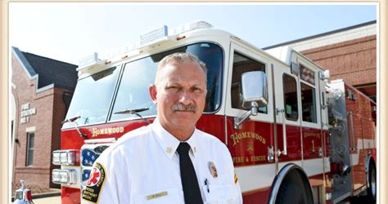

Slide 15
Recognition-primed Decision (RPD) Process
Generates
Situation
Assessed
Thru
Pattern
Matching
Affect The
Mental Simulations
Mental Simulations
Driven
By
Action Script
Cues
Help us Recognize
Mental
Models
Trigger
Patterns

Slide 16
Action Loop
Observe
Orient
Decide
Act

Slide 17
OBSERVE LESS
BUT BETTER

Slide 18
SALIENT
RELIABLE
Notes:
Amateurs look at everything, pros look at few key things

Slide 19
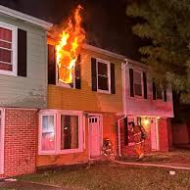
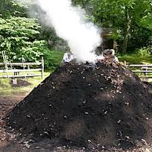

Slide 20
ORIENT TO
WHAT IT MEANS

Slide 21
SINGLE DECLARATIVE SENTENCE
(forms a mental model)
HOW BIG OF AN ALARM FIRE IT IS

Slide 22
DECIDE WHAT TO DO
Notes:
Decisive push (decisiveness- trainable)
Despite unknowns (tolerance of uncertainty)
Accept consequences of choosing wrong (tolerance of uncertainty)

Slide 23
CHOOSE AMONG ONLY VERY FEW POSSIBILITIES
(beware Hick’s law)
ACT IF A THRESHOLD IS CROSSED
Notes:
Story OF Dex and kids w stridor.

Slide 24
ACT IN A STRUCTURED WAY

Slide 25
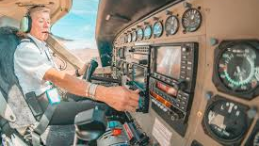
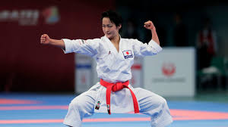
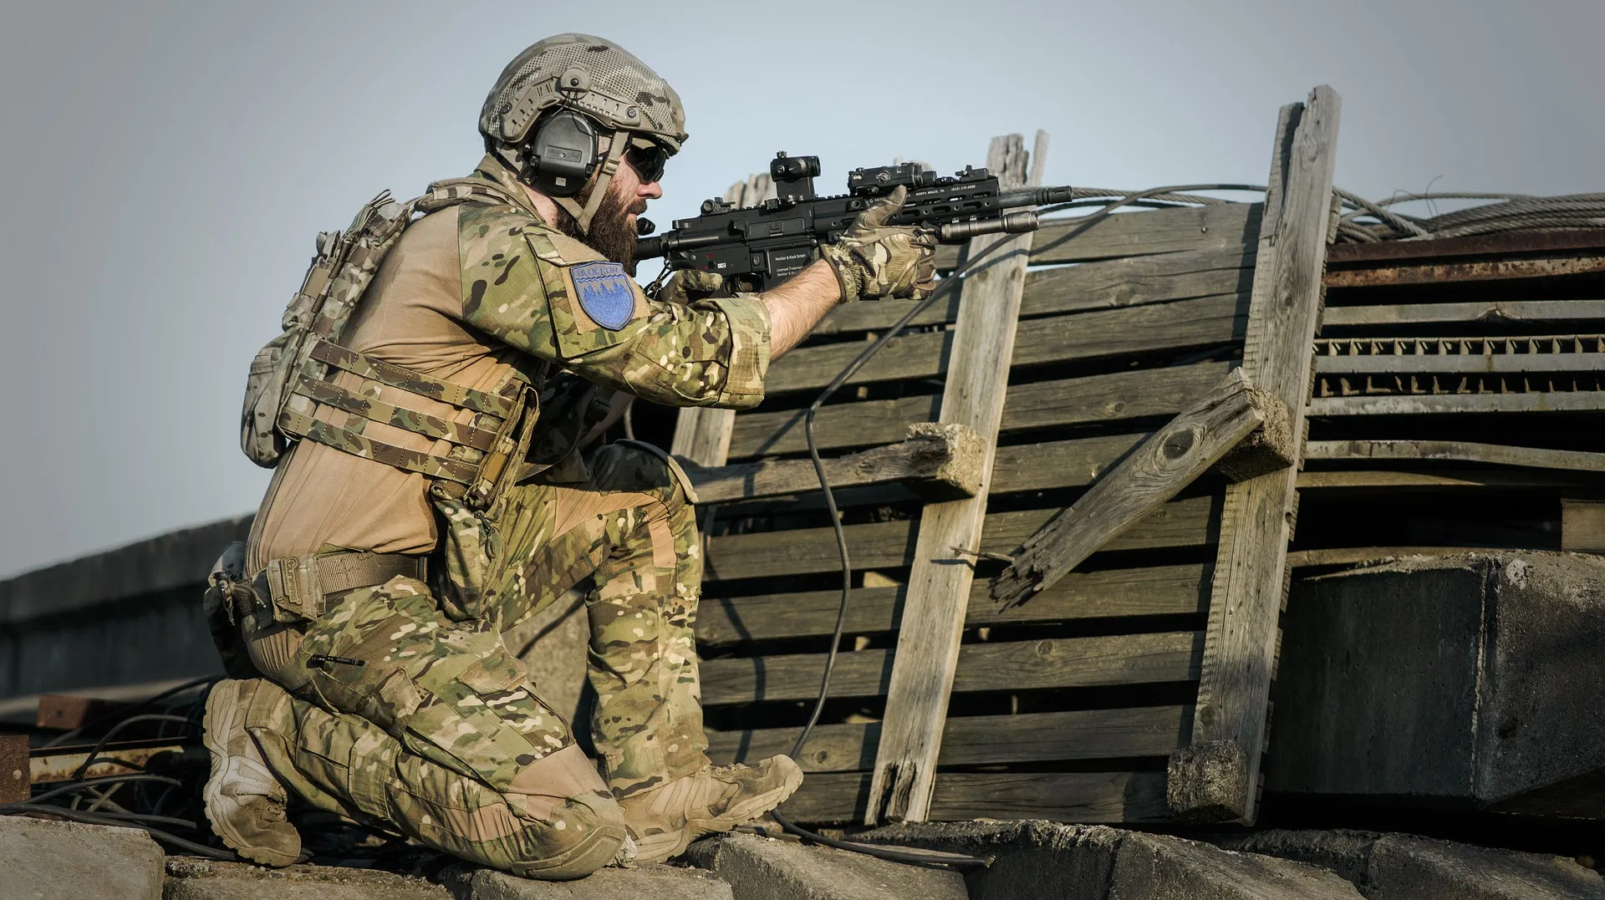
Action Packages
Notes:
Katas / Emergency Procedures / Immediate Action Drills
Specifically designed action sequences intended to execute clinical interventions with minimal cognitive load in the setting of marked time pressure and like all things regimented come from military drills and standards.
Once you have developed the IADs, you have to practice them under increasingly difficult conditions to make sure you can execute them under realistic stress and cognitive load.

Slide 26
Action Packages
BOOTS
SALE
CICO

Slide 27
Bob
Disoriented and somnolent
Cough and sputum
Fever
Gasping for air
HR 145, BP 90/60, RR 35, SpO2 73%, Temp 39.6
High work of breathing
Crackles diffuse bilateral
Mottled limbs

Slide 28
Look
Listen
Feel
ULTRASOUND

Slide 29
Airway
Changing
Stuff Mentation
(AVPU)

Slide 30
Airway Action Package
Meds (constrictors)
Position
Suction
PEEP

Slide 31
Airway: No change, Sputum, responds to voice: sit upright, suction
Breathing: O2 bad, moving lots of air, high work of breathing
Circulation: HR very high (?too fast), SI >1, poor mentation, poor periphery
Disability: decreased mentation, pupils ok, limbs ok

Slide 32
Breathing
O2
Moving Air Work of Breathing

Slide 33
Breathing Action Package
Meds (dilators)
Position
FiO2
PEEP

Slide 34
Airway: No change, Sputum, responds to voice sit upright, suction
Breathing: O2 bad, moving lots of air, high work of breathing FiO2, PEEP
Circulation: HR very high (?too fast), SI >1, poor mentation, poor periphery
Disability: decreased mentation, pupils ok, limbs ok

Slide 35
Circulation
<50 HR >130
TOO SLOW TOO FAST
Shock Index
Mentation Periphery

Slide 36
Circulation Action Package
Meds (constrictors)
Position
Access
Fluids

Slide 37
Airway: No change, Sputum, responds to voice sit upright, suction
Breathing: O2 bad, moving lots of air, high work of breathing FiO2, PEEP
Circulation: HR very high, SI >1, poor mentation, poor periphery
?Too Fast
PLR, 2 X IVs, 30cc/kg NS, Dirty Epi 10mcg bolus
Disability: decreased mentation, pupils ok, limbs ok

Slide 38
Disability
Mentation
Pupils Limbs

Slide 39
Breathing Action Package
Meds (bring back to middle)
Position
Metabolics
Imaging

Slide 40
Airway: No change, Sputum, responds to voice:
Breathing: O2 bad, moving lots of air, high work of breathing
Circulation: HR very high (?too fast), SI >1, poor mentation, poor periphery
Disability: decreased mentation, pupils ok, limbs ok observe

Slide 41
PAUSE
ASSESS FOR EFFECT
COMPLETE THE NEXT ACTION LOOP

Slide 42
GO DEEPER INTO THE SAME PROBLEM SPACE
(e.g. applying PEEP when FiO2 alone failed to solve hypoxia)
WIDEN THE PROBLEM SPACE
(e.g. listening to the lungs after O2 applied)
(e.g. goes to the heart if the lungs are solved)
Notes:
THE NEXT ACTION LOOP :

Slide 43
Circulation
<50 HR >130
TOO SLOW TOO FAST
GET an ECG
(SINUS VS TACHYARRHYTMIA)
Notes:
FG you can solve any complex space by turning it into a series of simpler binary/trinary decisions
Turn a complex problem space into a series of simpler binary decisions; and tie the decisions to actions

Slide 44
Tachyarrhythmias
Sinus
Age related maximums
Variability
Two squiggles between QRSs
Else
Above age maximums
Regularity
One squiggle between QRS
Notes:
FG

Slide 45
Tachyarrhytmias
Primary
  In the absence of other disease
  Causing the crisis
  Solving tachy solves the crisis
Secondary
  Due to another illness state
  Response to another crisis
  Solving tachy does not solve the crisis
Notes:
FG

Slide 46
Primary tachy
Unstable
  Synched cardioversion
Stable
  Diltiazem vs Procainamide vs Other
Notes:
FG

Slide 47
HAVE YOU BOUGHT STABILITY?
PAUSE
SBAR
LOOK TO THE FUTURE
CAN I THROTTLE BACK?

Slide 48
Jimbo
Cough and sputum
HR 105, BP 120/80, RR 18, SpO2 93%, Temp 36.2
Clear lungs

Slide 49
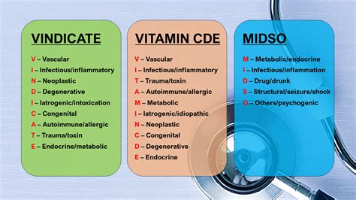

Slide 50
Forced To Act
Business As Usual
Slowing Down When You Should
Don’t Have Time
Consequence to Inaction
Have Time
Things Make Sense
Have Time
Things Don’t Make Sense
Action Loops
Observe
Orient
Decide
Act
Internal Medicine Model
Pause
Confirm Your Facts
Zoom Out
Widen the Search
Use First Principles
Notes:
Carol Ann Moulton. Story of lactate of 8 and SpO2 92% with PtP

Slide 51
Forced To Act
Business As Usual
Slowing Down When You Should
Don’t Have Time
Consequence to Inaction
Have Time
Things Make Sense
Have Time
Things Don’t Make Sense
Action Loops
Observe
Orient
Decide
Act
Internal Medicine Model
Pause
Confirm Your Facts
Zoom Out
Widen the Search
Use First Principles

Slide 52
Let’s try this!
67 yo very obese man seen for back sprain secondary to boating activities. PMH of HTN. BP of 105/65
Triaged to a side room
POCUS reveals 10.6 cm AAA and no FF
You step outside the room to call CT and vascular when….

Slide 53
55 year old morbidly obese woman
Sudden onset SOB and frothy sputum
RR 45, O2 sats 76% NRB, tore off the CPAP in EMS rig
Bilat crackles
No IVs accomplished by EMS
Combative and aggressive, thrashing

Slide 54


Slide 55
Questions?
Fil.gilic@gmail.com
ResusMastery.com

