Slide 2
BALLOT ISSUE EXPLANATORY STATEMENT
Your elected Board of Commissioners of San Juan County Fire Protection District No. 4, aka Lopez Island Fire & EMS have determined that the stable funding of EMS services on the island require more stable and consistent funding. If approved by the voters, this measure will authorize a ten-year emergency medical services (EMS) property tax levy at a rate not to exceed $0.50 per thousand dollars of assessed valuation.
Approval of the levy will allow the District to improve the level of emergency medical services provided to the citizens of the District. The District will use the revenue from this levy exclusively for emergency medical services.
If approved, the EMS tax on a $500,000 assessed valuation residence would not exceed $250.00 each year or approximately $20.83 per month for the emergency medical services.

Slide 3
Proposed New EMS Levy
The Lopez Island Fire and EMS District is placing a proposition on the August 3, 2021, Primary Election ballot asking Lopez Island voters to approve a ballot measure to create a NEW funding source for EMS services on Lopez Island. This measure, if approved by the voters, would establish an EMS levy for ten years beginning with a tax levy rate not to exceed $.50 per $1,000.00 of the property’s assessed value.
Currently, Lopez Fire and EMS operating, and capital expenditures are funded by several types of revenues, including a regular property tax, various grants, patient transport reimbursements and rental income.

Slide 4
Why an EMS Levy?
Costs associated with EMS response and equipment replacement have been consistently increasing at a rate greater than revenue streams. Lopez Fire has historically funded all services through a regular levy or “Fire Levy”. This model has, in recent years, fallen behind the revenue needed to provide for both EMS and Fire. Should an adequate and stable funding source not be found the district will need to begin making tough choices on the level of service provided. With an aging fleet, needed facility repairs, required equipment purchases and increasing EMS costs the needs of the fire district far exceed what is currently available.
In a move by the Washington State legislature, after the passing of initiative 747 in 2001, local taxing districts budget increases are limited to 1% each year. With an average increase of 2.23% in the greater Seattle consumer price index over the past 10 years, your department has been delaying much needed capital improvements and falling behind in operational necessities.

Slide 5
The EMS levy will provide the District with a stable, dedicated funding source for up-to 10 years that will provide the ability to retain Paramedics and volunteer emergency medical technicians; provide proper training; obtain, operate, and maintain EMS vehicles and facilities; obtain consumable medical supplies and appliances to equip vehicles, personnel, and facilities; and maintain an appropriate level of emergency medical services to the Lopez Island community and visitors. An EMS levy will keep 24/7 Paramedic coverage on Lopez island viable.
A dedicated EMS funding source would allow the District to focus spending existing property tax revenues on needed Fire personnel, equipment, training, maintenance, vehicles and facilities.

Slide 6
Why are costs increasing?
Besides the normal inflationary impact, Lopez Fire & EMS call volumes have steadily increased over the years from 365 (of which 300 were EMS) in 2009 to 504 (of which 416 were EMS) in 2020. In addition, EMS calls requiring air or boat patient transports, which takes more time and are more involved, have increased from 8% of EMS Calls to 35% of EMS calls over the past few years.
At the same time, unanticipated costs from aging facilities and vehicles have taken priority over new apparatus and equipment.

Slide 7
What has the Fire district done to delay a tax increase?
Grants: a great source for equipment but not reliable and very specific in funding requirements.
Billing: Lopez Fire bills for EMS transport service but this user fee is limited and does not cover the full cost of service
Purchasing used apparatus: This is a viable method to get by for a while, but it has its limitations. Homeowners insurance is calculated on the age of fire apparatus, among other things. An aged fleet does a disservice to taxpayers and costs more in maintenance costs year after year.
Refurbished older units: As stated above an aging fleet can have a negative impact on insurance costs to homeowners. A rebuilt fire pump is limited in its benefits when mounted on an older chassis. This method buys only a few years of the unit life.

Slide 8
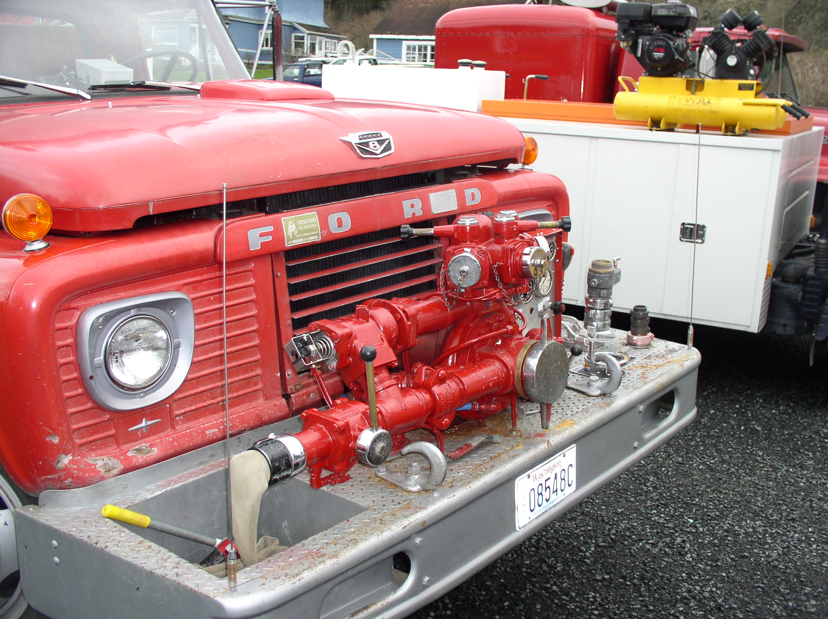
The Fleet
Engine 41: 1996 H&W International, new pump in 2021
Aid 41: 2015 Ram 4500 Braun Northstar Ambulance
Tender 41: 2006 Freightliner
Engine 42: 1989 Ford Grumman Engine (past due for replacement)
Tender 42: 2002 Freightliner (repurposed street cleaner)
Engine 43: 1966 Western States Ford (will be replaced with a 1997 Freightliner)
MCI Trailer: 2005
Engine 44: 1996 H&W International (new pump in 2021)
Aid 44: 2007 Ford E-350 American Emergency Vehicle ambulance (past due for replacement)
Medic response units x 3: 2011 Ford expedition, 2017 Chevy Tahoe, 2019 Chevy Tahoe (2011 Ford past due for replacement)
Command unit: 2007 Ford F-150 4x4 (soon will be replaced with a 2021 F-350 4x4, purchased through a grant)
Rescue 41: 2003 F-550 (High maintenance cost due to over weighted chassis)
Brush 42: 1996 Ford F-350 4x4 (soon to be replaced with a 2021 F-350 4x4, purchased through a grant)

Slide 9
Apparatus take funding and time.
Apparartus
Engine replacement | $450-600K
Tender replacement | $350-500K
Ambulance replacement (used) | $75,000
Ambulance replacement (new) | $200-250K
Medic car replacement | $65,000
Rescue Unit replacement | $350-450K
A new engine will take over a year from the time plans are submitted. The process will take over 15 months start to finish.
An ambulance can take over 6 months to build with a total project time of 9 months.
Most Fire apparatus take months between design, order, delivery and local outfitting. This includes smaller units such as medic cars and brush trucks.
Costs are estimated/varies by design

Slide 10
What does it take to equip a firefighter?
Helmet $350
Hood $80
Coat $1210
Gloves $90
Pants $850
Boots $425
Other accessories $200
Total $3205
Current health and safety guidelines recommend 2 sets of bunker gear for each F/F
Gear replaced every 10 years

Slide 11
What goes into equipping an ambulance?
New ambulance: $250,000
Lifepak 15 defibrillator: $30,000
Stryker Gurney: $15,000
Radios $10,000
Medications and supplies: $75,000

Slide 13
Projections with no change in spending/no emergency expenses/no major purchases
Year | Revenue |  | Budget forecast | Carry over
2021 | $1,101,660.00 |  | $1,161,695.00 | $444,160.00
2022 | $1,112,676.60 |  | $1,196,545.85 | $360,290.75
2023 | $1,123,803.37 |  | $1,232,442.23 | $251,651.89
2024 | $1,135,041.40 |  | $1,269,415.49 | $117,277.80
2025 | $1,146,391.81 |  | $1,307,497.96 | -$43,828.35
2026 | $1,157,855.73 |  | $1,346,722.90 | -$232,695.51
2027 | $1,169,434.29 |  | $1,387,124.58 | -$450,385.80
2028 | $1,181,128.63 |  | $1,428,738.32 | -$697,995.49
2029 | $1,192,939.92 |  | $1,471,600.47 | -$976,656.04
2030 | $1,204,869.32 |  | $1,515,748.48 | -$1,287,535.21
2031 | $1,216,918.01 |  | $1,561,220.94 | -$1,631,838.14
2032 | $1,229,087.19 |  | $1,608,057.57 | -$2,010,808.51

Slide 15
Questions?

Slide 16
Washington Survey and ratings Bureau
Apparatus
Equipment
Water systems
Training
Staffing
Age
Maintenance
Documentation

Slide 17
WSRB requirements
Organization. The department must be organized on a permanent basis under applicable state and/or local laws, have a defined service area, and provide service to all structures in the service area. The organization must include one person (usually with title of chief) responsible for operation of the department.
Membership. The department must have an active membership which provides a response of at least 4 firefighters to incidents for Protection Class 9 communities and at least 6 firefighters for Protection Class 8 and better graded communities.
Training. Structural fire suppression training must be conducted for all firefighters, at least 2 hours every 2 months for Protection Class 9 communities and at least 2 hours every month for Protection Class 8 and better graded communities.
Apparatus. Response to any fire must be with at least one pumper apparatus meeting the general requirements of National Fire Protection Association (NFPA) standard 1901. Provisions must be made for the housing of the apparatus. For details see Protection Class 8 and 9 minimum criteria at the end of this schedule. Apparatus criteria listed on the minimum criteria for Protection Class 8 communities also apply to better graded communities.
Notification. Means must be provided for 24-hour notification of fires and immediate dispatch of firefighters and apparatus.

Slide 18
NFPA Response standards
NFPA 1720
Demand Zone | Demographics | Mininum Staff to Respond | Response Time in Minutes
Urban area | More than 1,000 people per square mile | 15 | 9
Suburban area | Between 500-1,000 people per square mile | 10 | 10
Rural area | Less than 500 people per square mile | 6 | 14
Remote area | Travel distance of 8 miles or more | 4 | Depends on travel distance
Special Risks | Determined by the AHJ | Determined by AHJ based on risk | Determined by the AHJ

