Slide 1
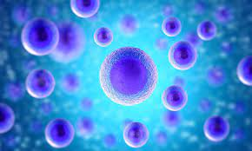

ANIMAL CELL
Presentation by:
Baladad, Kiana Jireh Charisse V.
Biao, Eddielyn R.
Juntilla, Mary Joy A.
Lacerna, Remalyn L.
Macmod, Aliyah C.

Slide 2
ANIMAL CELL
Presentation by:
Baladad, Kiana Jireh Charisse V.
Biao, Eddielyn R.
Juntilla, Mary Joy A.
Lacerna, Remalyn L.
Macmod, Aliyah C.

Slide 3
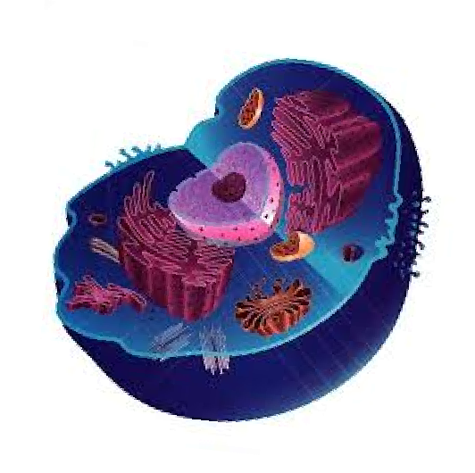
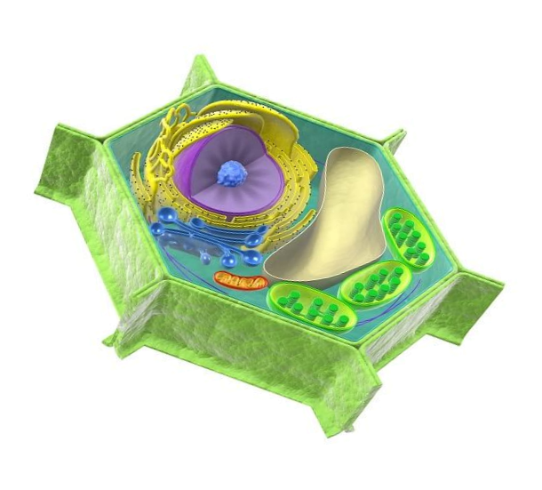
ANIMAL CELL
Image Source: https://biologydictionary.net/plant-cell/
Image Source: http://clipart-library.com/animal-cell-unlabeled.html
A type of eukaryotic cell that lacks a cell wall and has a true, membrane-bound nucleus along with other cellular organelles.

Slide 4
ANIMAL CELL VS. PLANT CELL
Image Source: https://biologydictionary.net/plant-cell/
Image Source: http://clipart-library.com/animal-cell-unlabeled.html
Image Source: https://biologydictionary.net/plant-cell/
Image Source: http://clipart-library.com/animal-cell-unlabeled.html
Notes:
Both plant and animal cells are eukaryotic, so they contain membrane-bound organelles.

Slide 5
 | Plant Cell | Animal Cell
Cell Shape | Square or rectangular | Irregular or round shape
Cell Wall | Present | Absent
Cell Membrane | Present | Present
Nucleus | Present and lies on the side of the cell | Present and lies in the center of the cell
Lysosomes | Present;are very rare | Present
Vacoules | Few large or a single, centrally positioned | Usually small and numerous
Image Source: https://biologydictionary.net/plant-cell/
ANIMAL CELL ORGANELLES
Image Source: http://clipart-library.com/animal-cell-unlabeled.html
Image Source: http://clipart-library.com/animal-cell-unlabeled.html
Image Source: https://biologydictionary.net/plant-cell/

Slide 6
ANIMAL CELL VS. PLANT CELL
 | Plant Cell | Animal Cell
Cell Shape | Square or rectangular | Irregular or round shape
Cell Wall | Present | Absent
Cell Membrane | Present | Present
Nucleus | Present and lies on the side of the cell | Present and lies in the center of the cell
Lysosomes | Present;are very rare | Present
Vacoules | Few large or a single, centrally positioned | Usually small and numerous
Image Source: https://biologydictionary.net/plant-cell/
Image Source: http://clipart-library.com/animal-cell-unlabeled.html
Image Source: http://clipart-library.com/animal-cell-unlabeled.html
Image Source: https://biologydictionary.net/plant-cell/
Notes:
However, plant cells and animal cells do not look exactly the same or have all of the same organelles, since they each have different needs. For example, plant cells contain chloroplasts since they need to perform photosynthesis, but animal cells do not.

Slide 7
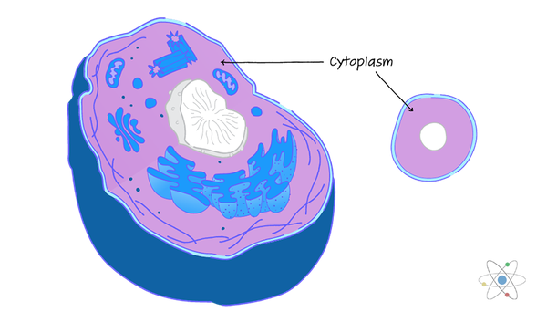
CYTOPLASM
Image Source: https://biologydictionary.net/plant-cell/
A jelly-like material which contains all the cell organelles, enclosed within the cell membrane.
Image Source: http://clipart-library.com/animal-cell-unlabeled.html
Image source: https://sciencing.com/cytoplasm-definition-structure-function-with-diagram-13717294.html
Image Source: http://clipart-library.com/animal-cell-unlabeled.html
Image Source: https://biologydictionary.net/plant-cell/
Notes:
The substance found within the cell nucleus, contained by the nuclear membrane is called the nucleoplasm.

Slide 8
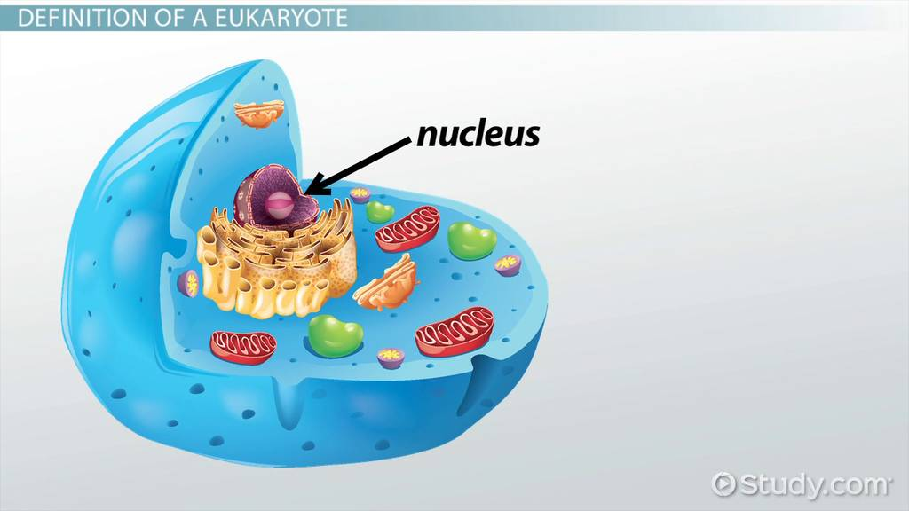
Image Source: http://clipart-library.com/animal-cell-unlabeled.html
NUCLEUS
Also known as the “control center of the cell”
Contains other several sub-organelles such as nucleolus and chromatins.
Also contains DNA and other genetic materials.
Image Source: https://biologydictionary.net/plant-cell/
Image Source: https://study.com/learn/lesson/nucleus-eukaryotic-cells-function.html
Image Source: http://clipart-library.com/animal-cell-unlabeled.html
Image Source: https://biologydictionary.net/plant-cell/
Notes:
A nucleus, as related to genomics, is the membrane-enclosed organelle within a cell that contains the chromosomes. An array of holes, or pores, in the nuclear membrane allows for the selective passage of certain molecules (such as proteins and nucleic acids) into and out of the nucleus.
The nucleolus is a spherical structure found in the cell's nucleus whose primary function is to produce and assemble the cell's ribosomes. The nucleolus is also where ribosomal RNA genes are transcribed

Slide 9
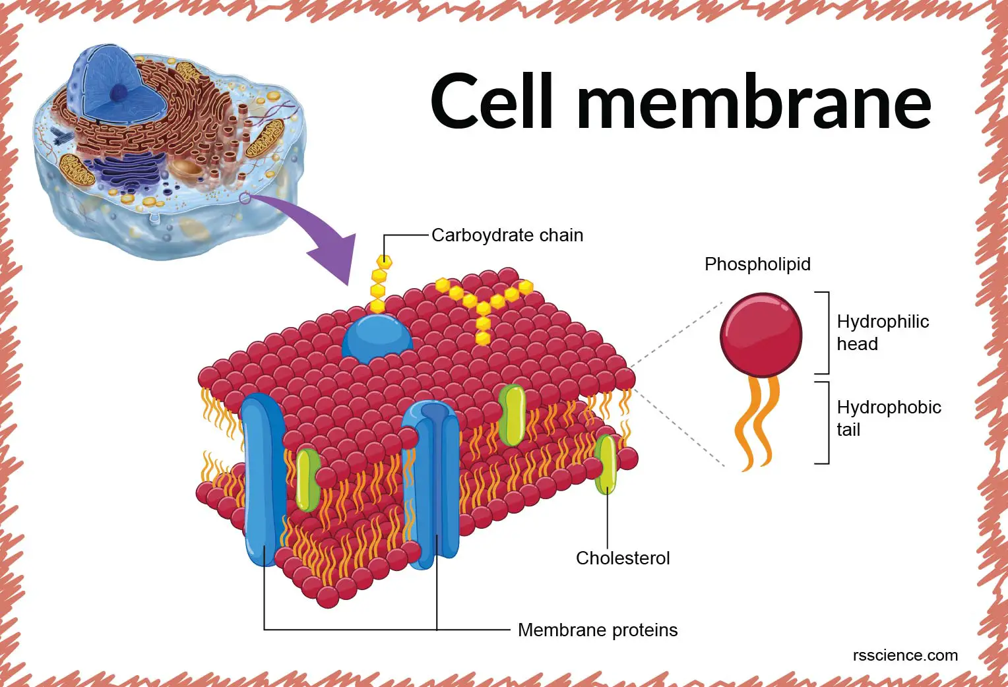
Image Source: http://clipart-library.com/animal-cell-unlabeled.html
CELL MEMBRANE
Image Source: https://biologydictionary.net/plant-cell/
A thin semipermeable membrane layer of lipids and proteins surrounding the cell.
Image Source: https://rsscience.com/cell-membrane/
Image Source: http://clipart-library.com/animal-cell-unlabeled.html
Image Source: https://biologydictionary.net/plant-cell/
Notes:
Its primary role is to protect the cell from its surrounding by controlling the entry and exit of nutrients and other microorganisms into the cell. Plant cells have a cell wall, as well as a cell membrane. In plants, the cell wall surrounds the cell membrane. This gives the plant cell its unique rectangular shape. Animal cells simply have a cell membrane, but no cell wall.

Slide 10
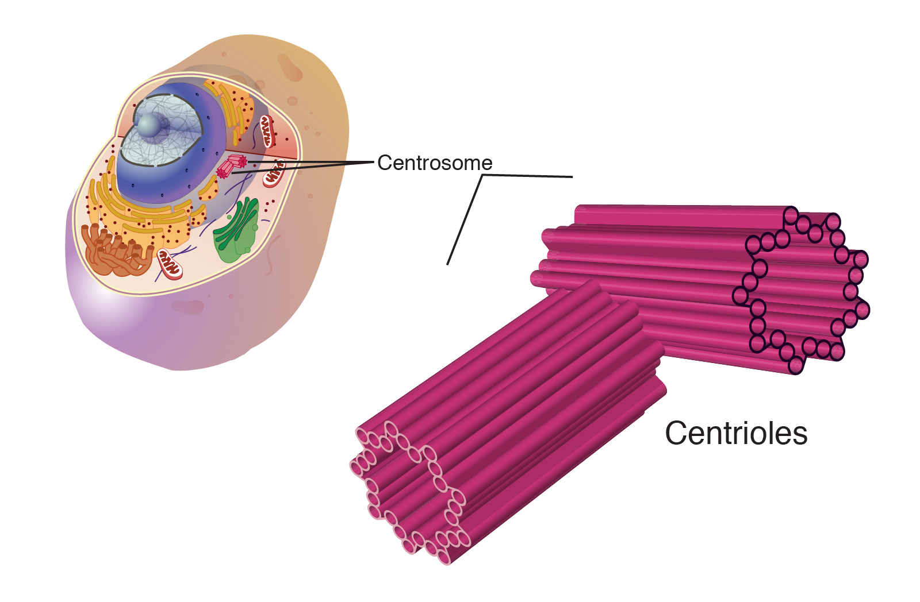
Image Source: http://clipart-library.com/animal-cell-unlabeled.html
CENTROSOME AND CENTRIOLES
Image Source: https://biologydictionary.net/plant-cell/
Centrosome is a small organelle found near the nucleus, which has a thick centre with radiating tubules.
Centrioles are paired barrel-shaped organelles located in the cytoplasm of animal cells.
Image Source: https://www.genome.gov/genetics-glossary/Centriole
Image Source: http://clipart-library.com/animal-cell-unlabeled.html
Image Source: https://biologydictionary.net/plant-cell/
Notes:
Centrosomes are where microtubles are produced.
Centrioles play a role in organizing microtubules that serve as the cell's skeletal system. They help determine the locations of the nucleus and other organelles within the cell. Centrosomes are found in animal cells, but do not exist within plant cells.

Slide 11
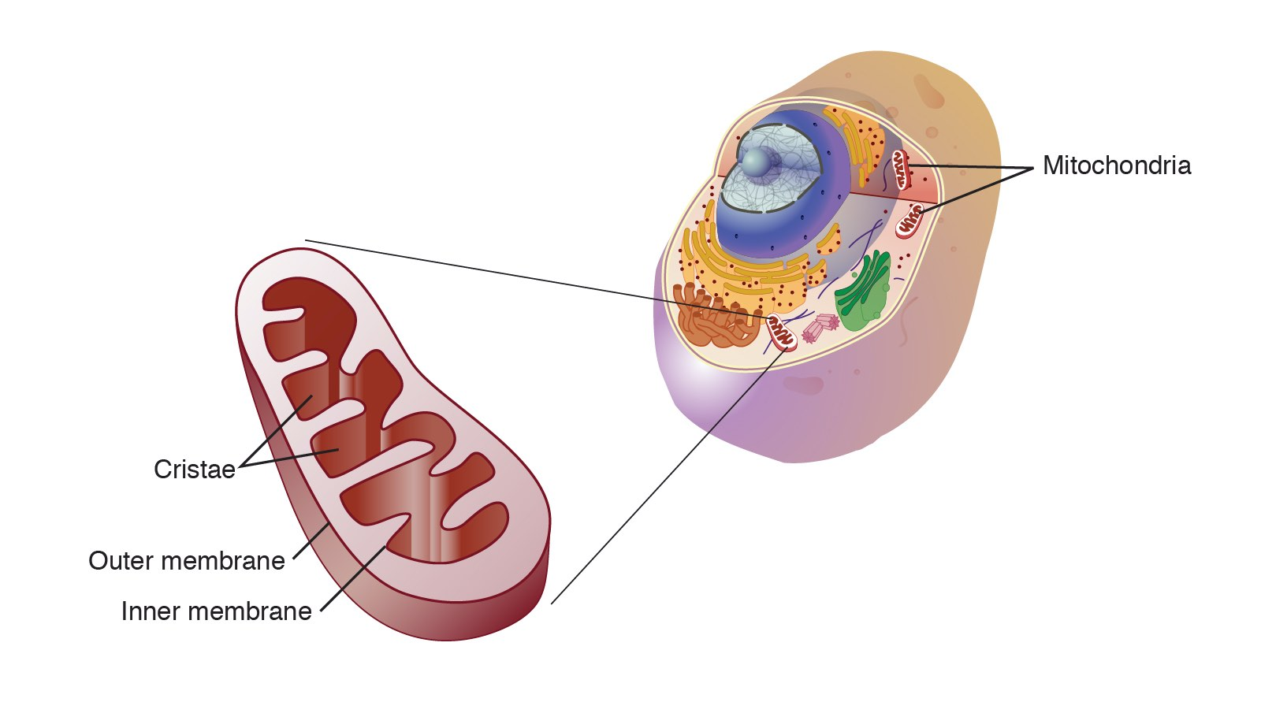
Image Source: http://clipart-library.com/animal-cell-unlabeled.html
MITOCHON-
DRION
Image Source: https://biologydictionary.net/plant-cell/
A spherical or rod-shaped organelles with a double membrane
Also known as the powerhouse of a cell as they play an important role in releasing energy.
Image Source: https://www.genome.gov/genetics-glossary/Mitochondria
Image Source: http://clipart-library.com/animal-cell-unlabeled.html
Image Source: https://biologydictionary.net/plant-cell/
Notes:
Mitochondria are membrane-bound cell organelles (mitochondrion, singular) that generate most of the chemical energy needed to power the cell's biochemical reactions. Chemical energy produced by the mitochondria is stored in a small molecule called adenosine triphosphate (ATP).

Slide 12
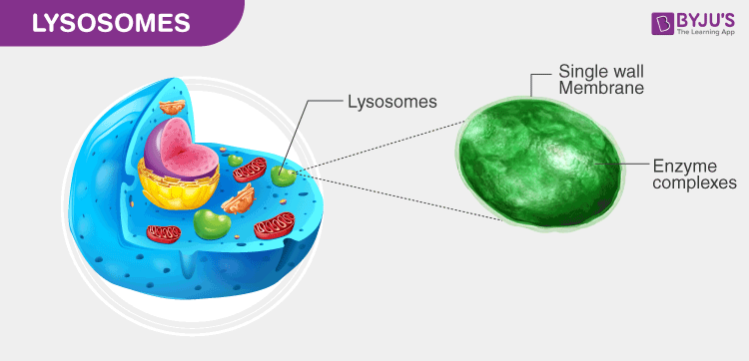
Image Source: http://clipart-library.com/animal-cell-unlabeled.html
LYSOSOME
round organelles surrounded by a membrane and comprising digestive enzymes which help in digestion, excretion and in the cell renewal process.
Image Source: https://biologydictionary.net/plant-cell/
Image Source: https://byjus.com/biology/lysosomes/
Image Source: http://clipart-library.com/animal-cell-unlabeled.html
Image Source: https://biologydictionary.net/plant-cell/
Notes:
Lysosomes are called "suicide bags" of the cell because they have hydrolytic enzymes stored in them. These enzymes are used to digest complex molecules in a cell. When released into the cytoplasm, these enzymes can "digest" or destroy the cell itself. Therefore, they are called "suicide bags”.

Slide 13
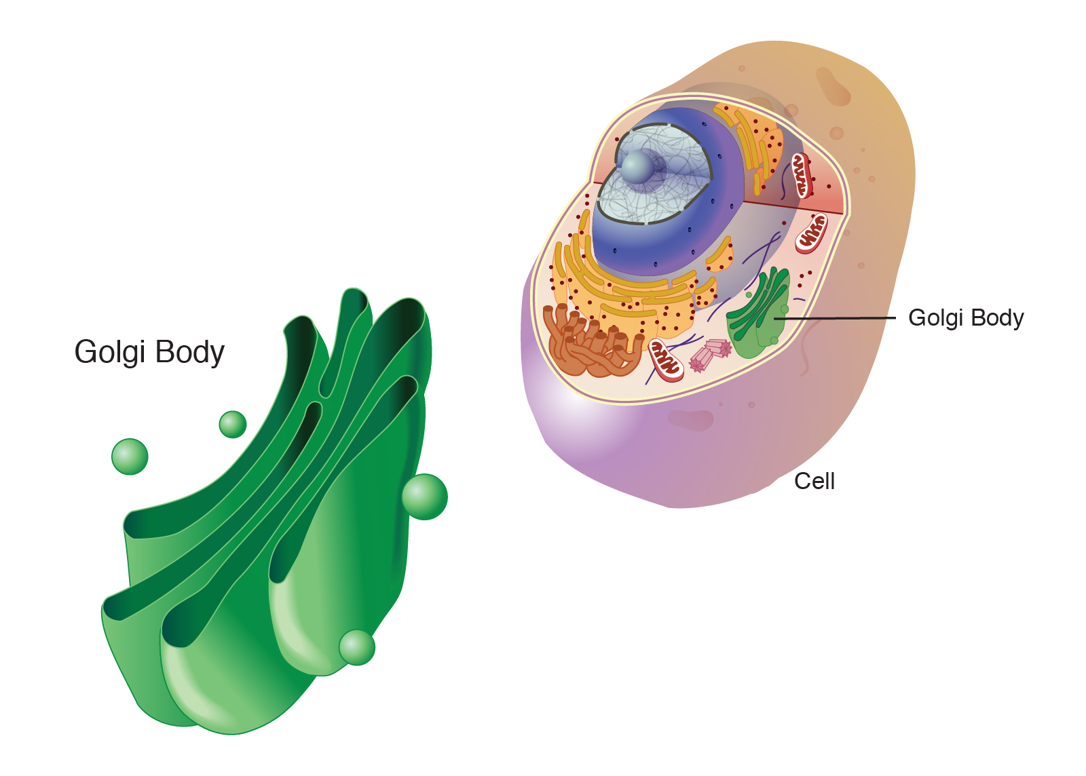
Image Source: http://clipart-library.com/animal-cell-unlabeled.html
GOLGI APPARATUS
Image Source: https://biologydictionary.net/plant-cell/
A flat, smooth layered, sac-like organelle which is located near the nucleus and involved in manufacturing, storing, packing and transporting the particles throughout the cell.
Image Source: https://www.genome.gov/genetics-glossary/golgi-body
Image Source: http://clipart-library.com/animal-cell-unlabeled.html
Image Source: https://biologydictionary.net/plant-cell/
Notes:
A Golgi body, also known as a Golgi apparatus, is a cell organelle that helps process and package proteins and lipid molecules, especially proteins destined to be exported from the cell. Named after its discoverer, Camillo Golgi, the Golgi body appears as a series of stacked membranes.

Slide 14
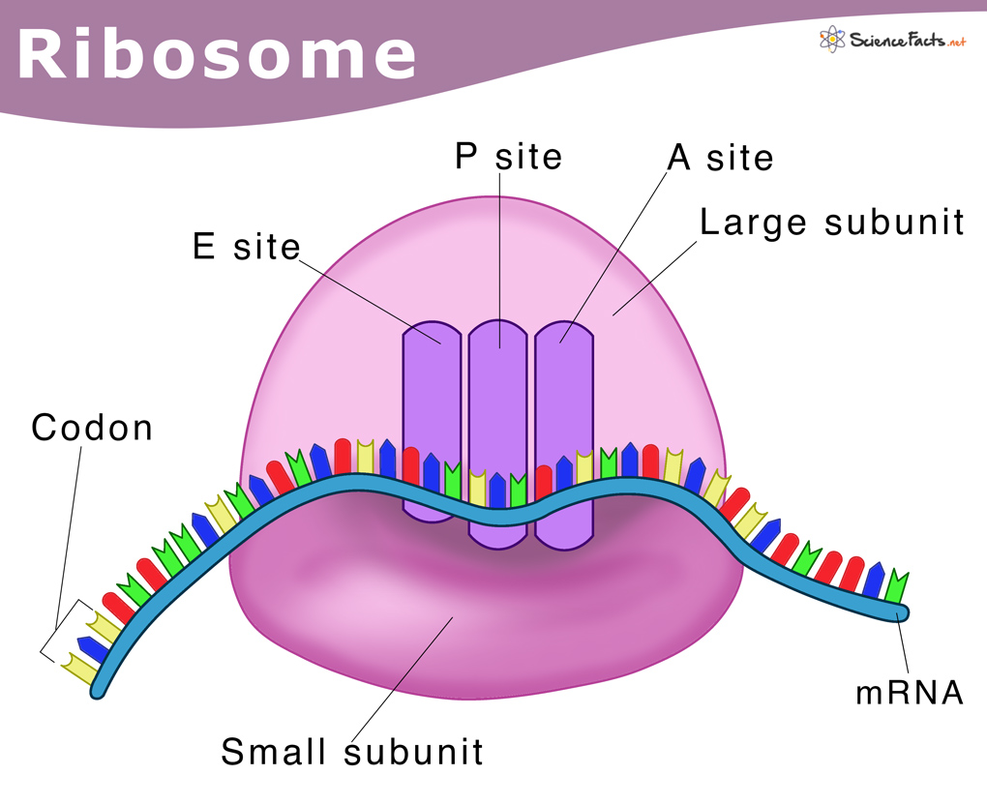
Image Source: http://clipart-library.com/animal-cell-unlabeled.html
RIBOSOME
Image Source: https://biologydictionary.net/plant-cell/
They are small organelles made up of RNA-rich cytoplasmic granules, and they are the sites of protein synthesis.
Image Source:https://www.sciencefacts.net/ribosomes.html
Image Source: http://clipart-library.com/animal-cell-unlabeled.html
Image Source: https://biologydictionary.net/plant-cell/
Notes:
The ribosome reads the messenger RNA (mRNA) sequence and translates that genetic code into a specified string of amino acids, which grow into long chains that fold to form proteins.

Slide 15
Image Source: http://clipart-library.com/animal-cell-unlabeled.html
REFERENCES:
Image Source: https://biologydictionary.net/plant-cell/
https://byjus.com/biology/animal-cell/
https://byjus.com/biology/difference-between-plant-cell-and-animal-cell/
https://www.genome.gov/genetics-glossary/Nucleolus#:~:text=The%20nucleolus%20is%20a%20spherical,ribosomal%20RNA%20genes%20are%20transcribed.
https://www.khanacademy.org/science/high-school-biology/hs-cells/hs-plant-vs-animal-cells/a/hs-plant-vs-animal-cells-review
Image Source:https://www.sciencefacts.net/ribosomes.html
Image Source: http://clipart-library.com/animal-cell-unlabeled.html
Image Source: https://biologydictionary.net/plant-cell/

