Slide 1
Over-view of
Iron & Steel Making
Mr. Bhavesh C. Lad
Sr. Manager, Technology Group
THEIS PRECISION STEEL INDIA PVT. LTD

Slide 2
Contents
History of iron making
Flow diagram of iron making to steel making
Different Section of Iron making
Basics of Blast Furnace (Introduction to blast furnace)
History of Steel Making
Introduction of Steel Making Furnaces
Ladle treatment / degassing treatment
Continuous casting process
Hot rolling

Slide 3
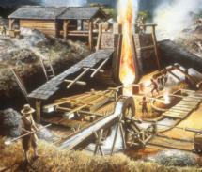
1. 3500BC Beads in Ancient Egypt for iron. 2. First Iron Production 3000BC Syria and Mesopotamia the comparatively advanced technique of hardening iron weapons by heat treatment was known to the Greeks about 1000 BC. 3. They were made by heating a mass of iron ore and charcoal in a forge or furnace having a forced draft. 4. The iron produced under these conditions usually contained about 3 percent of slag particles and 0.1 percent of other impurities. Occasionally this technique of iron`making produced, by accident, a true steel rather than wrought iron. 5. Ironworkers learned to make steel by heating wrought iron and charcoal in clay boxes for a period of several days. By this process the iron absorbed enough carbon to become a true steel.
History of Iron making :

Slide 4
General flow diagram of Iron – Steel making process :
Iron making
Steel making
Continuous casting
Rolling
Main products
Rail
Sheet pile
Pellet
Coke
Shape
Section mill
Bar
Iron ore
Sintered
ore
Limestone
Wire rod
Wire rod mill
Plate
Hot
direct
rolling
(HDR)
Plate mill
Hot metal
Billet
Hot rolled coil
and sheet
Basic oxygen furnace
(BOF)
Hot strip mill
Bloom
Cold rolled coil
and sheet
(also for plating)
Blast furnace
(BF)
Slab
Cold rolling tandem mill
Welded pipe
Butt welded pipe
Welded pipe mill
Scrap
Electric arc furnace
(EAF)
Seamless pip
Reheating furnace
Seamless pipe mill
Steel casting

Slide 5
Different section of blast furnace plant :
Bell Less Top
Sinter
Coke
Hot Blast Stoves
Gas Cleaning
Stock House
Gasholder
Scrubber
Slag, Hot Metal
Enrichment Gas
Combustion Air
Blower
Combustion Gas

Slide 6
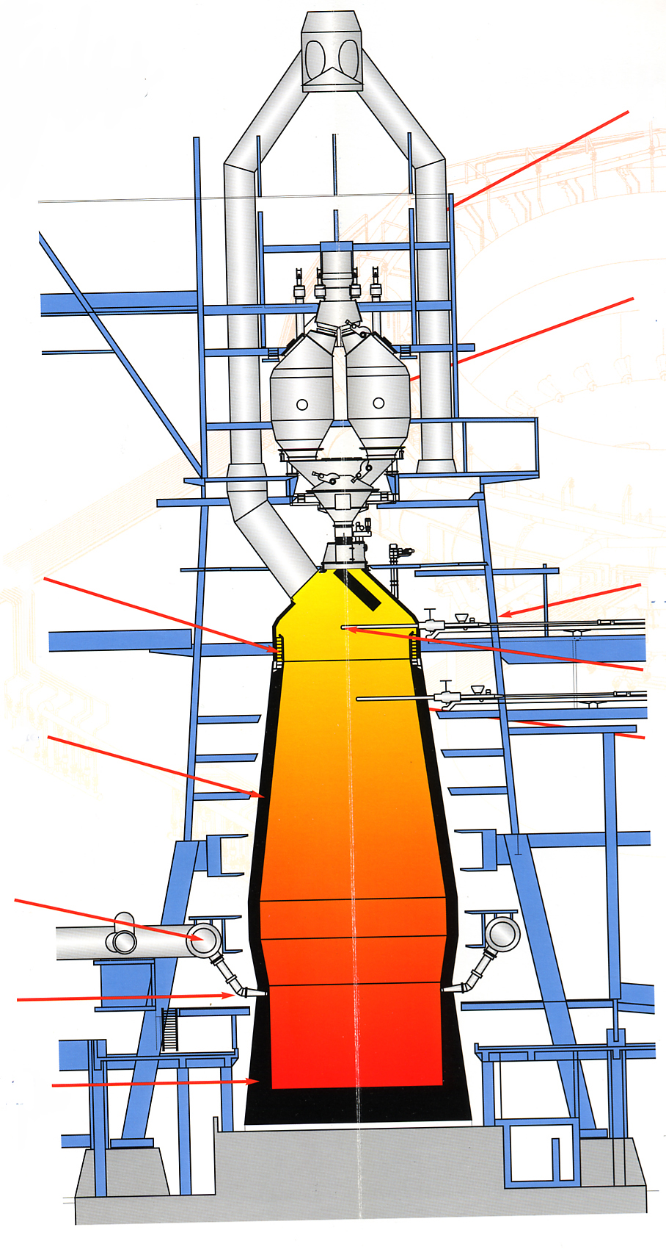
Operation Over-View :
Top Gas Mains
The Blast Furnace Process
1. The Iron Ore, Coke and Limestone, (the Charge), is conveyed to the top of the Furnace. 2. The Charge is stored in Bells until the timing is right for the charge to be dropped into the Furnace. 3. Hot air is then blown through pipes called Tuyeres, to fire the mixture. 4. The Coke burns to increase the temperature in the Furnace. 5. The Limestone attracts the impurities in the Iron Ore and forms Slag. This Slag is lighter than the molten Iron and so floats on top of it. 6. As the Furnace fills, the molten Iron is Tapped off. The Slag is also tapped off at regular intervals. Most Iron is taken straight from the Blast Furnace to the Steel Mill, but some is poured into buckets called Pigs. This Iron is called Pig Iron and is used to make Cast Iron.
Top Bins
Throat Armour
Above Burden Probe
Temperature Probe
Refractory Lining
Sub Burden Probe
Bustle Main
Tuyeres
Hearth Refractories

Slide 7
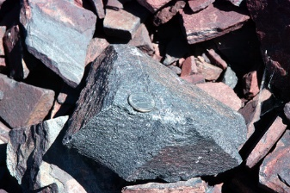
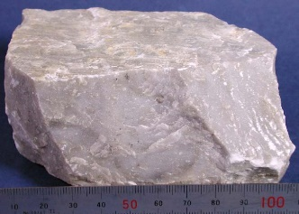
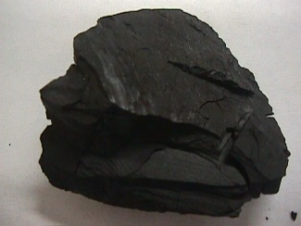
Raw Material for Blast Furnace :
Hematite Fe₂O₃
Limonite Fe₂O_{3.} xH₂O
Magnetite Fe₃O₄
Siderite FeCO₃
Iron
Ore
Fe content : 20 - 70%
SiO₂
Al₂O₃
CaO
MgO
P, As
S
- unwanted, less than 0,15%
Flux
Lime, dolomite CaMgCO₃ , CaO
Coke
Metallurgical coke
Hot Air / Gas
Coke oven / Blast Furnace Gas / Hot Air

Slide 8
Schematic diagram of B/F :

Slide 9
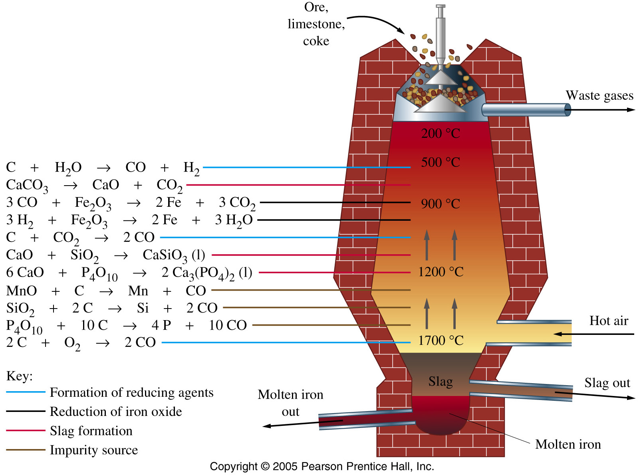
Main reactions in blast furnace :

Slide 10
Avg. Input for 1 T Iron Production with Chemistry
Coke
Flux
Ore
0.35 – 0.6t
0.4t
2t
Chemical composition
Fe | C | Si | Mn | P | S
90-95% | 3.0-4.3% | 0.5-3.0% | 0.5-3.0% | 0.05-2% | do 0.1%
Hot Gases
3.5 t Gas
1t Pig Iron

Slide 11
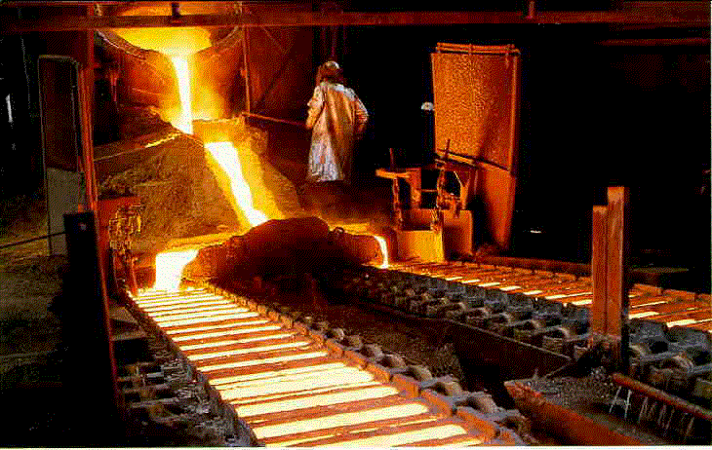
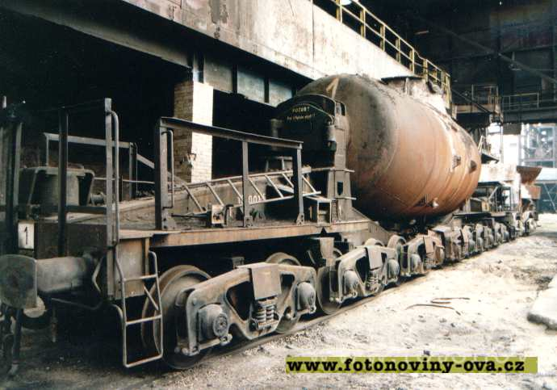
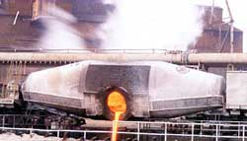
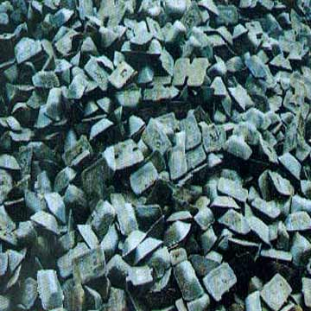
Product of Blast Furnace
Pig Iron is being casted to
ingot
TORPEDO LADLE

Slide 12
Other Product of Blast Furnace
Chemical composition
SiO₂ | CaO | Al₂O₃ | MgO, MnO, FeO, CaS, MnS, P₂O₅, BaS, atd.
26-40% | 36-48% | 10-20% | negligible
Slags
Chemical composition
CO₂ | CO | H₂ | CH₄ | N₂
8-14% | 23-32% | 1-4% | 0,2-0,4% | 55-60%
Stock gas

Slide 13
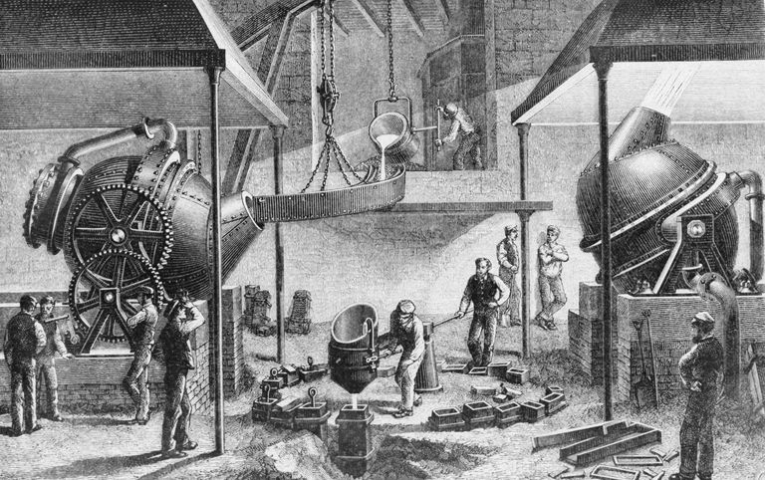
History of Steel making :

Slide 14
Introduction of Steel making furnaces :
- There are three core root for production of steel.
Open Hearth Process
Basic Oxygen Process
Electric Arc Furnace

Slide 15
Open Hearth Process :
The Converter
Melted high carbon iron (pig iron) + bottom injected air
Fast reaction:
[Fe-C] + {O₂ } → [Fe] + {CO }
Minor reaction :
[Fe] + {O₂ } → (FeO)
Liquid steel product
SiO₂ lining (acidic)
Melted iron (pig iron + scrap) + hot air + flue gas
+ magnesite lining + CaO powder

Slide 16
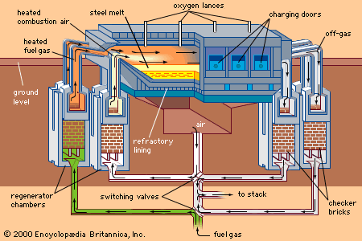

Slide 17
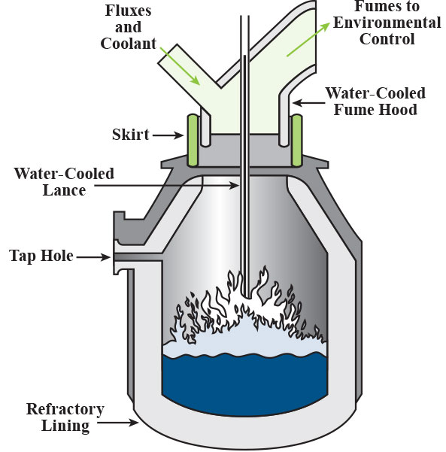
Basic Oxygen Process:
Liquid pig iron from blast furnace (higher content of C, Si, P, S,…)
Steel scrap (variable composition - also Cu, Zn, Pb, Cd,…)
Iron from direct reduction process (bloom, sponge, briquettes – quite pure Fe)
30-40%
60-70%
< 10%
[Fe-C] + {O₂ } → [Fe] + {CO } [Fe-P-S-Si] + {O₂ } + <CaO> → [Fe] + (P,S,Si in slag)

Slide 18
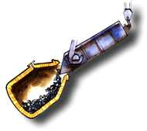
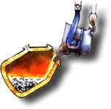
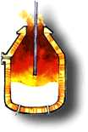
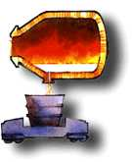
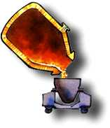
BOS Steel batch 200 000 kg O₂ : 500 normal m³/min 20 min Superficial velocity 1.5 m/s 250 vvm Gas power input 60 kW/m³ (or 8 W/kg) Mixing time 10-100 s Whole cycle 50 min
Operation over-view of Basic Oxygen Process:
Scrap
Liquid steel
Ladle
Oxygen Lance
Oxygen tuyere
Steel
Slag

Slide 19
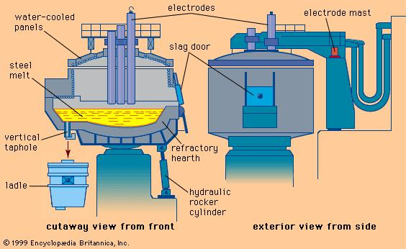
Electric Arc Furnace :

Slide 20
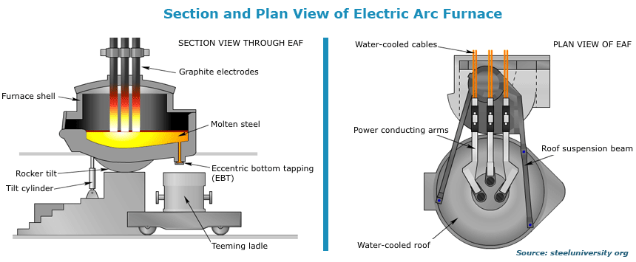

Slide 21
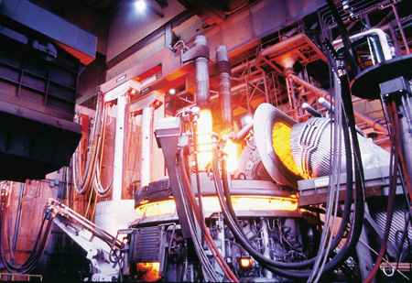

Slide 22
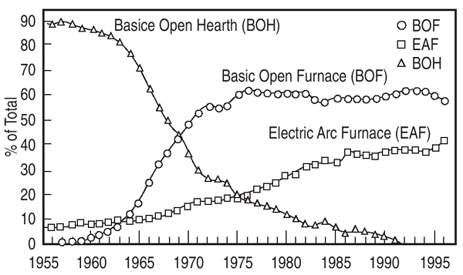

Slide 23
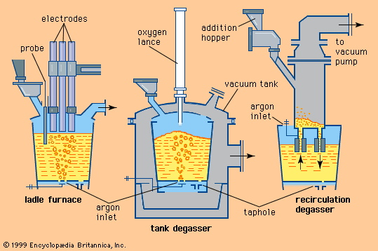
Ladle Treatment :

Slide 24
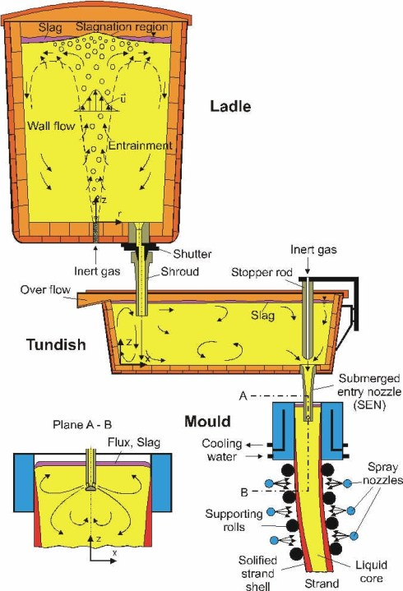
Ladle / Tundish Treatment :

Slide 25
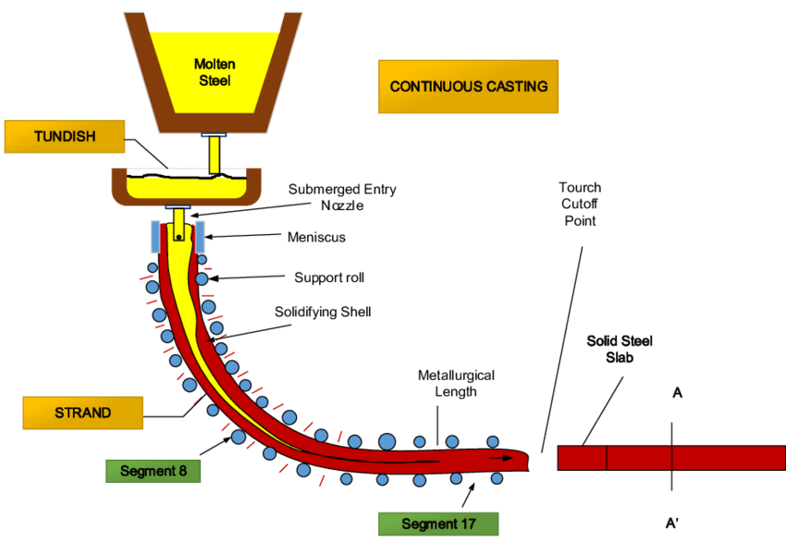
Continues Casting of Steel:

Slide 26
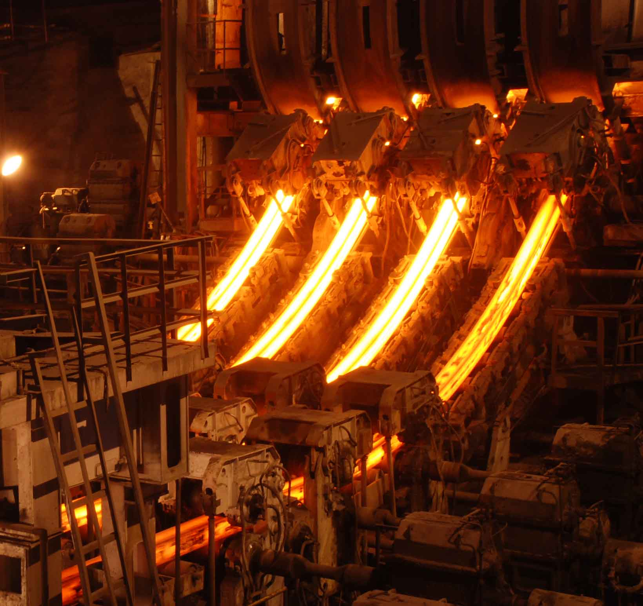
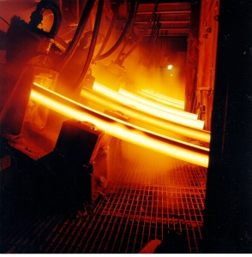
Continues Casting of Steel:

Slide 27
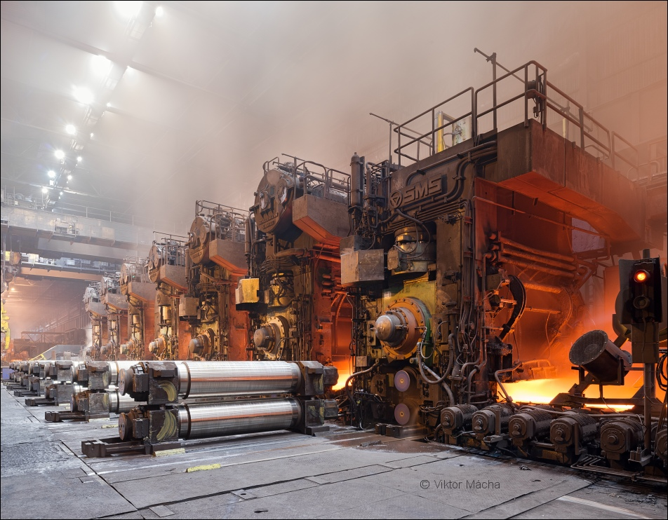
Hot rolling of steel:

Slide 28
Hot rolling Product :

Slide 29
Thank You….for attention
Any Questions….??

