Slide 1
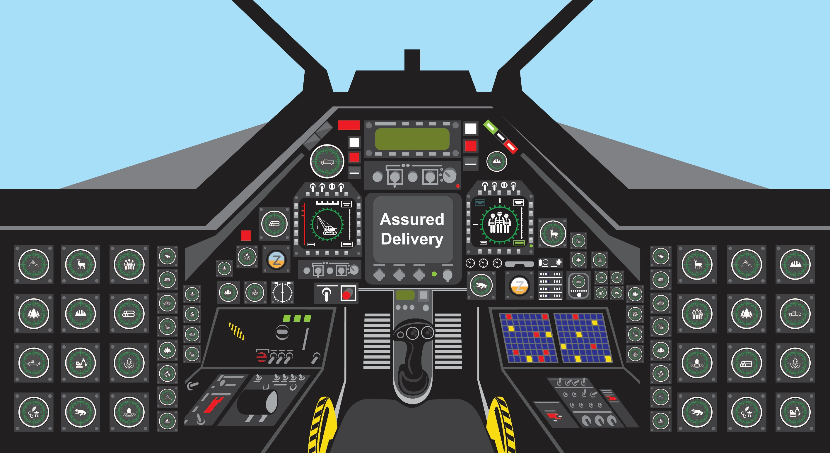
Task Saturation
Decision-making paralysis
Feeling of being overwhelmed

Slide 2
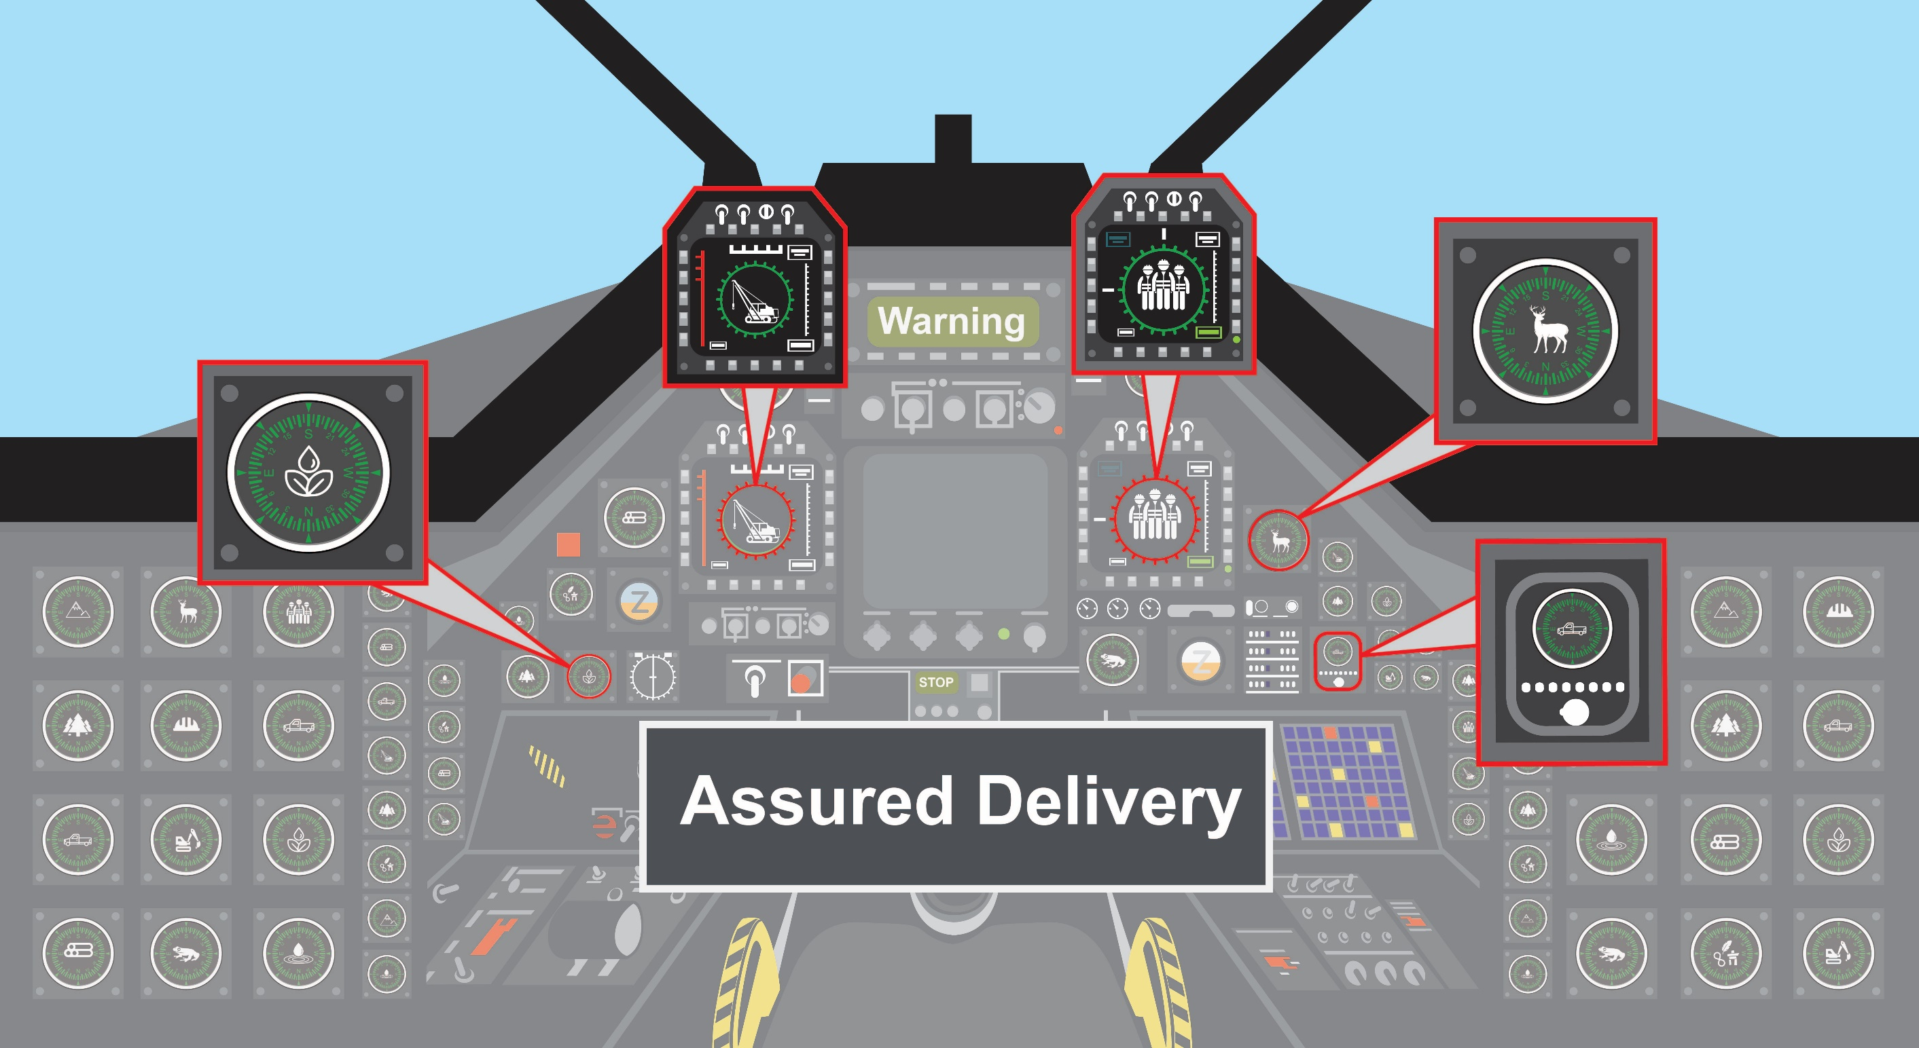
Identify Top 5 Priorities
Take a minute to breathe
Focus on big picture
Tackle items one at a time

