Slide 1
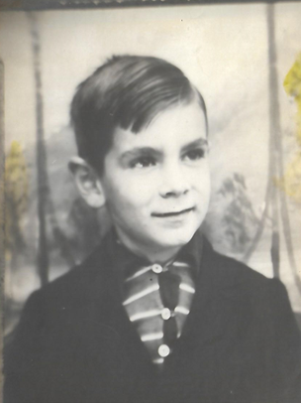
Louis Richard DePrisco
December 4, 1930 – March 17, 2024
A Life Well Lived!

Slide 2
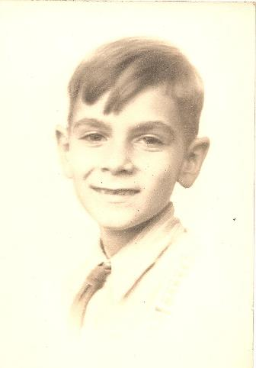
The Early Years
A favorite story of his that we remember was when he was 5 and they didn’t have a lot of money, he used to pull his wagon to the grocery store and offer to cart home people’s purchases for a nickel. He was trying to take care of people even back then.

Slide 3
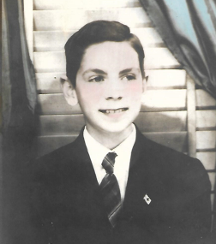
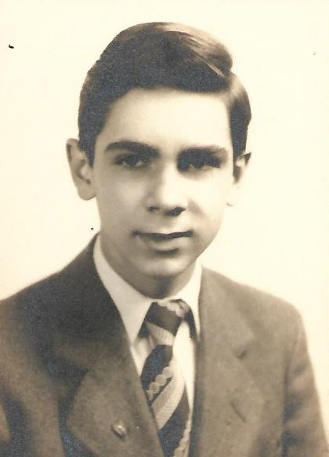

Slide 4
Lou – Honor Society HS trip to DC - 1947

Slide 5
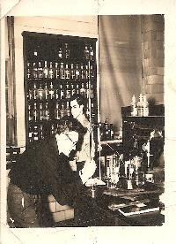
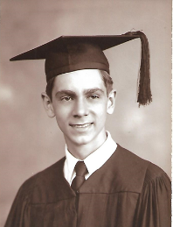
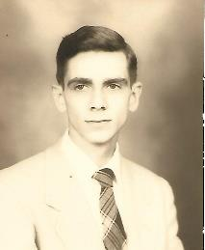
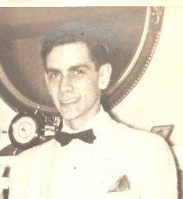
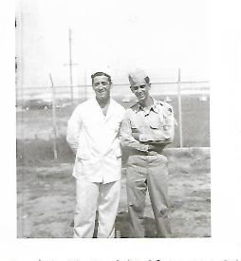
High School, Family, Friends, College, and the National Guard

Slide 6
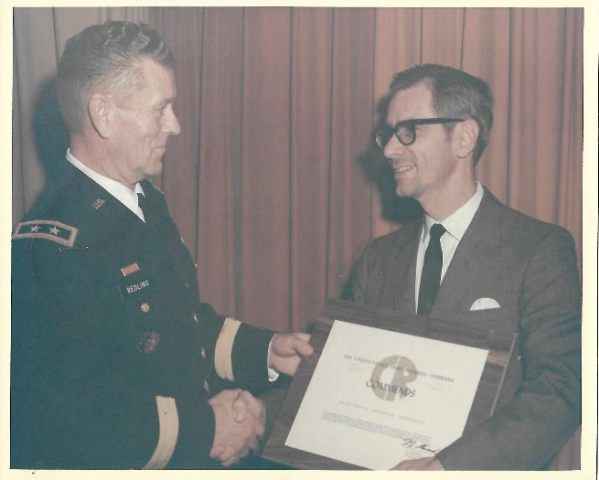
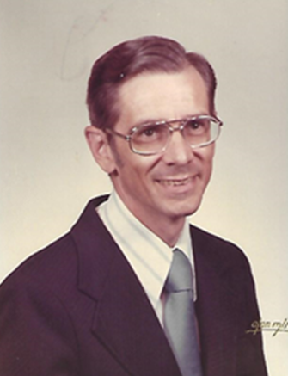
His work was very important to him, he was so dedicated, and he worked very hard.

Slide 7
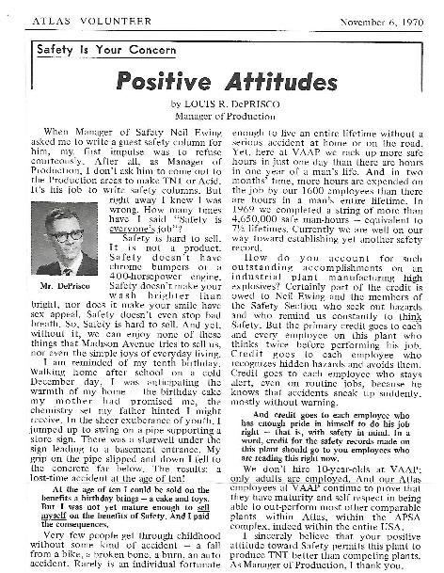

Slide 8
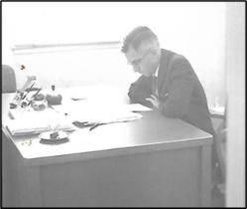
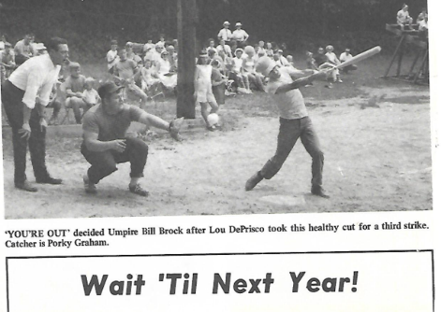

Slide 9
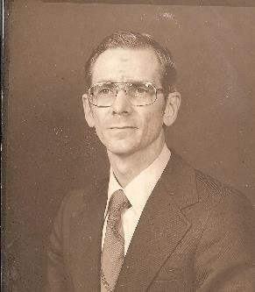
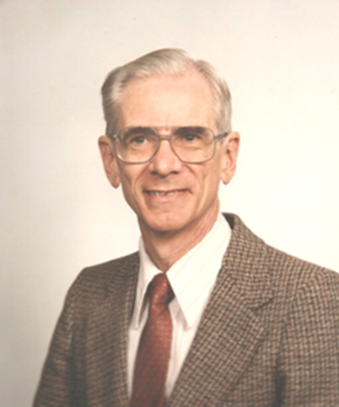
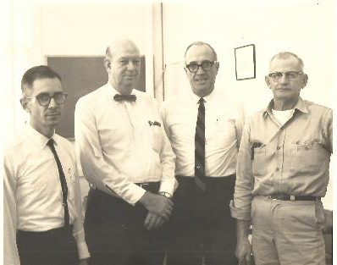

Slide 10
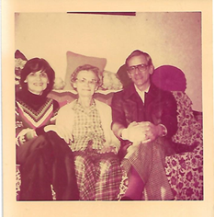
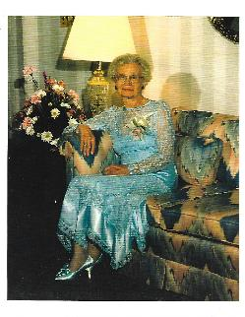
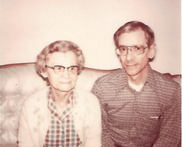
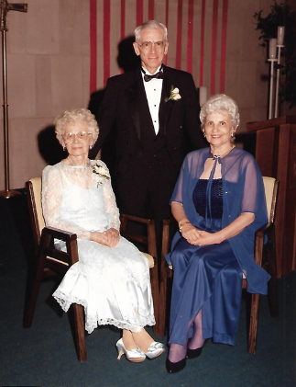
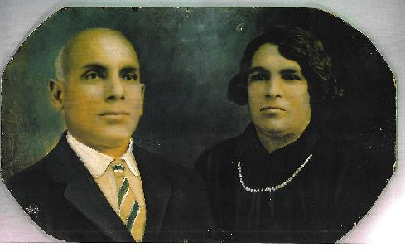
Family – Another Cornerstone in his Life
Grandparents – Giovanni ‘John’ and
Raphaele ‘Fanny’ DiPrisco

Slide 11
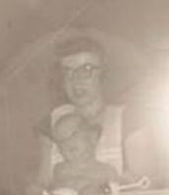
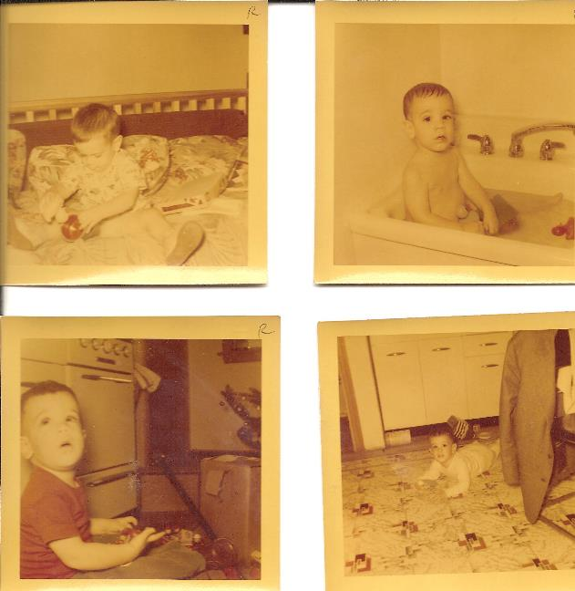
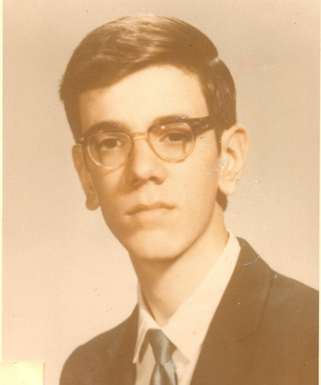
His
First
Born

Slide 12
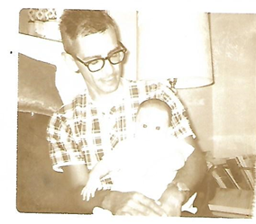
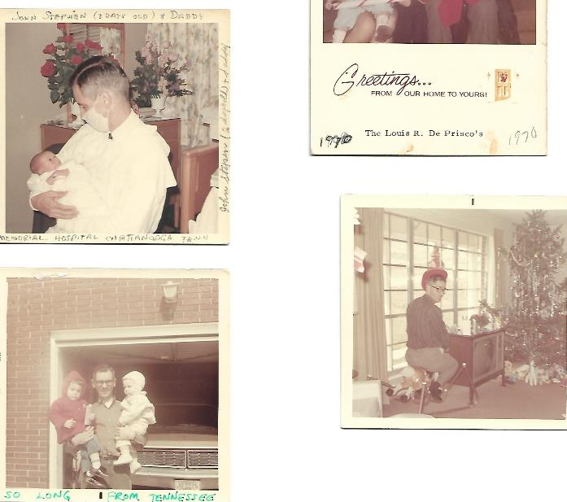
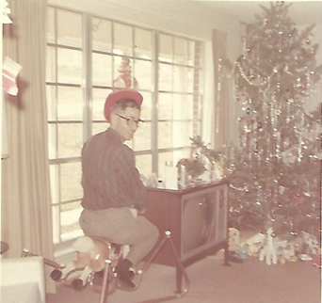
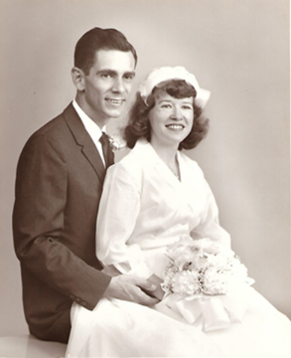
And then more…

Slide 13
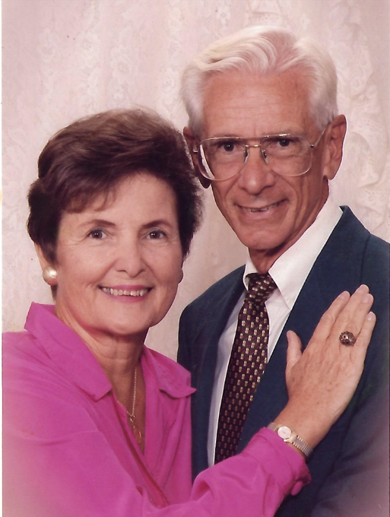
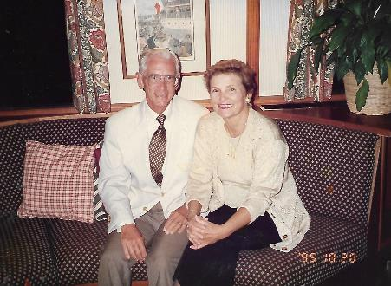
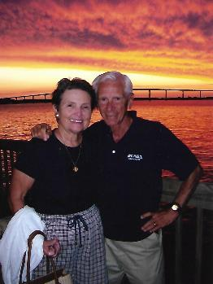
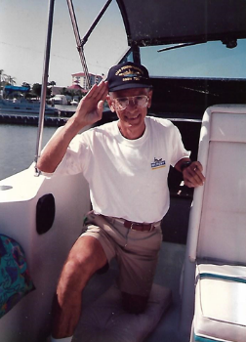

Slide 14
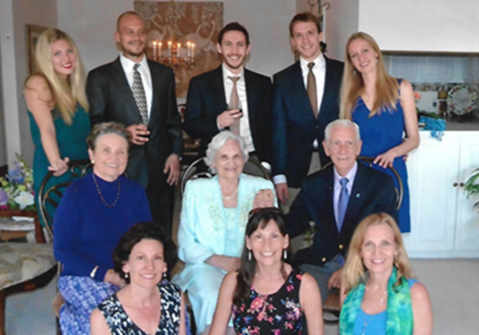
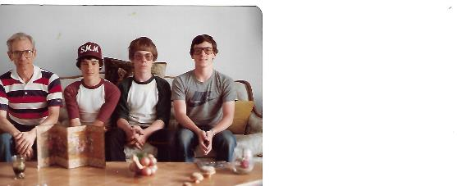
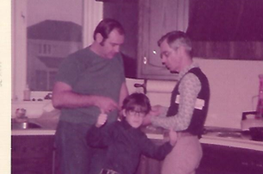

Slide 15
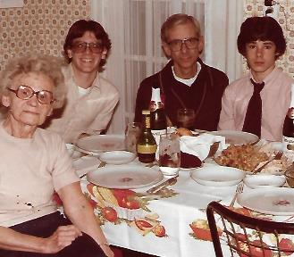
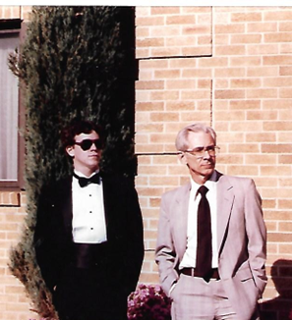
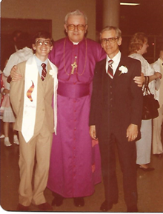
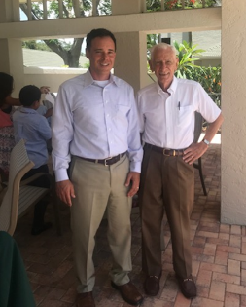
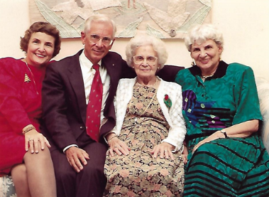

Slide 16
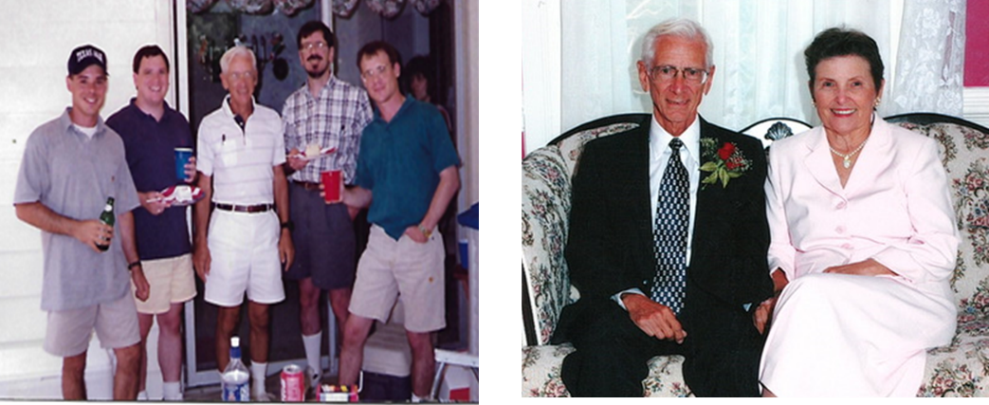

Slide 17
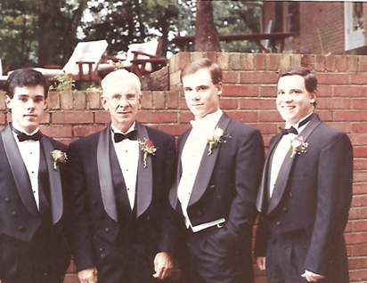
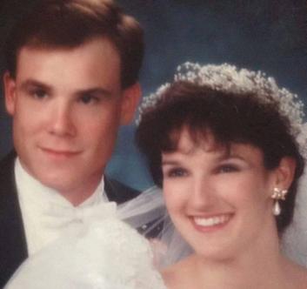
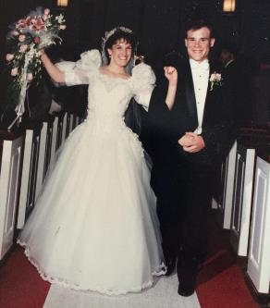
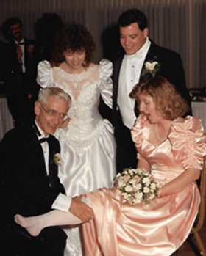
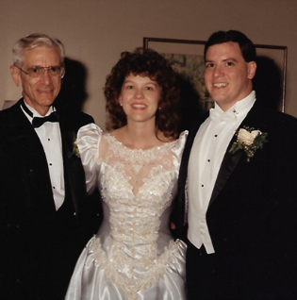
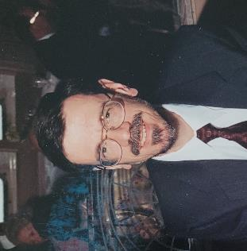
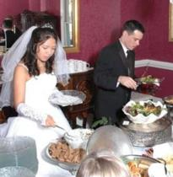
All Grown Up!

Slide 18
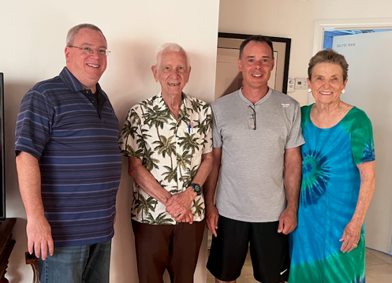

Slide 19
He Adored Mary

Slide 21
Always having fun

Slide 22
And all those Grandbabies!

Slide 24
He Loved to Travel
Eating Octopus in Japan
Stone Mountain, GA

Slide 25
Ireland
Africa

Slide 26
Italy,
Hawai’i, and
St. Thomas, Virgin Islands

Slide 27
Paris and Poland (he met a relative of Nana’s) on his trip with Rick.
Lou and Rick in Antarctica!

Slide 29
And Do Crazy Things…
Jumping out of a plane!
Climbing Mt. Kilimanjaro!
Sneaking into his TNT plant at night and crawling under the fence while there was a strike going on. And once by helicopter.
Avoiding TNT thrown on his front lawn by the Union.
Trying not to fall out of a small plane when the door opened; he was hanging by the seat belt trying to close the door.

Slide 30
Bungee jumping off a bridge in New Zealand!
Climbed a waterfall in Jamaica

Slide 31
Sooooo full of life!

Slide 33
Childhood Memories in an email from Lou to sister Gloria

Slide 35
John, I’m so sorry to hear your dad passed away. He was an amazing person. I know lots of people are calling you and you have a lot on your mind. We love you and let us know about arrangements and if there is anything we can do. Love and prayers. Peter Renzi
Things people shared when they heard he’d passed…

Slide 36
An Amazing Man Who We Will Miss So Much!

