Slide 1
Smarter Balance
Assessment Consortium (SBAC)
What is the SBAC?
Why is it different from other tests?
What does it mean to your child?
How can you help?

Slide 2
What is the SBAC assessment?
California began SBAC test in 2014.
SBAC aligned to the California State Common Core Standards.
All 3rd, 4th, and 5th graders take this assessment.
The assessment covers English Language Arts, Math, and Science (5th grade).
The assessment is taken completely on the computer.

Slide 3

TESTS
Smarter Balanced Summative Assessments in ELA and Mathematics
California Science Test (CAST) 5TH GRADE
Notes:
First, let’s take a moment to talk about the Smarter Balanced assessments in ELA and mathematics.
Why are these tests called the Smarter Balanced tests? Or maybe you’ve heard them referred to as the SBAC.
These tests were developed by a group of states and the name of that group is the Smarter Balanced Assessment Consortium.
As you saw in the umbrella graphic on the previous slide, they are part of the CAASPP system.
These tests are designed to measure or check what students know and can do – in other words the knowledge and skills they gained during the school year.
The California Science Assessment, also known as CAST, is a new assessment recently developed in California.
It is designed to test the students’ ability to think critically and solve problems, which are important skills for all students to have.
The CAST focuses on questions that cover more than one scientific area at a time, such as life science, earth and space science, and physical science.

Slide 4
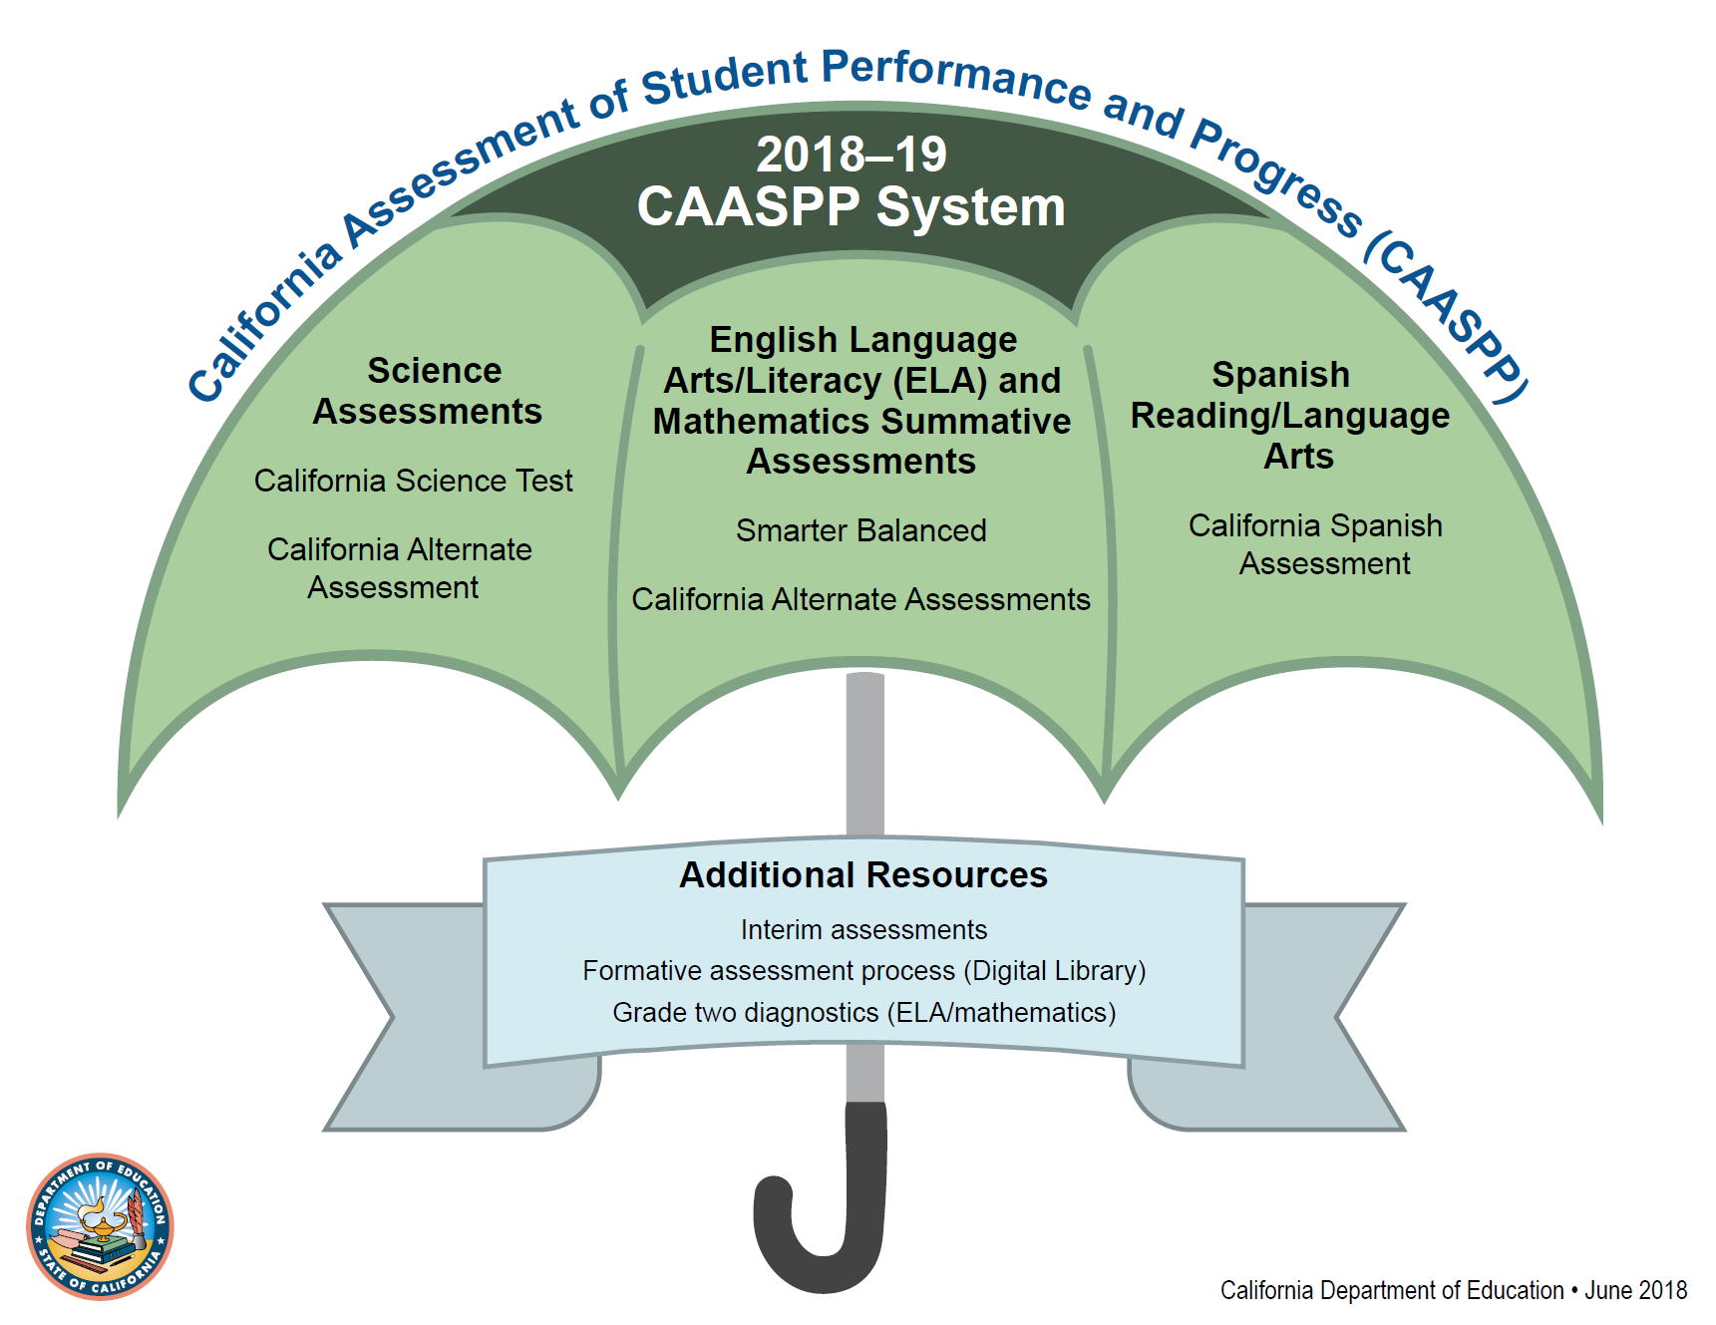
CAASPP System
Notes:
At the end of each school year, students in grade 3 and higher take statewide assessments, also known as summative assessments. They are called summative because they test the sum of what your child learned during the school year.
The umbrella term we use to talk about the summative assessments our students take is CAASPP which stands for the California Assessment of Student Performance and Progress.
The CAASPP system has three main parts:
Science assessments
English language arts/literacy, or ELA, and mathematics assessments
and the Spanish reading/language arts assessment, which is optional.
Today we will focus on the assessments of ELA, mathematics, and science, because most students will take those tests. The only exception is for those students who take the California Alternate Assessments based on their unique needs.

Slide 5
TIME SCHEDULES FOR TESTING
Tests | 3rd | 4th | 5th
Language Arts | CAT 1:30 PT 2:00 | CAT 1:30 PT 2:00 | CAT 1:30 PT 2:00
Math | CAT 1:30 PT 2:00 | CAT 1:30 PT 2:00 | CAT 1:30 PT 2:00
Science |  |  | 2:00
CAT-Computer Adaptive Test
PT-Performance Task
Suggested Times, all test are untimed

Slide 6

How?
On the computer
Varied question types
  Multiple choice
  Read and respond
  Drag and drop
  Constructed response
  Performance Task
Notes:
Now that we know what these tests are, why students take them, and in which grades, let’s spend a few minutes on what the tests look like.
The CAASPP assessments are all taken on a computer.
The Smarter Balanced Summative Assessments in ELA and mathematics are computer adaptive. That means that students take the test on a computer and the computer gives students questions that are easier, the same, or more difficult based on their answers to the previous questions. As students answer questions correctly, they receive more challenging questions. Incorrect answers trigger easier questions. This helps keep the test short for many students and makes sure the scores are very accurate, especially for students who score very low or very high.
The CAST test is not computer adaptive but are still taken on a computer.
These online tests give students many different types of questions. For some of the math questions, for example, your child might be asked to drag and drop things from one place on the screen to another, or draw a graph to solve a problem.

Slide 7

Why:
To provide teachers, students and parents with information about how students are doing in school.
Assist students in becoming college and career ready.
Notes:
You may be wondering why students need to take the CAASPP tests.
Test results are an important piece of information about how your child is doing in school.
Together with report cards, classroom work, homework, etc., test results tell us if your child is on track to succeed in higher grades and is ready for college and career.
Most importantly, the CAASPP system gives information to teachers, students, and their families about what students know and are able to do.
As a parent or guardian, you can use these test results and other information, to know if your child is on track or perhaps needs support in certain areas of English language arts, mathematics, or science.

Slide 8

When:
Tests available to teachers on Monday, April 22th.
Grades 3 and 4 are completed on May 24th.
Grade 5 is completed by May 31st.
Notes:
Now let’s talk about the timing of the CAASPP tests. We mentioned before that these tests are taken by students at the end of the school year. What does that mean exactly?
Students take summative assessments during what’s called the “testing window”. Each school selects its own testing window that can begin as early as January.
Our students will begin taking the CAASPP tests on [insert first day of testing].

Slide 9

How to help your child prepare for this assessment?
Check with your child’s teacher for exact tests dates.
Make sure your child has a good night’s sleep before tests.
Make sure your child has a healthy breakfast the day of the test.
Please do not make appointments or plan to be out of town on test days.

Slide 10


What’s new for 2019?
All assessessments are being given in the classrooms on Chromebooks
All test including Fifth Grade Science Test results are available to parents and teachers

Slide 11


What else is new?
Results will no longer be mailed to parents.
Parents can access results on LAUSD’s Parent Portal.

Slide 12


Parent
Portal
Questions? See
Sharon Kiemon
Community Rep.

Slide 13
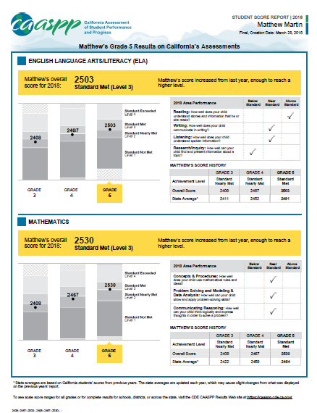
CAASPP
RESULTS
Notes:
Students who take the CAASPP tests will receive scores in the late summer or early fall. [Insert more specific information about the timing of this report for your school.]
When you receive your child’s student score report, take a moment to review it with your child and understand what it shows.
On the front of the report you will see your child’s test scores for ELA (top half of the page) and mathematics (bottom half of the page). It will show your child’s score and well as one of four achievement levels:
Standard Not Met or Level 1
Standard Nearly Met or Level 2
Standard Met or Level 3 or
Standard Exceeded or Level 4
When you’re reviewing this information remember that the goal for each child is to meet or exceed the standard, which means Level 3 or better.
You will also see information about how your child’s score from this year’s test compares to last year’s test.
And finally information about the four areas of ELA and three areas of mathematics knowledge your child was tested on and how they did.

Slide 14
CAASPP Practice Test Site
CAASPP.ORG
Practice and Training Tests
Student Interface: Practice and Training Test
Sign in as Guest User/Choose a Grade and Test
Settings/Audio
Pay attention to Universal Tools available to all.

Slide 15
Thank You!

