Slide 1


AI in Action
Real-Time Solutions for Entrepreneurs
Ian Carlstrom
West Central Minnesota SBDC

Slide 2

Since 1975 the world population has DOUBLED
(4.1B → 8.2B now)
More people ≠ More available workers
Shifts in work preferences → more people choosing flexible, gig, or remote jobs
Aging populations → in many regions, fewer people of working age
Skills mismatch → jobs available don’t always align with people’s skills
Geography → labor growth isn’t where businesses are located
Back then… the fear was that machines would replace people in the economy.
But now… the reality is many businesses can’t find enough people to hire.
What felt like a risk then, looks like an opportunity today.
Supporting AI adoption is just one more way the SBDC helps small businesses succeed.

Slide 3
Stages of Adoption: a Small Business AI Journey
AI doesn’t have to be overwhelming—it’s already helping small business owners save time, improve communication, and make everyday work easier.
This session shares practical lessons from working alongside a wide range of entrepreneurs as they explore and apply AI in real ways.
You’ll hear what’s working, what’s not, and simple tips and tricks that make AI more approachable.
Whether you're just getting started or looking to build on what you’ve tried, this is a chance to move forward with AI in ways that actually fit your business.

Slide 4

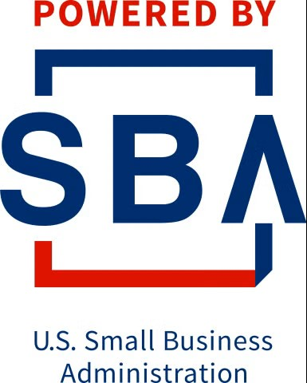


Hats Off to Our Host & America’s SBDC
Funded in part through a Cooperative Agreement with the U.S. Small Business Administration, the Minnesota Department of Employment and Economic Development, and regional support partners. The West Central SBDC is a proud member of the Minnesota SBDC Network. All opinions, conclusions, or recommendations expressed are those of the author(s) and do not necessarily reflect the views of the program sponsors. Programs are open to the public on a nondiscriminatory basis. Reasonable accommodations will be made upon request. Contact the West Central SBDC at (218) 299-6606.

Slide 5
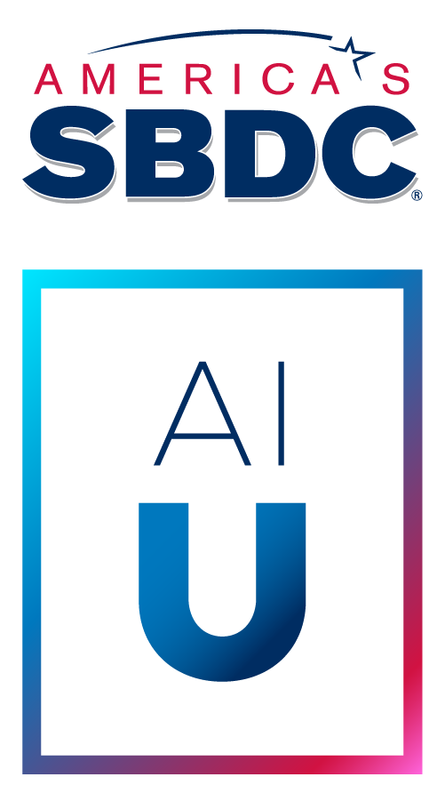
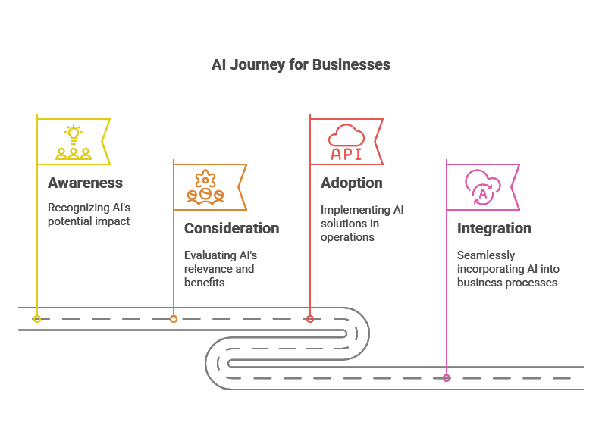
SBDC AI Readiness Assessment
1
3
Are you
ready for AI?
(America’s SBDC
AI U Toolkit)
2
4

Slide 6
AI Adoption Journey for Small Businesses
      Awareness:
      “I’ve Heard About AI, But I Have No Idea Where to Start.”
        Marketing & Social Media. Job Postings.
    Consideration:
    “I’m Curious About AI, But I Don’t Know Which Tool to Pick.”
      Marketing & Sales. Writing & Editing. Experimenting & Dabbling.
  Adoption:
  “AI Is Helping My Business, But It’s Not Fully Integrated Yet.”
    Business Productivity. Individualized Workflows. Custom GPTs.
Integration:
“AI Is Now a Core Part of My Business.”
  Creative & Miscellaneous. Team Applications & Workflows. Performance.
Notes:
It can be and should be easy, and low-risk to start.
Where you end up is as unique as how you use the internet or do your laundry.

Slide 7
The Small Business AI Journey
        “From Beginner Friendly, to Advanced Uses”
        What people are already using AI for:
          Marketing & social media
          Writing & editing
          Experimenting and dabbling
          Business & productivity
          Creative & miscellaneous
It can be easy and low-risk to start.
Where you end up is as unique as how you use the internet or do your laundry.

Slide 8
AI Adoption Journey | Awareness | Consideration | Adoption | Integration | SBDC Training Offering
Demystifying AI | X |  |  |  | AI Resource Lab: Online, on-demand AI resources & training
Intro to Generative AI | X
Basic Prompting | X
Getting Started with AI | X
Advanced Prompting |  | X |  |  | Exploring AI for Business: In-person focus groups, live demos and Q&A
Comparing Tools |  | X
Exploring Time Savings & Efficiencies |  | X
Business Function Use Cases |  | X
AI Routines & Workflows |  |  | X |  | 10[C]hats AI Con: Full-day, hands-on AI conference with facilitated build sessions
Multimodal Uses |  |  | X
Prompt Refinement & Layering |  |  | X
Custom GPTs & SOPs |  |  | X
Measuring ROI |  |  |  | X | Customized Training: Tailored AI training built for individual teams
Shadow AI |  |  |  | X
Training Teams & Creating Policies |  |  |  | X
Strategic Planning & Long-Term Considerations |  |  |  | X

Slide 9
You’ve Heard About AI, But Have No Idea Where to Start
STAGE 1: Awareness
AI is everywhere, but it still feels overhyped and a little foreign. You’re curious, yet hesitant—unsure how it fits your world. You’re open to trying something small, just to see what happens.
What to work on:
Demystifying AI – Learn what it really is (and isn’t)
Intro to Generative AI – Understand the basics and key terms
Prompting – Practice asking better questions for better answers
Getting Started with AI – Try one small, low-risk experiment
“Wait… AI can do that?! Can it do this??”

Slide 10
Before We Start, You Don’t HAVE to use AI.
“That’s Your Choice”
      But here’s the truth:
You already are using it — every time you search, scroll, shop, or send.
The only choice you have is whether to understand it… or stay in the dark.
Refusing to learn doesn’t stop AI — it just stops you from keeping up.
“The best time to start was yesterday…
…the next best time is now!”

Slide 11
You Are the Advantage, AI is Just the Tool
  “AI doesn’t make businesses better or better businesses…
  Entrepreneurs do!”
Small businesses that adopt AI with purpose and ownership will build faster, stronger, and smarter.
My Advice to YOU: don’t be an “AI Junkie”
  Be a research junkie,
    Be a learning junkie,
      Be a writing junkie… AI can help with all that!
AI won’t replace you today (probably not), but someone using AI will!

Slide 12
Mindset Shift for Success with AI
          “AI is a Team Member, Not a Magic Wand”
It doesn’t read minds, but it can handle brain dumps pretty well!
Quick Example:
“Make me a flyer.” | = bad prompt
“Create a flyer for my small-town bakery’s Spring Festival event, targeting families with playful language and a coupon offer.” | = better prompt

Slide 13
Prompting = Good Communication
      “You don’t get good AI results by typing fancy prompts.
        You get good results by talking to AI like a person”
People always ask me, “do you have a prompt for that??”
…No, we use NLP not HTML (no code programming)
If you’ve ever hired someone, trained a new employee, or delegated a task, you already know how to use AI
You don’t give your newest employee the tour, make introductions, show them to their desk, and immediately ask for a sales report
AI needs clear direction, clear goals, and real communication – just like a new hire

Slide 14
The Best First Ways to Get Started
          1. Use AI like a search engine
            Gain low-risk experience, practice
            See how it thinks, how it hallucinates, how it handles follow ups
2. Use AI as a starter for tasks you already know (as an assistant):
  First draft of newsletters, social media posts, checklists, FAQs
  You’ll catch mistakes because you know the subject
3. Then, use AI to learn what you don’t know (guided learning):
  Ask “what am I overlooking?” or “what else should I know?”… collaborate with AI!!!
Start with what you know, experiment, then use AI to show you what you didn’t even know you didn’t know!

Slide 15
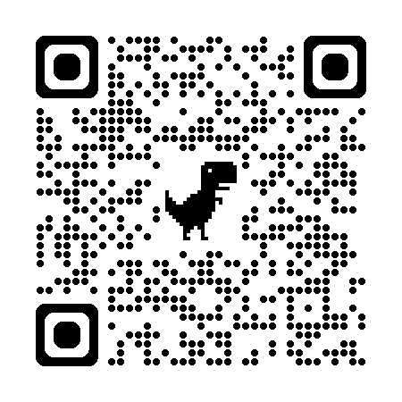
The Start of Your AI Journey… AI Resource Lab
      Empowering small businesses to unlock the potential of AI with hands-on tools and tailored guidance for success
*AI Bootcamp: 3 videos, ~30 minutes
  “Demystifying AI”
  “Getting Started with AI”
  “Getting the Most of AI” westcentralmnsbdc.com/ai-resources-lab
*Interactive AI Tools: tailored solutions (prebuilt GPTs) for business growth and innovation…
It all starts with experimentation, confidence building, and curiosity.
*Downloadable AI Toolkit: simple, actionable resources built for small business owners.

Slide 16
That Was Awareness…
Confidence and Curiosity drive progress!
Up Next: Consideration

Slide 17
Your Curious About AI, But Don’t Know Which Tool to Pick
STAGE 2: Consideration
You’ve tested AI, but the results are inconsistent—sometimes useful, sometimes frustrating. You’re starting to see it’s not plug-and-play, and success depends on finding the right use case.
What to work on:
Advanced Prompting – Go beyond basics to get consistent results
Comparing AI Tools & Platforms – See which ones fit your needs best
Business Function Use Cases – Focus on examples relevant to your work
Exploring Time Savings & Efficiencies – Identify where AI actually saves time
“Ok, some of this is working—but I need to figure out where it actually fits.”

Slide 18
Everyday AI In Action
“AI doesn’t have to be complicated – start with simple tasks”
Quick Writing Help
  Draft or polish an email
  Write a thank-you note
  Create a product description
Marketing Support
  Generate social post ideas
  Brainstorm taglines or headlines
  Rephrase website copy
Organization & Learning
  Summarize articles, notes, or PDFs
  Create a to-do list from meeting notes
  Explain business terms in plain language
Everyday Life
  Plan a meal or create a shopping list
  Draft a travel itinerary for a weekend trip
  Suggest gift ideas for a friend or client

Slide 19
Be Patient. Explore. Experiment.
  “Keep this in mind…”
Similar to working with a human,
at first it may take longer to train than to do it yourself.
You will spend a little extra time in the beginning. Why?
You’ve already honed your task or process, the old-fashioned way.
This is your learning curve to develop a new, better or faster way.
It’s an investment into future time saved!
Just like delegating, or managing people… they aren’t perfect, they don’t read your mind, they get things wrong… but they get better with feedback & iterations. It gets better when you don’t give up right away.

Slide 20
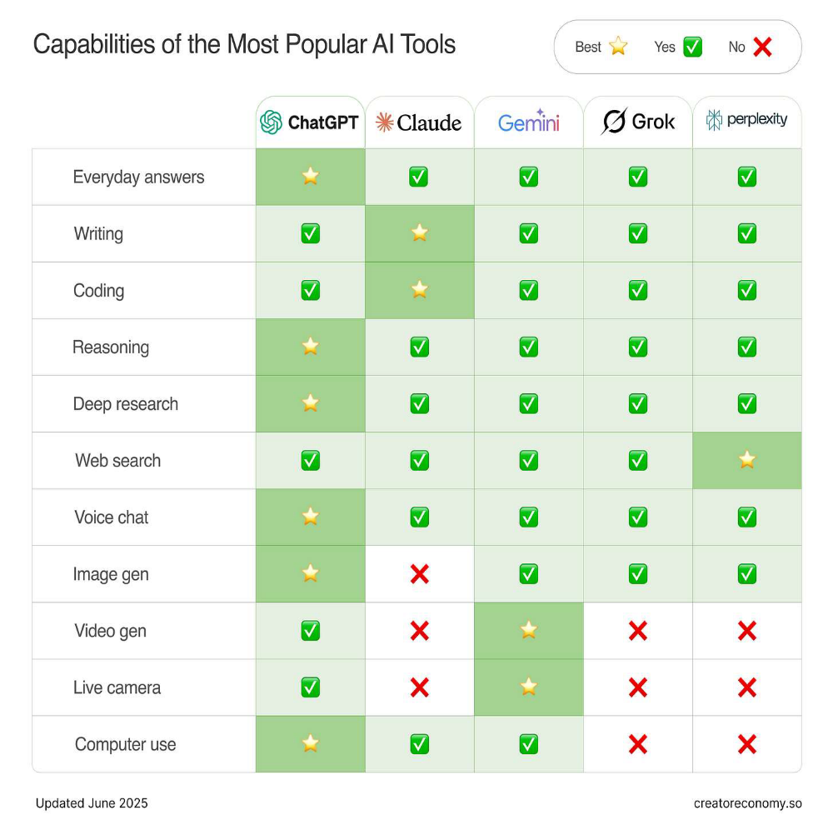
Comparing AI Tools & Platforms
      Which Platform to Use?
      So Many Choices!
Different Tools for Different Tasks
Unique Outcomes for Unique Users
Ever-evolving AI landscape
Understand what YOU want to do first.
Find a tool that works for you.
Don’t chase shiny things.

Slide 21
Leveling Up Your Prompting Game
            “Garbage in, Garbage out.”
        You’ve figured out that AI doesn’t read your mind.
But you can have a conversation, follow up, it remembers you...
Exploring some different prompting types or styles:
Zero-Shot & Few-Shot Prompting
Instructional Prompting or Backcasting
Multi-Turn and Chain-of-Thought Prompting (then Tree-of-Thought…)
And many more!
It’s not about one good answer, it’s about repeatable results.

Slide 22
Experiment Your Way Forward
            “Learn by Doing, Just Like Always.”
          AI: practice beats theory. Don’t study AI from the sidelines – practice it, mistakes and all.
As humans, we learn through taking, writing/typing, reading, doing.
AI is just another way of doing those same things – only faster, with feedback.
Try prompts, tools, tasks and workflows even if you’re not sure they’ll work.
Experience is the best teacher — you’ll learn faster by doing.
Mistakes (hallucinations, wrong answers, dead ends) are part of the process. They show you how AI thinks.
Using AI isn’t about finding the right way, it’s about finding your way.

Slide 23
That Was Consideration…
Exploration and Experimentation drive progress!
Up Next: Adoption

Slide 24
AI Is Helping Your Business, But Not Fully Integrated Yet
STAGE 3: Adoption
AI is part of your routine, but still a bit messy. You’re ready to move from one-off prompts to organized workflows that bring consistency and value to you and your team.
What to work on:
AI Routines & Workflows – Turn repeatable tasks into efficient systems
Multimodal Uses – Combine text, images, audio, and more for richer results
Prompt Refinement & Layering – Build prompts that improve with iteration
Custom GPTs & SOPs – Create tools & playbooks your whole team can use
“This is working pretty well—I just need to lock in a better system.”

Slide 25
From Experiments to Habits
            “Making AI Part of the Routine”
            In the Adoption phase, AI shifts from “every once in awhile” to part of your daily rhythm.
Beyond tools and platforms, skills or shortcuts – focus on the mindset.
      Because the way we think about AI,
          transforms how we work with it,
              and how it works for us!

Slide 26
Beyond Vending Outputs for Prompts
        “AI is no longer transactional, it’s a thought companion”
        Adoption is where prompts evolve from quick answers into structured systems you can rely on.
Prompt like you mean it, like a manager communicating to your team
Refinement: Iterate and improve, don’t restart.
Layering: Break tasks into steps that build on each other.
Frameworks: Apply structures (RIPE, COSTAR, CRAFT) for clarity and control.
Templates: Save prompts as reusable assets.
Consistency: Aim for reliable, repeatable outcomes across contexts.
Notes:
RIPE (Role, Instructions, Procedure, Examples)
COSTAR (Context, Objective, Style, Task, Action, Result)
CRAFT (Context, Role, Action, Format, Tone)

Slide 27
Workflows & Custom GPTs
        “Don’t just use AI, train it to work your way”
        This stage is about building reliable workflows and custom GPTs that reflect your business, not just generic outputs.
Workflows are a series of individual tasks related to an outcome/output.
You already integrate multiple (multimodal) platforms (calendar, CRM, pics, docs, etc).
GPTs: pre-trained assistants with your instructions, parameters, tone & knowledge.
Consistency, efficiency, and personalization — AI shaped around your workflows, not the other way around.

Slide 28
From Tasks to Workflows
“Identify where AI actually saves time or reduces errors,
how AI works for you.”
Repetitive/Time-Consuming Tasks
  Email management and responses
  Social media posting and scheduling
  Data entry and organization
Tasks You Dislike or Avoid
  Writing product descriptions
  Formatting documents/presentations
  Following up with cold leads
High-Value Tasks Needing Enhancement
  Customer proposal creation
  Competitor research and analysis
  Strategic planning documents
Mission-Critical Tasks That Need Quality
  Customer support responses
  Investment/financial analysis
  Legal/compliance document review

Slide 29
Responsibility Reminder
          “Own Your Outputs, and be Respectful”
AI isn’t here to make you lazy – it’s here to make you better.
If you blindly copy-paste AI work, it shows. And its on YOU.
Review, revise [pause] and put your voice into everything AI touches.
Always keep the human-in-the-loop. Human-AI sandwich.
Also, please, don’t record people without their consent!

Slide 30
That Was Adoption…
Consistency and Refinement drive progress!
Up Next: Integration

Slide 31
AI Is Now a Core Part of Your Business
STAGE 4: Integration
AI is built into how you work. Your team runs on repeatable systems that save time, improve quality, and keep getting better. You refine what works and use AI to think, plan, and delegate.
What to work on:
Measuring ROI – Track the value AI brings to your business
Shadow AI – Identify and manage unofficial AI use in your org
Training Teams & Creating Policies – Build skills and clear guidelines
Strategic Planning & Long-Term Considerations – Keep AI aligned over time
“This is just how we operate now—and we keep tweaking it to stay sharp.”

Slide 32
Hidden Risk: Shadow AI (and how to lead through it)
      “Know it or not, someone in your business is already using AI”
    Shadow AI = employees using free, unapproved tools. Left unmanaged, it can leak data, create liability, and produce inconsistent results.
The solutions isn’t to ban AI…
…it’s to lead AI use, with simple bottom-up (and top-down) policies.
Start the conversation.
Ask your staff: “How are you using AI today?” Build strategy from there!
Create a safe, approved tool list.
Set 2–3 simple rules (no sensitive data, review outputs, keep records).

Slide 33
Train Your Team & Build AI Policies
“Your people are your talent, AI is just the tool”
  AI success comes from people who know how to use it wisely. Training and policies make sure everyone feels confident, safe, & capable.
Set a Simple AI Guide: What’s okay, what’s not, and how to handle data.
Make It Everyone’s Job: AI responsibility belongs to every role, not just IT.
Train & Upskill Together: Hands-on sessions keep skills fresh and confidence high.
Create Feedback Loops: Share wins, flag risks, and adjust policies as AI evolves.
Keep the Conversation Open: Normalize AI use: talk about what’s working, what’s not.
Clear training and policies turn AI from a risk into a real advantage.

Slide 34
Measuring ROI with Intention
        “ROI isn’t just dollars – it’s time, quality, capacity”
The real ROI of AI is clarity – knowing how it changes the way your business works, and managing that change with intention.
What to Measure
Time Saved → Fewer hours on repetitive or manual tasks
Error Reduction → Fewer mistakes, better accuracy, higher quality
Training & Onboarding → Easier knowledge transfer, faster ramp-up
Workforce Gaps → Filling in where you can’t hire or scale
Job Impact → Is AI replacing, augmenting, or re-shaping roles? (intentionally,
not by accident)

Slide 35
Building for the Long Game
        “Don’t just patch today’s problems –
      set yourself up for tomorrow’s opportunities”
AI is moving fast, but that doesn’t mean you can only think short-term.
Create repeatable systems: Workflows that last beyond one project or employee.
Institutionalize knowledge: So AI (and your team) can apply lessons consistently.
Stay flexible: Design strategies that adapt as the tech evolves.
Balance quick wins with vision: Use band-aids when needed, but always keep an
eye on the bigger picture.
Long-term success comes from building foundations, not just fixes.

Slide 36
That Was Integration…
Strategy and Management drive progress!
Up Next: Bringing it all Together. Discussion. Q&A.

Slide 37
Your AI Journey, Your Pace
We’ve covered the 4 stages of AI adoption — Awareness, Consideration, Adoption, and Integration.
But remember:
Everyone starts in a different place.
Don’t compare your progress to someone else’s.
Each stage has its own skills and focus areas to grow into.
The goal isn’t speed, it’s sustainability. There is no finish line.
Don’t be overwhelmed. Don’t chase shiny things. Take it one step at a time.

Slide 38
Next Steps on your AI Journey
Every business is at a different stage with AI. The most important thing? Move forward, even if it’s a small step.
✔ If you’re just starting, pick one small way to try AI.
✔ If you’re researching, commit to testing a tool.
✔ If you’re using AI, make it a real part of your process.
✔ If you’ve fully integrated AI, track results and keep optimizing.
AI isn’t a trend—it’s a tool. The sooner you start, the more you’ll benefit.

Slide 39
Open Discussion
Questions?

