Slide 1
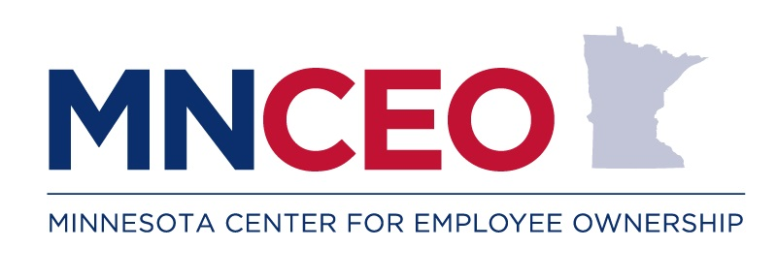
Your Guide to the
Employee Ownership Ecosystem
SBDC KEP
5/16/24
Notes:
Greeting
Introduce

Slide 2
Agenda
Game Time
Introduction
How We Help You & Your Clients
Employee Ownership Overview
Example
Q & A
Notes:
Our agenda for today is
We’ll start off with a little game
Talk about who we are
Get into how we can help you and your clients
Have a quick introduction to what we mean by broad based employee ownership
Talk with one of your colleagues about what it’s like to work with us
Time for Q & A at the end

Slide 3
What do you know about Employee Ownership (EO)?
What are the 3 primary forms of EO?
Which form of EO is suitable for a startup?
What does ESOP stand for?
What is the difference between a worker owned cooperative and other cooperatives?
What type of businesses fit best with EO?
Notes:
Get into groups of 5 or so people, we’re going to play a little game. Just to see where you’re at and help you understand where MNCEO can help. Old school - on paper
What are the 3 forms of EO?
Which form of EO is suitable for a startup?
What does ESOP stand for?
What is the difference between a WOC and other cooperatives?
What type of businesses fit best with EO?

Slide 4
What do you know about Employee Ownership (EO)?
Answers
What are the 3 primary forms of EO? ESOP, WOC, EO
Which form of EO is suitable for a startup? Worker Owned Cooperative
What does ESOP stand for? Employee Stock Ownership Plan
What is the difference between a worker owned cooperative and other cooperatives? The workers own the business.
What type of businesses fit best with EO? Virtually any business!
Notes:
What are the 3 forms of EO? - Employee Stock Ownership Plan (ESOP), Worker Owned Cooperative, & Employee Ownership Trust
Which form of EO is suitable for a startup? - Worker Owned Cooperative
What does ESOP stand for? - Employee Stock Ownership Plan
What is the difference between a WOC and other cooperatives? - In a Worker Owned Cooperative, the workers are the members who own the business.
What type of businesses fit best with EO? - Virtually any business!

Slide 5
What is MNCEO?
501c3 Non-profit
Raising awareness about EO
Connecting/Facilitating
Supporting the EO ecosystem
Notes:
We are a 501c3
Primarily grant funded with some individual and business donations
free services to business owners and service providers.
MNCEO has 3 objectives,
raising awareness about EO
Connecting companies that want to explore further
Partnering with, and supporting the EO ecosystem
- MNCEO = hub

Slide 6
MNCEO Services
Coaching & Consluting
More information on EO
  Presentations
  Monthly Webinar
Training
  Lunch and Learns
  Half or Full Day Trainings
  Ambassador Program
Connections to TA
Notes:
We are here to serve the MN business community
MNCEO provides services for business owners and business support professionals.
Coaching & Consulting - we can help you with any questions about EO that you or a client may have. We work directly with you and your client.
You are encouraged to be a part of it
Want you to stay with your client & it’s a learning opportunity for you
More Info on EO
Presentations - just about anything your group wants to learn about EO, we can provide a presentation. From ESOPs and charitable giving to cooperative bylaw structures.
We host a monthly webinar, last Thursday of every month at 10 am on the basics of EO. Great place to send clients or others. Plenty of Q & A time.
Training
Lunch & learns for groups, chambers, businesses, local trade groups, etc
More intensive half or full day trainings
Ambassador program, 4 weeks of 1hr sessions for a more deep dive
Connections to TA - we act as a hub
Great connections in MN EO world
Just started convening EOWG to give ecosystem a place to communicate

Slide 7
What is your experience?
Notes:
Poll the crowd (5 min)
Who has worked with companies where the owner wants to transition out, or by the employees of a business where the owner is looking to sell?
Of these, who has seen one or more of those businesses have to liquidate?
What are some of the reasons? (go out into the crowd for answers)
Were you able to help them?
Before today, who has heard about EO (ESOPS, WOC & EOT)? Can you explain them to clients?
Who’s ever worked with one, or knows enough about them to advise clients about them as options?

Slide 8
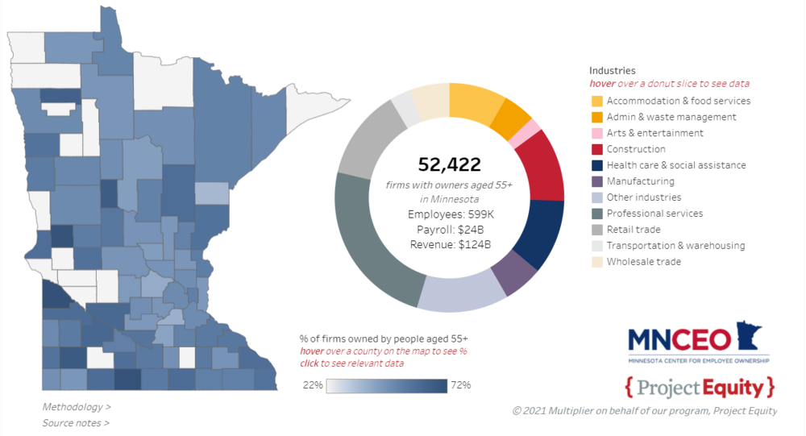
The Silver Tsunami
Notes:
Preface with EO is not just for transitions.
Baby boomers are the Silver Tsunami & at or nearing retirement age.
Interactive map from our website
Over 50k companies in MN are headed by people 55 or older transition over the next decade.
Almost 600k jobs depend on these & $24 billion in annual payroll
80% of businesses that go up for sale never find a buyer.
We can’t afford to lose these businesses & EO is the built in buyer

Slide 9
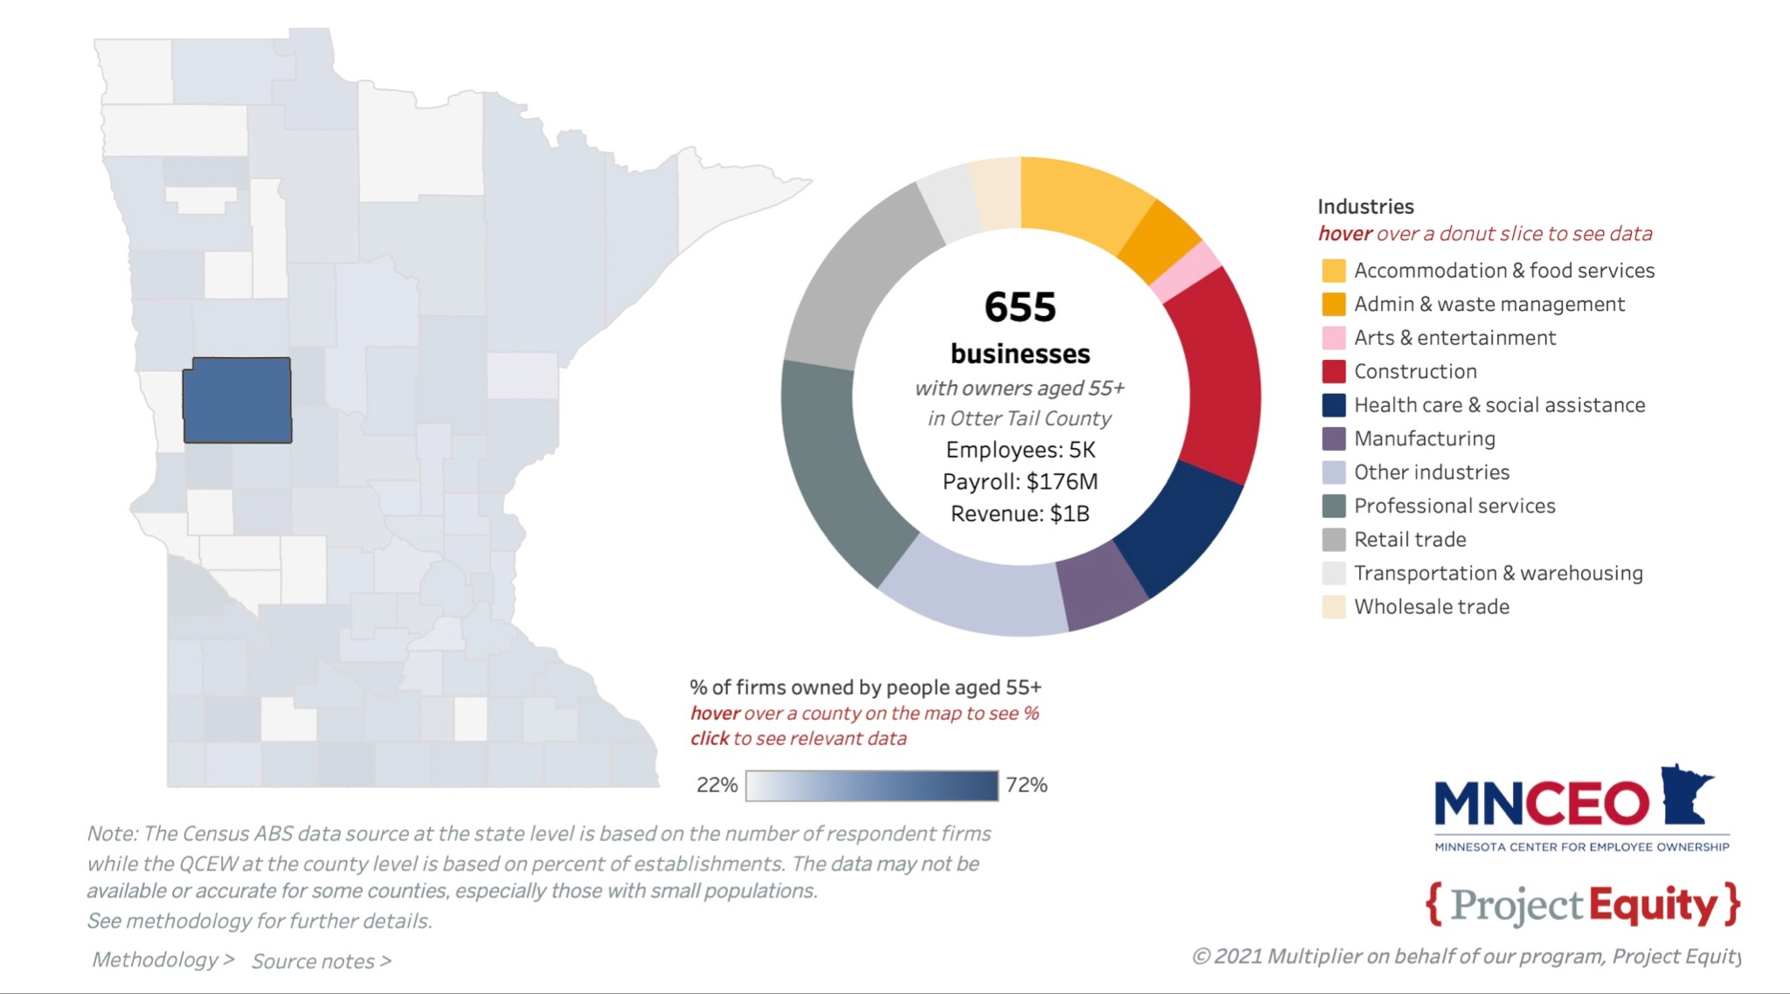
Otter Tail County, MN
Notes:
This is on our website mnceo.org = Otter Tail County
655 businesses
5k jobs
$176 Million in payroll

Slide 10

The Silver Tsunami is Coming Here
Notes:
Boomers are in their 60s and 70s
Sure 60s are the new 40s… and 70s are the new mid 60s…
The Tsunami is here

Slide 11

Employee Ownership
is the secret room
Notes:
When looking at this Tsunami, EO is like the secret room behind the bookcase. It presents more options when you think you have run out.

Slide 12
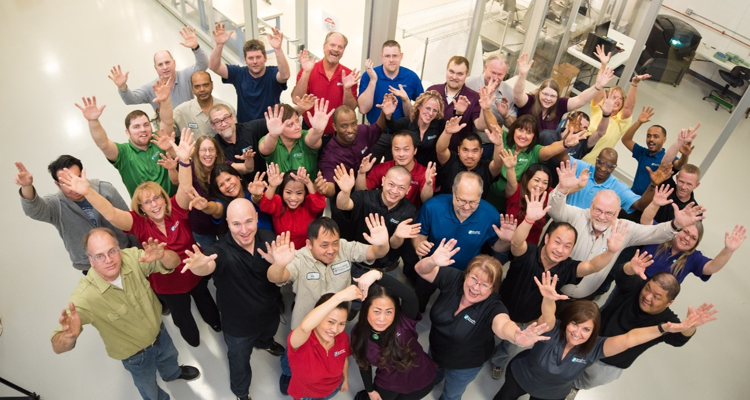
What is Broad-Based Employee Ownership?
Notes:
Broad based EO = making most, or all, of the workers owners building on the relationships that exist in a working team
creating a business the workers share in the responsibilities and rewards of running a business
In transitions it also preserves relationships between workers & businesses, Bus & community, while stabilizing communities.

Slide 13
3 Forms for Employee Ownership
Employee Stock Ownership Plan (ESOP)
Worker Owned Cooperative (WOC or Co-op)
Employee Ownership Trust (EOT)
Notes:
three basic structures of EO, ESOP, WOC and EOT - specific advantages and limitations

Slide 14
Employee Stock Ownership Plan - ESOP
Federally regulated retirement plan
Stock owned by trust & annual allocation
Can be 1%-100% of stock ownership
Built in benefits & requirements
Size minimum for ESOP
Increased Productivity
Better Recruitment and Retention
More loyal customer base
Potential Tax Benefits
Notes:
An Employee stock ownership plan, or ESOP is probably the most widely recognized form of broad based employee ownership. Over 6,500 nationwide, with over 225 in MN.
federally recognized and regulated plan
legal trust, trust owns stock benefit the employees
1% minimum to 100% and can change over time.
Benefits specific to an ESOP
federal tax benefits. In an S corp ESOP, the % of the stock that the ESOP owns is the percentage of profits that are Federally tax free! Minimum of 30% so 30% = 30%, 100% = 100% tax free profits!!!
ESOPs can be partial and % can change over time
Tend to build an ownership culture
Requirements specific to an ESOP
Since it is federally regulated,many reporting requirements annual costs
Doesn’t necessarily come with ownership culture, but can be a catalyst for building it
only recommend them to companies that have greater than $1.25M in EBITDA and 30+ employees

Slide 15

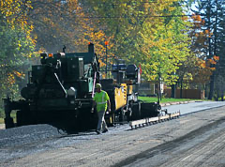
ESOP example
Started in 1920
ESOP created in 2004
100% ESOP in 2022
Notes:
Ulland brothers
Started in 1920 by… wood cutting
Now civil construction contractor w/ 3 locations (Cloquet, Virginia, Albert Lea)
Went through generations of owners, opened some up to employees
Had retiring group in 2004 and decided to create ESOP
Started as partial and % grew
Became 100% in 2022
Total plan assets of over $33 million

Slide 16



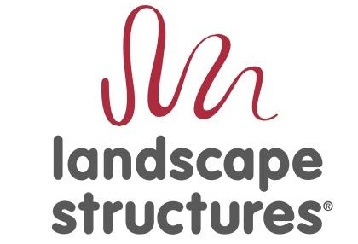


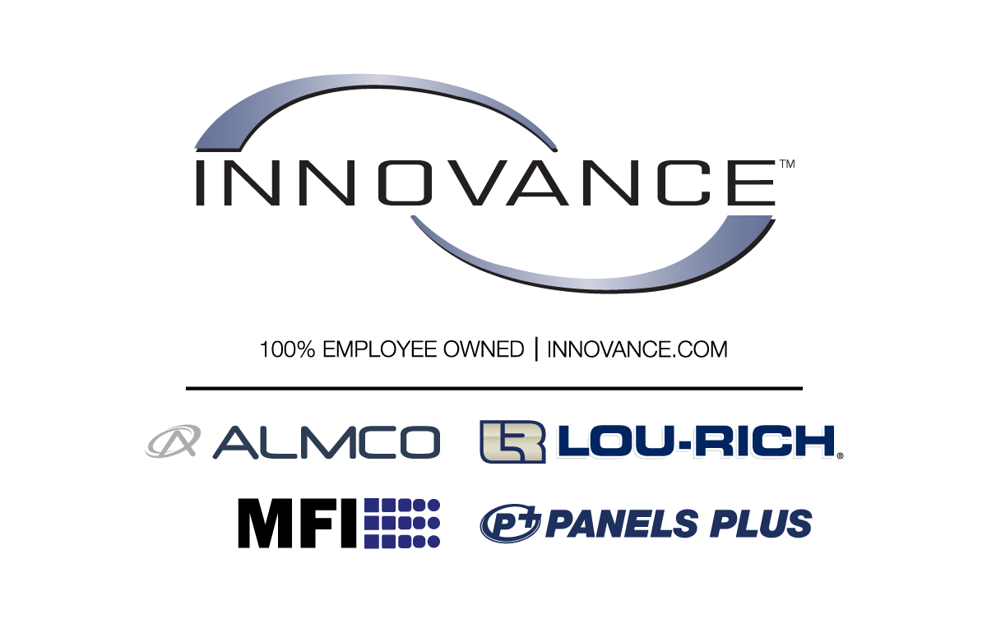

Other ESOPs in MN

Slide 17
Worker Owned Cooperative
Workers are the Owners/Members
Each Member owns 1 Share
Democratic Participation - 1 person 1 vote
Management Structure Varies
Members share surplus income
Tend to be smaller businesses
Increased Productivity
Better Recruitment and Retention
More loyal customer base
Potential Tax Benefits
Notes:
Co-op = entity for benefit of its members
democratically controlled
Co-op Examples
WOC v other co-ops
member owns 1 share held in equity account
1 person 1 vote
Management structure varys
Surplus & Patronage
Tax free surplus
tend to be smaller businesses (5-40 employees)
Can be used for a startup

Slide 18


Worker Owned Cooperative example
Started in 2022
DEED funded startup
14 Worker Owners
Notes:
Cardinal Comfort Care Cooperative
Based in 2 harbors, Started in 2022 by Susie Rosette - experience in hospice work
Wanted to create model that would help create better work environment/pay for workers
Got startup funds through a MN DEED program
Now have 14 worker owners

Slide 19
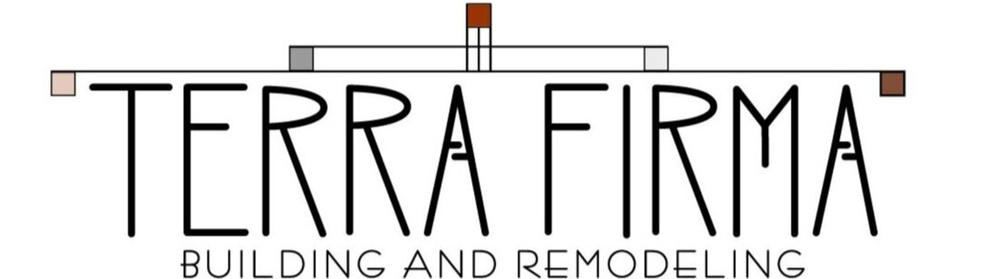
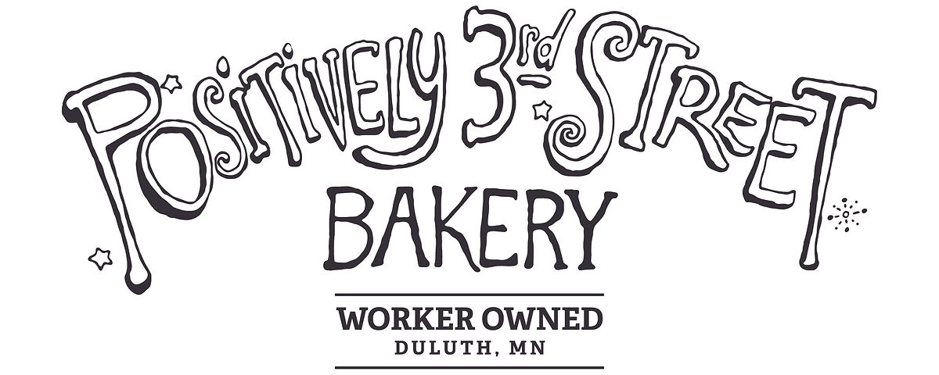


Examples of Worker Owned Cooperatives in MN

Slide 20
Employee Ownership Trust
Perpetual Purpose Trust owns the stock
Not federally regulated - flexible
Can be customized to suit seller’s desires
Common in UK, NZ & Australia
No tax benefits
Notes:
EOTs similar to ESOPs
A PPT
EOT is not federally regulated => flexible..
The trust created to suit the seller’s needs and desires for the future of the company.
EOTs new to US.
No specific tax benefits

Slide 21
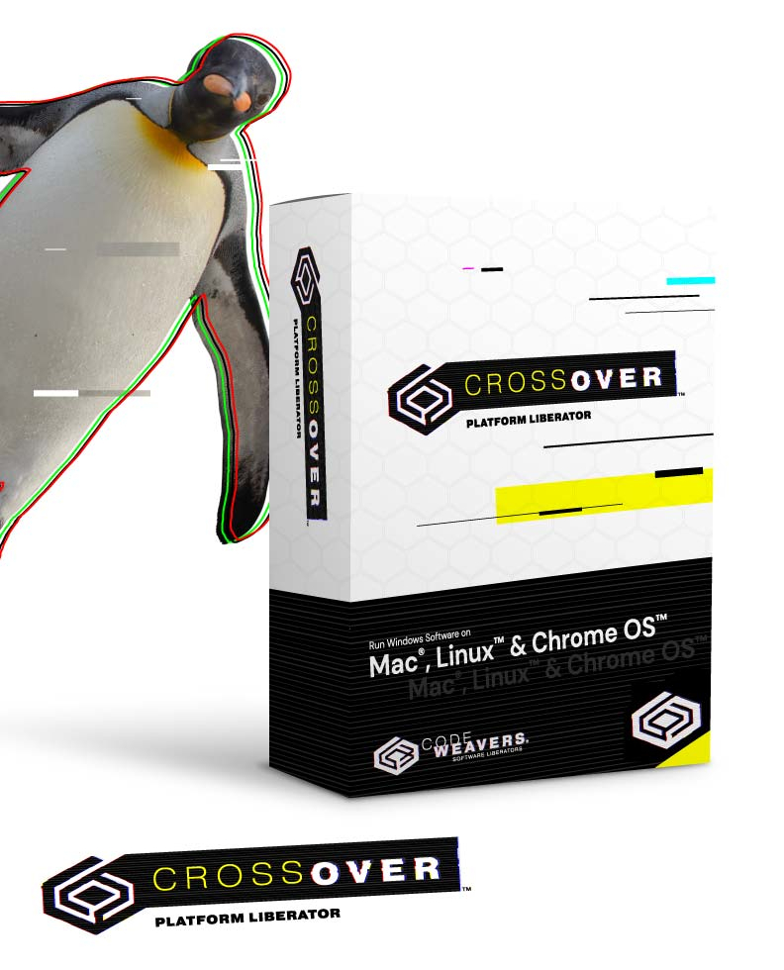

Employee Ownership Trust example
Founded in 1996
Transitioned to EOT 2023
Chose EOT for legacy
Notes:
CodeWeavers
Software firm in St Paul, founded by Jeremy White in 1996
EOT transition this year
Owner chose EOT for legacy preservation, $ to employees now and flexibility

Slide 22
What it’s like to work with MNCEO
Notes:
Find Christopher
What did you recognize in your clients that made you think that Broad Based Employee Ownership might be an option and that MNCEO could be helpful?
How did you come to that realization and make that connection?
What did you get out of the meetings with your clients and MNCEO?
What did your clients get out of it?
What are things that you think others in this room could get out of working with MNCEO?
Anything else you want to add?

Slide 23
Questions?

Slide 24
Thank You
MNCEO.ORG
Kirsten Kennedy - kkennedy@mnceo.org
Darren Mozenter - dmozenter@mnceo.org

