Slide 1

Financial Analysis Toolkit
The Loan Package
KEP 2025
Julie Anderholm
North Central Region
May 15th, 2025

Slide 2
Topics for today…
The “Project”
Commercial Financing
The Loan Package
North Central Region

Slide 3
T What is a “Project”?
Buying a Building/Equipment/Inventory
Building a Building/Addition/Remodeling
Working Capital or Line of Credit
Combination of above
North Central Region

Slide 4
Commercial Financing
Differs from Residential Financing
Rigorous Application & Approval Process
Terms vary
Interest Rates usually higher

Slide 5
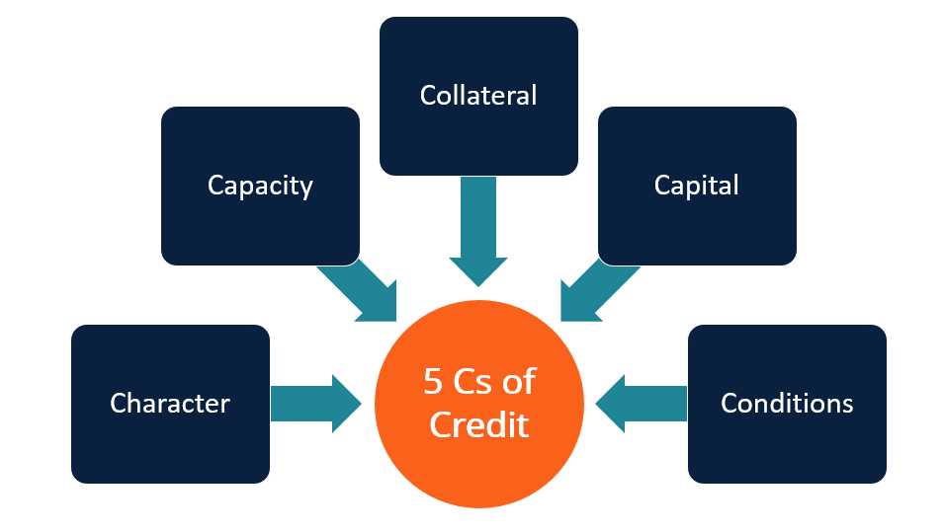
5 Cs of Credit
Subtitle
North Central Region

Slide 6
5 Cs of Credit
Capacity: the ability to repay the loan/debt to income ratio/cashflow
Capital: cash available for down payment & working capital
Collateral: borrowing capacity of assets
Condition: purpose of the loan in this market & economy
Character: integrity - willingness to repay
A 6th…
Credit History: may be part of Character
Personal credit score – history predicts future
These requirements tie into the Loan Package
North Central Region

Slide 7
The Loan Package
Consists of 9 components
Given to Lenders to determine financing approval
“Could & Should”
“Financially Feasible”

Slide 8
Successful Business Financing
Loan Package Includes
Business Plan
Historical Financial Statements
Summary of Project Costs – Sources & Uses
Collateral Analysis
Cashflow Projection
Applicable Forms – Legal Information
Personal Financial Statement
Resume
Personal Tax Returns
North Central Region

Slide 9
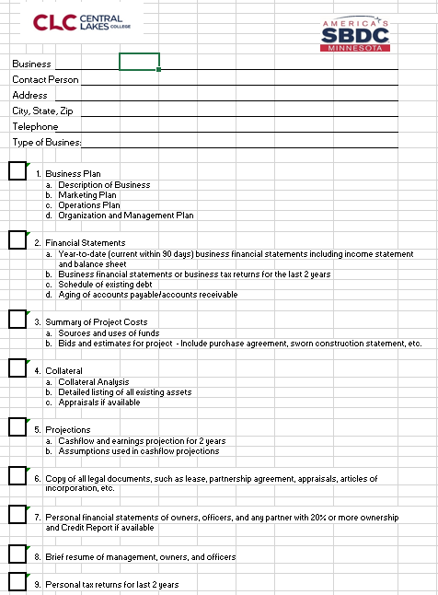
Lender’s Checklist
Cover sheet to the
Loan Package
North Central Region

Slide 10
#1 Business Plan
Outline
Title Page
Executive Summary
Marketing Plan
Operations Plan
Organization & Management Plan
Financial Plan
Appendices
Think of it as a Road Map...Address Risk Factors

Slide 11
#2 Historical Financial Statements
Income Statement (same as Profit & Loss) – Prior 2 years
Balance Sheet – Prior 2-year ends
Business Tax Returns – Past 2 years
Income Statement – Current year
Balance Sheet - Current year
Aging of A/R and A/P – Current Year
Not Applicable to new businesses
North Central Region

Slide 12
#3 Source & Use of Funds
Relating to the Project
Use = Project Costs
Source = How the Project Costs will be Funded
Uses = Sources
Owner Cash/Equity always part of the Source
North Central Region

Slide 13
Project Costs
Split out by:
Land & Building(s)
Equipment
Inventory
Working Capital
Leasehold Improvements
Blue Sky/Goodwill
North Central Region

Slide 14
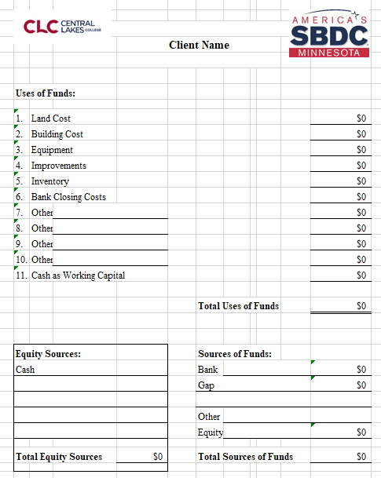
Statement of Sources and Uses
Use = Project Costs
Source = Funding of the Project
Uses = Sources
North Central Region

Slide 15
Sources of Funds
Lenders assume…Owner brings in Cash
Plus
Bank
Bank with Gap
Bank with SBA
Bank with SBA & Gap
Other Government Programs:
USDA, MDA, RUS
Maybe an occasional grant
North Central Region

Slide 16
Banks – Commercial Financing
Always in a first position…
if you default on your loan, the bank sells the assets pledged as collateral and gets paid back first
Stringent lending requirements…this is a good
Need to adhere to regulatory policy and audits
Relationships are important…maybe more so than the interest rate.
North Central Region

Slide 17
Other Sources of Funds
Gap Loans…fill a financing gap…geographically based
SBA Loans
SBA 504 – actual loan
SBA 7A – guarantee program
Usually, 2nd position behind the primary lender…3rd position if SBA involved
Interest rates not always lower than banks
Separate approval process
North Central Region

Slide 18
#4 Collateral
Borrowing capacity of assets – Helps determine financing structure
Projects are “never” financed 100%
Land & Building(s): 70% to 80%
Raw or Bare Land may be 65%
Special Use may be 60% (varies)
Equipment : 50% (varies)
Inventory : 0% to 50%
Working Capital : 0%
Leasehold Improvements: 0%
Blue Sky or Goodwill: 0%
Banks in “Senior” or 1st position/Other Lenders in “Subordinate or 2nd or 3rd position
North Central Region

Slide 19
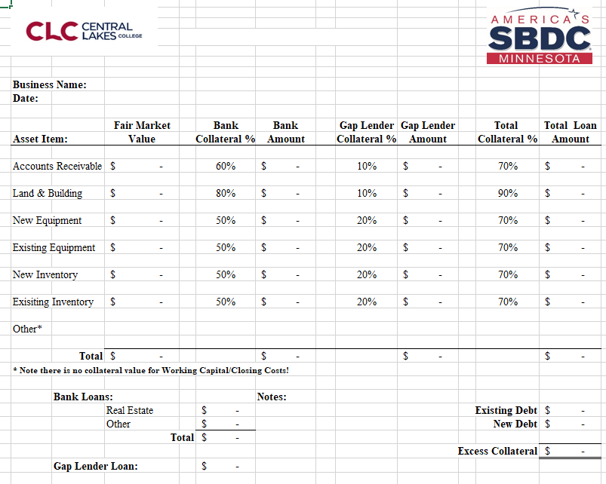
Collateral Analysis
Borrowing Capacity of Assets - %’s may vary
Bank in first position
Gap/Other lenders in 2nd/3rd position
Typically needs full collateralization
North Central Region

Slide 20
Source & Use/Collateral Analysis
Used to determine a Financing Structure
May look at multiple financing structures
What is best for the business?
Small payments – long pay back period
Large payments – short pay back period
Interest Rates vary
Terms Vary
Financing structure flows into the Cash Flow Projection

Slide 21
Loans have varying Terms
Land & Buildings –20 to 25 years
Equipment - 5 to 10 years
Inventory – 3 to 5 years
Working Capital – depends
Consider the useful life of the asset
Longer terms usually when SBA is involved
North Central Region

Slide 22
Loan Package
Where we are at: covered…to be covered
Business Plan
Historical Financial Statements
Summary of Project Costs – Sources & Uses
Collateral Analysis
Cashflow Projection
Applicable Forms – Legal Information
Personal Financial Statement
Resume
Personal Tax Returns
North Central Region

Slide 23

Cash Flow
North Central Region

Slide 24
#5 Cashflow Projection
The Project needs to “fit “ into the business Cash Flow
Like a Bank Account with inflows and outflows of Cash
Positive Cash Position with “Wiggle” room
Goal is to have Growing Cash
Need a balance available to fund the unexpected or small capital expenditures
North Central Region

Slide 25

Cash Flow Projection
Time Period…seasonality
Expenses…usually easier to project
Sales…project at the lowest common factor
Rough Draft
Research
Fine Tune
Repeat
Compare to Actuals
New Projection Annually
North Central Region

Slide 26

It’s better to fail on paper then in the real world
North Central Region

Slide 27
#6 Legal Documents
Articles of Incorporation
Articles of Organization
Lease Agreement
Sworn Construction Statement
Appraisal
Others – if applicable to the loan approval
North Central Region

Slide 28
#7 Personal Financial Statement
A personal Balance Sheet
Shows personal Assets and Liabilities
Lenders look at your “global” financial position
Banks have their own form
SBA also has a standard form
Credit Report can be included – lender will run one
North Central Region

Slide 29
#8 Resume
Format is flexible
Needs to be current
Show abilities that relate to the loan request
Banks have forms
SBDC has a form
North Central Region

Slide 30
#9 Personal Tax Returns
Past 2 or 3 years
Shows earning history and stability
What income are you giving up?
Will you have income outside of the business income?
North Central Region

Slide 31
Loan Package Includes…5 C’s
Business Plan – Condition & Character
Historical Financial Statements - Capacity
Summary of Project Costs – Capacity & Capital
Collateral Analysis - Collateral
Projection - Capacity
Applicable Forms – Legal Information
Personal Financial Statement – Capital & Credit
Resume - Character
Personal Tax Returns - Capacity
North Central Region

Slide 32

Successful Financing…
North Central Region

Slide 33
Thank You
North Central Region

