Slide 1

AI in Action
Live Demos & AI Use Cases
MState WDS & West Central SBDC

Slide 2
AI for Business
AI Resource Lab
AI Bootcamp, Sandbox, and Toolkit
Stages of Adoption
a Small Business AI Journey
A collaboration between
MState Workforce Development Solutions (WDS)
West Central Minnesota SBDC
Designed to support small business AI adoption
For entrepreneurs, business owners, and staff
Start free! Online self-paced AI Resource Lab
Practical, hands-on AI training. Without the hype.
Level 1: Basic Prompting
Level 2: Advanced Prompting
Level 3: Custom GPTs
Privacy, Security, & Ethics
Responsible Use
Live Demos & AI Use Cases
AI in Action
One-Hour. Full-Day. You Decide.
Customized Training

Slide 3

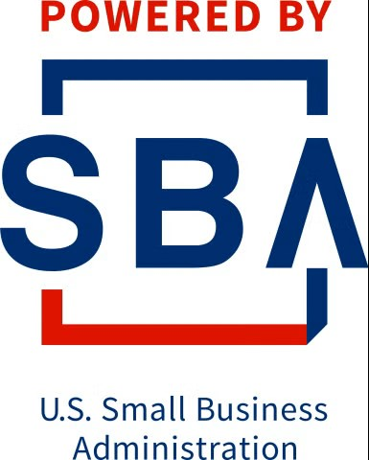


Hats Off to Our Host & America’s SBDC
Funded in part through a Cooperative Agreement with the U.S. Small Business Administration, the Minnesota Department of Employment and Economic Development, and regional support partners. The West Central SBDC is a proud member of the Minnesota SBDC Network. All opinions, conclusions, or recommendations expressed are those of the author(s) and do not necessarily reflect the views of the program sponsors. Programs are open to the public on a nondiscriminatory basis. Reasonable accommodations will be made upon request. Contact the West Central SBDC at (218) 299-6606.
Disclaimer: The tools provided by the West Central SBDC including the AI Resource Lab are experimental and intended for educational purposes only. They are not designed to provide legal, financial, or professional advice. Users should always consult with a qualified professional and fact-check all outputs before making decisions. The use of these tools is at the user’s own risk, and users are solely responsible for any actions taken based on the information provided.

Slide 4

Today’s Session: Live Demos
When Using AI…
Find your favorite AI app (ChatGPT, Claude, Gemini, Perplexity, etc)
Tell it what you’re working on. Upload any context, a picture even, instructions.
Tell it what you want it to do or what you think you need help with.
Collaborate, don’t delegate.
Take your time, or not, go back, skip ahead… don’t like it, tell it, correct it…
It may try to go too fast, that’s ok, give it more info, keep refining
Ask it “what else” or “what am I missing” or “what are we implicitly assuming”
Use the 80/20 approach, don’t try to get it 100% perfect within your AI chat
When it’s close, you put in the finishing touches, wordsmith it, finalize
Keep this chat open, keep building it, reuse it, recycle it

Slide 5
Custom Training Available
AI Resource Lab
AI Bootcamp, Sandbox, and Toolkit
Stages of Adoption
a Small Business AI Journey
Practical, hands-on AI training. Without the hype.
  Designed to help small and mid-sized businesses adopt AI safely, confidently, and intentionally.
Six structured sessions, supported by facilitated discussion and applied homework, help teams build shared skills and consistent, effective, responsible AI use across roles.
Start free! Online self-paced AI Resource Lab
Contact ian.carlstrom@minnesota.edu for more info
Level 1: Basic Prompting
Level 2: Advanced Prompting
Level 3: Custom GPTs
Privacy, Security, & Ethics
Responsible Use
Live Demos & AI Use Cases
AI in Action
½-Day ~ Full-Day ~ 6-Months. You Decide.
Customized Training

Slide 6
Thoughts, Comments, Questions?

