Slide 1
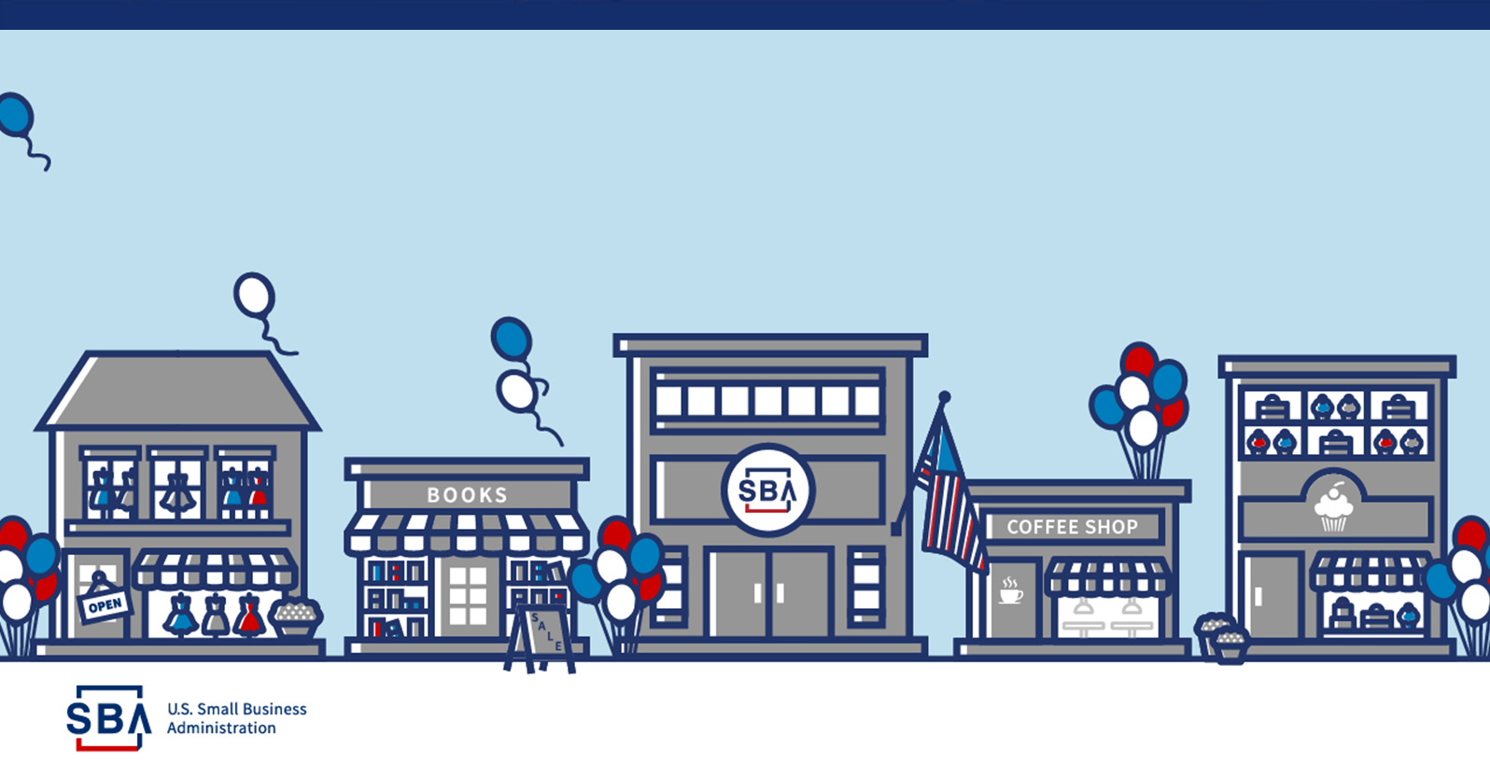

SBA Minnesota District Office Update
2025 SBDC KEP

Slide 2

Presenting:
Brian McDoanld
SBA Minnesota
District Director
Minnesota District Office
Email: Minnesota@sba.gov
By attending this event, you grant the SBA the right to use your name, voice and image in photographs, videos or other recordings to be distributed through any and all media.

Slide 3
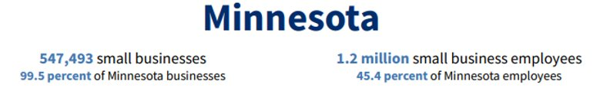
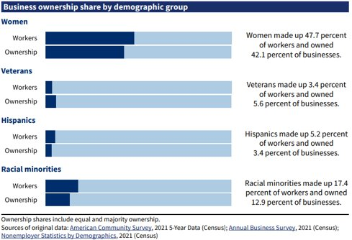
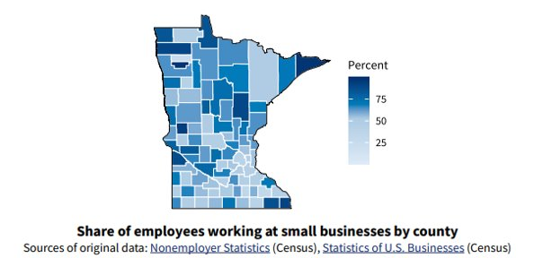
SBA's Office of Advocacy – SBA's Office of Advocacy – https://advocacy.sba.gov/
Notes:
SBA DATA from the Office of Advocacy:
Minnesota is home to over half a million small businesses that make up 99.4% of all Minnesota businesses.
Minnesota small Businesses employ over 1.3 million employees, making up 45 percent of all Minnesota employees.

Slide 4

FY 25
AWARDS, EVENTS, AND ACCOMPLISHMENTS

Slide 5

Meet SBA’s Minnesota 2025 NSBW Award Winners!
Small Business of the Year
Beth Benike, Busy Baby, LLC, Oronoco, MN
Family-Owned Small Business of the Year
Curtis, Anthony, Dean, & Sharon Reichmann, Reichmann Cattle Company, LLC, Glenwood, MN
Veteran-Owned Small Business of the Year
Jeffrey Anderson, ATEK Distribution, Minneapolis, MN
Young Entrepreneur of the Year
Brittany Howard, Victory Business Solutions, Minneapolis, MN
Woman-Owned Small Business of the Year
Donella Westphal, Jule’s Bistro, Saint Cloud, MN
Encore Entrepreneur of the Year
Paul Kirkman, Victual, Crosby, MN
Veteran Champion of the Year
John B Yang, Digital Synergy, St. Paul, MN
Woman Small Business Champion of the Year
Carol Anderson, Community Development of Morrison County, Little Falls, MN
SBDC Excellence & Innovation Center of the Year
West Central SBDC, Moorhead, MN
The winners were chosen for their success in starting their small businesses in Minnesota.

Slide 6
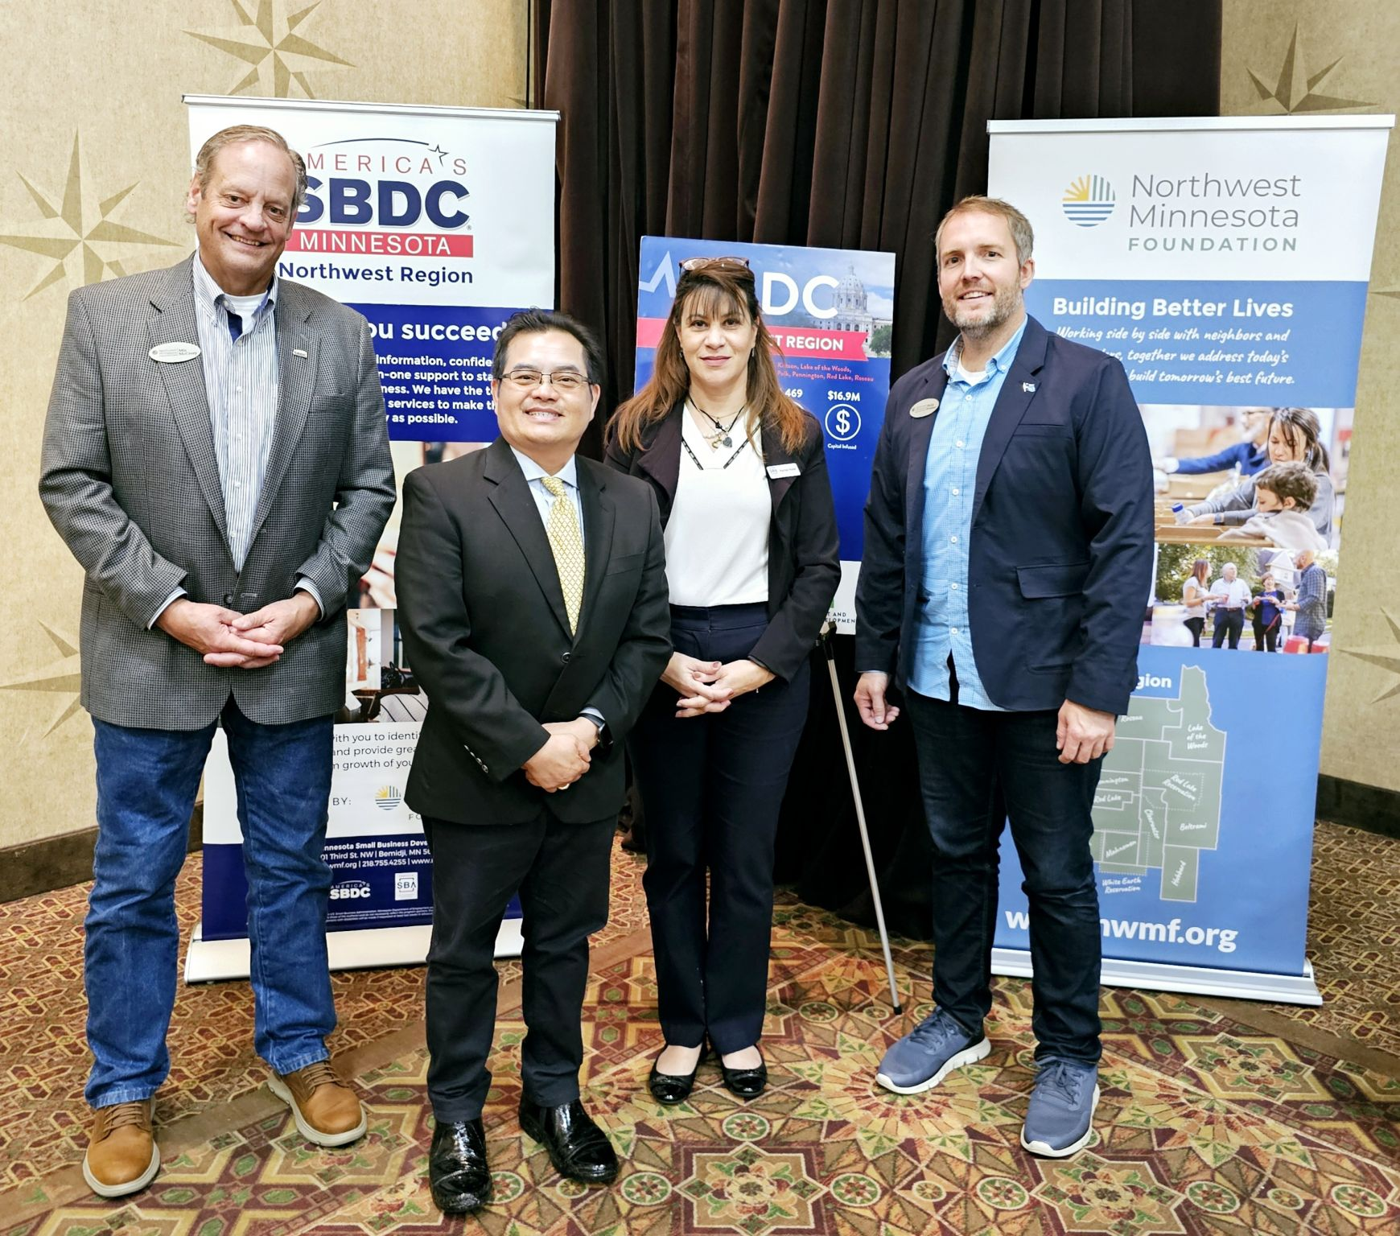
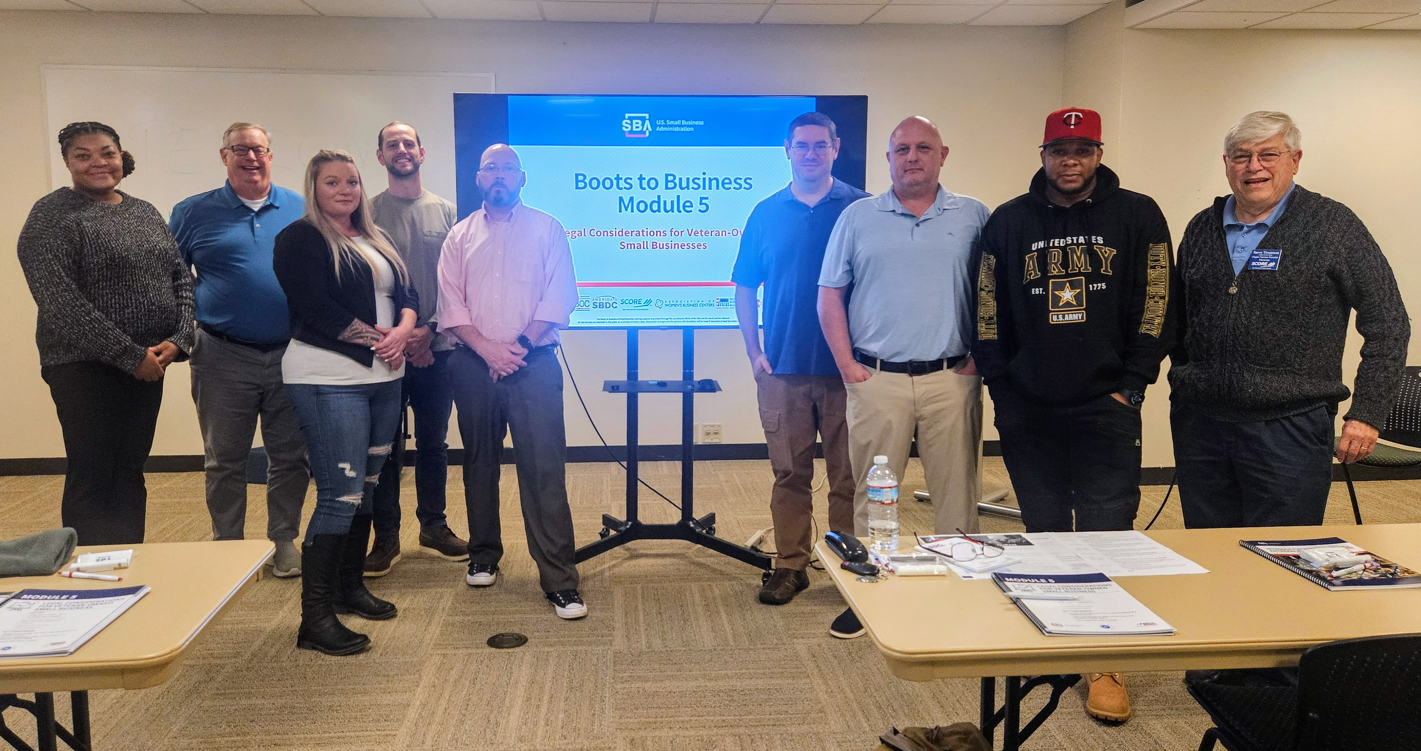
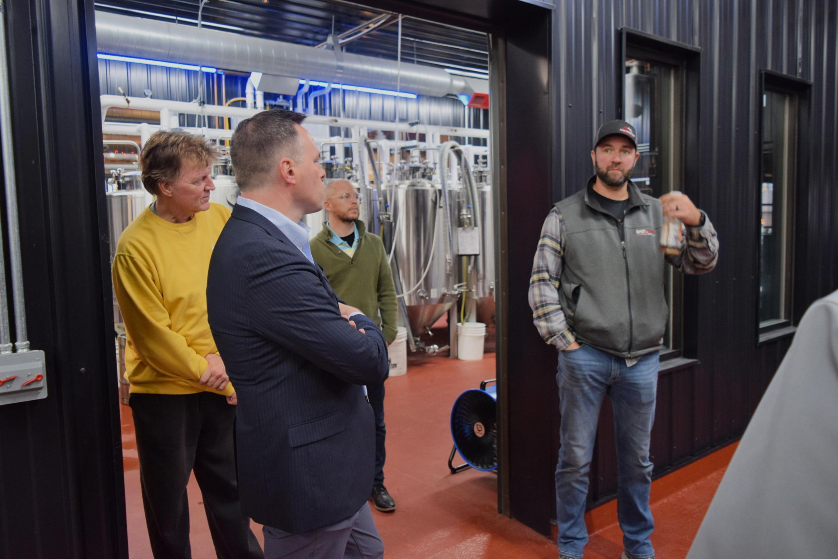
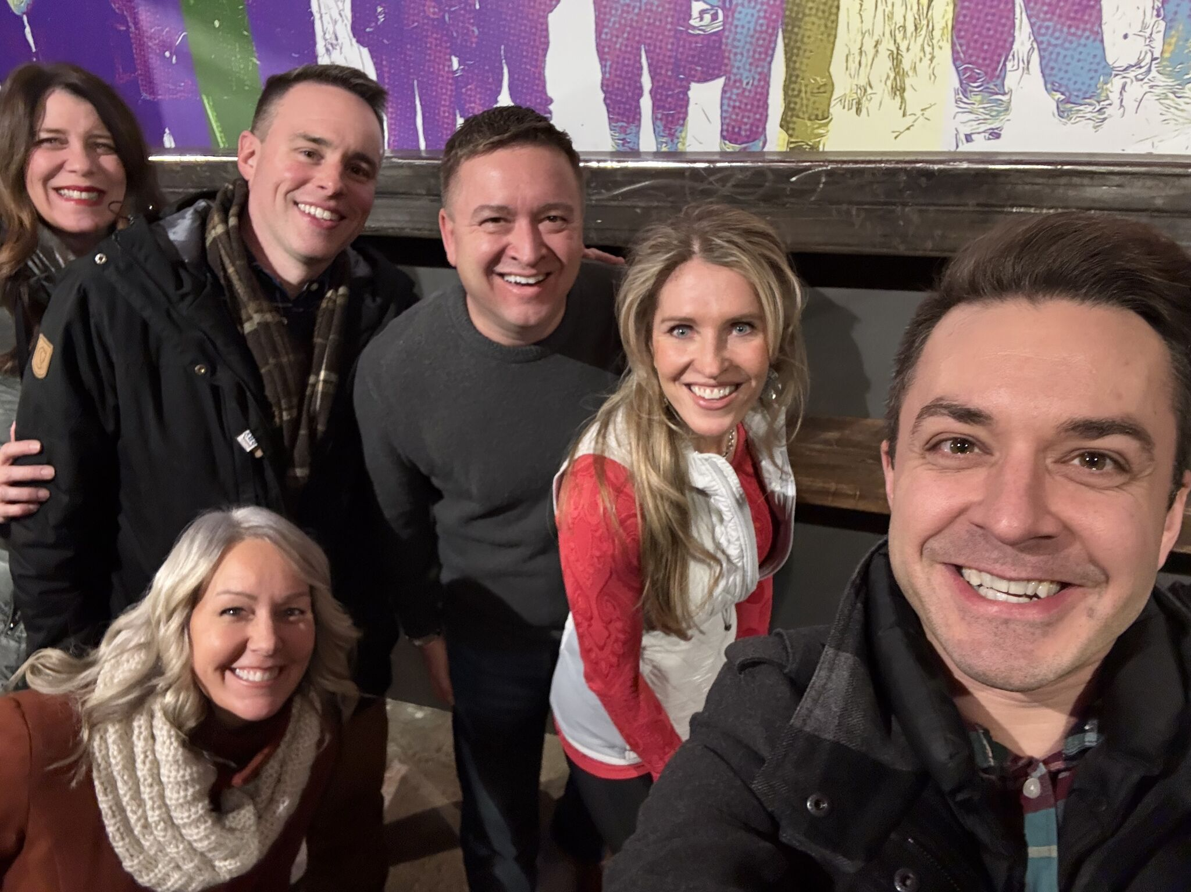
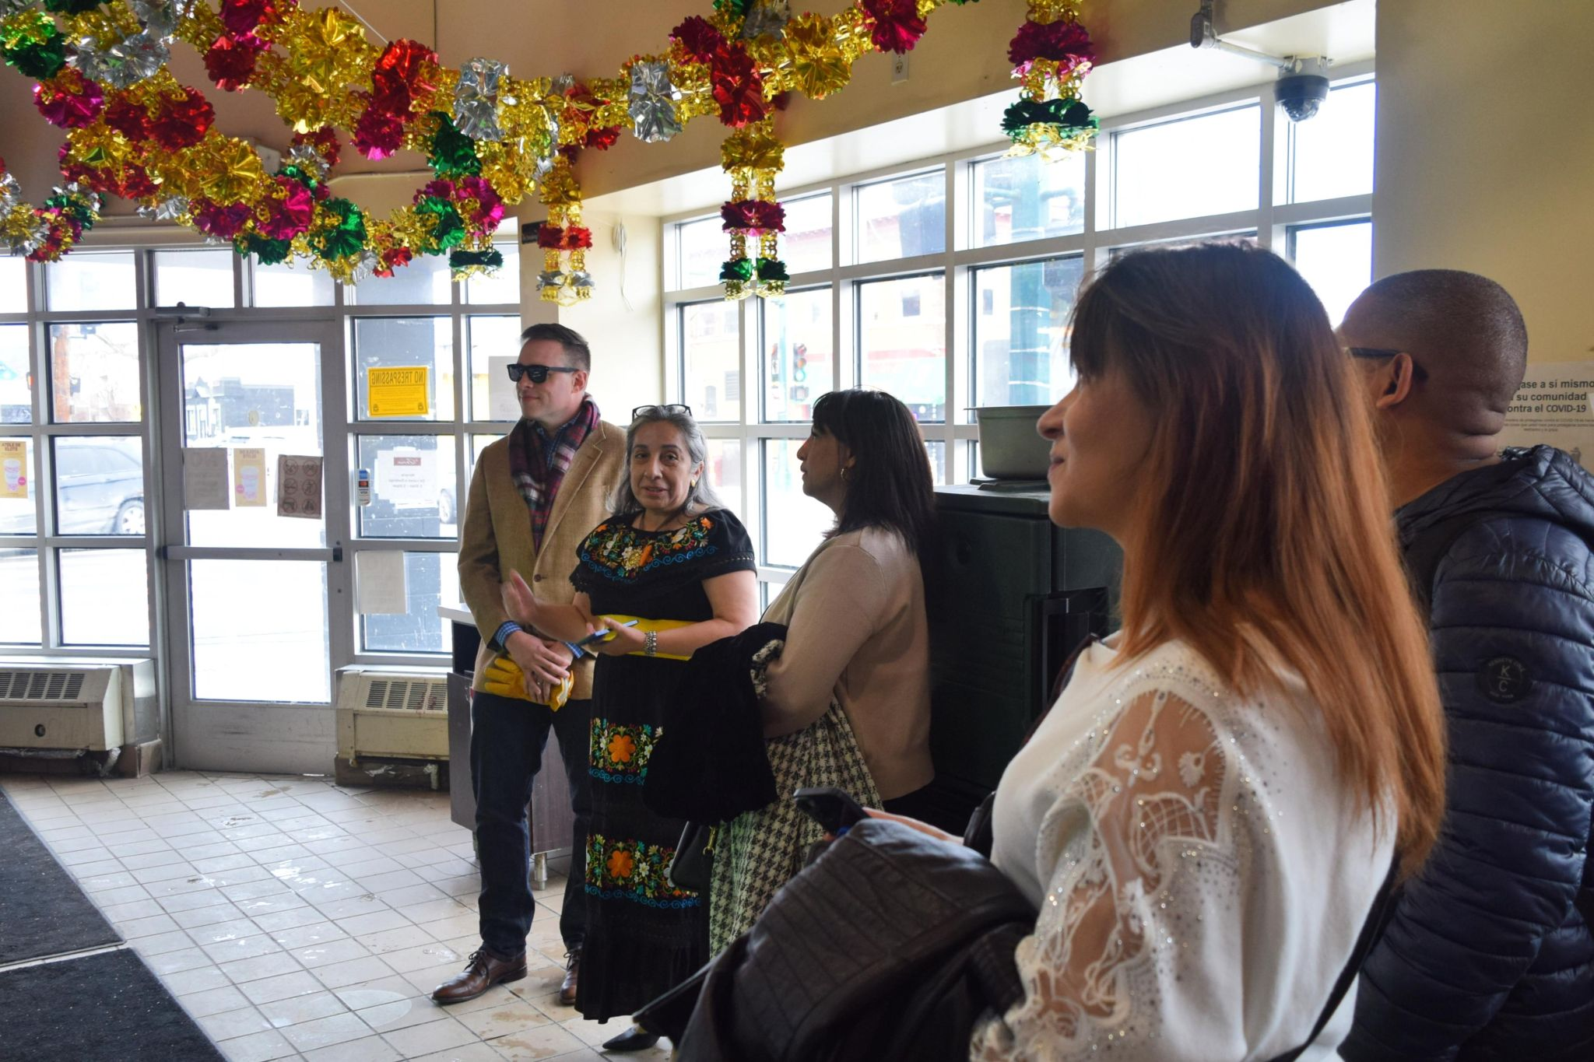
Highlights from FY25 Quarter 1
Greater MN Procurement Fair
THRIVE Cohort Graduation
Hmong Committee of 100 Luncheon
Season of Small Business Walking Tours
  St Joseph
  Stillwater
  Lake Street
Veteran Focused Training (“Reboots”)
  St Cloud
  Rochester

Slide 7
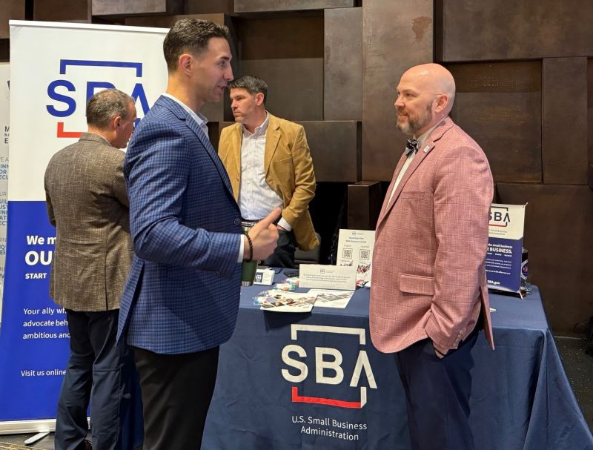
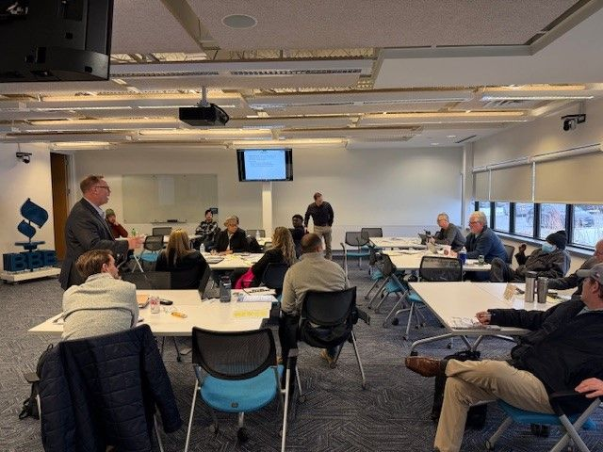
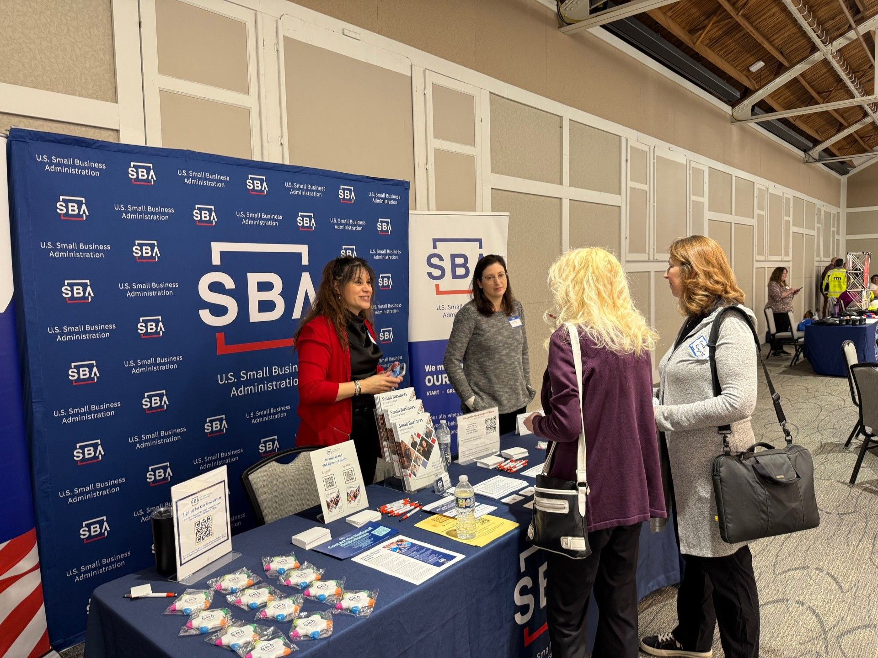
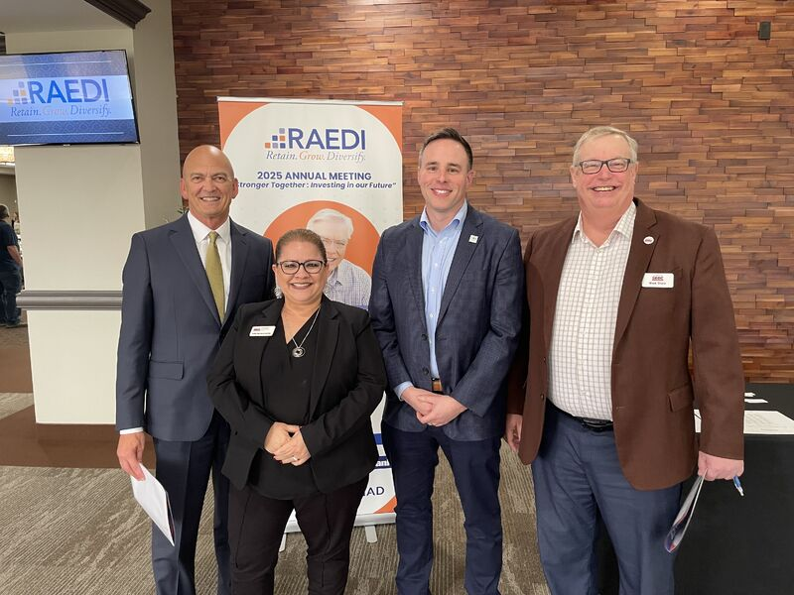
Highlights from FY25 Quarter 2
BBB Veteran Focused Training (“Reboot”)
RAEDI Economic Summit
DARPA Road Tour
SADBOC Procurement Fair

Slide 8

HUBZone Program
Fuels small business growth in historically underutilized business zones with a goal of awarding at least 3% of federal contract dollars to HUBZone-certified companies each year.
14 Governor-Designated Covered Areas in Minnesota
Otter Tail County HUBZone Expansion Event 22 May 2025

Slide 9
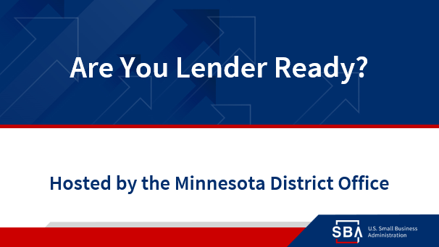
July 22, 2025!
This program equips established small business owners with the knowledge and tools to secure funding!

Slide 10
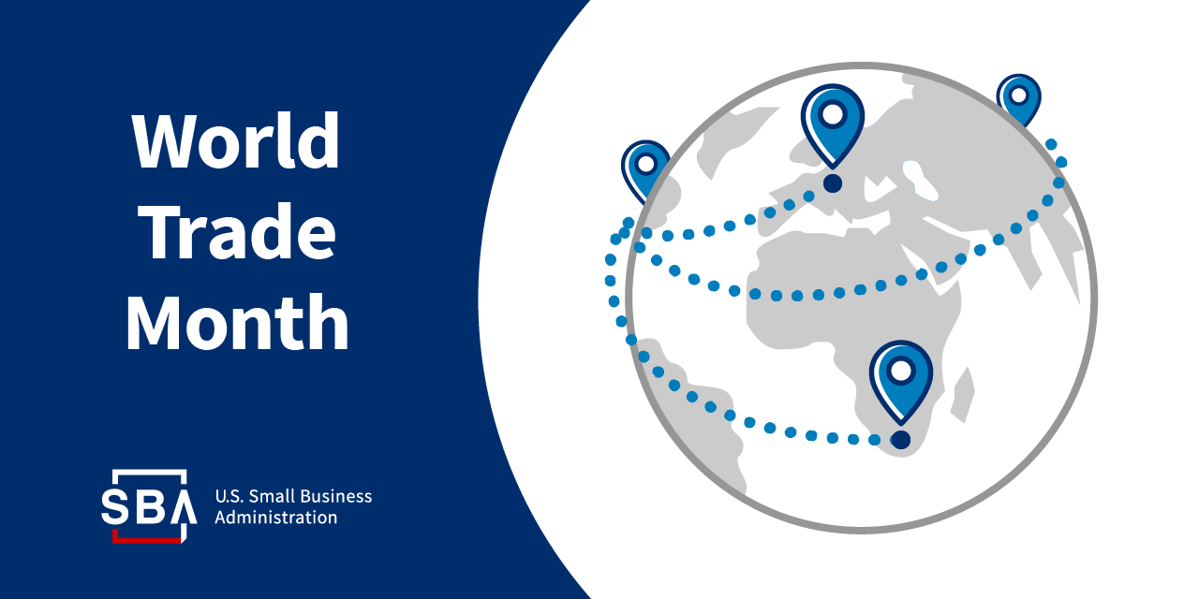
Notes:
May is world trade month.
Each May, World Trade Month is celebrated in the United States to recognize the importance of exporting and encourage U.S. businesses to begin or expand their export efforts.

Slide 11





Putting American manufacturers first
SBA is leading a task force that is laser focused on growing American-based manufacturers.
Cutting red tape for small manufacturers
Increasing access to capital
Taking your manufacturing business global
.
Manufacturing success stories
sba.gov/manufacturing
Notes:
One of our current initiates is putting American Mfg first.
SBA is helping to restore American industries and bring back the blue-collar boom.
We have a webpage dedicated for manufacturers that can help them cut red tape, increase access to capital, export and more.

Slide 12


If you have concerns about federal regulations that negatively impact small businesses, call 1-800-827-5722 and press option 3 or email RedTape@sba.gov.
Learn more: advocacy.sba.gov/hotline
Notes:
When it comes to cutting the red tape, together with the office of Advocacy – we are working to provide the red tape hotline where businesses can let the federal government know about regulations that are negatively impacting their small business.

Slide 13
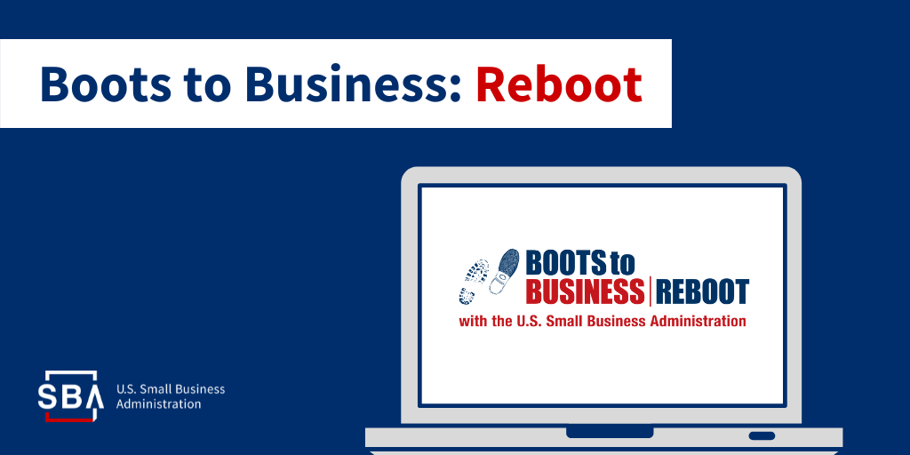
Entrepreneurial education and training program for service members and military spouses.
Working with VBOC and local SBDC for upcoming trainings:
Bemidji – July 2025
Brainerd – November 2025
Notes:
Veterena’s brief

Slide 14

FY 25
Lending Activity
&
Training

Slide 15

SBA Loan Programs in Minnesota
Minnesota Lender Activity
FY 2024
Minnesota Lender Activity
FY 2025 as of 5/7/2025
Loan Program | Number | Dollar
504 Total | 195 | $159.5 Million
7A Total | 1,616 | $687.1 Million
Microloan | 152 | $2.7 Million
Totals | 1,963 | $849 Million
Loan Program | Number | Dollar
504 Total | 139 | $146.4 million
7A Total | 1,033 | $407 million
Microloan | 55 | $1 million
Totals | 1,022 | $554.8 million
  In 2024, the SBA backed over $849 million in funding to help Minnesota small businesses start, grow, expand and recover with: 7(a) General Small Business Loans, 504 Loans, and Microloans.
Notes:
SBA Financial Assistance Non-COVID Products Status
7a, 504, Community Advantage, Microloans, Cap lines, Surety Bonds, SBIR/STTR, Contracts, exports,
SBA financial products are non-predatory in nature so as to preserve the wealth-building capacity of the business owner with values such as affordable rates, longer repayment terms than conventional bank loans, and regulating for transparency to assure the risk is mitigated for intermediary lenders (such as non-profit lenders and community banks) and remains accessible for owners who otherwise would not get capital

Slide 16
Number of Loans by MN SBDC Regions

Slide 17
Amount of Loans by MN SBDC Regions

Slide 18
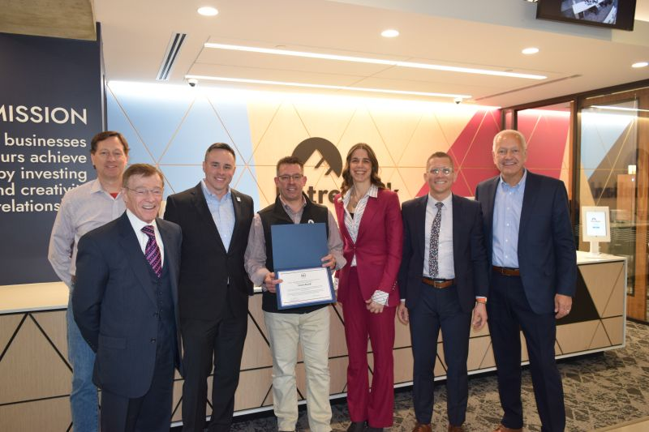
Lender Outreach and Assistance
New Delegated Authorities
Preferred Lender Program – EntreBank
7(a) Express – St. Cloud Financial Credit Union

Slide 19

Minnesota Bankers Association
SBA Lending Classes Roadshow!
Representatives from the SBA's Minnesota District Office take a deep dive into information and updates on the SBA guaranteed lending programs. This workshop is appropriate for all levels of SBA lending experience and lending roles.
SBA Lending 2025
May 20
May 21
May 22
June 4

Slide 20

FY 25
RESOURCE PARTNER ACTIVITY

Slide 21
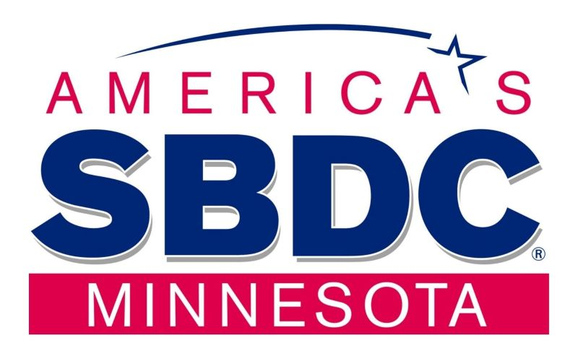
Resource Partner Impact
Small Business Development Centers (SBDCs)
5,000+ clients served
SBDCs are a network of centers that provide no cost, confidential counseling and training to help small business owners with a variety of topics.
mnsbdc.com

Slide 22

Resource Partner Impact
SCORE Business Mentors
SCORE is the nation's largest network of volunteer business mentors. Experienced executives share real-world knowledge as often as you need - in person, virtually or via email.
3,279 mentoring sessions
7,073 workshop attendees
SCORE.org/twincities

Slide 23


Resource Partner Impact
Women’s Business Centers (WBCs)
Women interested in starting or growing a small business can tap into a national network of community-based WBCs.
972 mentoring sessions
womenventure.org
entrepreneurfund.org

Slide 24

Resource Partner Impact
Veteran Business Outreach Centers (VBOC)
Veteran entrepreneurs or small business owners can receive business training, counseling and mentoring, in addition to financing options and procurement guidance which can help veterans compete for government contracts.
49 clients served in MN
wwbic.com/veterans

Slide 25

FY 25 Strategic Priorities
Access to Capital Training
“Are You Lender Ready?” Collaborative effort between the field and HQ to develop training content centered around what business owners need to know to start engaging with SBA’s financing programs. (Pilot Program)
Direct lender training with MBA Roadshows, Annual Lender’s Conference and high-level lender inquires and visits.
Expanding Contracting & Lending
Identity demand for both contracting and lending programs. Looking for areas where the MNDO can provide education.
Collaborative Outreach
Continue to let the MNDO know how we can be most helpful.
Areas of interest manufacturing and rural.

Slide 26
Who Can Help?
Sign up for our newsletter:
www.sba.gov/updates
Follow us on Twitter:
@sba_Minnesota
Find us on LinkedIn:
SBA Minnesota District Office
SBA Minnesota website:
www.sba.gov/mn
Minnesota District Office
Serving all 87 counties in Minnesota
Send us your questions:
minnesota@sba.gov

Slide 27

How are we doing?
Please take a minute to let us know
www.sba.gov/feedback

