Slide 1
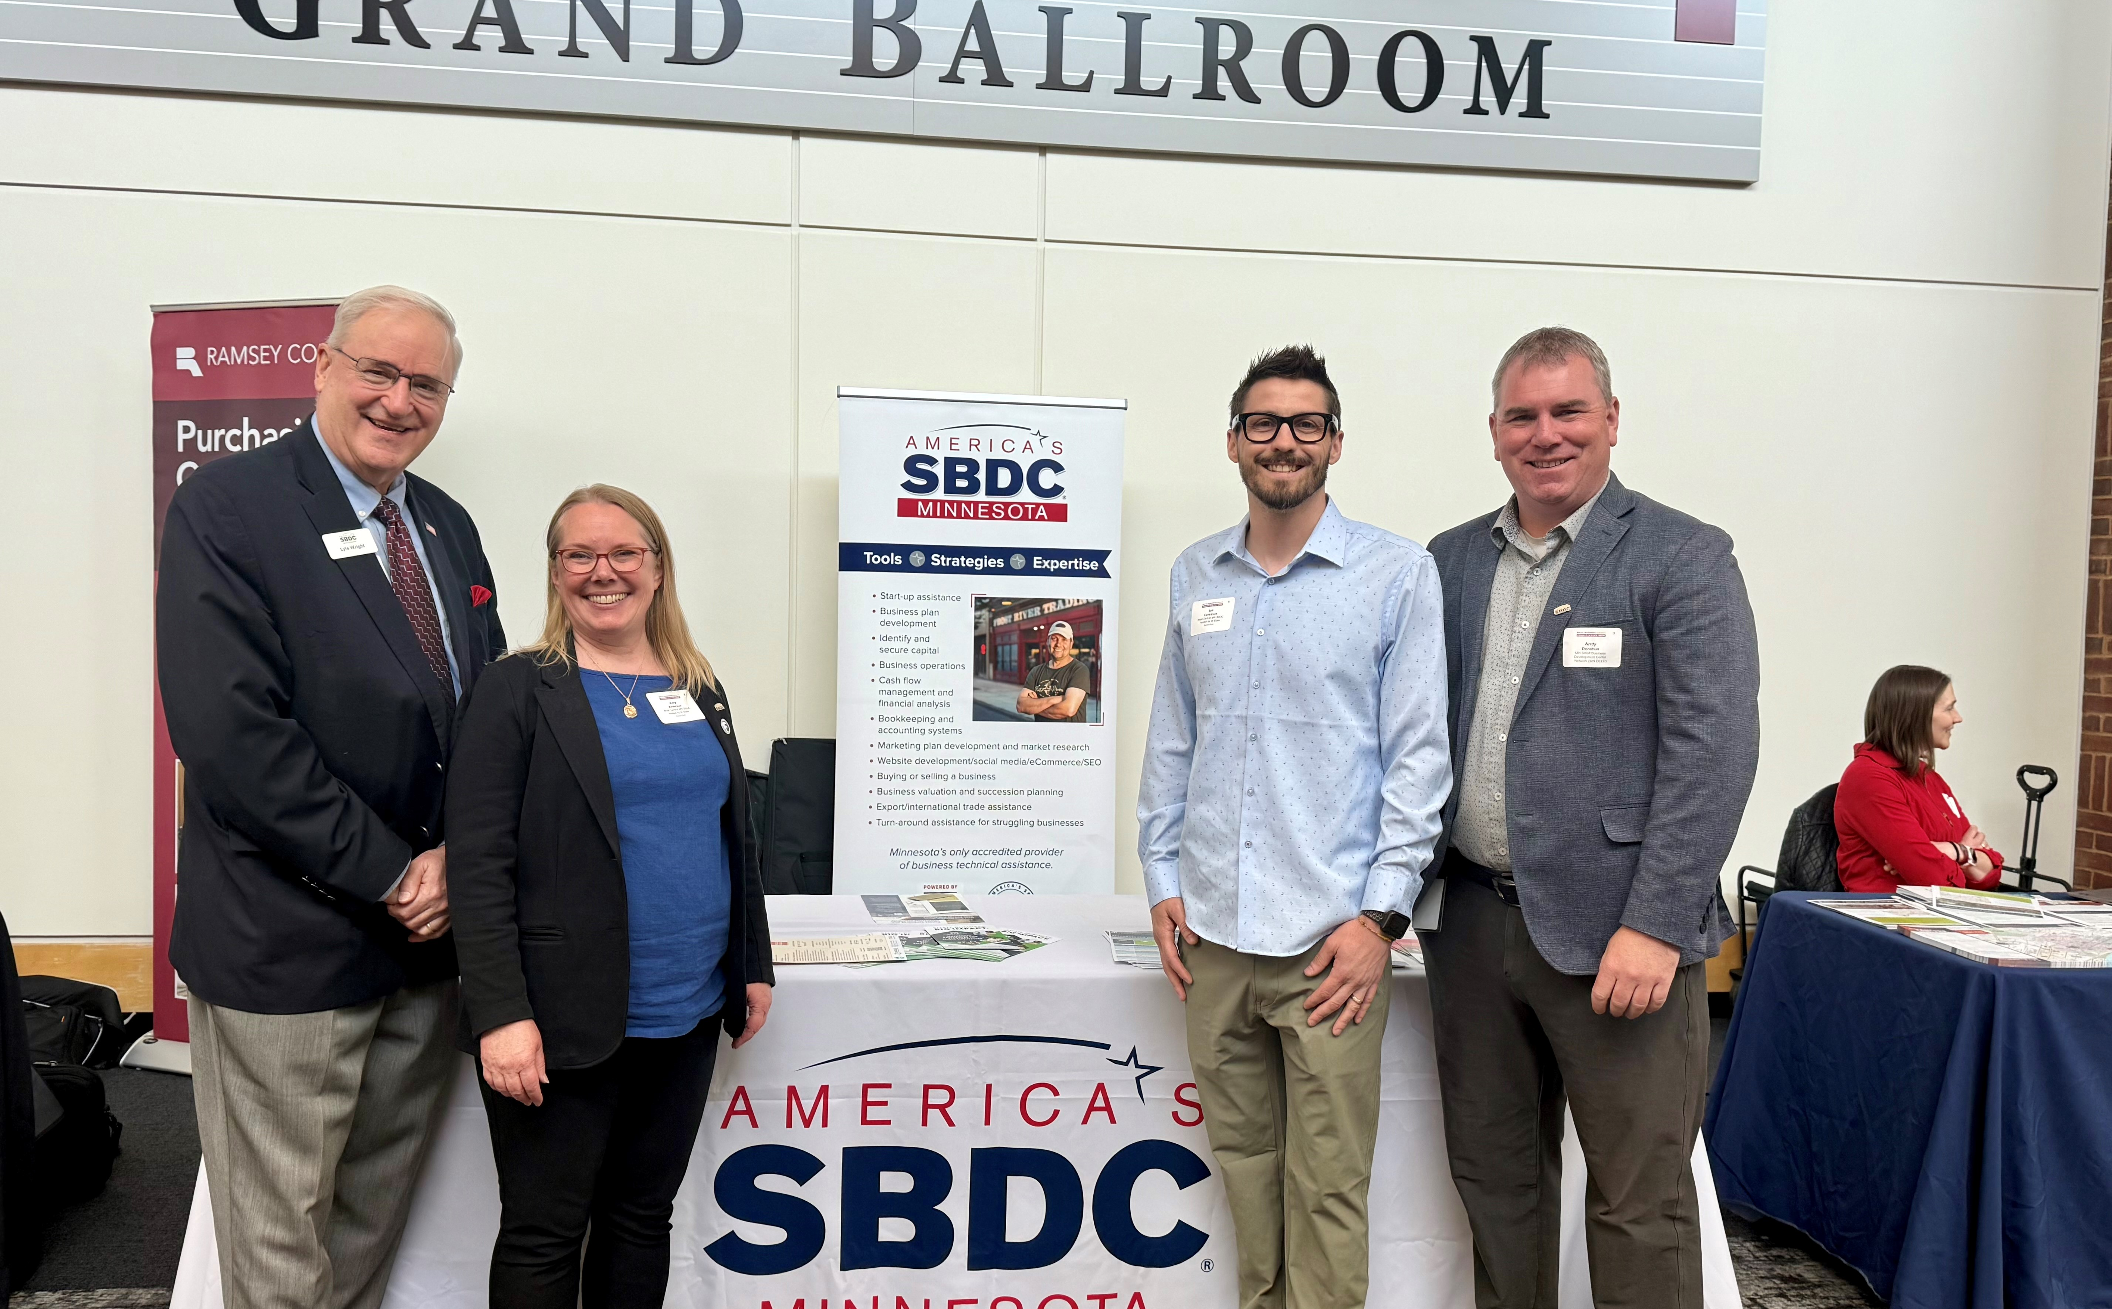
SBDC
KEP Meeting
May 2025

Slide 2
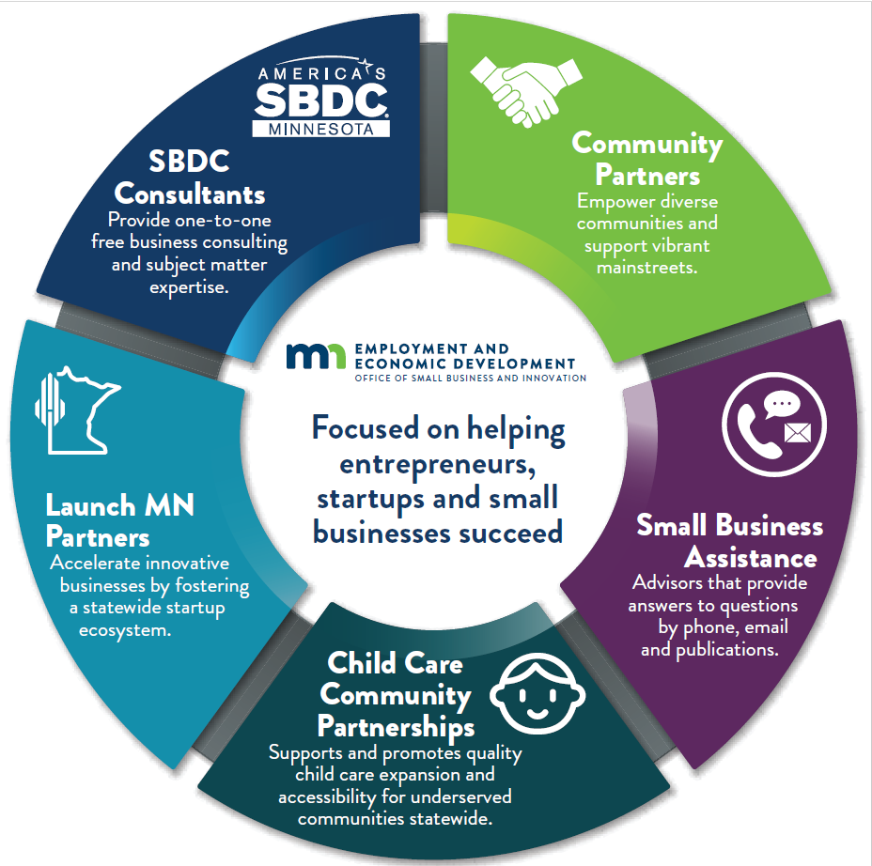
Office Small Business & Innovation
Increasing access to capital
Improving connectivity between businesses and resources
Expanding capacity for businesses to start and scale

Slide 3
The power of SBDC
State
Local
Federal

Slide 4

Impact
Records Set
Historic Funding
State Office: Center Reviews, Accreditation, New Opportunities
Collaboration (MN SB Call, HubZone, Training, Referrals)

Slide 5
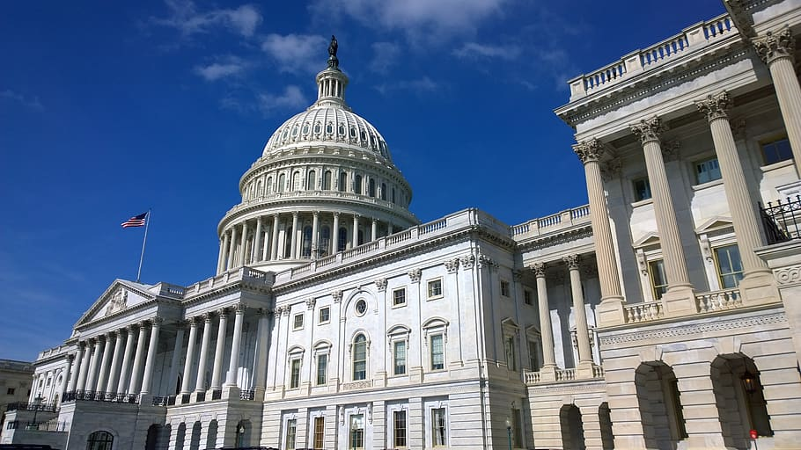
Adoptability
& Innovation
- Uncertain Times
Opportunity to Innovate
Onward!

Slide 6

Collaboration & Partnership
Regional Partnerships
Referrals
Statewide Support

Slide 7






overview
Small Business Assistance team
MN Small Business Call
Statewide calendar
Guidebook and resources
Welcoming Wednesdays
Monthly newsletter

