Slide 1

Dispelling AI:
Understanding AI Beyond the Hype
Navigating the Foundations of Artificial Intelligence

Slide 2

Navigating the Foundations of AI
Defining AI
Real life examples
Types of AI
Common Misconceptions
Newer more disruptive applications (gpt)
Exploring use cases of AI in the MnSBDC
I am not the expert, and we’re just scratching the surface

Slide 3
Introduction to AI
Definition of AI:
  Artificial Intelligence (AI) refers to the simulation of human intelligence in machines that are programed to think and learn
What does it mean to be “smart”?

Slide 4
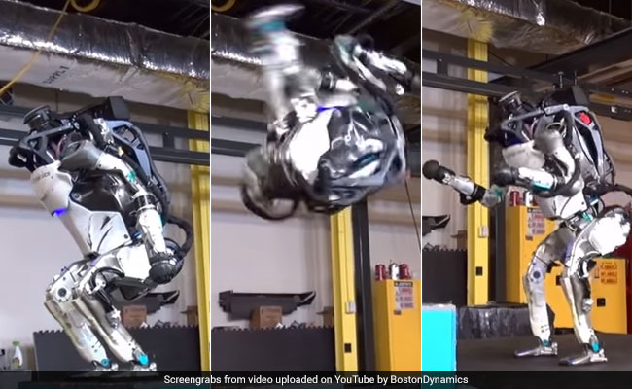

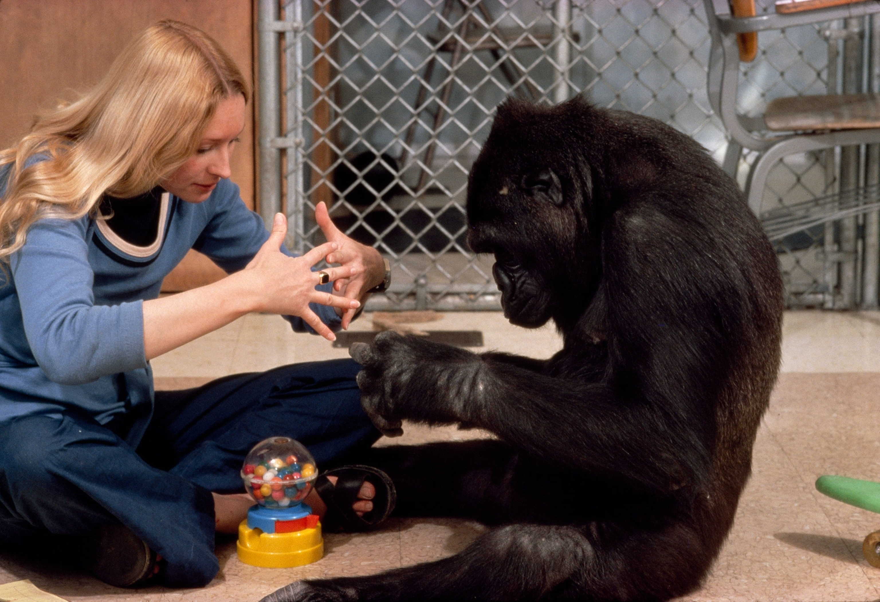
Are These “Smart”?
Programming a Robot to Back Flip
Training a Dog to Sit
Teaching a Gorilla to Sign

Slide 5
Exploring Current AI/Smart Applications
Welcome to the World of AI
New and disruptive applications are getting all the hype
But, in fact, AI has been a part of our lives for years
Let’s explore how AI has shaped our present

Slide 6
Everyday AI Examples
Spellcheck and Synonyms: Tools like MS Word enhance our writing using AI algorithms
Email Filters: Sorting through emails effortlessly is AI at work
Photo Editing: AI-based photo editing tools automate enhancements, filters, and style transfers
Navigation and Traffic Prediction: Navigation apps leverage Ai to analyze real-time traffic data and provide optimized routes

Slide 7
In Your Pocket – AI in Smartphones
Facial Recognition: Unlock your phone with Face ID
Predictive Text: AI suggesting the next word as you type
Image Recognition: AI-powered features in photo applications categorize and tag images based on content
Virtual Assistants: Daily interactions with Alexa, Siri, or Google Assistant rely on AI
Voice-to-Text: AI-Powered voice recognition enables accurate transcription of spoken words into text

Slide 8
Social Media Insights
Personalized Content: Algorithms showing you content tailored to your interests
Friend Recommendations: AI suggesting people you may know
Social Listening: AI monitors conversations to identify trends, sentiments, and discussions around specific topics, helping businesses stay informed about public opinions
Automated Content Moderation: (Safe Search) AI is used to identify and filter out inappropriate content, hate speech, and spam
Facial Recognition for Tagging: AI-driven facial recognition technology is employed for automatically tagging individuals in photos

Slide 9
AI in Learning & Education
Language Learning: AI-driven learning apps adapt to individual user progress, offering personalized lessons and adapting difficulty levels
Real-Time Translation: AI facilitates real-time language translation features, enabling users to communicate seamlessly across language barriers
Plagiarism Detection: AI tools assist educators in detecting plagiarism by analyzing and comparing student work against a vast database of academic content
Early Intervention Systems: AI identifies students at risk of falling behind with specific concepts, allowing educators to intervene early and provide targeted support

Slide 10
AI in Entertainment
Personalized Recommendations: Platforms like Netflix using AI to suggest movies, Spotify curating playlists based on your preferences
Gaming Enhancements: AI is used in gaming application for non-player character behavior, dynamic difficulty adjustments, and realistic graphics rendering
Deepfake Technology: AI-driven deepfake technology is used for realistic face swaps in videos

Slide 11
AI in the Home
Smart Home Integration: AI technology integrates with smart home devices, allowing users to control lights, thermostats, and security systems
Recipe Suggestions: AI suggesting recopies based on available ingredients
Smart Refrigerators: AI-powered appliances tracking your grocery needs
Smart Doorbells: AI recognizes motion, visitors, offers two-way communications, and enhances home security
Automated Vacuum Cleaners: AI-driven robotic vacuum cleaners map and navigate homes, avoiding obstacles, and adjusting cleaning patterns

Slide 12
AI Enhancing Our Lifestyle
Health and Fitness Tracking: Health apps use AI to analyze and interpret date, providing insights into fitness progress and health trends
Financial Services: AI-powered financial apps use algorithms to analyze spending patterns, offer personalized budgeting advice, and detect potential fraud
Sleep Tracking: Health and wellness apps utilize AI for sleep tracking, analyzing sleep patterns, and providing insights into improving sleep quality
Virtual Fashion Try-On: AI is used in fashion apps to simulate how clothing items will look on users
Ride-Sharing: Uber and Lyft use algorithms to optimize routes, estimate fares, and match drivers with passengers efficiently

Slide 13
AI for Small Business
Chatbots: Customer service chatbots on websites and messaging apps use AI algorithms to understand and respond to user queries
Predictive Maintenance: AI helps anticipate equipment failures and optimize maintenance schedules
Job Matching: AI is integrated into job search platforms to match candidates with relevant job opportunities based on skills, experience, and preferences
Predictive Analytics for Ad Campaigns: AI is used to analyze past ad performance and predict the success of future ad campaigns, optimizing targeting and budget allocation
Automated Accounting & Bookkeeping: AI-powered accounting software automates tasks such as invoice processing, expense tracking, and financial reporting, saving time and reducing errors

Slide 14
Types of AI
Narrow/Weak AI: (Here Now)
  Designed for a specific task, e.g., virtual assistants
  Fixed domain models provided by programmers
  Learns from thousands of labeled examples
General/Strong AI: (Theoretical)
  Possesses human-like intelligence, capable of handling various tasks
  Self-learns and reasons with its operating environment
  Learns from few examples and/or from unstructured data
Artificial Superintelligence: (Futuristic/Scifi)
  Hypothetical AI surpassing human capabilities

Slide 15
Common AI Misconceptions
AI is Not Human-Like: AI lacks consciousness, emotions, and self-awareness
AI is a Tool: It’s a tool created and guided by human input
Not Infallible: AI models can make errors based on data quality and biases
Can it make mistakes?... YES!

Slide 16


Slide 17
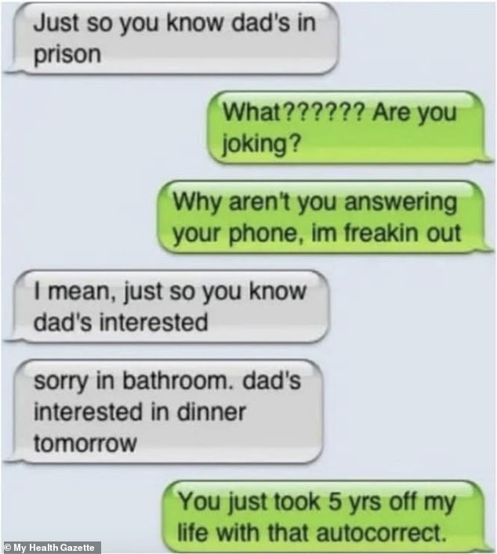

Slide 18
Machine Learning
Definition: Subset of AI focusing on developing algorithms and statistical models, where machines learn patterns and make decisions without explicit programming
  (the capability of a machine to imitate intelligent human behavior)
Types: Supervised learning, unsupervised learning, and reinforcement learning
Real-World Applications: Image recognition, language translation, and recommendation systems

Slide 19
Deep Learning
Definition: Subset of machine learning using neural networks to simulate human brain functions
  (teaching computers to process data in a way that’s inspired by the human brain)
Neural Networks: Layers of interconnected notes mimicking human neurons
Applications: Speech recognition, robotics, image classification or computer vision, and natural language processing (NLP)

Slide 20
Newer & Disruptive AI Applications
(Moving closer to General/Strong AI)
Introducing ChatGPT: A powerful language model that can assist in various tasks (Simplifying AI: Making AI accessible for everyone)
Autonomous vehicles: AI Algorithms are advancing self-driving cars and improving safety features in transportation
AI for Personalized Medicine: AI analyzes genetic and patient data to tailor medical treatments, offering personalized medicine solutions based on an individual’s unique characteristics
AI for Cybersecurity: AI is used to detect & prevent cyber threats in real-time, using advanced algorithms to analyze network behavior, identify anomalies, enhancing overall cybersecurity

Slide 21
GPT (But Not Just ChatGPT)
State-of-the-art language modeling designed to understand human-like text (Generative Pre-trained Transformer)
Key Features
  Natural Language Understanding: comprehending and responding to natural language queries and prompts
  Generative Text: able to generate coherent and contextually relevant text based on inputs
  Context Retention: maintains context throughout a conversation, allowing it to understand and respond appropriately
  Vast Knowledge Base: trained on diverse internet data

Slide 22
GPT Use Cases
Conversational AI: GPT can be employed in applications where natural in interactive conversations with users are essential, such as chatbots and virtual assistants
Content Generation: It excels in content creation, including writing articles, generating creative writing pieces, and producing human-like text
Programming Assistance: Developers can use GPT to get help with coding tasks, writing code snippets, or understanding programming concepts
Language Translation: GPT can assist in translating text between languages, providing a valuable tool for overcoming language barriers.

Slide 23
GPT Limitations and Considerations
Contextual Sensitivity: GPT might generate responses that are contextually sensitive, requiring careful input to yield accurate and desired outcomes.
Lack of Real-world Understanding: While proficient in generating text, GPT lacks real-world understanding and may provide inaccurate or nonsensical answers.
Potential Bias: Like any large language model, GPT may reflect biases present in the training data, emphasizing the importance of cautious and ethical use.

Slide 24
Privacy Considerations
Yes, ChatGPT has privacy concerns, but in all fairness have you read any of the following:
  Facebook Terms of Service
  Apple Media Terms and Conditions
  iCloud legal agreement
  Microsoft services agreement
  Google Terms of Service
We’re giving away our “privacy” everyday, not just on our own devices, also being in proximity to others around us
Follow SBDC Code of Conduct, don’t share client sensitive info

Slide 25
Experimenting with AI: Building a ChatBot
Have you used the “live chat” button on your favorite website?
Why do they have that?
There’s a problem, it can be a solution.
What about other problems that this could be the solution for?

Slide 26
Introducing: a MN SBDC Chatbot
It’s an experiment, you can do this too!
Referencing the MnSBDC Operations Manual (word doc)
Also linked to other critical/key data (websites, files, prompts)
It’s free, not unlimited (50 messages per day)

Slide 27

Building a ChatBot in Under 3-Minutes

Slide 28
Key Takeaways & Call to Action
Embrace AI: It’s part of our everyday lives, making tasks easier and more efficient
Explore AI: Discover how it can enhance your personal and professional endeavors
Consider how might we embrace AI to advance the Mn SBDC?
Consulting & Client Deliverables | Streamlining Internal Processes
Training & Onboarding | Answering FAQs

Slide 29
Speed Sharing to
User Generated Content
Moving traditional speed sharing into institutional knowledge
User generated content that can be leveraged
Can be made into 1-page summaries for future reference
Can be the learned knowledge base of a chatbot
What else could we do with this?

Slide 30
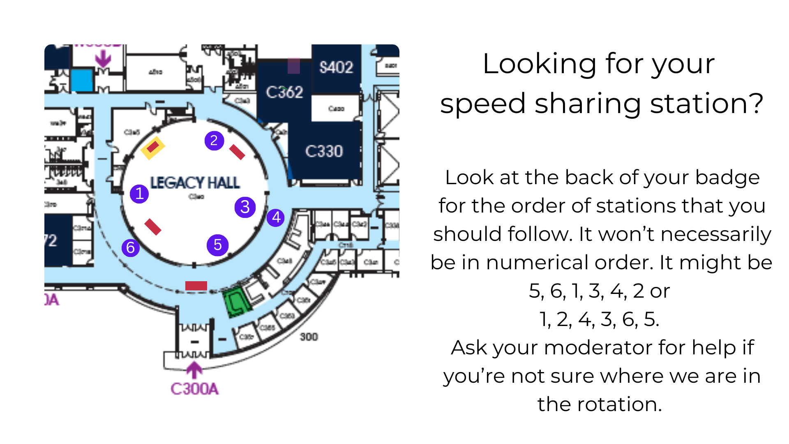
SPEED SHARING

Slide 31
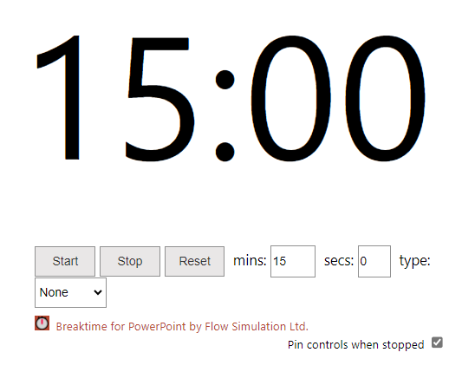
Speed Sharing Session

