Slide 1
Inflation, labor markets, and Business conditions
May 16, 2024
Joe Mahon
Regional Outreach Director

Slide 2
DISCLAIMER
The views expressed here are the presenter's and not necessarily those of the Federal Reserve Bank of Minneapolis or the Federal Reserve System.

Slide 3
Agenda
Federal Reserve background
Economic update
  Labor market progress
  Inflation dynamics
  The Fed’s response
Regional business conditions

Slide 4
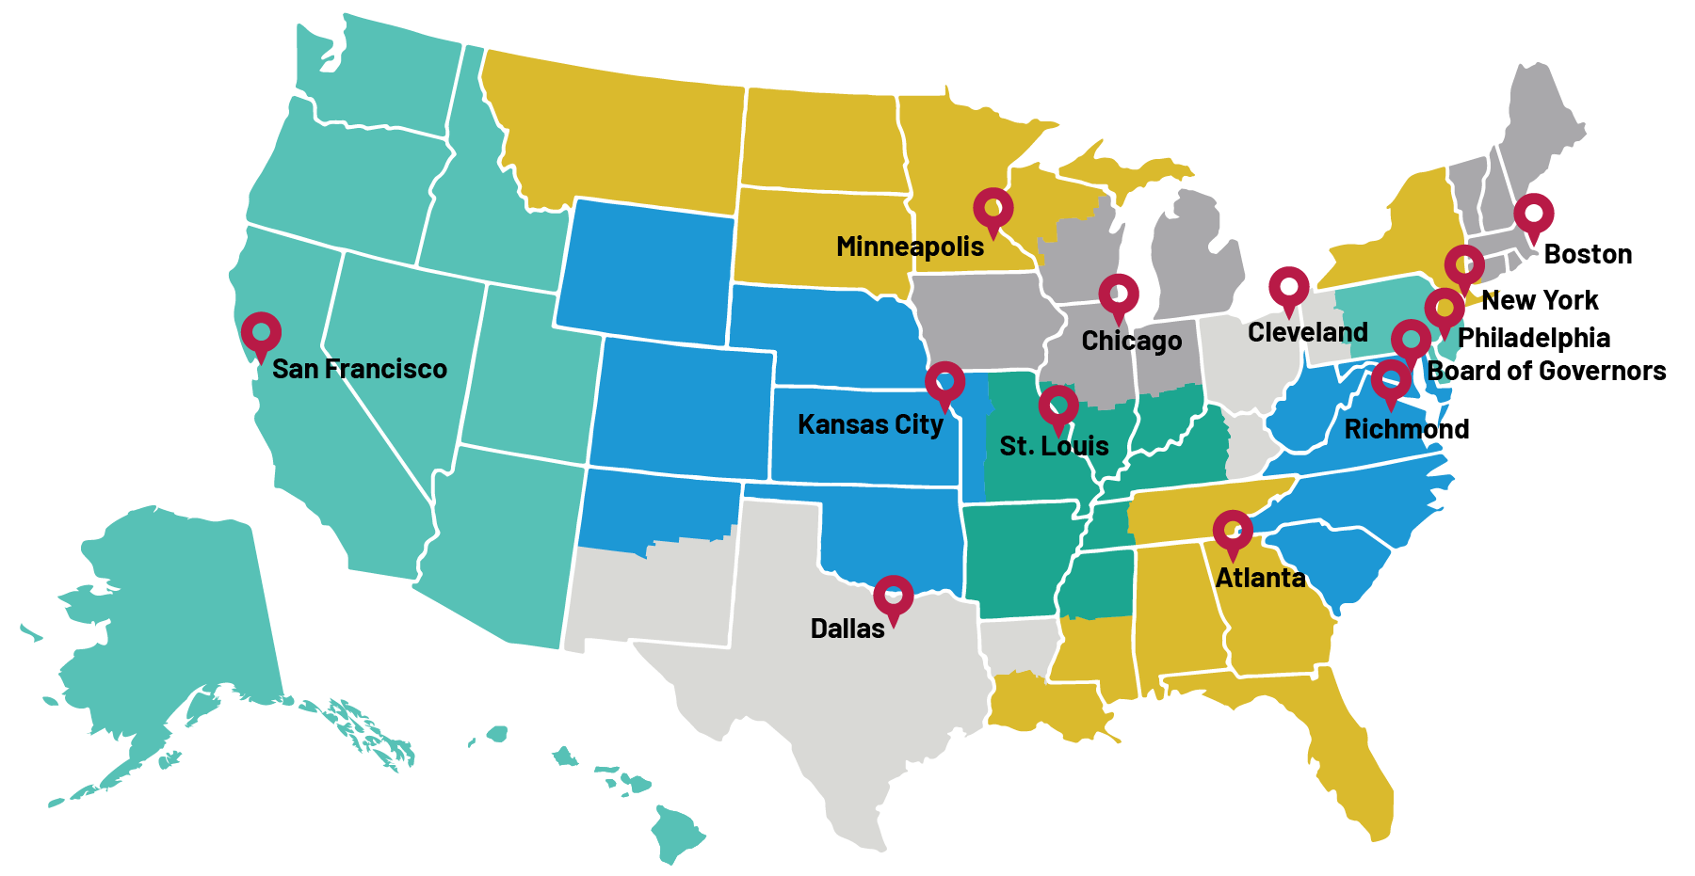
Organization of the Fed

Slide 5
U.S. economic update

Slide 6
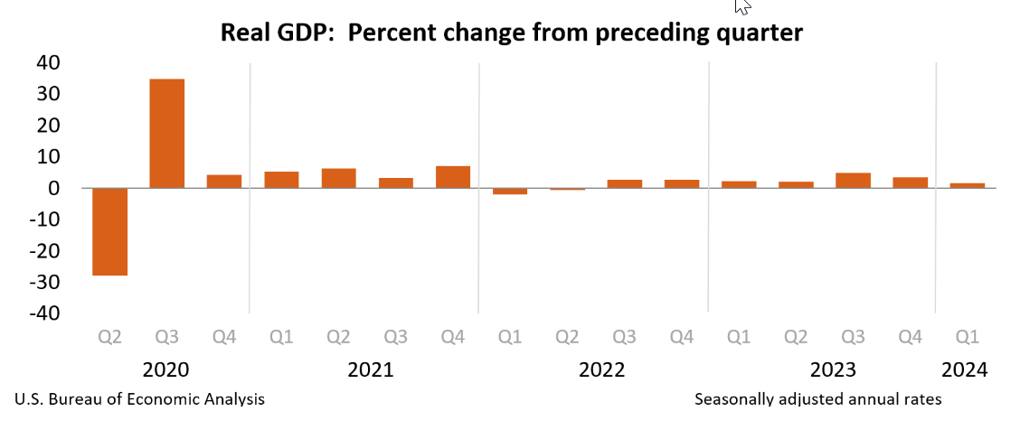
Recession? Not yet.

Slide 7
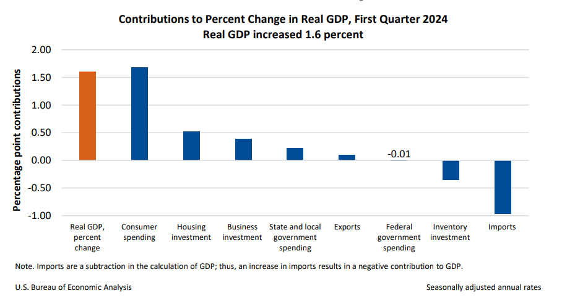
Recession? Not yet.

Slide 8
Employment mandate progress

Slide 9
Unemployment below pre-pandemic levels
Source: Bureau of Labor Statistics

Slide 10
employment Well above pre-pandemic peak
Millions, Level
Source: Bureau of Labor Statistics

Slide 11
Employment–Population ratio
16+, percent
Source: Bureau of Labor Statistics

Slide 12
Labor force participation rate
16+, percent
Source: Bureau of Labor Statistics

Slide 13
Prime age Labor force participation rate
Age 25-54, percent
Source: Bureau of Labor Statistics

Slide 14
Wages rising (before inflation)
Source: Bureau of Labor Statistics

Slide 15
Inflation Mandate progress

Slide 16
Inflation rate has declined steadily
Source: Bureau of Labor Statistics

Slide 17
Wholesale prices trending in the right direction
Source: Bureau of Labor Statistics

Slide 18
What’s going up/down the most?

Slide 19
Inflation took a bite out of wage gains
Source: Bureau of Labor Statistics

Slide 20
recent inflation increasingly services driven
Components of CPI inflation
Percentage point contribution, NSA
Source: Bureau of Labor Statistics

Slide 21
The Fed’s response

Slide 22
The federal funds rate
Rates increasing
Source: Board of Governors of the Federal Reserve System

Slide 23
Long-term Rates eased recently
Source: Board of Governors of the Federal Reserve System

Slide 24
Balance sheet normalization

Slide 25
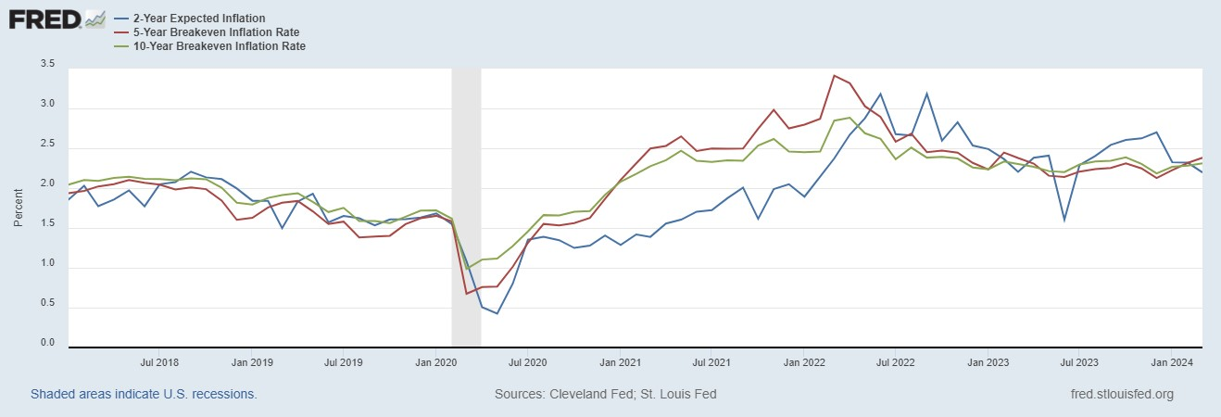
Long term inflation expectations stable

Slide 26
Regional Business conditions

Slide 27
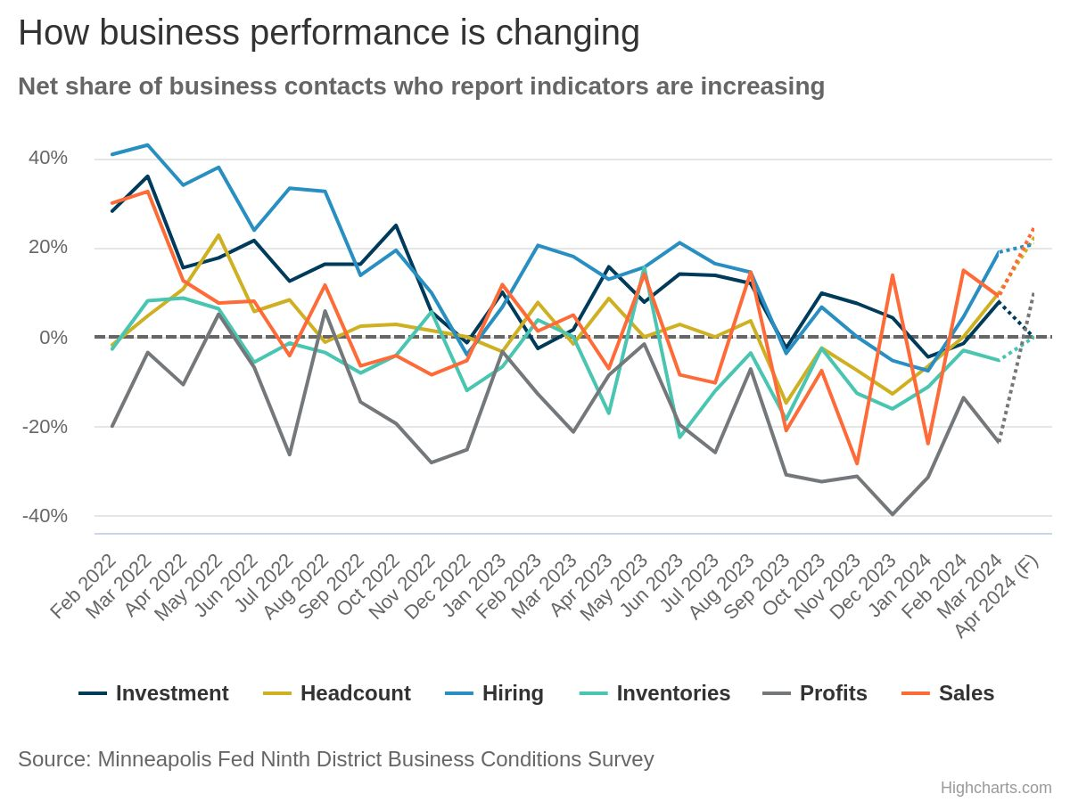
NEW: Monthly Business Conditions Dashboard

Slide 28
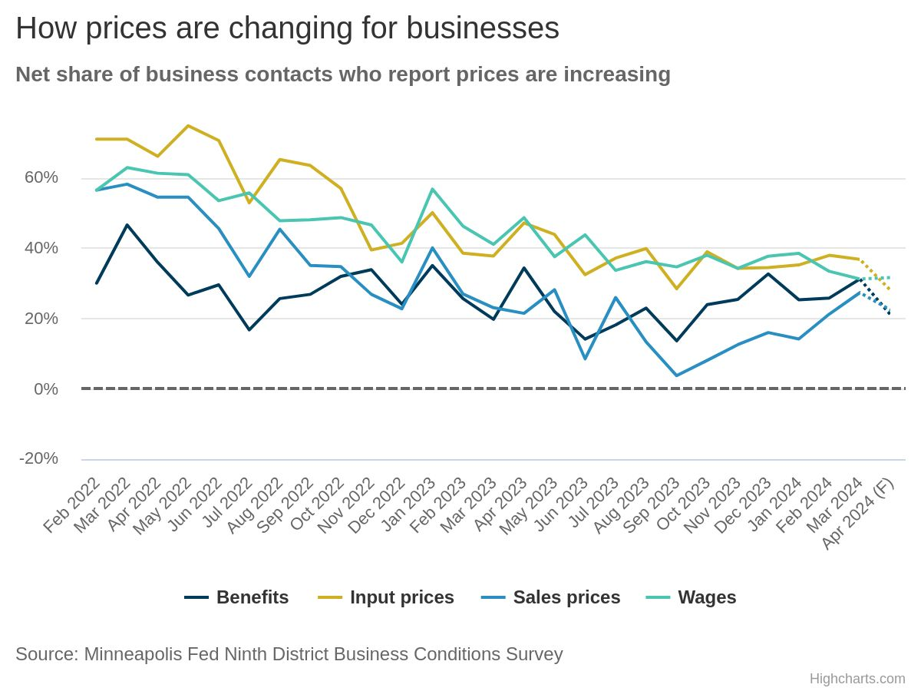
NEW: Monthly Business Conditions Dashboard

Slide 29
General Business Survey
  Conducted between January 16 and February 6, 2024
  600+ responses from across the Ninth District
  Shout out to our partners for distributing the survey!
  Continued balance by firm size, sector and state
  Results are a snapshot
  Non-probability sampling
  Interpret cautiously
Notes:
HC

Slide 30
Quick take-aways
Most recent 3-month period saw continued lower revenue and lower profit trends
Smaller firms continued to see poorer results. The other bad news: The gap narrowed
Tricky to square with fact that overall economy has been growing; however, Ninth District states have been slower than national average
Hiring still happening, but slowing
Inflation top concern, followed by interest rates
Labor availability improving; wage pressure still present, but easing
Outlook: Overall sentiment is modestly positive
Notes:
HC

Slide 31
Recent revenue trends
Notes:
RW

Slide 32
recent and future revenue
More firms seeing lower revenues
Unseasonably warm winter impacted many respondents
Some compositional factors influencing overall sentiment (more on this in a bit), but probably not enough to change the overall trend
Notes:
RW

Slide 33
Y-O-Y survey comparison
Revenue trend worsening, and expected to continue
Notes:
RW

Slide 34
Workforce & wage trends
Notes:
HC

Slide 35
Labor demand
Many firms still hiring in some capacity, but overall labor demand lower
More firms cutting or not hiring
Share hiring more full-time workers continued to erode
Notes:
HC

Slide 36
Staffing: Mixed signals
Overall, more firms expect future staffing will increase than decrease
However, share continues to erode, especially compared with Jan 2023 survey
Notes:
HC

Slide 37
Challenges
Notes:
RW

Slide 38
Challenges to operations
Notes:
RW

Slide 39
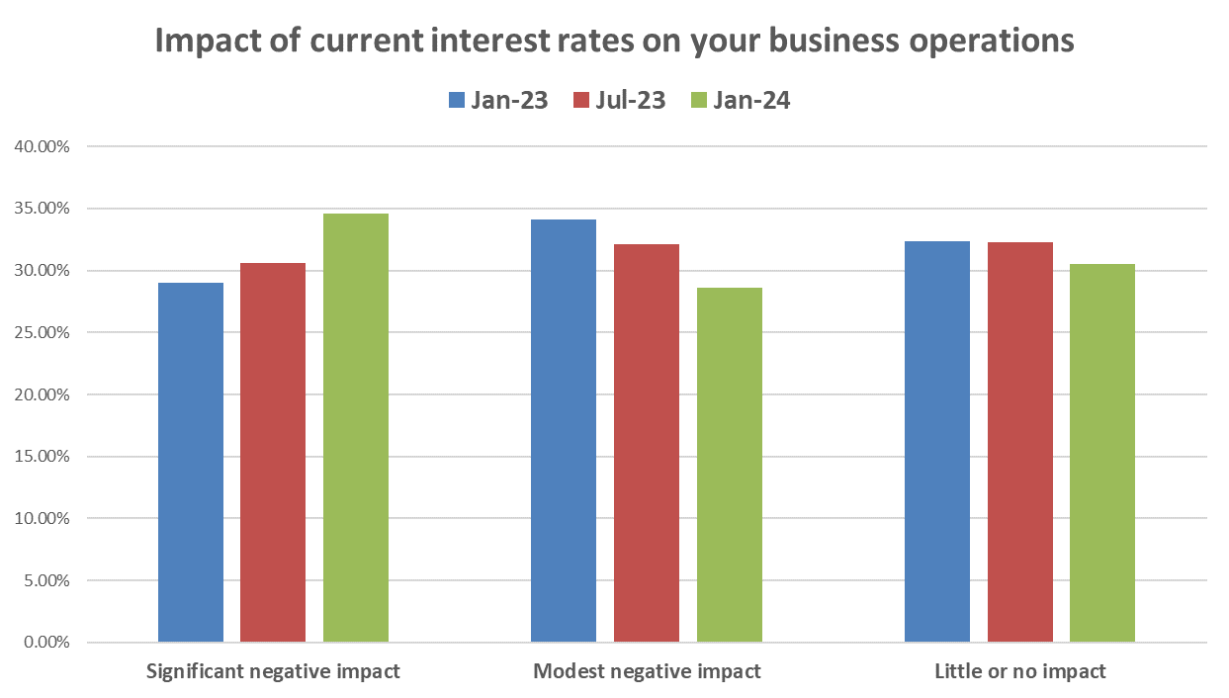
Interest Rates
Interest rates are now #2 challenge for businesses
Also asked about positive impact; not surprisingly, few are seeing positive effects (< 5%)
Notes:
RW

Slide 40
Outlook
Notes:
RW

Slide 41
Outlook: decline, still positive overall
This year’s outlook worsened slightly compared with other years
Still net positive, despite revenue and profit trends
Also fairly similar across firm size
Notes:
RW

Slide 42
Thank you!
@MinneapolisFed
Joseph.mahon@mpls.frb.org
Or Connect on LinkedIn

