Slide 2
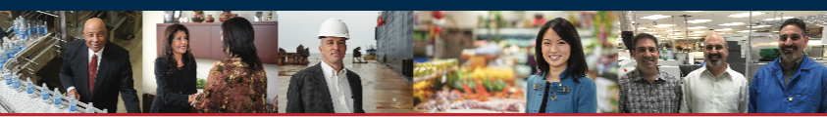
Knowledge Exchange Program (KEP)
Thursday, May 16th | Fergus Falls, MN
U.S. Small Business Administration
– Minnesota District Office –
START • GROW • EXPAND • RECOVER
Start or buy a business - Grow a business - Expand a business – Recover or transition a business
www.sba.gov
Notes:
Talking Points:
Working with the SBA, small business owners and entrepreneurs are empowered to succeed with access to capital, valuable resources, business know-how, and the right expertise for each stage of the business lifecycle.
Where are you in your business lifecycle? What are you looking to achieve? (lead-in to following topic slides)

Slide 3
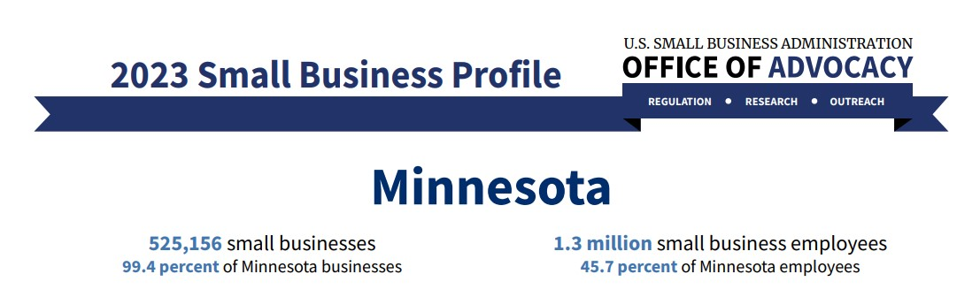
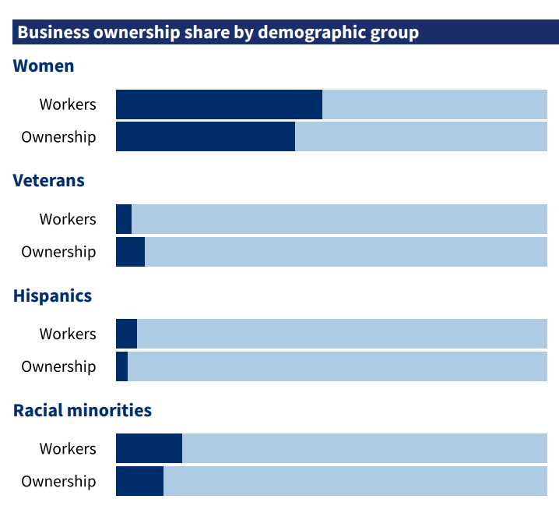
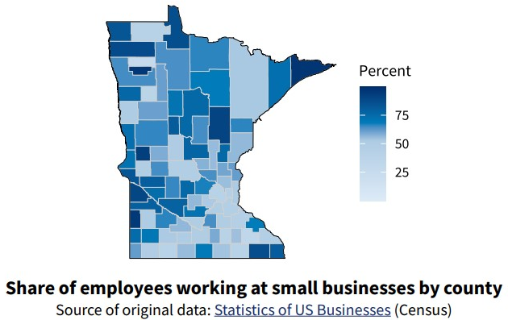
SBA's Office of Advocacy – SBA's Office of Advocacy - https://advocacy.sba.gov/
Notes:
SBA DATA from the Office of Advocacy:
Minnesota is home to over half a million small businesses that make up 99.4% of all Minnesota businesses.
Minnesota small Businesses employ over 1.3 million employees, making up 46 percent of all Minnesota employees.
Women made up 47.9 percent of workers and owned 41.1 percent of businesses.
Veterans made up 4.1 percent of workers and owned 6.9 percent of businesses.
Hispanics made up 4.9 percent of workers and owned 2.6 percent of businesses. Racial minorities made up 13.9 percent of workers and owned 10.1 percent of businesses.

Slide 4
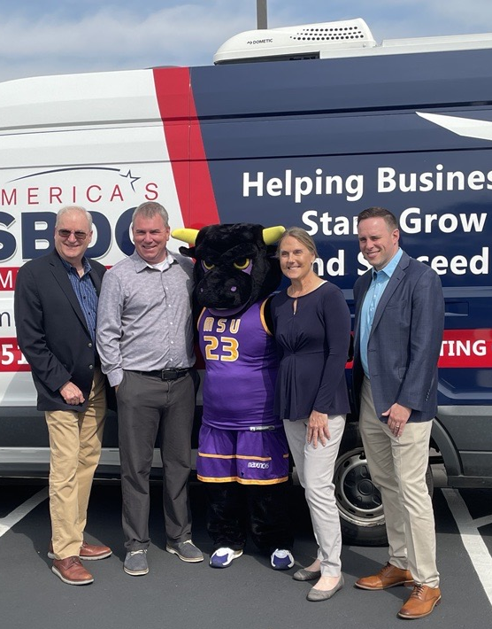
SBA Minnesota District Office Local Highlights
  Hosted 43 events, with over 1,400 attendees. A few highlights include:
  THRIVE Emerging Leaders Cohort
  Veterans Related Trainings - Boots to Business Reboots
  FDIC MoneySmart for Small Businesses (Financial Literacy)
  IP Basics with USPTO and SBDC
  Small Business Saturday collaboration with BBB
  Resource Partner Quarterly's
  SADBOC Procurement Fair
  Increased engagement with Black and AAPI communities
Notes:
THRIVE Emerging Leaders Reimagined graduated a cohort of 18 CEOs. A comment on that topic is that we will begin accepting applications for the 2023 cohort in a couple of weeks.

Slide 5
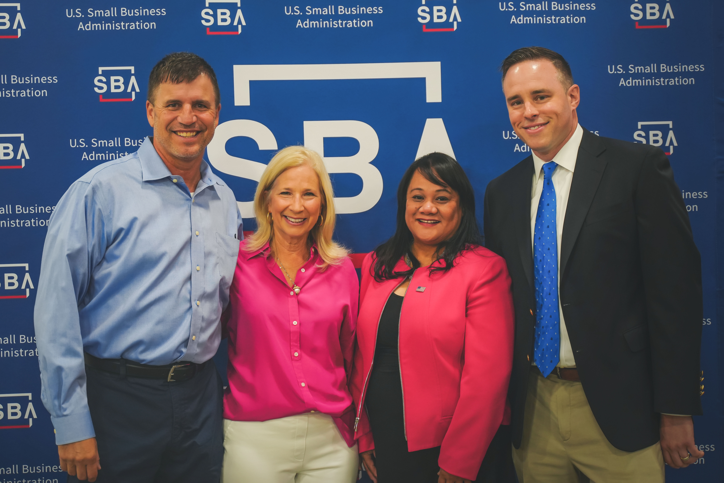
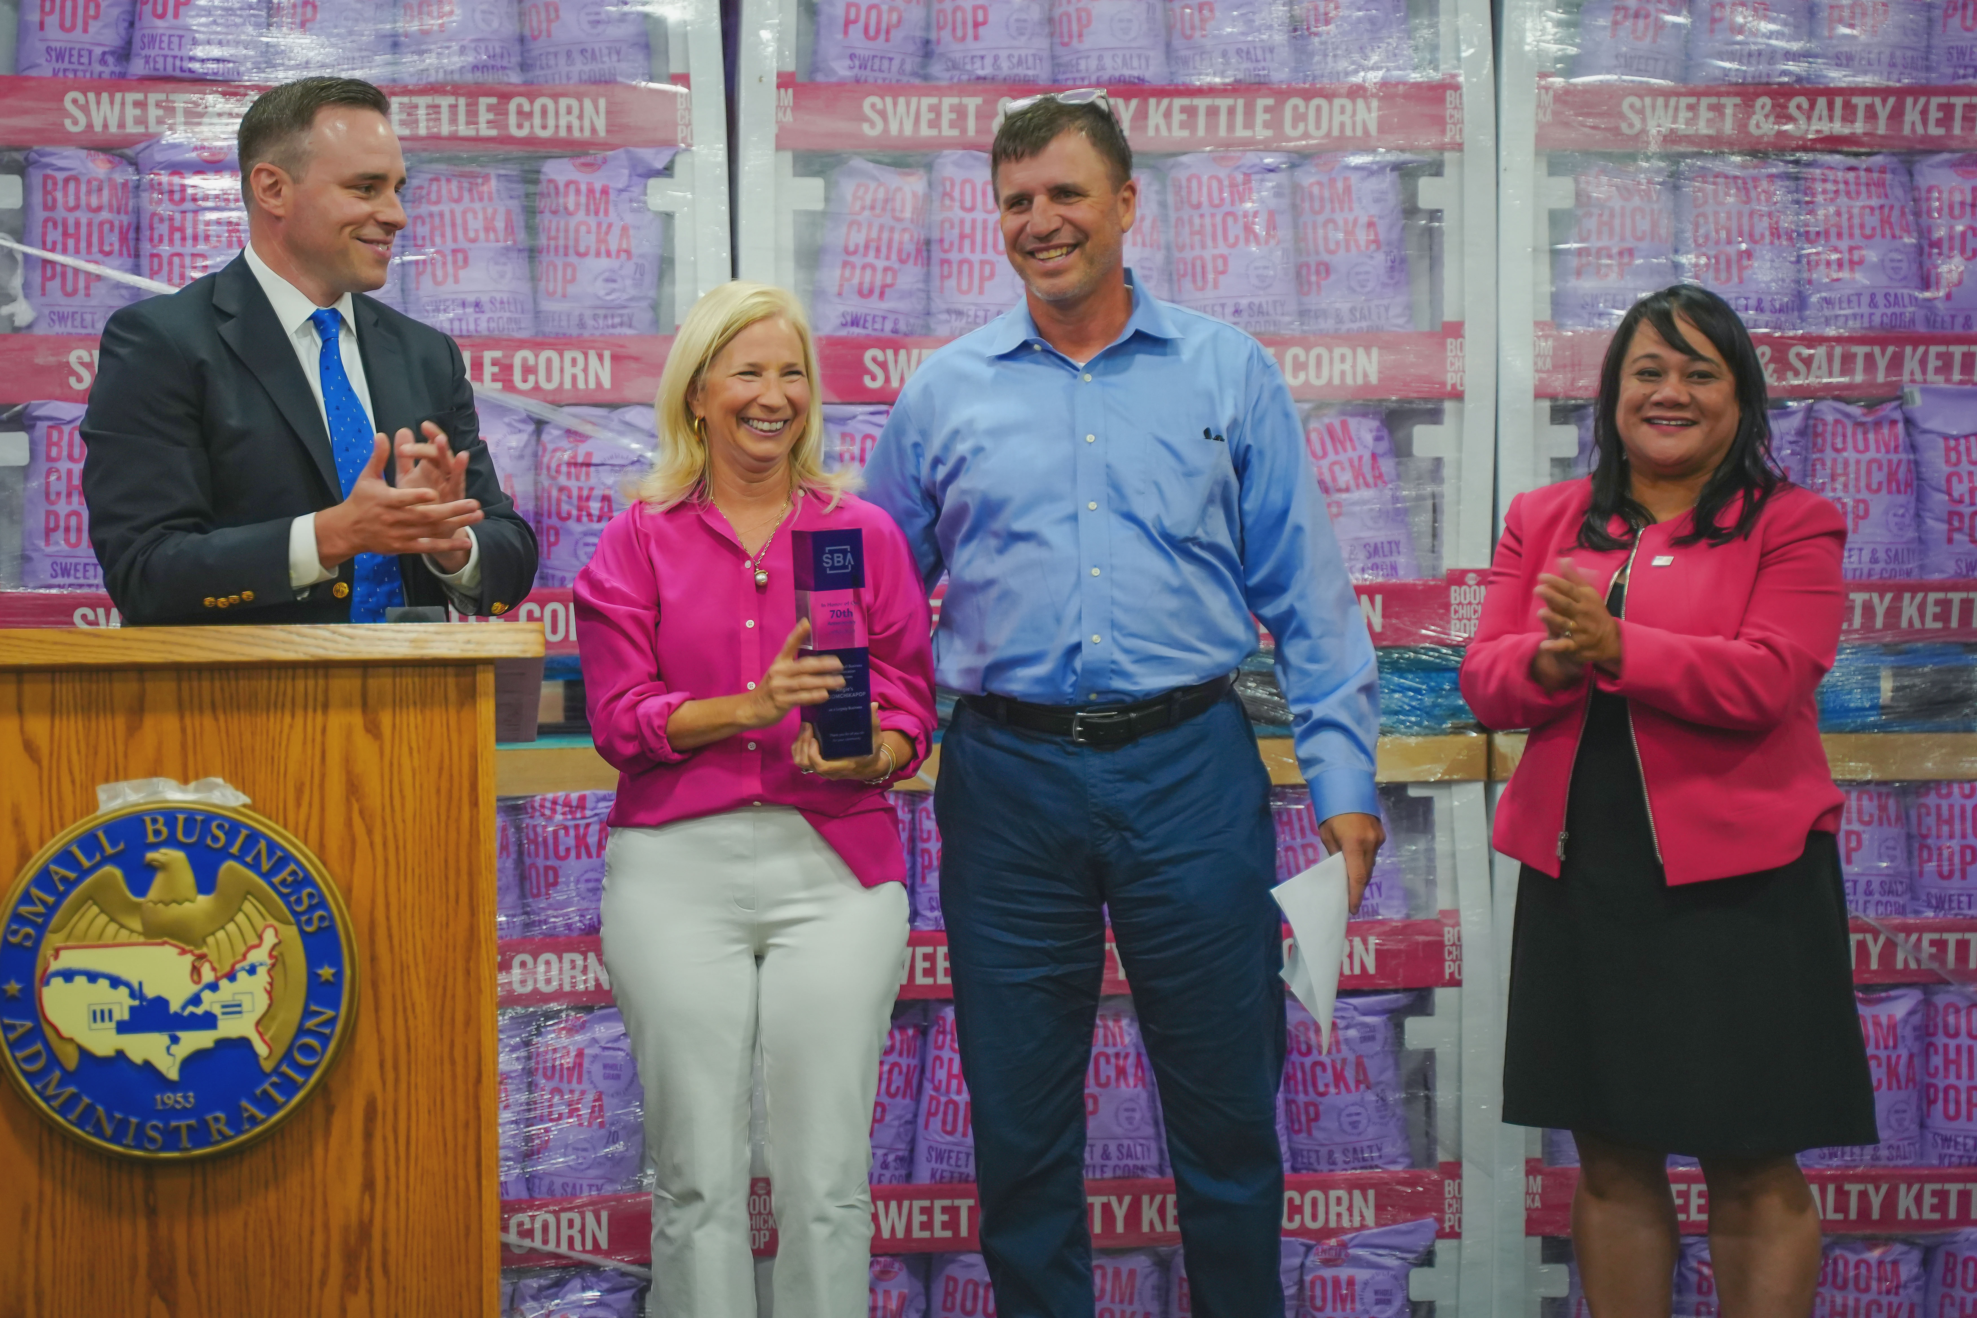
SBDC Client Honored for SBA's MN Legacy Award
The Minnesota District Office celebrated the SBA's 70th Anniversary by honoring Angie's BOOMCHICKAPOP as the state's legacy business.
Starting Angie's BOOMCHICKAPOP in their garage, Angie and Dan Bastian worked closely with their local SBDC from 2005 – 2012. They utilized SBA backed financing for a factory build-out enabling them to grow. During their time as owners, the Bastian's employed nearly 300 people. In October 2017, Angie's BOOMCHICKAPOP was acquired by Conagra Brands.

Slide 6


Slide 7
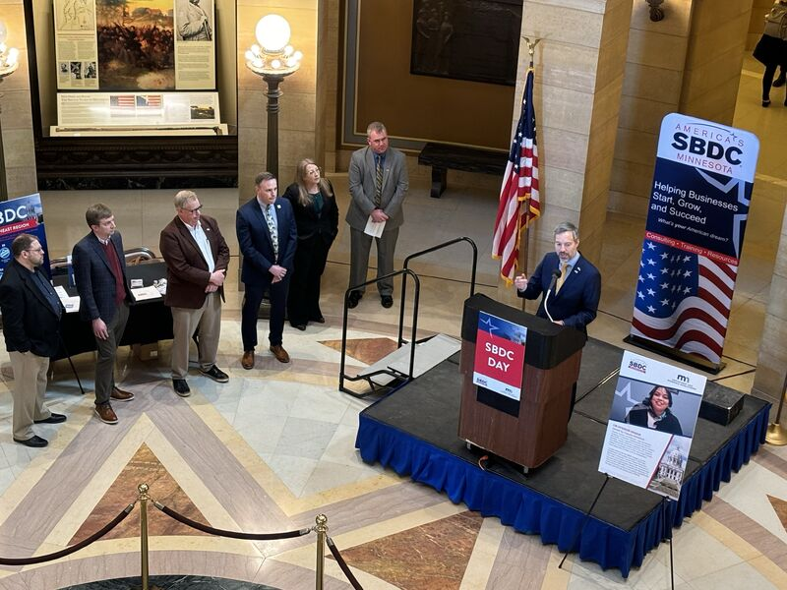

Slide 8
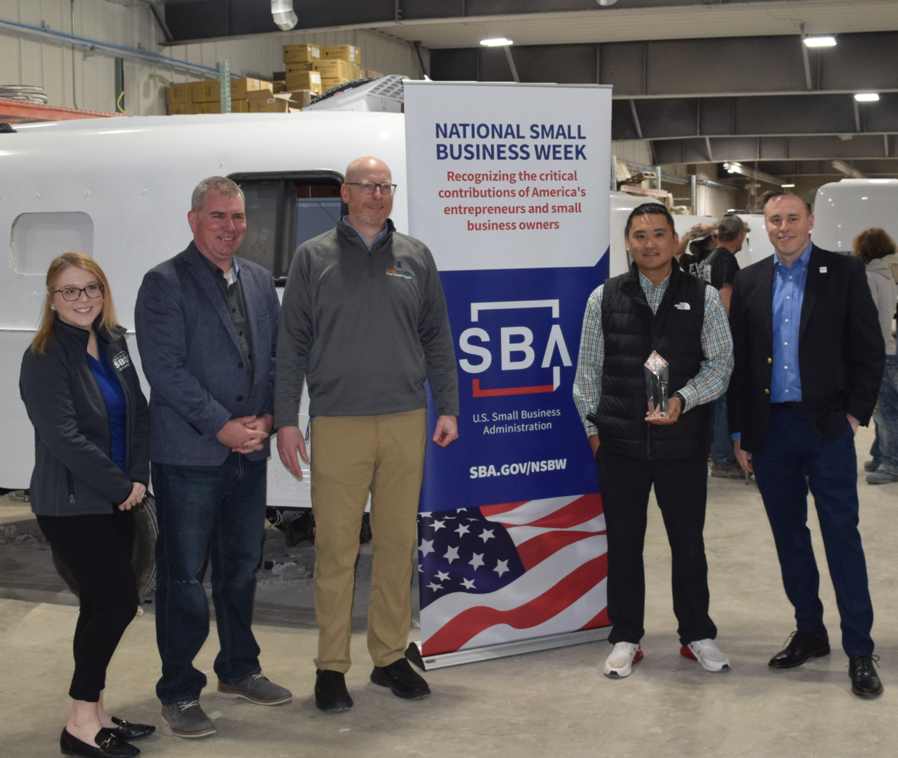

Slide 9
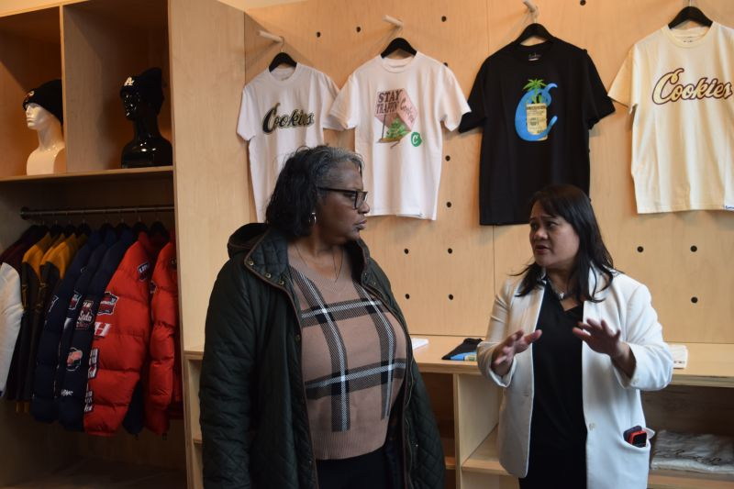

Slide 10


Slide 11


Slide 12
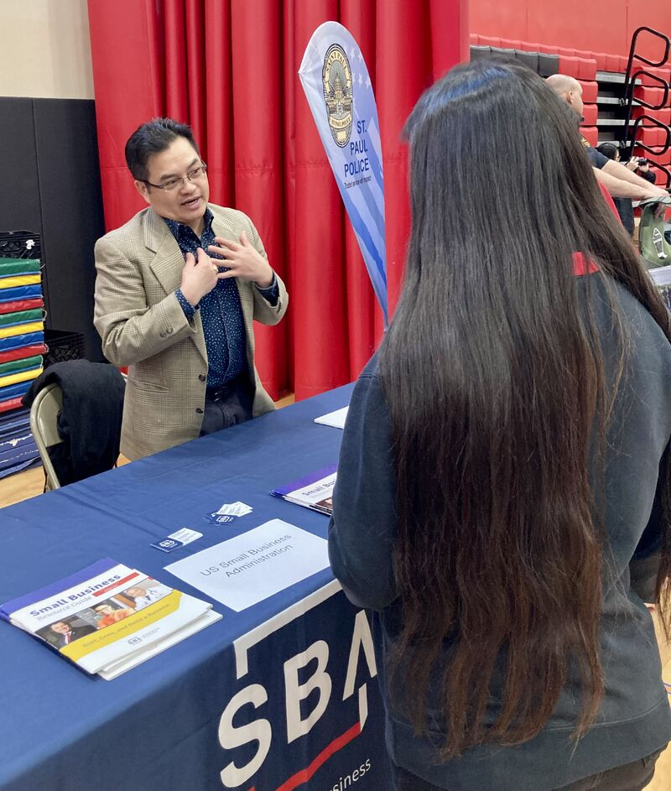

Slide 13
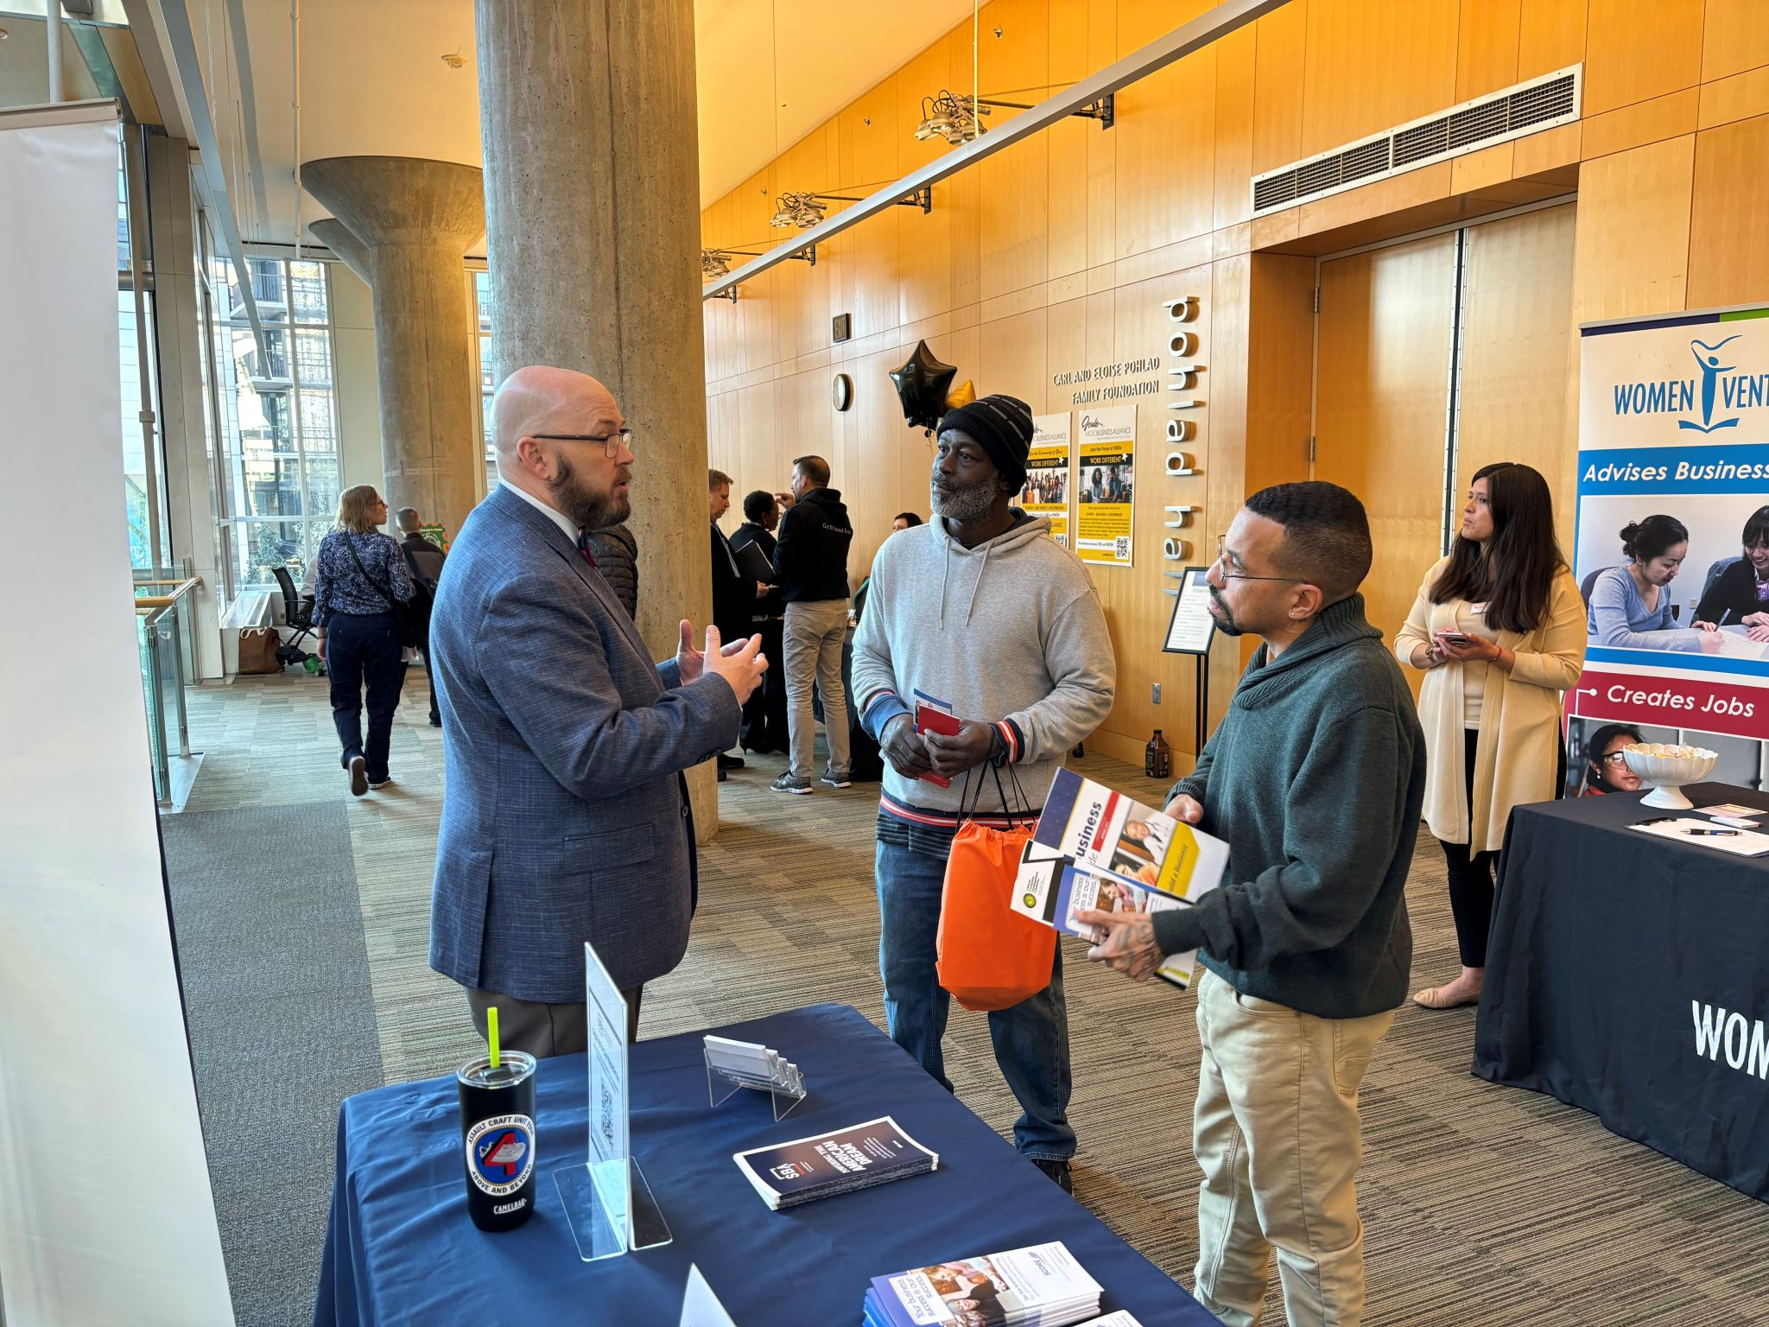

Slide 14
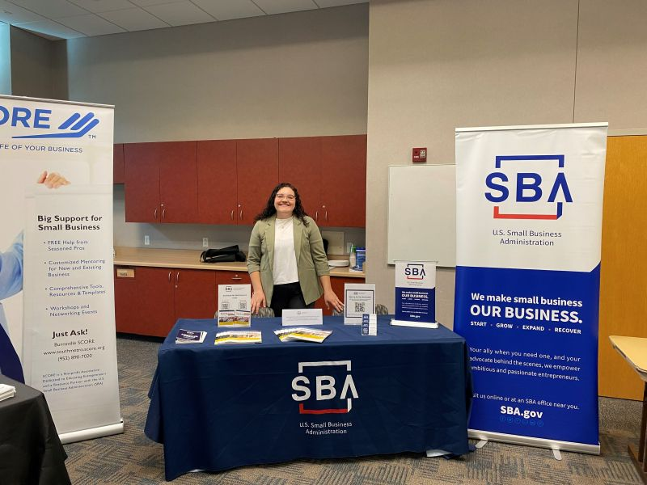

Slide 15
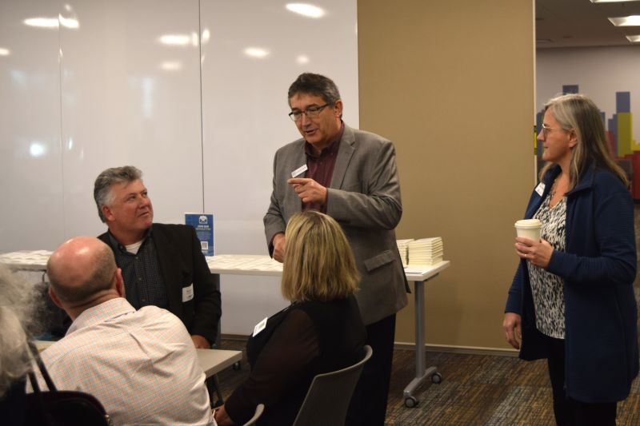

Slide 16


Slide 17
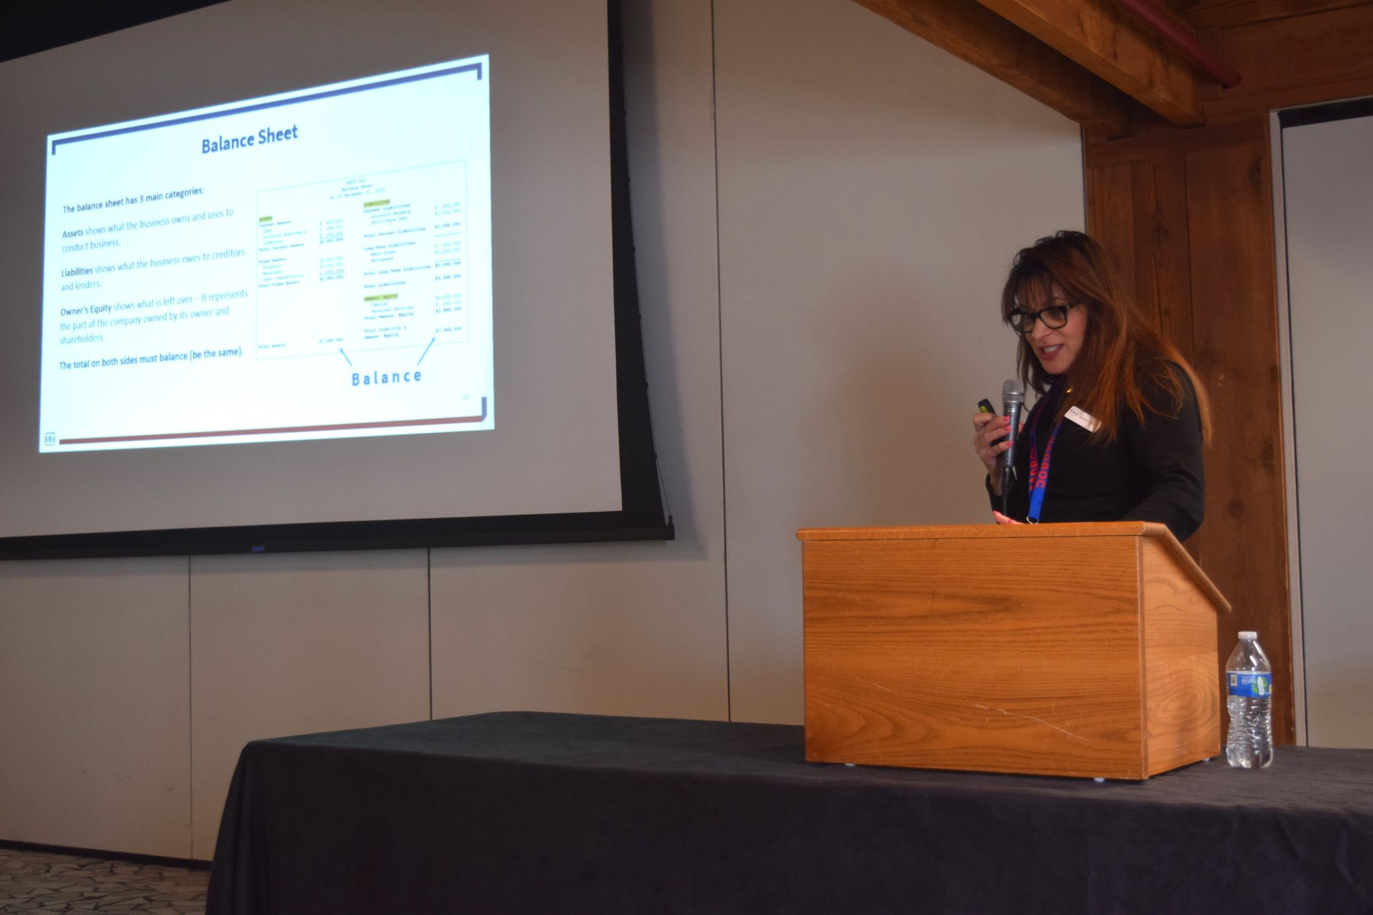

Slide 18
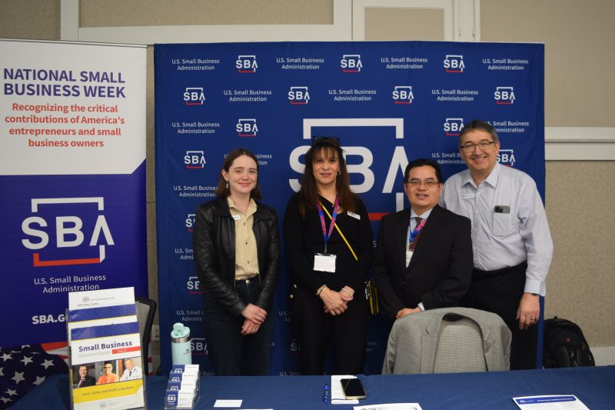

Slide 19


Slide 20


Slide 21


Slide 22




SBA RESOURCE PARTNERS IN MINNESOTA
  SBA Resource Partners are trusted local intermediaries that play a key role in starting, growing, and building businesses. We are incredibly grateful to these amazing partners that help the Minnesota District Office reach everyone corner of our great state.
Minnesota Resource
Partner Impact
- FY2023 -
Resource Partner | Clients Served
SBDC | 4,281
SCORE | 2,662
VBOC & Vet Outreach | 645
WBC | 2,280
Totals | 9,868

Slide 23

SBA LOAN PROGRAMS IN MINNESOTA
Minnesota Lender Activity
- FY2024 -
Loan Program | Number | Dollar
504 Total | 104 | $77 million
7A Total | 897 | $363 million
Microloan | 84 | $1.3 million
Totals | 1,969 | $441.3 million
  In FY2024 the SBA provided over $440 million* in funding to help Minnesota small businesses start, grow, expand and recover with:
  7(a) General Small Business Loans
  504 Loan Program
  Microloan Program
  *Data as of 3 May 2024
In FY2023 the SBA 7(a) program increased the number of Minority-Owned (Black, Hispanic/Latino, AANHPI, and Native American) loans by 15%.
Notes:
SBA Financial Assistance Non-COVID Products Status
7a, 504, Community Advantage, Microloans, Cap lines, Surety Bonds, SBIR/STTR, Contracts, exports,
SBA financial products are non-predatory in nature so as to preserve the wealth-building capacity of the business owner with values such as affordable rates, longer repayment terms than conventional bank loans, and regulating for transparency to assure the risk is mitigated for intermediary lenders (such as non-profit lenders and community banks) and remains accessible for owners who otherwise would not get capital

Slide 24
SBA Minnesota Lending Trends 504 and 7(a) Loans
MN vs Nation vs Region 5
- FY23 vs FY24 -
 | $ Approvals FY23 (MN) | $ Approvals FY24 (MN) | % change (MN) | % change (National) | % change (R5)
October | $58,971,400 | $39,846,900 | -32% | -24% | -14%
November | $122,101,900 | $112,047,100 | -8% | -7% | 4%
December | $188,606,200 | $191,435,400 | 2% | -6% | 1%
January | $230,193,000 | $253,129,000 | 10% | -3% | 6%
February | $288,330,100 | $304,604,600 | 6% | 1% | 9%
March | $371,054,100 | $362,936,600 | -2% | 2% | 8%
April | $422,210,400 | $408,307,500 | -3% | 5% | 10%
May | $479,459,800 | $440,032,300 | -8% | -7% | -4%
 | # Approvals FY23 (MN) | # Approvals FY24 (MN) | % change (MN) | % change (National) | % change (R5)
October | 152 | 100 | -34.2% | -7% | -23%
November | 276 | 220 | -20.3% | 9% | -1%
December | 439 | 376 | -14.4% | 10% | 3%
January | 562 | 517 | -8.0% | 14% | 6%
February | 695 | 658 | -5.3% | 16% | 7%
March | 883 | 839 | -5.0% | 16% | 8%
April | 1,023 | 922 | -9.9% | 20% | 9%
May | 1,167 | 1001 | -14.2% | 5% | -4%

Slide 25
SBA Minnesota Lending Trends 7(a) Loans
MN vs Nation vs Region 5
- FY23 vs FY24 -
Fiscal Year | $ Approvals FY23 (MN) | $ Approvals FY24 (MN) | % change (MN) | % change (National) | % change (R5)
October | $42,793,400 | $29,098,900 | -32% | -27% | -19%
November | $85,161,900 | $87,508,100 | 3% | -5% | 9%
December | $131,743,200 | $156,996,400 | 19% | -7% | 6%
January | $164,355,000 | $205,318,000 | 25% | -2% | 13%
February | $211,599,100 | $244,695,600 | 16% | 2% | 14%
March | $280,250,100 | $296,937,600 | 6% | 3% | 13%
April | $317,610,400 | $337,576,500 | 6% | 6% | 15%
May | $366,787,800 | $362,957,300 | -1% | -6% | -1%
Fiscal Year | # Approvals FY23 (MN) | # Approvals FY24 (MN) | % change (MN) | % change (National) | % change (R5)
October | 130 | 89 | -31.5% | -6% | -22%
November | 240 | 191 | -20.4% | 12% | 1%
December | 375 | 333 | -11.2% | 12% | 5%
January | 482 | 457 | -5.2% | 17% | 9%
February | 598 | 585 | -2.2% | 19% | 9%
March | 769 | 752 | -2.2% | 19% | 9%
April | 890 | 828 | -7.0% | 22% | 10%
May | 1,022 | 897 | -12.2% | 7% | -3%

Slide 26
SBA Minnesota Lending Trends 504 Loans
MN vs Nation vs Region 5
- FY23 vs FY24 -
Fiscal Year | $ Approvals FY23 (MN) | $ Approvals FY24 (MN) | % change (MN) | % change (National) | % change (R5)
October | $16,178,000 | $10,748,000 | -34% | -13% | 8%
November | $36,940,000 | $24,539,000 | -34% | -14% | -13%
December | $56,863,000 | $34,439,000 | -39% | -5% | -17%
January | $65,838,000 | $47,811,000 | -27% | -7% | -17%
February | $76,731,000 | $59,909,000 | -22% | -3% | -9%
March | $90,804,000 | $65,999,000 | -27% | -5% | -10%
April | $104,600,000 | $70,731,000 | -32% | -1% | -8%
May | $112,672,000 | $77,075,000 | -32% | -13% | -16%
Fiscal Year | # Approvals FY23 (MN) | # Approvals FY24 (MN) | % change (MN) | % change (National) | % change (R5)
October | 22 | 11 | -50.0% | -18% | -26%
November | 36 | 29 | -19.4% | -15% | -20%
December | 64 | 43 | -32.8% | -6% | -20%
January | 80 | 60 | -25.0% | -8% | -20%
February | 97 | 73 | -24.7% | -5% | -14%
March | 114 | 87 | -23.7% | -5% | -12%
April | 133 | 94 | -29.3% | -3% | -12%
May | 145 | 104 | -28.3% | -13% | -20%

Slide 27
SBA Minnesota Lending Trends 7(a) Loans
MN Demographics
- FY23 vs FY24 -
Amount | FY 23 7(a) | FY 24 7(a) | 7(a) % Change | WOSB % Change | VOSB % Change | MOSB % Change | AI/NI % Change | AANHPI % Change | Black % Change | Hispanic % Change | Rural % Change
October | $42,793,400 | $29,098,900 | -32% | -37% | -58% | 35% | 90% | 51% | 49% | -93% | -58%
November | $85,161,900 | $87,508,100 | 3% | 43% | -20% | 48% | 19% | 121% | 17% | -45% | -18%
December | $131,743,200 | $156,996,400 | 19% | 94% | -33% | 86% | 5% | 138% | 24% | 118% | -10%
January | $164,355,000 | $205,318,000 | 25% | 68% | 4% | 81% | -41% | 94% | 40% | 158% | 7%
February | $211,599,100 | $244,695,600 | 16% | 21% | -19% | 54% | -41% | 64% | 8% | 142% | 13%
March | $280,250,100 | $296,937,600 | 6% | 16% | 2% | 42% | -272% | 60% | 20% | 77% | 14%
April | $317,610,400 | $337,576,500 | 6% | 18% | -12% | 30% | -690% | 56% | 7% | 85% | 19%
May | $366,787,800 | $362,957,300 | -1% | -1% | -26% | 15% | -690% | 22% | 5% | 45% | 6%
Volume | FY 23 7(a) | FY 24 7(a) | % Change | % Change | % Change | % Change | % Change | % Change | % Change | % Change | % Change
October | 130 | 89 | -32% | -18% | -20% | -24% | 67% | 0% | -38% | -80% | -57%
November | 240 | 191 | -20% | 6% | -22% | -6% | 33% | -13% | -16% | -45% | -34%
December | 375 | 333 | -11% | 27% | -7% | 4% | 0% | 22% | 0% | -13% | -22%
January | 482 | 457 | -5% | 20% | 25% | 10% | -25% | 10% | 19% | 5% | -15%
February | 598 | 585 | -2% | 20% | -13% | 12% | -25% | 23% | 18% | -3% | -13%
March | 769 | 752 | -2% | 15% | 0% | 12% | -40% | 19% | 14% | 8% | -7%
April | 890 | 828 | -7% | 7% | -3% | -1% | -100% | 7% | 7% | -4% | -5%
May | 1022 | 897 | -12% | -4% | -6% | -10% | -100% | -13% | -2% | -8% | -14%

Slide 28
SBA Minnesota Lending Trends 504 Loans
MN Demographics
- FY23 vs FY24 -

Slide 29
Number of Active Lenders
Minnesota has 138 Active Lenders as of 10 May 2024
Top 10 Lenders
Lender Name | $ Approved | # Approved
Minnesota Business Finance Corporation | $27,945,000 | 37
Platinum Bank | $24,524,300 | 15
The Huntington National Bank | $23,550,900 | 114
Twin Cities-Metro Certified Development Com | $21,605,000 | 28
U.S. Bank, National Association | $21,395,900 | 120
Live Oak Banking Company | $20,321,000 | 11
Frandsen Bank & Trust | $15,220,400 | 26
Bremer Bank, National Association | $15,147,500 | 18
Bankvista | $13,452,900 | 38
Choice Financial Group | $13,135,000 | 24
Lender Name | $ Approved | # Approved
U.S. Bank, National Association | $21,395,900 | 120
The Huntington National Bank | $23,550,900 | 114
Bankvista | $13,452,900 | 38
Minnesota Business Finance Corporation | $27,945,000 | 37
Twin Cities-Metro Certified Development Com | $21,605,000 | 28
Wells Fargo Bank, National Association | $6,666,500 | 28
Frandsen Bank & Trust | $15,220,400 | 26
Choice Financial Group | $13,135,000 | 24
Bayfirst National Bank | $2,958,300 | 24
Amplio Economic Development Corporation | $12,116,000 | 19
Microlending
In FY24 Minnesota has 8 active lenders, completing 84 microloans for $1,268,000
44 loans done for women owned small businesses for $632,090
6 loans done for black owned small businesses for $210,802
3 loans done for Native American owned small businesses for $69546
2 loans done for Veteran owned small businesses for $78,500
1 Loan for AANHPI small business for $50,000

Slide 30
How Can an SBA-backed Loan Help You?
Launch, grow, or repair a start-up
Start or purchase a small business
Access revolving credit or working capital for day-to-day expenses
Purchase, renovate, or expand facilities
Purchase inventory, equipment, or machinery
Purchase land or real estate
Export a product or service
Notes:
The SBA provides financial assistance through its loan guarantee programs.
The SBA will guarantee a percentage of a loan to the participating lender.
The guarantee allows the lender to offer more flexible terms to the borrower.
For loans up to $5.5 million, SBA-backed loans can be used for most business purposes, including long-term fixed assets and operating capital. The SBA can help you access funding through several lending programs for various uses to meet your unique business needs at any stage of your business lifecycle such as:
Launch, grow, or repair a start-up
Start or purchase a small business
Access revolving credit or working capital for day-to-day expenses
Purchase, renovate, or expand facilities
Purchase inventory, equipment, or machinery
Purchase land or real estate
Export a product or service
Some loan programs set restrictions on how you can use the funds, so check with an SBA-approved lender when requesting a loan. Your SBA lender can match you with the right loan for your business needs.

Slide 31
Increase Your Chances of Securing a Loan
Lenders want to know they’re making a smart choice by giving you a loan. Your local SBA Resource Partners can help you develop your:
Business plan
Expense sheets
Financial statements
Financial projections
Notes:
Talking Points:
We can connect you with local SCORE, SBDC, or WBC offices who will help you prepare your business plan and loan package.
Resource partners can help you prepare to speak with SBA Lenders, who will want to discuss your:
Size and purpose of your loan
Size and age of your business
Credit history
Collateral
Financial projections
Technical assistance/mentoring needs

Slide 32
Looking Forward and Collaboration Opportunities
Upcoming FY24 SBA MNDO Events:
American's Seed Fund – 2024 Road Tour: Great Lakes
  July 15 – 19, 2024
MN Small Business Lenders Conference
  September 12, 2024
MN Banker's Association (MBA) 2024 SBA Lending Workshops
Region 5 Leadership Retreat
Increasing Access to Affordable Small Dollar Lending in Minnesota
  In partnership with FDIC, OCC, Minneapolis Federal Reserve Bank
Potential Collaborations:
Training on Legacy Planning and SBA Loans
SBDC Client Success Stories

Slide 33
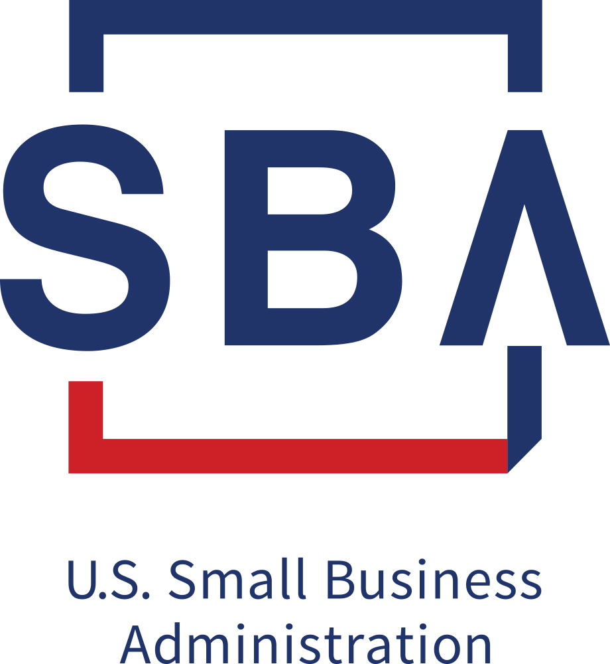
SBA MINNESOTA STAFF CONTACTS
General Questions and Help:
Minnesota@sba.gov
Follow on Twitter.com & LinkedIn:
@SBA_Minnesota
https://www.linkedin.com/showcase/sbaminnesota/
District Website: www.sba.gov/mn

