Slide 1


10[C]hats
AI Training that Works for SBDCs
Ian Carlstrom
West Central Minnesota SBDC
Ian.Carlstrom@Minnesota.edu

Slide 2
You found your way to an AI session…
Not just any AI session, but one built specifically for SBDCs.
That tells me two things:
You’re probably already feeling the pressure to ‘do something’ with AI back home.
You don’t just want ideas—you want something that actually works. Something you can teach, scale, and be proud of.
That’s what we’re going to unpack & explore together today.

Slide 3
My goals for our time together today
Tell our story and give you a peek behind the scenes
Not just another AI training session, but an AI train-the-trainer session
Share insights into what works and what doesn’t work
Share documents that you can use, tailor, and build on
Answer your questions, have a discussion, connect & learn from each other
This is for “R&D” purposes (for you to “Rip-off” and “Duplicate”)

Slide 4
“10[C]hats”
Before we start…
What the heck is it?
It’s not a tool or a platform. It’s more than a skill or a shortcut.
It’s a mindset for success – the way you think about AI that will transform how you work with it… and how it works for you.

Slide 5

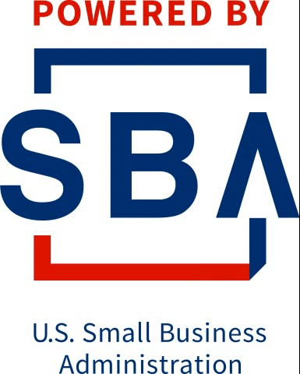


Hats Off to Our Host & America’s SBDC
Funded in part through a Cooperative Agreement with the U.S. Small Business Administration, the Minnesota Department of Employment and Economic Development, and regional support partners. The West Central SBDC is a proud member of the Minnesota SBDC Network. All opinions, conclusions, or recommendations expressed are those of the author(s) and do not necessarily reflect the views of the program sponsors. Programs are open to the public on a nondiscriminatory basis. Reasonable accommodations will be made upon request. Contact the West Central SBDC at (218) 299-6606.

Slide 6
Background & About Me
Before We Ever Launched Anything
I was not an early adopter (well sort of…) but at first, I said “NO” to AI
Early wins and experimentation, trial and error, curiosity
Peer sharing & learning, Minnesota SBDC (KEP) presentation
Pursued training, certifications, ASBDC AI U (1st Cohort in Atlanta)
Notes:
I entered my AI Consideration Phase January 2024
KEP – May 2024
ASBDC – September 2024

Slide 7
The Principles Behind our AI Work
Purposefully & consciously committed to:
Independent appreciation of AI. NO content regurgitation
Not convincing people to use AI. (Encourage people NOT to use AI.)
Timeless over trendy. Refreshingly simple, relatable, content that ages
People before prompts. Understanding our audience and their needs
Relevance over reach. Knowing our place serving (rural) small business
Learning in public. We share wins, failures, and experiments. Be curious.
Built to outlive us. If it can’t be shared, scaled, & repeated, is it worth building?
Our work should spark momentum far beyond the room we’re in.
Notes:
I entered my AI Consideration Phase January 2024
KEP – May 2024
ASBDC – September 2024

Slide 8

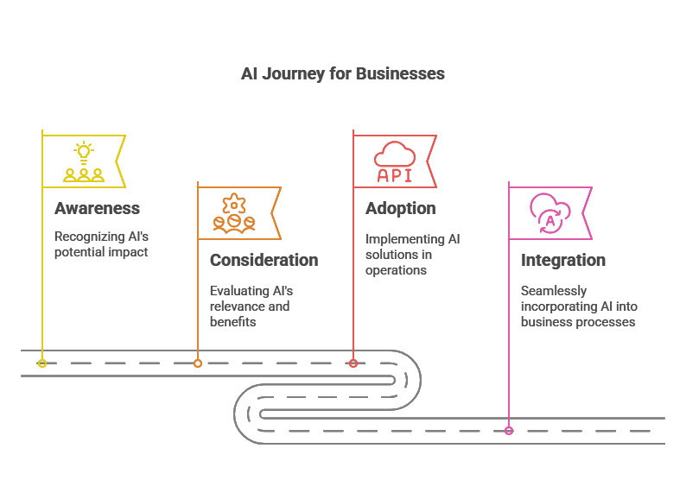
SBDC AI Readiness Assessment
1
3
Are you
ready for AI?
(from the
AI U Toolkit)
“The best time to start was yesterday…
…The next best time is now!”
2
4
Notes:
I entered my AI Consideration Phase January 2024
From Zero-to-60: I very quickly began using ChatGPT daily

Slide 9
AI Awareness & Discovery Journey
“Training That Meets Them Where They’re At”
Phase of AI Readiness
SBDC Training Offering
Awareness:
"I’ve Heard About AI, But I Have No Idea Where to Start."
Consideration:
"I’m Curious About AI, But I Don’t Know Which Tool to Pick."
Adoption:
"AI Is Helping My Business, But It’s Not Fully Integrated Yet."
Integration:
"AI Is Now a Core Part of My Business."
AI Resource Lab :
Online, on-demand AI resources & training
Exploring AI for Business:
In-person focus groups, live demos and Q&A
10[C]hats AI Con:
Full-day, hands-on AI conference with facilitated build sessions
Customized Training:
On-site, tailored AI training built for individual teams

Slide 10
AI Awareness & Discovery Journey
“Training That Meets Them Where They’re At”
Phase of AI Readiness
SBDC Training Offering
Awareness:
"I’ve Heard About AI, But I Have No Idea Where to Start."
Consideration:
"I’m Curious About AI, But I Don’t Know Which Tool to Pick."
Adoption:
"AI Is Helping My Business, But It’s Not Fully Integrated Yet."
Integration:
"AI Is Now a Core Part of My Business."
AI Resource Lab :
Online, on-demand AI resources & training
Exploring AI for Business:
In-person focus groups, live demos and Q&A
10[C]hats AI Con:
Full-day, hands-on AI conference with facilitated build sessions
Customized Training:
On-site, tailored AI training built for individual teams

Slide 11
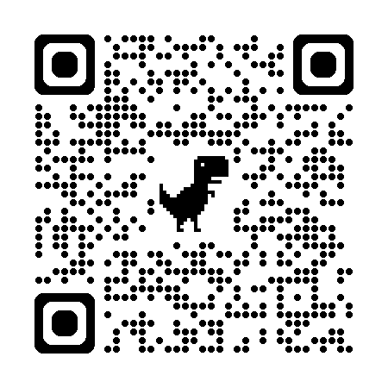
Launching Point: AI Resource Lab
Empowering small businesses to unlock the potential of AI with hands-on tools and tailored guidance for success
*AI Bootcamp: 3 videos, ~30 minutes
“Demystifying AI”
“Getting Started with AI”
“Getting the Most of AI” westcentralmnsbdc.com/ai-resources-lab
*Interactive AI Tools: tailored solutions (prebuilt GPTs) for business growth and innovation…
It all starts with experimentation, confidence building, and curiosity.
*Downloadable AI Toolkit: simple, actionable resources built for small business owners.
(added later)
Notes:
October 2024

Slide 12
AI Resource Lab | What Is It?
Our way of moving from AI conversations, to AI experiences.
Started with the AI Bootcamp videos & 9x basic GPTs (and a disclaimer)
Nothing special. Cuts through the noise. Keeps it simple.
Squarely in the Awareness phase — Building confidence & curiosity — the real drivers of progress at this stage
Where we send people stuck on “It didn’t work for me” to try again with better tools
A myth‑busting hub to replace bad info with hands‑on experience
A sandbox where they can learn at their own pace and get quick wins

Slide 13
AI Resource Lab | Beyond What You See Online
First page of Google immediately, no paid ads or SEO needed
Added downloadable content later, can grow with us
Content Marketing. Sharable. For us, our stakeholders, partners
Digital asset, value to host institution, web traffic
Consultant tip: When you hear “I don’t know where to start” or “I’m not tech‑savvy,” point them here
Acts as a landing page, elevated conversations, our reputation
Saves us from repeating AI 101 — next session starts further ahead

Slide 14
AI Awareness & Discovery Journey
“Training That Meets Them Where They’re At”
Phase of AI Readiness
SBDC Training Offering
Awareness:
"I’ve Heard About AI, But I Have No Idea Where to Start."
Consideration:
"I’m Curious About AI, But I Don’t Know Which Tool to Pick."
Adoption:
"AI Is Helping My Business, But It’s Not Fully Integrated Yet."
Integration:
"AI Is Now a Core Part of My Business."
AI Resource Lab :
Online, on-demand AI resources & training
Exploring AI for Business:
In-person focus groups, live demos and Q&A
10[C]hats AI Con:
Full-day, hands-on AI conference with facilitated build sessions
Customized Training:
On-site, tailored AI training built for individual teams

Slide 15
Exploring AI for Business | What Is It?
Focus Groups. Live Demos with Q&A.
10x In-Person Sessions
No-Cost & Inclusive (We wanted to see who shows up)
Various Communities (Including Rural) Across our Region
Small Groups, Informal Discussions (~6-12 Participants Each)
Scheduled for 60-Minutes. Most ended up much longer.
Spent the Majority of Time in AI, not on AI! Show and Tell!

Slide 16
Exploring AI for Business | What We Did
5-slides in 15-minutes.
2-demos in 60-Minutes.
About SBDC (AI is just one of the many ways we support small business)
Introductions
About Me
Around the Room (Brief Intro. What’s your experience with generative AI?)
AI Resource Lab
AI Basics (What is GenAI, Common Models, Privacy, Bias, Hallucinations, Prompting)
AI Tips & Tricks
Multi-Modal AI Demos
Creating a Marketing Campaign
HR Hiring Workflow
[see handouts]
Discussion
Experimentation
Q&A
Survey
Notes:
Refer to the marketing Demo

Slide 17
Exploring AI for Business | Survey Questions
What’s your experience with generative AI tools?
How helpful was today’s live AI demonstrations?
What else would you like to learn to help you use AI effectively?
How confident do you feel about exploring AI for your business?
Please share any additional Comments or Questions

Slide 18
Exploring AI for Business | Audience Data
The majority had little to no experience:
20% had “never” used AI
34% tried it once or twice
37% somewhat familiar
9% feeling comfortable
2% using AI daily
What people are already using AI for:
Marketing & social media
Writing & editing
Experimenting and dabbling
Business & productivity
Creative & miscellaneous

Slide 19
Exploring AI for Business | Feedback
AI topics people WANTED to learn more about:
21% - Marketing & customer engagement
16% - Financial planning & budgeting
13% - Industry specific tools/applications
11% - Prompting for better results
11% - Data security and privacy
9% - Integrating AI with existing tech stacks
7% - Streamlining ops (scheduling, inventory management)
6% - Customer service
5% - Fact-checking and hallucinations

Slide 20
Exploring AI for Business | What We Learned
People at the Awareness stage ask the wildest questions
By definition, they have little/no real-life experience with AI (no real context)
They repeat what they hear (telephone game)
They are curious and want to learn (or not, some prefer heckling, or flexing)
Show, Don’t Tell. Demos Matter!
People will have ah-ha moments. “If it can do that, can it do this?!?!”
Have prompts ready to copy-paste. Skim, don’t read everything.
Your Audience can make or break your session! (industry, role, stage)
Your goal is to navigate clients to & through Consideration stage

Slide 21
Key Takeaway: What People Wanted More Of
More Time,
More hands-on guided practice,
More examples & use cases!

Slide 22
AI Awareness & Discovery Journey
“Training That Meets Them Where They’re At”
Phase of AI Readiness
SBDC Training Offering
Awareness:
"I’ve Heard About AI, But I Have No Idea Where to Start."
Consideration:
"I’m Curious About AI, But I Don’t Know Which Tool to Pick."
Adoption:
"AI Is Helping My Business, But It’s Not Fully Integrated Yet."
Integration:
"AI Is Now a Core Part of My Business."
AI Resource Lab :
Online, on-demand AI resources & training
Exploring AI for Business:
In-person focus groups, live demos and Q&A
10[C]hats AI Con:
Full-day, hands-on AI conference with facilitated build sessions
Customized Training:
On-site, tailored AI training built for individual teams

Slide 23

As an entrepreneur, you wear a lot of hats…
Now instead of wearing 10 hats,
You can have 10 Chats.
10[C]hats
AI Solutions
For Every Hat You Wear

Slide 24
Welcome to 10 [C]hats
AI Conference 2025
Moorhead | June 10th Carlton | June 17th
Put on by the West Central SBDC and Northland SBDC

Slide 25
AI Con | What We Did
2x (Twin), Full-Day, Hands-On AI Conferences
Moorhead & Carlton, MN (1-week apart)
General sessions, breakout sessions, panel discussion, “hackathon”
2 SBDCs collaborating, same team for both (only SBDC personnel)
Ticket pricing (various prices, discounts, freebies)
$99 (Early Bird) $149 (Full Price) $74.50 (2-for-1)
Coffee, lunch, snacks, SWAG
AI Adoption Workbook
Developed a flexible AI training model, works in multiple formats
(conference, cohort, workshop series, etc.)

Slide 26
AI Con | Pre-Planning
Behind the Scenes: Logistics and Other Early Considerations:
9 Person Team (2 Regions: 2 Directors, 2 Associate Directors, 5 Consultants)
Plan at least 6-months ahead. (You’re a project manager now.)
Establish roles, to do lists, deadlines, expectations, meeting cadence, etc. (you never don’t have the next meeting scheduled)
We had our leadership be in coordination/planning roles, consultants as presenter & facilitator roles.
We had an emcee, host coordinator, a runner, a timer, etc.
Share slides with each other. Everyone knows the run of show.
Rehearse! Schedule peer shadowing feedback sessions.

Slide 27

AI Con | Agenda
Interactive 3-Part Experience
[coffee]
Part 1: General session → [break] → then a breakout session
[lunch]
Part 2: General session → [break] → then another breakout session
[snacks]
Part 3: Panel discussion → then a hands-on hackathon challenge
(Let’s dive into each section and give you the play-by-play.)

Slide 28
AI Con | Play-By-Play
Facilitated Build Session #1 – AI Assistant
Foundations
Talent Planning & Acquisition
Customer Service (FAQ) Responder Chatbot
Marketing Strategy Overview
Content Generation for Blogs, Social & Media
(Beginner 1-on-1)
Facilitated Build Session #2 – Customizing
AI for Your Business
Talent Planning & Acquisition
Customer Service (FAQ) Responder Chatbot
Marketing Strategy Overview
Weekly Social Media Calendar
(Beginner 1-on-1)
Breakout Session #3 – Hackathon
“100-Hour Challenge”
General Session #1 – AI Foundations
Demystifying AI
Intro to Generative AI & Fundamentals
Best Uses & Limitations of AI
AI Readiness & Adoption
General Session #2 – Advanced AI Concepts
& Prompting
Prompt Engineering: Writing Effective AI Prompts
Choosing the Right AI Tool
Security, Privacy & Ethical Considerations
General Session #3 – Panel Discussion

Slide 29
AI Conference: Attendee Demographics

Slide 30
AI Con | Industries Represented (all of them)
Public Service & Economic Development
Retail & Consumer Services
Construction & Trades
Apparel & Lifestyle
Materials & Energy
Financial Services
Education & Arts
Manufacturing & Industry
Real Estate
Technology
Healthcare / Health, Beauty & Wellness
Consulting / Professional & Business Services
Child Care
Nonprofit Organizations
Chambers & Ecosystem Support
Government & Public Sector
Food & Hospitality

Slide 31
AI Con | What We Learned
You can never be too beginner friendly. (People needed help logging in)
Plan to give-away [up to ½ the] tickets. This is strategic marketing!
Consider your ticket price. What fits for your market, audience?
Thoughtfully design your venue & setup, put yourself in their shoes.
Conferences are expensive, there’s no profit without major sponsors.
Background music sets the vibe, adds energy when people walk in.
Plan to actively manage time. Don’t get behind/ahead. Flex breaks.
Plan ahead, overprepare. There will be surprises.
Notes:
Slowest buffalo effect

Slide 32
AI Awareness & Discovery Journey
“Meeting Them Where They’re At”
Phase of AI Readiness
SBDC Training Offering
Awareness:
"I’ve Heard About AI, But I Have No Idea Where to Start."
Consideration:
"I’m Curious About AI, But I Don’t Know Which Tool to Pick."
Adoption:
"AI Is Helping My Business, But It’s Not Fully Integrated Yet."
Integration:
"AI Is Now a Core Part of My Business."
AI Resource Lab :
Online, on-demand AI resources & training
Exploring AI for Business:
In-person focus groups, live demos and Q&A
10[C]hats AI Con:
Full-day, hands-on AI conference with facilitated build sessions
Customized Training:
On-site, tailored AI training built for individual teams

Slide 33
Custom AI Training | The Basics
Paid, on-site AI training program
Tailored design for Adoption → Integration
Individualized for each training client organization
Designed for organizations with 6+ employees (all staff)
Think flexible pricing ($500-$5,000), depending on scope, size
Host partner: Workforce Development Solutions/customized training

Slide 34
Custom AI Training | What’s Included
Pre-assessment. Target outcomes.
Top-down and bottom-up discovery
Functional (department) & All-staff workshops
Tracts for boots-on-the-ground through Leadership
AI usage guide & policy workshop & training session
Customized strategic action plan. Follow-up support.
We’re giving them anything & everything we’ve got, just 1-on-1
(AI Resource Lab, Exploring AI for Business, 10[C]hats, and more)

Slide 35
AI Adoption Journey | Awareness | Consideration | Adoption | Integration | SBDC Training Offering
Demystifying AI | X |  |  |  | AI Resource Lab: Online, on-demand AI resources & training
Intro to Generative AI | X
Basic Prompting | X
Getting Started with AI | X
Advanced Prompting |  | X |  |  | Exploring AI for Business: In-person focus groups, live demos and Q&A
Comparing Tools |  | X
Exploring Time Savings & Efficiencies |  | X
Business Function Use Cases |  | X
AI Routines & Workflows |  |  | X |  | 10[C]hats AI Con: Full-day, hands-on AI conference with facilitated build sessions
Multimodal Uses |  |  | X
Prompt Refinement & Layering |  |  | X
Custom GPTs & SOPs |  |  | X
Measuring ROI |  |  |  | X | Customized Training: Tailored AI training built for individual teams
Shadow AI |  |  |  | X
Training Teams & Creating Policies |  |  |  | X
Strategic Planning & Long-Term Considerations |  |  |  | X

Slide 36
Closing Thoughts
SBDCs can lead AI adoption by meeting businesses exactly where they are—using a structured, scalable, and hands-on approach that builds curiosity, confidence, and capability.
It’s not about flashy tools—it’s about mindset, experimentation, and real-world application.
Use our playbook, or build your own from scratch—just start somewhere. It doesn’t have to be perfect. One intentional step at a time is how momentum begins.

Slide 37
Check Out the APP | Survey and Handouts
Please fill out the survey in the app
Check out all the attachments!
From today’s presentation to many of the handouts we’ve created
Download them all, use them, modify them, put your own logo on them

Slide 38
Ask. Share. Connect.
Ian Carlstrom
West Central Minnesota SBDC
Ian.Carlstrom@Minnesota.edu

