Slide 1

Empowering Childcare Businesses: Strategies for Business Growth and Sustainability in SBDCs

Slide 2


Slide 3


Michelle Spriggs
Center Director, Kentucky SBDC in Eastern Kentucky
Team Lead of the Kentucky SBDC Childcare Initiative
Amanda Kelly
Small Business Training Director
Southeast Kentucky Economic Development Corporation

Slide 4

Table of Contents
Creating A Childcare SBDC Initiative
Our Methodology & Services
Key session takeaways
Why childcare businesses matter
Collaboration and Partnerships
Challenges & Opportunities in Childcare Businesses
Industry Specific Training Developed
All STARs Calculator
Why Curriculum Matters
Case Study & Best Practices
Kentucky SBDC Childcare Initiative success stories
Childcare in a Box
Maximizing Impact
Key Challenges Identified
Strategic Outreach
Our Impact
A Model for America’s SBDCs
Call For Questions
Open Q&A and session wrap-up

Slide 5
Creating A SBDC Childcare Initiative

Slide 6






Our Methodology
Because we knew that there was significant need for focused services in the childcare industry, the Kentucky SBDC partnered with SKED, and created a concerted team called The Kentucky SBDC Childcare Initiative.

Slide 7

The Kentucky SBDC Childcare Initiative provides personalized business coaching services to support the success of childcare centers in Kentucky. We provide:
Guidance: Properly establishing the business side of a new childcare center.
Support: Improving operations and financial management for existing centers.
Strategies: Enhancing the overall sustainability of childcare businesses.
Assistance: Increasing All-STARS ratings within a childcare center.
Trainings: Training programs are designed to support the growth and success of childcare centers in Kentucky.

Slide 8

Key Session Takeaways
Understand the unique challenges and opportunities in the childcare industry
Explore strategies to enhance financial sustainability and operational efficiency
Learn from successful case studies of the Kentucky SBDC Childcare Initiative
Discover ways to build strong community partnerships for business resilience and growth

Slide 9
Why Childcare Businesses Matter
Kentucky Childcare Crisis: Key Facts
Shortage of Childcare Slots
162,732 childcare spots vs. 265,100 children (ages 0-4)
66% of KY counties are childcare deserts (3+ children per slot)
31% of childcare needs are unmet (61,000+ children lack care)
Educational Impact
Kindergarten readiness dropped to 48% (3% decline from pre-pandemic)
Early learning gaps affect long-term academic success
Lower school performance linked to inadequate early childhood education
Economic Impact
Childcare shortages contribute to $2.1 - $3.2 billion in projected economic losses
Limited workforce participation in Eastern KY, discouraging business investment
Notes:
AK “Early Childhood Profile,” Kentucky Center for Statistics, August 2023, https://kystats.ky.gov/Latest/ECP. “Kids Count Data Center,” Annie E. Casey Foundation, accessed March 15, 2024, https://datacenter.aecf.org/data/tables/6429-child-population-estimates-by-age-group#detailed/2/any/false/2048,574,1729,37,871,870,573,869,36,868/174,155/13332.

Slide 10
Collaboration and Partnerships
Child Care Aware of Kentucky
Family Child Care Network of Kentucky
Kentucky Youth Advocates
Prichard Committee for Academic Excellence
Kentucky Cabinet for Health and Family Services
Truist
Division of Childcare, Early Childcare Education – Training Resource Information System
Appalachian Cradle to Career Partnership
Cumberland Region Community Early Childhood Council:
Appalachian Cradle to Career Partnership
Notes:
AK

Slide 11
Challenges & Opportunities in Childcare Businesses

Slide 12

Kentucky SBDC Childcare Industry Specific Training Developed
We identified a critical need for training in childcare startups, financial management, and operations. In response, we developed targeted programs to equip providers with essential tools for long-term success:
Kickstart
Building Blocks
Strategies for Building a Strong, Committed Childcare Team
STARs Calculator

Slide 13

Childcare Business Kickstart
1 Hour Live and On Demand Training
State your “WHY”
Self-evaluation
Your Credit Score
Industry Terms
General Regulations
Market Research
Introduction to "Building Blocks: A Comprehensive Guide to Launching Your Childcare Business"

Slide 14
Childcare Business Building Blocks
2 Hour Live Class offering 2 Continuing Education Credits
Outline:
Understanding your credit Business Plan Components Market Analysis Adverising Family Engagement Policies & Procedures | Hiring Great Employees Financial Projections Budgeting Expense Control Financial Record Keeping Childcare Standards

Slide 15

Strategies for Building a Strong, Committed Childcare Team
2 Hour Live Class offering 2 Continuing Education Credits
Outline:
Understanding Your Needs
Attracting the Right Candidates
Job Descriptions
Mock Job Interview
Cultural Fit, Background Checks, Reference Checks
Employee Development & Recognition
Exit Interviews

Slide 16
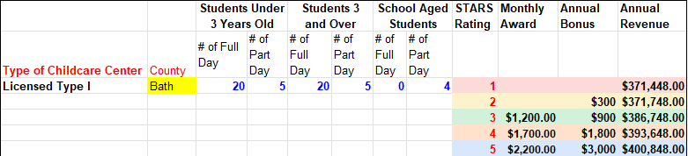
All STARS Calculator
Notes:
AK

Slide 17

Why Curriculum Matters
Enhances Child Development
Ensures Consistency
Prepares Children for School
Supports Staff Training & Development
Improves Parent Confidence
Increases Business Credibility
Encourages Engagement & Creativity
Facilitates Ongoing Assessment
Notes:
Enhances Child Development – Provides structured learning that supports cognitive, social, and emotional growth.
Ensures Consistency – Creates a standardized approach to teaching and caregiving across classrooms.
Prepares Children for School – Builds early literacy, math, and problem-solving skills essential for kindergarten readiness.
Supports Staff Training & Development – Gives educators clear guidelines and best practices for effective instruction. Saves the teachers hours per week and supports teacher success while avoiding burnout
Improves Parent Confidence – Reassures families that their children are receiving high-quality education and care.
Increases Business Credibility – Helps centers stand out and meet state licensing or accreditation standards.
Encourages Engagement & Creativity – Provides teachers with tools to create interactive and stimulating learning experiences.
Facilitates Ongoing Assessment – Helps track children's progress and adjust teaching methods as needed.

Slide 18
Case Study & Best Practices

Slide 19

The Owl's Treehouse Childcare & Learning Center
Non-Profit Childcare Center in a childcare desert
Assistance began in May 2024
Completed 12-hour QuickBooks training focused on accounting setup and resource management
Kentucky SBDC Provided equipment assistance and supported STARS curriculum implementation for startup
51-seat childcare center
Infants – school aged children
Opened in March 2025

Slide 20
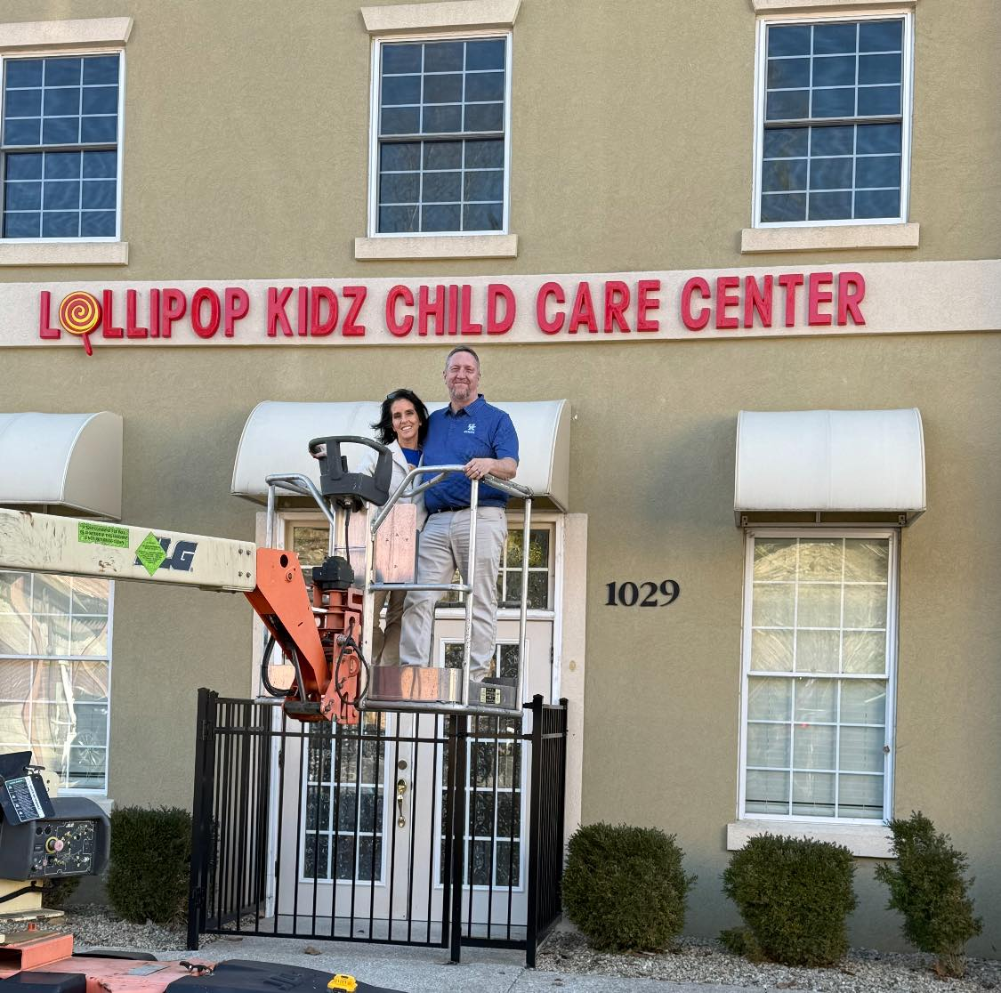
Lollipop Kidz Child Care Center
Former Kentucky SBDC client
Initial meeting for this business venture held in February 2024
Type 1 facility serving infants to 5-year-olds
Capacity 20 seats
Self-funded startup
Navigated multiple challenges to launch
Kentucky SBDC provided equipment assistance and supported STARS curriculum implementation for startup
Scheduled to opened in May 2025
Notes:
Tonya and Mike met many challenges in trying to open their center. They self-funded their center so their challenges came on the side of regulations. We assisted

Slide 21

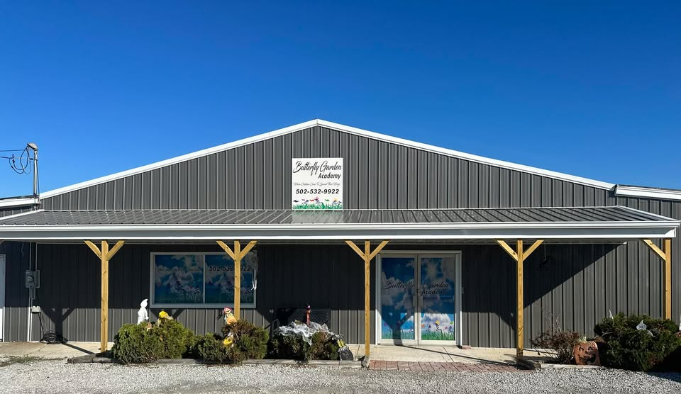
Completed 8-week Early Education Cohort in 2023
Actively participates in ongoing Kentucky SBDC childcare trainings
Opened their 6th location in December 2024
Operates six locations with a total of 465 childcare seats in Kentucky
Participated in QuickBooks training
Received equipment assistance and support for STARS curriculum implementation for all childcare centers
Notes:
Cohort began in August 2023. They have Type 1 centers located in multiple counties in Central Kentucky, that care for infant to school aged children and include childcare centers within schools that provide after school childcare. Their newest facility has increased their childcare seats from 373 to 465, with the addition of a new 92 Type 1 facility.

Slide 22
Childcare in a Box: A Turnkey Solution for Communities
Ready-Made Childcare Business Model – A fully developed plan for launching a childcare center quickly and efficiently.
Standardized Floor Plan & Building Design – Simplified construction process similar to retail chain models.
Comprehensive Business Plan – Includes financial projections, licensing guidance, and operational templates.
Scalable & Community-Focused – Designed to be easily adapted for different town sizes and demographics.
Workforce & Training Support – Provides hiring guidelines, staff training materials, and curriculum recommendations.
Addresses Childcare Deserts – Helps underserved areas establish high-quality childcare options.
Investment & Partnership Ready – A plug-and-play model that can attract funding from local governments, economic development groups, and private investors.
Notes:
AK

Slide 23
Maximizing Impact

Slide 24




Key Challenges Identified in Year One
Big Question – How do we find childcare centers in Kentucky?
01
No entity had a comprehensive document containing this information
02
There was and is no website that lists a complete list of childcare centers in Ky
03
So how do we find those already working in Kentucky
04

Slide 25

THE LIST!
Comprehensive List of Registered Childcare Centers in Kentucky
Objective: Ensure all centers are reachable and informed
Scope: Covers all 120 Kentucky counties
Key Data Collected:
Name, address, phone number
STARS rating & director’s name
Capacity & center type
Website (if available) & digital footprint notes
Building this list was a time-intensive process

Slide 26

Strategic Outreach
Our mailing list allowed us to reach every childcare center across Kentucky.
We gathered valuable feedback and expanded our network of childcare providers.
Centers had the opportunity to win a free QuickBooks license to support their business operations.
This initiative helped us establish trust and strengthen relationships with childcare centers statewide.
Notes:
We sent out around 900 of these. Mention Ryan, Amanda and the process it took to get this darn thing out! It isn’t easy people or a fast process – just say it nicer!

Slide 27
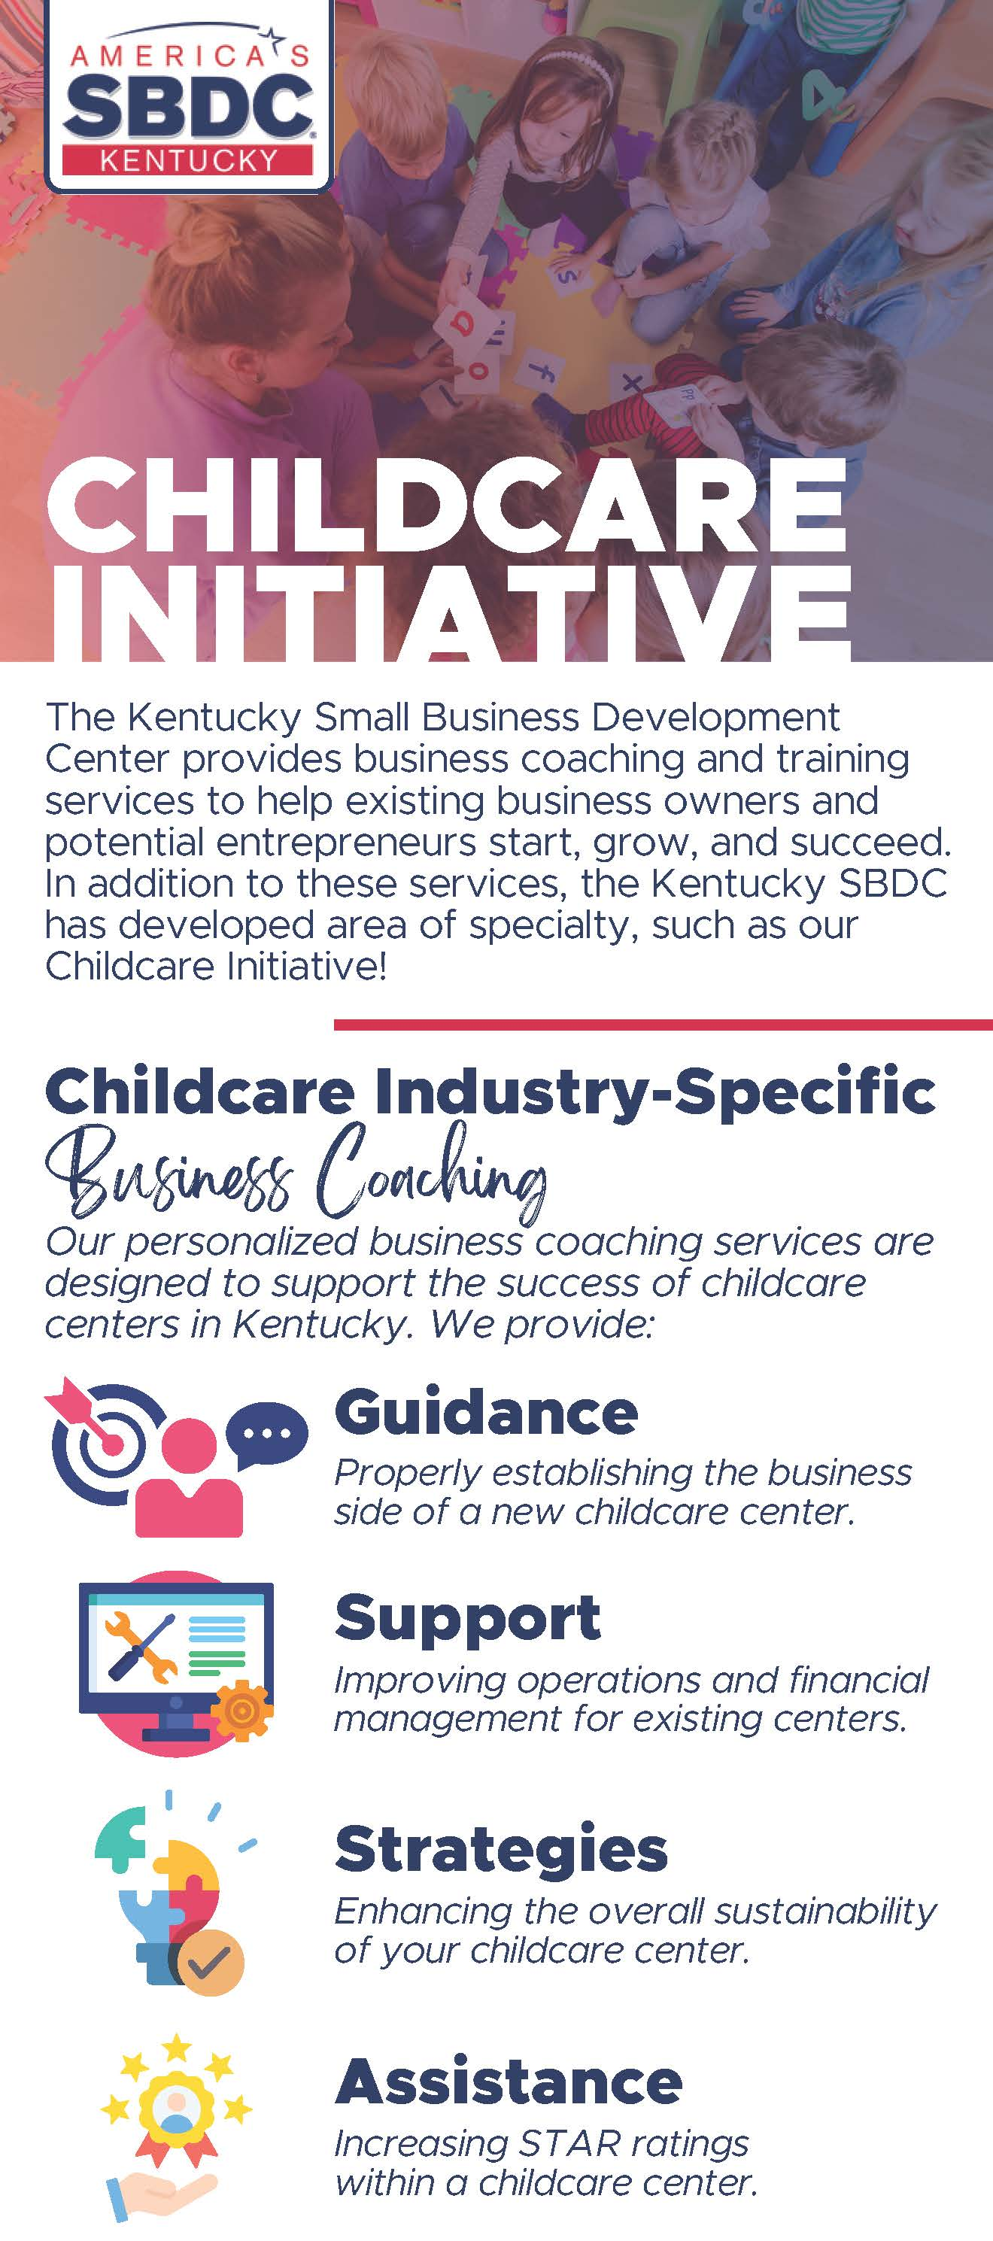
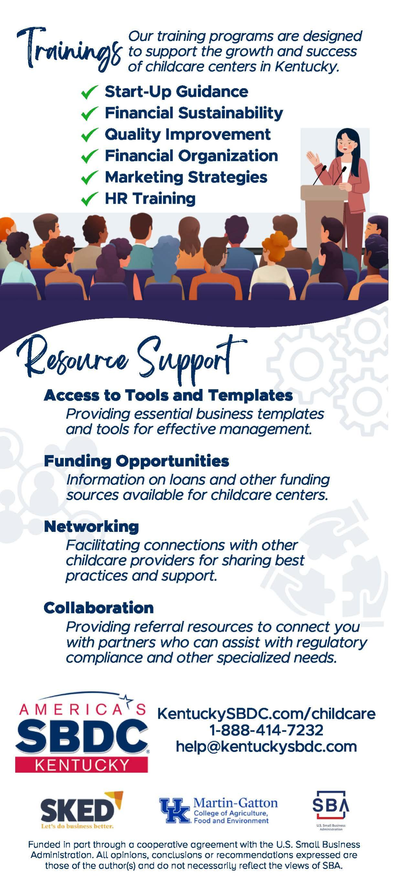

Kentucky SBDC Childcare Initiative Rack Card

Slide 28

Kentucky SBDC Childcare Initiative Impact
18 months of Impact February 2024 – June 30, 2025
Trainings Conducted - 24
Total Attendees - 211
Technical Assistance Hours -1,451
Clients Served -247
New Businesses Started -10
Jobs Created -87
Jobs Supported - 424
Capital Funding Secured - $5.1 million
Lives Impacted - 6,467

Slide 29
A Model for America's SBDCs
Nationwide
Insufficient Childcare Slots: In 2022 12.3 million seats needed, 8.7 million were available
Widespread Childcare Deserts: 51% of Americans live in a childcare desert
Workforce: Since Covid the childcare industry is down over 39,000 employees
Economic Impact: over 1 million parents have reduced work hours or missed work due to insufficient childcare.
Other Small Business Development Centers (SBDCs) across the country can model Kentucky’s approach to childcare support by adopting the following strategies:
Recognizing Childcare as Critical Economic Infrastructure
Providing Business Support for Childcare Providers
Building Statewide & Regional Partnerships
Implementing Data-Driven Strategies
Scaling Through Strategic Programming
Notes:
MS & AK
Child care is the workforce behind our future workforce and investments will ensure a bright future for our children and families. Child care is infrastructure that we must have in place to support local economies. Working parents need peace of mind that someone is taking care of their child and that their child has been happy while they are away.
Other Small Business Development Centers (SBDCs) across the country can model Kentucky’s approach to childcare support by adopting the following strategies:
1. Recognizing Childcare as Critical Economic Infrastructure
Engage business leaders & policymakers to highlight how childcare shortages impact workforce participation and economic growth.
Advocate for childcare-friendly policies, including grants, tax incentives, and loan programs for providers.
2. Providing Business Support for Childcare Providers
Offer specialized training and resources on business planning, financial management, and marketing tailored for childcare centers.
Facilitate access to funding through SBDC-led workshops on SBA loans, state grants, and private investment opportunities.
Help childcare businesses navigate licensing and compliance processes.
3. Building Statewide & Regional Partnerships
Collaborate with economic development agencies, workforce boards, and educational institutions to align childcare with workforce needs.
Partner with local governments and nonprofit organizations to develop sustainable childcare expansion programs.
4. Implementing Data-Driven Strategies
Conduct childcare supply-and-demand assessments to identify gaps and target resources effectively.
Use real-time data to advocate for investment in childcare deserts.
5. Scaling Through Strategic Programming
Develop initiatives similar to Kentucky’s Childcare Business Initiative in partnership with economic development groups like SKED.
Launch pilot programs that provide direct consulting, funding assistance, and operational support to childcare businesses.
By implementing these strategies, SBDCs nationwide can strengthen their childcare ecosystems, improve workforce participation, and support small business growth in their communities.

Slide 30
A Model for America's SBDCs
To address the childcare crisis, linking childcare access to workforce and economic development has been critical. Childcare impacts every community, influences workforce participation, attracts investments, and is more widely recognized as essential infrastructure when framed within economic growth.
To make this a success, three things are of utmost importance:
Support from State and Regional Agencies to ensure funding, policy alignment, and sustainability.
A collaborative team approach strategically spread across Kentucky to assess needs, implement solutions, and advocate effectively.
Strategic programming and partnerships, such as those with Kentucky SBDC, SKED, and other key stakeholders, to provide resources, training, and business development support for childcare providers.

Slide 31
Open Q&A Session Wrap Up

