Slide 1


Flowerverse
Chelsea Wagner, Molly Zygmunt, Kaylee Woodhull, Jason Lee, & Cameron Turak

Slide 2


Introduction
Goals:
  Make floral planning more sustainable through the use of Flowerverse to limit the use of real flowers and ultimately producing less waste.
  Introduce florists to the Flowerverse program to assist in creating floral design.
  Florist leave the event educated on Flowerverse and how it can assist them in their careers.
Two day hybrid event at The Fig House in Los Angeles, CA to launch program Flowerverse
Event Mission:
Our mission is to create an event to introduce the Flowerverse program to floral designers and educate guests on how to use the program so they can integrate it into their careers.

Slide 3

Landscape Analysis
The cut flower market is projected to reach value of $52 Billion by 2031
As of 2022, research found that 93% of adult consumers said they were curious about the metaverse
A Vancouver report found that traditional floristry produces up to 100,000 tons of plastic waste each year

Slide 4

Event Concept
To encapsulate our vision, we will be hosting a two-day floral event at the Fig House that will incorporate the Metaverse throughout the event. Through our two-day hybrid event, the attendees will be able to see how AI can benefit the floral community.
On day one, we will be providing a verbal step-by-step process on how to use the Flowerverse and then we will have to our speaker, Kristen Griffith-Vanderyacht, proceed with the rest of the walkthrough by showing the guests how the Flowerverse can create beautiful floral arrangements.
Day two will start with another brief description of the Flowerverse so that our attendees have it fresh in their minds, and after that, we will be inviting the attendees create designs of their using Flowerverse.

Slide 5


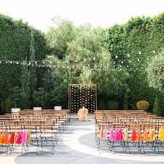
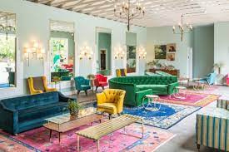
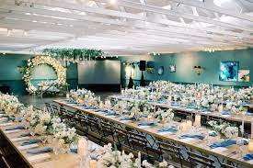

Event Project Plan
The Fig House located in Los Angeles, CA
Notes:
We are planning for the launch of flowerverse to be at the Fig House in Los Angeles, CA. The fig house has a beautiful outdoor space that matches the theme of the projected product we are presenting.
With Natural Sunlight in their grand Hall to the stunning outdoor space at The garden it's a perfect location to hold the event

Slide 6

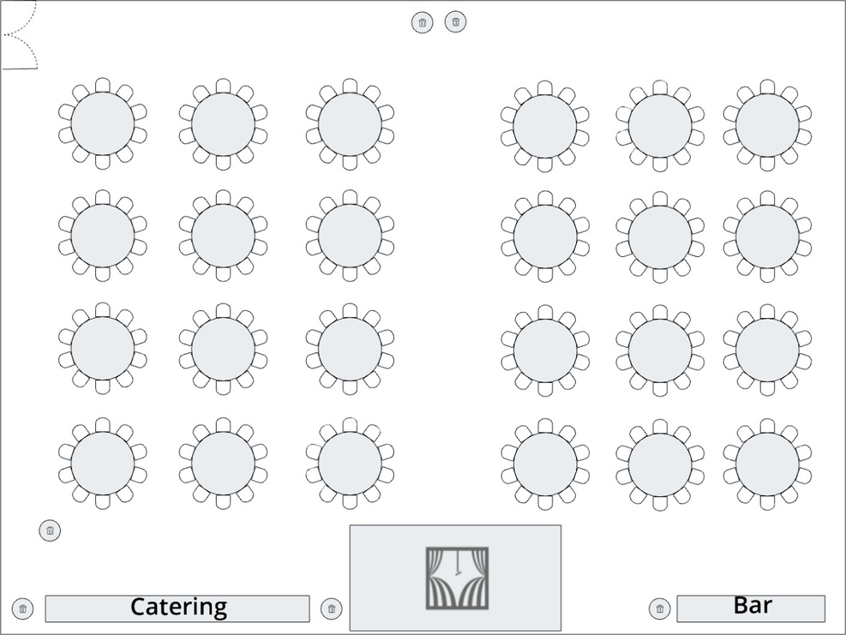
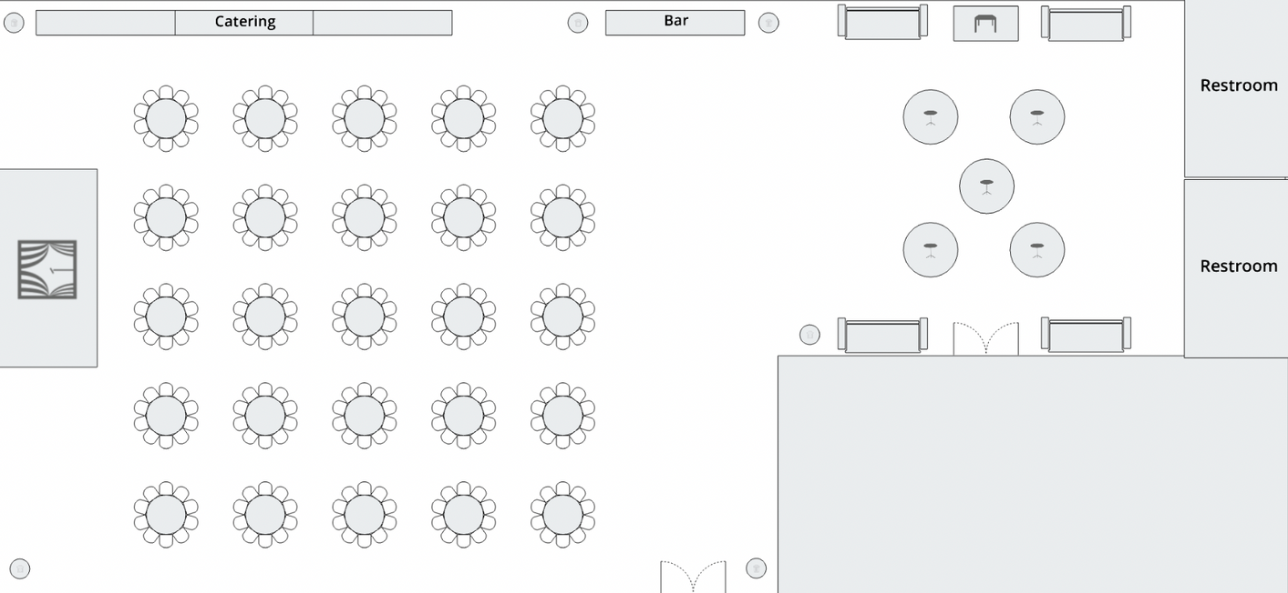
Schedule of Events
Day 2: 11am-5pm
“The Grand Hall”
Day 1: 11am-7:30pm
“The Garden”

Slide 7
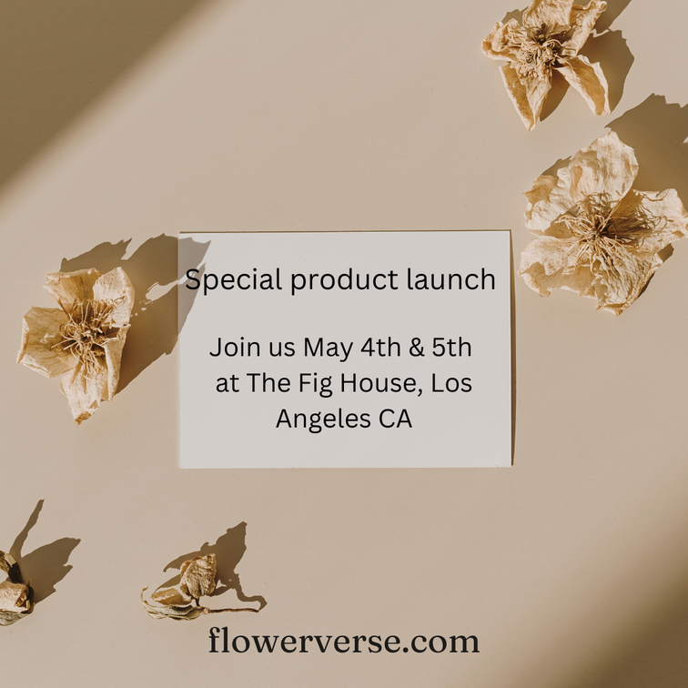

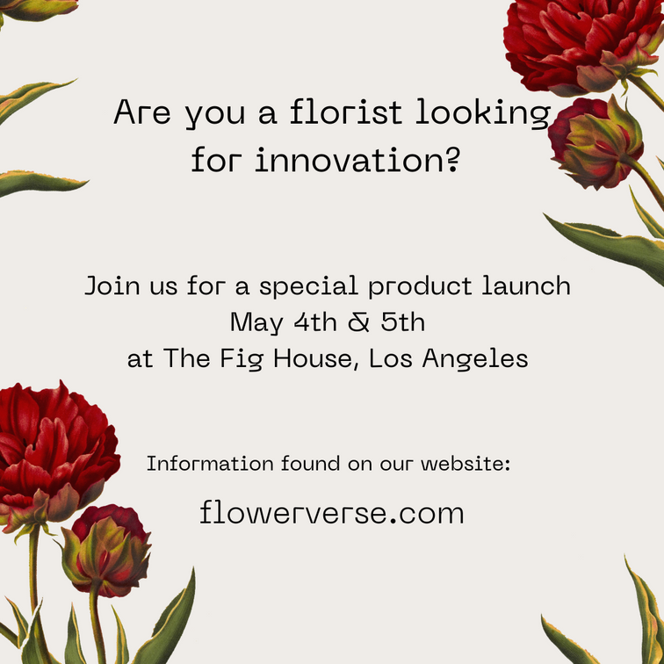
Target Market & Marketing Plan
Our target market are florists & women aged 25-60 years old .
80% of flower sales come from women.
Reach our target market on social media platforms and promotional emails.

Slide 8



Sponsorship packages
Rose
Tulip
Daffodil
$25,000
  All benefits of Daffodil and Tulip and also include the following:
  Logo Placement: Prominent logo placement on the event website, promotional materials, and banners.
  Exclusive Branding: Exclusive branding of specific event elements (e.g., registration area, networking breaks).
  Premium Speaking Opportunity: Keynote speaking slot or exclusive panel participation.
  Tickets: 15 complimentary event tickets for company representatives.
  Post-event Recognition: Additional social media and email newsletter recognition.
$10,000
  All benefits of Daffodil and also include the following:
  Logo Placement: Enhanced logo visibility on the event website and promotional materials. Exclusive Content: Option to provide branded content or information in event attendee packets.
  Speaking Opportunity: Opportunity to deliver a brief presentation or participate in a panel discussion.
  Tickets: 10 complimentary event tickets for company representatives.
  VIP Treatment: Exclusive access to the VIP lounge and designated seating area.
$5,000
  Logo Placement: Company logo displayed on event website and promotional materials.
  Social Media Exposure Mention and recognition on event's social media platforms.
  Recognition: Acknowledgment during event opening and closing remarks.
  Tickets: 5 complimentary event tickets for company representatives.
  Networking Opportunities Access to pre-event networking sessions.

Slide 9










Sponsors From
Rose
Tulip
Daffodil
Notes:
We are getting Sponsorship contributions from the following:
Rose $25,000:
Netflix
Cvent
1-800 Flowers ( donating an additional $5,000 for flower decor)
Tulip $10,000 :
Social Tables
Society of American Florist
Burpee Seeds
Daffodil $5,000:
KetelOne Vodka

Slide 10
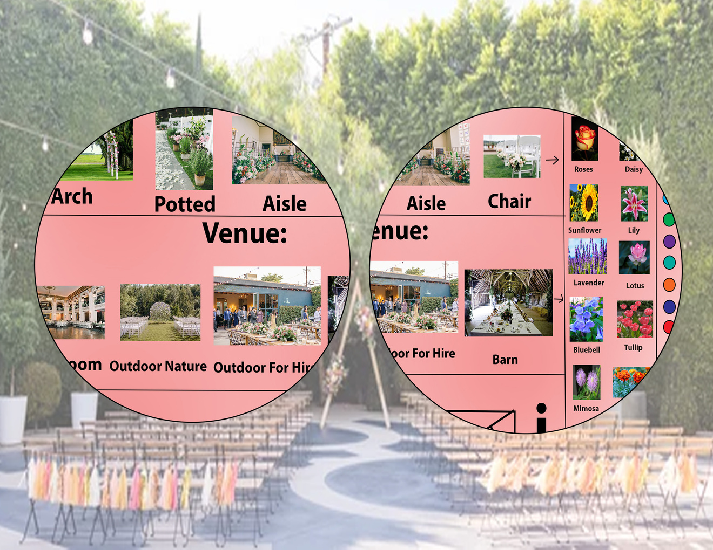
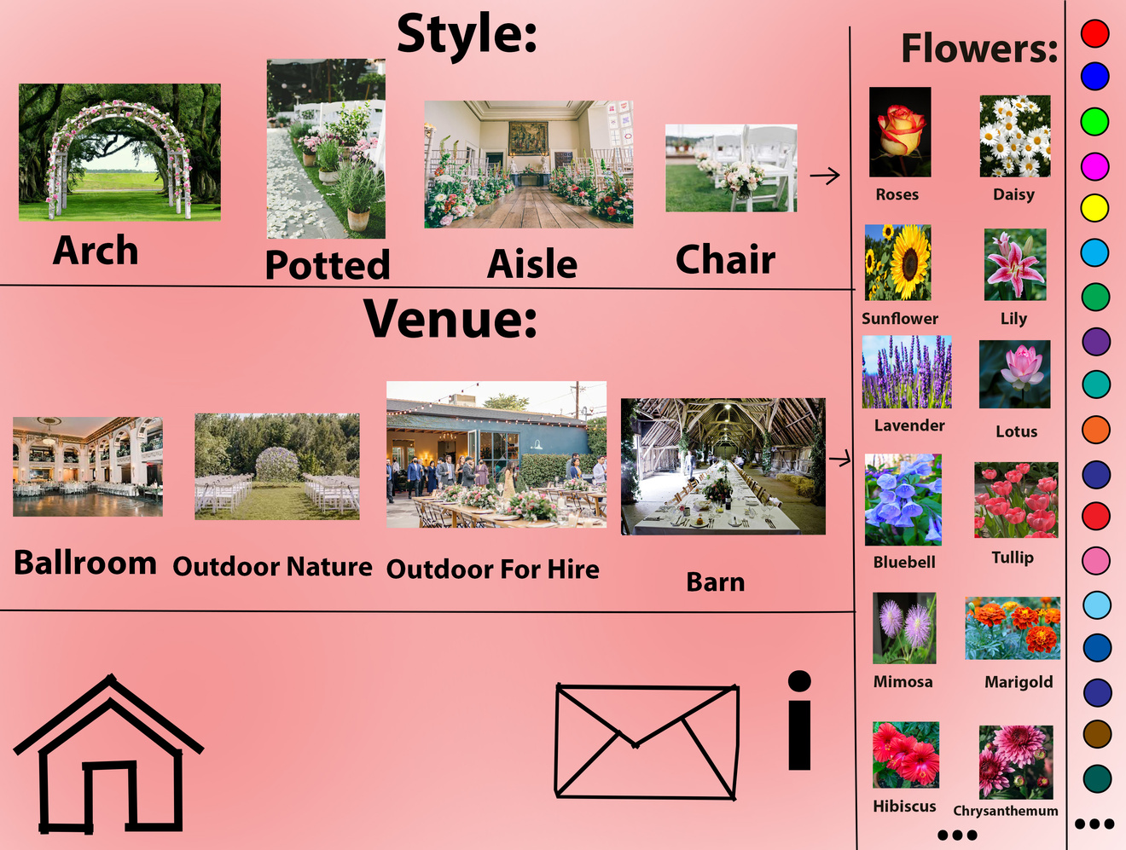
Projected VR look

Slide 11


Financial Plan
Revenues:
We will be funding the event through ticket sales and sponsorship contributions. There is an expected revenue of about $3,215,338.00.
Expenses:
We will be expecting expenses from the venue rental, guest speaker fee and accommodations, staff salaries, staff accommodations, shuttle bus rentals, catering, valet parking, advertisement costs, and a contingency expense of 5%. There is an expected expense of about $594,762.00

Slide 12

Thank you for your time!

