Slide 1
Planned Giving: What to Keep in Mind
Johanna J. Allex, Esq.
Stafford Rosenbaum LLP
222 W. Washington Ave., Suite 900
Madison, WI 53701
608-259-2664

Slide 2
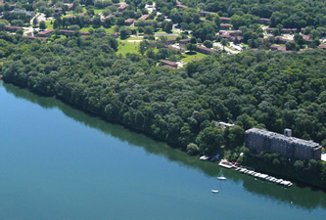
Planned Giving: What to Keep in Mind
Wally Bauman Woods: University of Wisconsin-Madison
Lakeshore Nature Preserve

Slide 3
Planned Giving: What to Keep in Mind
For Today…
What is a planned gift.
Tips on preparing your organization to start a planned giving program.
Common planned giving tools.
Wrap up/Questions.

Slide 4
Planned Giving: What to Keep in Mind
1. What is a planned gift?
Major to the donor; and
Part of the donor’s financial or estate plan.
2. Why is a planned gift different from other gifts?
Requires more planning, counsel, negotiation;
Typically larger in size or impact; and
Different focus: “vision gifting”.

Slide 5
Planned Giving: What to Keep in Mind
1. What must you know about planned gifts?
Made during lifetime and/or death.
Three giving options: current outright gifts, expectancies, and deferred gifts.
2. What assets might be used to make a planned gift?
Cash, appreciated securities, business interests, life insurance, personal property, real estate, and retirement plans.

Slide 6
Planned Giving: What to Keep in Mind
Some Tips to Starting a Planned Giving Program
Institutional Readiness:
Clarify your mission/vision;
Be financially accountable;
Be sure to have board support; and
Plan out your communication strategy.

Slide 7
Planned Giving: What to Keep in Mind
Some Tips to Starting a Planned Giving Program
Policies and Guidelines:
Adopt a Gift Acceptance Policy;
Determine the scope of your planned giving options.
Prior approval by your board should be considered.
Adopt an Investment Policy.

Slide 8
Planned Giving: What to Keep in Mind
Current Gifts: Tools
Cash – King!
Gift of Appreciated Stock (publicly traded or privately held)
Gift of Real Estate

Slide 9
Planned Giving: What to Keep in Mind
Current Gifts: Tools (cont.)
Donor-Advised Fund
Donor makes a gift to a specific purpose fund held and administered by a charity.
Charity makes grants to recipients to satisfy the fund’s purpose.
Donor may make recommendations (or may designate who may make recommendations) to the charity.

Slide 10
Planned Giving: What to Keep in Mind
Current Gifts: Tools (cont.)
IRA Qualified Charitable Distribution (“QCD”)
Donor can make a rollover gift to a charity of up to $100,000 if the donor is over 70.5 years of age.
The Donor can exclude the QCD from their taxable income for the year of the gift.

Slide 11
Planned Giving: What to Keep in Mind
Expectancies: Tools
Bequests – Will or Revocable Trust Agreement
1. Specific:
I give Fifteen Thousand Dollars ($15,000) to the Peach Valley Public Library Foundation, Inc.,….to purchase books and chairs for the Children’s Reading Nook.
2. Residual:
Ten percent (10%) of the Net Trust Estate shall be distributed to the Peach Valley Public Library Foundation, Inc,…to purchase books and chairs for the Children’s Reading Nook.

Slide 12
Planned Giving: What to Keep in Mind
Expectancies: Tools (cont.)
3. Retirement Plans
Donor can name a charity as a beneficiary of a retirement account.
Donor does not have to part with the retirement account while they are alive.
4. Life Insurance
Donor can gift an existing policy or a new policy to a charity while the donor is alive.
Donor can name a charity as the beneficiary of a policy.

Slide 13
Planned Giving: What to Keep in Mind
Deferred Gifts: Charitable Gift Annuity
Contract between a donor and a charity – in return for contributed property, the charity agrees to pay a fixed amount of money each year for the lifetime of one or two people.
Annual payment is dependent upon number of people covered and their life expectancies.
State regulated.

Slide 14
Planned Giving: What to Keep in Mind
Ten Planned Giving Tips
1. Do your own estate planning first.
2. Get your organization ready and ask for help if needed.
3. Update your website and be present on social media.
4. “Prepare the flower bed” by creating a planned giving community.
5. Listen carefully to the goals, passions, fears, of the potential donor that you are speaking with.

Slide 15
Planned Giving: What to Keep in Mind
Ten Planned Giving Tips
6. Consider baby steps – beneficiary designations, Will bequest.
7. Be sensitive to timing.
8. Explain the process and options in understandable terms and know when to ask for help from the experts.
9. Include other family members in planned giving meetings, if possible.
10. Paint a picture of the ultimate result and tie it to your organization’s vision.

Slide 16
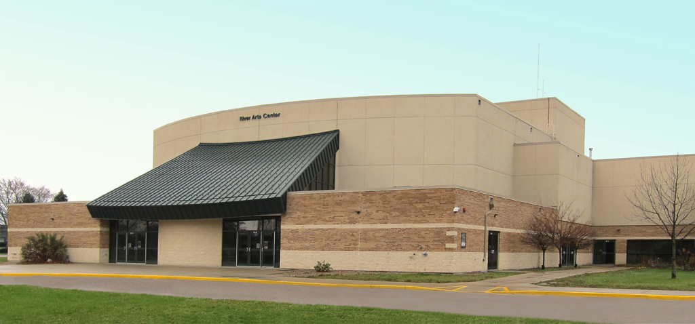
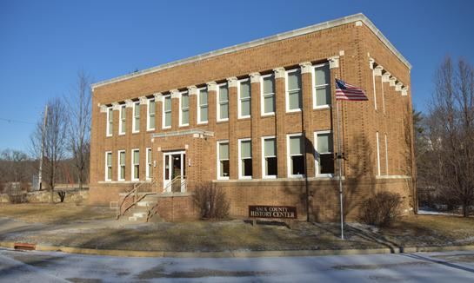
Planned Giving: What to Keep in Mind
River Arts Center /River Arts Center Gallery – Prairie du Sac, Wisconsin

Slide 17
Planned Giving: What to Keep in Mind
Sauk County Historical Society History Center – Pillars of Progress – Baraboo, Wisconsin

Slide 18
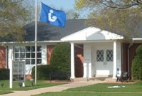
Planned Giving: What to Keep in Mind
Sauk City Public Library – Sauk City, Wisconsin

Slide 19
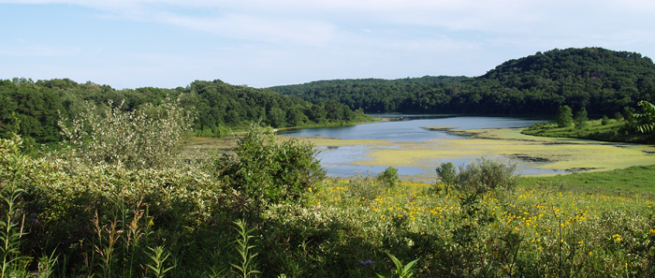
Planned Giving: What to Keep in Mind
Governor Dodge State Park
Dodgeville, Wisconsin

Slide 20
Planned Giving: What to Keep in Mind
University of Wisconsin Paul P. Carbone Comprehensive Cancer Center, University of Wisconsin-Madison

Slide 21
Planned Giving: What to Keep in Mind
University of Wisconsin –
Baraboo/Sauk County

Slide 22
Questions?
Thank you!
Johanna J. Allex, Esq.
Stafford Rosenbaum LLP
222 W. Washington Ave., Suite 900
Madison, WI 53701
608-259-2664

