Slide 1

✅ Empowering journalists.
✅ Protecting credibility.
✅ Scaling efficiency.
“From News to Newscast — at Lightning Speed.”
www.AutoNewsProducer.com
© 2025 | AutoProducer AI, LLC

Slide 2

The Problem
• Shrinking budgets & staff
• Producer shortage due to burnout
• Newscast quality & ratings suffer
• Erosion of public trust
www.AutoNewsProducer.com
© 2025 | AutoProducer AI, LLC

Slide 3

The Solution
• AutoNewsProducer → AI
newsroom automation
• Continuous scan of sources
• Instant rundowns & scripts →
producer refines/approves
• 50% less workload, less stress,
better storytelling
www.AutoNewsProducer.com
© 2025 | AutoProducer AI, LLC

Slide 4
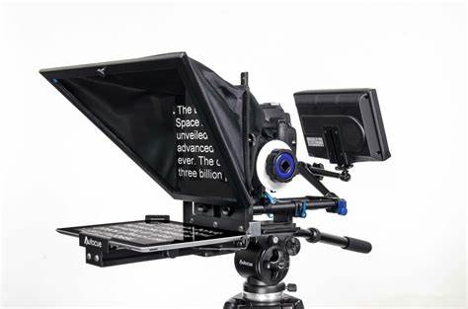
Key Features
• Auto Rundowns & Scripts →
hours to seconds
• Auto GFXs & online content
• NewsVerify.AI → protects credibility
• Ethics, standards & style controls
• Integrates ratings & research goals
www.AutoNewsProducer.com
© 2025 | AutoProducer AI, LLC

Slide 5

Market Opportunity
• Global AI in media forecast:
$100B by 2030
• 1,500+ U.S. TV stations →
thousands of shows daily
• Budget cuts & staffing shortages
• Expansion potential
www.AutoNewsProducer.com
© 2025 | AutoProducer AI, LLC

Slide 6
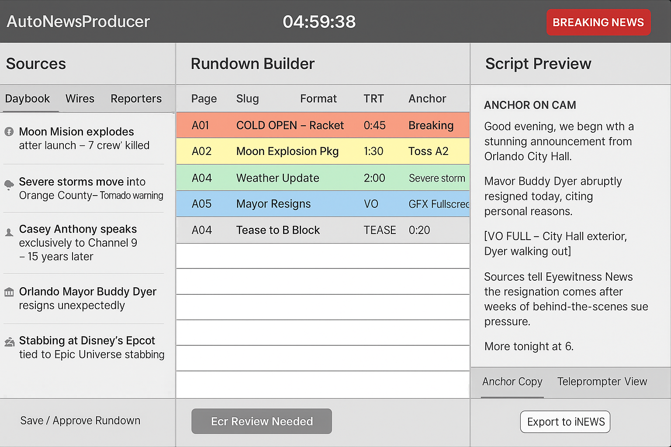
Modern Familiar Look ~ Voice Interactive Control
www.AutoNewsProducer.com
© 2025 | AutoProducer AI, LLC

Slide 7

Competitive Advantage
• Newsroom insider → 15 years
producing, Murrow winner
• Familiar UI → iNews/ENPS look
• News-specific AI → built for
journalism, not generic tools.
• Journalists stay in control
www.AutoNewsProducer.com
© 2025 | AutoProducer AI, LLC

Slide 8
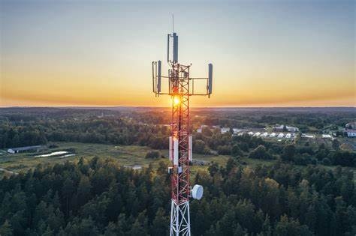
Business Model
• SaaS Subscription → by market size
• Direct Partnerships →
broadcast groups newsroom
system integrations
• Future Revenue Streams:
• White-label licensing to vendors
• Add-ons: analysis & ratings
www.AutoNewsProducer.com
© 2025 | AutoProducer AI, LLC

Slide 9

Vision
• AutoNewsProducer =
industry standard
• Expansion: TV → radio →
digital → global media
• Long-term: trusted AI partner
that empowers journalists
www.AutoNewsProducer.com
© 2025 | AutoProducer AI, LLC

Slide 10
Legacy Systems (ENPS, iNews)
✅ Trusted, widely used in newsrooms
❌ Slow to innovate, AI add-ons are clunky
❌ Expensive licensing, heavy IT requirements
❌ Corporate IT focus, not producer workflow
AI Startups & Tools
✅ Some niche solutions (transcription, clipping, gfxs)
❌ Single-task, don’t cover full rundown workflow
❌ Often don’t integrate well into newsroom systems
❌ Few founders with real newsroom experience
AutoNewsProducer
✅ integrated design (rundown + scripts + assets in one)
✅⚡ Speed: rundowns & draft scripts in seconds
✅ 🔎 Built-in credibility / fact-check assist
✅ 🛠 Familiar UI → minimal training needed
✅💡 By a Murrow-winning producer who lived the paiim

Slide 11

Team
• Founder: 15+ years producing
• Edward R. Murrow Award
• #1 rated shows in multiple cities
• Knows producer burnout &
workflow
• Not built by a tech co. guessing
• Advisors: (broadcast + tech + AI)
www.AutoNewsProducer.com
© 2025 | AutoProducer AI, LLC
www.AutoNewsProducer.com
© 2025 | AutoProducer AI, LLC

Slide 12

The Ask
• Seeking funding or partnership to:
• Build working prototype
• Launch beta test with broadcast group
• Scale across multiple markets
• Join us in shaping the future of
AI-powered journalism
www.AutoNewsProducer.com
© 2025 | AutoProducer AI, LLC
www.AutoNewsProducer.com
© 2025 | AutoProducer AI, LLC

Slide 13
Valuation Roadmap
Valuation Roadmap: Phase 1 – Seed / Pilot Stage (Now)
• Raise: $150K – $250K
• Use of Funds: Build MVP, run pilot at WFTV
• Valuation: ~$1M – $3M pre-money
(typical for most software/media startups)
“A pilot to prove the concept, reduce newsroom headcount, and demonstrate measurable cost savings.”
www.AutoNewsProducer.com
© 2025 | AutoProducer AI, LLC
www.AutoNewsProducer.com
© 2025 | AutoProducer AI, LLC

Slide 14
Valuation Roadmap: Phase 2 – Post-Pilot / Early Traction (12–18 months)
Trigger: Successful proof-of-concept with measurable ROI (e.g.,
eliminating 3–5 producer roles saves ~$500K+ annually per station)
• Raise: $2M – $5M growth round
• Valuation: ~ $10M – $20M pre-money
“Validated technology with real-world newsroom adoption. Clear financial benefit at a single station, ready to scale.”
www.AutoNewsProducer.com
© 2025 | AutoProducer AI, LLC
www.AutoNewsProducer.com
© 2025 | AutoProducer AI, LLC

Slide 15
Valuation Roadmap: Phase 3 – Scale / Market Expansion (3–5 years)
• Trigger: Product scaled across multiple station groups
• Financial Impact: $15M – $30M in annual savings for one group alone.
• Valuation Potential: $100M – $300M+ (based on SaaS-style multiples of
annual savings / recurring revenue).
Category-defining automation platform that reshapes how local TV news is produced. Expanding from broadcast into digital/video publishing.
www.AutoNewsProducer.com
© 2025 | AutoProducer AI, LLC
www.AutoNewsProducer.com
© 2025 | AutoProducer AI, LLC

Slide 16
Video Pitch Deck & More Information
www.AutoNewsProducer.com
AutoNewsProducer.com
© 2025 AutoNewsProducer LLC

