Slide 1
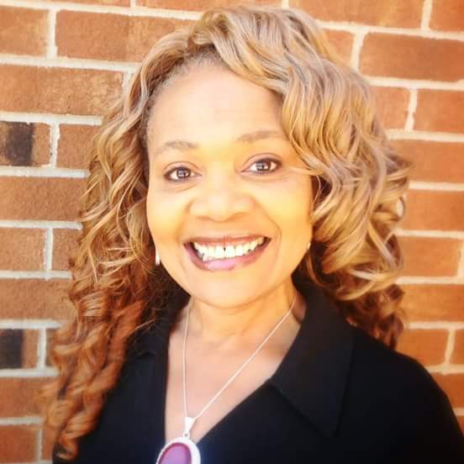
2024 Frankye L. Herald Memorial Scholarship

Slide 2
Our FIRST Recipient!!
Ms. Briahna Galvin
Junior at Loyola Chicago University
Major: Cellular and Molecular Neuroscience (Pre-Med)
“My mom works hard back home, working to support both my little sister and I, but it remains to be hard financially. I hope to return what she has given me; not only financial help, but endless love and support, even when she was fighting her own battles. I truly hope you are able to join me on my journey to receive the education required to give back and help those
in need.”

