Slide 1
Biochar Now
OMRI certified
USDA Bio-preferred
TSCA Listed

Slide 2
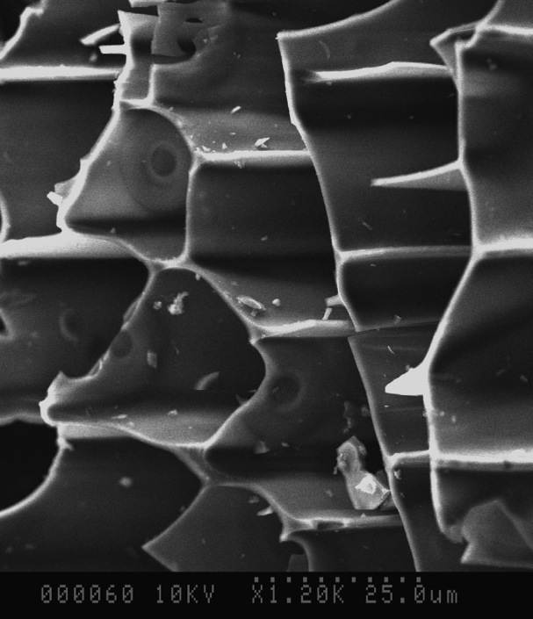
Electron Microscope Image
Cation Exchange Property allows nutrient and water molecules to lightly bind to the empty walls until the plant root takes up the molecules.
Biochar Now at 1200X

Slide 3
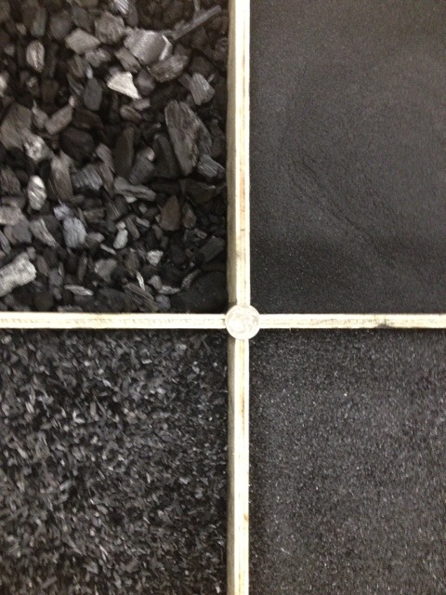
4 Sizes Available – Each targeted for differing applications
medium
Chip
small
powder

Slide 4
Proven Product
Ag Nutrients Removed from Dirty Water Solutions Using Biochar Now biochar Independent Test Results
Nutrients |  | Starting mg/L | % Adsorbed
Phosphorus | non-soluble P | 27 | 99.9%
Phosphorus | P | 27 | 99.8%
Phosphate | PO4-P | 284 | 86.6%
Ammonia | N | 1.1 | 89.7%
Nitrate | NO3-N | 52 | 64.3%
Solids Removed from a Dirty Water Solutions Using Biochar Now biochar Independent Test Results
Solids |  | Starting mg/L | % Removed
Turbidity | NTU* | 68 NTU | 99.9%
Phosphorus | Non-soluble P | 27 | 99.9%
Solids | SS | 506 | 80.2%
Water holding capacity = 5.6 x the weight of biochar

Slide 5

Water Conservation
  California golf course tested 1 acre with Biochar Now biochar
  Main course needed 3 waterings per week
  Biochar Now biochar acre needed 1 watering per week
  Water savings: 67%!

Slide 6
Biochar Water Retention
Plants withstand longer drought conditions

Slide 7
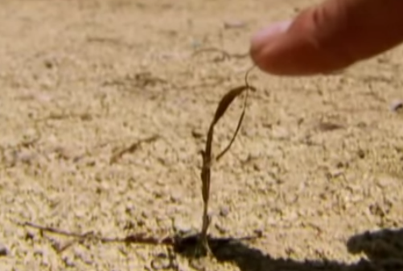
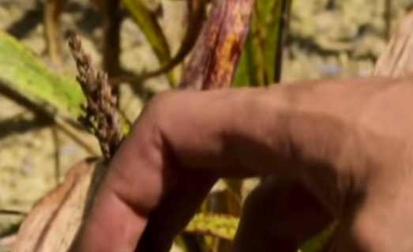
Cornell Experiment
Control Plot | Fertilized Plot
Cornell has used Biochar Now biochar in many different experiments over the years –
the current experiments focus on our use as a carbon negative concrete additive.

Slide 8
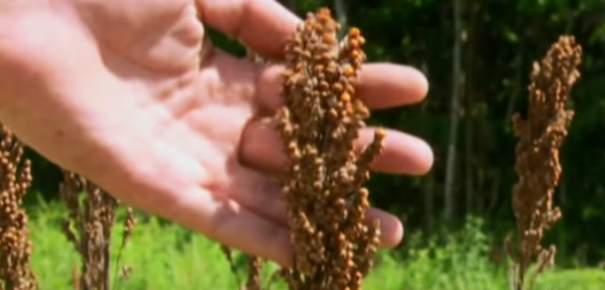
Cornell Experiment
10% Biochar by Volume in Root Zone with Fertilizer
880% yield improvement over fertilized plot
Native soil, same NPK fertilizer, biochar added

Slide 9
Biochar Nutrient Retention Efficiency
(after 20 Complete Rinses)
Ammonia 77%
Nitrate 77%
Phosphorus 81%
Potassium 5%
Sulfate 81%
Tests performed to simulated multi-inch rain with each rinse. Average of 1% of most nutrients leached with each rinse. Compare to commercial fertilizer retention, which will largely rinse from soil after a couple of rinses. Biochar is a long term nutrient release mechanism.

Slide 10
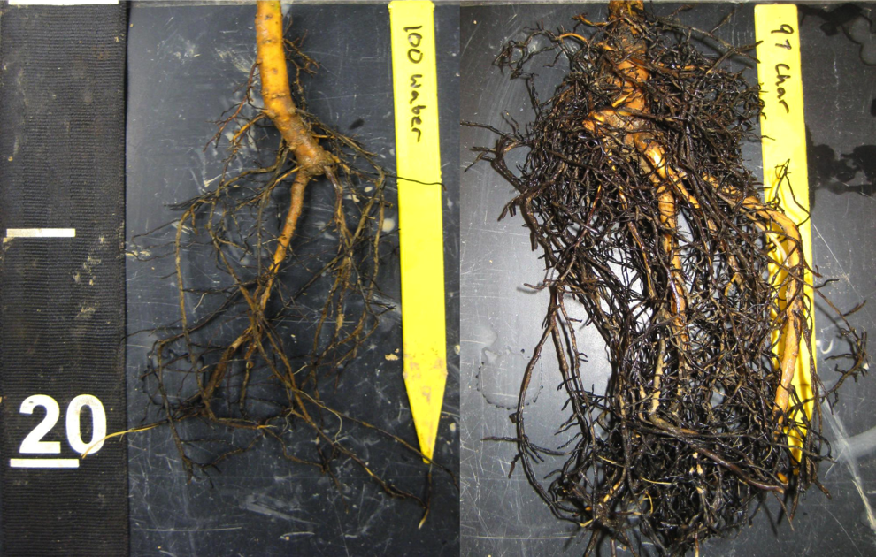
Biochar Increases Tree Root Growth
Root growth of honey locust seedlings growing in compacted soil after 18 months of no treatment (left) and an application of biochar top-dressing (right). Photo: Morton Arboretum Soil Science Laboratory

Slide 11
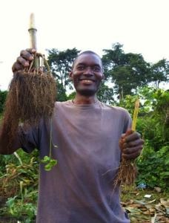
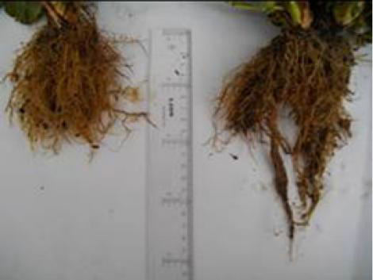
Biochar Increases Smaller Plant Root Growth
Strawberries
Corn

Slide 12
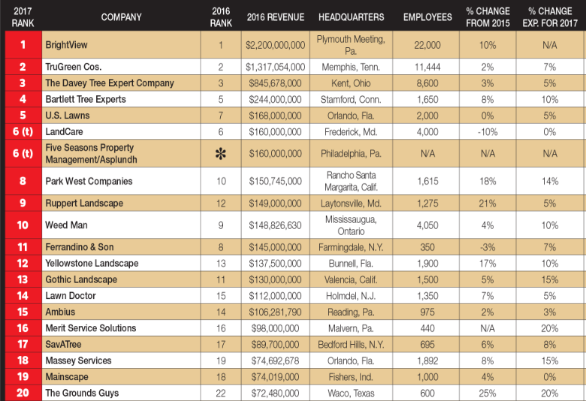
Lawn & Landscape
Top 20 service companies (2016)
2 of top 4 providers have approved our biochar for national rollout
Top 100 provider
market size is $8B

Slide 13
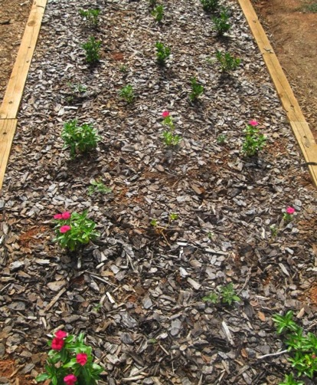
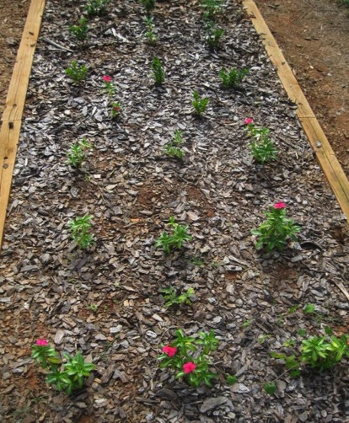
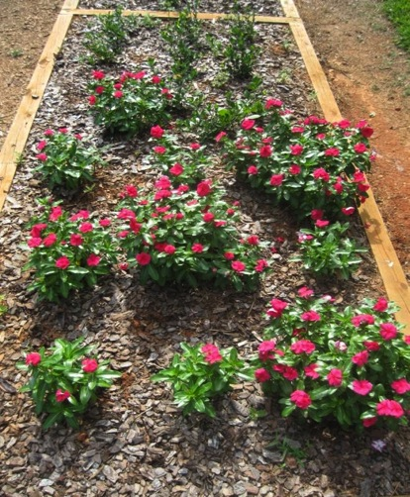
Disease Combative Potential
Vinca and Gardenia inoculated with Phytophthora
Control Compost Biochar

Slide 14
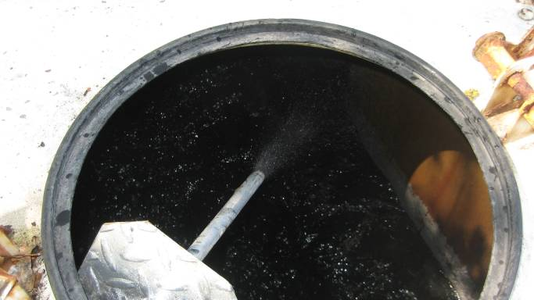
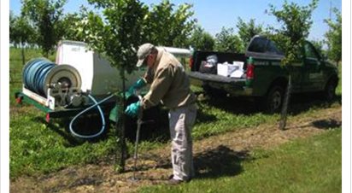
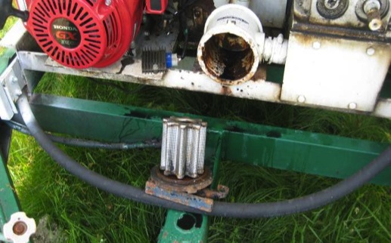
Powder Application
The powder Biochar mixed and suspended within one minute. The product went through the filter when transferred to the back tank. It was then mixed with liquid fertilizer and transferred back to the front tank. Then the material was pumped back through the system and injected into the ground.

Slide 15
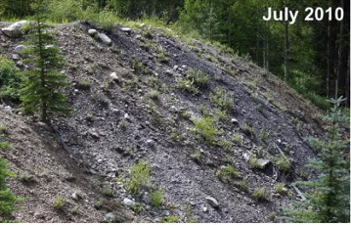

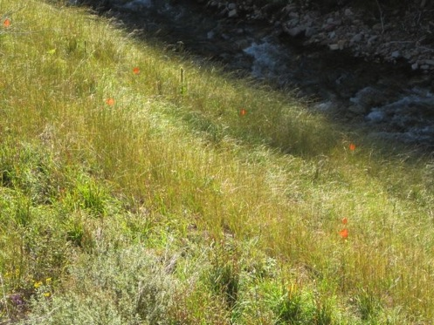
Biochar Retains Toxins and Helps Restore Sterile Soils
September 2012

Slide 16
Proven Product
Metals and Other Materials Removed from a Dirty Water Solutions Using Biochar Now biochar Independent Test Results
Metals |  | Starting mg/L | % Removed
Aluminum | Al | 638 | 100%
Arsenic | As | 203 | 100%
Barium | Ba | 0.17 | 66.0%
Beryllium | Be | 0.16 | 99.0%
Cadmium | Cd | 0.015 | 100%
Chromium | Cr | 166 | 100%
Cobalt | Co | 219 | 100%
Copper | Cu | 1.0 | 99.7%
Iron | Fe | 66 | 99.6%
Lead | Pb | 45 | 100%
Lithium | Li | 0.17 | 39.0%
Magnesium | Mg | 3 | 69.2%
Molybdenum | Mo | 96 | 100%
Nickel | Ni | 211 | 100%
Selenium | Se | 215 | 100%
Tin | Sn | 0.17 | 100%
Vanadium | V | 0.15 | 75.0%
Zinc | Zn | 75 | 99.7%

Slide 17
END

