Slide 1
Abnormal grain growth in polycrystalline Ni-base superalloys –
an industry perspective
M. G. Fahrmann, D.A. Metzler, T. R. Mann, and A. H. Hernandez
Haynes International, Inc.
Research & Technology Dept.
Kokomo, IN, USA
Rex&GG 2026, Hamilton, Ontario
1

Slide 2
Processing of polycrystalline Ni-base superalloys, cast & wrought and P/M,
industry essentially encounters three types of AGG
Annealing of lightly worked
(ε ~ 5-10 %) areas of
certain components
Example:
formed sheet metal combustor
cans in gas turbines - typically
single-phase solid-solution
alloys like X, 617, 230…
Super-solvus annealing
of TMP components
Example:
forged P/M RR 1000
gas turbine disks –
annealed slightly above
gamma-prime solvus
Sub-solvus annealing
of TMP components
Examples:
“Gatorized” MERL76 -
primary gamma-prime
“Minigrain” 718 -
delta
2

Slide 3
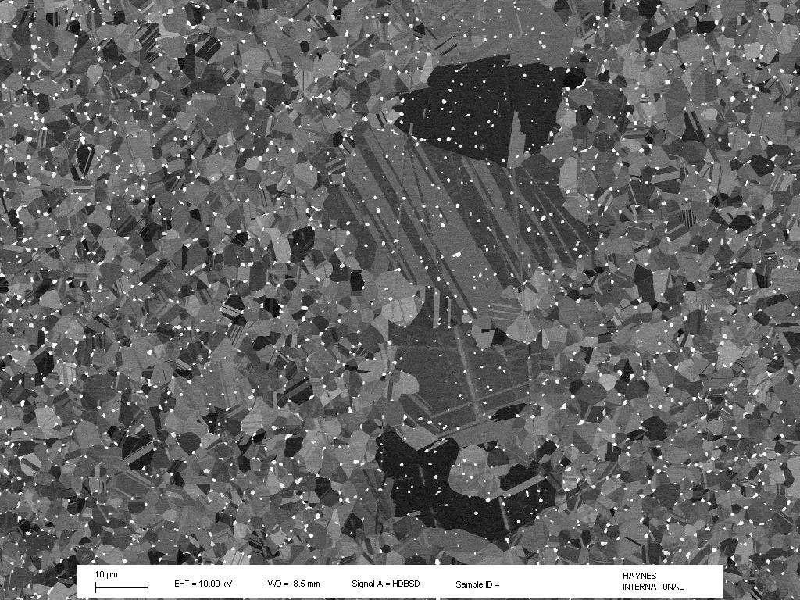
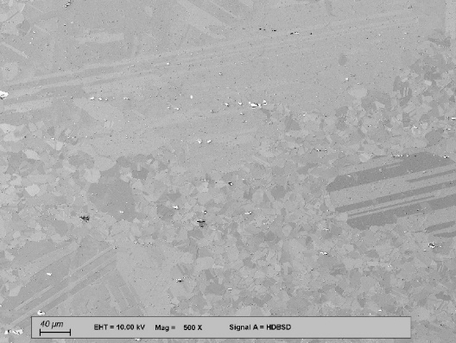
Examples of AGG encountered in various Haynes alloys
HAYNES 244 alloy hot-rolled bar
GB-pinning precipitates=mu phase
matrix grain size ASTM ~ 10
HAYNES 233 alloy hot-rolled plate
GB-pinning ppts=secondary carbides
matrix grain size ASTM ~10
Common footprint: abnormally large (~10x matrix grain size), heavily twinned grains
with precipitates delineating the original matrix GBs
3

Slide 4
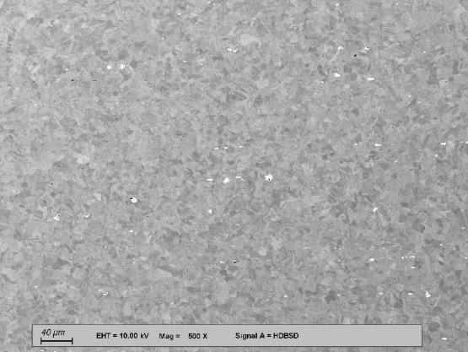
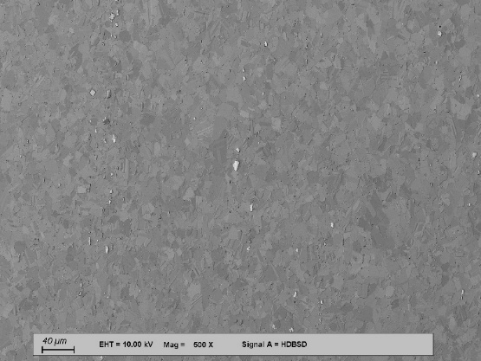
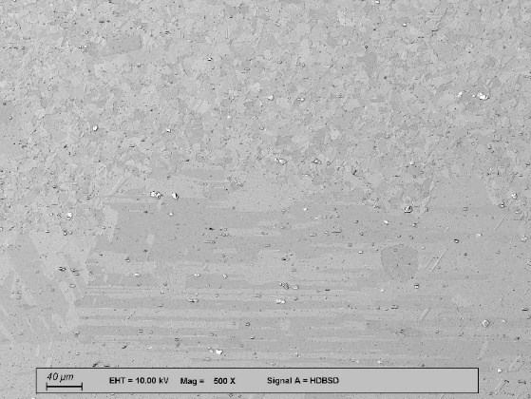
Another important commonality – AGG incubation time
Sub-solvus annealed 233 alloy hot-rolled plate (as-rolled DRX GS ASTM 10)
1093ºC/15 min - GS 8, no AGG 1093ºC/30 min - GS 8, no AGG 1093ºC/60 min – massive AGG
Incubation time: - temperature-dependent => thermally activated process
- dependent on prior TMP
4

Slide 5
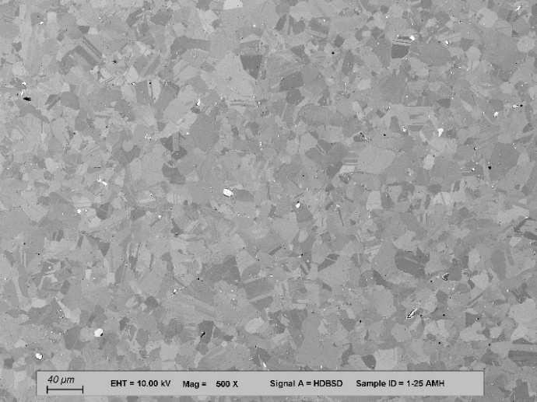
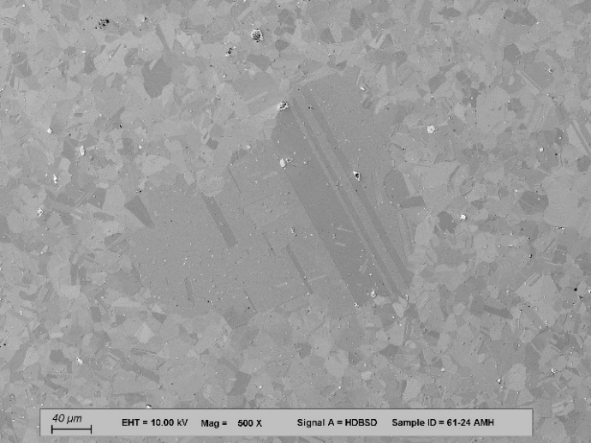
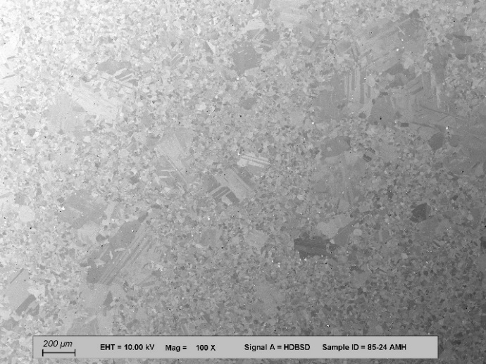
Commonality – AGG incubation time
Sub-solvus annealed 233 alloy 18 mm dia. cold-worked bar
1107ºC/15 min - GS 8, no AGG
1107ºC/30 min – GS 8, commencing AGG
1107ºC/80 min – AGG spreading
Like in hot-rolled plate, incubation found to be thermally activated!
5

Slide 6
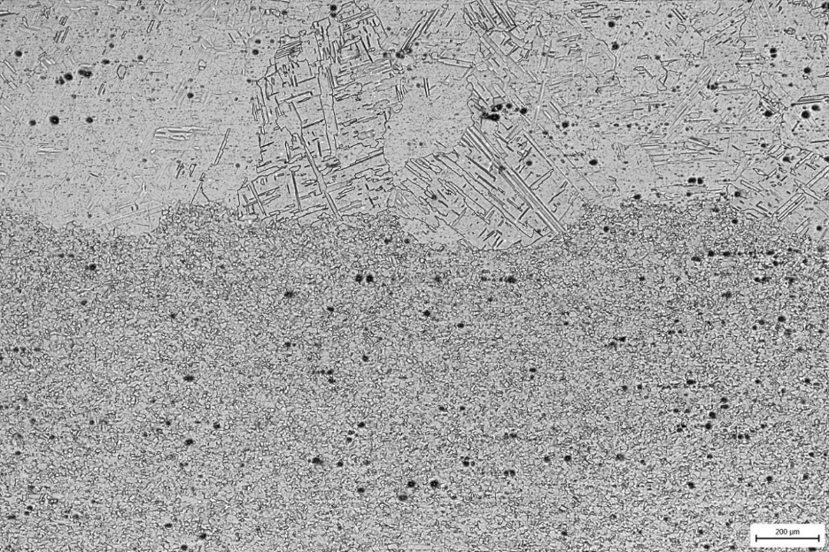
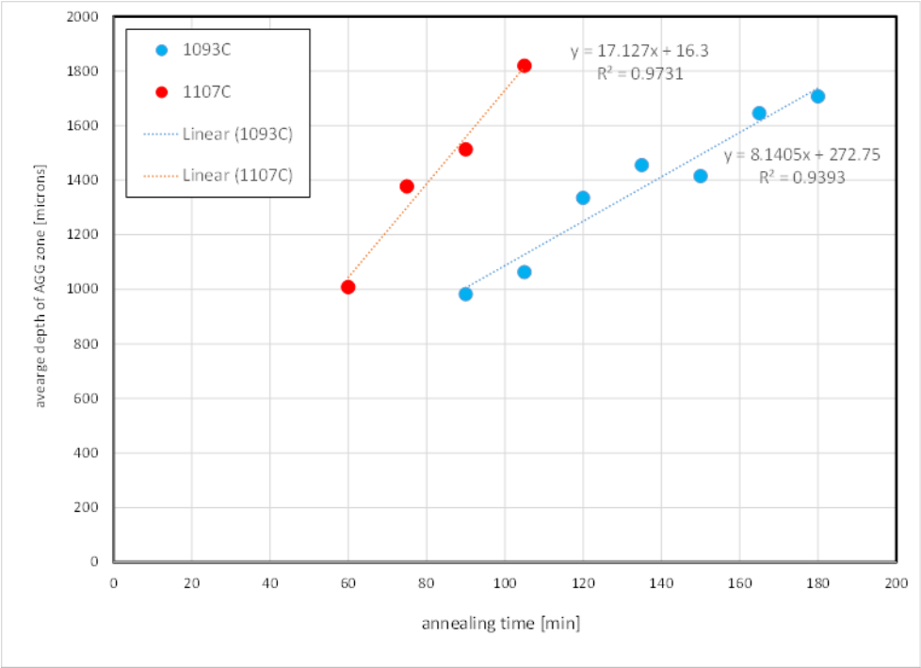
AGG progression past the incubation time
233 alloy hot-rolled plate – unique case
almost straight AGG fronts growing
uniformly inward from both surfaces
AGG progression: - speed is temperature-dependent => thermally activated
- speed apparently only weakly orientation-dependent – straight front
- comparable speeds in sub-solvus annealed plate and bar
6

Slide 7
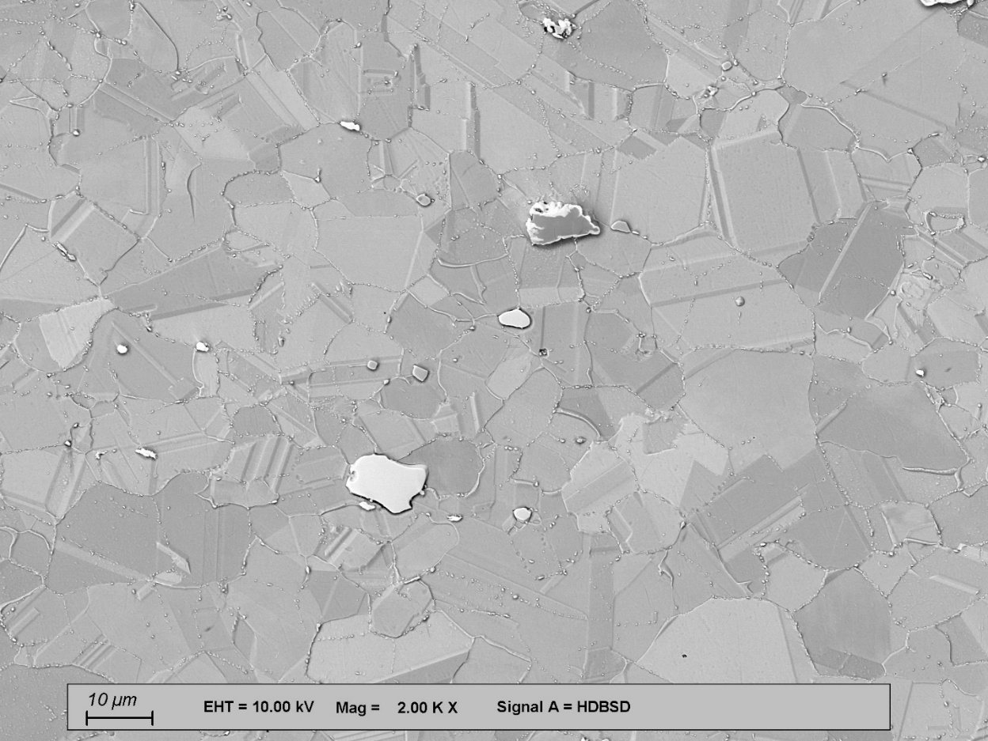
Microstructure evolution during the incubation time
Typical 233 alloy microstructure – both product forms - before commencement of AGG
Concurrence of precipitation and SRX – many GBs pinned but several broke away from ppts –
then grain structure remains static until first abnormally large grains nucleated
7

Slide 8
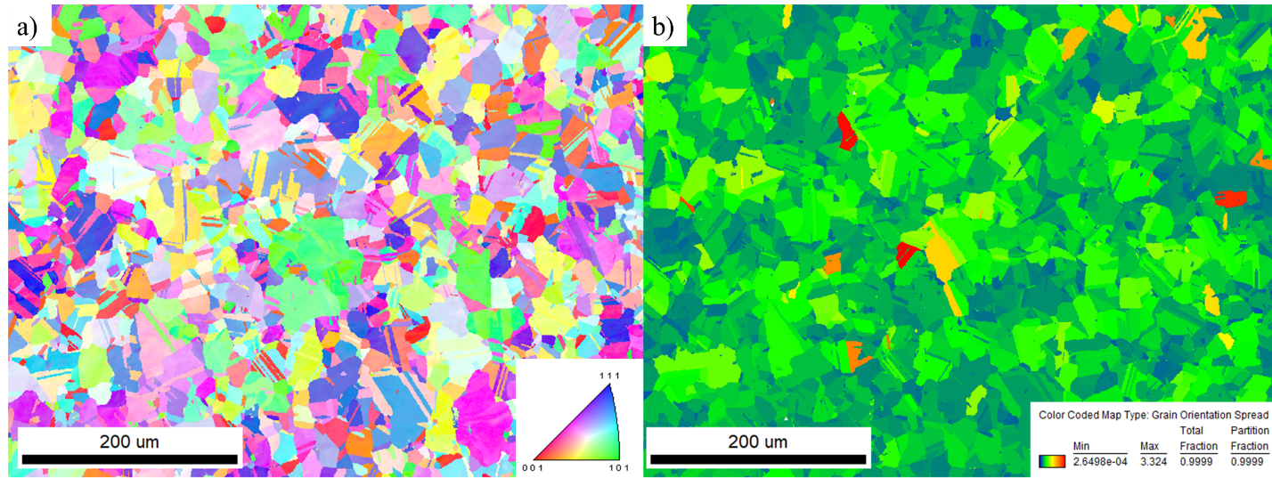
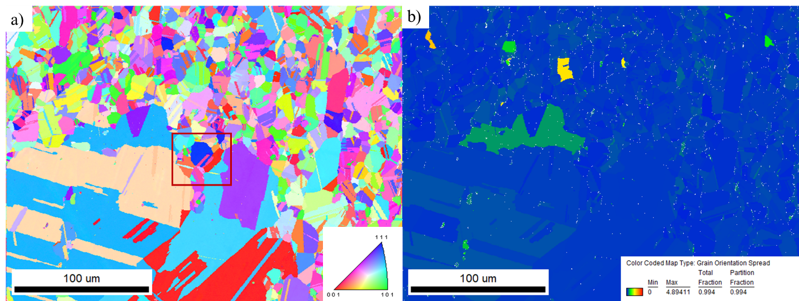
What controls the nucleation of abnormally large grains?
1093ºC/15 min
no AGG
max GOS ~ 3º
1093ºC/90 min
massive AGG
max GOS ~ 4º
EBSD maps: - significant reduction in stored energy early in incubation period
(max GOS of ~ 14 degrees as-hot-rolled!) – then very little change
8

Slide 9
Additional thoughts on nucleation of abnormally large grains…
Abnormally large grains consume on the order of 10⁴ or more matrix
grains before impinging on other abnormally large grains – then static GS
The number density of low-stored-energy “blue” grains surrounded by
higher stored energy grains seems much greater than the density of
the AGG nuclei
Apparently, additional conditions (local texture, locally highly mobile GBs…)
must be met for nucleation:
p(AGG nucleus) = p(favorable local stored energy) * p(favorable local texture)
* p(favorable local GB mobility) *… << 1!
9

Slide 10
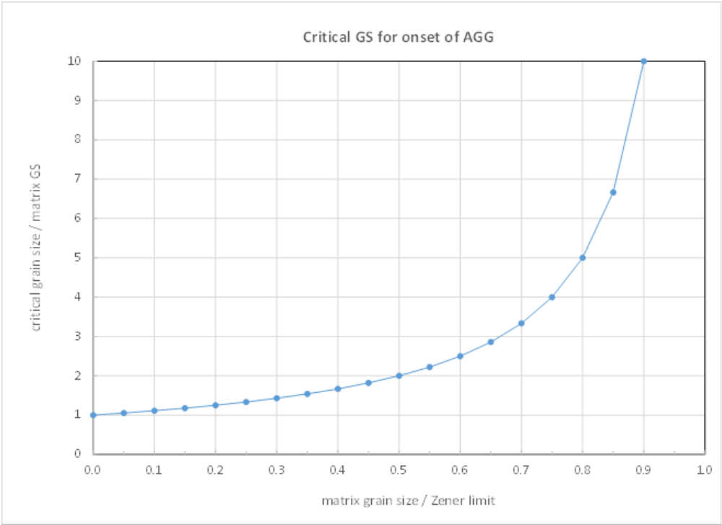
Unabated growth of abnormally large grains – critical size?
Conceptual framework: - matrix GS << Zener limit -> many nuclei -> normal grain growth
- matrix GS ~ 0.8*Zener limit -> AGG nucleus ~ 5*matrix GS –> only few
- matrix GS > Zener limit -> no AGG, stable grain structure
10

Slide 11
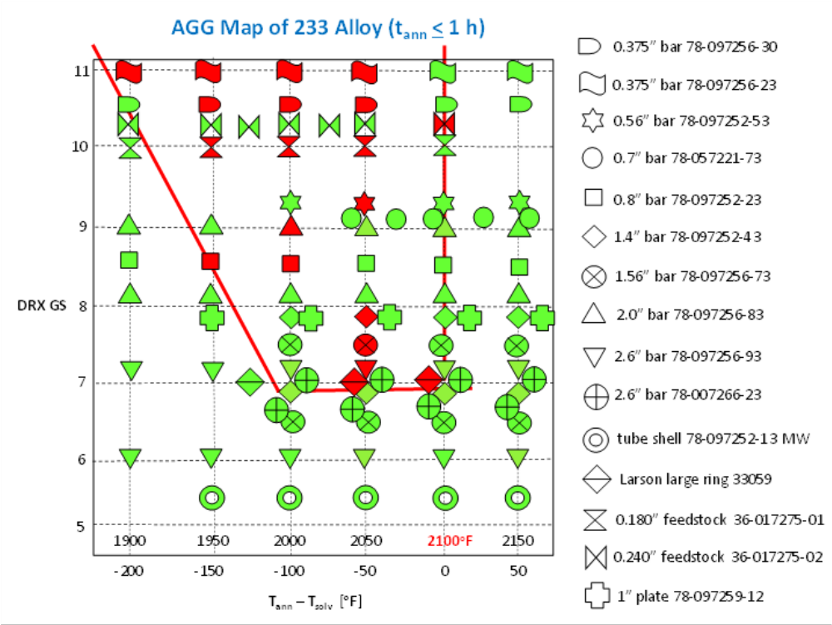
Control of AGG in industrial practice?
Risk management: AGG-prone region of hot-worked products corresponds to a combination
of fine DRX grain size and near-solvus annealing, consistent with
the proposed framework
11

Slide 12
Summary and conclusions
Of the several types of AGG encountered in polycrystalline Ni-base superalloys,
the one in the presence of potentially grain boundary pinning precipitates is perhaps
the most perplexing.
Once certain grains exceeded a critical size, their growth was unabated,
sweeping across the “minefield” of the precipitates.
The conditions that favor nucleation of these abnormally large grains remain
elusive – it appears to be a combination of several local factors.
Due to the present lack of predictability of AGG under those circumstances,
the best recourse for industry might be risk management by means of processing maps.
12

