Slide 1
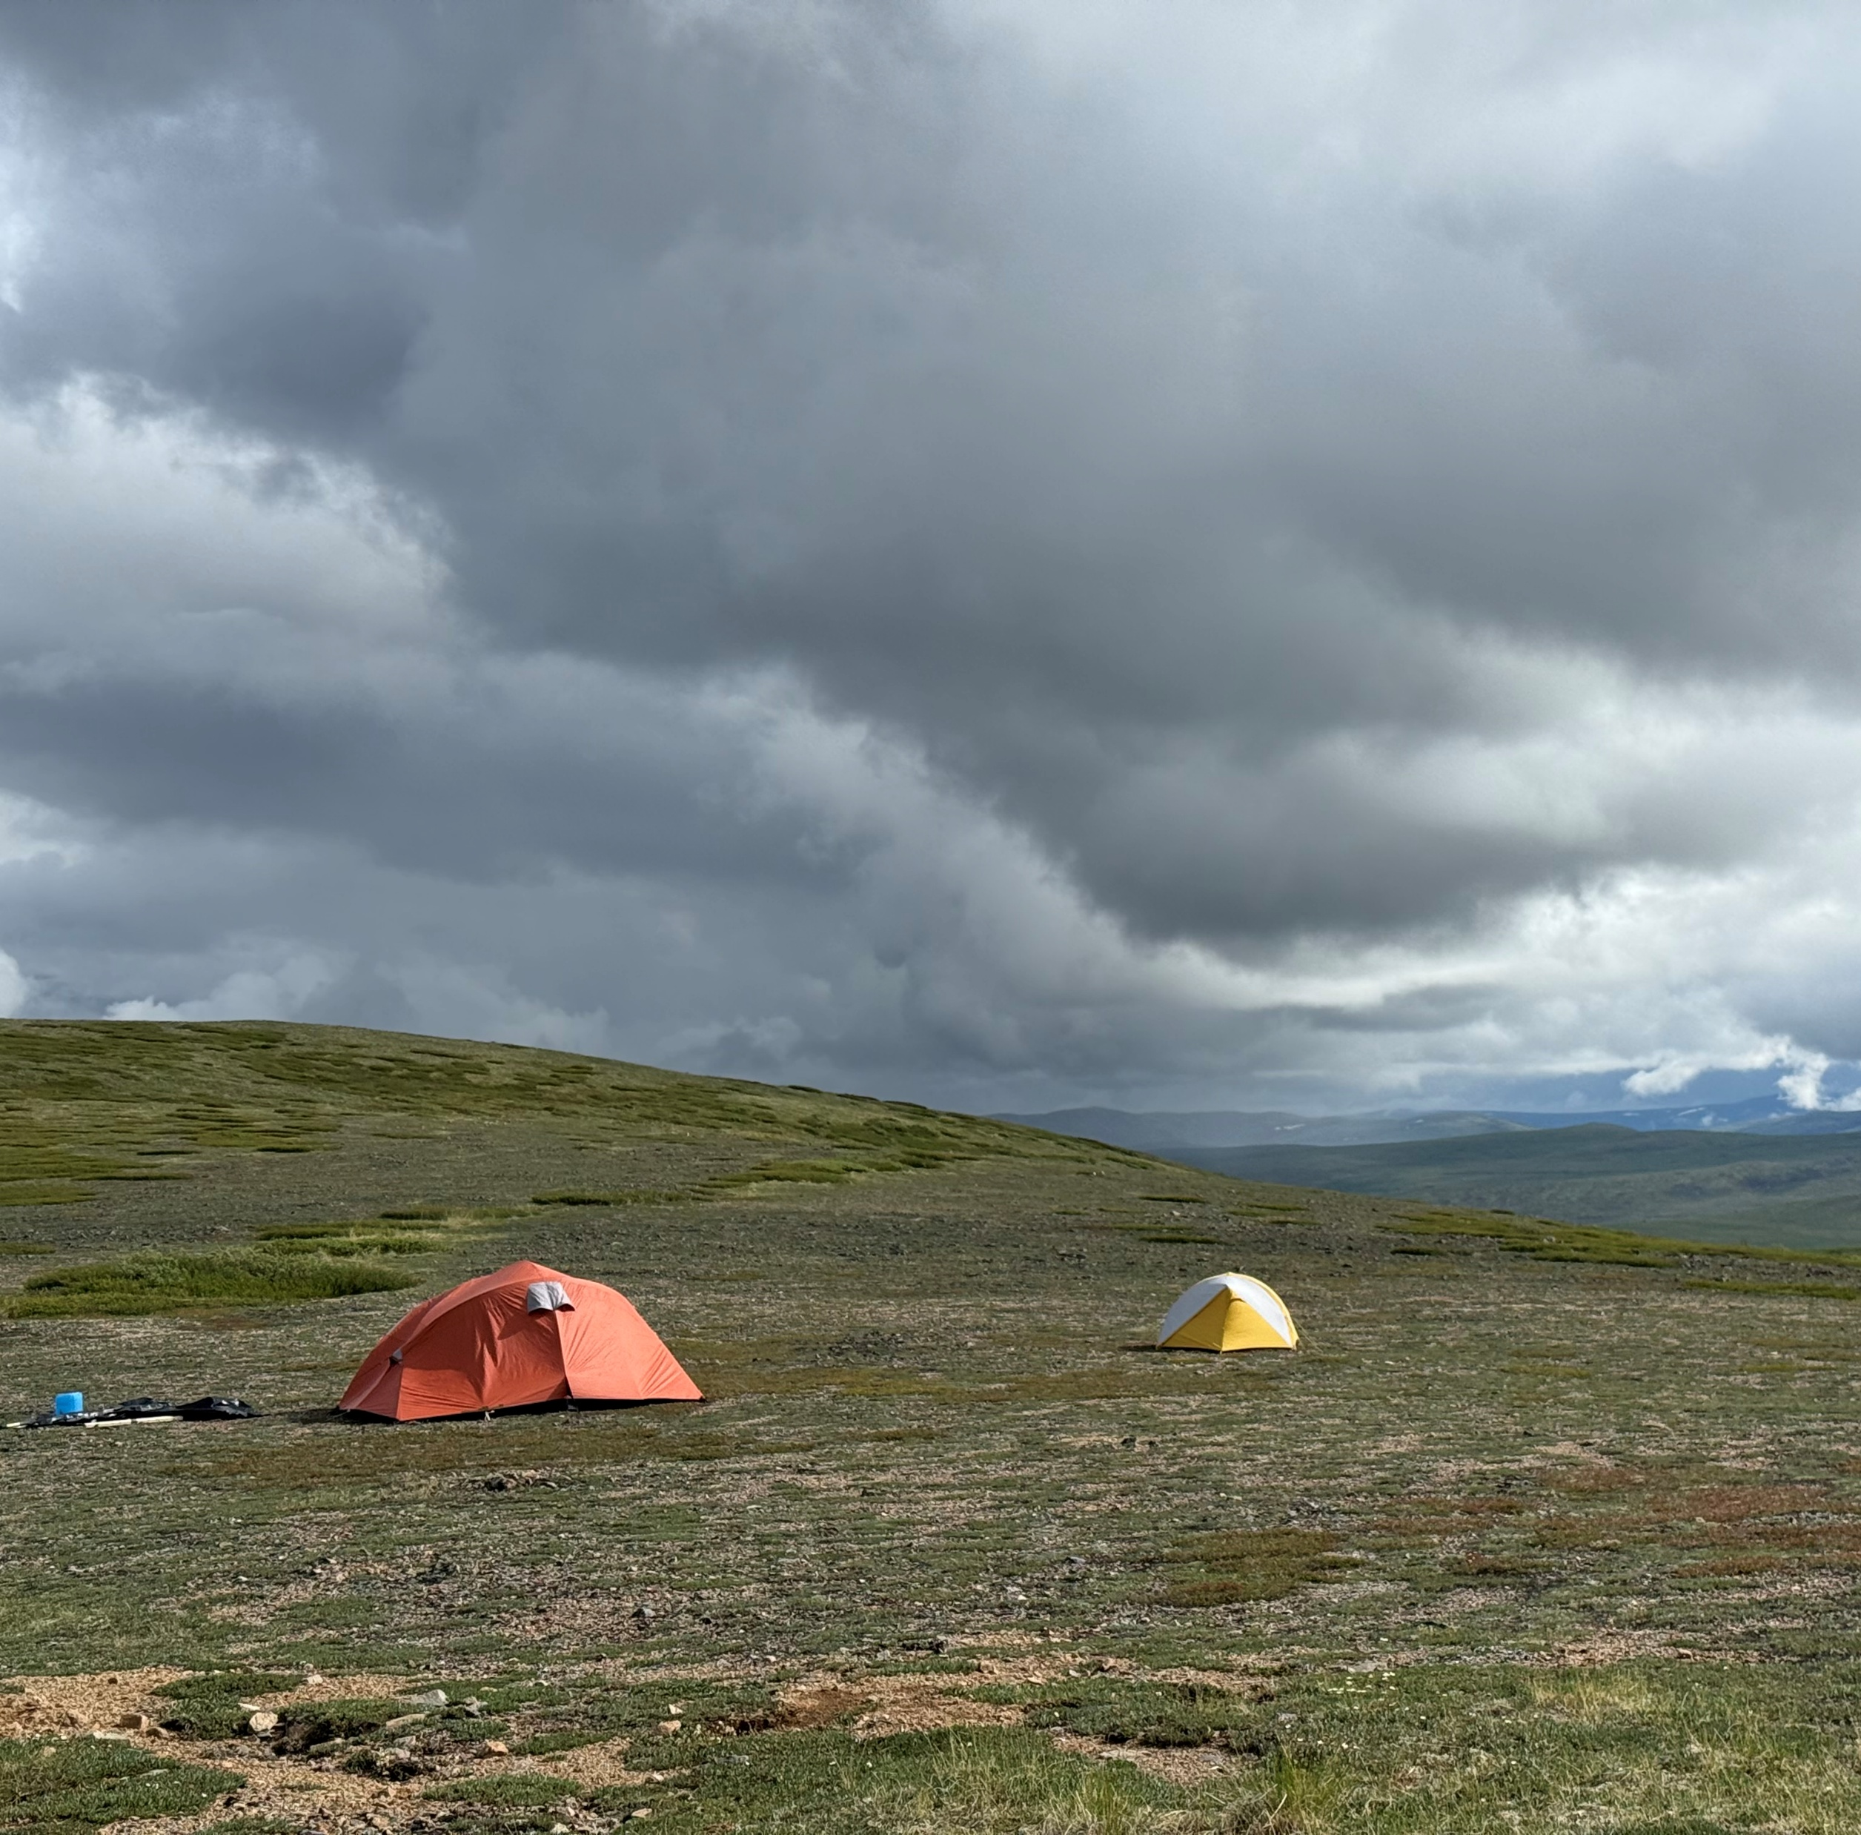
TAUT PORPHRY _______________
COPPER-Gold
Molybdenum
YUKON – WHITEHORSE MINING DISTRICT
Roger Hulstein (867) 335-1261
E-mail: rogerwhulstein@gmail.com
William Mann (867) 334-2343
E-mail: wdmgeology@gmail.com

Slide 2
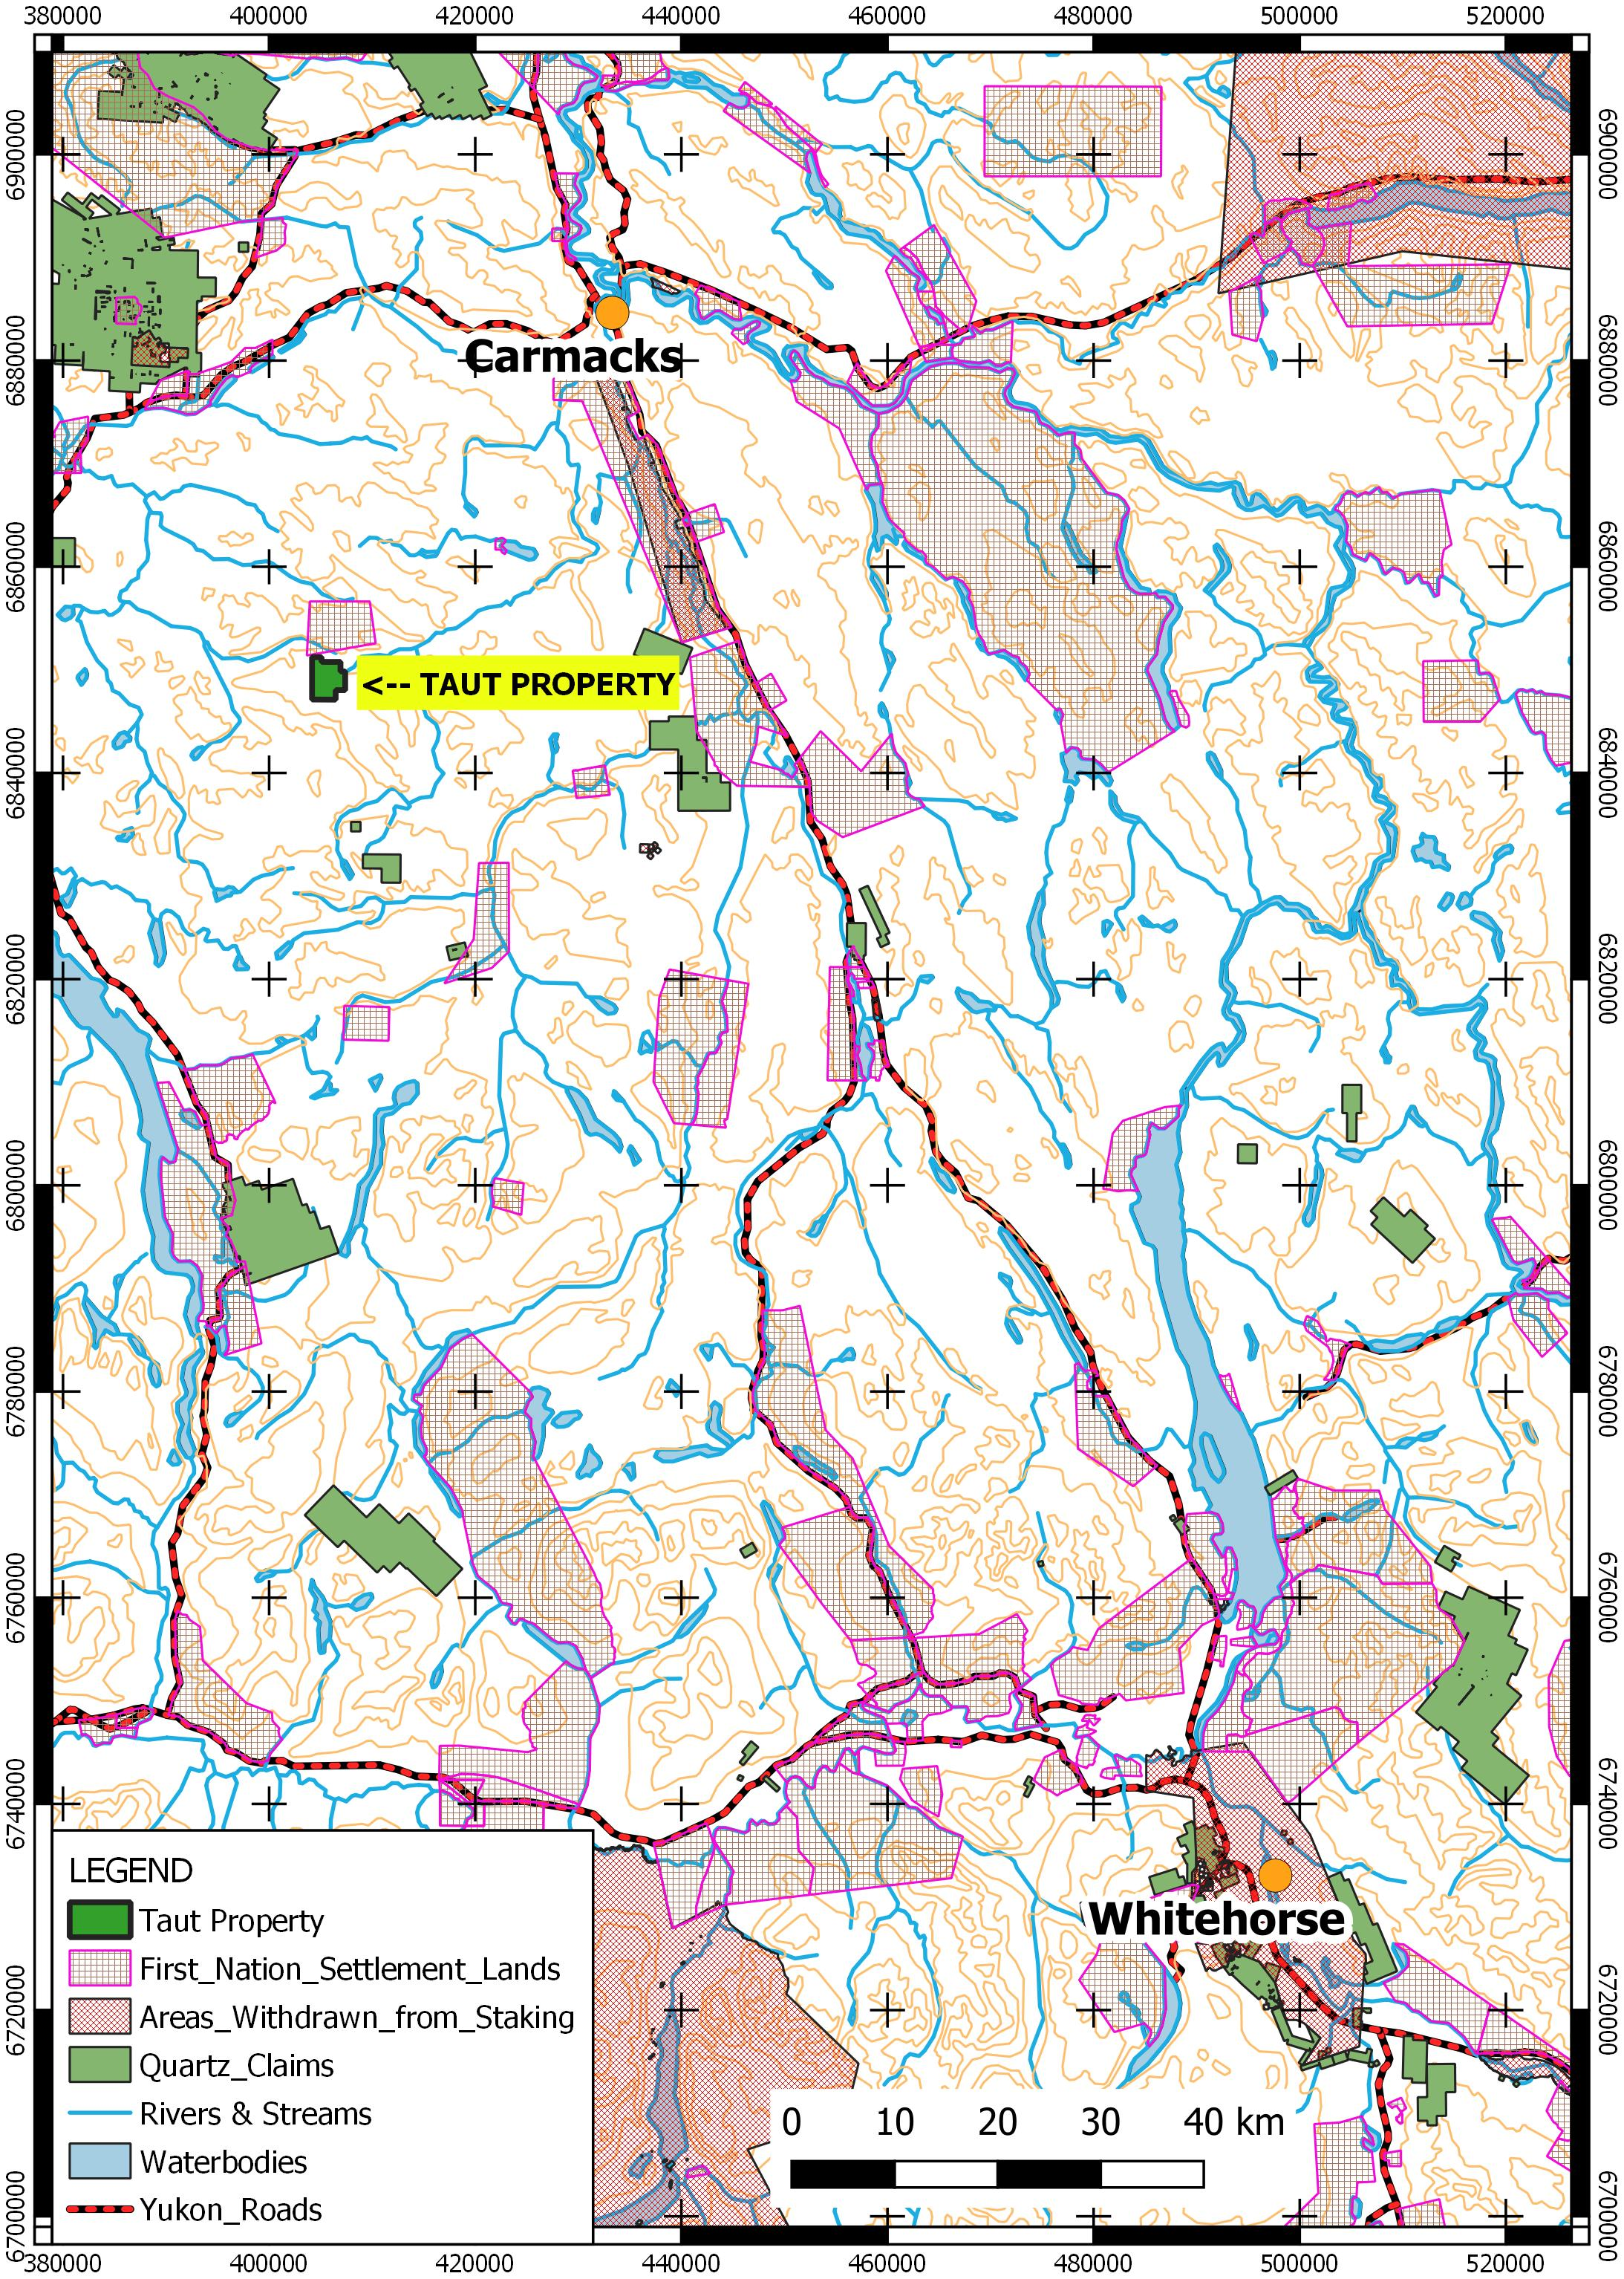
Project Location
In the Traditional Territory of the Little Salmon Carmacks First Nation (LSCFN) and the Champagne and Aishihik First Nation (CAFN).
Whitehorse Mining District, Yukon
150 kilometres northwest of Whitehorse and 43 km southwest of Carmacks, Yukon (and Klondike highway).
55 minute helicopter trip from Whitehorse
Location map: Taut Project, Yukon Territory

Slide 3
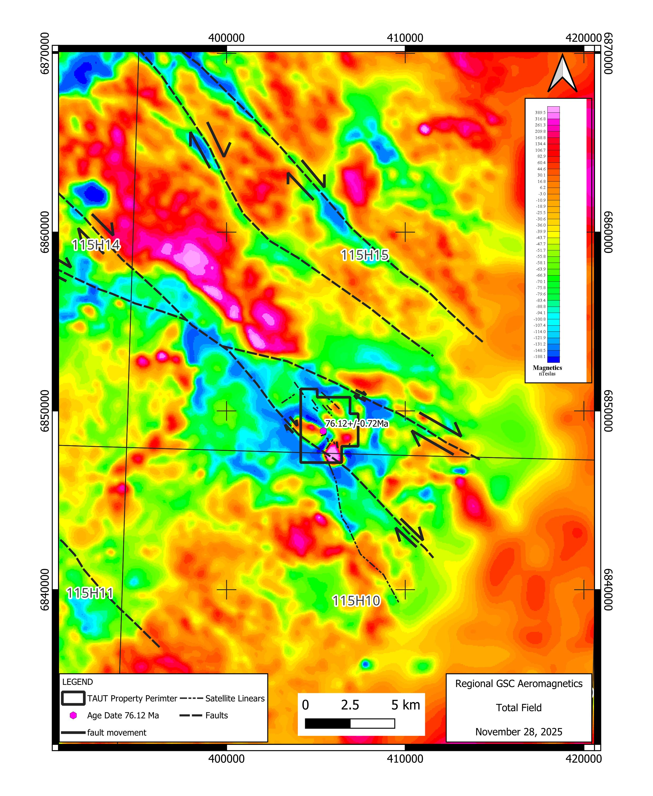
An Under Explored Calc Alkaline Porphyry Intrusion Related Gold-Copper-Molybdenum System
Typical aeromagnetic signature of a calc-alkaline porphyry intrusion system
Magnetic annular low surrounding a number of magnetic highs.
Quartz veins containing molybdenum.
Soil gold anomaly in area of 76.12 Ma age dated porphyry intrusion.

Slide 4
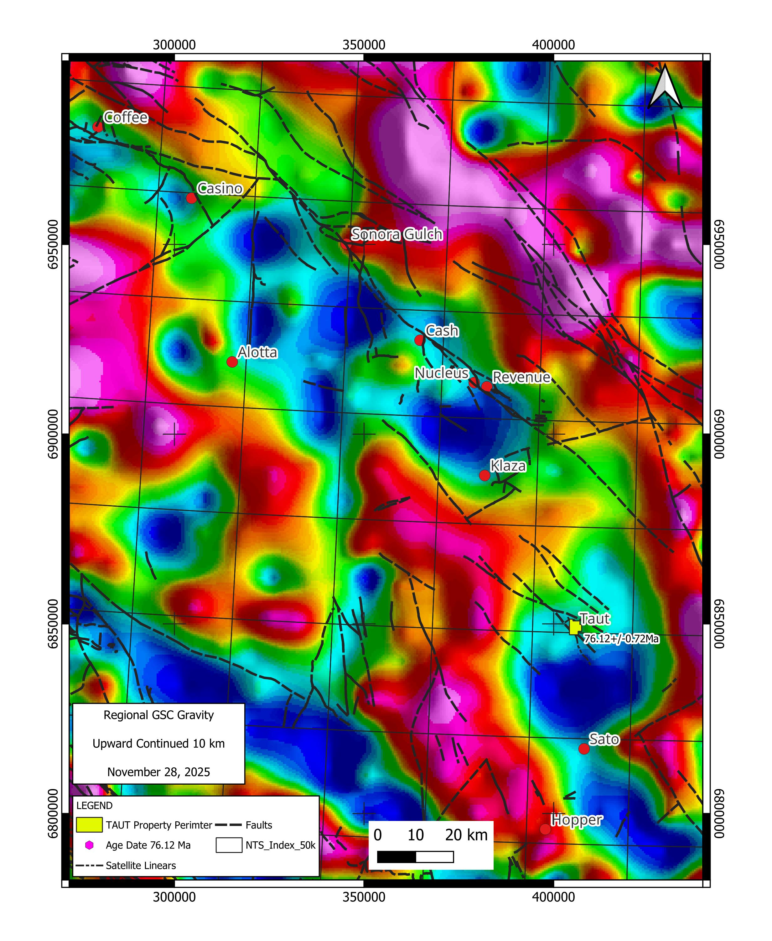
Regional Gravity
Gravity lows (light crust) are thought to be underlain by Late Cretaceous granitoid intrusions.
Porphyry and vein deposits are located on margins of lows (granitoid intrusions) where rheology contrasts are greatest.
Regional strike slip faults provide structural conduits for intrusions and mineralizing fluids.

Slide 5
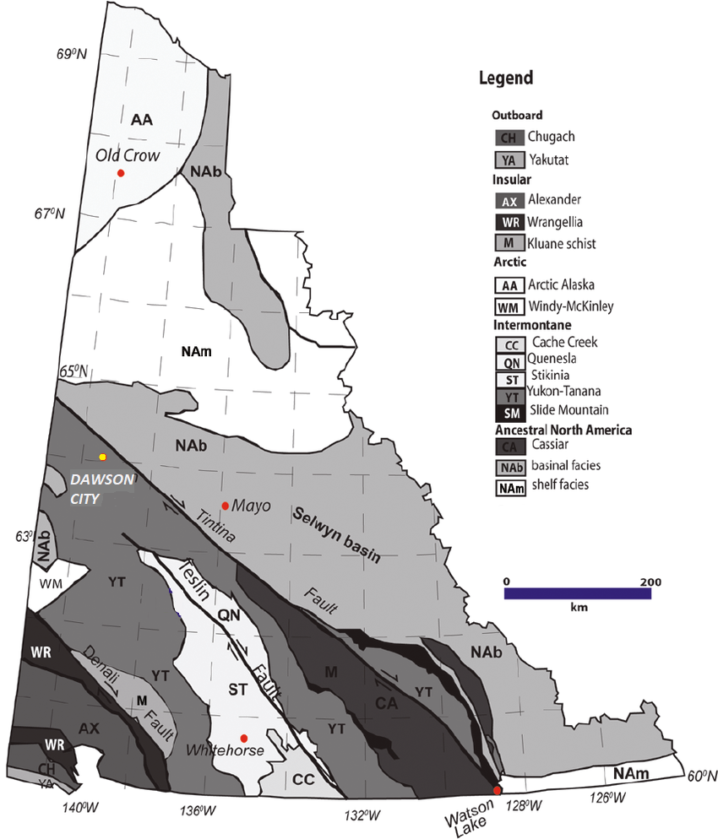
Tectonic Setting
On the margin of Whitehorse Trough, near the boundary between Stikinia and Yukon – Tanana Terranes.
Taut Project

Slide 6
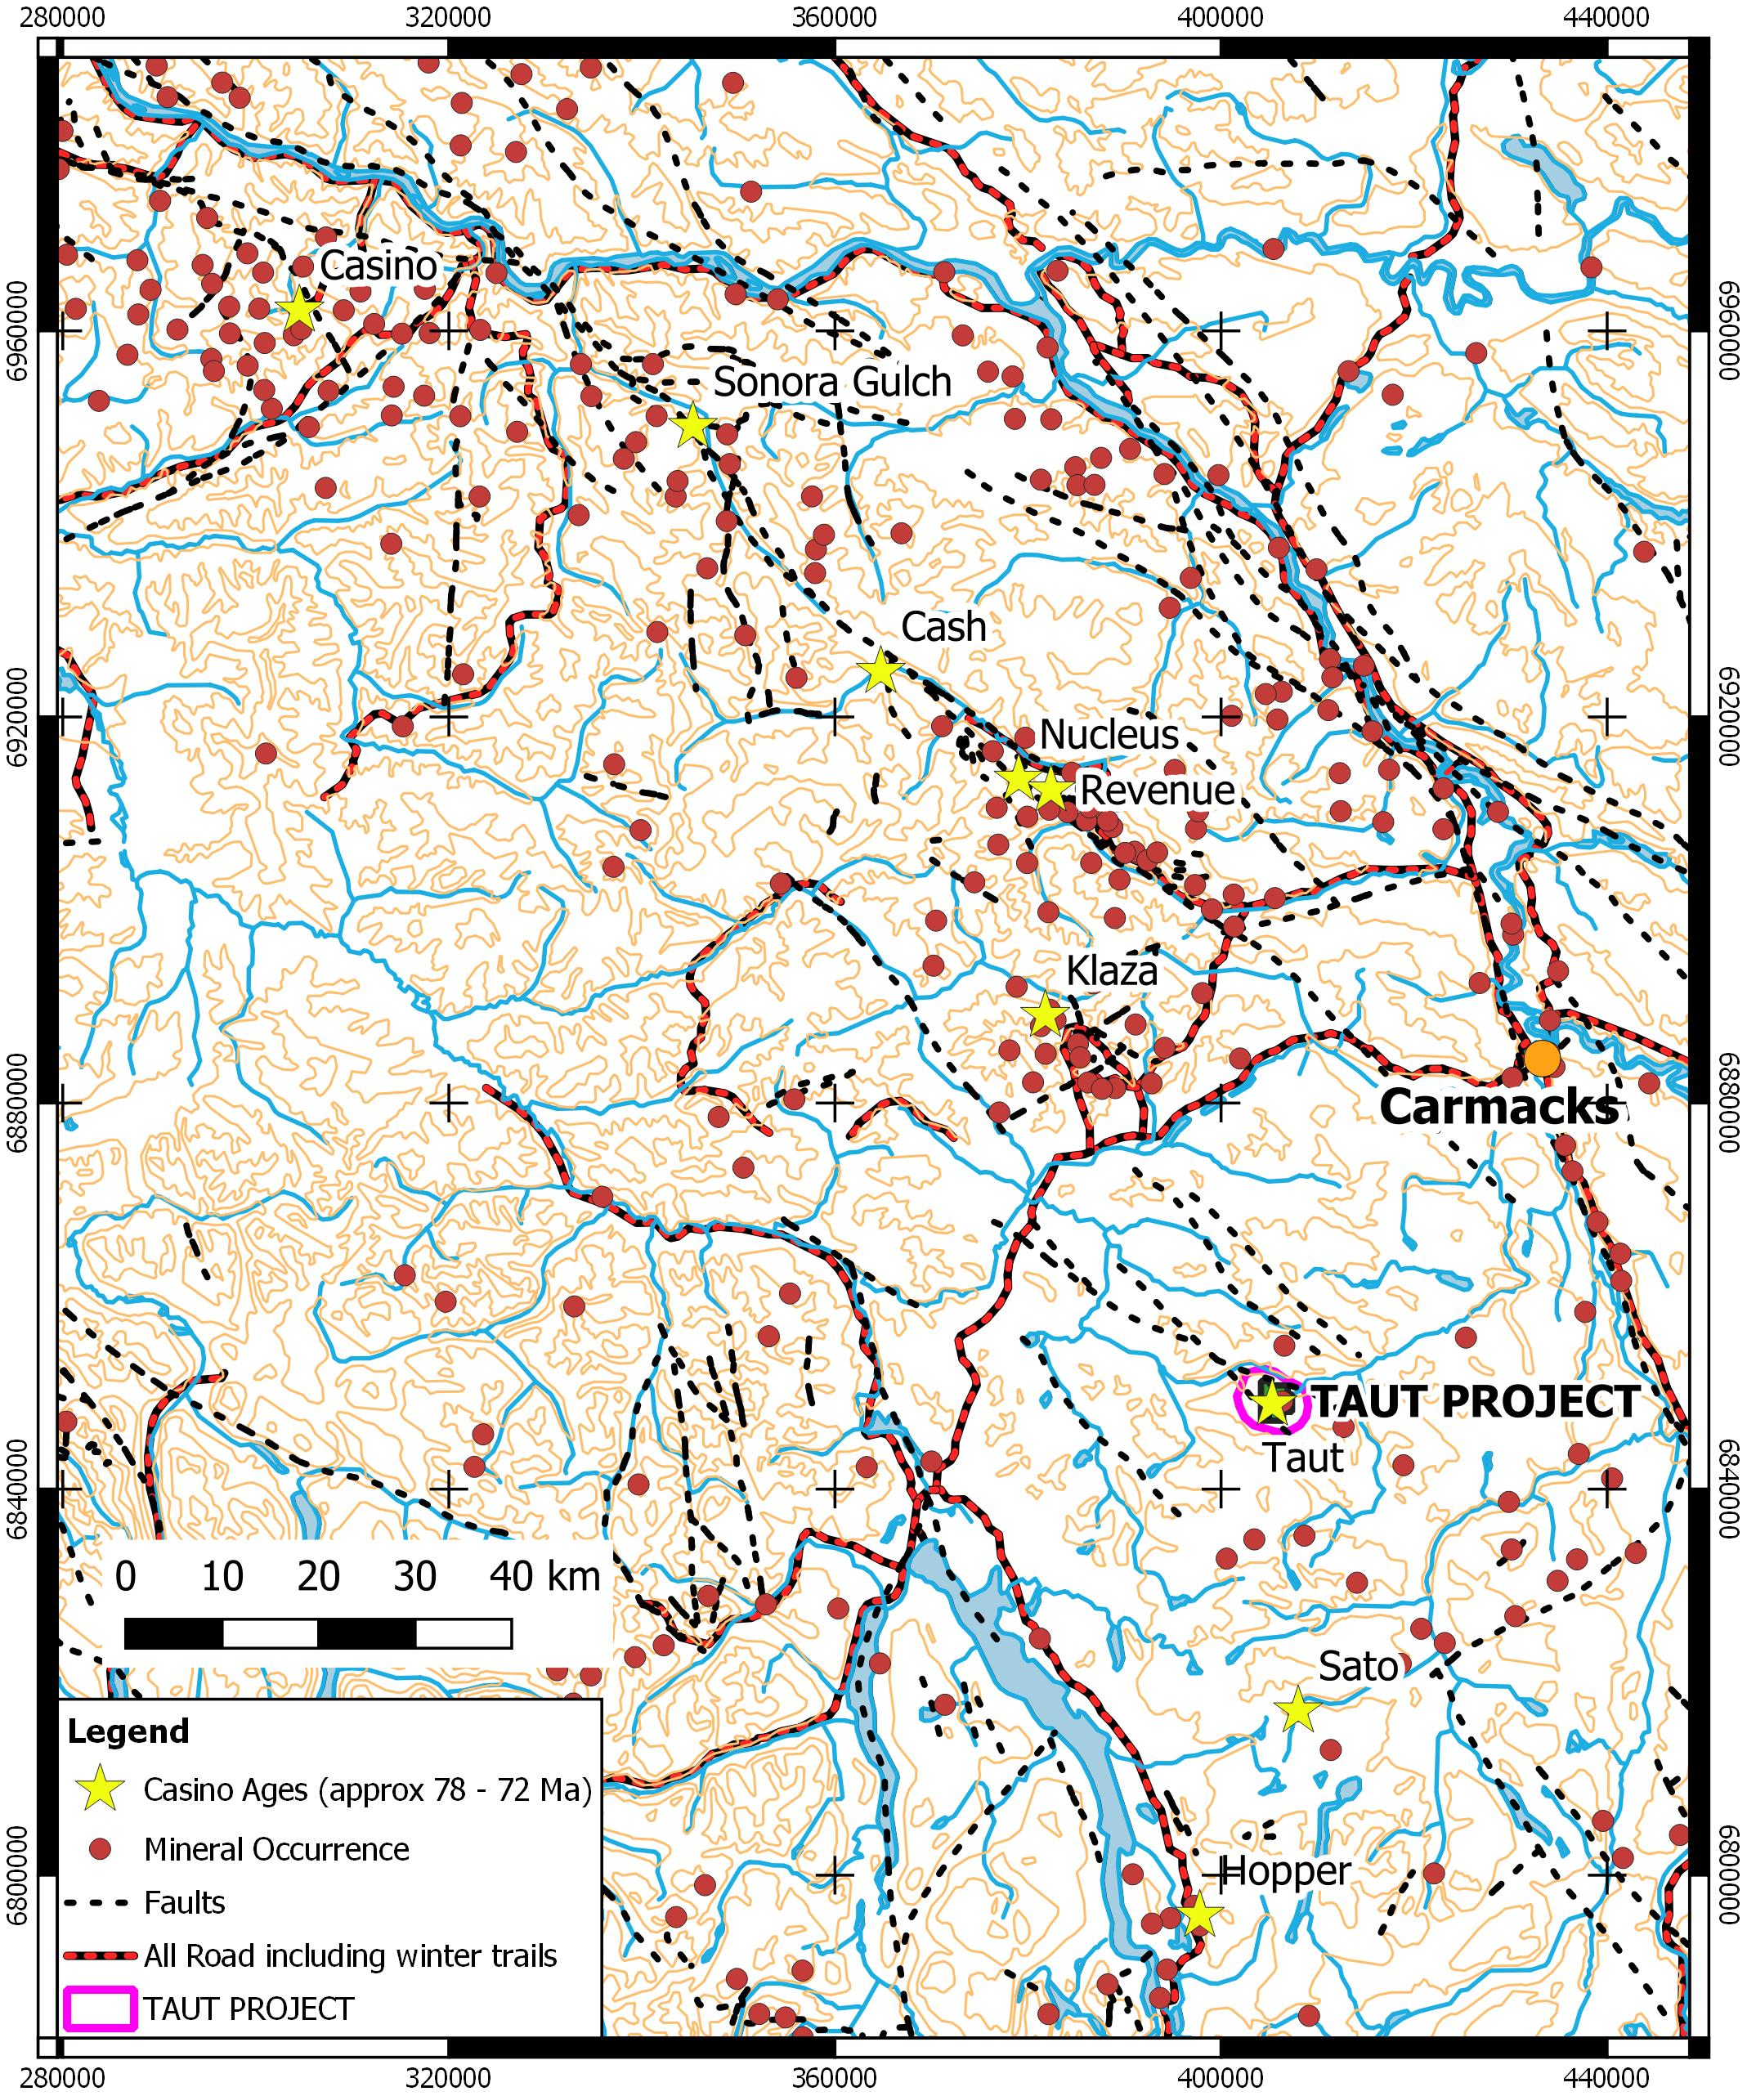
Project Overview
The Taut Project claims cover one of many Casino aged (72.12 +/- 0.72 Ma) porphyry copper-gold-molybdenum porphyry and precious metal deposits and occurrences.
Casino aged mineralization found in a northwest trending arc extending over 200 km.
Located on a along a long-lived northwest trending fault structure on the margin of the highly prospective Stikine Terrane (Whitehorse Trough).

Slide 7
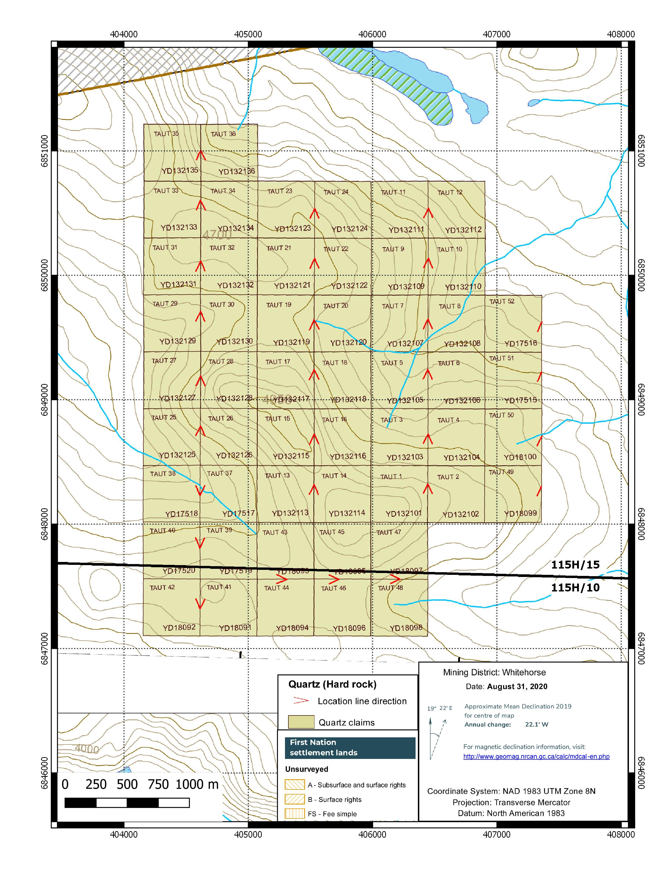
Tenure
52 mineral claims (Yukon Quartz Claims)
approximately 1086 hectares (2683 acres)
William Mann, 100% registered owner
No incumbrances on claims
Class 1 Exploration Permit
on NTS map sheet 115H/15 and 115H/10 in the Whitehorse Mining District, Yukon

Slide 8
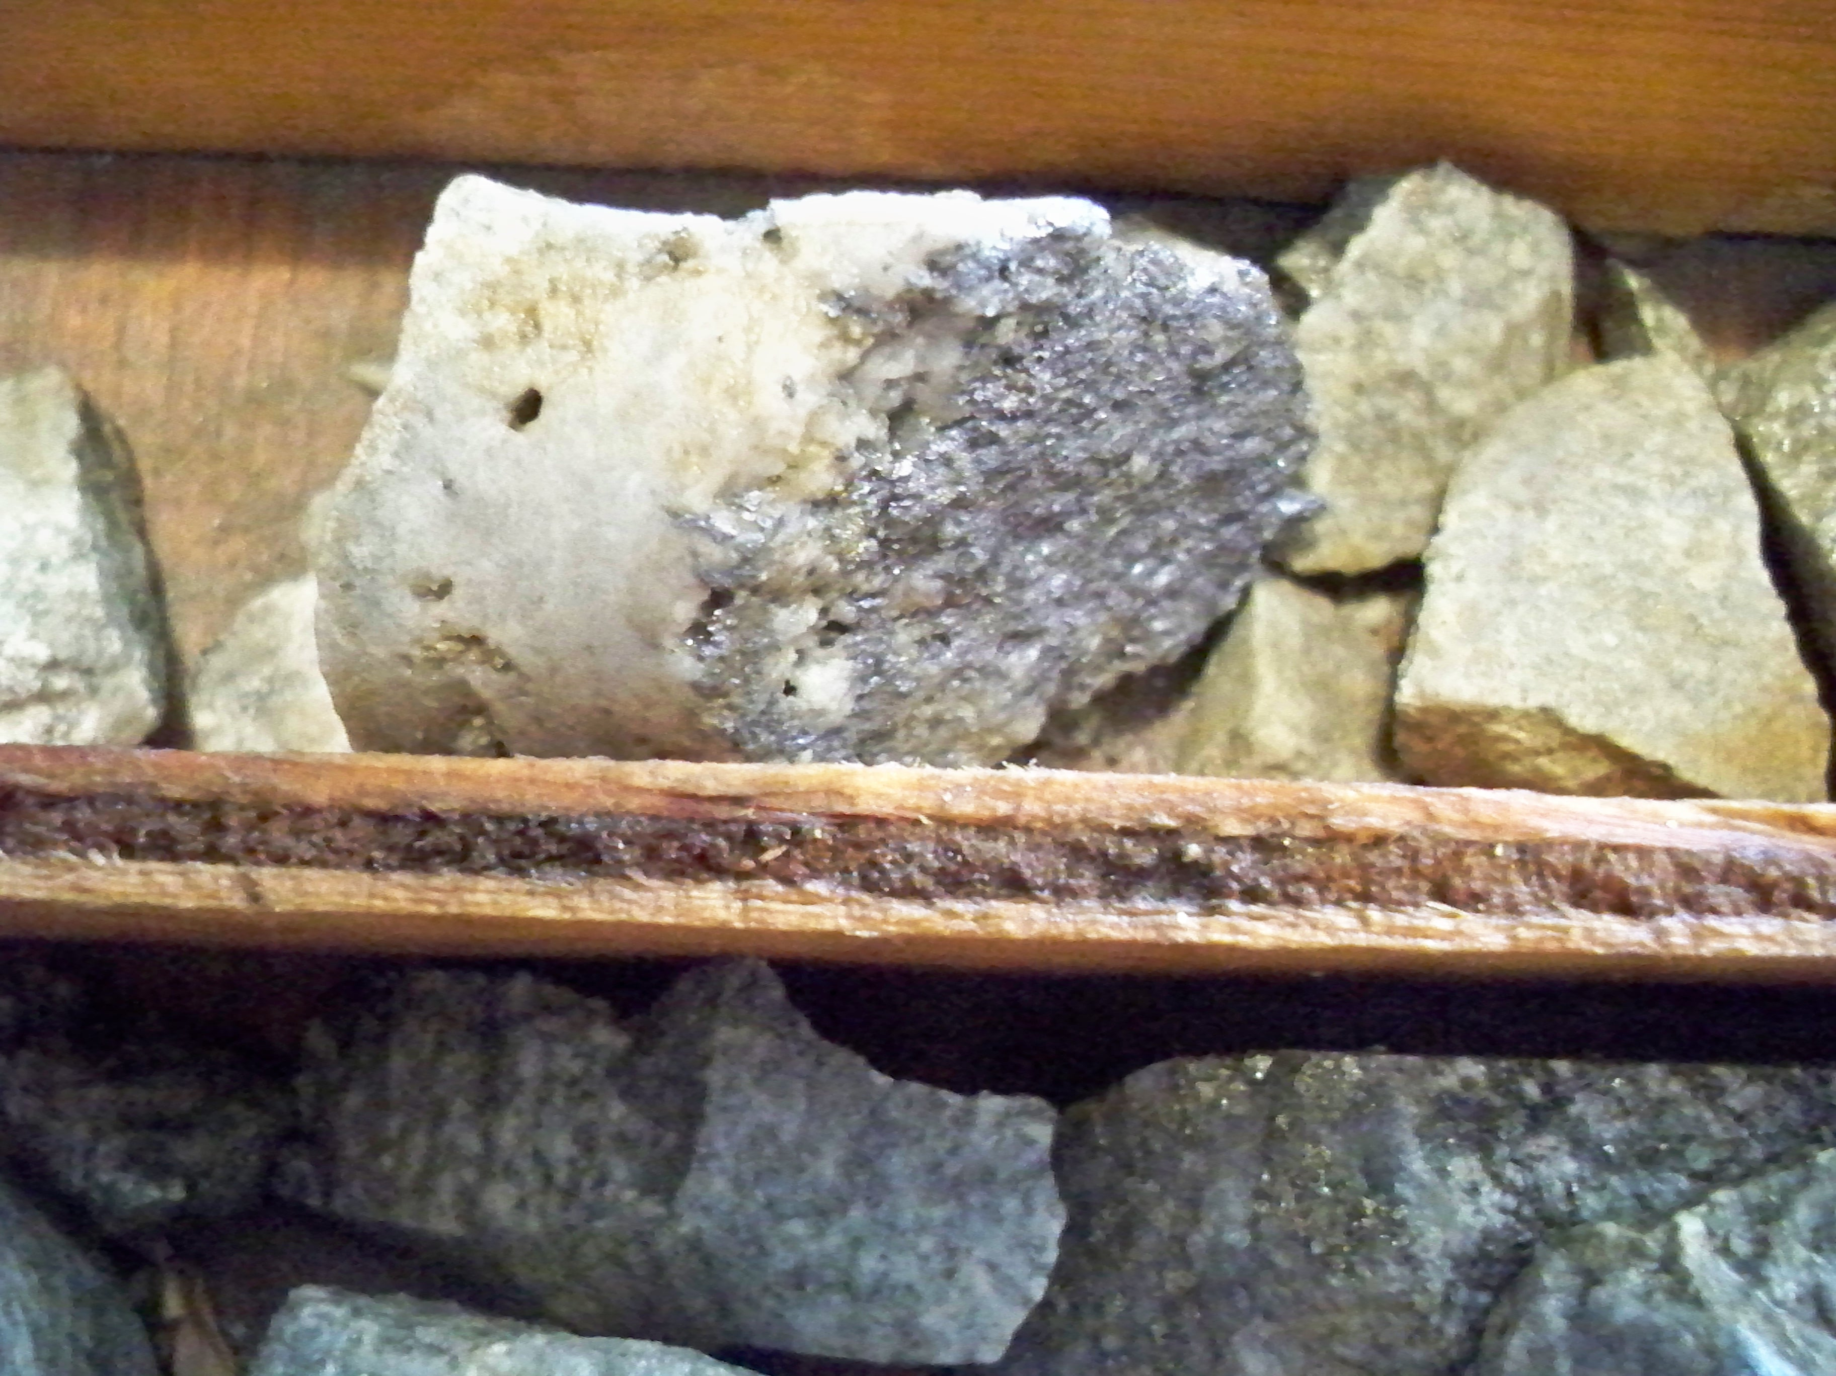
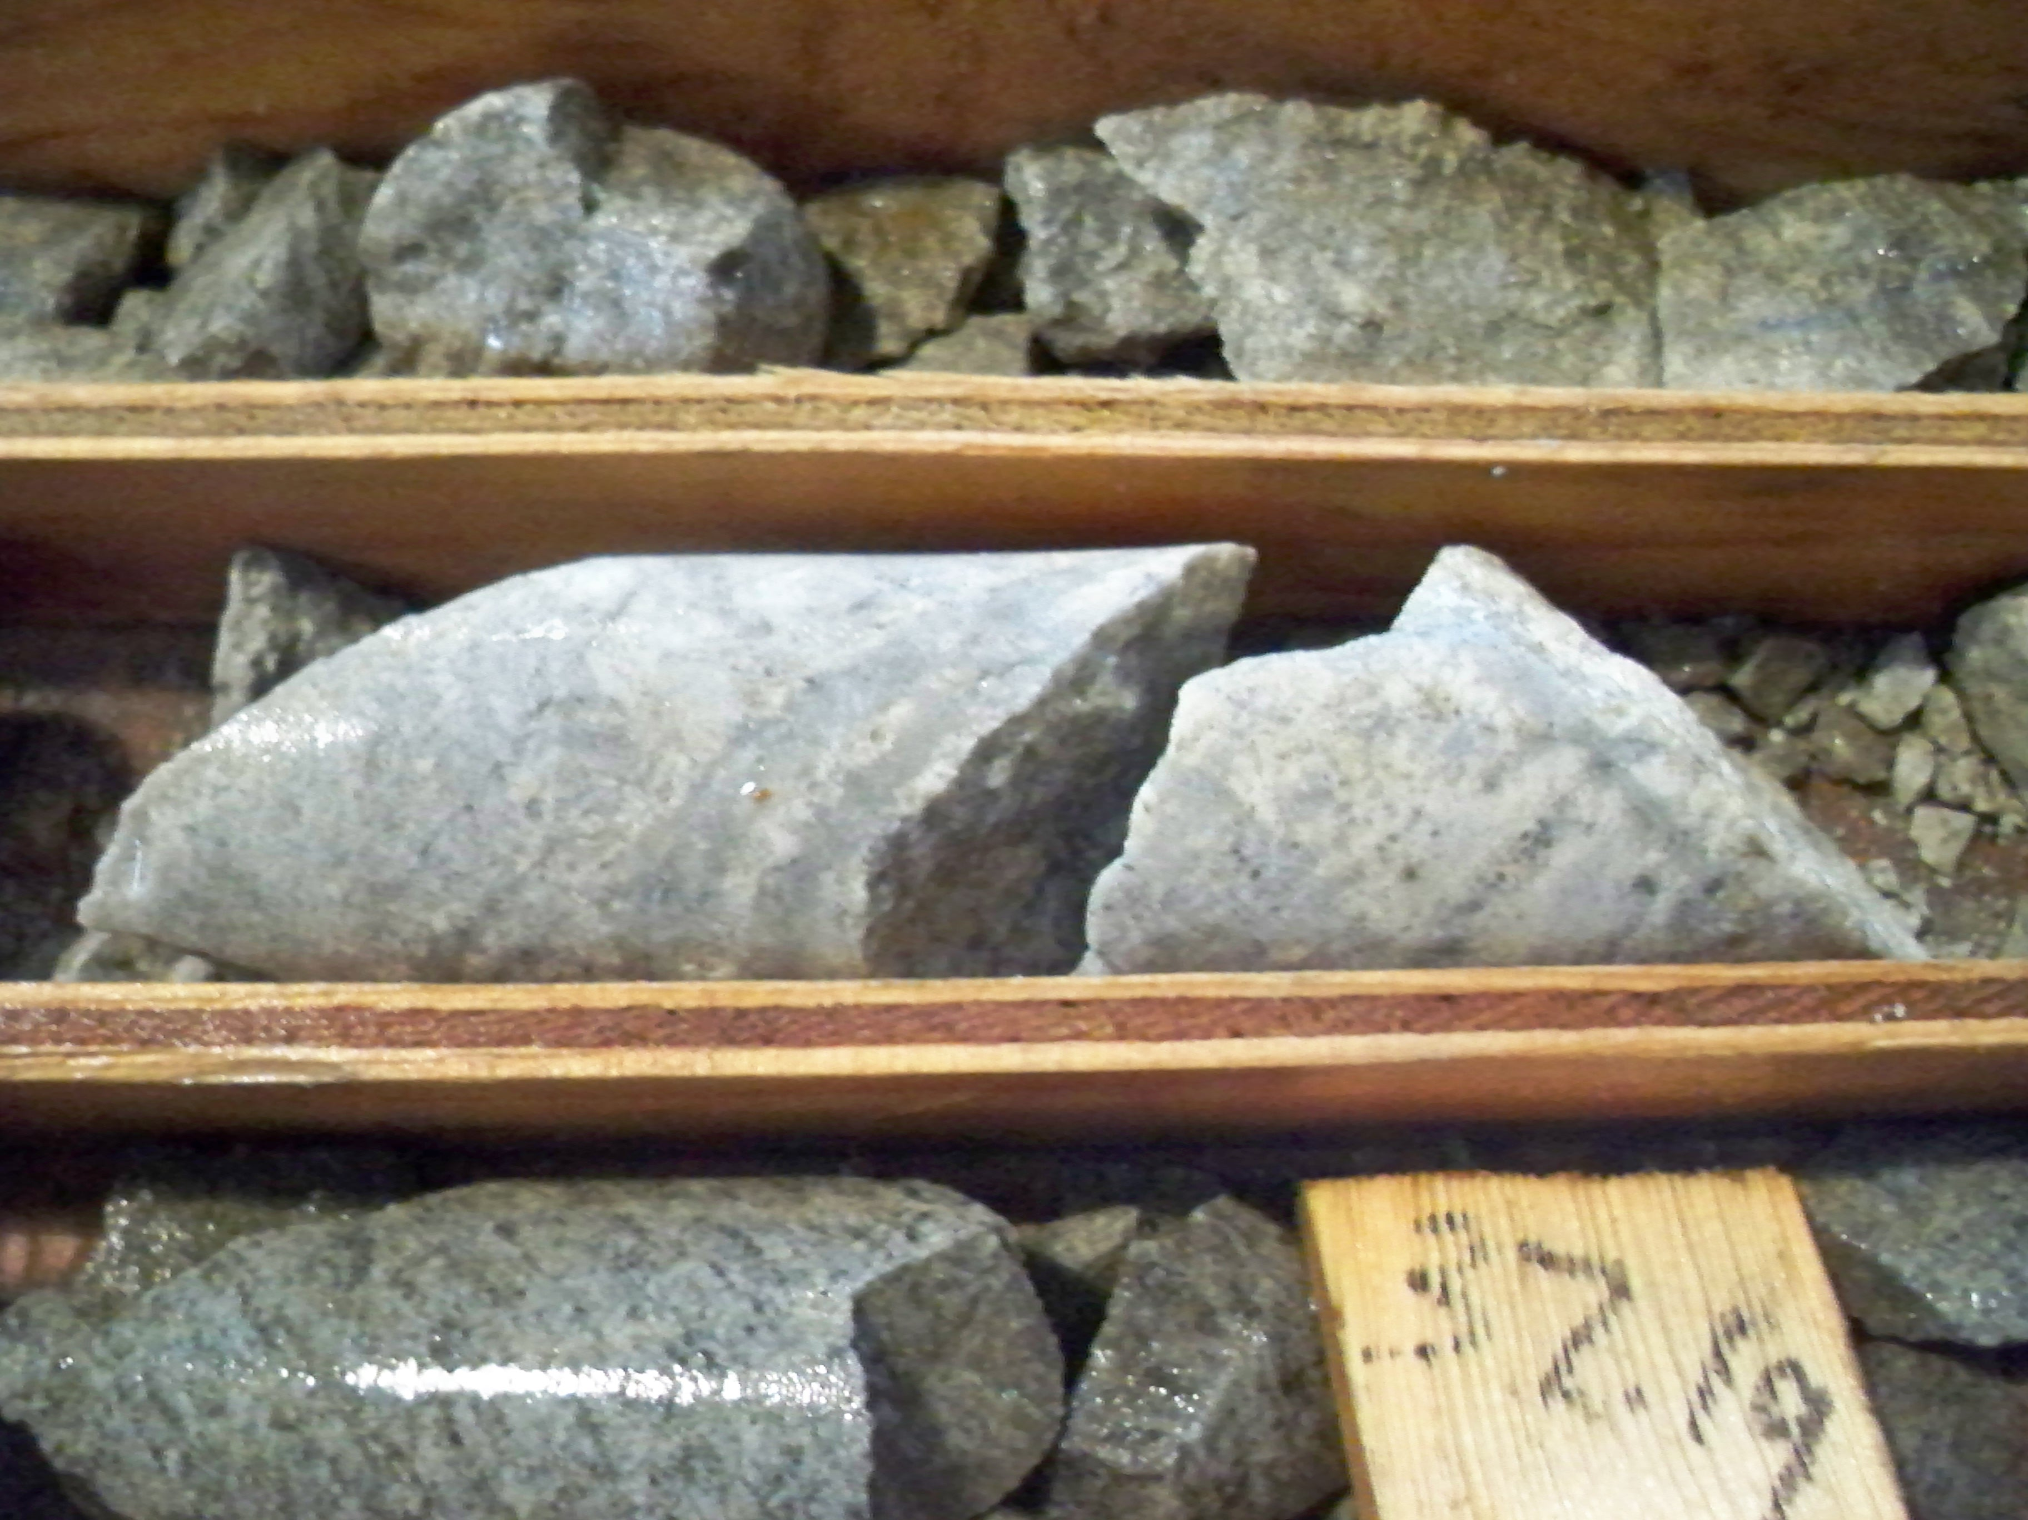
Mineral Occurrence History
3 diamond drill holes - 271 m total testing for porphyry mineralization (1980):
Noranda in late 1970’s explored project area by mapping, stream sediment & soil geochemistry, ground geophysics, and 3 exploration drill holes testing IP anomalies.
An IP survey in 2013 confirmed and refined the Noranda IP chargeability anomaly. Two of the Noranda drill holes are on the margins of the strongest IP anomalies.
In 1980 Noranda drilled three shallow diamond drill holes (total 271 m) testing IP anomalies in the overburden covered Mystery Bowl target. Overburden in the drill holes ranged from 11 m to 26.5 m.
Highest values in reanalysis of drill core: 170 ppb Au, 1134 ppm Cu, 229 ppm Mo.
Previous work is available in assessment reports. Core stored at YGS core library.

Slide 9
Prospective Ground Intruded by Late Cretaceous (Casino age) Granitoid
Prospective metal rich area bounded in part by regional northwest trending strike-slip faults and intruded by a by a Late Cretaceous (72.12 +/- 0.72 Ma) Casino age granitoid intrusion.
Never explored as a precious metal target prior to 2019, gold soil anomaly (>5 ppb to 1018.2 ppb Au) extends 3.5 km northwest by 2 km in width.
Resampling of remaining drill core in 2010 yielded an intersection of 65.53 m with 60 ppb Au, 549 ppm Cu and 46 ppm Mo (including 7.5 m of missing core with no values). Highest values 170 ppb Au, 1134 ppm Cu, 223 ppm Mo.
The overburden covered Mystery Bowl is approximately 1300 m in diameter.
Typical aeromagnetic signature of a calc alkaline porphyry Cu-Au-Mo system; an annular low surrounding a number of magnetic highs.
Highly anomalous gold values located south and north of the Mystery Bowl.

Slide 10
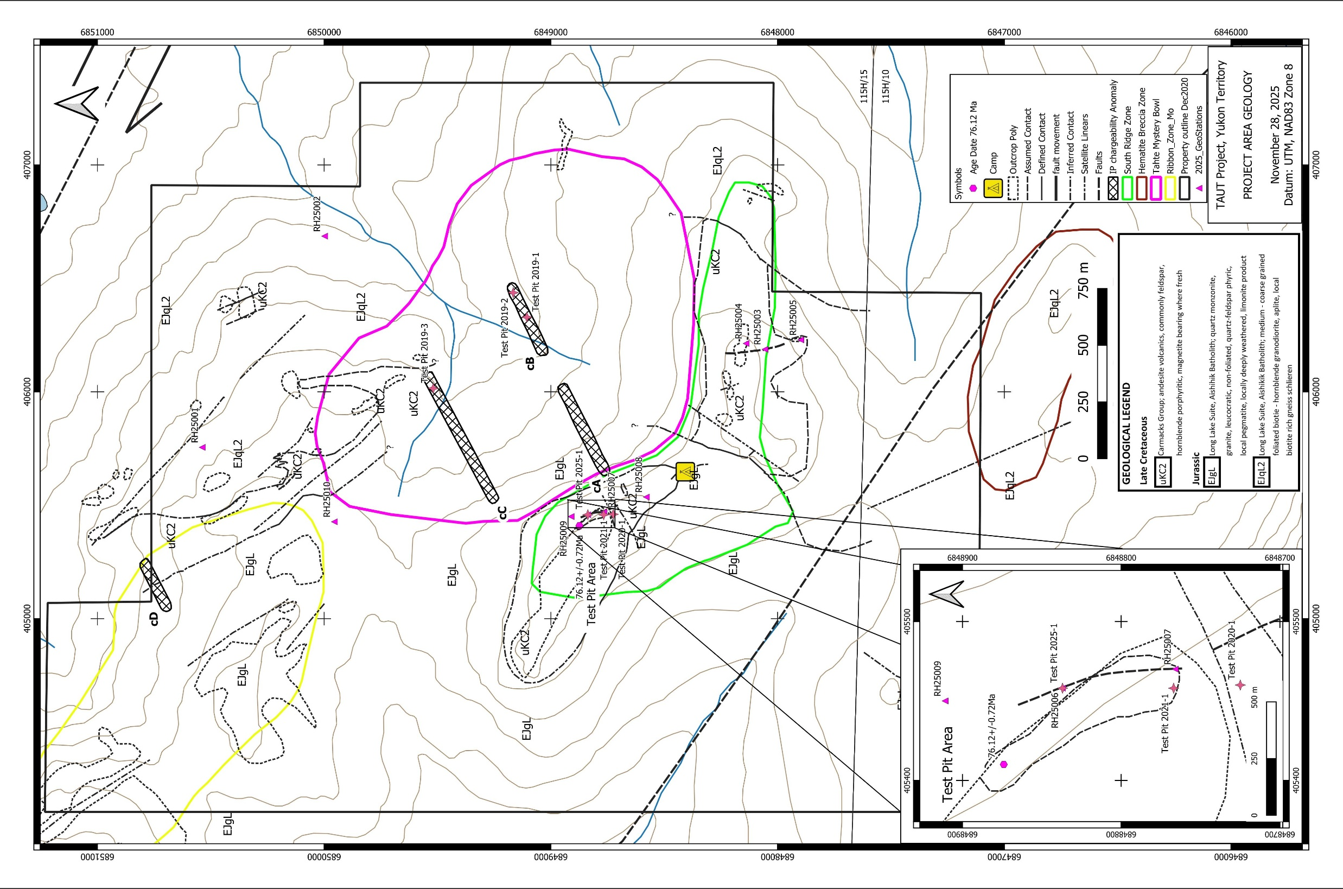
Project Geology
Multiple Zones:
Ribbon Mo
Mystery Bowl
  Overburden
  Drilled
  IP
South Ridge
  Andesite Porphyry
  Age date
  Gold values
Faults
NW Trend

Slide 11
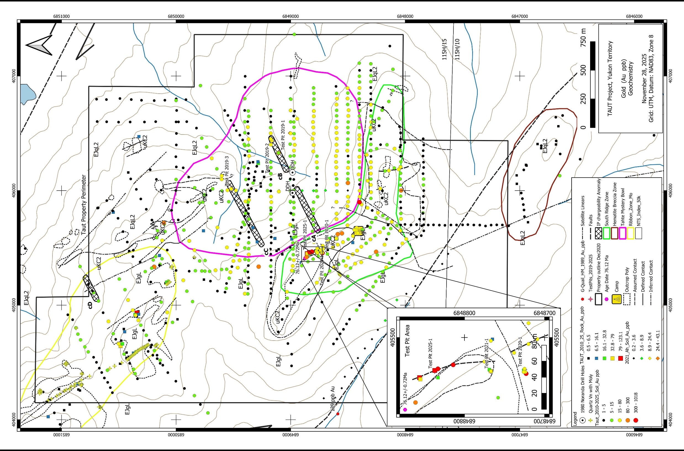
Gold
Geochemistry
743 B-C Horizon soil samples
47 Ah Horizon soil samples
Anomaly 3.5km by 2km (>5 to 1018 ppb Au)

Slide 12
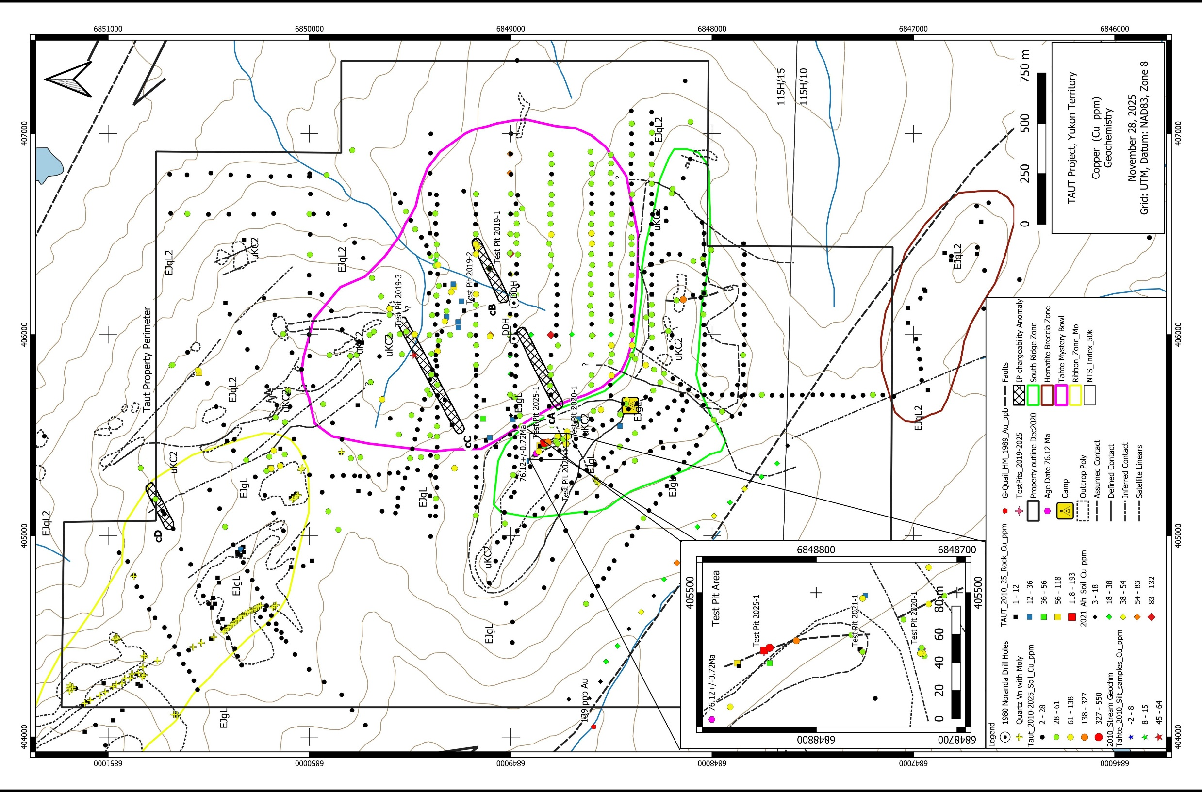
Higher values centered over the Mystery Bowl Target
Copper Geochemistry

Slide 13
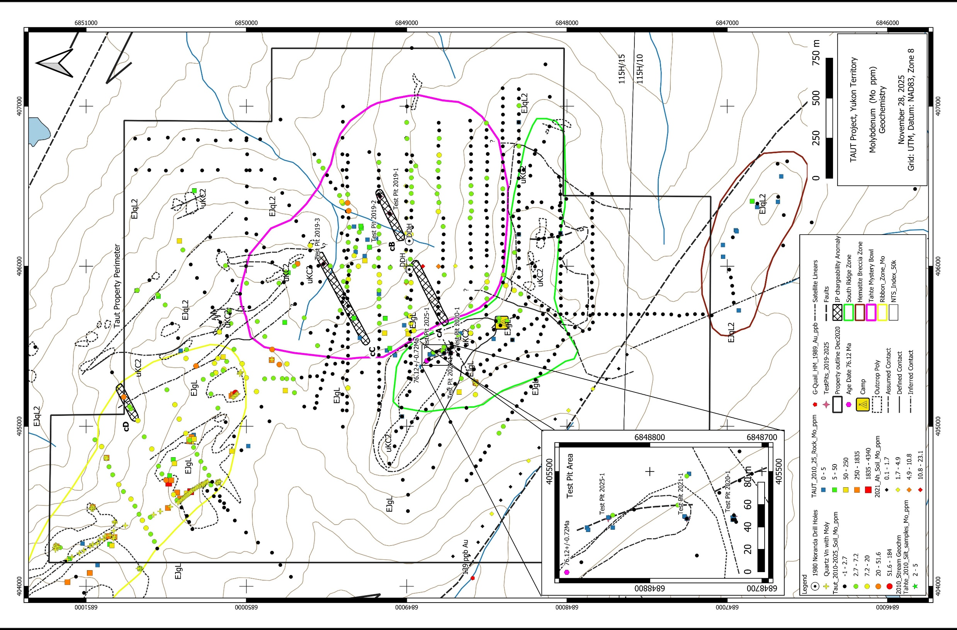
Rock grab samples
Molybdenum Geochemistry

Slide 14
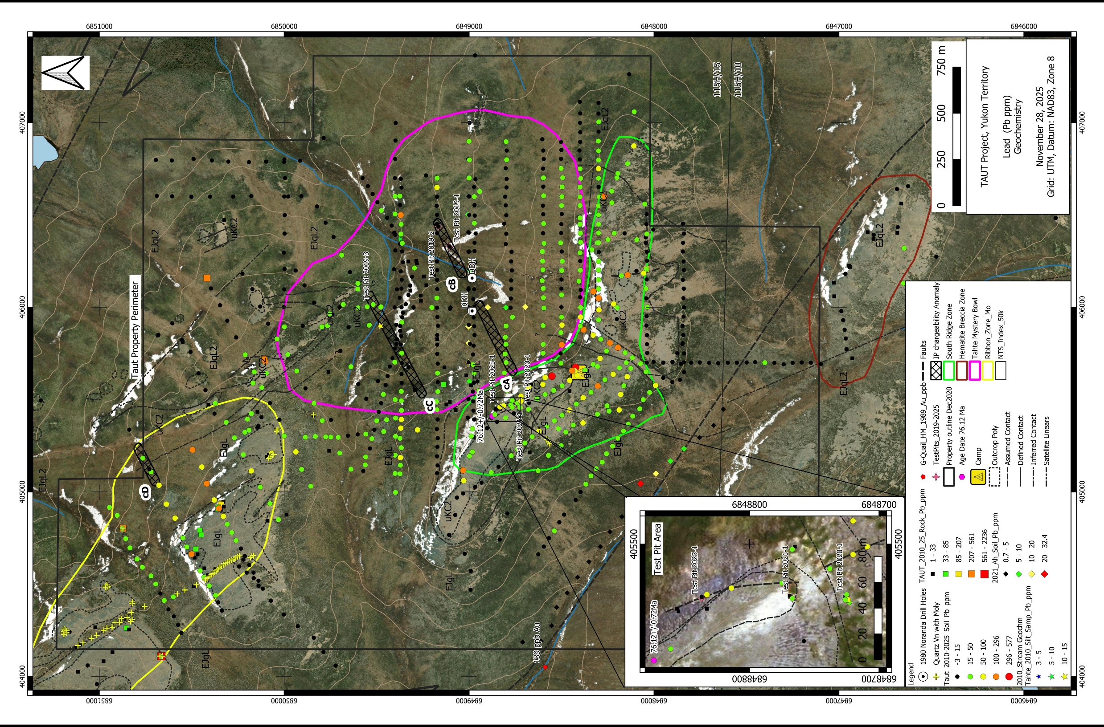
Rock grab samples
Lead Geochemistry

Slide 15
TAUT Project Key Points
Never adequately explored for gold prior to 2019.
First identified as a calc alkaline porphyry intrusion copper – gold – molybdenum target in 1979. Porphyry deposit is the exploration model.
Favorable geological and structural setting including:
Late Cretaceous intrusion
On the margin of the Stikinia Terrane, bounded by northwest trending regional long-lived strike slip faults.
Drill ready.
Recommended future work includes detailed magnetics, radiometrics, Lidar, additional IP.
Historical and recent dataset available including geological and structural mapping, geochemistry (silt, soil, rock, drill core), geophysics (regional airborne magnetics, 3 lines of IP).
Previous work is available in assessment reports.

