Slide 1
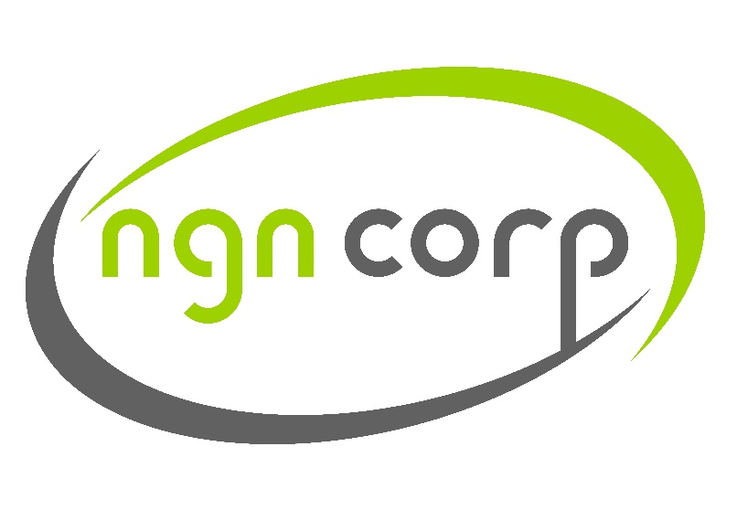
SMS Platform
Technical and Security specifications

Slide 2
DATA CENTER
Servers are hosted in Germany at Tier1 data center which is highly secure and resilient. DC is adopted by many large enterpsirses and financial institutions

Slide 3
BACKUP
Backup servers in Finland DC including databases are already configured and ready to handle live traffic in case any main server or even main DC location experiences downtime.
Also, redundant ISPs are connected to prevent any connectivity issues

Slide 4
DATA CENTER CERTIFICATION
Data center is certified in accordance with DIN ISO/IEC 27001
The internationally recognized standard for information security certifies that the DC has established and implemented an appropriate information security management system (ISMS).
DC utilizes the ISMS in its infrastructure and complete operations for the data center parks.
FOX Certification, a third party certification authority, audited the DC for the certification process.

Slide 5
DDoS
DDoS protection is applied all across the DC network.
DC automated system recognizes almost all attack patterns in advance, allowing it to block the attacks and effectively thwart the vast majority of them.
DC system protects you and your data by utilizing Arbor and Juniper hardware and providing you with first-rate protection against large-scale DDoS attacks.

Slide 6
SSL
256-bit SSL encryption is integrated all across the system.

Slide 7
Code & DB
MySQL database is used and stored data is encrypted using industry standard 256-bit AES algorithms.
Also, DB is not reachable from the public internet side.
PHP is used for the back-end development.

Slide 8
SYSTEM PRIVILEGES
Segregated layers of data access levels is used for management and employees.

